Slide 1
Drones: Transforming Media
Broadcasting Media 2014
Baltimore, MD
20 October 2014
John V. Pavlik, Ph.D.
Professor, Journalism & Media Studies, SC&I
Rutgers University
jvpavlik@gmail.com

Slide 2
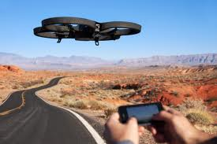
Drones and Media
Equipped with geo-located high-definition video cameras, drones are emerging as important new tool for broadcasting media and film-makers.

Slide 3
Drones and military
The term "drone” conjures negative imagery to the public, including their use in military strikes and spying (threatening privacy).

Slide 4
History of Drones
Drones have a long history, dating to at least the mid-1800s, when unmanned air balloons were used to deliver bombs from Vienna to Venice.
In 1915 inventor Nicola Tesla proposed creating a fleet of UAVs designed for combat (Dempsey 2010).
UAVs, or drones, have become widely used in military operations, both for surveillance and for the delivery of explosives.

Slide 5
Quadricopter by any other name
Quadricopters are multicopters that lift and propel via four rotors.
Quadricopters are an increasingly common, inexpensive and relatively safe form of unmanned aerial vehicle (UAV).

Slide 6
Regulatory Framework
The government classifies quadricopters as rotorcraft rather than fixed-wing aircraft.
Regulatory frameworks for quadricopters are still in an unsettled state in the U.S. and internationally.

Slide 7
Regulations
Most US regulations as of this writing (March 2014) take the form of time, place and manner restrictions.
Restrictions are based on 1) altitude (i.e., drones may not fly more than about 400 feet above ground), 2) location (e.g., drones are prohibited from flight over groups of persons or heavily populated areas) and 3) line-of-sight flight only (i.e., remotely controlled drone flight is permitted only when the pilot or operator maintains direct visual sight of the drone).
No commercial or business purposes.

Slide 8
FAA to issue rules by 2015
Pres. Obama has ordered FAA to issue commercial drone use rules by 2015.
In meantime, Amazon, Google are testing drone delivery outside US, including India

Slide 9
FAA to permit some drones
In Sept. 2014, the FAA said it would permit filmmakers to use drones over populated areas, on sets and locations
This is an exception to commercial ban, and suggests future rules will permit
Notes:
http://www.washingtonpost.com/world/national-security/faa-said-to-be-planning-to-let-filmmakers-operate-drones/2014/09/24/cea7bc60-4415-11e4-b437-1a7368204804_story.html?hpid=z4

Slide 10
First Amendment battle
Should drone video use be protected by First Amendment?
Balance against privacy concerns?
Paparazzi with drones? Would you want an uninvited drone flying near your wedding reception?
Microdrones coming

Slide 11
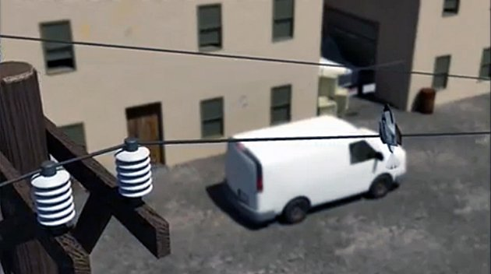
Insect sized drone…on a wire
Notes:
http://www.businessinsider.com/air-force-bug-sized-drones-are-scary-2013-2

Slide 12
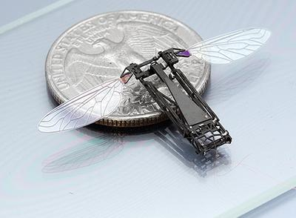
Butterfly inspired
Notes:
http://www.popsci.com/article/technology/rise-insect-drones

Slide 13
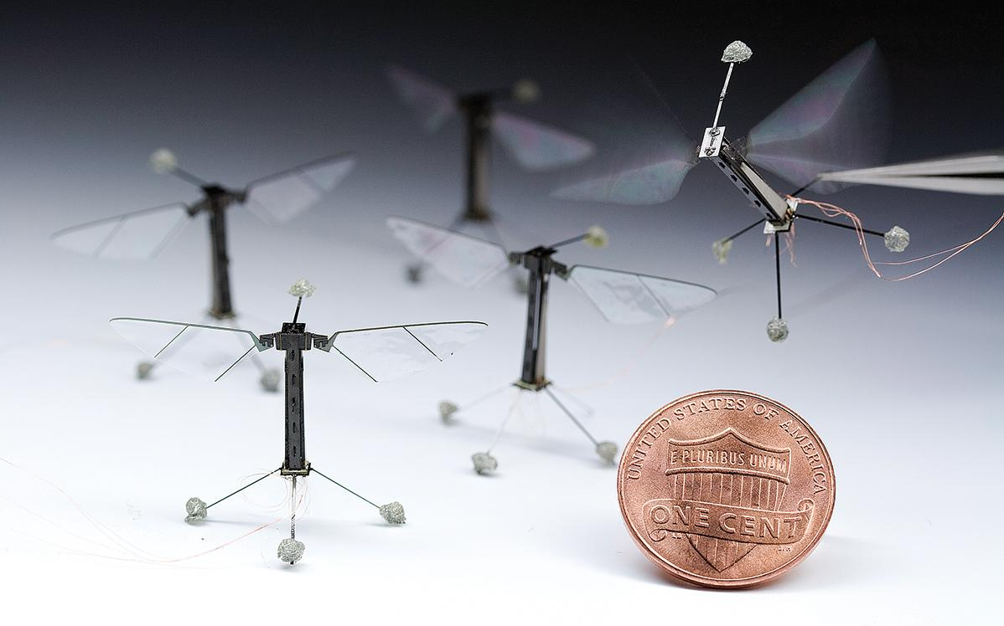
Some working prototypes

Slide 14
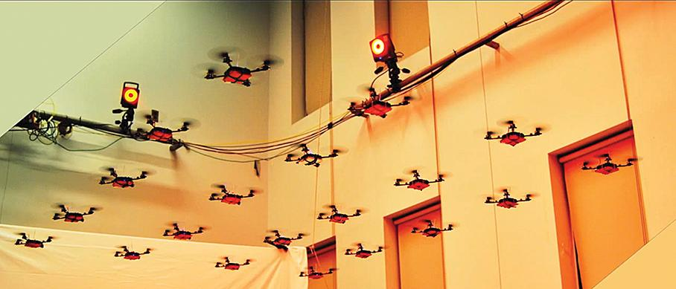
Swarming, coordinated flight

Slide 15
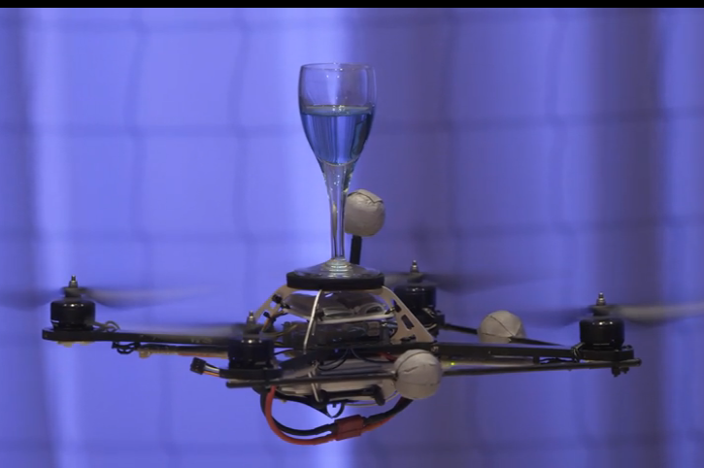
Drones as Athletes
Notes:
raffaello_d_andrea
http://www.ted.com/talks/raffaello_d_andrea_the_astounding_athletic_power_of_quadcopters

Slide 16
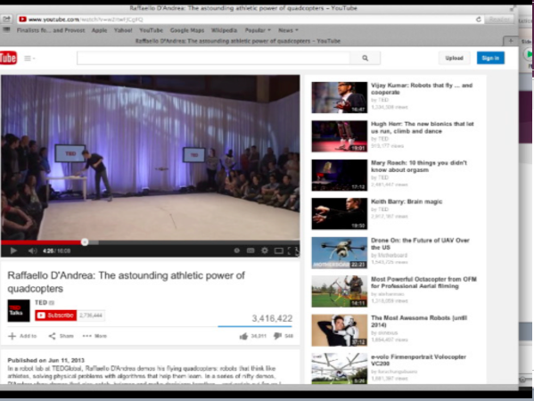

Slide 17
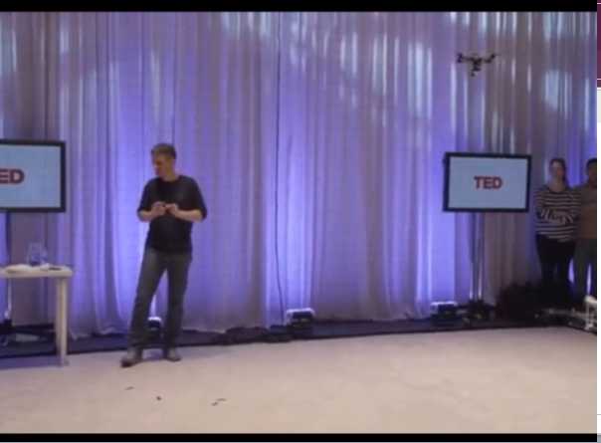

Slide 18
Commercial marketplace
Several companies making quadricopters bring various approaches to the technology.
One company, Paris-based Parrot SA, has developed a wifi-controlled quadricopter (selling for about $299) piloted remotely via smartphone or tablet.
Features 2 cameras (forward HDTV, downward Standard definition).

Slide 19
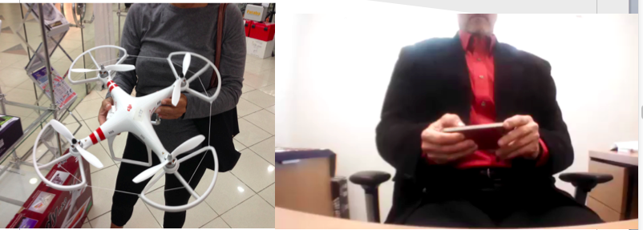
Drones for Media
Notes:
Phantom At City Center Mall, Doha, Qatar 1 November 2013. Emirates now developing drone delivery program, like Amazon.
Drone video of gray whales off California coast 2014: http://lifebuzz.com/drone/

Slide 20
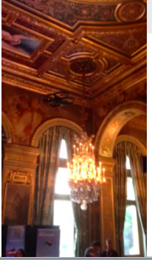
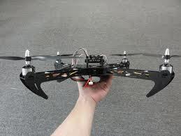
Geo-located technology
Geo-located video cameras
Camera synchs w/smartphone
Notes:
Kinomap sample and NU-Q QF ARC project
https://youtube.googleapis.com/v/3ArC8Lmsxds

Slide 21
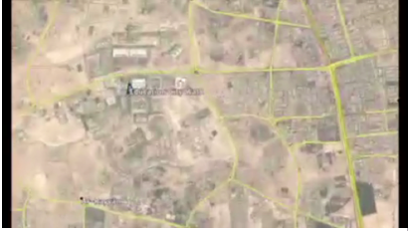
Pavlik and Vance (2013)
• Kinomap Maker
• iOS iPhone
• Several locations
in Doha

Slide 22
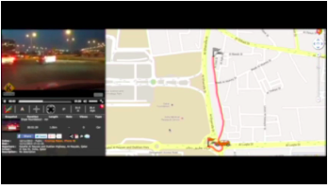
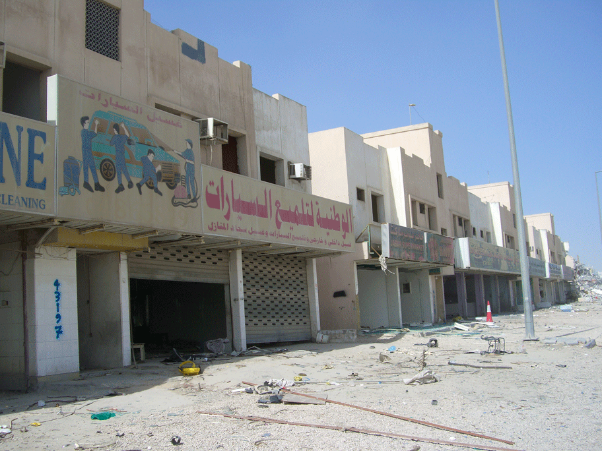
Documenting Change, Authenticating Reporting
Road has been moved.

Slide 23
Geolocated Video Model
Reporter
Geolocated Video
Authenticated
Immersive Storytelling
Standard Video
Debated
PassivelyViewed

Slide 24
Cost advantages of drones
Video-camera-equipped quadricopters offer broadcasting media and film industry important capabilities for producing aerial video at a much lower cost than traditional methods utilizing helicopters, which cost a million $ or more.

Slide 25
Safety
Because of their relative safety, small size (about one meter in diameter, made of mostly plastic) and ease of use, quadricopters can be used to shoot video in-doors or in other tight spaces.

Slide 26
Uses
Their applications range widely from making deliveries to delivering Internet access (Bilton 2014).
Broadcasters and filmmakers are making increasing and sometimes innovative use of drones in video production.
British Broadcasting Corporation (BBC) used an underwater drone to capture video. BBC producers employed a camera-equipped robotic tuna to obtain underwater video of a large dolphin pod swimming in the sea near Costa Rica.

Slide 27
Uses…continued
Documentary makers have already started using drones in production of documentaries.
Oscar-nominated documentary-maker, Bayley Silleck, used a quadricopter to film under low bridges over the Rappahannock River in the Chesapeake Bay watershed.

Slide 28
Transforming Storytelling
The BBC has used a drone (a hexacopter, or multicopter with six rotators) to capture unique aerial video shot in a port and on a farm from angles and proximity to objects (2014). This and other drone video can be viewed on YouTube http://www.youtube.com/watch?v=ZTWHP80hei0

Slide 29
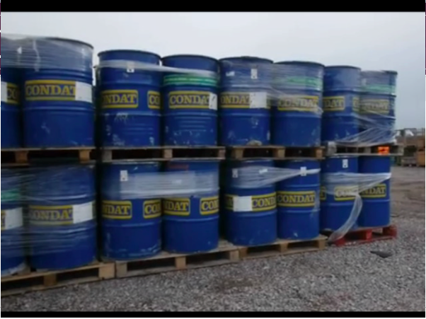

Slide 30
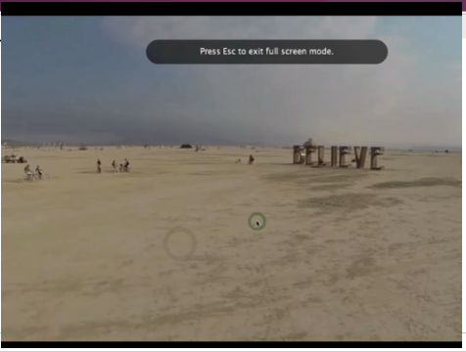
Drone at Burning Man

Slide 31
What’s drone effect on media?
1) How media pros work (e.g., news
gathering)
2) Content (e.g., storytelling)
3) Organizational structure (e.g., management, funding)
4) Relationships with public (e.g.,
engagement, citizen drone video)

