Slide 1
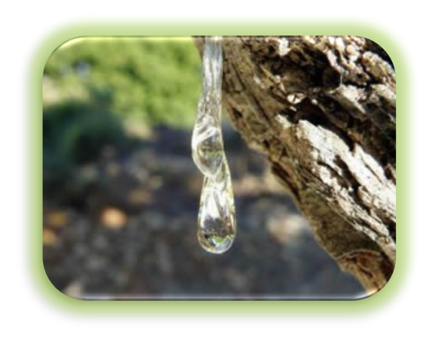
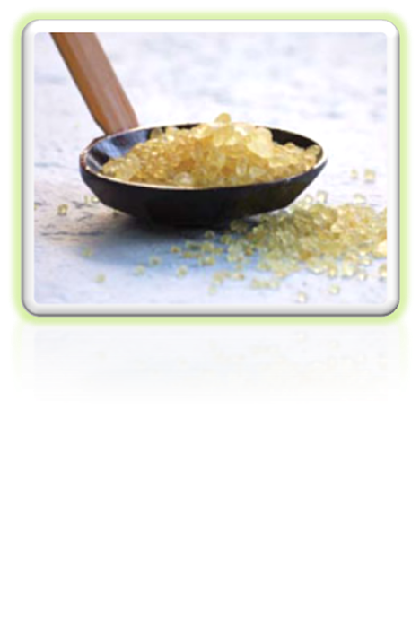
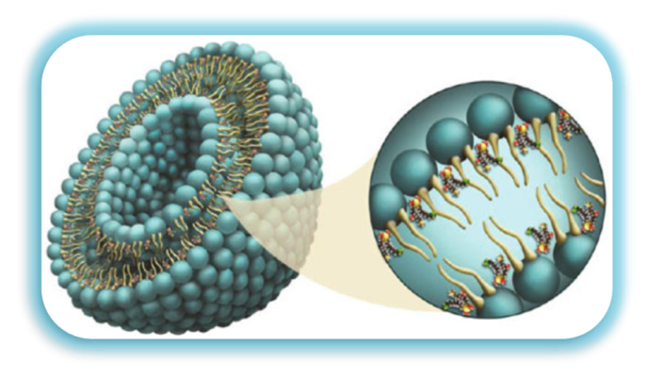
Assessment of biological activity of Chios mastic gum (acid, neutral and total fraction) extracts before and after encapsulation in liposomes.
O. Gortzi, D.-A. Karagkini, D. Kouretas, J. Tsaknis

Slide 2
Mastic is a well-known natural resin from the trunk and branches, of Pistacia lentiscus var. chia (Anacardiaceae), which is grown as endemic only in the Greek island of Chios.
It has been used in traditional Greek medicine for various gastrointestinal disorders, while the plant has been mentioned by famous ancient Greek physicians (Dioscorides, Theophrastos, etc.) recommending its healing properties.

Slide 3
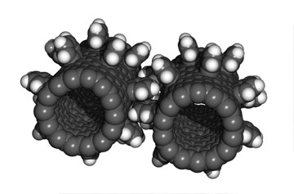

What is Nanotechnology?
Nanotechnology is the study of nanoparticles, and by definition, a nanoparticle is any material measuring less than 100 nanometers in at least one dimension.

Slide 4
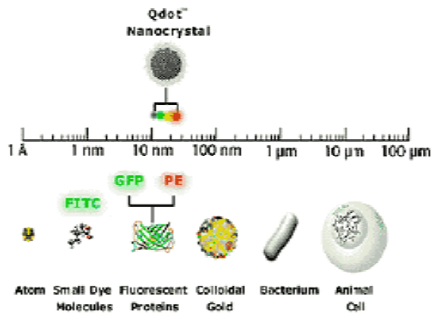
Nanomaterials
Nanomaterials may be sophisticated structures or devices that:
are created (“nanoengineered”) to perform specialized functions,
or they may simply be smaller versions of larger materials (“nanoscale”).

Slide 5
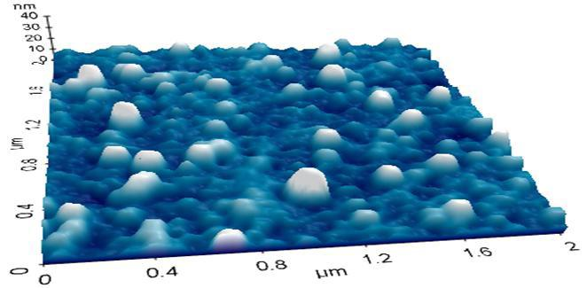
What are Liposomes
Liposomes are composite structures made of phospholipids and may contain small amounts of other molecules.
Structurally , liposomes are concentric bilayered vesicles in which an aqueous volume is entirely enclosed by a membranous lipid’
Bilayer mainly composed of natural or synthetic phospholipids.
Figure 1. 3D rendering of AFM images of lliposomes in liquid with the XE-100 (2 μm size scan)

Slide 6

Why to use Liposome??
Basic reasons for using liposomes as bioactive components carriers:
Direction
Duration
Protection
Internalization
Amplification

Slide 7
Advantages of liposomes
Direction. Liposomes can target to the in-tended site of action in the body, thus enhancing its therapeutic efficacy (drug targeting, site-specific delivery).
Duration. Liposomes can act as a depot from which the entrapped compound is slowly released over time.
Protection. Bioactive molecules incorporated in liposomes, in particular those entrapped in the aqueous interior are protected against the action of detrimental factors.

Slide 8
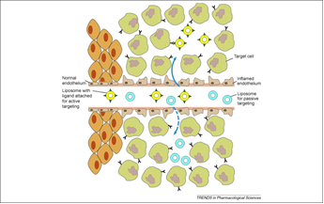
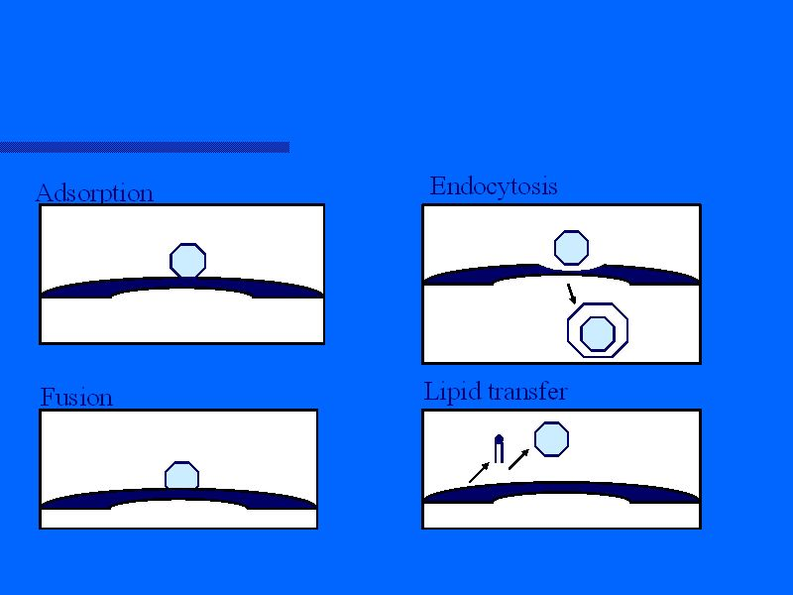
Advantages of liposomes ( cont)
Internalization. Liposomes can interact with target cells in various ways
Are therefore able to promote the intracellular delivery of bioactive molecules molecules that in their ‘free’ form (i.e. non-encapsulated) would not be able to enter the cellular interior.

Slide 9
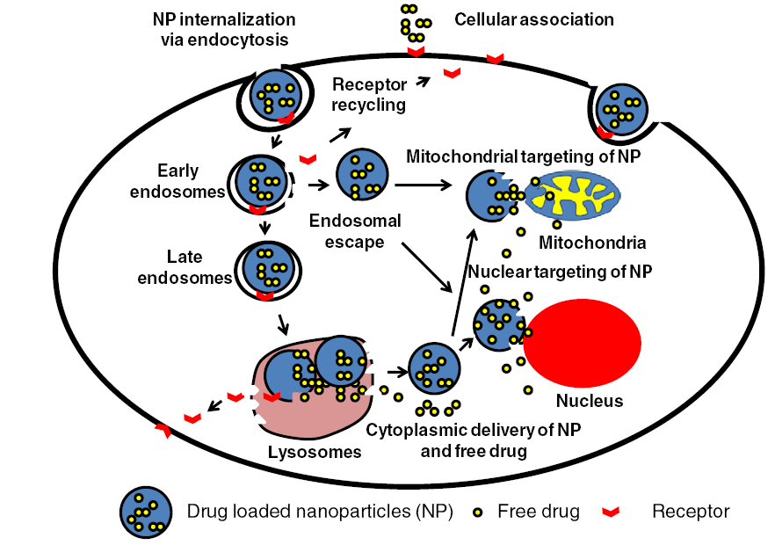

Slide 10
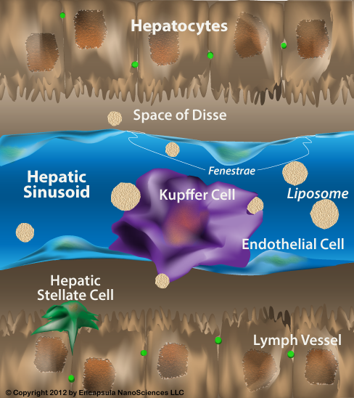

Slide 11
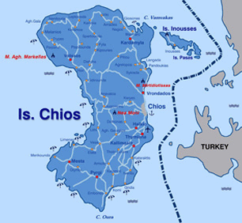

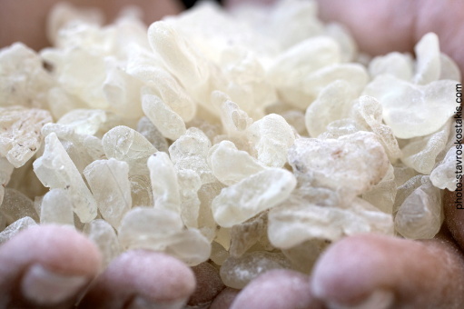
Pistacia lentiscus var. chia
Chios mastic gum, the resin obtained as an exudate from the trunk and branches of Pistacia lentiscus L var. chia, has found extensive use in pharmaceutical products and as a nutritional supplement.
A total mastic extract without polymer was prepared after removal of the contained insoluble polymer of poly-β-myrcene in order to ameliorate solubility and enhance in vivo activity.
To overcome the drawbacks of mastic gum extracts (acidic and a neutral fraction), the selection of a suitable carrier is crucial.

Slide 12

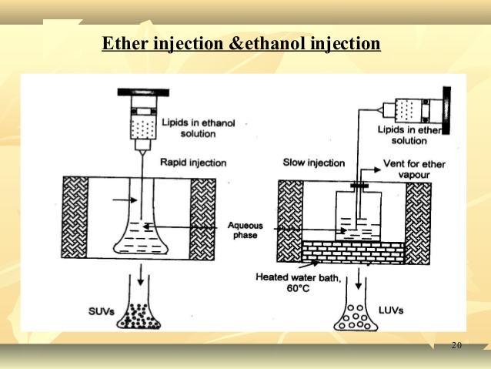
Method of liposome preparation:
Ethanol Injection (EI)

Slide 13
Total mastic gum extract/liposomes interaction was studied using:
Fourier transform infrared spectroscopy (FT-IR) and differential scanning calorimetry (DSC).
The effects of different preparation methods on the physicochemical properties of colloidal systems were evaluated by:
Means of (SEM),
Size distribution using a particle size analyser.

Slide 14
Particle size distribution
The mean particle size and polydispersity of liposomes obtained with EI method and loaded with TMGE, NMGE, AMGE are summarized in Table 1.
Table 1particle size distribution of liposomes.
Extract used | Mean particle size (nm) | Polydispersity
TMGE | 110.3±2.5 | 0.208±0.003
NMGE | 115.9±3.8 | 0.356±0.004
AMGE | 118±2.3 | 0.323±0.006

Slide 15
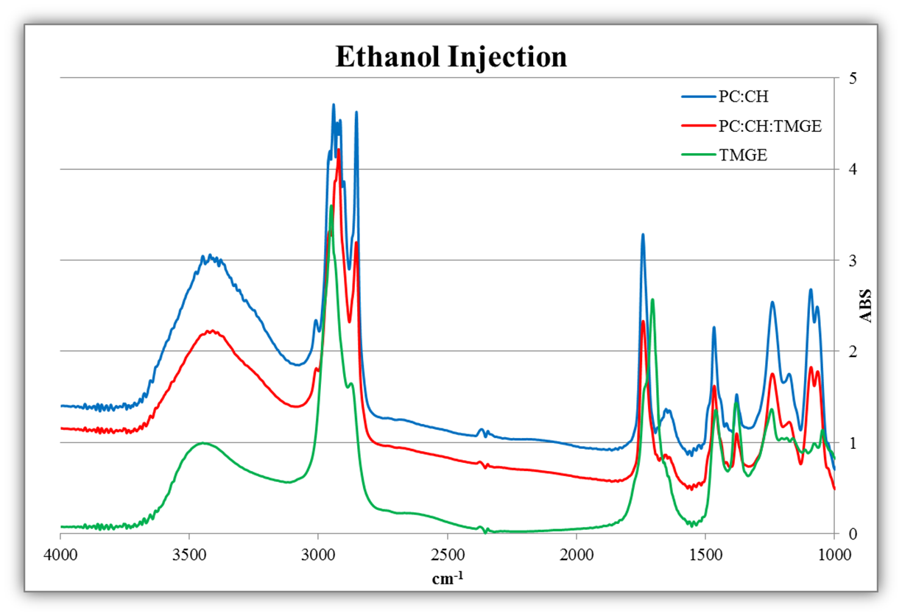
Comparative FT-IR graphs of EI preparations

Slide 16
FT-IR interpretation of EI preparations (empty and TMGE loaded).
Spectra in the transmission mode were carried out at the region of 4000-400 cm⁻¹. In the case of the stretching vibration of OH groups (3600-3000 cm⁻¹) hydrogen bonds between TMGE components and the containing phospholipids were proved.
In the case of the stretching vibration of C=O of ester groups (1750-1735 cm⁻¹) hydrogen bonding to the ester carbonyl groups in the case of TMGE loaded liposomes were take place.
The stretching vibration related to the P=O bond (1720-1236 cm⁻¹) assumed the interaction between the polar heads of phospholipids and TMGE compounds.

Slide 17
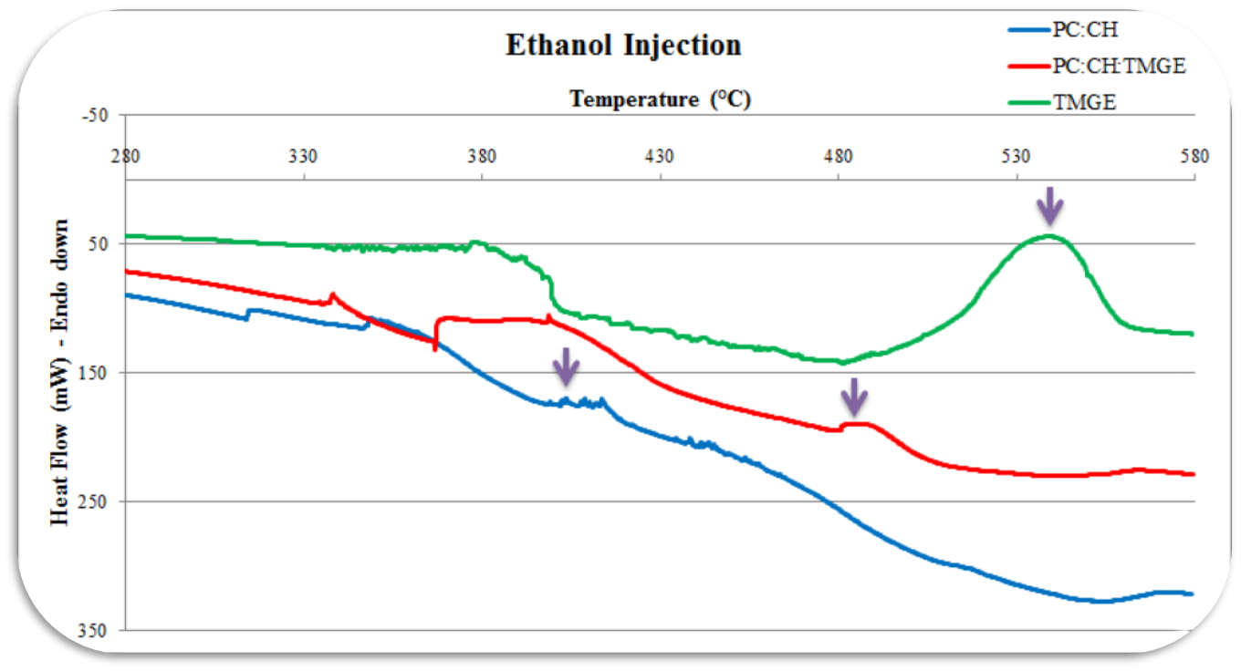
Thermal profile of EI preparation with DSC.
The oxidative stability of prepared liposomes increased after encapsulation .
The encapsulated TMGE possess new physicochemical characteristics due to possible interactions between the compounds of TMGE extracts and phospholipids.

Slide 18
Thermal oxidative decomposition EI preparations (empty and TMGE loaded liposomes) was studied by the DSC method, using the onset temperature (T_{o}) of curves at the point where the auto-oxidation process begins.
The encapsulated TMGE possess new physicochemical characteristics due to possible interactions between the compounds of TMGE extracts and phospholipids.

Slide 19
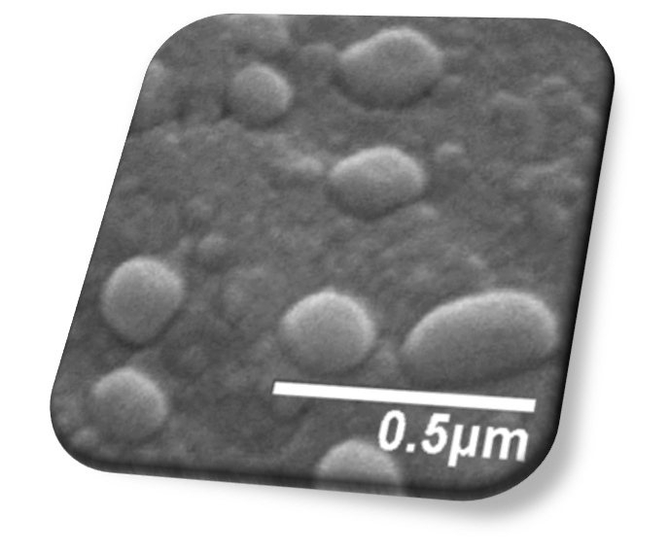
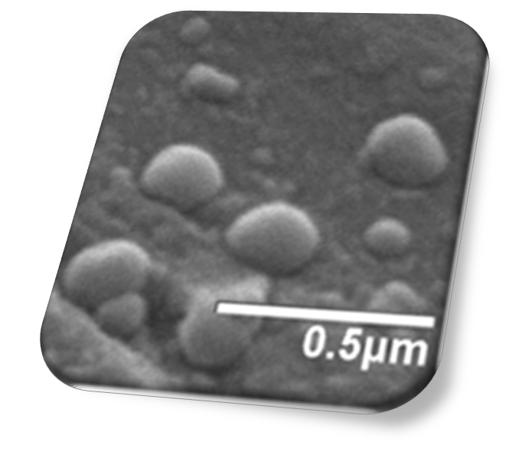
Scanning electron microscopy
The SEM photograph of optimized formulation revealed that particles were roughly spherical. Additionally, an uniformity was observed.
An average particle size below 120 nm could be achieved and reproduced.

Slide 20
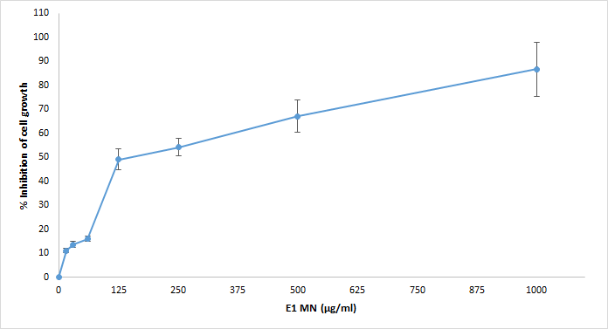
Effect of liposomes NMG extract loaded on the viability of HepG2 cells at various concentrations of liposomes suspensions for 24 h. Results are expressed as percent of viable cells in comparison with the control.
Each experiment was performed in triplicate and the bars represent standard error values.
IC50 = 132 + 8.5 μg/ml

Slide 21
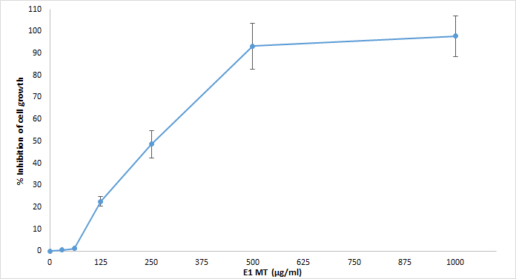
Effect of liposomes TMG extract loaded on the viability of HepG2 cells at various concentrations of liposomes suspensions for 24 h. Results are expressed as percent of viable cells in comparison with the control.
Each experiment was performed in triplicate and the bars represent standard error values.
IC50 = 255 + 14.3 μg/ml

Slide 22
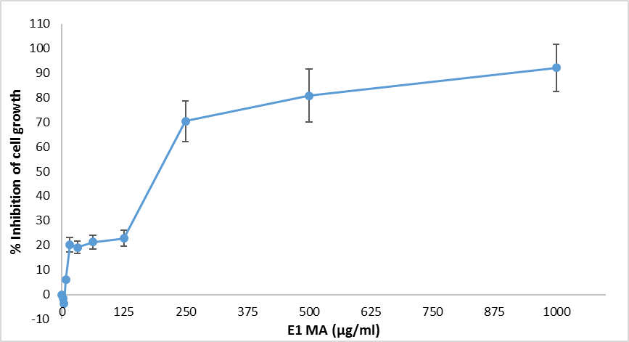
Effect of liposomes AMG extract loaded on the viability of HepG2 cells at various concentrations of liposomes suspensions for 24 h. Results are expressed as percent of viable cells in comparison with the control.
Each experiment was performed in triplicate and the bars represent standard error values.
IC50 = 184 + 12.3 μg/ml

Slide 23
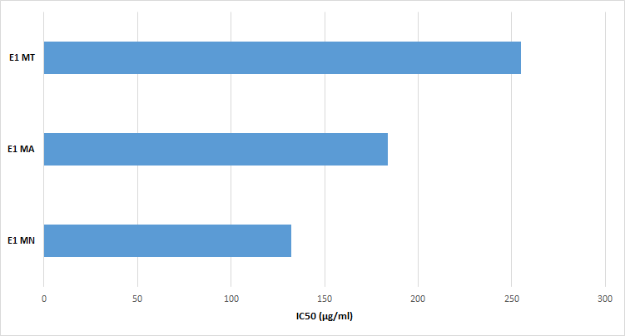

Slide 24
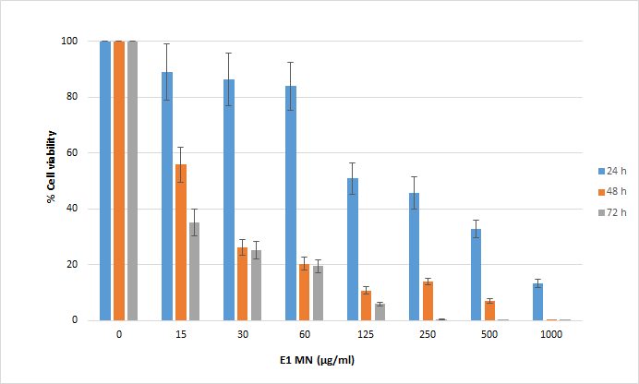
Effect of liposomes NMG extract loaded on the viability of HepG2 cells at various concentration of liposomes suspensions for 24 h, 48h, 72h. Results are expressed as percent of viable cells in comparison with the control.
Each experiment was performed in triplicate and the bars represent standard error values.

Slide 25
In conclusion….
Colloidal systems containing MGE (N,A,T) were successfully prepared with EI methods. Besides, previous studies proved that EI method was more suitable for entrapment of active agents than other methods.
The effect of different doses of these recently prepared and characterized liposomes on the growth and viability of HepG2 was evaluated.
Our results reveal that liposomes MG extract loaded cause a dose and time depended inhibition of survival in malignant HepG2 cells studied.
When comparing the results of the different liposomal formulations tested, it is clear that liposomes NMG extract loaded were found to be significantly more toxic.
The inhibitory activity of the extracts against the cell growth indicates that they potentially could be used as chemo protecting agents .
Nevertheless, further studies are needed to clarify the mechanism by which liposomes MG extracts loaded interact with HepG2 cells (internalization or fusion with the cell membrane).

Slide 26
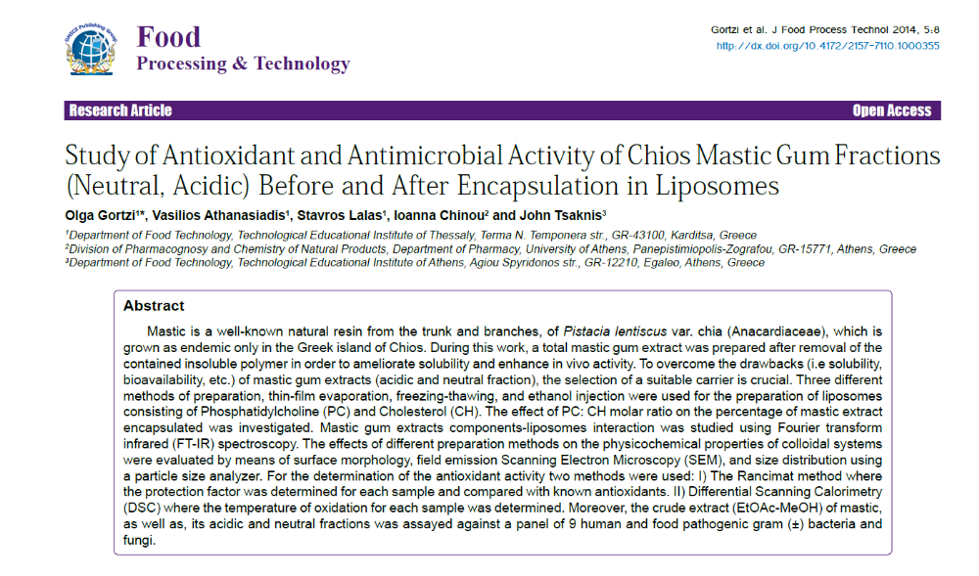

Slide 27


