Slide 1
Stemming the Tide of Obesity:
What Needs to Happen
John F. Tomer
Department of Economics & Finance
Manhattan College,
Riverdale, New York, USA

Slide 2
Purpose: Argue for efforts necessary to resolve obesity
Perspective: ambitious, idealistic
Due to large scale: social movement necessary, comprehensive policy efforts needed
Obesity growth last 30 years esp in advanced industrial nations; it’s epidemic
Obesity associated with severe medical problems, all ages
Purpose: not specifics of antiobesity policy plans, outlining important efforts to fix obesity, scope of effort

Slide 3
A Socio-Economic Model of Obesity
Model is alternative to mainstream model & conventional wisdom on health science
Health science based on writings of Mark Hyman & Gary Taubes: Obesity caused by poor diet & behavior
Poor diet:
High in refined, processed carbohydrates
High in bad fats
Low in fiber
Low in antioxidants
High in oxidants
Poor behavioral patterns:
Overly rapid eating
Eating when stressed
Sleep deprivation
Lack of exercise
High exposure to toxins

Slide 4
Why has obesity grown so much in last 30 years?
It’s too many negative external & internal factors influencing choice of diet & behavior
Internal Factors: PC, social capital, health capital, genes
External Factors: Technological change causing food price change, infrastructure of obesity, factors causing chronic stress, advice from health professionals
Infrastructure of Obesity: Features of socio-economy influencing eating (& behavior) negatively
1) Influences from food suppliers, agricultural, food processing, food distribution, & food preparation industries
Increasingly selling unhealthy foods: 1. Bad fats,
2. Carbohydrates with low phytonutrient index & high glycemic load (esp. refined grains, sugar, sugary items, processed food, junk food)
Selling fewer healthy foods: whole, unprocessed foods, full of fiber, antioxidants, vitamins, minerals, phytonutrients, healthy fats

Slide 5
Figure 4
Factors Causing Increase in Overweight and Obese Individuals
Rising Chronic Stress
External Factors (above individual)
Growing Infra- structure of Obesity
Technological Change
Falling Food Prices
*
Poor Advice from Health Practitioners
Rising Exercise Prices
Markets
*
Poor Health & Weight Outcomes
Over- weight, Obesity
Poor Diet & Life Pattern Choices
Poor Habits, Addiction
Individual
Low Social Capital
Low Personal Capital
W much greater than W*
Low Health Capital
Genes: Physical & Psychol. Predis- positions
Internal Factors (below individual)
Socio-Economic Worst Case
12

Slide 6
Food Suppliers cont’d
Not just supplying unhealthy foods, actively designing:
Adding sugar, fat, salt to make them
hyperpalatable, 2) override body’s satiety signals, 3) more habit forming
Goal: to get you hooked, creating “craveability”, customers who are “conditioned hypereaters” Kessler
Aggressive advertising, marketing strategies
Creation of toxic food environment
Socio-Economic Change
2) Influence of important socio-economic patterns:
People spending more time away from home, eating less at home
Shift to foods requiring less home preparation

Slide 7
Second External Factor
Impact of technological change on markets for food & exercise:
Lower food prices, higher exercise prices
Prices of fats, oils, sugars, sweets, sodas are lower
Prices of fresh fruits, vegetables, fish, dairy higher
Thus incentive to eat less healthfully
The Internal Factors
Personal Capital (PC)
Its human capital (HC), embodied in humans
Different from standard HC, largely noncognitive, nonphysical
PC: personal qualities, partly from efforts to mature & grow
Example: emotional intelligence
Determines person’s response to external factors
Person with small/poor endowment of PC likely succumbs to external influences, incentives
Person with greater emotional competencies, ability to control impulse, delay gratification can resist
People with low PC are vulnerable, likely to develop habits pushed by food suppliers; they become conditioned hypereaters, compulsively eating processed, palatable, cheap, unhealthy food

Slide 8
Health capital (HLC)
Consists of individual learning related to physical & mental health
HLC learning relates to eating & exercise patterns, use of medicines & nutritional supplements, use of alcohol & drugs, etc
Person who learns to eat slowly, get enough sleep, eat healthy food, & exercise less likely to be obese
HLC overlaps with PC
Individual with strong, positive PC, HLC, SC likely to choose good diet, behavior even if strong negative influences/incentives from infrastructure of obesity & food markets
Not so if weak PC, HLC, SC
Relative strength of internal, external factors determines outcome

Slide 9
Related Patterns & Issues
“Nutrition transition”, a longer term view
Societies at early stage of development:
High fertility, high mortality
High prevalence of infectious diseases
High prevalence of undernutrition
Societies moving toward modernity
Lower mortality & fertility
Infectious diseases recede
Lower famine
Rise of nutrition-related noncommunicable diseases (NR-NCD)
NR-NCD only arise after contact with modern, Western lifestyles, dietary practices
NR-NCD: diseases of civilization, affluence, Western
NR-NCD: obesity, diabetes, cardiovascular, hypertension & stroke, cancer, appendicitis,…
Causes: “civilized lifestyles, esp diet
Rising use of white flour, sugar (1800s) correlated
growth of chronic diseases (cancer)
Taubes: all refined, easily digestible carbohydrates
Developed countries (esp US) have toxic food environments

Slide 10
World’s Longest Living People
No famine or high mortality, low infectious diseases
Low rates of NR-NCDs
5 Places: Greek island, Okinawa, Italian village, valley in Pakistan, county in southern China
Exceptionally healthy, long-lived
Retain best of traditional whole food diets, avoided negative diets of civilization
My acquaintances: 75 year old man, Bolivian student
He had not been to doctor in 60 year, excellent health
Diet: largely uncooked whole foods, Trampoline exercise
He grew up in Northern India
Her observations of Bolivia: no obesity; Bolivians buy fresh food every day in local market, avoid fast food, processed food

Slide 11
Goal of Antiobesity Efforts
Everyone maintaining ideal weight, excellent health
Requires excellent diet, genuinely satisfying, healthy behavioral patterns
Problem: negative socio-economic influences & incentives
Need to transform dysfunctional patterns
Prevention vs Medical Care
Medical treatments, innovations: enormous cost
Chronic diseases are preventable
Obesity prevention: eliminating poor environment, changing individual behavior patterns
Eliminate negative influence of infrastructure of obesity, foster investment in IC
Health Promotion Also Needed
Promotion of healthy diets, regular physical exercise
Raise consumer knowledge, improve attitudes
Its social marketing

Slide 12
Scope of Antiobesity Efforts
Comprehensive Government Antiobesity Programs
Many authors have called for comprehensive programs with many specific measures
A Social Movement Is Also Needed
Social movement: mobilization of many grass-roots groups, strongly motivated by common threat
Example: tobacco control in U.S., clear threat (lung cancer)
Government, business actions not enough to stop obesity

Slide 13
Social movement organizations: grass-roots, some involving professionals
Purpose; Create powerful influence countering cause of social problem, mobilizing community, govt, business
Create socio-econ. environment conducive to health
Factors associated with successful health social movements:
Problem involves high, clear risk
Scientific evidence on cause exists
Clear goals, specific targets can be set
Goals are persuasive, motivating
Victims such as children, for whom much sympathy
Some highly motivated, passionate leaders
Some reasons for optimism about antiobesity SM
Much current interest & concern about food issues

Slide 14
Governmental Antiobesity Policy: General Approach
Behavioral Economics & Policy Design: The Singapore
Experience
Awareness of decision making departing predictably, regularly from economic rationality
Cognitive biases: loss aversion, status quo bias, framing, saliency, etc.
Bounded rationality, willpower, self-interest
Rules of thumb used if situations not simple
Improves policy design & outcomes
Combine with standard economics, efficiency
Experiment to find right policy design

Slide 15
Any Individual Antiobesity Measures Insufficient
Individual measures like tax on sugary beverages, nudges to eat vegetables don’t change basic patterns
Don’t change individuals’ knowledge, attitudes, values
Can be included as elements in comprehensive policy plans
Latter enable multiple facets of environment to be addressed; therefore greater chance of success
Different elements could have synergistic effects, enabling rapid change in social norms

Slide 16
Taxing Fattening Food
Two types of negative externality:
Insurance: due to their behavior obese incur higher health costs resulting in higher health insurance costs for all
Labor market: obese have lower labor productivity, imposing costs on others
Due to externality, typical recommendation: Pigouvian tax on sale of good equal to MC imposed on others; its efficient solution
But not by itself a solution to obesity
Example, tax on sale of sugary beverage
Government competency: determining correct amount of tax, which goods to tax, etc
Likely regressive incidence of tax
Likely little effect on consumption patterns related to obesity
OK as moderate consumption discouragement, and as stigmatization of fattening food (part of comprehensive policy)
Or joined with subsidies for healthy food
But financial incentives alone not an obesity solution

Slide 17
Intangible Investment as a Key to Fixing Obesity
To lower obesity rates, vulnerable people (deficient in IC) should make investments in PC, HLC, SC
IC investments incur costs early making possible later benefits, lower weight, greater health
Individuals carry out investment but communities, businesses, govts may guide, encourage process
To resist negative influences, need to invest in PC, developing emotional intelligence, character
Becoming more self-regulating, more able to delay gratification, better integration of emotion & thinking
Thereby overcoming unhealthy habits, compulsive hyper-eating tendencies
Various types of counseling/therapy can help

Slide 18
Investment in HLC, specific knowledge pertinent to physical & mental health
Learning about healthy food & exercise opportunities, avoidance of unhealthy food, how to integrate into their lives
South Korea example: traditional diet healthy (low in fat, high in vegetables)
South Korean transition starting 1960s
1980s warning signs: increasing obesity?
Campaign to promote virtues of traditional diet
Food preparation training, diet articles, seminars, internet information
Successful in retaining diet, low obesity rate (2.4 %)

Slide 19
The Infrastructure of Obesity and Problematic Food Business Behavior
At heart of external, toxic food environment is negative opportunistic behavior of many food suppliers
U.S food businesses: developing new foods, new ways to process foods, new marketing strategies
Many resulting foods: fewer nutrients, more calories, more effective marketing to young & vulnerable
Example, nuggets of chicken: high fat, sugar, salt, flavoring, tastes great; very profitable, fattening
Obvious need for govt policy due to societal costs
Devising policies complicated: it’s not one good or few; it’s negative patterns
Also not all food suppliers are negatively opportunistic

Slide 20
Guidelines needed for antiobesity policy on food companies
Businesses differ in their responsibility orientation
1) Highly socially responsible
Behaviors good for society, stakeholders, themselves
2) Market oriented
Self-interested response to incentives, follow norms, no harm but no helpfulness
3) Negatively opportunistic
Low ethical orientation; seek opportunities to gain at expense of others
Healthiness of foods: Healthy or unhealthy; important or unimportant
Possibilities arrayed in Figure 2, boxes 1-6; of greatest interest: upper triangles, boxes 2, 4, 6 (important unhealthy food)

Slide 21
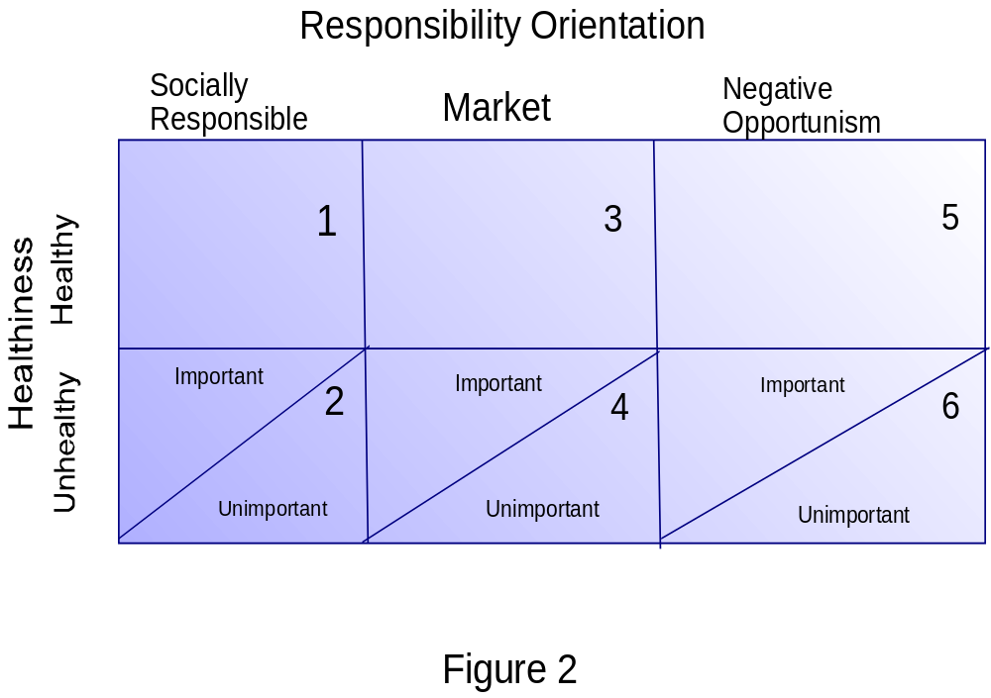

Slide 22
Policy goal: Influence companies to healthier food
Kind of influence: Depends on responsibility orientation
Market oriented & negative opportunism require control-oriented policies
Socially responsible best with commitment approach policy
Control-oriented: Uses rewards & penalties administered by govt. to attain govt. goal
Examples: Market incentive & command & control regulation
Companies not trusted, little capability for taking responsibility
Commitment approach: Allows firms to be largely self-regulating
Companies trusted, capable of commitment
Firms’ actions require integration with govt. goals & informed by govt.
Desirable, only works with companies with highly developed capabilities
Also desirable, encouraging companies to become more responsible, committed

Slide 23
Food Company in New Zealand
“Habitual Fix” is fast food restaurant in Wellington
Not usual fast food: fresh daily vegetables in sandwiches, wraps, salads; juices squeezed onsite
Commitment to healthy food, paying off
Presumably IC investments to develop distinctive capabilities
Fast food not necessarily unhealthy food
Ultimate Solution to Obesity: Socio-Economic
Transformation
Required: 1) People understand obesity, act on knowledge
2) Food companies accept responsibility for obesity, improve food healthiness
3) Health practitioners provide good advice
Societal change in values, valuing health, healthy living patterns

Slide 24
Conclusions
Progress against obesity is possible
NYC schools: obesity rate down 5.5 % in 5 yrs
Aggressive actions: advertising against sugary soda, healthier options on lunch menus, better content in vending machines, etc
But antiobesity social movement needed
Needed more investment in IC, becoming more emotionally intelligent with food, exercise
Businesses: change practices, accept responsibility
Up to people to act on vision

