Slide 1
Patient Safety –
Assurance through Accreditation?
John Sweeney, CEO

Slide 2
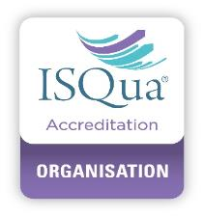
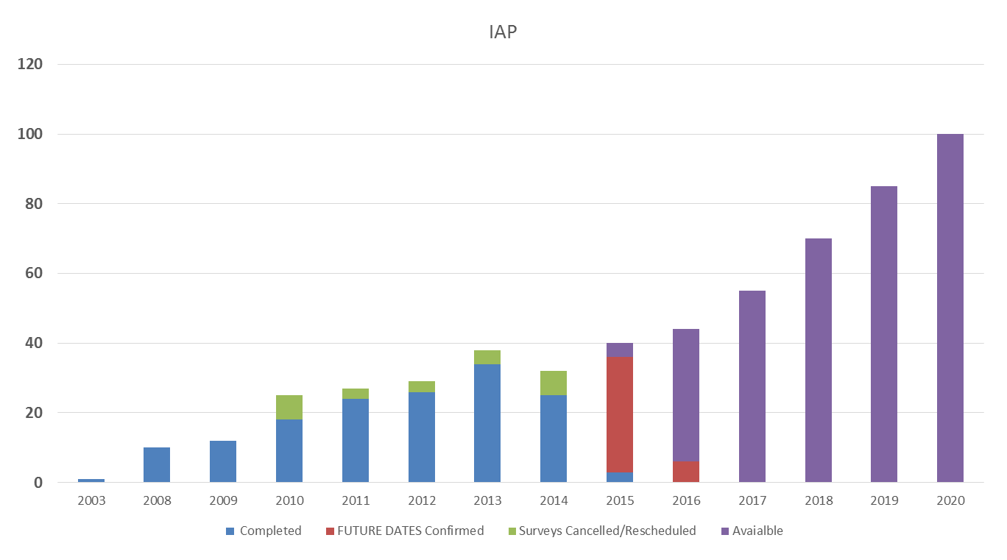

Slide 3
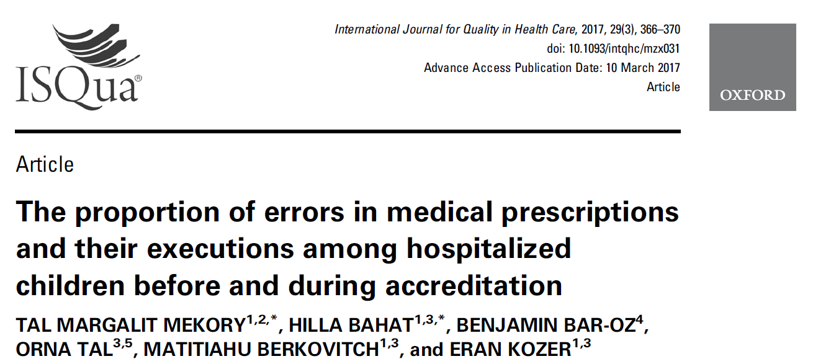
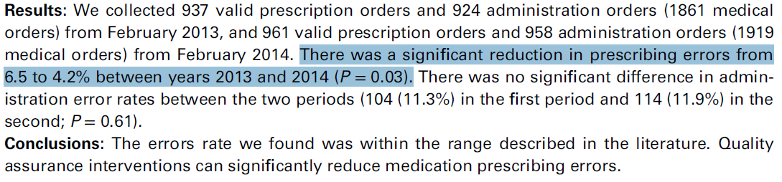

Slide 4
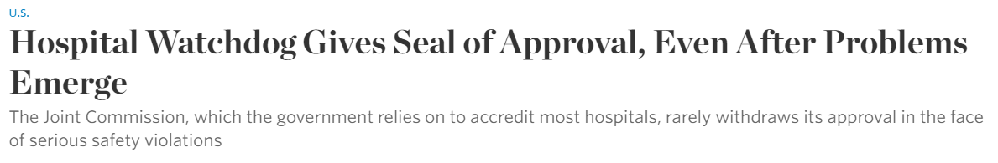

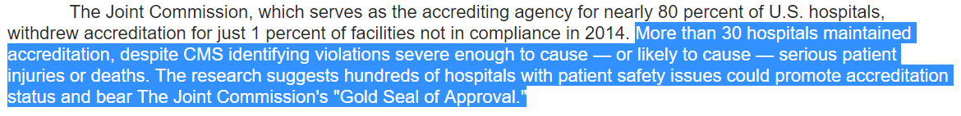

Slide 5
Positives V’s Negatives

Slide 6
Specific changes
Organisational reflection
Priority for important but non-urgent
Leverage for internal groups
Ratchet effect of raising standards
Defensive or minimal compliance
Pointless conformance
Creative compliance
Inhibiting innovation
Distorting internal priorities
Walshe 2007

Slide 7
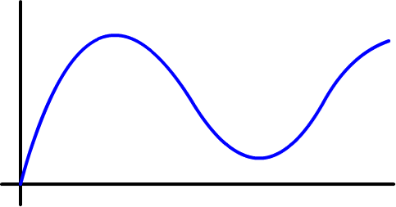
Improvement Not Sustained
Cycle
Walshe 2007

Slide 8
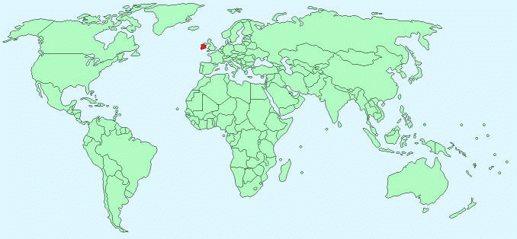


Slide 9

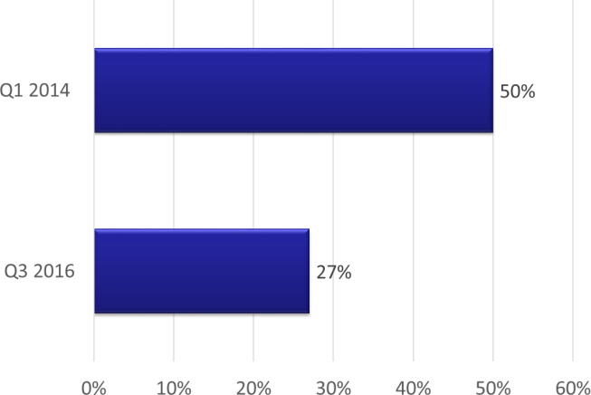
Medication Management Non-compliance
Residential Aged Care
Notes:
early 2015, 50% of the providers inspected were found to be non-compliant in Medication Management, whereas within the last quarter of this year, those rates of non-compliance have dropped to 27%,* still an area requiring improvement, but one in which the regulation has embedded evidence based best practice throughout the sector.

Slide 10
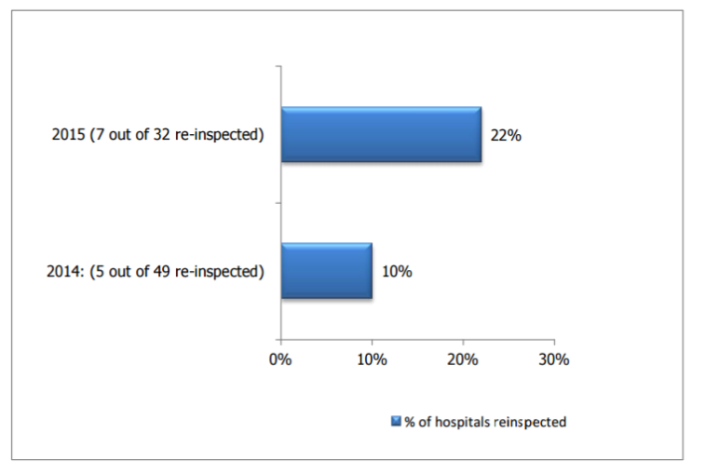
Prevention and Control of Healthcare Associated Infections
Re-inspection Level
Notes:
Under this regulation process, where high levels of non-compliance or risk are identified within a facility, HIQA completes a re-inspection to drive rapid improvement in hospital’s compliance with the standards.

Slide 11
Process of Accreditation
Cultural Challenge

Slide 12
1960’s Process
Observation
Interview
Document Review

Slide 13
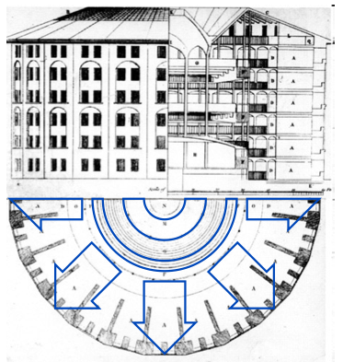
Panopticon - Jeremy Bentham 18c

Slide 14
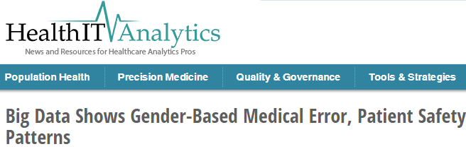
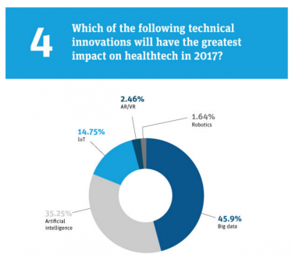
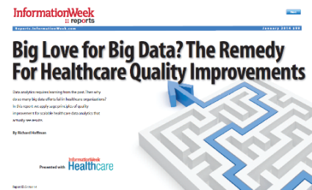

Slide 15
The Concept
“Stop – Start” -> Continual Access Monitoring (CAM)
HOW?
Regulators access to information systems in real time.
A “window into the soul” of the organisation
The first step has already been taken……

Slide 16

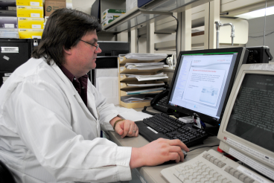



Slide 17
Continuous Access Monitoring
(CAM Regulation)
Real Time Monitoring
  Continuous assessment of information / indicators
Reduced Cost
  Focused Onsite – Targeted Involvement
Increased Patient Safety Impact
  Knowledge - Support - Enforcement

Slide 19

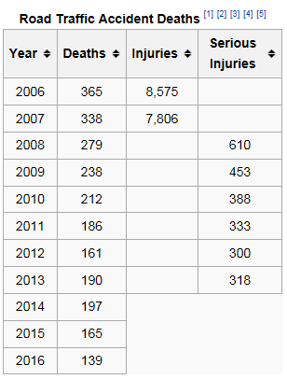
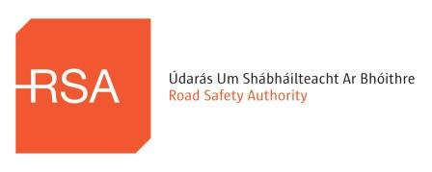
Cultural Change
Notes:
RSA Budget - Number of Deaths patient safety incidents 44,000 in USA – 660 deaths in Ireland

Slide 20

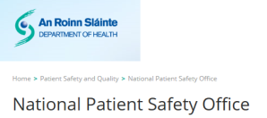

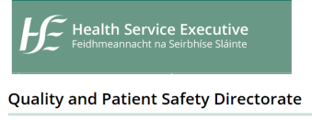
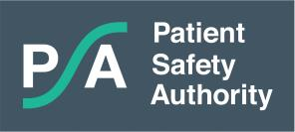

Slide 21
Patient Safety –
Assurance through Accreditation?
Yes It Can - Change of Process - Change of Culture
john.sweeney@hci.care

