Slide 1


Slide 2

Generation of long-term human pancreatic islet cell activity in vivo by induction of immune tolerance to human stem cells
John S. Pixley, M.D.
University of Nevada SOM, USA

Slide 3
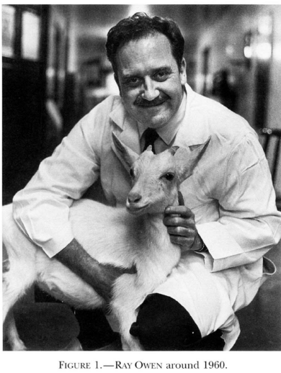
Immunogenetic Consequences of Vascular Anastomoses between Bovine Twins
Intermingling of siblings cells in placental circulation results in long-term chimerism
Immune tolerance is acquired during development
Existence of stem cells and their engraftment
Science, Vol. 102:400-401 (1945)

Slide 4
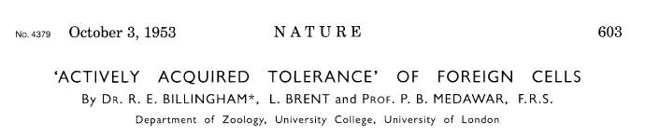
The inoculum from A-line male suspension in ringer’s solution of small organized tissue clumps, isolated cells and cell debris prepare by prolonged chopping with scissors of testis, kidney and splenic tissue
0.01 ml injected via intraperitoneal injection into day 15-16 fetuses of a CBA X CBA mating
After birth skin graft acceptance was determined
Summary
Cellular inoculum during development results in skin graft tolerance in adult life
The tolerance is donor specific (i.e. full ability to respond to 3rd party donor)

Slide 5
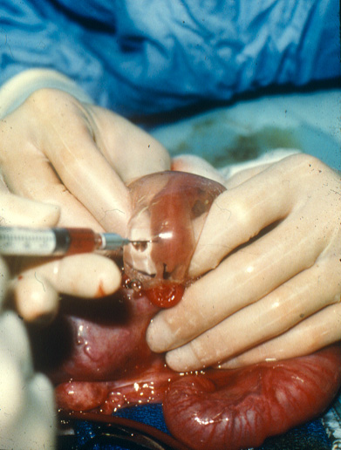
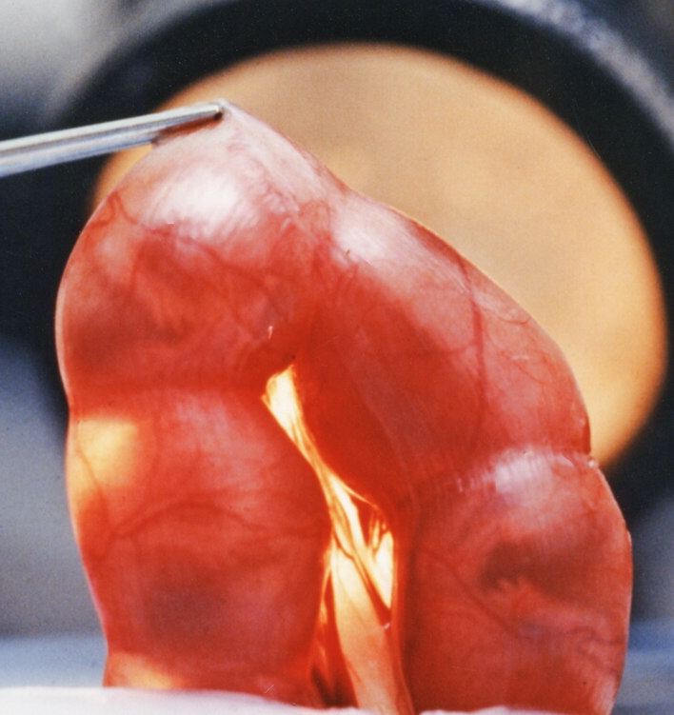
Intrauterine transplantation
IP injection on day 58-65
IP injection on day 14-16
SHEEP
MOUSE

Slide 6
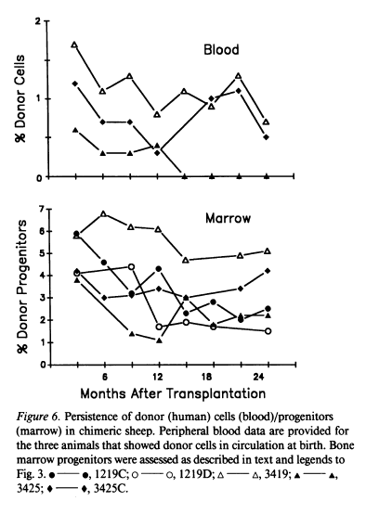
Engraftment and Long-term Expression of Human Fetal Hematopoietic Stem Cells in Sheep Following Transplantation in Utero
Fetal age at transplantation day 48-54 term gestation 145 days
J Clin Inv 1992; 89: 1178-88

Slide 7
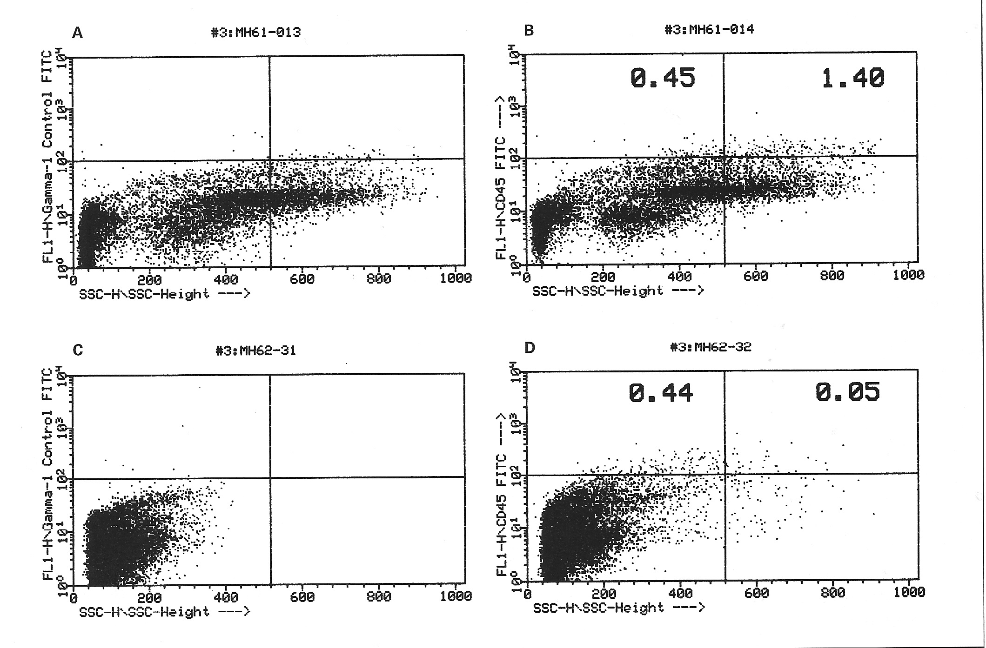
Prolonged hematopoietic chimerism in normal mice transplanted in utero with human hematopoietic stem cells
Peripheral blood
Human CD45
Thymus
Side scatter
Pathobiology 1998; 66: 230-39

Slide 8
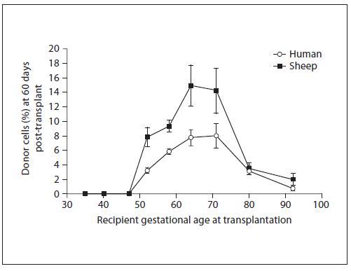
Engraftment receptivity is gestational age dependent
Sheep gestational age
ENGRAFTMENT WINDOW: day 52-72
Fetal Diagn Ther 2009;25:102-110

Slide 9
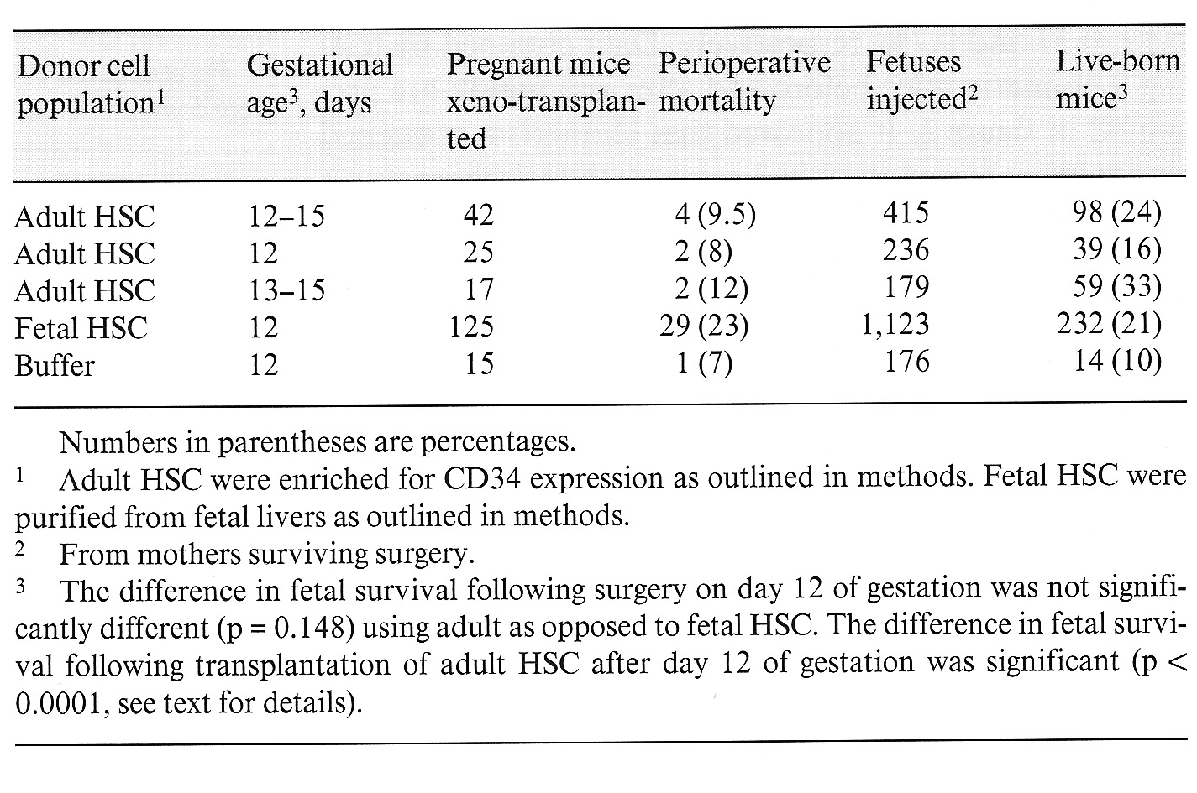
Murine maternal and fetal viability following in utero transplantation of human HSC
Engraftment frequency or chimeric index
Engraftment = marrow presence usually HSC phenotype
Expression = differentiation markers external to the marrow
Pathobiology 1998; 66: 230-39

Slide 10
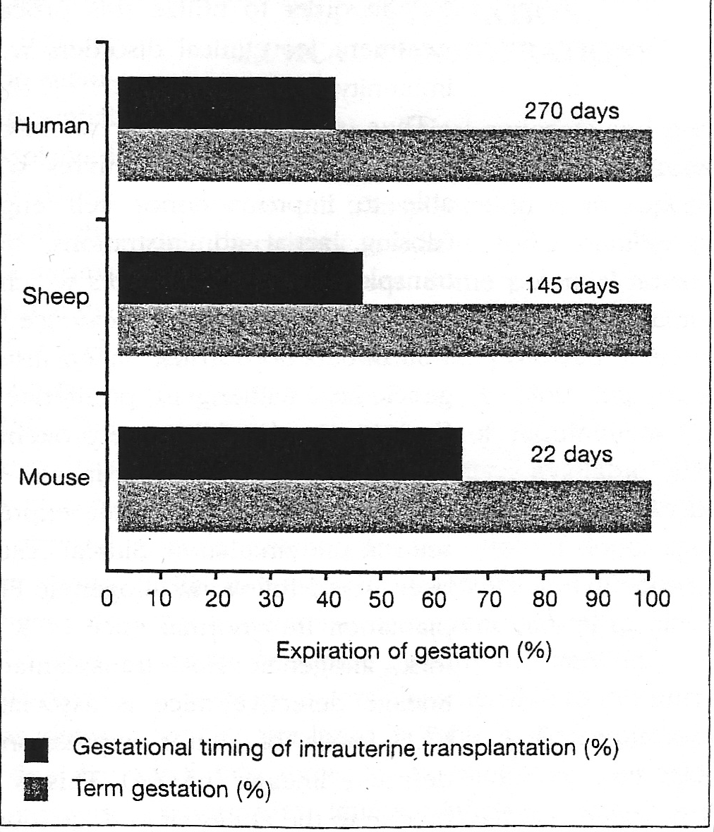
Day 54-65
Day 14-16
Engraftment frequency or chimeric index
Engraftment = marrow presence usually HSC phenotype
Expression = differentiation markers external to the marrow
Reviews in Clinical and Experimental Hematology 8: 11-32, 1999

Slide 11
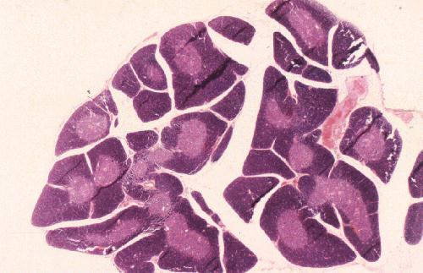
Embryology of the thymus:
At a defined stage in development the thymus demarcates and undergoes vascularization with formation of the medulla.
Gestational timing of demarcation:
Sheep beyond day 50
Mouse day 14-16
Immunology 1987; 62: 97–105.
Eur J Immunol 2000; 30:1948-1956 [PMID: 10940884]

Slide 12
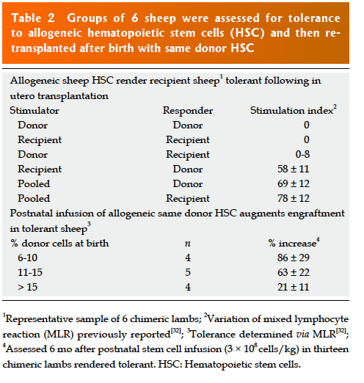
World J Stem Cells 2013 April 26; 5(2): 43-52
doi:10.4252/wjsc.v5.i2.43

Slide 13
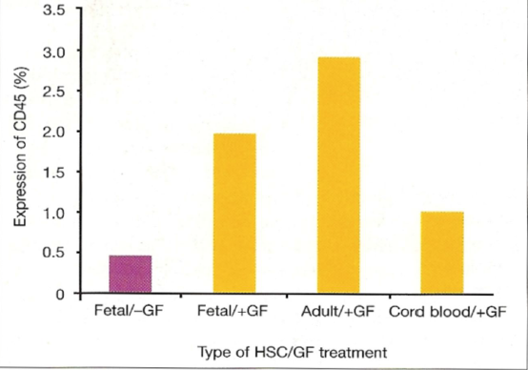
Human (xeno) and allogeneic grafts are expandable after in utero transplantation
Growth Factor treatment
No growth factors
Human CD45 + cells in transplanted mice
Allogeneic in mice
Prenatal tolerance induction and postnatal nonmyeloablative bone marrow transplantation
Blood. 2002; 100: 2225-2234
Xenogeneic (human) in sheep
Postnatal administration of human growth factors
Exp Hematol. 2007; 35: 1594–1600.

Slide 14
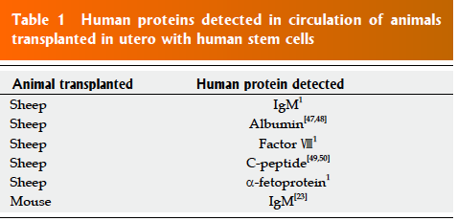
World J Stem Cells 2013 April 26; 5(2): 43-52
doi:10.4252/wjsc.v5.i2.43

Slide 15
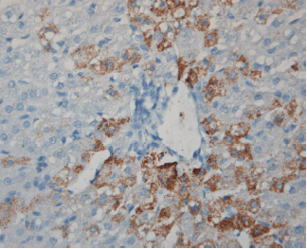
Liver section obtained at 11 months post transplant from sheep transplanted with CB-derived CD34-Lin- cells and stained with anti-human hepatocyte antibody
Blood First Edition online July 1, 2004; DOI 10.1182/blood-2004-01-0259
Tolerance to solid organ antigens/ Where are sheep NK cells?
Blood 2004; 104: 2582-2590
[PMID: 15231580 DOI: 10.1182/blood-2004-01-0259]

Slide 16
Stem Cell (SC) populations studied for in vivo differentiative capacity
Human fetal pancreas derived mesenchymal SC
Exp Hematol 2010; 38: 311-320 [PMID:
20170708 DOI: 10.1016/j.exphem.2010.02.005]
2. Embryonic SC derived CD34 cells
using mouse S17 BM stromal cell line and
embryoid body formation and differentiation in vitro
Exp Hematol 2010; 38: 516-525.e4 [PMID: 20227460 DOI: 10.1016/j.exphem.2010.03.002]

Slide 17
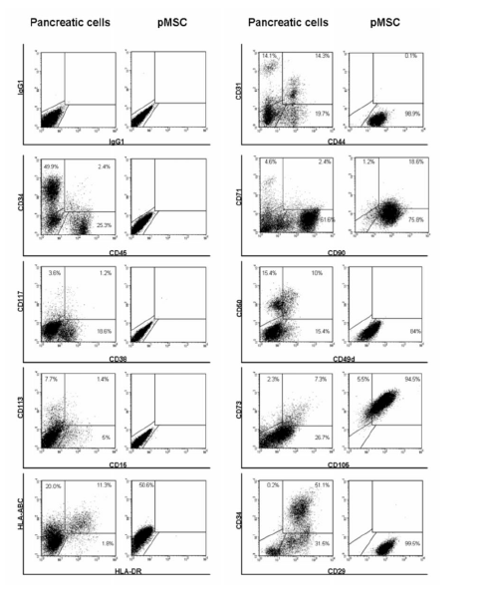
hfpSC (human fetal pancreatic SC) phenotype in comparison to input population
hfpSC + for mesenchymal markers:
CD29, 44, 73,90 and 105

Slide 18
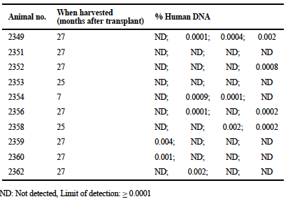
Real time quantitative PCR detection of human DNA following transplantation with hfpSC (human fetal pancreatic stem cells)
Four 1 mm³ samples from the pancreatic tail
Limited sampling method
Chimeric incidence: 79%

Slide 19
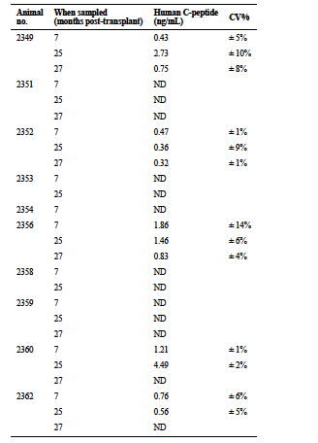
Circulating human insulin
in sheep 7 months to 2 years after transplantation of hfpSC in utero
Exp Hematol 2010; 38: 311-320 [PMID: 20170708 DOI: 10.1016/j.exphem.2010.02.005]

Slide 20
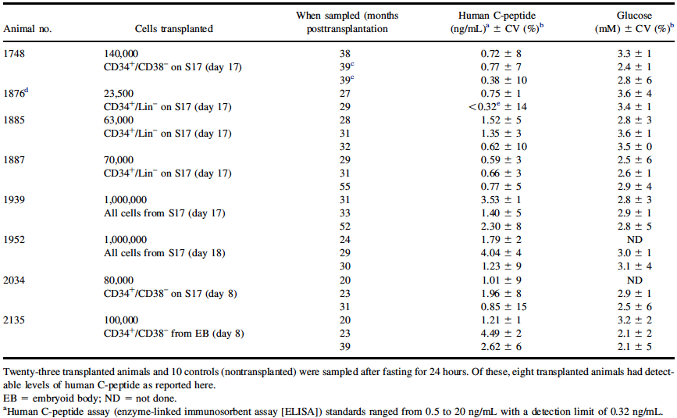
Human C-peptide levels in sheep ~ 2-3 years after transplantation of human ESD-CD34+ SC during the fetal tolerance window
A.D. Goodrich et al. Exp Hematol 2010; 38: 516-525.e4 [PMID: 20227460 DOI: 10.1016/j.exphem.2010.03.002]

Slide 21
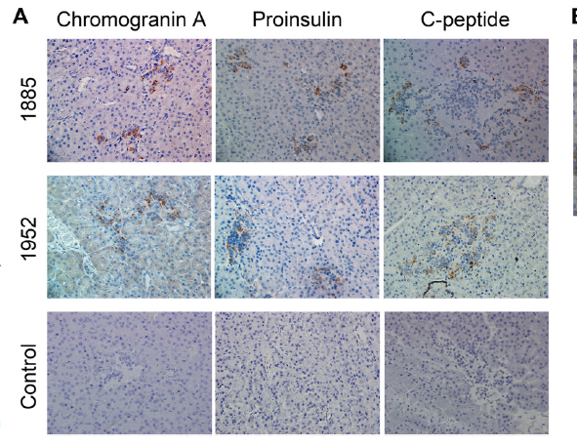
In situ human islet activity in 2 sheep transplanted with human stem cells
Chromogranin A is predominantly in α-cells
A.D. Goodrich et al. Exp Hematol 2010; 38: 516-525.e4 [PMID: 20227460 DOI: 10.1016/j.exphem.2010.03.002]

Slide 22
Summary and conclusion
Transplantation of allogeneic or xenogeneic SCs during the fetal tolerance window in any experimental animal renders that animal tolerant to donor specific SCs and their differentiated progeny including species specific proteins
Any mulitpotent self-renewing SC population would likely be effective
The (self-)tolerant environment allows unfettered differentiation into both hematopoietic and solid organ lineages
Present evidence suggests these grafts are expandable

Slide 23
Summary and conclusion continued
5. In utero transplantation is a powerful but poorly understood investigative method that:
should provide detailed understanding of mechanisms underlying self-tolerance
may provide alternative methods for the
investigation of biologic systems
may allow alternative solutions to a number of clinical problems

Slide 24
Acknowledgements
Alireza Torabi, M.D., Ph.D.
Jessica Reed, DVM, Ph.D.
Adel Ersek, Ph.D.
A Daisy Goodrich, Ph.D.
Esmail D Zanjani, Ph.D.
My Family: Janice, Aaron and Jedediah

