Slide 1
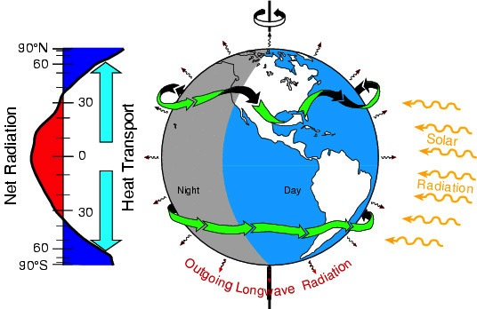

Closing the Earth’s Energy Imbalance
J.P. Abraham, B.D. Plourde, University of St. Thomas
K. E. Trenberth, NCAR Earth Systems Laboratory
S. A. Mandia, Suffolk County Community College
3rd international Conference on Earth Science and Climate Change

Slide 2
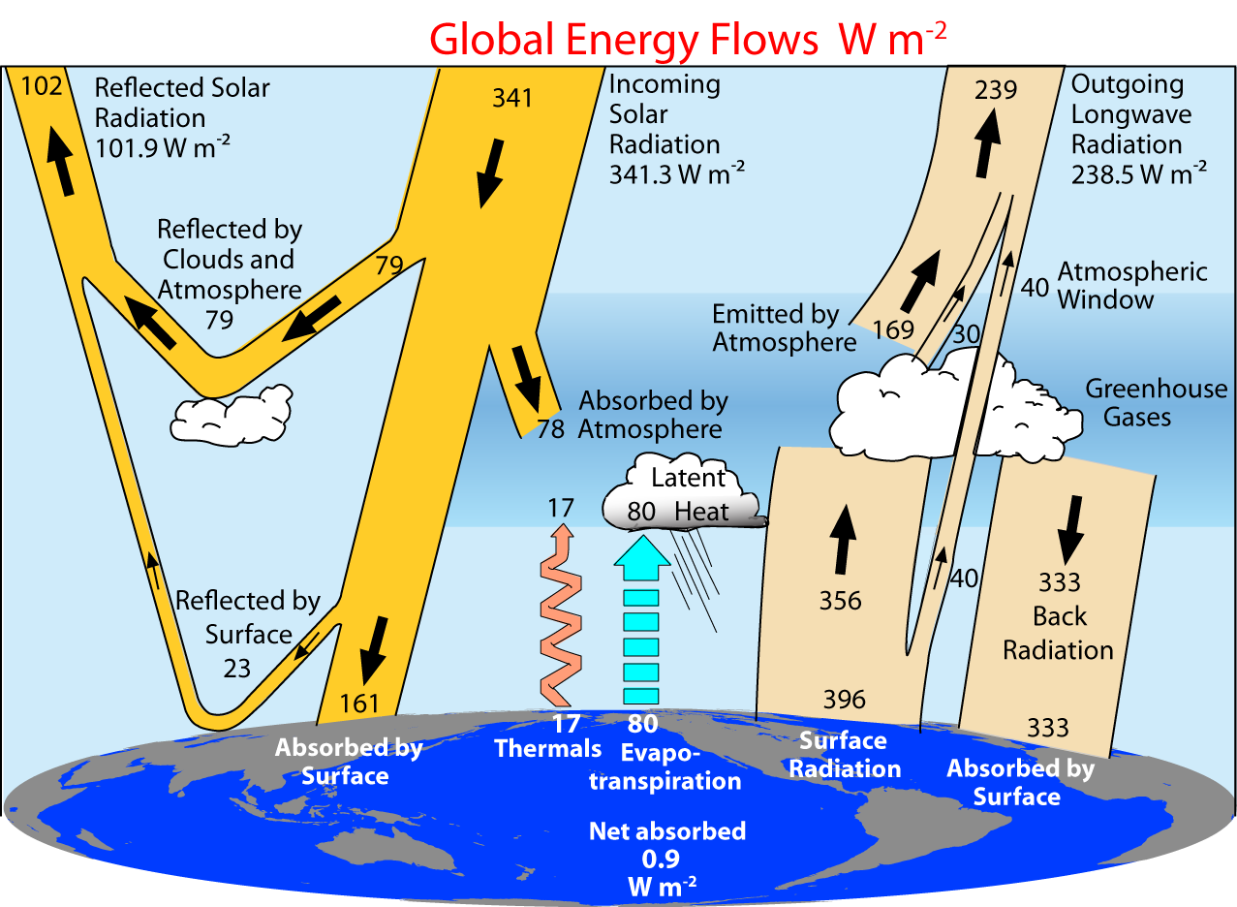
Earth Energy Balance
Quantifying Energy Flow
Trenberth, 2009
3rd international Conference on Earth Science and Climate Change

Slide 3
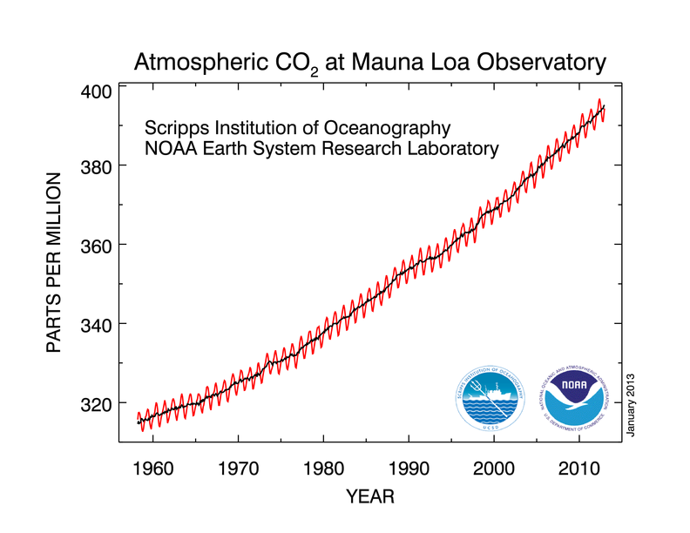
Earth Energy Balance
Greenhouse Gas Levels
3rd international Conference on Earth Science and Climate Change

Slide 4
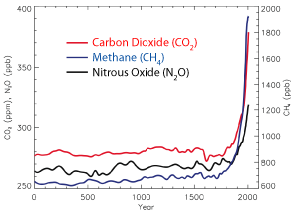
Earth Energy Balance
History of Greenhouse Gases
This increase in CO₂ is also accompanied by increases in other greenhouse gases.
Methane is ~20 times more potent than CO₂ over a 100 year period.
Nitrous Oxide is 300 times more potent than CO₂ over a 100 year period.
IPCC, 2007
3rd international Conference on Earth Science and Climate Change

Slide 5
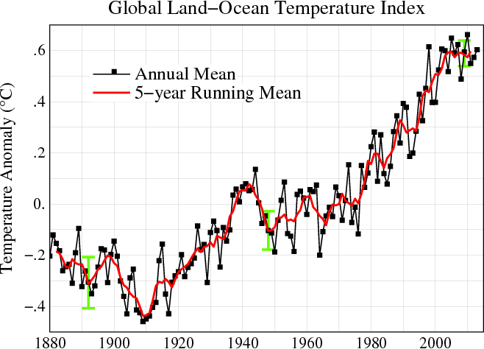
Earth Energy Balance
A History of Measuring Devices
Hottest Years on Record
2010
2005
2007
2002
1998
2013
2003
2009
2006
2012
2014?
3rd international Conference on Earth Science and Climate Change

Slide 6
Earth Energy Balance
A Hiatus?
Has global warming
stopped?
3rd international Conference on Earth Science and Climate Change

Slide 7
Earth Energy Balance
How is Earth’s Energy Imbalance Measured?
Direct measurements from space, absorbed solar radiation, outgoing long wavelength radiation, net radiant flux.
  - Measurements are not absolutely accurate but can measure changes in time.
Measure energy storage on Earth.
  - A challenge to make adequate measurements of thermal reservoirs (oceans).
Climate models with specified forcings.
3rd international Conference on Earth Science and Climate Change

Slide 8
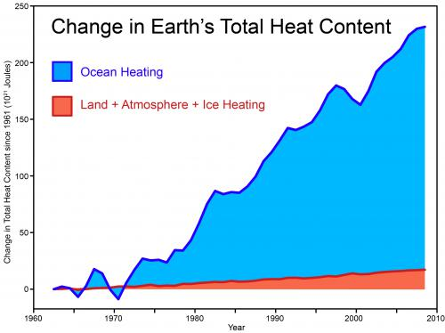
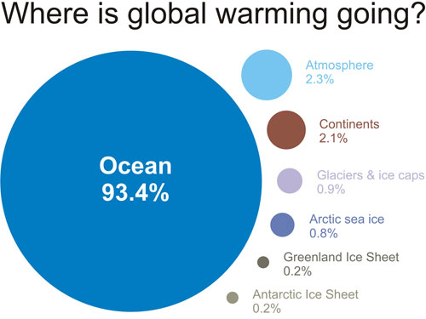
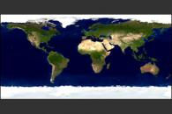
Earth’s Energy Balance
The Difficult Challenge – Measuring the Oceans
Nuccitelli et al, 2012
SKS, 2014
NASA, 2014
3rd international Conference on Earth Science and Climate Change

Slide 9
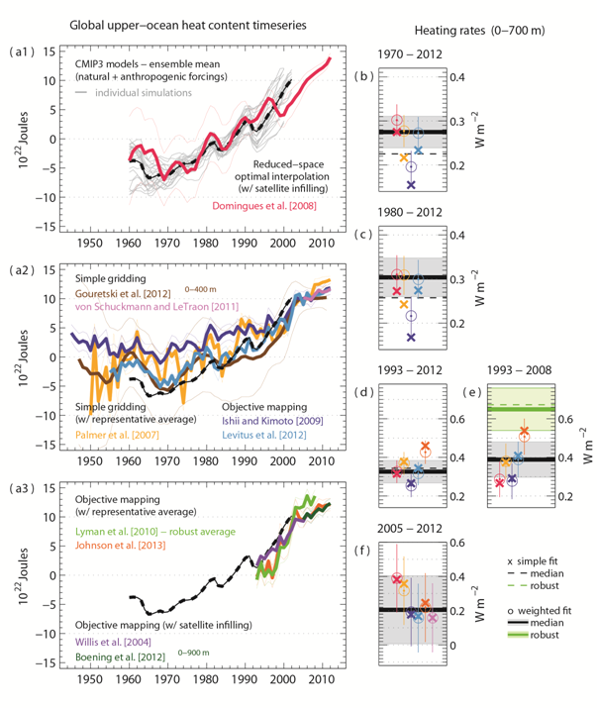
Improvements to Ocean Heat Content Measurements
Measuring Ocean Heating
CMIP3 models and Domingues, 2008 estimates
Upper Oceans – various estimates, simple gridding
Upper Oceans – various estimates, mapping
Slopes, past four decades
Abraham et al., 2013
3rd international Conference on Earth Science and Climate Change

Slide 10
Earth Energy Balance
Progress on Closing the Earth Energy Budget
ORAS4 – A new Ocean ReAnalysis System, based on the European Center for Medium-Range Weather Forecasts (ECMWF) model.
Reanalysis spans 1958-current.
Improves fit of models to observations including interannual variability and seasonal predictions.
Data are assimilated using XBT, CTD, Mooring, etc. measurements.
Forcings from ERA-40 (prior to 1989), ERA-Interim (1989-2009), and ECMWF analysis from 2010-present.
M. Balmaseda, K. Mogensen and A. Weaver, Evaluation of the ECMWF Ocean Reanalysis System ORAS4, Quarterly Journal of the Royal Meteorological Society, Vol. 139, pp. 1132-1161, 2013.
3rd international Conference on Earth Science and Climate Change

Slide 11
Earth Energy Balance
What is Reanalysis?
From ECMWF (http://www.ecmwf.int/en/research/data-assimilation)
“To make a forecast, we need to know the current state of the Earth’s surface (land and oceans). The weather forecasts produced at ECMWF use data assimilation to estimate local conditions for the forecast model from meteorological observations.”
Models are run forward in time, new observations are continually used to update the simulation.
The models are run as ensembles – multiple simulations including small perturbations in the initial conditions.
3rd international Conference on Earth Science and Climate Change

Slide 12
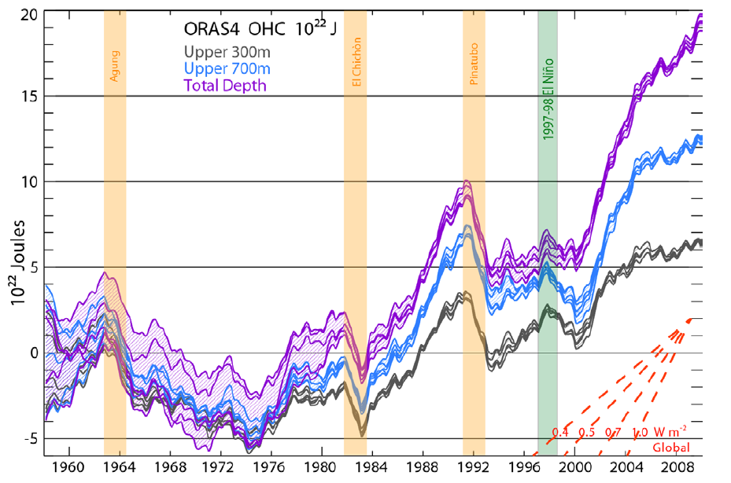
Earth Energy Balance
Ocean Warming
Has global warming
stopped?
Which slope
Matches OHC?
Balmaseda et al., 2013
3rd international Conference on Earth Science and Climate Change

Slide 13
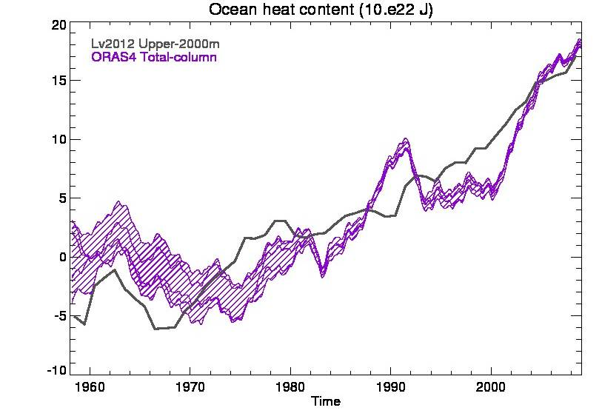
Earth Energy Balance
Measurements vs. Reanalysis
Trenberth, 2013
3rd international Conference on Earth Science and Climate Change

Slide 14
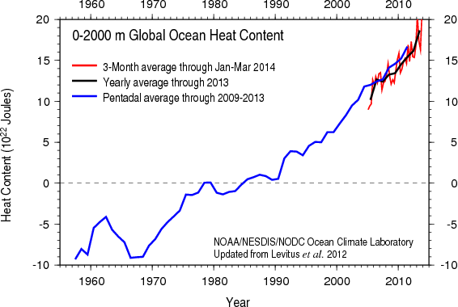
Earth Energy Balance
Most Recent Ocean Warming
3rd international Conference on Earth Science and Climate Change

Slide 15
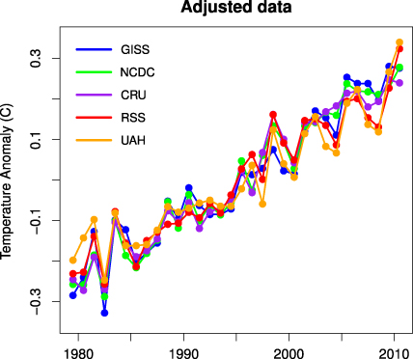
Earth Energy Balance
Long-Term Continued Warming
Foster and Rahmstorf, 2011
When account is made for volcanoes and ENSO, and when the entire ocean is measured, the “hiatus’ becomes hard to find.
3rd international Conference on Earth Science and Climate Change

Slide 16
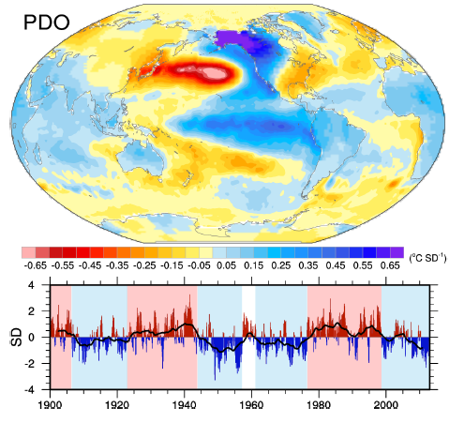
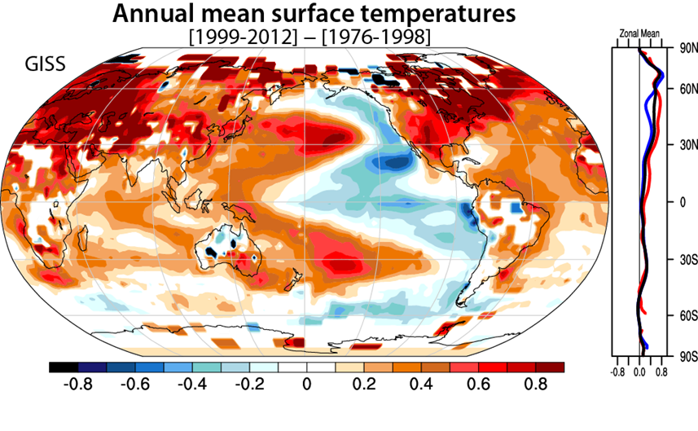
Earth Energy Balance
Why Has Deep-Ocean Heat Storage Increased?
Temperature difference per st. dev. PDO
Trenberth et al., 2014
3rd international Conference on Earth Science and Climate Change

Slide 17
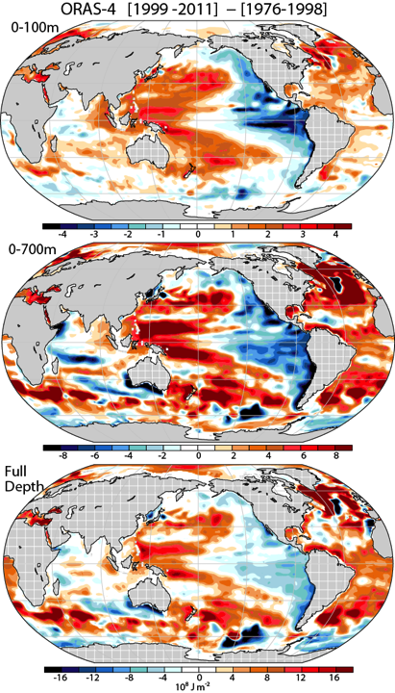
Earth Energy Balance
Why Has Deep-Ocean Heat Storage Increased?
Comparison of ocean heat content for different water layers.
Waters in the Eastern Pacific have gotten colder
Waters in the Western Pacific have gotten warmer
3rd international Conference on Earth Science and Climate Change

Slide 18
Earth Energy Balance
Pacific Pressure and Winds
Trenberth 2013
3rd international Conference on Earth Science and Climate Change

Slide 19
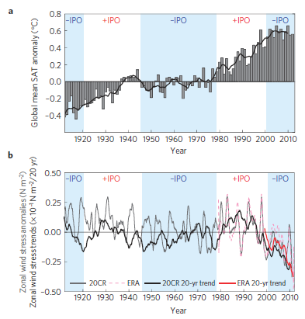
Earth Energy Balance
Pacific Oscillation, Temperatures, and Winds
Is this natural internal variability? Is it partly caused by human-induced climate change?
England et al., 2014
3rd international Conference on Earth Science and Climate Change

Slide 20
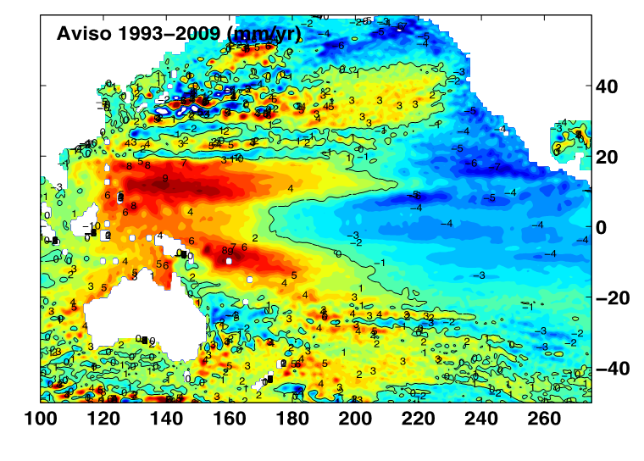
Earth Energy Balance
Impact on Regional Sea Level – 3mm/yr removed
Lagerloef, 2013
3rd international Conference on Earth Science and Climate Change

Slide 21
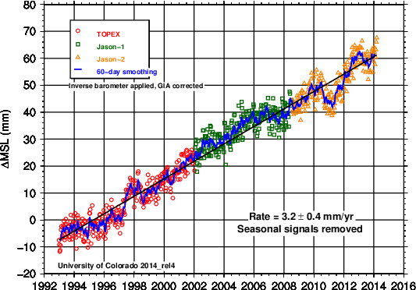
Earth Energy Balance
Global Sea Level – Also no Hiatus
3rd international Conference on Earth Science and Climate Change

Slide 22
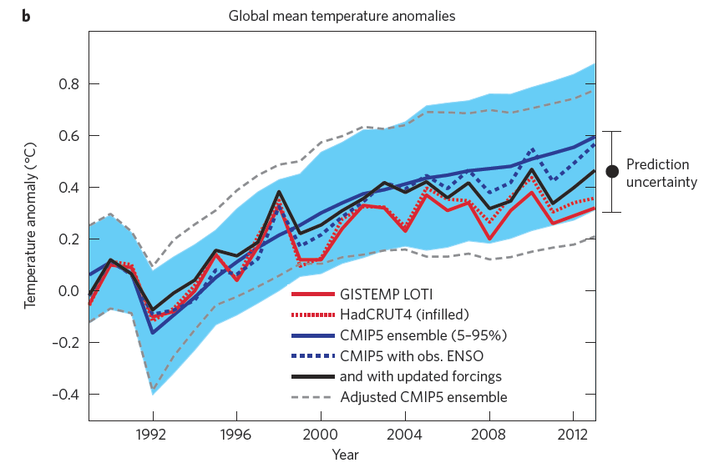
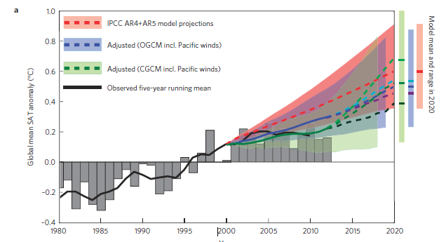
Earth Energy Balance
Where Does This Leave Us?
Schmidt et al., 2014
England et al., 2014
3rd international Conference on Earth Science and Climate Change

Slide 23
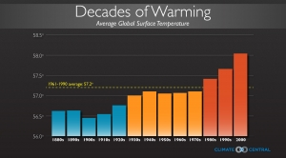
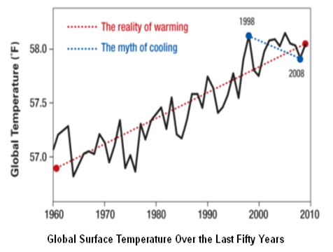
Earth Energy Balance
Where is the Hiatus?
UCS, K. Hayhoe
3rd international Conference on Earth Science and Climate Change

Slide 24
Earth Energy Balance
Thank you….
John Abraham
University of St. Thomas
jpabraham@stthomas.edu
3rd international Conference on Earth Science and Climate Change

