Slide 1
Methods for Chromatin Analysis—Precipitating Protein, RNA & DNA from Chromatin
John M. Rosenfeld, Ph.D.
External Innovation Manager
EMD Millipore
Temecula, CA
Genomics & Pharmacogenomics 2015

Slide 2
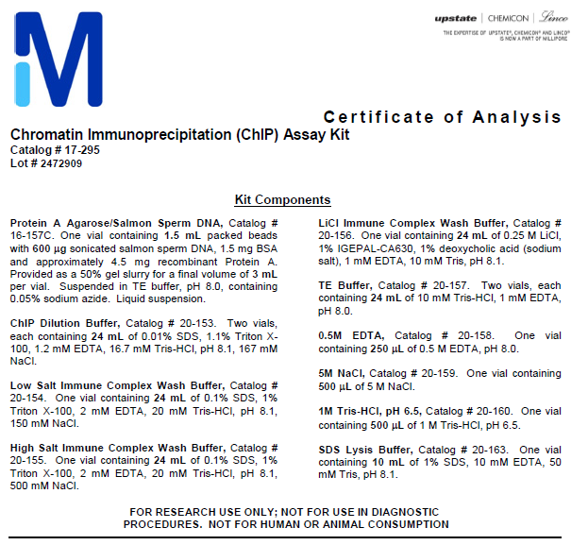
Chromatin Biology has come a long way…
1st gen ChIP Kit ~1999
Fully disclosed recipes
And protocol
4th gen ChIP Kit
Every major supplier offers one

Slide 3
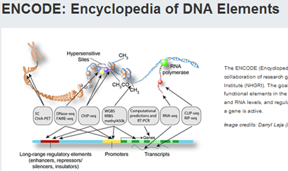

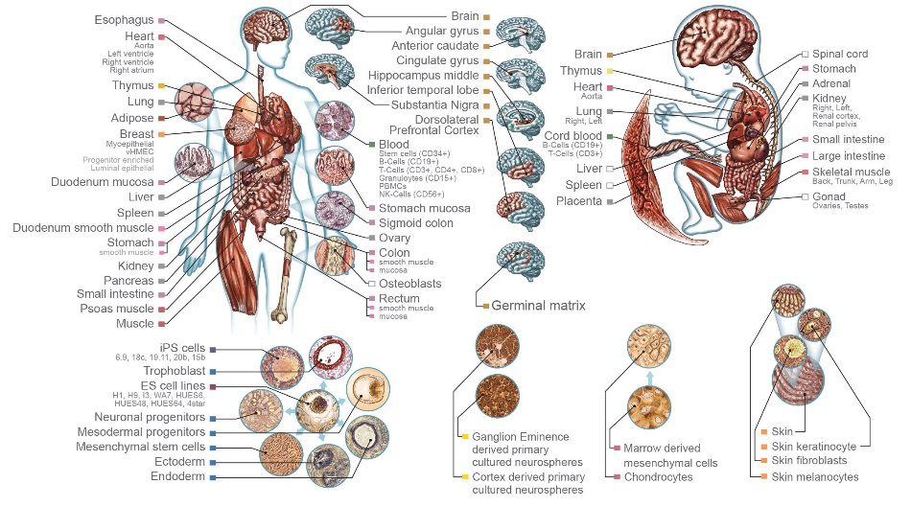

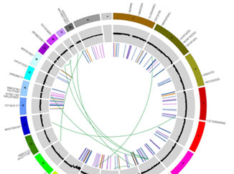
Major Consortium Efforts in Genetics & Epigenetics--The Age of Omics?
From 2003…
111 tissue & cell types
Multi-omic
WGS 1000 tumor types
11,000 samples
To 2015
https://www.encodeproject.org
http://www.roadmapepigenomics.org/
http://cancergenome.nih.gov/

Slide 4
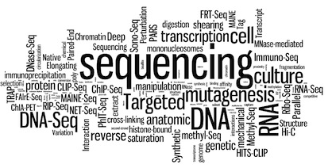
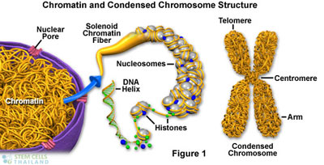
Next Gen Sequencing Drives Discovery in Chromatin Analysis
ChIP-seq
DNAse-seq
Gro-seq
RIP-seq
CLIP-seq
Methyl-seq
…
Nextgenseq.com
http://stemcellthailand.org/chromosomes/

Slide 5
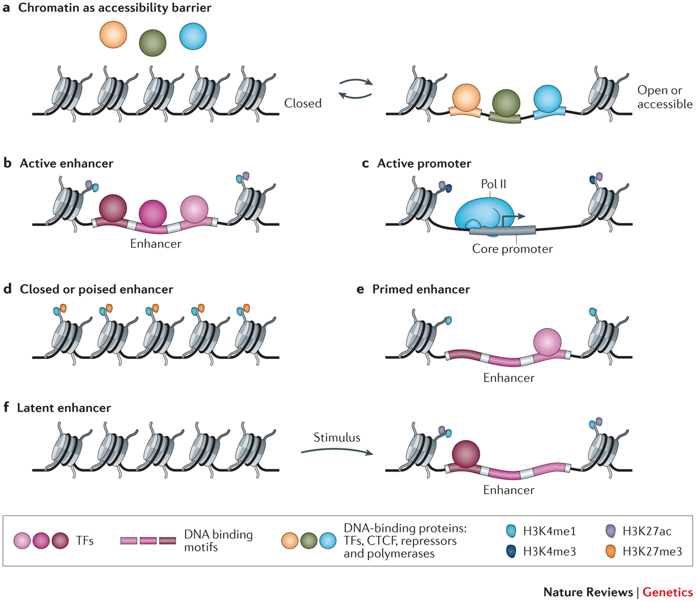
Transcription and Chromatin
Enhancers
Promoters
AcH3K27
H3K4me1
H3K4me3
AcH3/H4
H3K4me1
H3K27me3
Access to chromatin influenced by PRC2, MLL/Compass, Swi/Snf (BAF)
Large number of mutations in components of these pathways
20% of sequenced tumors have BAF subunit mutations
Shlueyva, Nat. Rev. Genetics, 2014
Confidential & Property of EMD Millipore Corporation

Slide 6
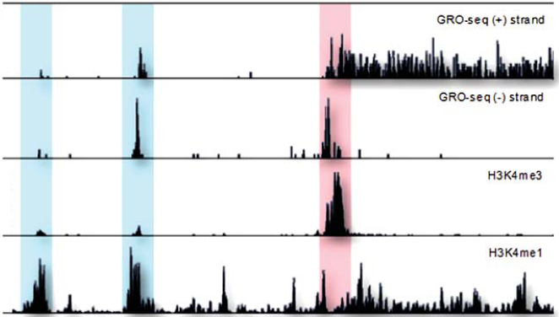
A cryptic 3rd component of chromatin--ncRNAs
RNA-seq (Gro-seq) reveals in eukaryotes, genomes are pervasively transcribed
A small percentage of these transcripts encode for proteins, whereas the majority are transcribed as non-coding RNAs (miRNA, piRNA, PAR, eRNA, lncRNA)
Non-coding transcripts are marked by histone modifications characteristic of enhancers
and promoters
Enhancer transcripts (H3K4me1)
mRNA transcript (GRO-seq)
Antisense Transcripts (GRO-seq)
Kaikkonen et al., Cardiovascular Research, 2011
Notes:
Next generation sequencing technologies, in combination with chromatin state mapping, have helped to identify new classes of non-coding RNAs in the genome, and transcriptomic profiling that is possible with new sample prep and platform technologies has revealed the complexity of the nuclear RNA realm.
(Click 1) In eukaryotes 90% of genomic DNA is transcribed
(click 2) However, only 1-2% of these transcripts encode for proteins (25,000 protein-coding gene, according to Human Genome Project estimate), whereas the majority are transcribed as non-coding RNAs. Yet, over the past decade, numerous studies have shown that ncRNAs have distinct biologic functions and operate through defined mechanisms.
Different classes of these RNAs are: miRNA, piRNA, Promoter-associated RNA (PAR), Enhancer RNA (eRNA), long non-coding RNA (lncRNA).
Transcription of many of these new RNAs often overlaps with protein coding open reading frames and can share their cis-regulatory elements (such as promoters and enhancers). This figure shows transcription start sites for antisense transcripts, enhancer transcripts that were detected by RNA-SEQ.
Interestingly, The promoter-associated RNAs (highlighted in red) colocalize with H3K4me3 histone mark, whereas the eRNAs (highlighted in blue) are revealed by their overlap with H3K4me1 mark.

Slide 7
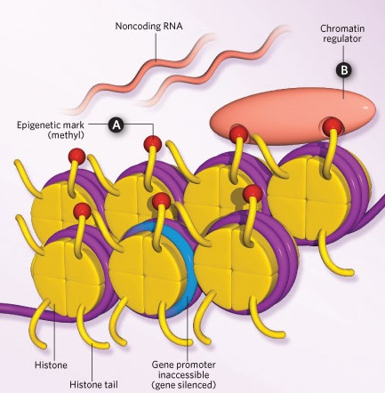
Interrogating Interactions in Chromatin
Protein:DNA
ChIP-seq
Histone Mods,
Chromatin modifiers,
Transcription Factors
General Txn Machinery
Modified DNA
Methyl-seq (BS mC)
MeDIP-seq (MBD-seq mC)
Ox-BS (HMC)
TAB-seq (HMC)
Modified RNA
MeRIP (m6A)
BS-Seq (mC)
Protein:RNA
Nuclear RIP-seq
CLIP-seq
ncRNA:DNA
ChIRP-seq
Chart-seq
RAP-seq
Many require high quality, high affinity & specificity antibodies
Esteller, Scientist, 2011

Slide 8
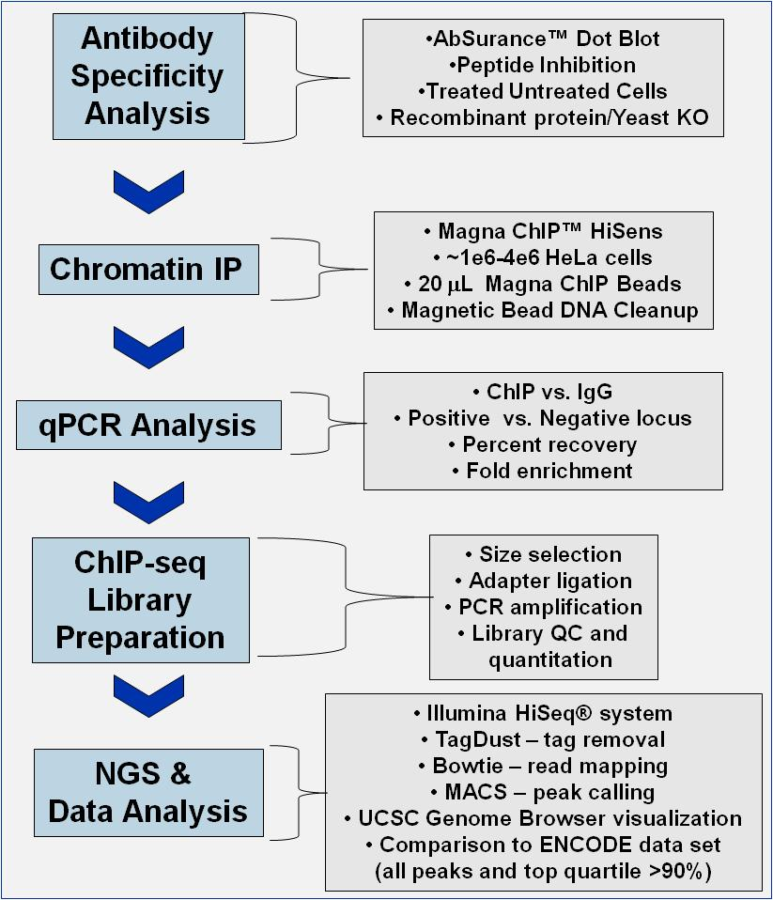
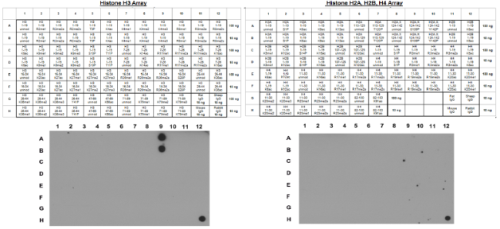
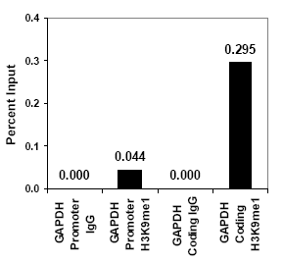
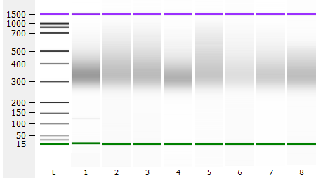
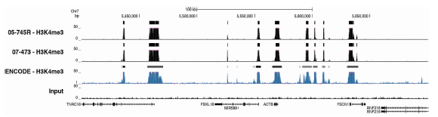
A Screen for Antibody Specificity for ChIP-seq
H3K9me1

Slide 9
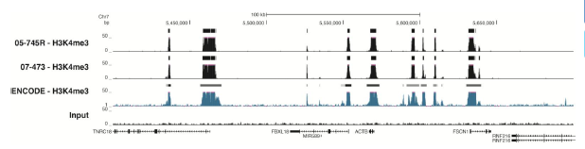
Results for Dot Blot and ChIP-seq Screen
NGS
Library
Prep
Dot Blot
NGS
35 Passed
15 no signal
2 non-specific
13 Antibodies
ChIP-seq
>90%
Top Quartile
52 Antibodies
(30 modifications)
21 Libraries
Passed
Multiple antibodies to same modification passed, both polyclonal & monoclonal
Tracks published on website and antibodies offered as Trial Size
Used Magna ChIP HiSens Kit and commercial NGS Library Kit
Utilized embedded positive controls and replicate testing

Slide 10
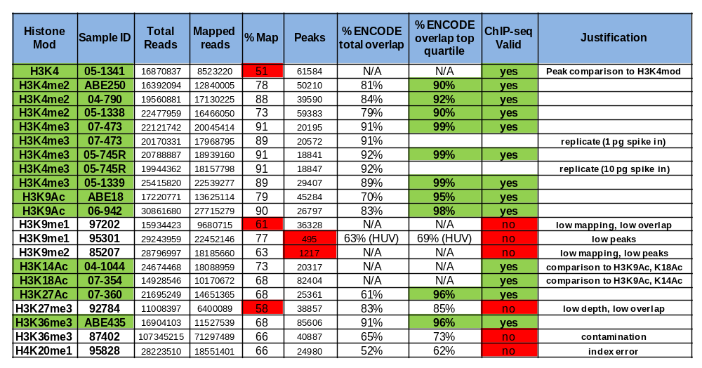
Cutoffs for “ChIP-seq” claim ≥ 90% in top quartile

Slide 11
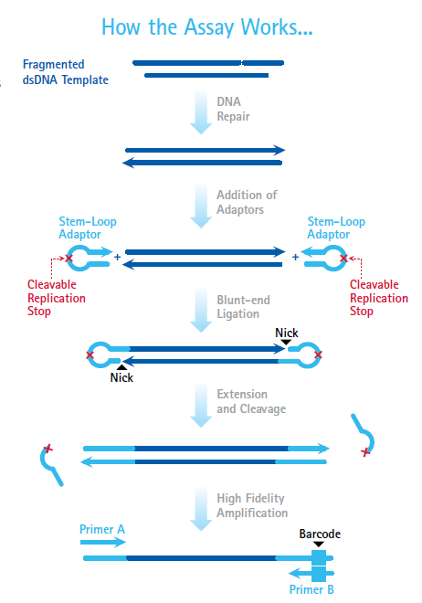

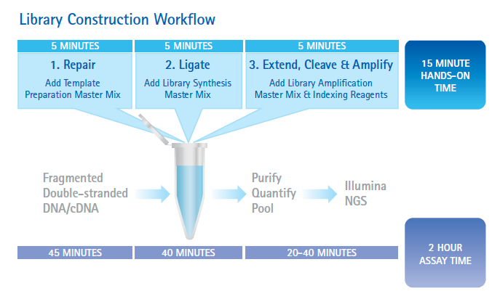
A method to enhance low input ChIP-seq for Trans Factors
Patented technology outperforms Nextera
& NEB in library complexity, duplicate reads, & input range

Slide 12



Tools For Exploring ncRNA & mRNA Function
Nuclear RIP—Like ChIP, but for discovering RNAs
ChIRP—Pull down lncRNAs from chromatin and discover genomic sites of action as well as protein interactors
meRIP—analysis of RNA methylation
Protein:RNA
RNA:DNA and RNA:Protein Interactions
Methylation of
RNAs

Slide 13
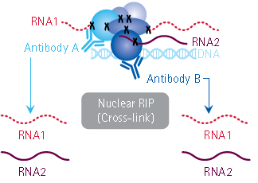
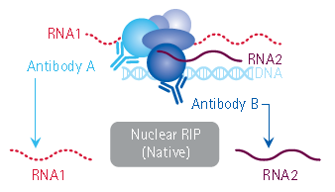
Magna Nuclear RIP—Two Options for Interrogation
Magna Nuclear RIP (Native) vs. Magna Nuclear RIP (Cross-Linked).
While both native and cross linked approaches are used to analyze chromatin associated RNA, native RIP typically allows recovery of high affinity, more direct interactions. Conversely, the cross-linking method is designed to capture higher molecular weight complexes and more readily trap weaker interacting RNAs.

Slide 14
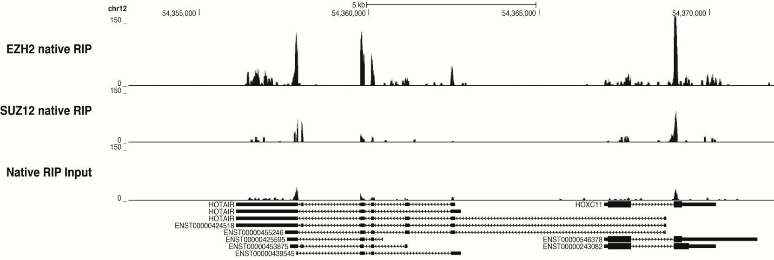
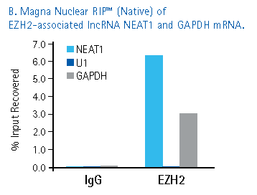
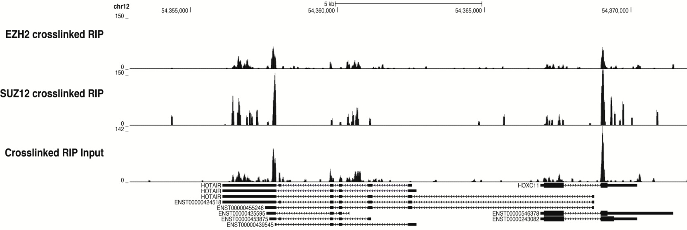
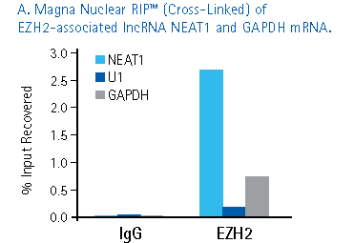
Nuclear RIP for PRC2 Components
HOTAIR
HOXC11
Genome Wide RNA-seq or Transcript Specific Measurement (qRT-PCR)
Notes:
RIP-Seq analysis
Using the Magna Nuclear RIP™ cross-linked protocol (upper panel) or the Magna Nuclear RIP™
native protocol (lower panel) and anti-EZH2 clone AC22 (Cat. No. 17-6620 and anti-SUZ12,
clone 2AO9 (Cat. No. 05-1317), nuclear RIP was performed with HeLa cells. Following isolation,
immunoprecipitated RNA was subjected to RNA-seq. Data shown are consistent with binding
of HOTAIR lincRNA to complexes containing EZH2 and SUZ12.

Slide 15
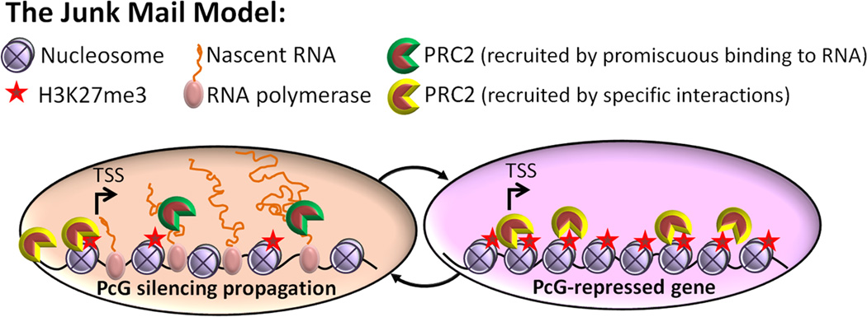
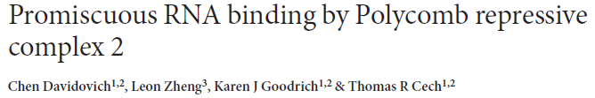
Nuclear RIP for PRC2 Components
Genome Wide RNA-seq or Transcript Specific Measurement (qRT-PCR)
Nat. Struct. Mol. Biol. 2013
Notes:
RIP-Seq analysis
Using the Magna Nuclear RIP™ cross-linked protocol (upper panel) or the Magna Nuclear RIP™
native protocol (lower panel) and anti-EZH2 clone AC22 (Cat. No. 17-6620 and anti-SUZ12,
clone 2AO9 (Cat. No. 05-1317), nuclear RIP was performed with HeLa cells. Following isolation,
immunoprecipitated RNA was subjected to RNA-seq. Data shown are consistent with binding
of HOTAIR lincRNA to complexes containing EZH2 and SUZ12.

Slide 16
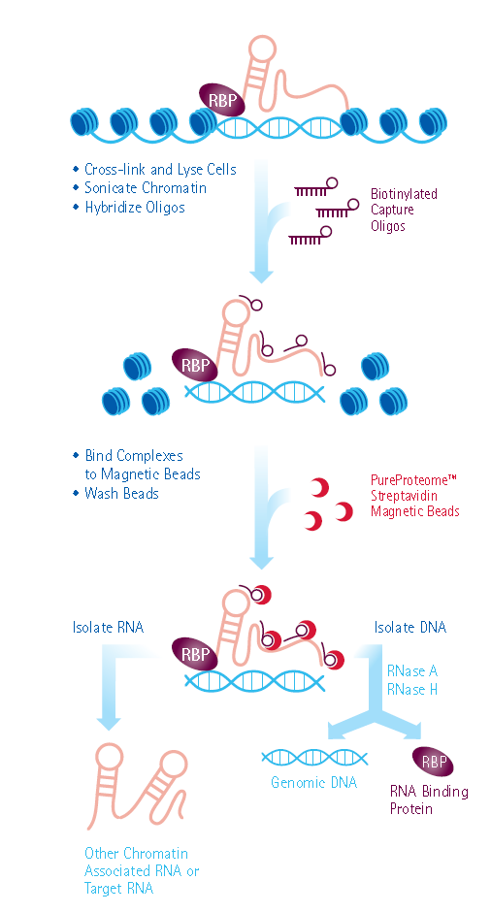
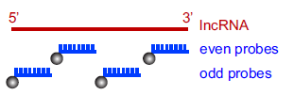
Chromatin Isolation by RNA Purification
Precipitation of ncRNA—chromatin
complexes
Split-probe’ strategy eliminates off-target hybridization artifacts
Given ncRNA of interest, design
biotinylated probes to tile and
immunoprecipitate from glutaraldehyde
crosslinked chromatin
  Verify RNA recovery via qRT-PCR
  Discover genomic sites of action
  via DNA-seq
  Discover protein partners via Mass Spec

Slide 17
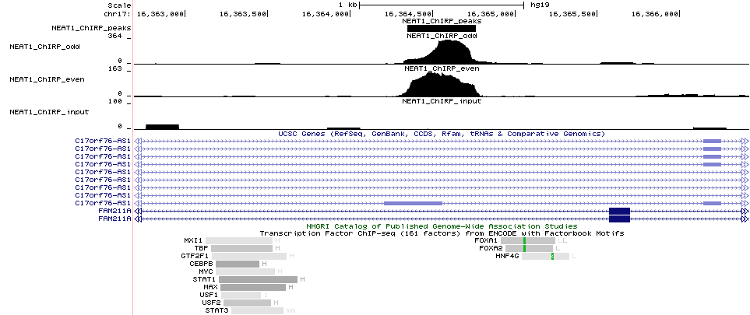
Neat1 interacts with intronic sequence from another ncRNA with motifs for various transcription factors
Odd Pool
Even Pool
Input
Candidate
Chromatin RBPs
Analyzed similar to ChIP-seq, can infer interacting proteins by overlaying ChIP-seq data sets

Slide 18
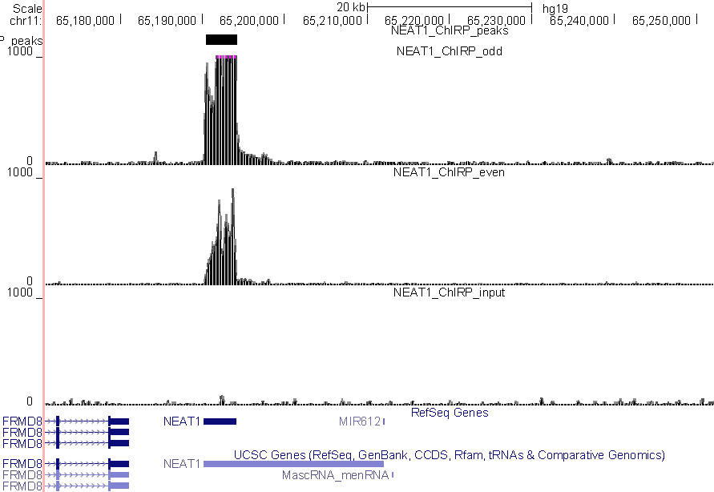
Positive Control Data from Neat1 ChIRP-seq
NEAT1 ChIRP
Odd
NEAT1 ChIRP
Even
    Odd & Even datasets allow verification of probe
    Design to eliminate “false positives”
Input
Positive Control Region
Neat1 autoregulates it’s own transcription
Ref. Simon MD, et al. Proc Natl Acad Sci U S A. 2011 108(51):20497-502

Slide 19
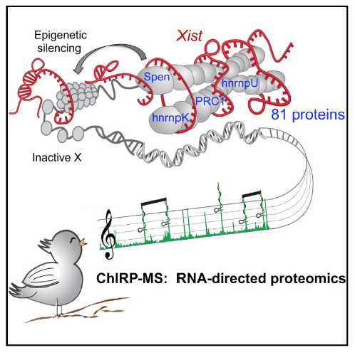
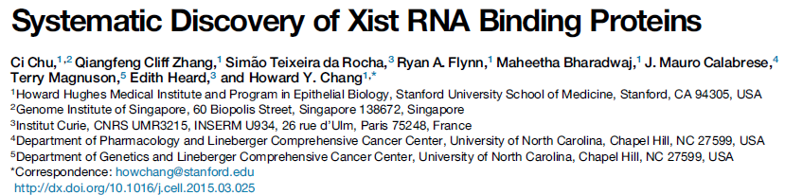
ChIRP-Mass Spec for Proteomic Discovery
Cell, 2015

Slide 20
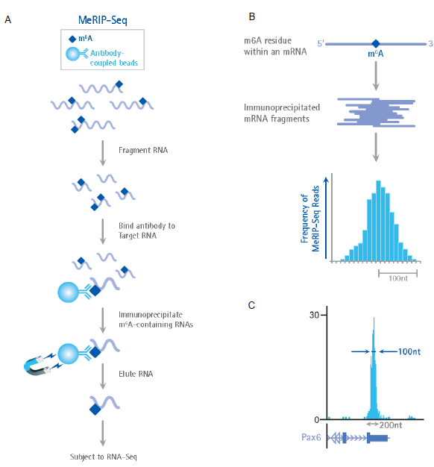
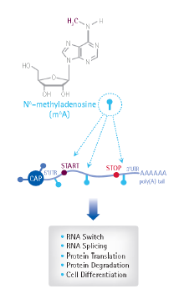
m6A—Reversible Modification of RNAs
Found in many types of RNA
Mtase & demethylases known
Involved in RNA stability, splicing
choices

Slide 21
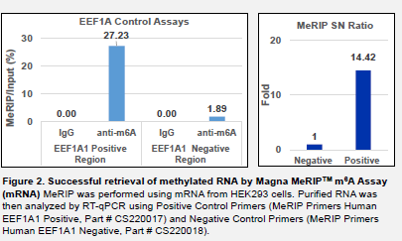
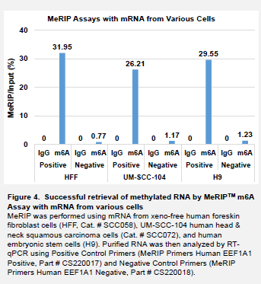
meRIP of methylated RNA

Slide 22
Summary
NGS has spawned many interesting sample prep methods for epigenomic profiling, allowing dissection of chromatin regulation from many angles
ChIP-seq for transcription factors and chromatin modifiers—Pure Genome Library Construction
Nuclear RIP-seq for discovery of RNAs associated with Chromatin
ChIRP-seq for characterization of long non coding RNA interactions (also utilizes Pure Genome NGS kit)
meRIP-seq for identification of m6a modified RNAs

Slide 23
Acknowledgements
Zirong Li, Ph.D. (ChIP-seq)
Kan Saito, Ph.D. (RIP-seq, ChIRP-seq & meRIP)
Konstantin Taganov, Ph.D (ChIP-seq, ChIRP-seq)
Tracy Cooke (ChIP-seq)
Jeremy Simon, Ph.D. UNC Chapel Hill, NGS Analytics
Michael Sturges, Ph.D.
Nick Asbrock
James Hoberg

