Slide 1



About OMICS Group
OMICS Group International is an amalgamation of Open Access publications and worldwide international science conferences and events. Established in the year 2007 with the sole aim of making the information on Sciences and technology ‘Open Access’, OMICS Group publishes 500 online open access scholarly journals in all aspects of Science, Engineering, Management and Technology journals. OMICS Group has been instrumental in taking the knowledge on Science & technology to the doorsteps of ordinary men and women. Research Scholars, Students, Libraries, Educational Institutions, Research centers and the industry are main stakeholders that benefitted greatly from this knowledge dissemination. OMICS International also organizes 500 International conferences annually across the globe, where knowledge transfer takes place through debates, round table discussions, poster presentations, workshops, symposia and exhibitions.

Slide 2
About OMICS International Conferences
About OMICS Group
OMICS International is a pioneer and leading science event organizer, which publishes around 500 open access journals and conducts over 300 Medical, Clinical, Engineering, Life Sciences, Pharma scientific conferences all over the globe annually with the support of more than 1000 scientific associations and 30,000 editorial board members and 3.5 million followers to its credit.
OMICS International has organized 500 conferences, workshops and national symposiums across the major cities including San Francisco, Las Vegas, San Antonio, Omaha, Orlando, Raleigh, Santa Clara, Chicago, Philadelphia, Baltimore, United Kingdom, Valencia, Dubai, Beijing, Hyderabad, Bengaluru and Mumbai.

Slide 3
Workshop:
Metabolomic Research
using Bio-electrochemical Systems
John M. Pisciotta
April 27, 2015
Metabolomics and System Biology
Philadelphia ,PA

Slide 4
Workshop Overview
Types of BESs & their Set up
Reactor Configurations
Electrode Types & Materials
HPLC analysis of cell metabolites
Bioelectrochemical techniques (CA, LSV)
Cell & Metabolite Sampling
Unique Opportunities for Metabolomics
Considerations
Summary / Demos Units

Slide 5
Bioelectrochemical Systems: Types
Microbial Fuel Cells (MFCs) exo-electrogenic bacteria on anode breakdown chemicals and donate useful electrons through a circuit. (Air cathode) = Electricity
Microbial Electrolysis Cells: exo-electrogenic bacteria on anode breakdown chemicals and donate useful electrons through a circuit (Anaerobic cathode + voltage boost = Hydrogen Gas)
Microbial Electrosynthetic Cells: use electrotrophic bacteria on the MEC cathode to accept electrons to store input electrical energy as chemical bonds.
Enzymatic BESs: use redox active enzymes attached to electrodes to carry out specific reactions.

Slide 6
BES History
1911: M.C. Potter, at the University of Durham discovered that bacteria could produce direct electric current.
1934: Cohen develops 35 V microbial ½ cell.
1999: BH Kim discovered microbes do not require external mediators to generate current.
2014: hundreds of new BES article every year!

Slide 7
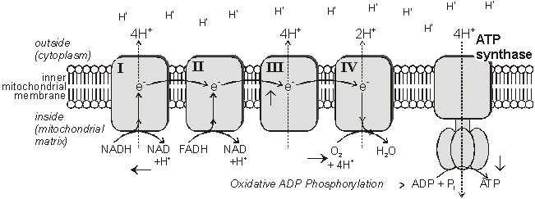
O2 = Terminal Electron Acceptor (TEA) in Aerobic Systems
Aerobic respiration allows full use
of the energy in food/fuel, it is little wonder
This mode of existence predominates today
Aerobic Electron Transport Chain

Slide 8
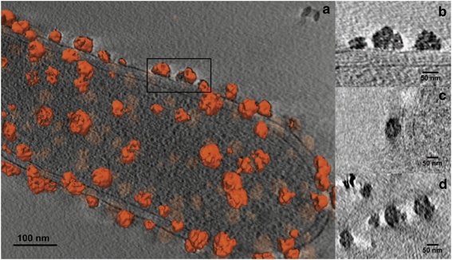
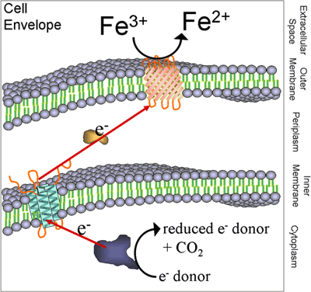
BES = Bioelectrochemically Controlled Combustion
Iron reducing bacteria
Luef et al., 2013. ISME Journal

Slide 9
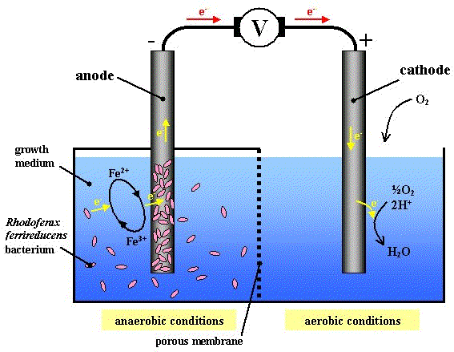
MFC electron flow

Slide 10
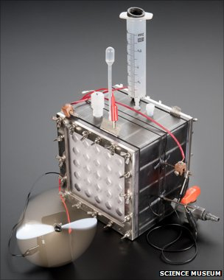
Understanding the Engineering
Microbes consume organic waste and transfer high potential electrons through an electrical device positioned between microbes and the system’s cathode TEA (O2).
Not just any Microbe can donate
Electrons to MFC anode:
-EXOELECTROGENS
(ex. Geobacter sp.)

Slide 11
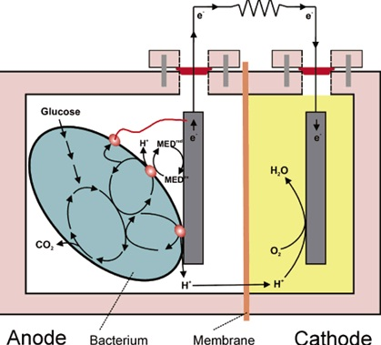
Electron Transfer Mechanisms from exo-electrogen to anode
Direct electron transfer: Geobacter sulfurreducens
Soluble Mediators: Shewanella oneidensis
Metabolomic methods can help ID mediators
Image Source
Seminar only

Slide 12
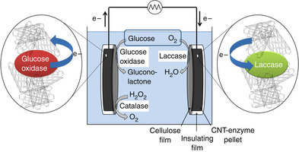
Other BESs use Enzymes:
Metabolomic methods can determine product formation rates
Zebda et al., 2011. Nature Communications

Slide 13
Some BESs use Enzymes:
-Difficulty in purifying enzymes
-Difficulty in adhering to electrode
-Difficulty in sustaining enzyme activity (just catalysts)
-Can not self repair or regenerate.
-Can not spread
-Can not be genetically programmed
Zebda et al., 2011.
Nature Communications

Slide 14
BES Configurations
Single Chamber
Simple & inexpensive
Amenable to High throughput screening
Dual Chamber
  Complex & Expensive
  Separation of Anolyte from Catholyte (PEM)
  Preferred for metabolomic studies

Slide 15
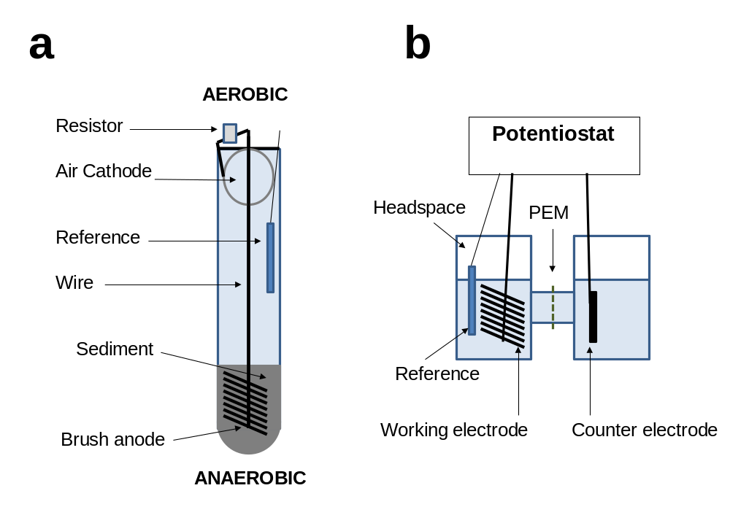
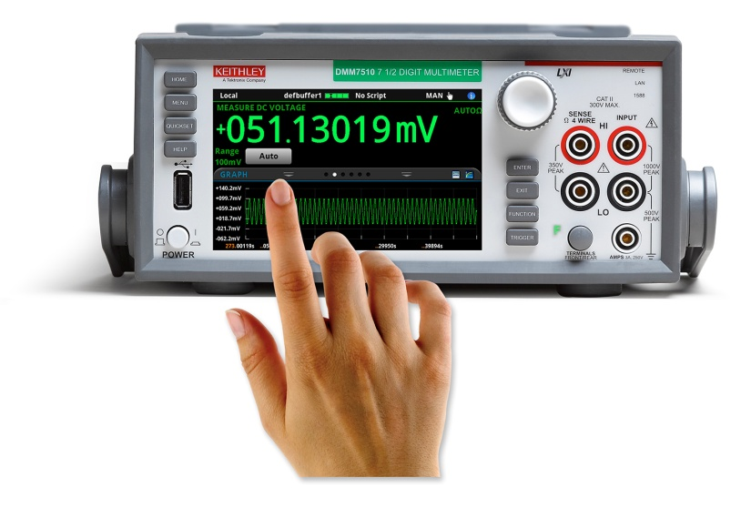
Single Chamber MFC
Ohm’s law used to
Calculate current
I = V/R

Slide 16
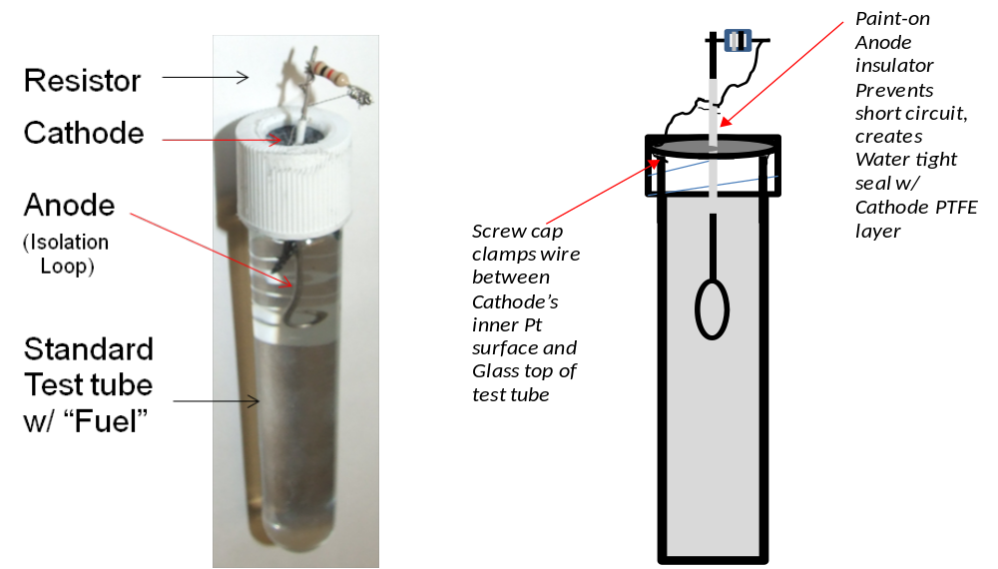
Single Chamber Customization: Spec Tube MFC

Slide 17
Spec Tube MFC
Electrogenic Activity
(Current determined by V drop across resistor)
Current (mA)
Time (days)
0 7 14 21 30
Days

Slide 18
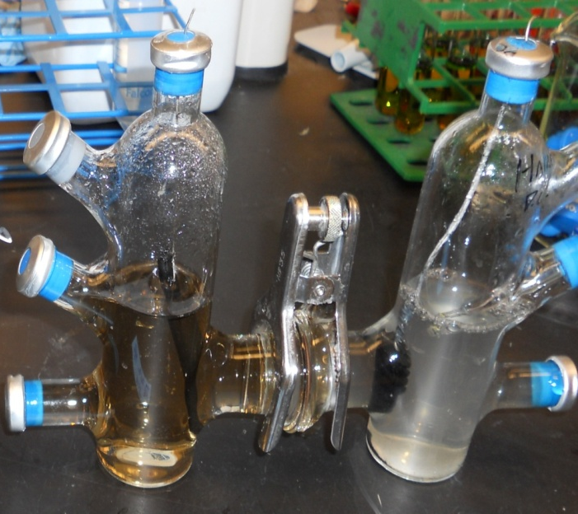
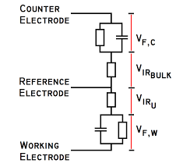
Dual Chamber “H-type” Reactor

Slide 19
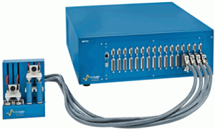
Potentiostat
Electronic hardware required to control a three electrode cell and run most electroanalytical experiments.
Serves to maintain electric potential of the working electrode at a constant level versus a reference electrode by adjusting current at an auxiliary electrode.

Slide 20
Electrodes & Electrode Materials used on other Type of BESs
Photosynthetic Microbial Fuel Cells
(UMD / Baskakov)
Dark Electrotrophic Systems
(Penn State / Logan)
Experimental Considerations for optimizing Metabolomic analysis using BESs

Slide 21

Electrogenic and Electrotrophic Microbial Fuel Cells
e-
Biocathode
CO₂
Bioanode
Biofuel

Slide 22
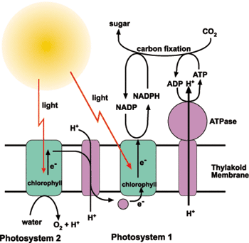
Electrogenic Activity of Cyanobacteria
Idea: Convert sunlight to electricity using
photosynthetic organisms on an anode and H2O as electron source.
(A living solar panel)
PI: Ilia Baskakov,
U. Maryland Center For Marine Biotechnology

Slide 23
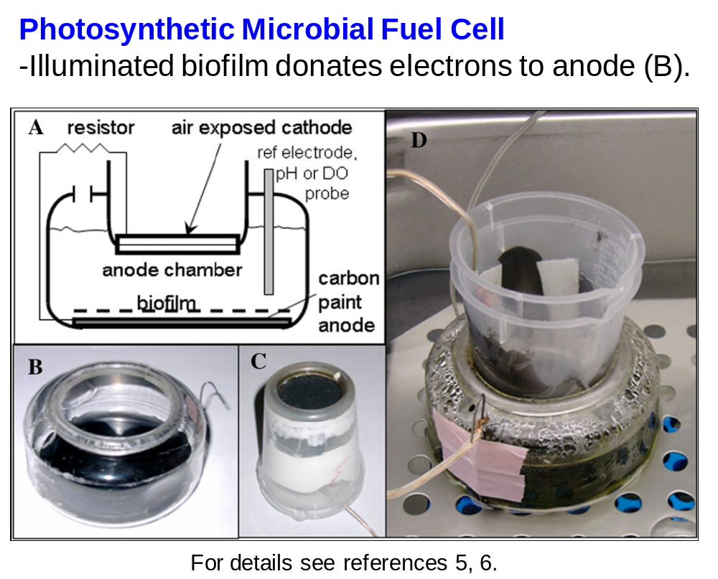
Single Chamber Cyanobacterial Fuel Cell
Carbon paint anode / carbon cloth Pt cathode

Slide 24
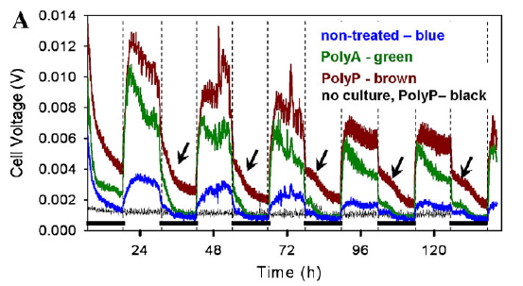
Rapid Light-Dependent Rise in Voltage
Photosynthetic Biofilm

Slide 25
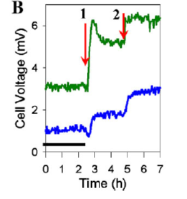
Increasing light boosts electrogenic response (polyaniline coating boosts voltage)
Poly A
Carbon Paint
Zou, et al. 2010, Bioelectrochemistry

Slide 26
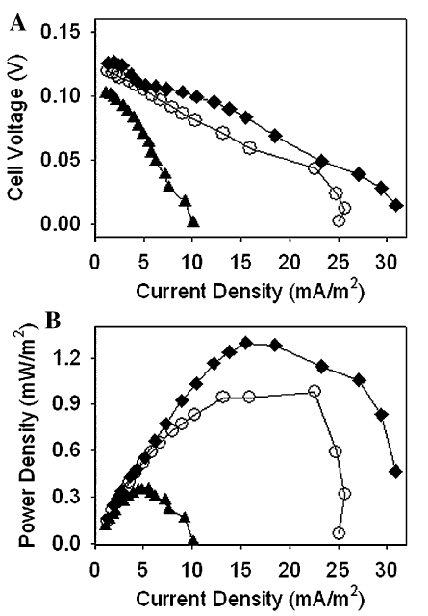
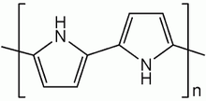
Conductive Polymer
coated electrodes allow
Greater Power
-Carbon Paint Base-
Untreated
Poly Pyrrole
Poly Aniline

Slide 27
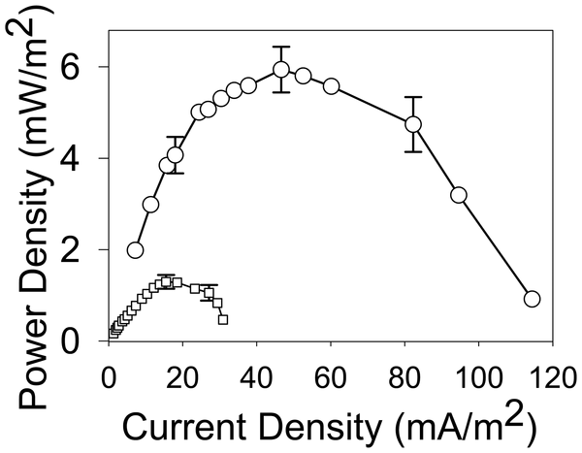
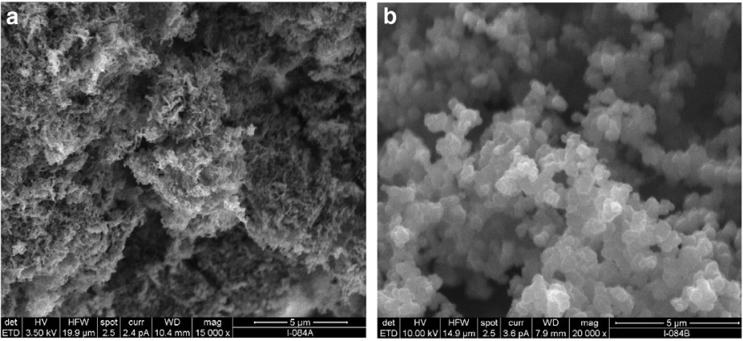
Poly Pyrrole nanostructure also
affects –Power-
Photosynthetic Biofilm
Fibrular Granular
Fibrular Poly P
Poly P
Zou, et al. 2010, Bioelectrochemistry

Slide 28
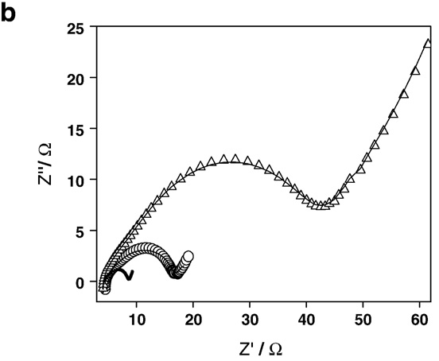
Likely through Decreasing Resistance
EIS Analysis
Untreated
Poly Pyrrole, granular
Poly Pyrrole, fibrular
Photosynthetic Biofilm

Slide 29
Electrochemical impedance spectroscopy (EIS)
Allows analysis of the internal resistance of BESs, electrodes & materials, catalyst coatings, biofilms and reactions on the anodes and the cathodes.
Requires potetiostat

Slide 30
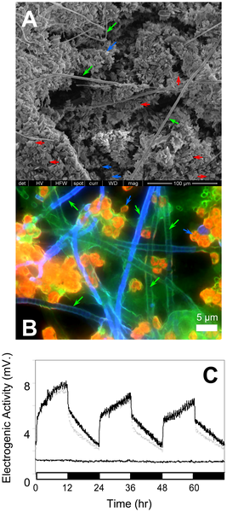
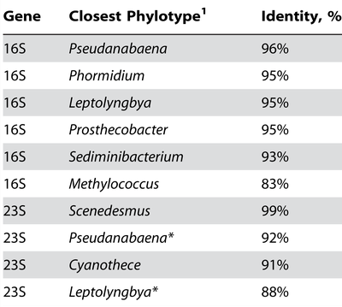
Species Composition of
Photosynthetic biofilm
Non-phototrophic bacteria: Sediminibactetium (a2), Prosthecobacter (a3, a4) and Methylococcus (a7) detected.
Pisciotta et al., 2010, PLoS One

Slide 31
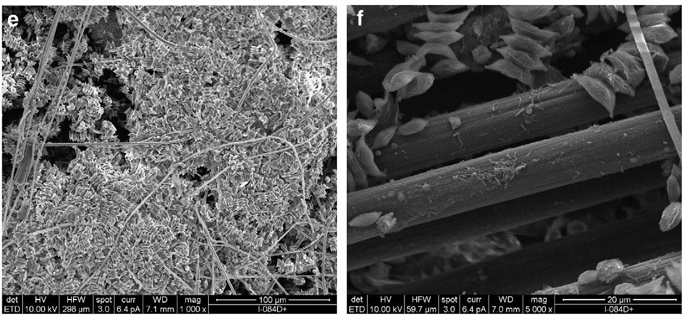
Scenedesmus microalgae growing on PMFC
carbon nanofiber electrodes
Zou et al., 2009

Slide 32
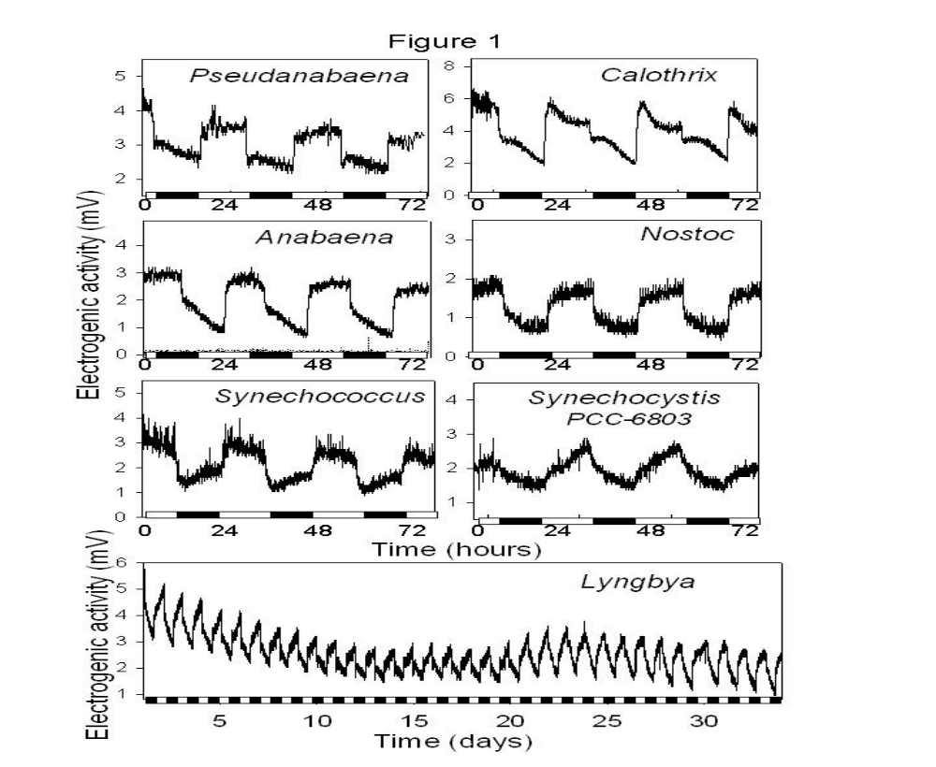
Electrogenic fingerprints.
Pisciotta et. al., 2011. AMB

Slide 33
What is the Biological Basis?

Slide 34
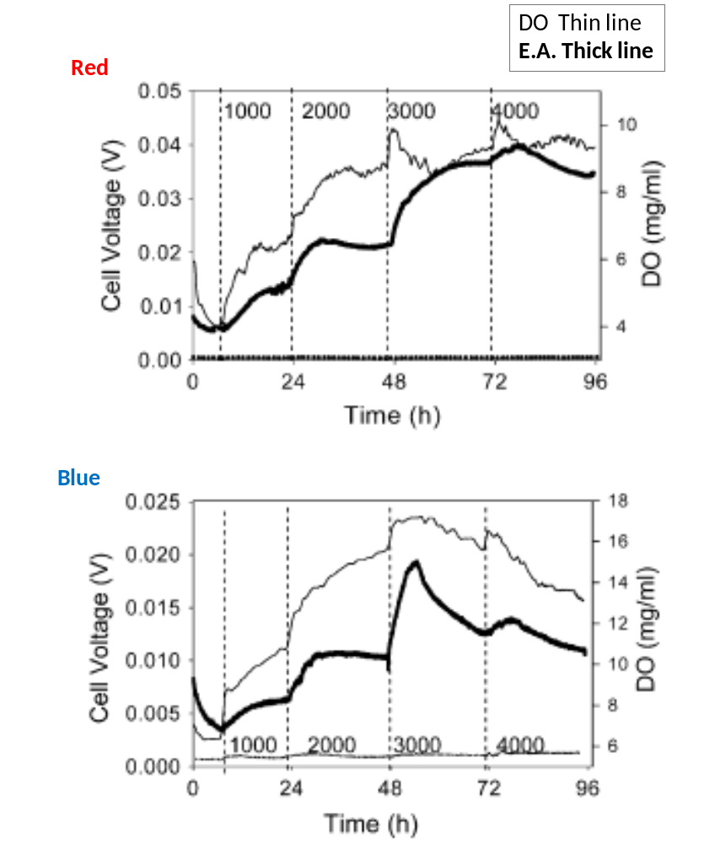
Electrogenic activity peaks
under strong light,
Suggesting possible function: photo-protection

Slide 35
Can metabolite production be influenced by
Bioelectrochemical Interfacing?

Slide 36
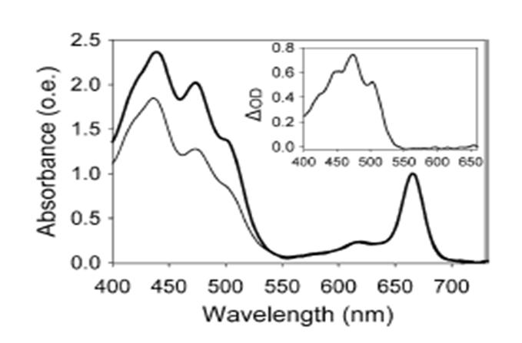
Metabolomic HPLC analysis
Photo-protective Carotenoids less prominent in electrically-connected (thin line) versus Disconnected (thick line) PMFCs.
Pisciotta et. al., 2011. AMB

Slide 37
DARK
Electrotrophic BES.
e-
Biocathode
CO₂
Bioanode
Biofuel

Slide 38
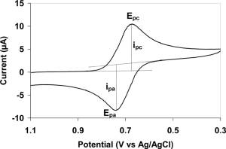
Electrochemical Methods to ID effective e- uptake from Biocathodes
1) Linear Sweep Voltammetry (LSV)
- Short term electron uptake (i.e. reduced overpotential)
2) Cyclic Voltammetry (CV)
Reversibility of electron exchange
/ mediator characterization
3) Chronoamperometry (CA)
- Long term electron uptake by monitoring Negative Current over time
4) Metabolomic Identification of Product (ex. GC of gas phase)

Slide 39
Electrotrophic CO₂ fixation using Biocathodes
  Idea: Enrich and isolate bacteria able to accept electrons from a cathode for reduction of CO₂ into fuel.
  the “electrotrophs”

Slide 40
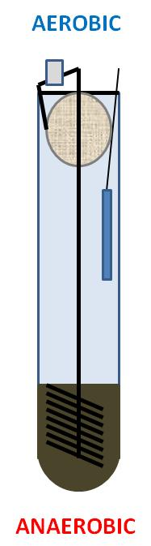
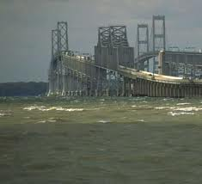
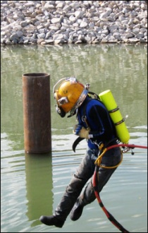
Sources Tested:
MFC establishment
conditions
Unpoised
-200 mV*
Chesapeake Bay Sediment
Baltimore Harbor Sediment
* -200 mV vs Ag/AgCl reference electrode (aka “Set”)

Slide 41

Sediment MFC anode to MEC cathode by Inversion Method.
Cathode
Reference
Wire
Brush anode
Sediment
AEROBIC
A) MFC anodes in anaerobic sediment
establish electrogenic biofilm.
B) MFC anode then inverted to form functional
MEC biocathode.
Potentiostat
A
B
LSV
CV
Current Uptake
Chemical Analysis
ANAEROBIC
(Pisciotta. et al., 2012. AEM)

Slide 42
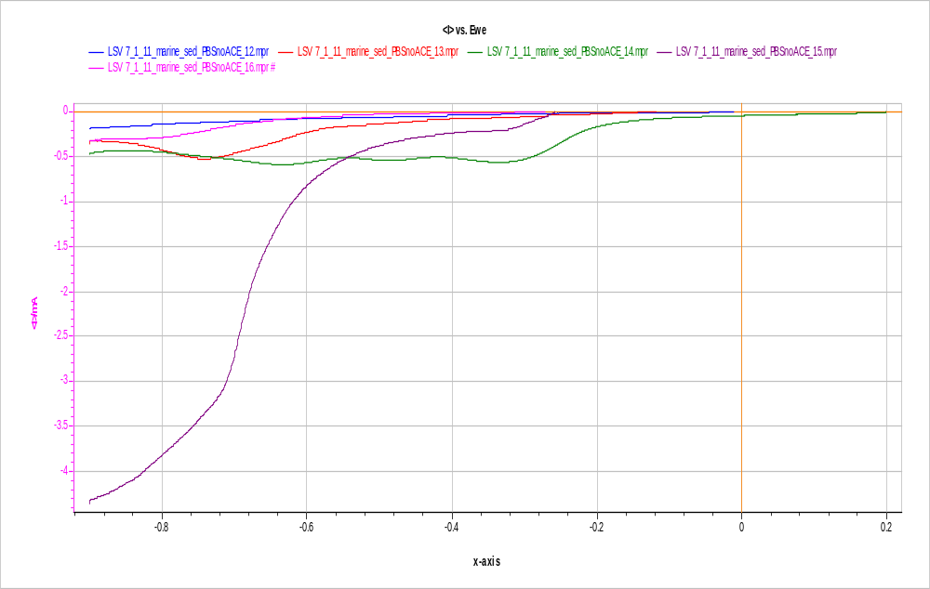
Linear Sweep Voltammetry (LSV) indicates highest short term electron uptake by harbor biocathode.
0
2
4
Control
Bay
Bay SET
Harbor
Harbor SET
Current (mA)
-0.9 -0.6 -0.3 0
Biocathode Potential (vs Ag/AgCl)

Slide 43
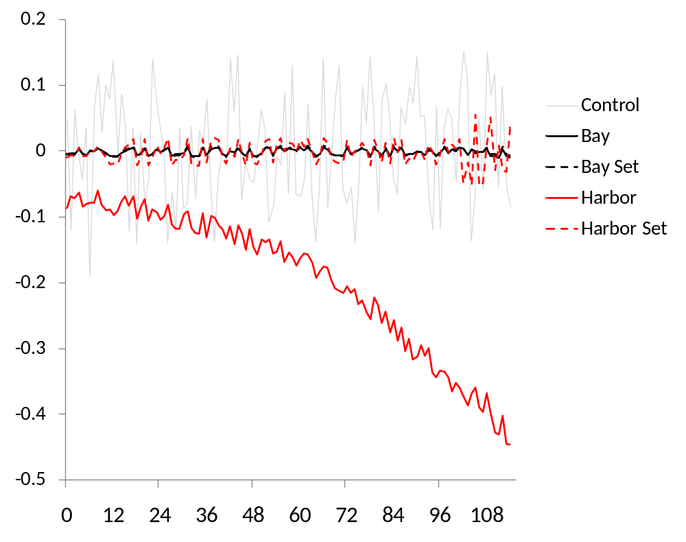
Chronoamperometery
Development of negative current
(-650 mV vs Ag/AgCl)
Current (mA)
20:80 (CO₂:N₂)
50 mM PBS,
10 ppt NaCl
No substrate
Time (Hours)

Slide 44
Sustained current uptake Vs. sterile control.
Coulombs of Charge
0 1 2 3 4 5 6 7
Time (days)

Slide 45
Metabolomic GC Analysis
CO₂ depletion from cathode chamber headspace
after 1 week at -650 mV or -750 mV
Week 1, -550 mV
(no changes detected)
Week 2, -650 mV
Week 3, -750 mV
-27%
-52%
CO₂ % N₂ I.S.
All Reactors
Degassed w/ 20:80 CO2/N2
Prior to each weekly trial

Slide 46
Biogas production and electron consumption.
0
-100
-200
-300
-400
Current
Headspace gas
I (uA)
0
Time (Days)

Slide 47
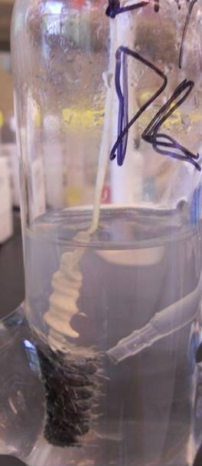
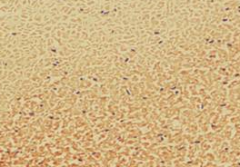
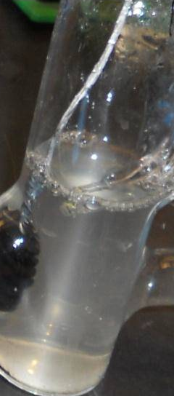
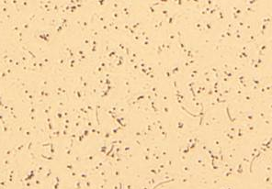
Task 2.2.3 – Milestone
Delayed Growth was Apparent
Electrotrophic growth is apparent
Follow up objective
Transfer to sterile MECs
-Is direct perpetuation
possible?
Bay, -650 mV (note Bay’s lack of gas bubbles )
Harbor, -650 mV

Slide 48
Mass Spectrometric Analysis of Cell Metabolites
1) Targeted Analysis
2) Metabolite Profiling
3) Global Metabolomic Analysis

Slide 49
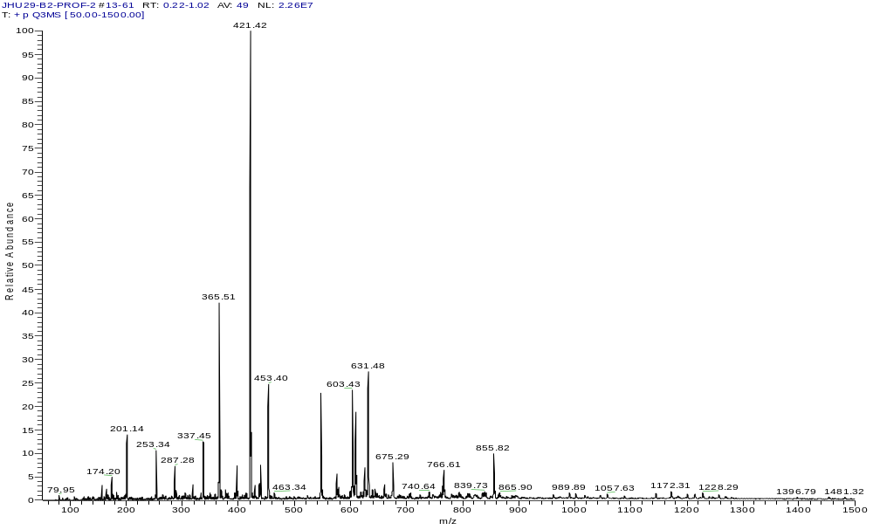
.
Microbial Metabolomic (Lipidomic) Spectrum Profiling
Monoacylglycerides
Diacylglycerides
Triacylglycerides
Phospholipids
(Li Adduct of Isoprene acetal)
MSG
D(1S/3P)G
DPG?
DSG
Note: DSG = 631
TSG = 897
MPG
IS
PL

Slide 50
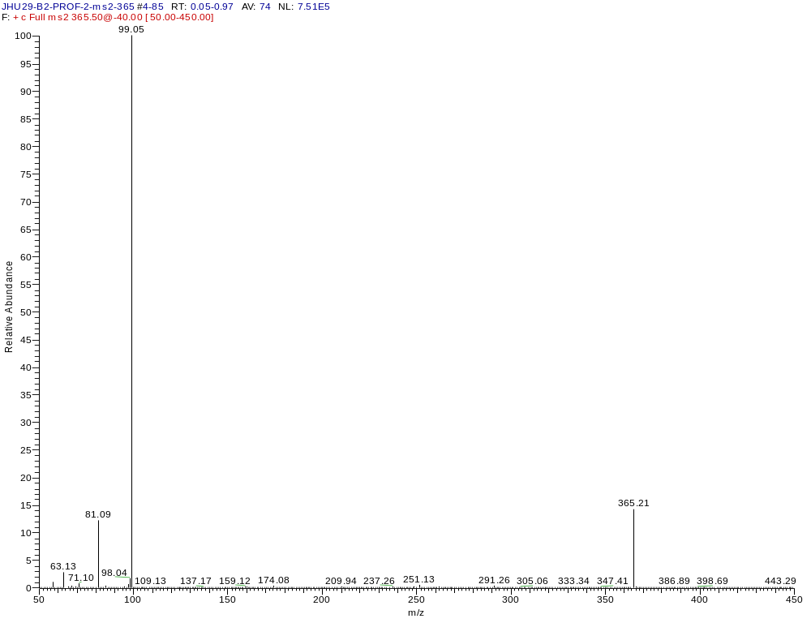
.
MS/MS Identification vs Standard
Glycerol Backbone
MS/MS Confirmation of MSG @ 365
Note loss of H2O (m/z 18)
From glycerol results in
81 and 63 m/z peaks
Unfragmented
MSG C18:0

Slide 51
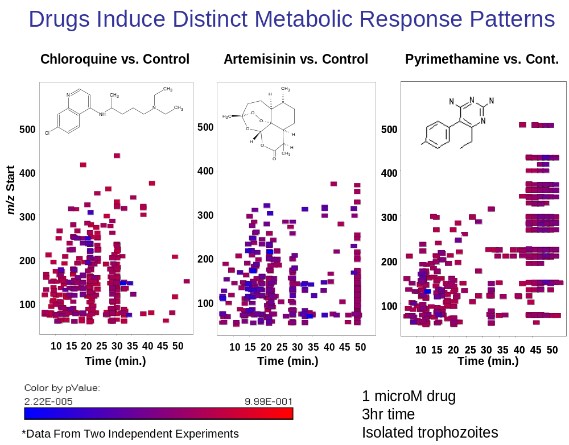
John Pisciotta,* Abhai Tripathi,* Joel Shuman,‡ Vladimir Shulaev‡ & David J. Sullivan Jr*

Slide 52
Issues concerning Metabolomic comparisons:
Extraction method standardization
Large library of metabolite standards needed
Timing and degree of BES exposure
Normalization of cell / enzyme number to electrode surface area

Slide 53
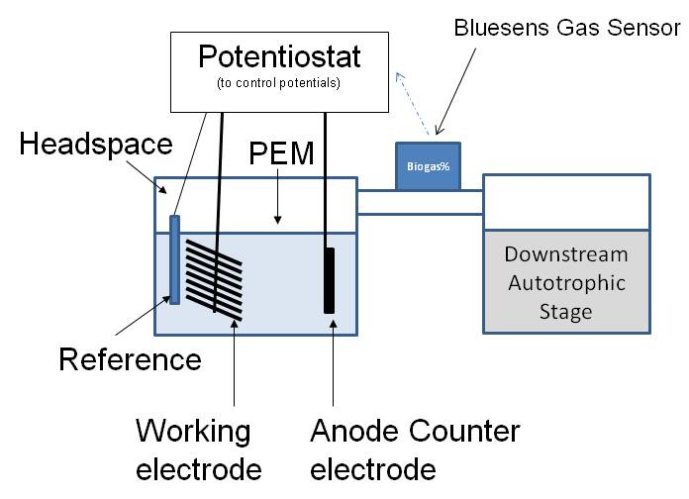
- Hybrid Systems-
Anode respiration to boost Photosynthetic metabolite production
CO2
CO2
Enhanced waste to fuel conversion with a bioelectrochemically controlled
autotrophic bioreactor. Pisciotta et al., 2013. Blusens Industrial Report III

Slide 54
Concluding Remarks:
Metabolomic researchers interested in redox active proteins can gain fresh insight by using BES systems.
The MFC research community also has much to gain from an improved understanding of Metabolomics.
Stable Isotope studies may eventually help determine how voltage influences electrically directed metabolism in exo-electrogens and electrotrophs

Slide 55
Acknowledgments
JHU Sullivan Lab: Metabolomic GC-MS/MS training using Malaria.
UMD Baskakov Lab: Metabolomic analysis of pMFC using HPLC / PDA detector.
PSU Logan Lab: Electochemical Biocathode analysis
West Chester University: Hybrid Designs (MEC-PBR)

Slide 56
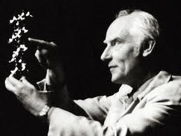
Central Dogma of Molecular Biology, 1958
DNA Genomics
mRNA Transcriptomics
Protein Proteomics
Metabolites > Metabolomics
Francis Crick
1962 Nobel Prize
w. Crick and Wilkins
UV Stress >> Thiamine dimers >> Tyrosinase mRNA 2x >> Melanin 7x
Eller et al., Nature. 1994

Slide 57
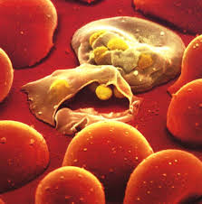
Why Metabolomics?
It sometimes provides best (or only) insight into pathways involved in response to a stress.
A genetically hard-wired metabolic transcriptome in Plasmodium falciparum fails to mount protective responses to lethal antifolates.
Ganesan et al., 2008. PLoS Pathogens

Slide 58
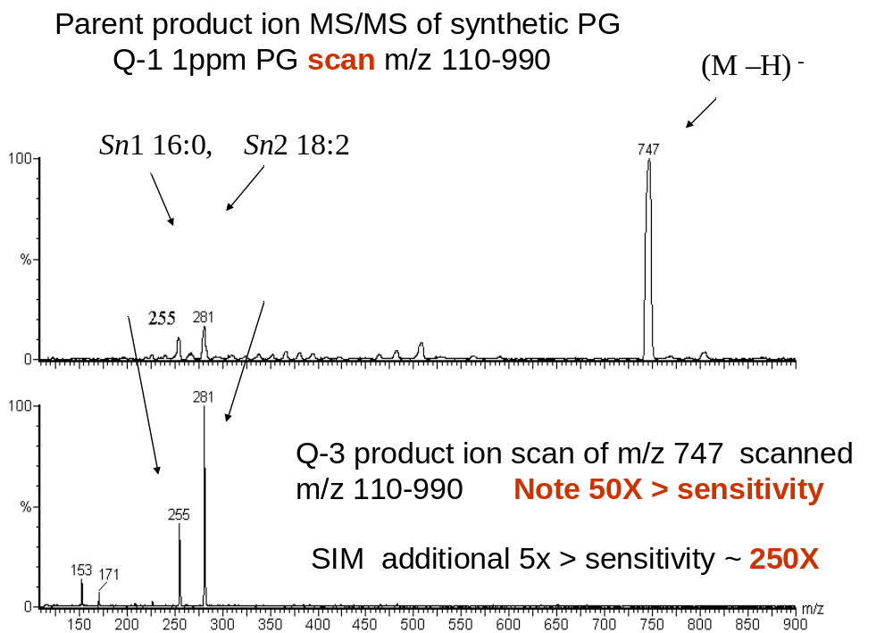

Slide 59
16s Clone Library Chesapeake Bay
(n = 97)

Slide 60
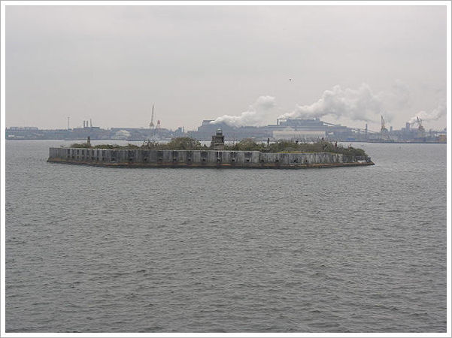
Thank you for your Attention!

Slide 61
Let Us Meet Again
We welcome you all to our future conferences of
OMICS International
Please Visit:
www.metabolomicsconference.com
www.conferenceseries.com
http://www.conferenceseries.com/clinical-research-conferences.php

