Slide 1



About OMICS Group
OMICS Group International is an amalgamation of Open Access publications and worldwide international science conferences and events. Established in the year 2007 with the sole aim of making the information on Sciences and technology ‘Open Access’, OMICS Group publishes 500 online open access scholarly journals in all aspects of Science, Engineering, Management and Technology journals. OMICS Group has been instrumental in taking the knowledge on Science & technology to the doorsteps of ordinary men and women. Research Scholars, Students, Libraries, Educational Institutions, Research centers and the industry are main stakeholders that benefitted greatly from this knowledge dissemination. OMICS International also organizes 500 International conferences annually across the globe, where knowledge transfer takes place through debates, round table discussions, poster presentations, workshops, symposia and exhibitions.

Slide 2
About OMICS International Conferences
About OMICS Group
OMICS International is a pioneer and leading science event organizer, which publishes around 500 open access journals and conducts over 300 Medical, Clinical, Engineering, Life Sciences, Pharma scientific conferences all over the globe annually with the support of more than 1000 scientific associations and 30,000 editorial board members and 3.5 million followers to its credit.
OMICS International has organized 500 conferences, workshops and national symposiums across the major cities including San Francisco, Las Vegas, San Antonio, Omaha, Orlando, Raleigh, Santa Clara, Chicago, Philadelphia, Baltimore, United Kingdom, Valencia, Dubai, Beijing, Hyderabad, Bengaluru and Mumbai.

Slide 3
Use of electricity to direct microbial metabolite production
John M. Pisciotta
West Chester University
Department of Biology
4th International Conference and Exhibition on Metabolomics and Systems Biology
Philadelphia, PA,
April 28, 2015

Slide 4
- Talk Objective -
Discuss recent discoveries detailing how electrical energy, alone or in combination with other factors, can be used to direct microbial metabolite formation.
Touch on the potentials, possibilities and challenges for future research.
Highlight the key role Metabolomics can play.

Slide 5
- Introduction -
Organisms have evolved to respond to external stimuli ranging from radiation to chemicals to magnetic fields.
Responses can often be measured metabolically.
Exposure to stresses like radiation or carcinogens may result in characteristic perturbation of the normal metabolite profile.
In humans, induced metabolic changes can help us diagnosis illnesses – in microbes they can yield useful products.

Slide 6
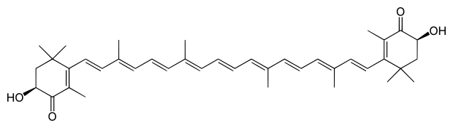
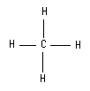
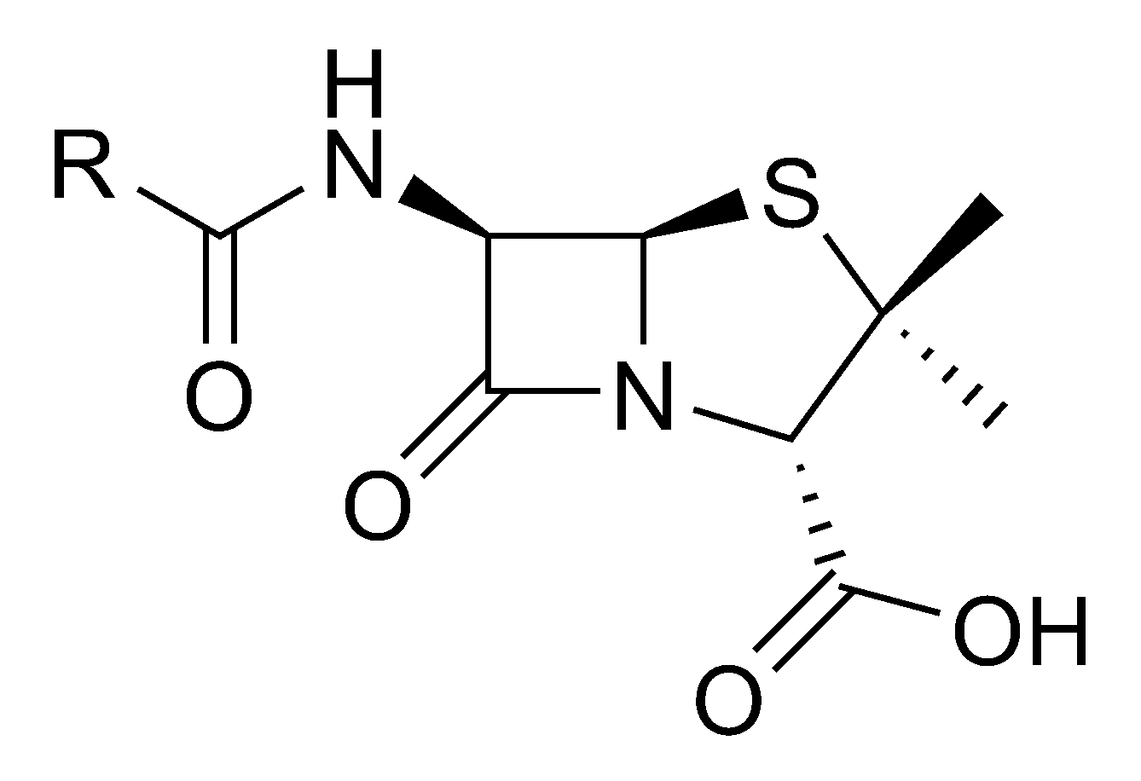
Why use Metabolomics?
In Biotechnology & Industrial Microbiology the product is often a Metabolite.
Pigments (Carotenoids)
Nutrients (Omega 3 fatty acids)
Antioxidants (Astaxanthin)
Biofuels (Ethanol / Methane)
Biosurfactants (Lipopeptides)
Antibiotics (Penicillin)

Slide 7
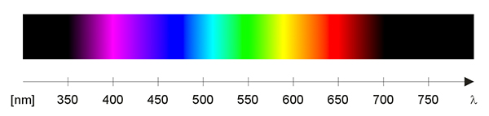
But what about Electricity as an inducer, and / or energy source?
Diverse Physicochemical parameters have successfully
be used to time, tune & optimize metabolite output.
Chemicals
pH
Light
Temperature

Slide 8
Bio-Electrochemical System (BES)
System that use microbes (and/or cell products) to convert chemical energy to electrical energy, or vice versa, and provide a useful service.
BESs use electrode enzymes or cells (usually bacteria) as biocatalysts to drive oxidation & reduction reactions at 2 opposing electrodes.
Bioanode and / or Biocathode

Slide 9
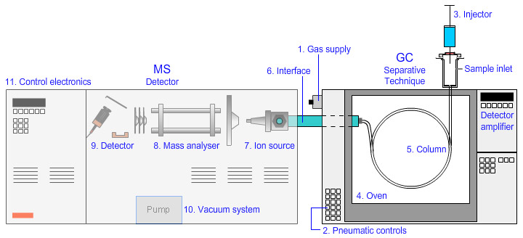
Metabolomic Methods Used
HPLC, GC, MS and potentiostatic techniques are used to study products of mixed or pure cultures or syntrophic associations.

Slide 10
Microbial Fuel Cell
4 e-
O2
Substrate
CO₂
H+
H+
H+
H+
PEM
Anode (e- enter circuit) Air Cathode (e- exit circuit)
Anaerobic Aerobic

Slide 11
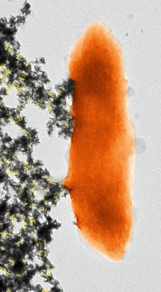
Microbial Fuel Cell
4 e-
O2
Metal reducing
bacteria
Substrate
CO₂
H+
H+
H+
H+
PEM
Geobacter TEM
Cologgi, 2011
Anode (e- enter circuit) Air Cathode (e- exit circuit)
Anaerobic Aerobic

Slide 12
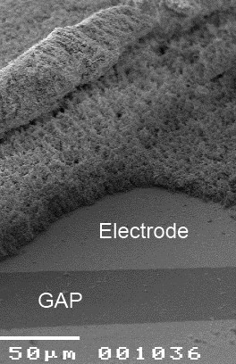
Microbial Fuel Cell
CO₂
H₂O
H₂O
PEM
Malvankar,et al. 2011
Anode (e- enter circuit) Air Cathode (e- exit circuit)
Anaerobic Aerobic : O2 is e- acceptor > H2O

Slide 13
Microbial Electrolysis Cell = H₂
Cheng & Logan, 2007, PNAS
MEC’s convert organic wastes (ex. acetate) to usable hydrogen, producing 140%+ more usable energy than electrical energy consumed.
Requires applied
Voltage
CO₂
H₂
H₂
PEM
Anode (e- enter circuit) Cathode (e- exit circuit)
Anaerobic Anaerobic : H+ is e- acceptor

Slide 14

Electro-methanogenesis
Direct Biological Conversion of Electrical Current into Methane by Electro-methanogenesis
Cheng et al. 2009. Environ. Sci. Technol.
Conversion efficiencies of up to 96% at 1 Volt.
Major Advance: Use of BIOCATHODE (archaea).
Implication: Electrically-guided Microbial CO2 fixation

Slide 15
Microbial Electrosynthesis
Microbial Electrosynthesis: Feeding Microbes Electricity To Convert Carbon Dioxide and Water to Multicarbon Extracellular Organic Compounds
Nevin et al., 2010. mBio.
Acetogenic bacteria can use electricity to fix CO₂ into organic molecules.
Efficiencies of around 80% using Wood Ljungdahl pathway.

Slide 16
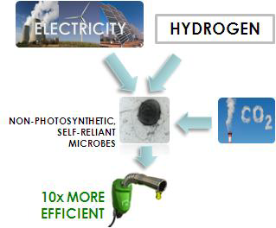
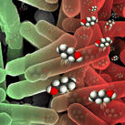

Electrosynthesis:
The DOE ARPA-E Electrofuels initiative 2010-2013

Slide 17

Enrichment of microbial electrolysis cell (MEC) biocathodes from sediment microbial fuel cell (sMFC) bioanodes.
Pisciotta et al., 2012. AEM
Cathode
Reference
Wire
Brush anode
Sediment
AEROBIC
A) MFC anodes in anaerobic sediment
establish electrogenic biofilm.
B) Electrode inverted to form functional
MEC biocathode.
Potentiostat
A
B
LSV
CV
Current Uptake
Chemical Analysis
ANAEROBIC

Slide 18
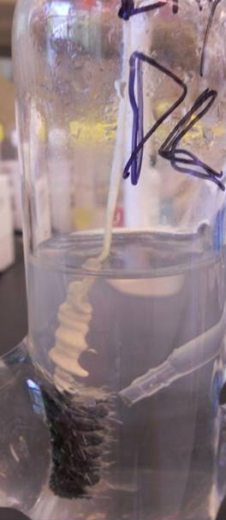
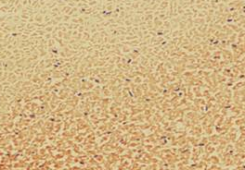
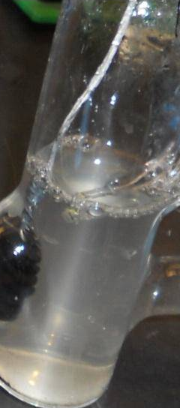
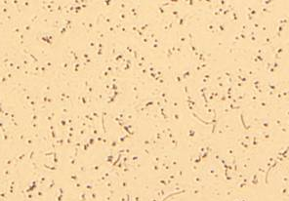
Task 2.3 – Milestone
Electrotroph Cultivation on CO₂
Identification of “Electrotrophs”
Objectives
1) Demonstrated Transferability
2) Build 16s Clone Libraries
Bay
Harbor
Pisciotta et al., 2012. AEM

Slide 19
16s DNA Clone Library:
Chesapeake Bay
Pure Culture Testing
(n = 97)

Slide 20
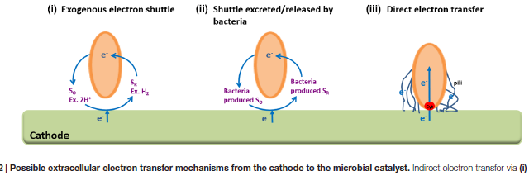
Major Question for Metabolomics
The Mechanistic Basis of Electron Uptake?
Tremblay & Zhang. 2015.
Frontiers in Microbiology

Slide 21
- Summary -
Electricity can be used for autotrophic conversion of CO₂ to useful metabolites.
Selective enrichment of “electrotrophs” from diverse environments is possible.
Coupling current with other stimuli (ex. light) may accelerate, expand types of metabolites formed.
Metabolomics can help screen for novel electrotroph products, explore voltage effects and determine the electron exchange pathways involved.

Slide 22

Acknowledgments
JHU Sullivan Lab: Metabolomic GC-MS/MS training.
UMD Baskakov Lab: Metabolomic analysis of pMFC using HPLC w/ PDA detector.
PSU Logan Lab: Electrochemical Analysis
West Chester University: Hybrid Designs (MEC-PBR)
Many thanks to the Meeting Organizers.

Slide 23
Let Us Meet Again
We welcome you all to our future conferences of
OMICS International
Please Visit:
www.metabolomicsconference.com
www.conferenceseries.com
http://www.conferenceseries.com/clinical-research-conferences.php

