Slide 1
Hyaluronidase, Hyaluronan and Inflammation: Answers from the air pouch
John Huang, Ph.D.

Slide 2
Agenda
Background
  HA, rHuPH20 & Enhanze technology for drug delivery
Studies on HA and rHuPH20 in inflammation
  In vitro: HA-TLR interaction
  In vivo: Air pouch model

Slide 3
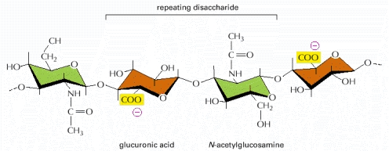
Hyaluronan (HA) is a glycosaminoglycan (GAG) of up to 25,000 repeating disaccharide units
HA synthase
Polysaccharide
Negatively charged and hydrophilic
Forms viscous hydrated gel in ECM
HA + collagens (and other ECM proteins) form semi-permeable matrix between cells
~15 g HA in an adult human being, with ~5 g turned over daily
Tissue distribution
Tissue | % total
Skin | 50%
Skeleton and supportive tissue | 25%
Muscle and Viscera | 15%
Other tissues | 10%
Hyaluronidase
(PH20)
Laurent & Fraser, 1992

Slide 4
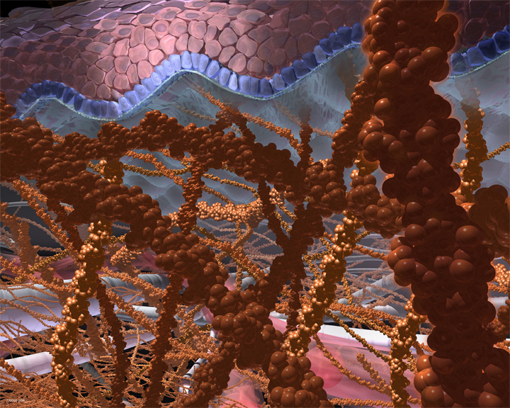
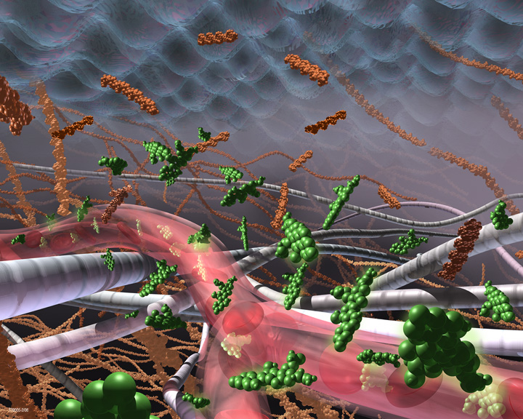
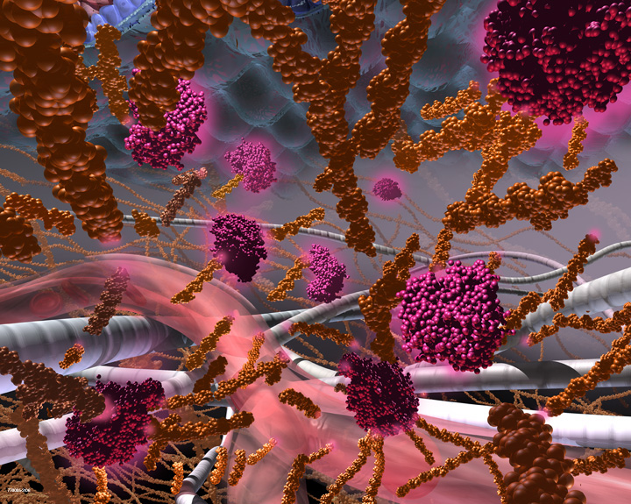

PH20 Mechanism of Action

Slide 5
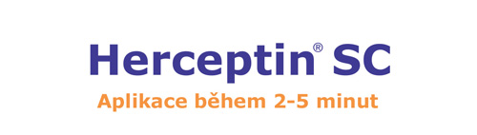
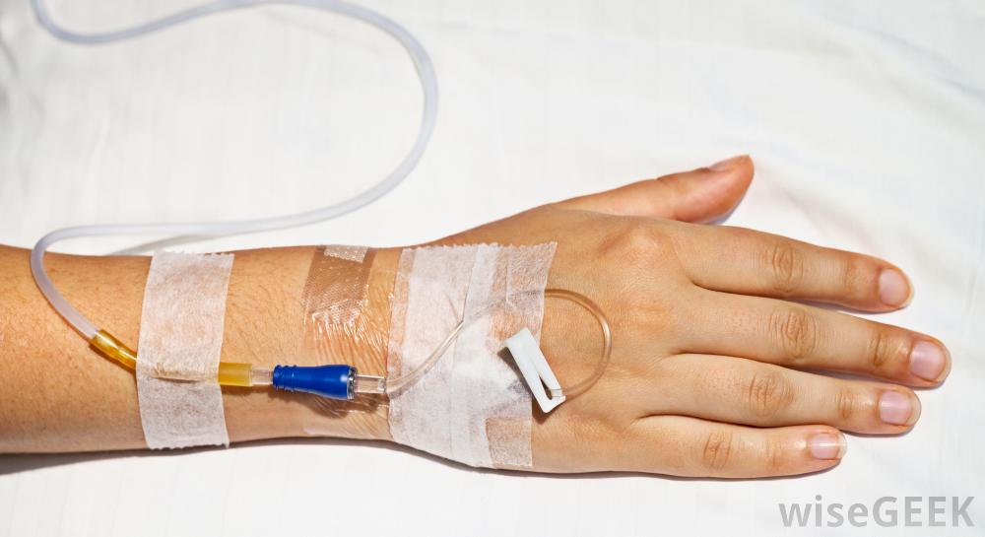
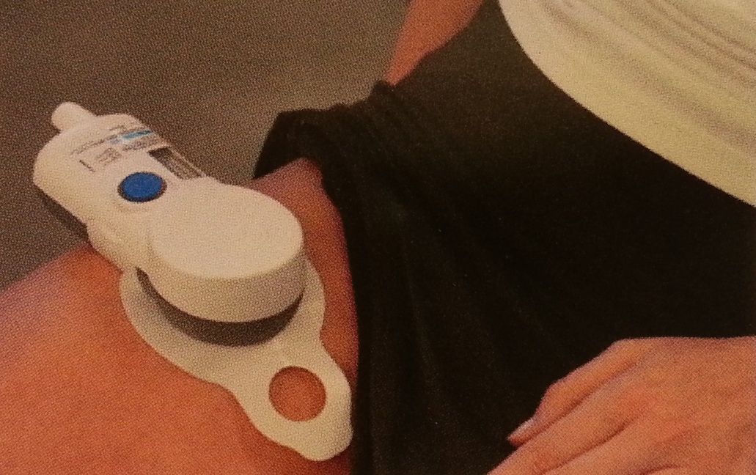
Enhanze Technology: Subqutaneous Dosing of Biotherapeutics
IV SC

Slide 6
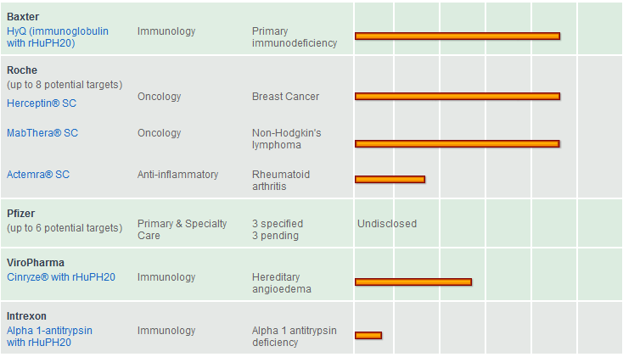
Current Drugs using Enhanze Technology: Approved and Investigational
IV → SC

Slide 7
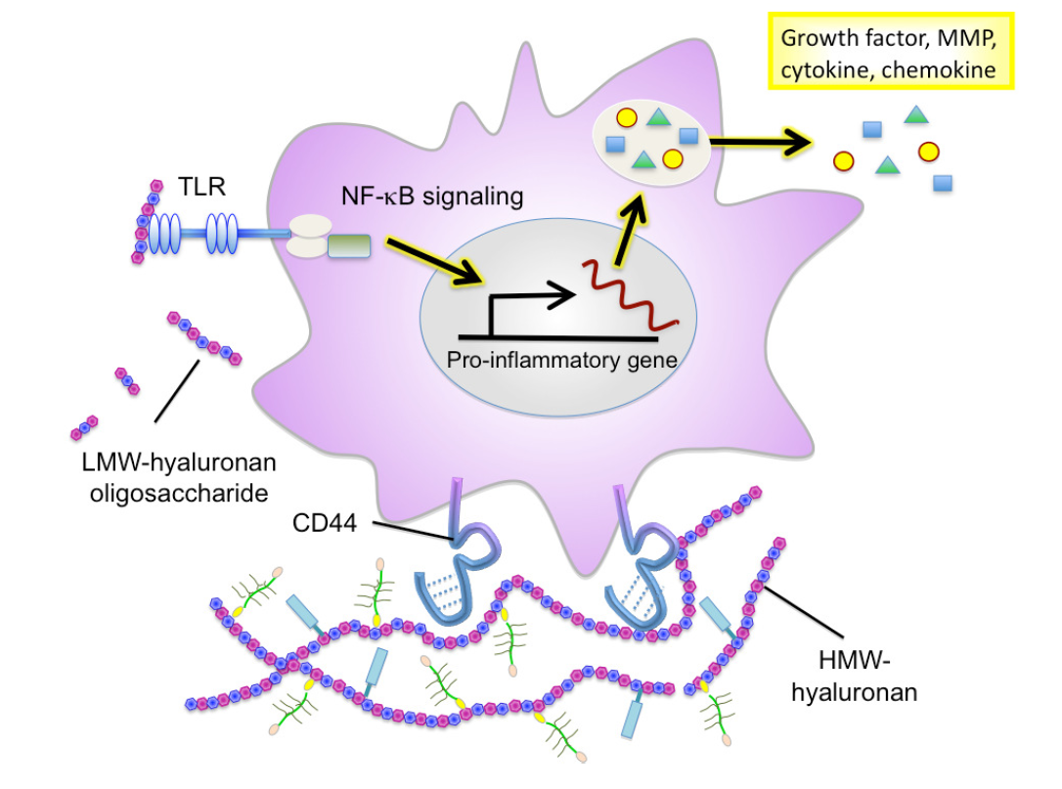
Literature Proposed Mechanism of Pro-Inflammatory Response by LMW HA
(Catabolic product of PH20)
CCL2/MCP1
CCL3/MIP1a
CCL4/MIP1b
CCL5/RANTES
CXCL1/GRO/KC
CXCL2/MIP2a
CXCL9/MIG
CXCL10/IP10
IL-1b
IL-8/LIX
IL12 p40/p70
TNFa
(5-750 kDa)
(>1,000 kDa)
Since rHuPH20 degrades HMW HA → LMW HA fragments, does it stimulate inflammation?
(Iijima et al., 2011)

Slide 8
HEK-Blue hTLR2 and hTLR4 reporter system
HMW and LMW HA?
hTLR2 or hTLR4
NFκB
SEAP
Alkaline Phosphatase activity assay

Slide 9
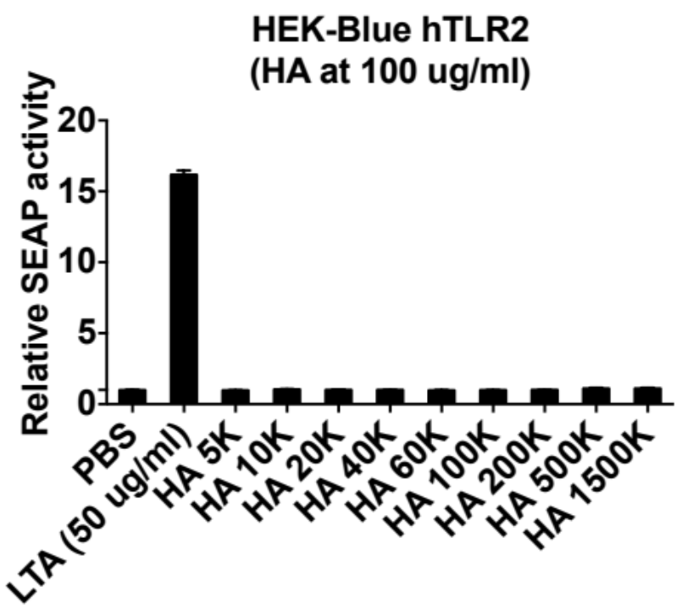
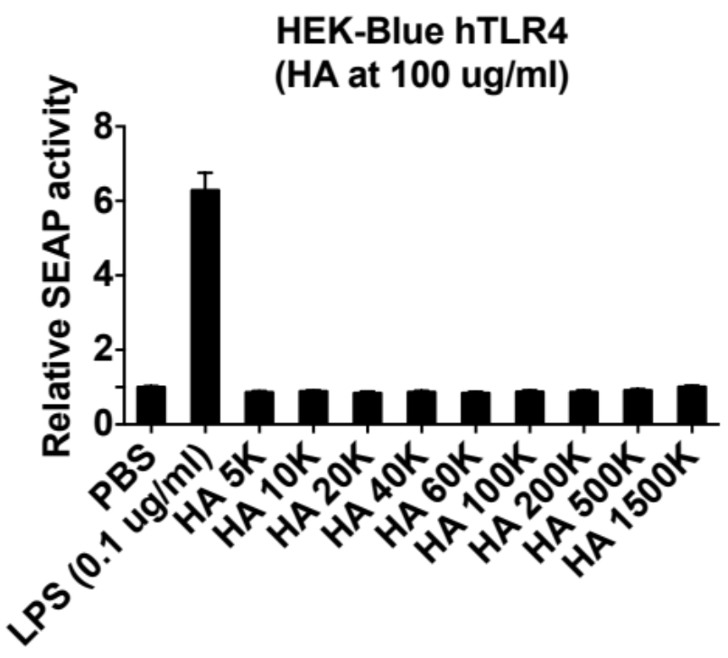
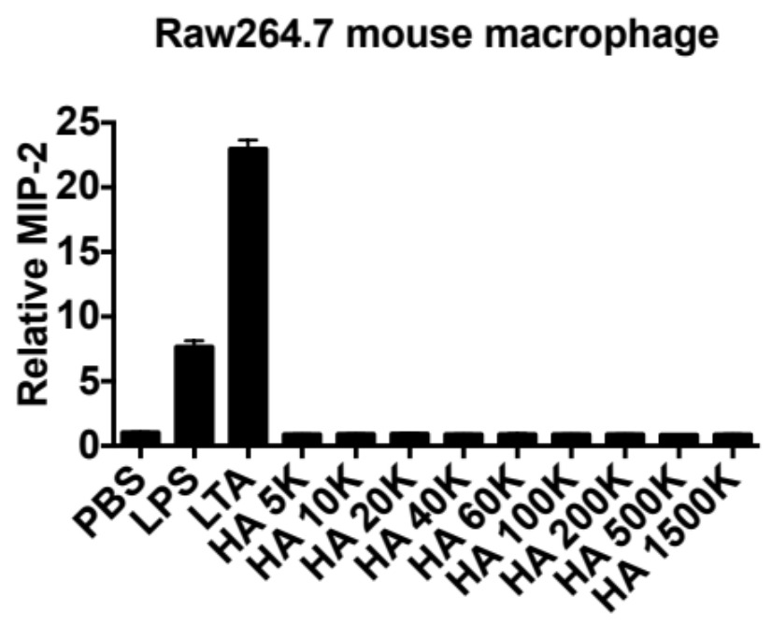
HA does not activate TLR2/TLR4 in cell-based assays
*
*
*
*

Slide 10
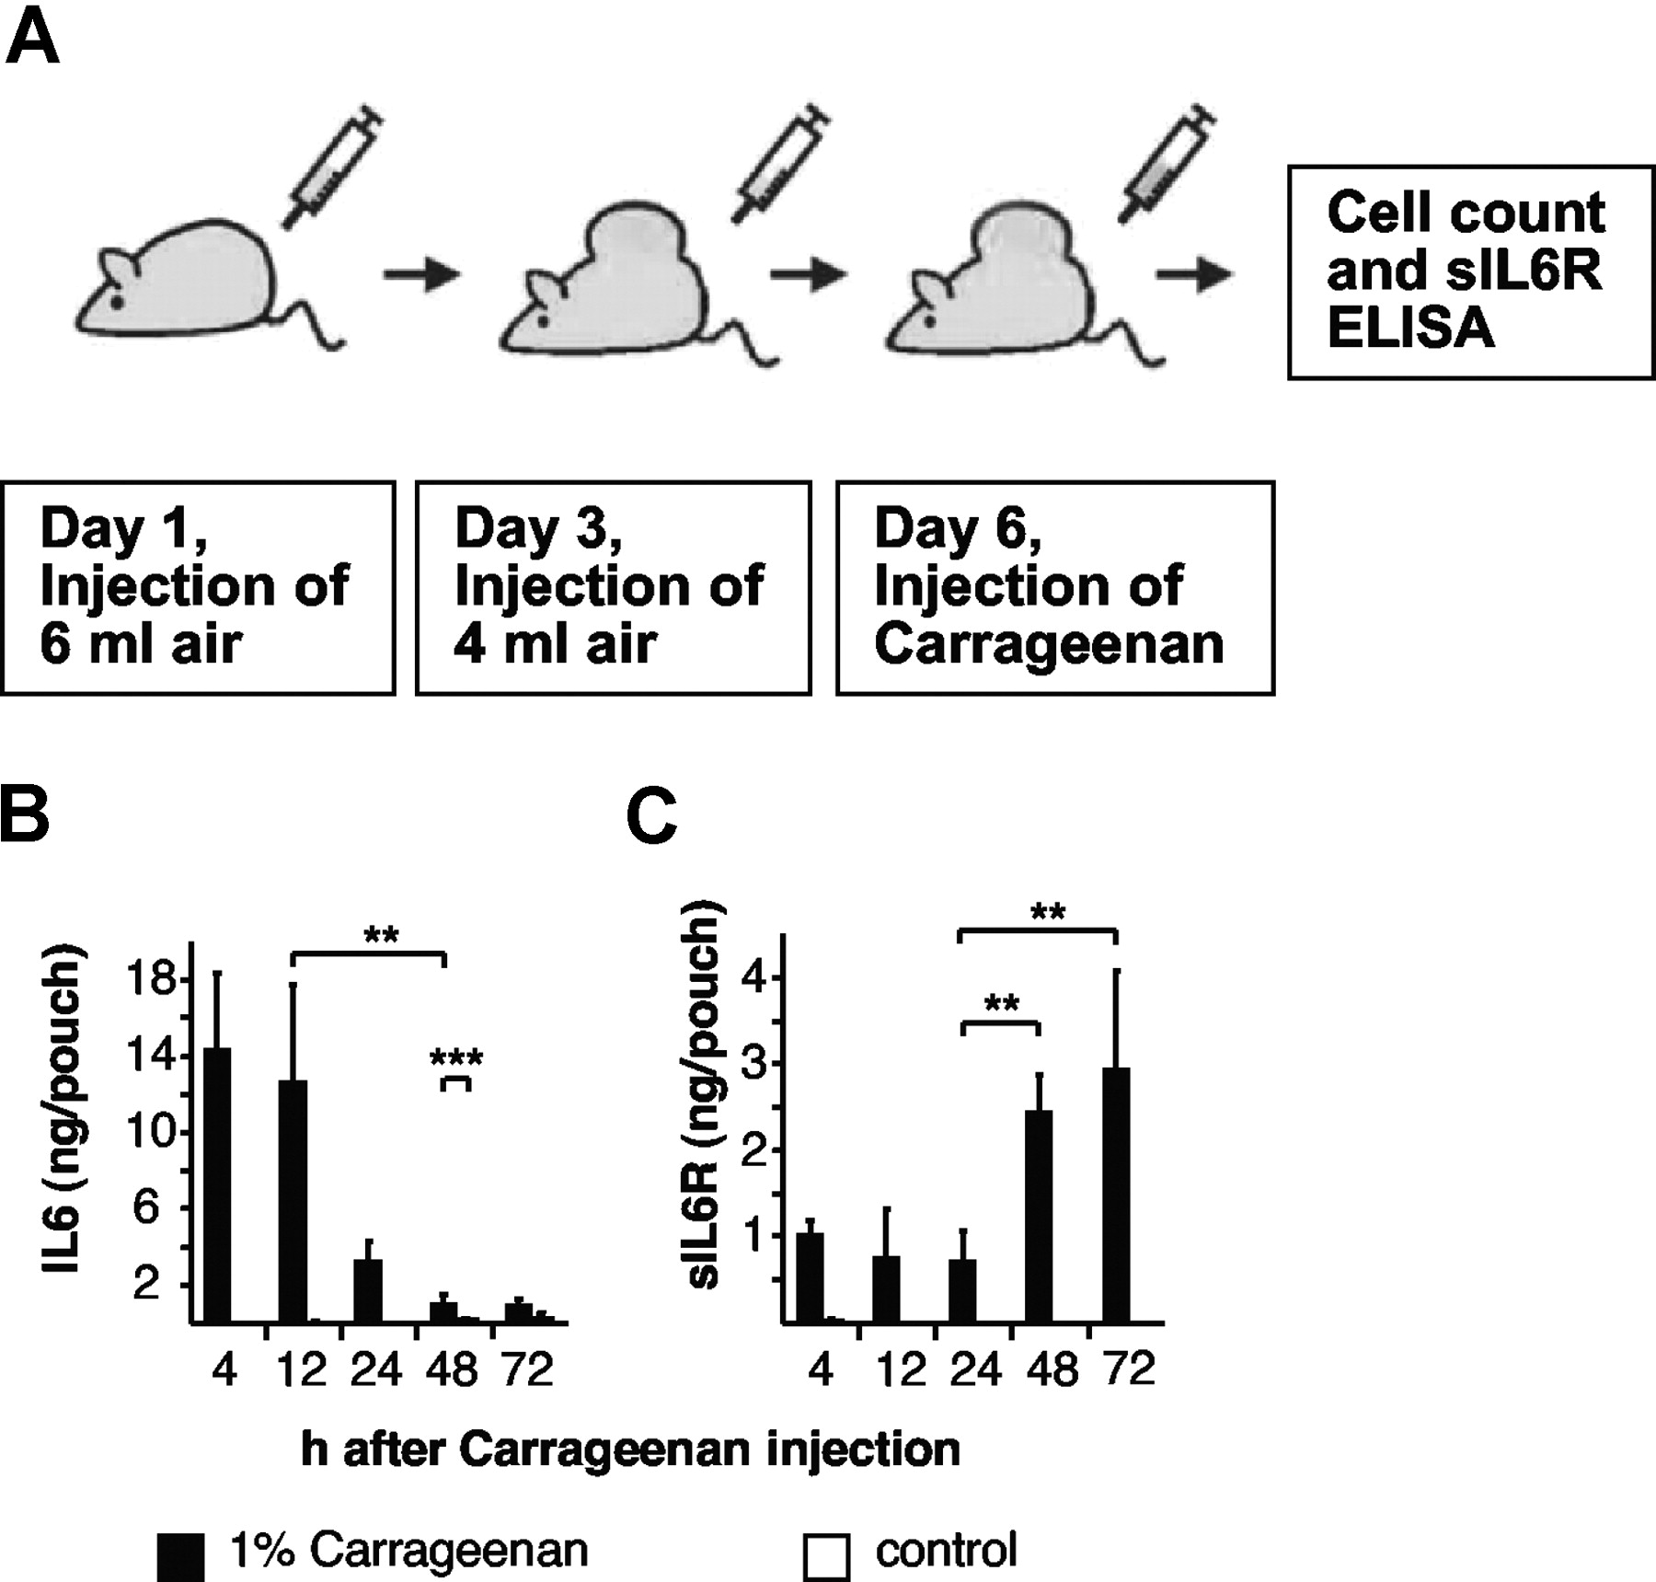
Air Pouch Model of inflammation
AP stimulation:
LPS
rHuPH20
LMW HA
Sigma Hyal type I-S
Sigma Hyal type IV-S
APE analysis:
Cytokines/Chemokines
AP infiltrating cells

Slide 11
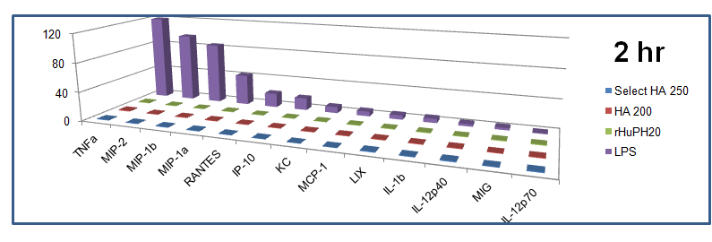
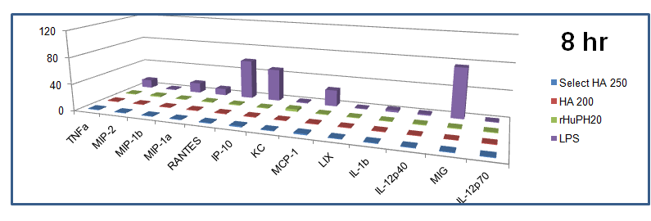
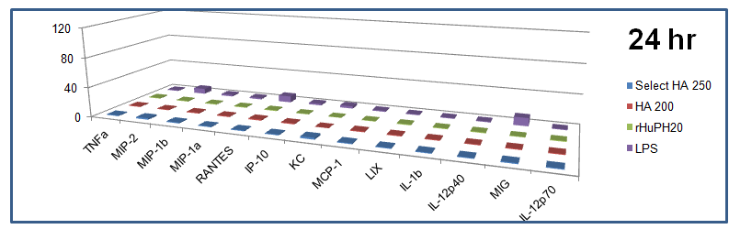
Neither LMW HA nor rHuPH20 stimulated cytokine/chemokine production in the air pouch
Fold (over control)

Slide 12
Neither LMW HA nor rHuPH20 induced neutrophil influx into the air pouch
*

Slide 13
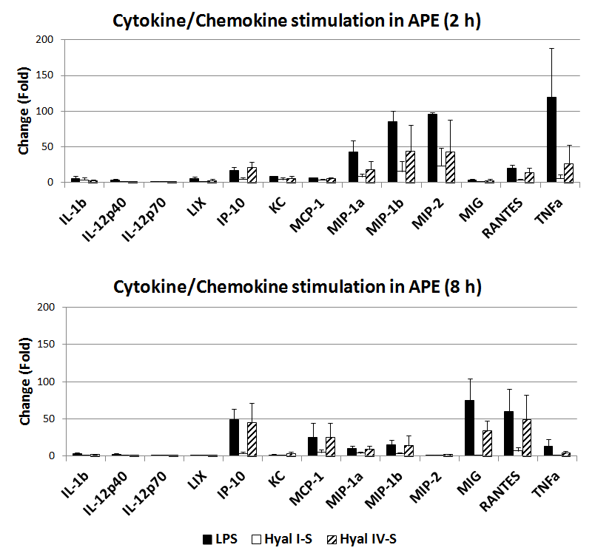
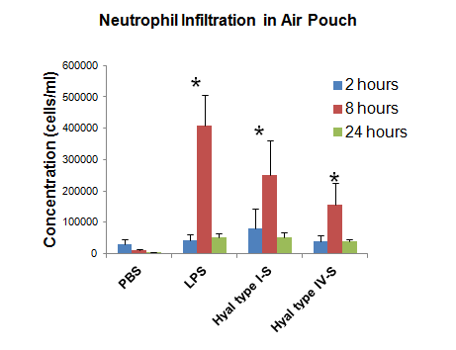
Hyal type I-S and IV-S are pro-inflammatory in vivo

Slide 14
Endotoxin Level in the Test Reagents correlates with inflammation
Reagent | Endotoxin (EU/ml) | Stimulation of Inflammation
PBS | <0.1
LPS (1 ug/ml) | 3905 | +
rHuPH20 (2,400 U/ml) | <0.1 | -
Hyal type I-S (2,400 U/ml) | 34.7 | +
Hyal type IV-S (2,400 U/ml) | 234 | +
Select-HA 250 (500 ug/ml) | 0.7 | -
HA 200 (500 ug/ml) | <0.1 | -

Slide 15
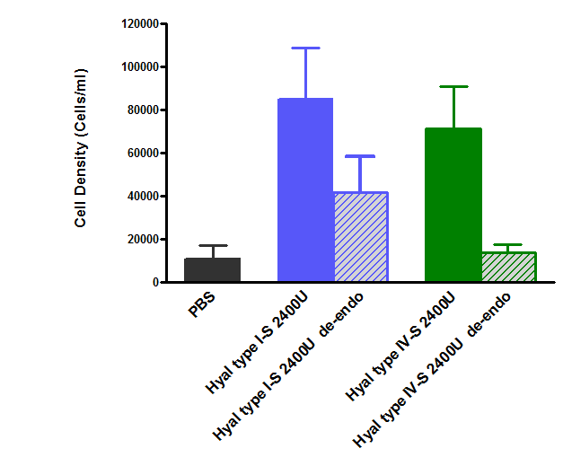

Depletion of Endotoxin Reduced the Pro-inflammatory Activity of BTHs
Cell Count in the Air Pouch Exudate
*
BTH
Endotoxin depleted BTH
 | Endotoxin
Hyal type I-S | 0.29 U/mg
Hyal type IV-S | 0.31 U/mg
* p<0.05
PBS
Hyal type I-S
Hyal type IV-S
Endotoxin is one of the pro-inflammatory components in Hyal type I-S
Endotoxin is the major pro-inflammatory component in Hyal type IV-S

Slide 16
Many other proteins may also contribute to the pro-inflammatory activity of Hyal type I-S and IV-S.
Summary
rHuPH20, and its catabolic product LMW HA, do not stimulate inflammation in models evaluated
Bovine testis hyaluronidases (commercial source) stimulate inflammation
The endotoxin (and possibly other protein contents) but not the hyaluronidase activity are the contributing components in bovine testicular hyaluronidases that induces inflammation
rHuPH20
Hyal type I-S
Hyal type IV-S
250 kDa
148 kDa
98 kDa
64 kDa
50 kDa
36 kDa
22 kDa

Slide 17
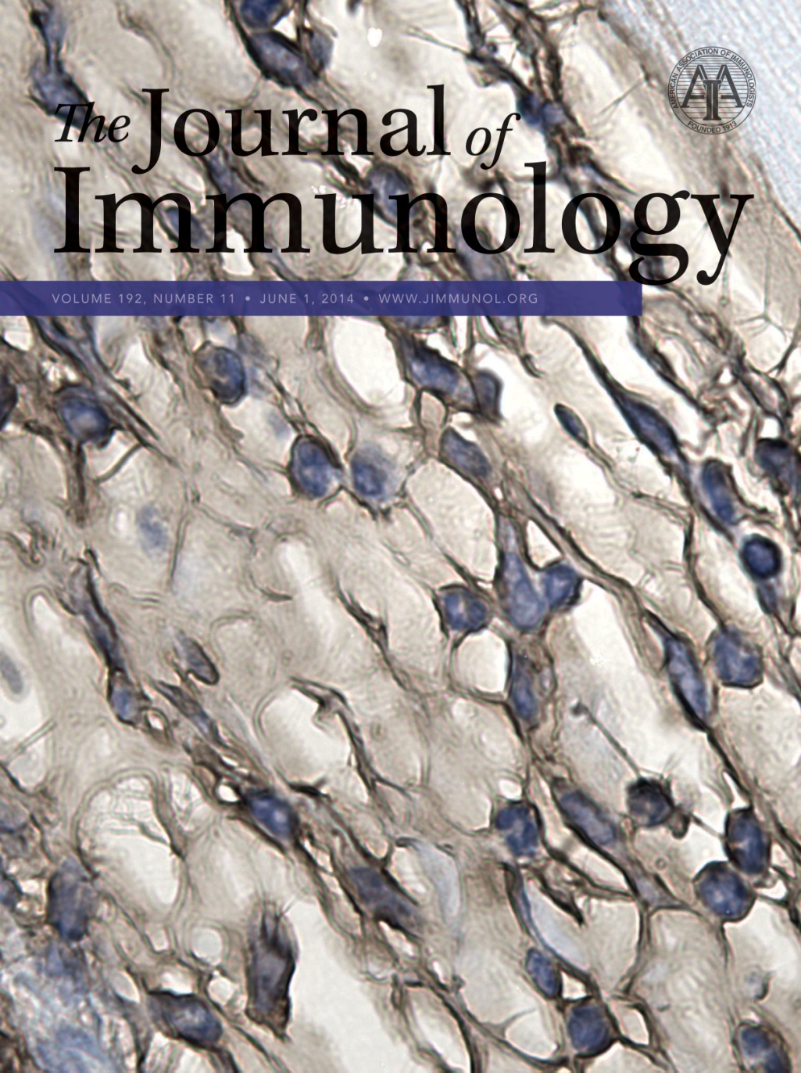
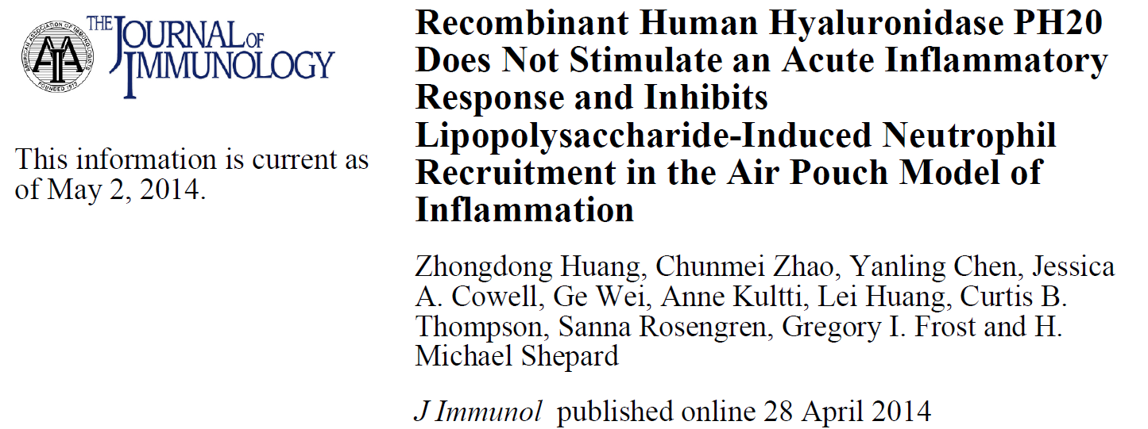
rHuPH20 and LMW HA are not pro-inflammatory
HyQvia®
FDA BPAC meeting: 7/31/2014
FDA approval: 9/12/2014

Slide 18
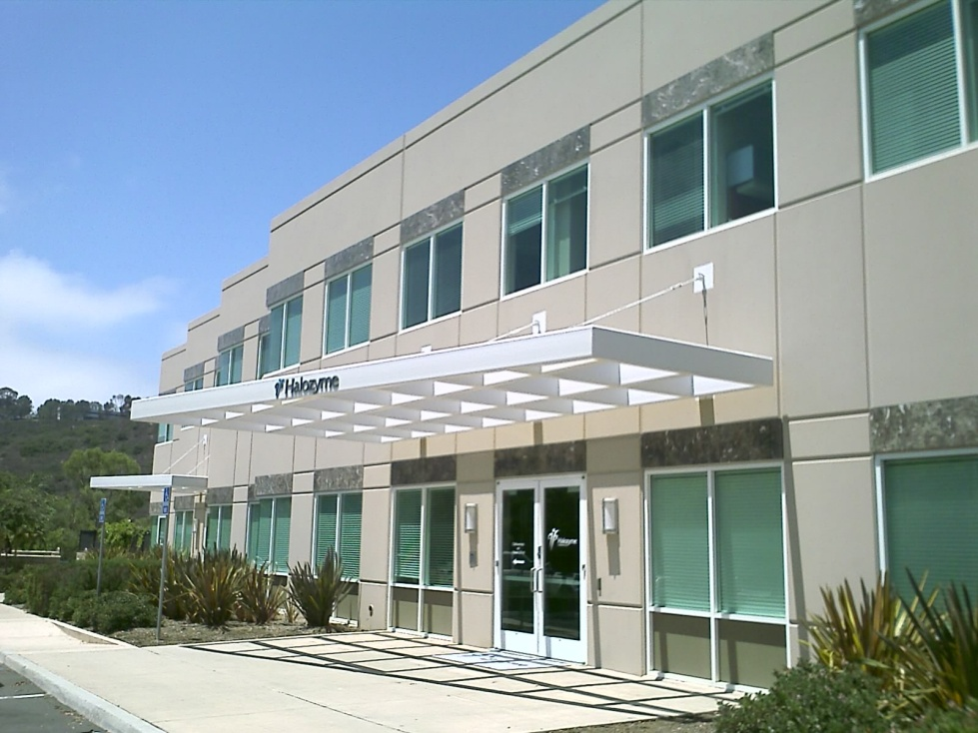
Acknowledgements
Michael Shepard
Gregory Frost
Dan Maneval
Paula Lapinskas
Gilbert Keller
Curt Thompson
Chunmei Zhao
Yanling Chen
Jessica Cowell
Lei Huang
Marie Printz
Anne Kultti
Susan Zimmerman
Steve Rowe
Rebecca Simons
Gina Wei

