Slide 1


The Curse of Wet Hands!
Significance of hand drying and efficacy of different methods
Professor John Gammon
j.gammon@swansea.ac.uk

Slide 2


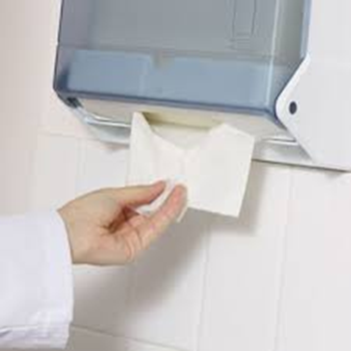
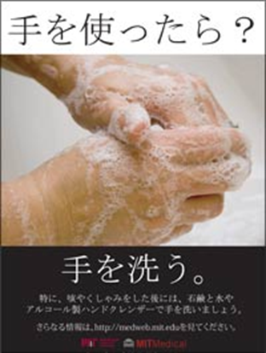
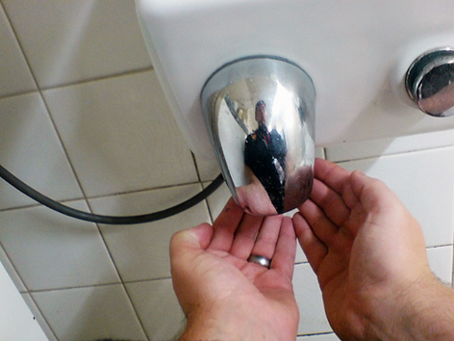
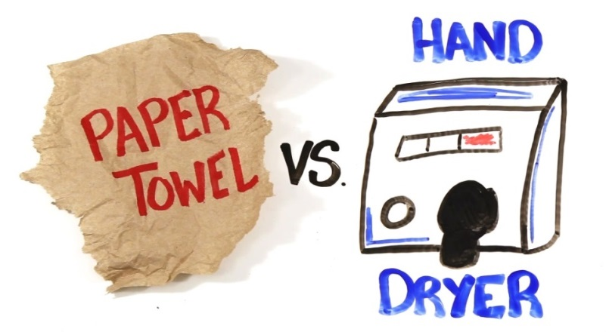

Aim - the Imperative to wash and dry hands!

Slide 3
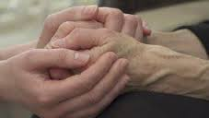


Hands that comfort and reassure, often become vehicles for pathogens which act as deadly weapons.
Notes:
2

Slide 4

The Challenge!
Research shows:
  Frequency and compliance is suboptimal
  Behavioural interventions have limited impact and not sustained
  Hand drying is a neglected aspect of practice
  A paucity of research exists both in terms of extent of drying and efficacy of different methods
  Environmental contamination and microbial dispersion of drying methods

Slide 5

Hand Hygiene Compliance
Range of compliance from 10% -86%
Compliance on average is 40.4%.
A systematic review WHO(2009) noted compliance on average 38.7% with a range 5-89%.
Little change from 1990s when average of 30% was quoted
Notes:
13

Slide 6
Interventions to improve hand hygiene
Positive impact the range was a 9% - 50%, with the average behaviour change being 26.1%
WHO (2012) note an average of 17.6% change.
Post intervention compliance range was 36% - 98%, the average being only 64.5%
Pre intervention compliance range was 11% - 89%, the average being 37.6%
Notes:
18

Slide 7
Research evidence on the extent of drying and effectiveness of hand drying methods
Dry or Not – the curse of wet hands!

Slide 8
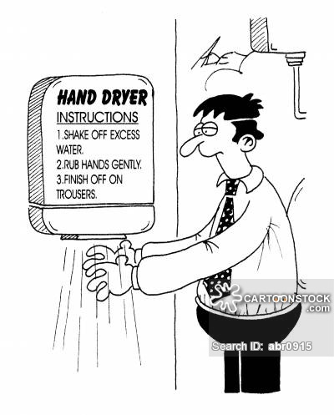
How many of us are familiar with this?

Slide 9
The curse of wet hands!
Research suggest hands often remain wet or have residual dampness after washing
80% of practitioners do not dry their hands effectively
Increased risk of cross infection if hands are wet and thus HCAI’s
‘Wet Work Concept’ - repeated exposure to water causes evaporation from skin and so desiccation, leading to skin irritation and occupational hand dermatitis
Occlusion effect of gloves - heat and moisture collecting, facilitating the activation of other potential irritants and microbial growth.
Prevalence of irritant contact dermatitis in healthcare professionals has been shown to be 10 – 45%.

Slide 10
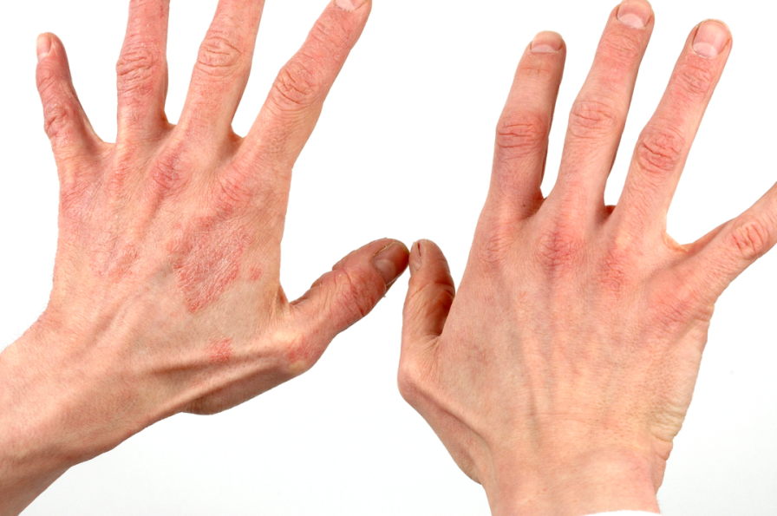
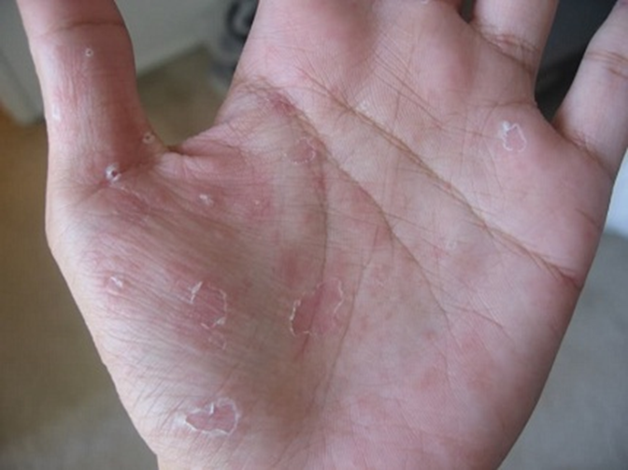
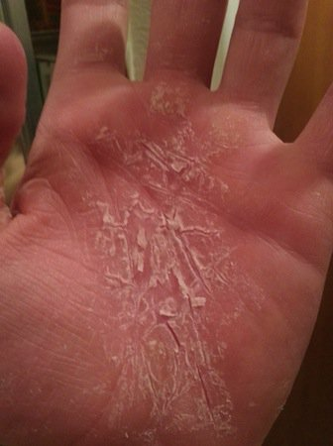
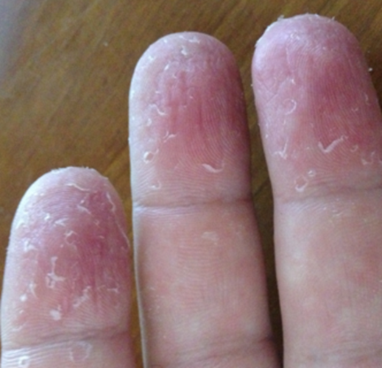
Consequences of wet hands and ineffective drying

Slide 11

The Curse!.....wet hands increase risk of cross infection.
Micro-organisms transfer most effectively from wet surfaces so always dry hands thoroughly
Research notes damp hands spread germs a 1,000 times more than dry
Patrick et al 1997: a determinant of the number of micro-organisms trans-located from hands is the extent of residual moisture on hands

Slide 12

Dry Hands are Safe Hands
Drying is the additional critical factor limiting the spread of infection by touch contact
Moisture left on hands acts as a bridge allowing alarmingly high numbers of bacteria to be transferred
Bacterial numbers translocating on touch-contact progressively decrease as drying removes moisture
Drying, extent and effectiveness is a critical factor in determining the potential for skin irritation
Recognition that drying must inform our guidelines, clinical policies and practice.

Slide 13
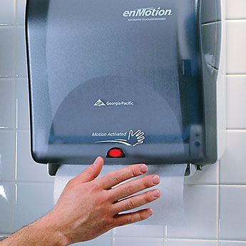

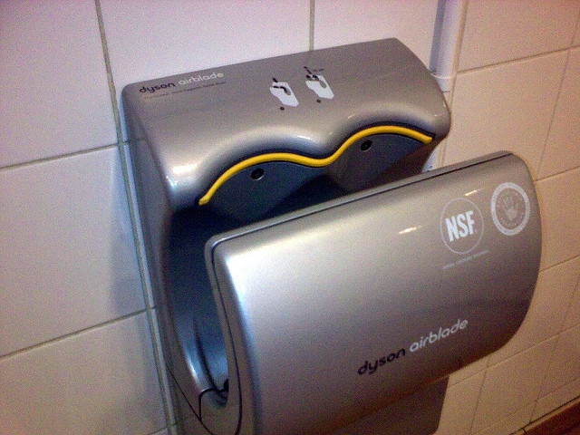

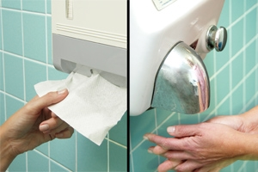
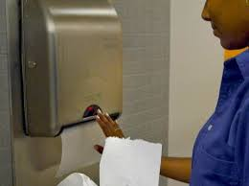
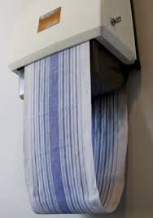
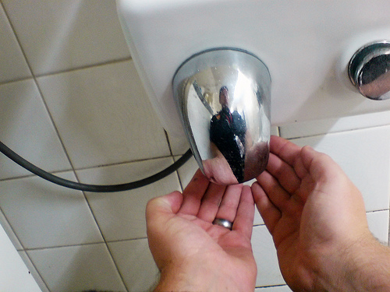
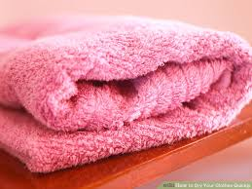

Hand Drying Research
Notes:
19

Slide 14

Hand Drying Methods – the evidence
Limited research evidence to inform practice.
Which is the most effective method?
Studies suggest that paper towels are the most effective method for drying, reducing the number of bacteria on the hands and reducing the risk of transfer. That paper towels in terms of speed and microbial environmental contamination are the recommended method in clinical settings

Slide 15
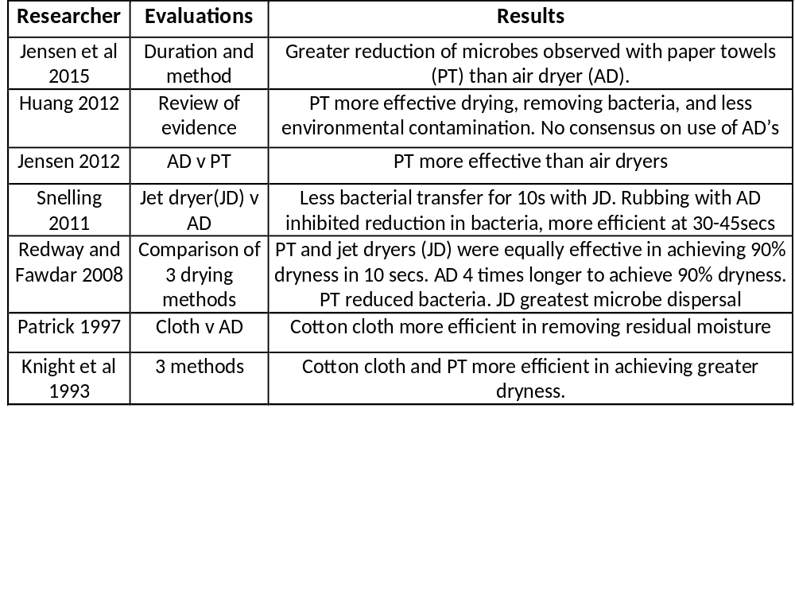

Drying Studies – method efficacy
Notes:
19

Slide 16
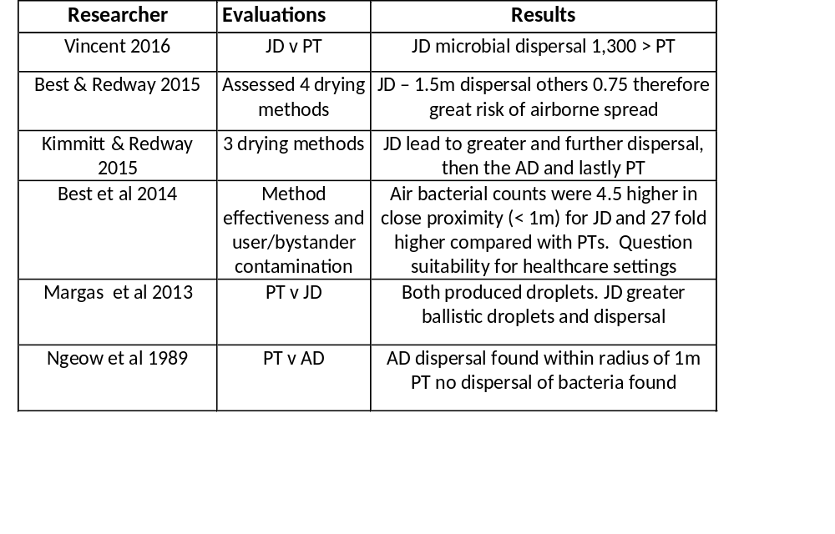

Drying Studies – microbial dispersal
Notes:
19

Slide 17
The significance of dry hands and the curse of wet hands!

Slide 18

CONCLUSIONS
Handwashing compliance remains suboptimal
An imperative for hand drying to be an equal part of the hand hygiene procedure
Lack of robust evident to inform practice
‘Wet hands’ result in skin irritation which impacts on compliance, and also increases the translocation of organisms, and thus the risk of cross infection
Effective hand drying not only removes residual moisture but bacterial contamination
The efficacy of different dry methods and their environmental impact varies, each having clinical implications.

Slide 19

.
Thank you for your attention
j.gammon@swansea.ac.uk

