Slide 1

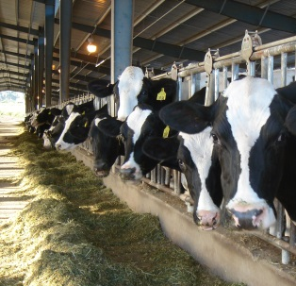

Research Animal Welfare & Scientific Integrity:
An AAALAC International Perspective
John F. Bradfield, DVM, PhD, DACLAM
Senior Director, AAALAC International

Slide 2
Agenda
Welfare and Science
Review AAALAC trend data
Common challenges

Slide 3

Why Animal Welfare in Science Matters
Ethical Imperative
  Society
  Veterinarians
Scientific Integrity
  Healthy, well-cared for animals + properly designed studies = better science
Notes:
Good welfare = ? 5 freedoms (hunger/ thirst; discomfort; pain, injury, disease; normal behavior; fear, distress). Adaptive homeostasis. State of health and well-being. Psychological well-being. The “Pigness” of a pig, “dogness” of a dog, or “mouseness” of a mouse. (ethos of the animal).
Good science – merit, likelihood of benefit, accuracy, validity

Slide 4
Welfare and Scientific Integrity
Animals with subclinical disease….
Post-procedural pain relief….
Prompt veterinary care…..
Appropriate environment….
  Space - pens/ cages
  Social housing
  Enrichment
  Husbandry
  Illumination
  HVAC function

Slide 5
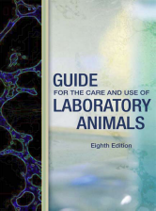
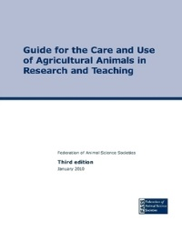

AAALAC Mission
……enhances the quality of research, teaching, and testing by promoting humane, responsible animal care and use…..
Accreditation
  Voluntary
  Confidential
  Peer-review
  Site visit every 3 years

Slide 6

Number of Accredited Programs
Notes:
There are currently 941 accredited institutions (October 2014)
Approximately 310 site visits per year or about 100+ visits per trimester

Slide 7
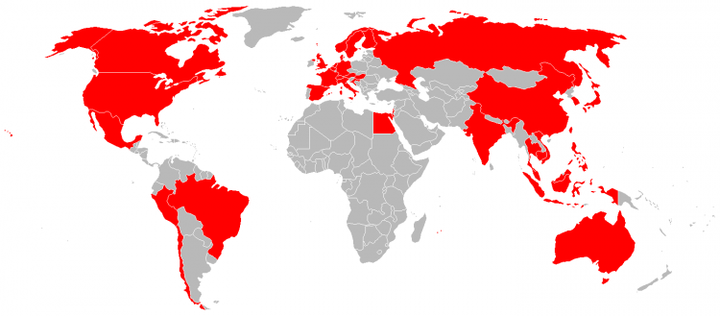
Accredited Institutions in 41 Countries/ Regions
Middle East .3%
North America 74%
Europe 9%
Pacific Rim 15%
Latin America/ Caribbean ~1%
Africa .3%
Notes:
Generate the map above at traveltip.org

Slide 8
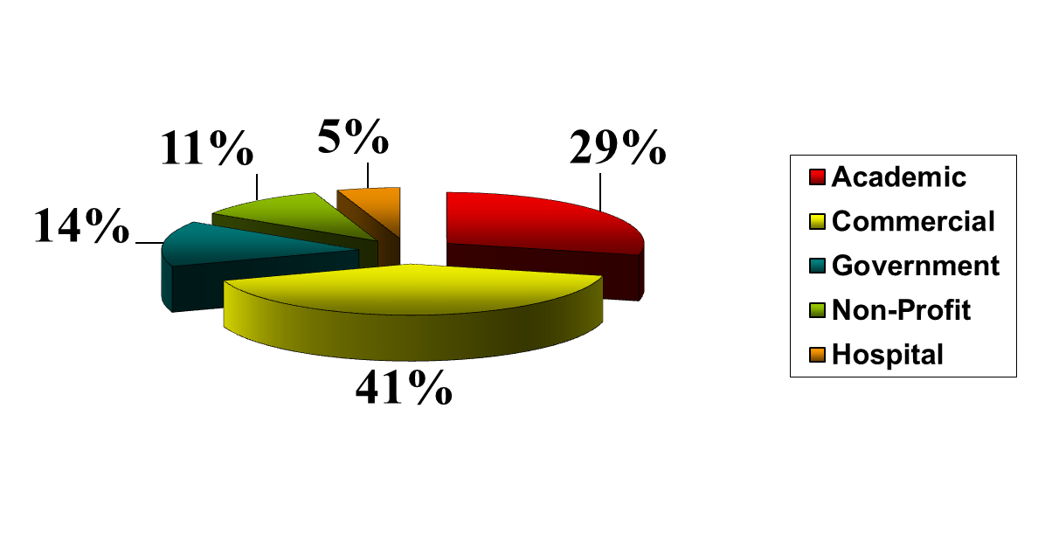
Demographics
- proportion of accredited units by industry sector
Notes:
With growth in recent years in the pacific rim region, there has been a marked increase in the number of commercial institutions seeking/attaining accreditation. Until several years ago, academic institutions represented the largest sector. Continued growth in the pacific rim region is expected to continue. New applications from the pac rim comprise over half of the total new applications each year.

Slide 9

Findings - Trends
671 site visits
4815 findings – described at the exit briefing….

Slide 10
Two Categories of Findings….
Mandatory – a deficiency that must be corrected in order to maintain (or attain) full accreditation
Suggestion for Improvement (SFI) – a deficiency that if corrected would improve the program, but correction is not essential to maintaining full accreditation status

Slide 11
Analysis of Findings
Notes:
12% of all findings were mandatories, 88% SFI’s
22.6% of the findings in Animal Environment were related to behavioral and social management. One could argue that those findings are really IACUC-related (IACUC expectations for EE and social housing). If one placed those finding in the IACUC component, then IACUC would increase by 25% and would comprise a total of 24% of the findings and the component most often cited (and AE would drop to 20%)
There are 34 categories within the program components and 116 subcategories among the categories.

Slide 12
IACUC-Related Findings

Slide 13
Protocol Review

Slide 14
Vet Care Findings
Clinical care……………………………41%
Drug use/ storage………………….34%
Vet authority/ qualifications….11%
Procedures….71%
Analgesia/anesthetic use…..89%

Slide 15
Animal Environment - Findings
Social housing……93%
Food/ water…………………..32%
Husbandry procedures…..25%
Monitoring effectiveness……48%
Notes:
93% of the mandatories in behavioral and social management are due to issues with social housing…

Slide 16
Physical Plant - Facilities
HVAC report……………….25%
Environ. monitoring……21%
Temp./ hum. control…..20%
Directional airflow……..18%

Slide 17
Occupational Health & Safety
Notes:
Personnel p0rotection is the most often cited area of the program. An issue with personnel protection is found in 2 of every 3 site visits (and this category is the 2nd most common mandatory deficiency).
Workplace risk assessment issues are found in over half of all site visits

Slide 18

Analysis - Global Regions

Slide 19
Overall Mandatory issues – by Region
Region Prevalence
North America…… 0.5 (1 in 2 site visits)
Europe…………… 0.86 (8 in 10 site visits)
Pacific Rim………. 1.13 (> 1 each site visit)

Slide 20
Veterinary Care Mandatory Issues
Region Prevalence
North America…… 0.05 (1 in 20)
Europe…………… 0.08 (1 in 13)
Pacific Rim………. 0.22 (1 in 5)
Notes:
Most common issues identified (VC):
NA – vet medical care
EU – vet medical care and euthanasia
PR – vet medical care

Slide 21
Animal Environment - Mandatory Issues
Region Prevalence
North America…… 0.08 (1 in 13)
Europe…………… 0.13 (1 in 8)
Pacific Rim………. 0.12 (1 in 8)
Notes:
Most common issues identified (AE):
NA - social housing
EU – husbandry
PR – social housing

Slide 22
IACUC/OB - Mandatory Issues
Region Prevalence
North America…… 0.09 (1 in 11)
Europe…………… 0.08 (1 in 13)
Pacific Rim………. 0.29 (1 in 3)
Notes:
Most common issues identified (OB):
NA – protocol review and prog review/ inspections
EU – policies
PR - Policies

Slide 23
Physical Plant - Mandatory Issues
Region Prevalence
North America…….0.10 (1 in 10)
Europe…………… 0.22 (1 in 5)
Pacific Rim………. 0.07 (1 in 14)
Notes:
Most common issues identified (PP):
NA – HVAC
EU – HVAC
PR - HVAC

Slide 24
OHSP- Mandatory Issues
Region Prevalence
North America…….0.12 (1 in 8)
Europe…………… 0.13 (1 in 8)
Pacific Rim………. 0.20 (1 in 5)
Notes:
Most common issues identified (OHS):
NA – personnel protection
EU – personnel protection
PR – Workplace risk assessment + personnel protection

Slide 25
Summary
Common challenges include
  IACUC/ OB - protocol review/ policies
  Vet care – vet medical care/ euth./ p/d
  Animal env. – social management/ husbandry/ sanitation
  Physical plant – HVAC!
  OHS – personnel protection/ workplace risk assessment

Slide 26
Summary
Issues that impact animal welfare, impact scientific integrity:
  IACUC/OB review
  Social housing
  Pain and distress
  Injury, disease, subclinical disease
  Animal environment and husbandry

Slide 27
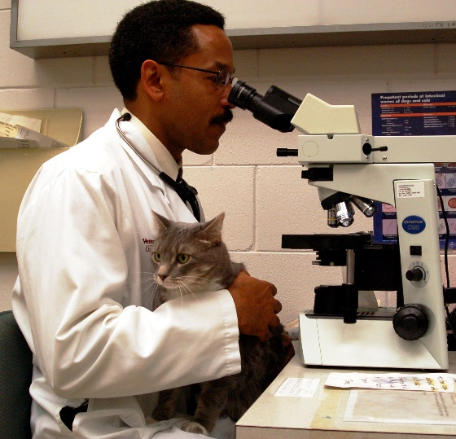
Advocate for the animal – Value the science

