Slide 1
TBI + Coagulopathy
Current Concepts and Controversies
Mr Batchelor
Consultant in Emergency Medicine

Slide 2
TBI + Coagulopathy
DEFINITION

Slide 3
TBI + Coagulopathy
What we know about it

Slide 4
TBI + Coagulopathy
INCIDENCE

Slide 5
TBI + Coagulopathy
Incidence in adults
35.2% (weighted average)
Epstein et al. Injury. 45: 819. 2014

Slide 6
TBI + Coagulopathy
Not related to any specific type of brain injury.

Slide 7
TBI + Coagulopathy
TBI induced coagulopathy is much more common in patients with severe head trauma compared to patients with mild or moderate.

Slide 8
TBI and Coagulopathy
First reports:-
Preston FE et al, 1974.
Goodnight SH et al, 1974.
Keimowitz et al, 1973.
Druskin MS et al, 1972.

Slide 9
Brain Tissue Factor
Drake TA et al demonstrated that brain
tissue contains high levels of Tissue Factor.
Am J Pathol. 134:1087-97. 1989.

Slide 10
Theory of TBI Coagulopathy
Release of Tissue Factor from brain tissue
Keimowitz RM et al
J Neurosurg. 39:178-180. 1973.
Activation of protein C Pathway
Secondary to Hypotension
Brohi K et al. 2007

Slide 11
Facts About TBI + Coagulopathy
Independent Predictor For
Mortality
Poor Outcome
IC Haematoma Progression

Slide 12
Multivariate Logistic Regression:
Prediction For Mortality
Manoel. 2014
Coagulopathy OR =5.61 (CI:2.65 – 11.86)
Greuters. 2011
Coagulopathy OR =3.75 (CI:1.07 – 13.51)
Franschman. 2012
Coagulopathy OR =5.3 (CI:2.1 – 13.4)

Slide 13
Adult Cohort Studies
Author Year N= Inclusion Criteria
Wu 2014 84 GCS < 13 and Positive Head CT scan
Joseph 2014 591 Any GCS level and Positive Head CT scan
Franschman 2012 218 Mod and Severe TBI
Greuters 2011 107 CT post Scan and Extra C (AIS <3)
Lustenberger 2010 278 Severe TBI (AIS >3) and Extra C (AIS <3)
Talving 2009 436 TBI: AIS >3
Carrick 2005 184 Mod and Severe TBI and Extra C (AIS <3)
Hulka 1996 91 All TBI patients with Post CT
Olson 1989 269 All TBI patients with Post CT
Kumura 1987 100 GCS 14-3. All had positive CT scan
and Extra C (AIS <3): extracranial injury less than AIS 3

Slide 14
Adult Cohort Studies
Author %Coag %DIC M M+ Coag M-Coag
Wu 54.3% NG 7.4% 9.1% 5.4%
Joseph 13.4% NG 13% 23% 12%
Franschman 61% NG 32.1% 36.3% 17%
Greuters 24.3% NG 31.8% 56% 26%
Lustenberger 45.7% NG 45.7% 40.9% 5.3%
Talving 36% NG 22% 50.4% 7.1%
Carrick 26% NG 18% 62% 38%
Hulka NG 41% 28.6% 54% 11.1%
Olson NG 7.4% 36% 100%* 55%*
Kumura NG 24% 58% 7% 12%**
M= Mortality %Coag= for the whole cohort
* Subgroup analysis
**Although DIC was less frequent in the non survival group the coagulation parameters were statistically worse
For the non survival group c.f. to the survival group (PT, aPTT, PC, Fibrinogen but not FDP).

Slide 15
TBI + Coagulopathy
Is there a difference between general trauma
induced coagulopathy and coagulopathy
from isolated TBI ?

Slide 16
Comparative Studies
Genét et al. J Neurotrauma. 2013
Compared coagulation profiles between patients with
1. isolated TBI (n=23)
2. TBI + other injuries (n=15)
3. non-TBI (n=42)
Incidence coagulopathy 13%
Extensive Range of coagulation parameters including PC and APC

Slide 17
TBI + Coagulopathy
Genét et al found no significant difference
between the coagulation parameters
between the three groups.

Slide 18
Comparative Studies
Manoel et al. Neurocrit Care. 2014
Also compared three groups of patients
1. isolated TBI (n=48)
2. TBI + other injuries (n=137)
3. non-TBI (n=160)

Slide 19
Comparative Studies
Parameters Measured
INR, aPTT, Platelet Count,
Fibrinogen, D-dimer
Tissue factor, clotting factors
TEG-R, TEG-K, TEG-Alpha, TEG-MA,TEG-Lys30%

Slide 20
TBI + Coagulopathy
Again no significant difference
between groups using the parameters measured including TEG.

Slide 21
TBI + Coagulopathy
Haematoma Progression

Slide 22
The Specific Head Injury Inclusion Criteria
Author Specific Inclusion Criteria
Wu et al¹¹, 2014 GCS < 13 and Positive Head CT scan
Joseph et al¹², 2014 Any GCS level and Positive Head CT scan
Juratli et al¹³, 2014 Any GCS level and Positive Head CT scan
Yuan et al¹³, 2012 Any GCS level and Positive Head CT scan
Allard et al¹⁴, 2009 GCS < 8 Positive Head CT scan
White et al¹⁵, 2009 Any GCS level and Positive Head CT scan
Yadav et al¹⁶, 2008 Any GCS level and Positive Head CT scan
Kaups et al¹⁷, 2004 Severe TBI (AIS >3)
Sanus et al¹⁸, 2004 Any GCS level and Positive Head CT scan
Oertel et al¹⁹, 2002 Any GCS level and Positive Head CT scan
Stein et al²⁰, 1993 GCS < 13
Stein et al²¹, 1992 GCS < 13

Slide 23
The Mean ISS values And Also The Relative Contribution
For The Four Main Types Of Intracranial Bleeding.
Author Mean ISS SDH% EDH% SAH% ICH%
Wu et al¹¹, 2014 NG 48.1 21 53 69.1
Joseph et al¹², 2014 16(median) 49.4 11.4 54 42
Juratli et al¹³, 2014 NG 35.7 20 88.6 NG
Yuan et al¹³, 2012 NG NG NG NG 31
Allard et al¹⁴, 2009 33+ 11 33 11 54 68
White et al¹⁵, 2009 21 NG NG NG NG
Yadav et al¹⁶, 2008 NG 55.6 3.7 NG 17.4
Kaups et al¹⁷, 2004 26 + 11 64 NG NG NG
Sanus et al¹⁸, 2004*** 24.56 14.2 18.3 28.5 19.3
Oertel et al¹⁹, 2002 NG 37 25 58 66
Stein et al²⁰, 1993 29.5 14.1 6 5.4 61
Stein et al²¹, 1992 NG 13.8 6 14.2 67

Slide 24
Coagulation Parameters And Cut-Off Values
Used For Each Study
Author INR PT aPTT Platelet Count CT DD
Wu et al¹¹, 2014 > 1.2 > 40s < 120x10⁹/L NU NU
Joseph et al¹², 2014 > 1.5 > 35s < 100 x 10³/µL NU NU
Juratli et al¹³, 2014 > 1.2 > 36s < 100x10⁹/L NU < 501µg/L
Yuan et al¹³, 2012 > 1.2 > 40s < 100x10⁹/L NU < 0.3mg/L
Allard et al¹⁴, 2009 > 1.2 > 35s < 100x10⁹/L NU NU
White et al¹⁵, 2009 > 1.2 NG NG NU NU
Yadav et al¹⁶, 2008 > 1.5xc > 1.5xc NG NG NU
Kaups et al¹⁷, 2004 OAC NG NG < 100x10⁹/L NU NU
Sanus et al¹⁸, 2004 NG > 14s > 35s < 200x10⁹/L NU NU
Oertel et al¹⁹, 2002 > 11.5s > 33.4s <143,000/mm³ NU NU
Stein et al²⁰, 1993 NG NG NG NU NU
Stein et al²¹, 1992 NG NG NG NU NU

Slide 25
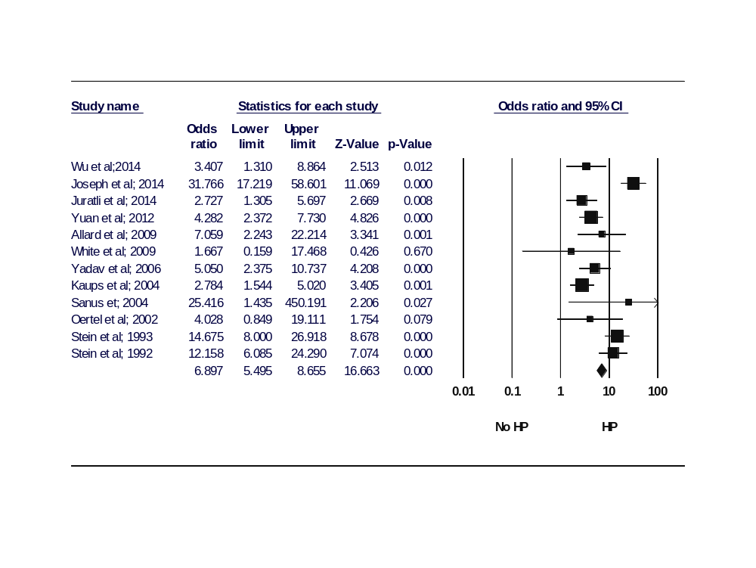
Forest Plot For The 12 Studies

Slide 26
TBI + Coagulopathy
Haematoma Progression. Which is the most important parameter
INR, APTT, DD,Platelet Count.

Slide 27
TBI and Coagulopathy
The percentage contributions of the three parameters is variable however the general pattern is:-
INR and PC appear to be the major components.
aPTT is probably the least important.
D-dimer is frequently raised but not always
clinically significant or specific

Slide 28
Percentage Contributions
Author Year n= %Coag INR aPTT PC DD
Joseph 2014 591 13.4% 6.6% 8.0% 3.6% NG
Wu 2014 82 54.3% 40.9% 9.1% 79.5% NG
Yuan 2012 466 NG 7.5% 3.0% 3.8% 3.8%
Tian 2010 194 NG 3.1% 2.0% 6.7% 43.2%
Lustenberger 2010 127 45.7% 59.8% 49.6% 17.3% NG
Pahatouridis 2010 61 69% 78.6% NG NG 83%
Allard 2009 72 35% 27.7% 6.9% 15.3% NG
Zehtabchi 2008 224 17% 8.4% 2.2% NG NG
Carrick 2005 184 26% 20% 5% 14% NG
Engström 2005 27 NG 11.1% 0% 29.6% NG
Kuo 2004 61 72.1% 6.6% 24.5% 3.3% 59%
Oertel 2002 142 NG 92.9% 91.5% 75% NG
Selladurai 1997 204 NG 78% 67% NG 79%
Hulka 1996 91 41% 25% 20% 0% 70%
Bredbacka 1994 20 NG 35% 40% 50% 90%
Olson 1989 269 NG 22.3% 26.4% 10.7% NG
Cortiana 1986 60 NG 72% 27% 33% NG

Slide 29
Most Predictive For Mortality ?
Joseph (Univariate). 2014
INR . 1.5 OR = 2.3 (CI: 0.9 – 5.8)
aPTT > 35s. OR = 2.8 (CI: 1.6 - 4.3)
PC. 100 x 10³ OR = 5.1. (CI: 1.4 – 8.4
Allard (Univariate). 2009
INR OR = 6.27. (CI: 1.84 – 21.35)
aPTT OR = 2.77. (CI: 0.42 – 18.31)
PC OR = 0.82. (CI: 0.16 – 4.27)
D-dimer OR = 1.019 (1.006 – 1.033)
Schnüriger (Univariate analysis). 2009
Severe TBI subgroup
INR OR = 2.49. (CI: 1.08 – 5.78)
aPTT OR = 9.09. (CI: 2.82 – 29.41)
PC OR = 9.52. (CI: 1.26 – 71.43)

Slide 30
Most Predictive For HPI ?
Chang EF. 2006
PC. 100 x 10³ OR <1 p=0.322
INR . 1.5 OR = 2.1 (CI: 1.11 – 4.85)
aPTT > 35s. OR = 3.19 (CI: 1.11 – 11.2)
Juratli 2014 (multivariate)
INR OR = 1.96. (CI: 0.42 – 9.08)
aPTT OR = 1.09. (CI: 0.15 – 7.83)
PC OR = 5.78. (CI: 0.97 – 33.51)
D-dimer OR = 1.12 (0.29 – 4.36)

Slide 31
Most Predictive For HPI ?
Yuan 2012 (Multivariate)
INR OR = 3.53. (CI: 1.47 – 8.50)
PC OR = 6.53. (CI: 1.50 – 28.45)
D-dimer OR = 9.95 (2.31 – 42.84)
Tian 2010 (Binary LR)
PC OR = 4.247. (CI: 1.095 – 37.826)
Fg OR = 3.209 (CI: 1.318 -7.811)
D-dimer OR = 11.850 (5.672 – 24.758)

Slide 32
Temporal Patterns
Early < 12 Hours
Mild Abnormalities (1 or more clotting factors)
[Mild abnormalities often transient (resolve 24 hours),
but may progress to moderate or severe]
Moderate –variable duration
Severe-often with DIC

Slide 33
Temporal Patterns
12-24 Hours
Mild/ Moderate/severe
Delayed (1-5 Days)
Mild/ Moderate/severe

Slide 34
Temporal Patterns
Franschman et al. 2012
41% no coagulopathy.
10% Early transient coagulation abnormalities.
20% Developed delayed coagulopathy.
29% Early sustained coagulopathy.

Slide 35
Temporal Patterns
Lustenberger et al. 2010
64.6% of coagulopathic episodes last > 24 hours
29.9% of coagulopathic episodes last > 72 hours

Slide 36
Temporal Patterns
No individual clotting factor is predictive
of progression from mild to severe disease

Slide 37
sTBI + Coagulopathy in the Pediatric Population
Reported Incidence
15% - 87%

Slide 38
sTBI + Coagulopathy in the Pediatric Population
Clinical Facts
1.Independent predictor of Mortality
2.Poor Outcome
3.Haematoma progression
4.DIC + sTBI significantly increases mortality

Slide 39
Paediatric Cohort Studies
Author Year N= Inclusion Criteria
Peiniger 2012 200 severe TBI (AIS >3) OI* (AIS <3)
Talving 2011 320 severe TBI (AIS >3) OI* (AIS <3)
Vavilala 2001 69 Median GCS =8 (range 3-15)
Chiaretti 2001 60 45% Severe head injury 46.% OI*
Hymel 1997 147 Any level of injury
Miner et al. 1982 87 42.5% Severe head injury. 59% OI*
OI*= Other Injuries

Slide 40
Paediatric Cohort Studies
Author %Coag %DIC M M+ Coag M-Coag
Talving 42.8% NG 7.8% 17.5% 0.5%
Peiniger 28.0% NG 13.5% 51.6%** 5%**
Vavilala NG NG NG NG NG
Chiaretti NG 10%* 18.3% 100%(DIC) 14.3*
Miner et al. NG 32% 25.0% 54%(DIC) 12%
Hymel NG NG 21.5% 50% 11.2%
M= Mortality %Coag= for the whole cohort
M+Coag= Mortality in patients with at least one abnormal coagulation parameters
M-Coag= Mortality in patients with no coagulation parameters
*22.2% of children with severe TBI had DIC. All children with DIC (n=6) had severe TBI and all died
**Refers to the mortality in the severe TBI group

Slide 41
%Contribution PT, aPTT, PC
Author Year n= %Coag INR aPTT PC DD
Peiniger 2012 150 28% 81% 52% 24% NG
Talving 2011 320 42.8% 40.9% 20.9% 7.2% NG
Vavilala 2001 69 NG 20.2% 15.9% 4.3% 63.7%
Chiaretti 2001 60 NG 33.3% 16.7% 8.3% 16.7%
Hymel 1997 101 NG 54% 24% 1% NG
Miner 1982 37 87% 50% 44% 13% NG

Slide 42
sTBI + Coagulopathy in the Pediatric Population
Study by Talving et al. 2011
Retrospective Cohort 320 children with sTBI
Mean ISS = 15
Incidence Coagulopathy 42.8%

Slide 43
Study by Talving et al. 2011
0-3yrs 4-6yrs 13-17yrs
Coagulopathy 26%(13/50) 43.8%(14/32) 50.7%(76/150)
INR >1.2 26%(13/50) 37.5%(12/32) 49.3%(74/150)
aPTT > 36s 18%(9/50) 28.1(9/32) 23.3%(35/150)
Platelets < 100 2.0%(1/50) 3.1%(1/32) 10.0%(15/150)
Incidence coagulopathy may be less in infancy
Thrombocytopenia less of a feature

Slide 44
Thrombocytopenia in TBI
Why does thrombocytopenia occur
in TBI Coagulopathy ?

Slide 45
Thrombocytopenia in TBI
Stein et al, 2004 - Fatal TBI
Stein et al, 2002 - Fatal TBI and Pig Model
Maeda et al, 1997 – Rat Model
Kaufman et al, 1984 - Fatal TBI
Coccheri et al, 1975 - Fatal TBI
All five groups noted cerebral intravascular thrombus.

Slide 46
Thrombocytopenia in TBI
More recent work has not added much.
Nekludov M et al. 2014. J Neurotrauma
Noted circulating microparticles within
the cerebral vessels in TBI.

Slide 47
Platelet Dysfunction
Platelet dsyfunction has been shown to occur
early in patients with isolated TBI.
(Davies PK et al, Neurocritical Care 18(2): 201-8. 2012)
Platelet dysfunction occurs in the absence of hypotension
therefore is a distinctive to the platelet dysfunction which occurs
in patients with non cranial trauma major trauma.
(Castellino FJ et al. J Trauma, Acute Care Surgery. 76:1169. 2014)

Slide 48
Platelet Dysfunction
The degree of Platelet dysfunction does correlate
with the degree of brain injury but not with platelet
count where the correlation appears poor.
(Castellino FJ et al. J Trauma, Acute Care Surgery. 76:1169. 2014)

Slide 49
Platelet Dysfunction
Lippi G et al, 2013
Blood Coag Fibrinolysis. 27(7): 780.2013
Compared platelet count and plated volume of 54 patients
with MTB versus 339 blood donors.
Both the platelet count and MPV (mean platelet volume) was
significantly reduced in patients with MTB and positive CT head
compared to healthy controls.

Slide 50
TBI and Thrombocytopenia
Subclinical thrombocytopenia in TBI may be
more common than previously appreciated.

Slide 51
TBI + Coagulopathy
1.Separate entity from coagulopathy of
extra-cranial trauma and shock.
2.Trigger mechanisms unclear ? TF

Slide 52
TBI and Coagulopathy
From a clinical perspective although abnormalities of clotting factors are fairly common, bleeding during neurosurgery is rarely a problem with mild derangements of INR or APTT.

Slide 53
TBI and Coagulopathy
Correction of mildly deranged INR levels
is often ineffective when FFP is used.
Optimal management of these patients is unclear

Slide 54
TBI and Coagulopathy
Future Research: Goal directed strategies
Transfusion of platelets for platelet
counts < 100,000 may to too low.
Transfusion of platelets for evidence of
severe platelet dsyfunction
Role of TXA unclear

Slide 55
TBI + Coagulopathy
Any Questions ?

