Slide 1


RebelBio
John Carrigan
CSO
RebelBio
@RebelBio
john.carrigan@sosv.com
Notes:
RebelBio is an innovation engine to accelerate and de-risk science, to change the world, build the future - with life itself

Slide 2
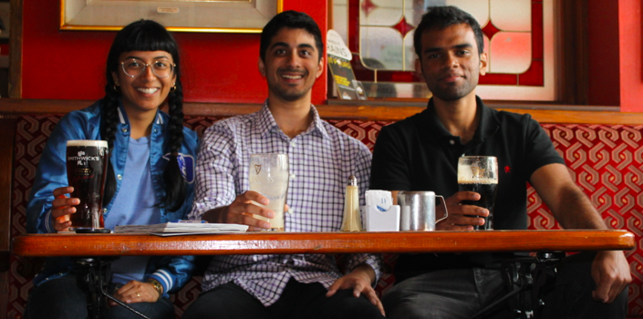
Well made business model ??
Notes:
RebelBio is an innovation engine - and we add rocket fuel to that fire!

Slide 3










#1 most active investor for female founders
#1 Most active early-stage investor globally
#1 most active life sciences investor

Slide 4
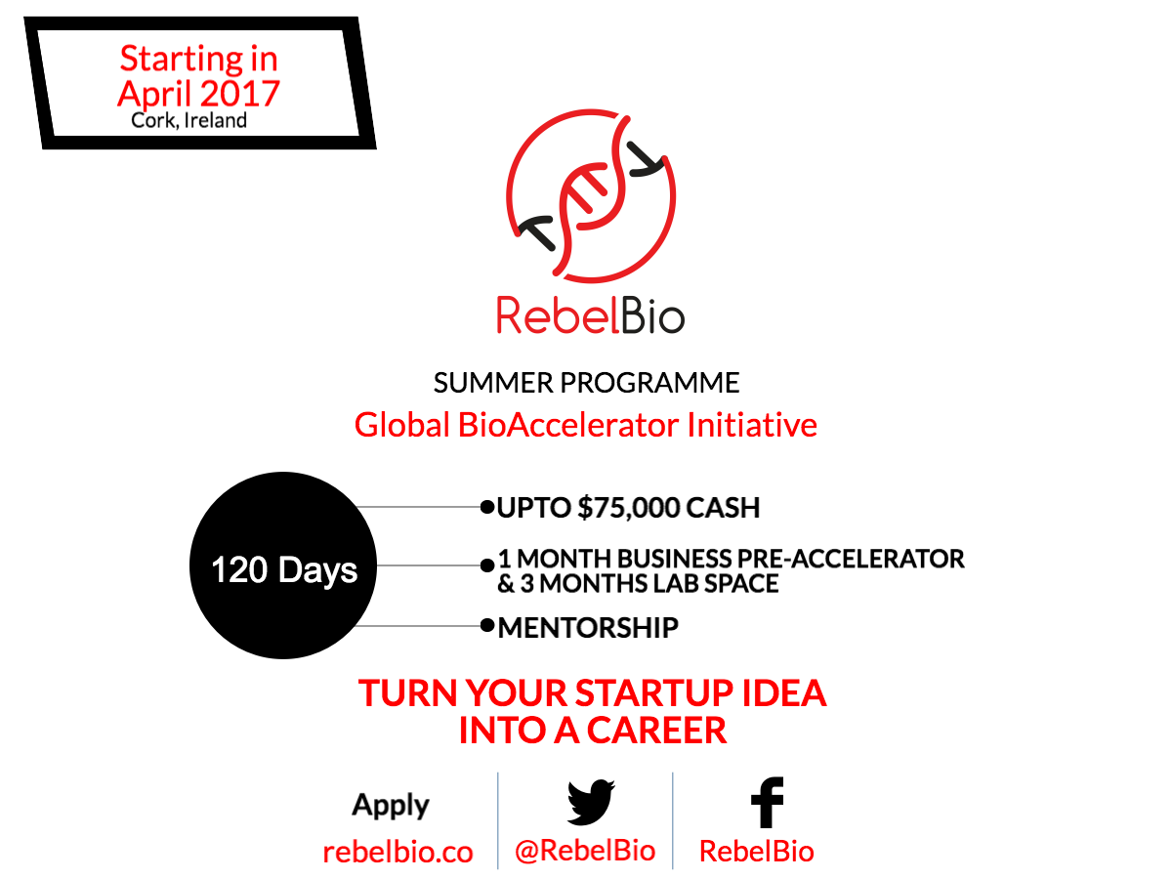
Notes:
Steve Jobs, one of the greatest rebels, saw the revolution coming. And if we look at what's happening in biology -this is spot on!

Slide 5
RebelBio is….
A VC backed biotech accelerator
Managed by independently successful serial entrepreneurs
Also staffed by scientists
A hive mind
Founder (not just company!) friendly

Slide 6
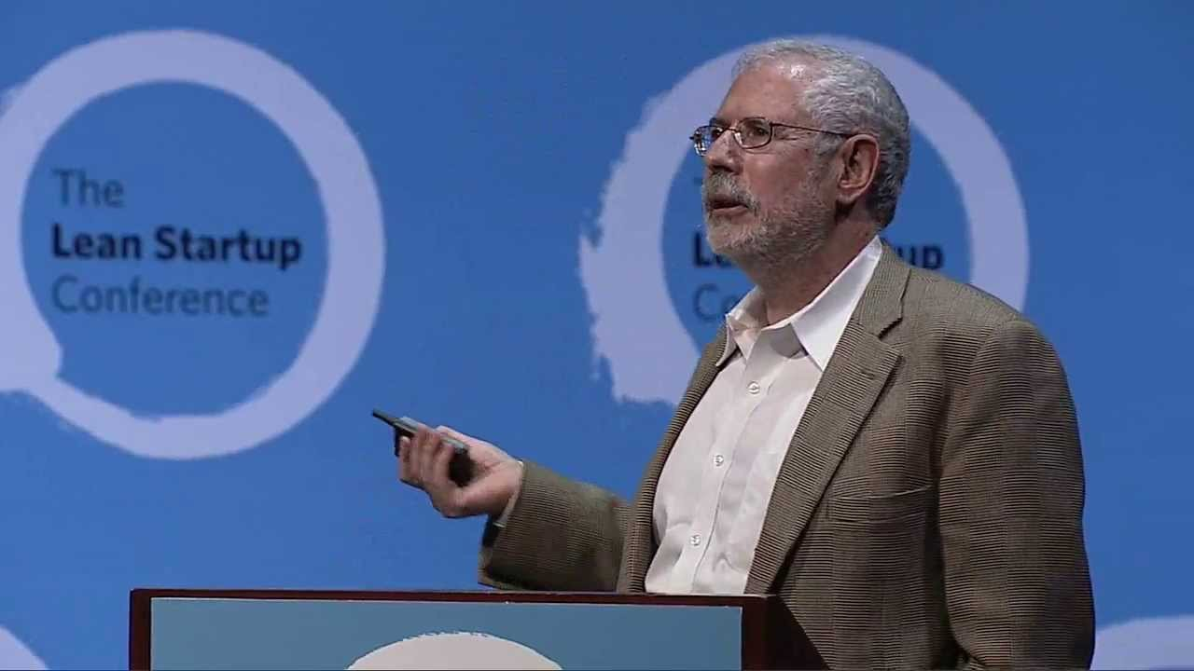
Scientists are horrible at commercialisation…Steven Blank (Commenting on the SBIR)
Notes:
Steve Jobs, one of the greatest rebels, saw the revolution coming. And if we look at what's happening in biology -this is spot on!

Slide 7
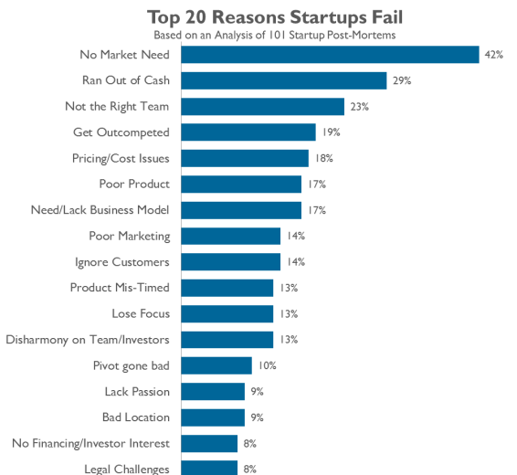

Slide 8
RebelBio is….
For those who want to commercialise a product or an idea
For those who want to become functioning entrepreneurs
For those who want to make a difference to the world
Notes:
Steve Jobs, one of the greatest rebels, saw the revolution coming. And if we look at what's happening in biology -this is spot on!

Slide 9

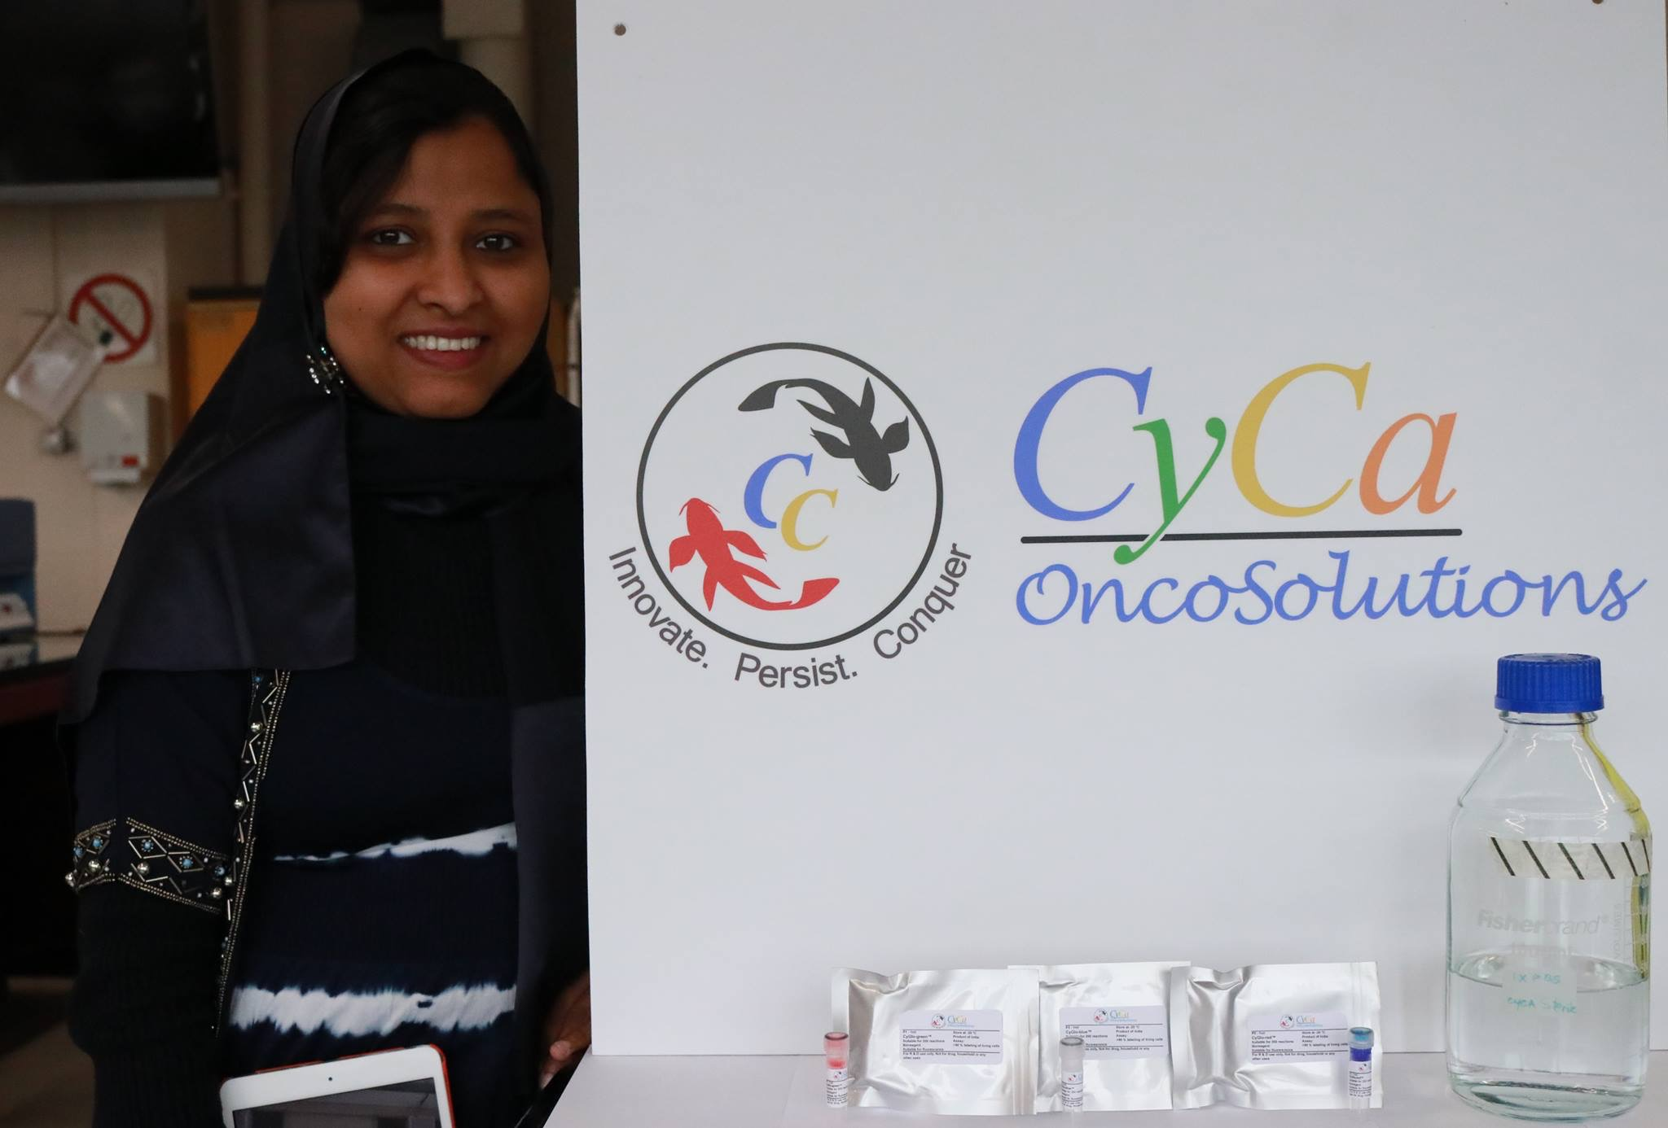
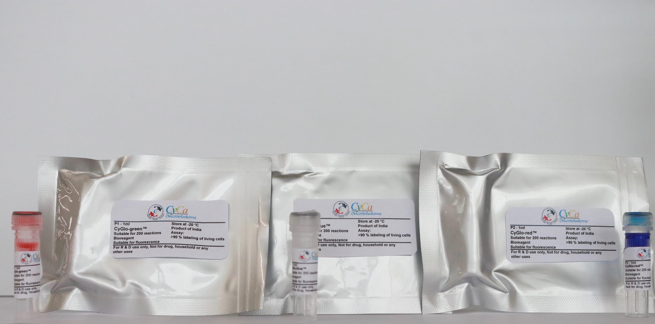
RebelBio is….looking for Postdocs

Slide 10


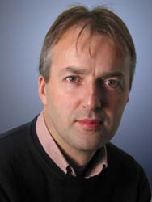
RebelBio is….looking for academic teams

Slide 11

RebelBio is….looking for PhDs

Slide 12
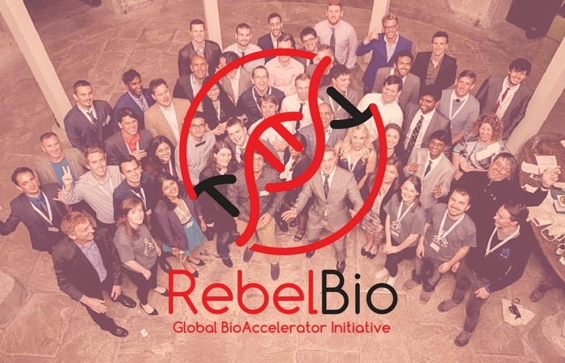
ITS NEVER TOO EARLY TO TALK TO US!!
@RebelBio
RebelBio
john.carrigan@sosv.com
@CarrigJB
@CarrigJB
Notes:
RebelBio is the Innovation Engine. Where we pursue big dreams and have a factory to accelerate its course.
When did we stop dreaming? Picasso – al children are artists. Dreamers, inventors, astronauts, reaching for the stars. Rebellious against the status quo, disobedience to change the world for the better. Ghandi, King, DaVinci, Tesla, Curie, Musk, Jobs.
We’re the rebels and the dreamers and the bio-makers, we’re RebelBio.

