Slide 1
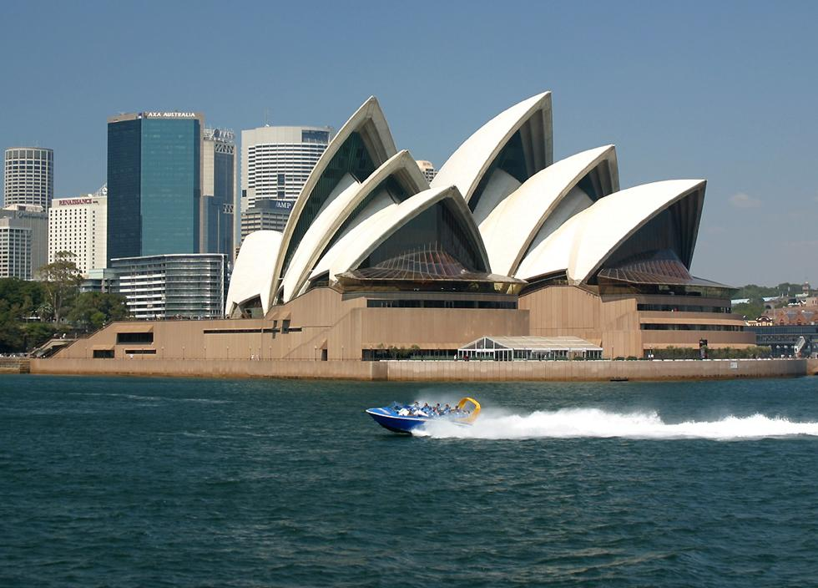
Oral Pathology and Clinical Physiology – ‘New Horizons’
The Dental-Systemic Disease Connection Conundrum: Improved Management Through Understanding
John Loudon Ph.D. - perfectly happy dentist ☺
Sydney NSW Australia
[jon.uk1515@gmail.com]

Slide 2
British born and part education = don,t hold that too much against me though ☺
Sydney University trained – BDS
America specialty-
Prof Carl Allen – Oral Pathology- OSU Ohio
HQ Sydney Australia ☺ (my favourite city favourite country ☺

Slide 3
Outline - 1
Introducing Amlexanox – flagship drug of my collaboration - a dental drug – Aphthous ulcer management
Amlexanox properties
Related compounds: Resveratrol, Rebamipide, Luteolin
Selected current researches

Slide 4
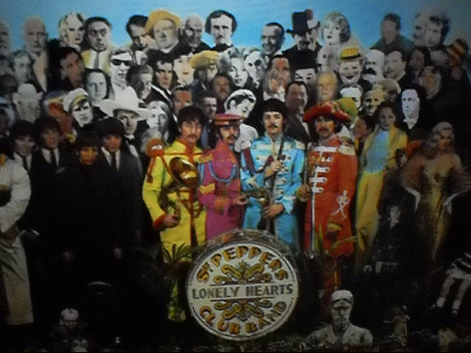

Thank you!
The sun never sets on the amlexanox
Empire!
Australia: Prof John Christodoulou, Genetics Unit, Children’s hospital, Westmead; Prof Helen Leonard, Telethon Inst. Perth.
US: Prof Andy South, Thomas Jefferson University, Philadelphia; Prof Richard Gatti, UCLA; Prof Lawrence Gardner, New York University, NY; Mr PC’s family with CF, Palo Alto Ca.
GB: Prof Mike Cheetham, UCL, London
France: Dr Terence Beghyn, INSERM Lille & Apte=s
Japan: Prof Takeshi Iwata; Tokyo Medical Center
India: Dr Utkarsh Raj, Indian Institute of Information
Technology, Allahabad, India
Dr Ruben Agrelo, Montevideo & Madrid

Slide 5
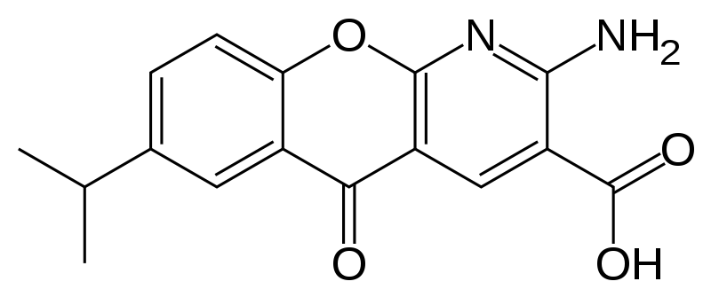
Enter – Amlexanox – carries the ‘chromone’ nucleus – a lipophilic compound - synthetic
Chromone nucleus

Slide 6
Pharmacokinetics – safety
50mg dose – post meal – unchanged serum drug level 1 hr = 2.69microg/ml peak (Cmax)
Cmax = ~ 9microM – so blood levels in microM range *******
Half life = 2(1/2) hr
Metabolite – hydroxide = removal per kidney

Slide 7
Properties
Translational readthrough
Mast cell targeting – like IntalTM
Targets inflammatory kinases TBK1 Ikkepsilon – modulators of the key transcriptional inflammatory regulator NF-kappaB

Slide 8
Readthrough - restoration of protein function via insertion of amino acid at PTC – nonsense mutation
normal end of coding sequence stop mutations respected;
reason = sequence context

Slide 9
Example – Cystic Fibrosis – collaborator project - France/Israel
Trp1282stop CFTR mutation

Slide 10
EpithelixTM MucilAirTM Biopsy-driven system (Trp1282*) – Amlexanox
Recovery of CFTR function ~5-10%
Sufficient to alter phenotype – rule of readthrough = a little goes a looooooong way!
To clinical trials 2016 Israel

Slide 11
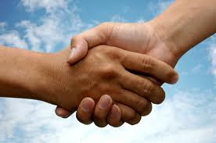
Structure-function relationship

Slide 12
Full length proteins = (?) functionality

Slide 13
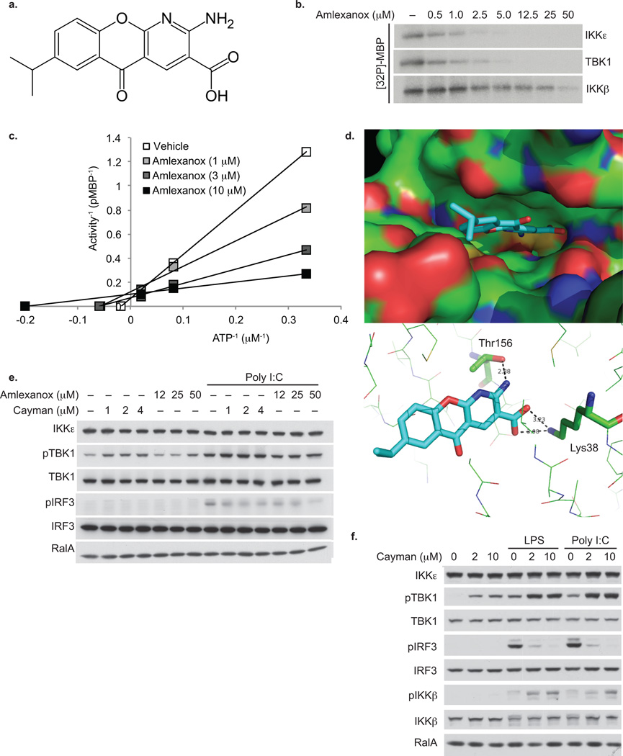
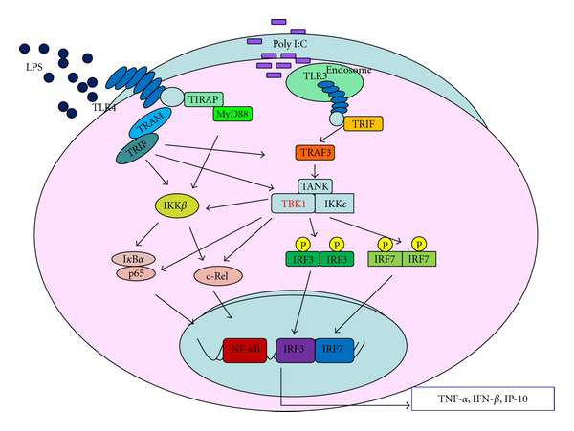
Amlexanox – inflammation targeting
Targets the inflammation/oncokinases
TBK1 – Ikkepsilon - microM range of effective inhibition (IC50 = 1-2microM)
TBK1/ikkepsilon – activate key proinflammatory transcriptional factor: NF-kappaB
Discovered by Reilly et al. 2013 Nature Med

Slide 14

Amlexanox Human trial = positive on target effect: TBK1 and ikkepsilon in vivo
Reilly et al 2015 Nat Commun
Tackles human insulin resistance
Merged to 150mg dose per day – 12 weeks

Slide 15
Application – with my ‘Amlexanox’ collaboration

Slide 16
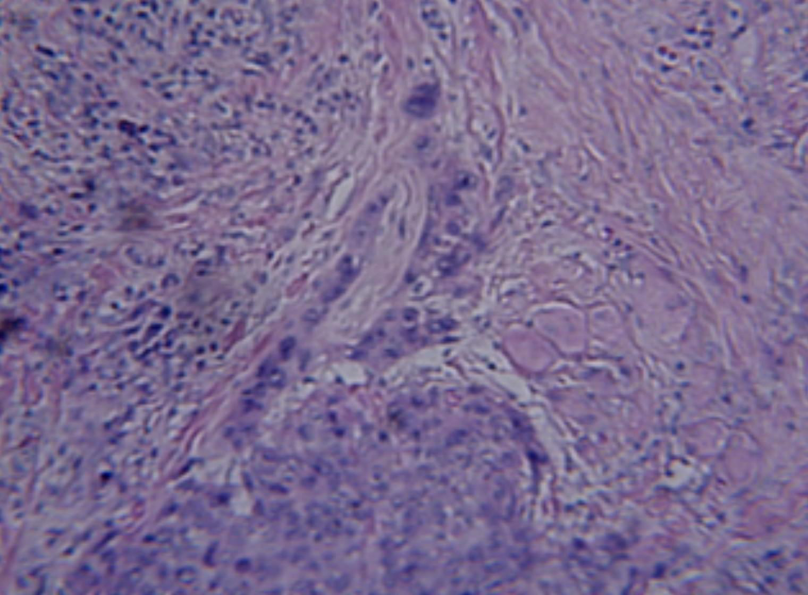
invasive ‘tongue’ /front of oral squamous cell carcinoma - taken by Celestron LCD digital microscope #44340 400x (original H and E section – courtesy The Ohio State University Dental Pathology Service )

Slide 17
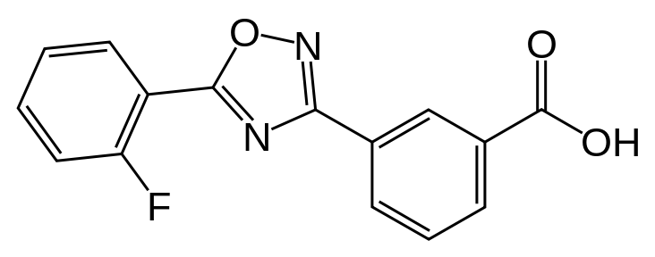
Readthrough for cancer –
Oncol Res 2010 - jl
My initial proposal; J Loudon Oncol Res 2010
‘rescuing’ tumour suppressor PTC (nonsense mutations) by readthrough
Only available drugs were the aminoglycosides (natural produced antibiotics) and recently discovered reafthrough agent Ataluren:
`

Slide 18
Tp53 nonsense mutations mouth cancers total = 15 – eg=
Position 342
Mutation c.1024C>T
Mutation (Amino Acid) p.R342*
Mutation Type Substitution
nonsense

Slide 19
THE CANCER STORY – in vivo proof of concept
Restoration of APC gene function in colonic cancer cells by aminoglycoside- and macrolide-induced read-through of premature termination codons
Alona Zilberberg, Lital Lahav, Rina Rosin-Arbesfeld
Gut 2010;59:496e507. doi:10.1136/gut.2008.169805

Slide 20
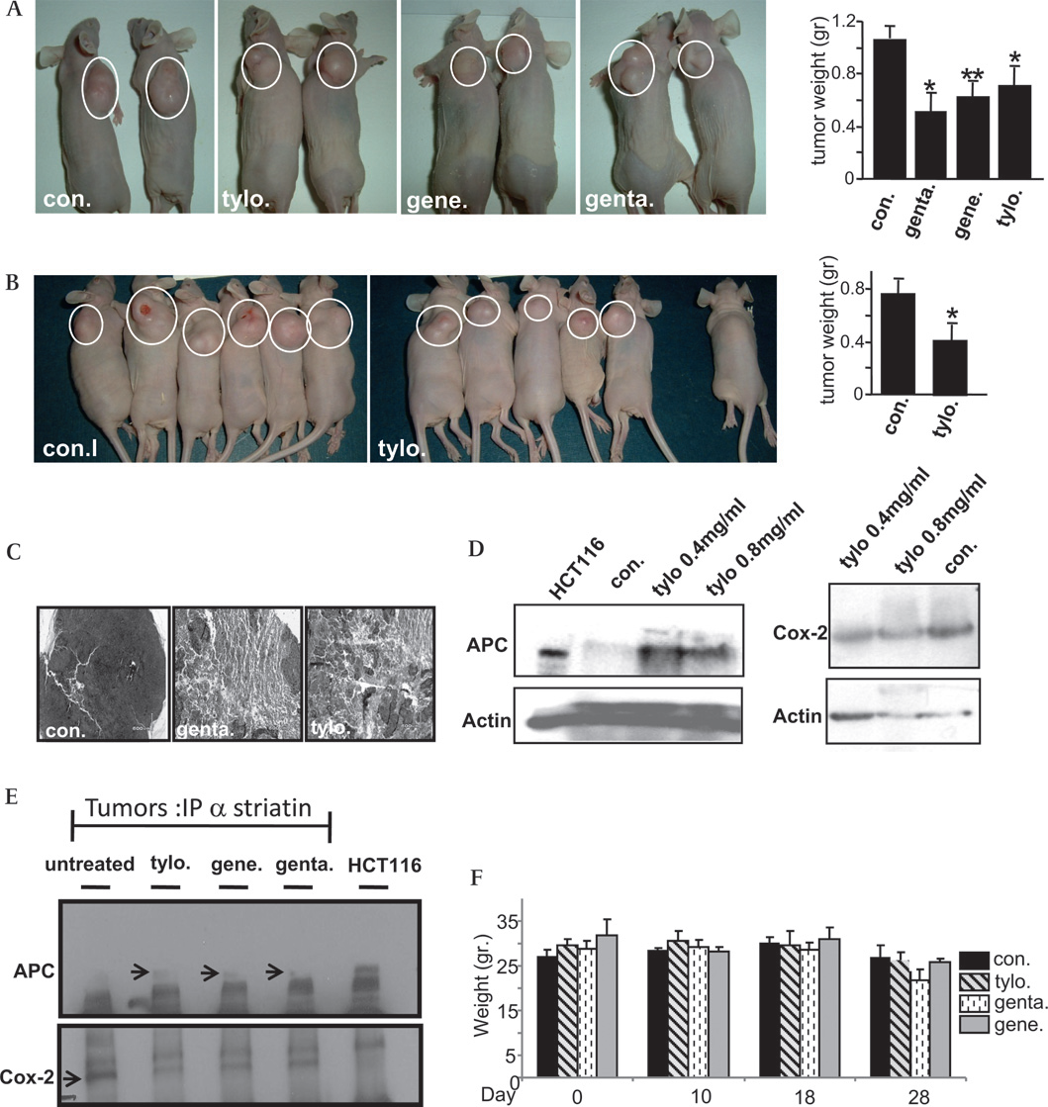
Gentamicin – effective in vivo
Red arrow = control (APC blocked – ‘red light’
Green arrow = test – APC given the - ‘green light ‘ – readthrough to full length TS – rescue to WT)

Slide 21
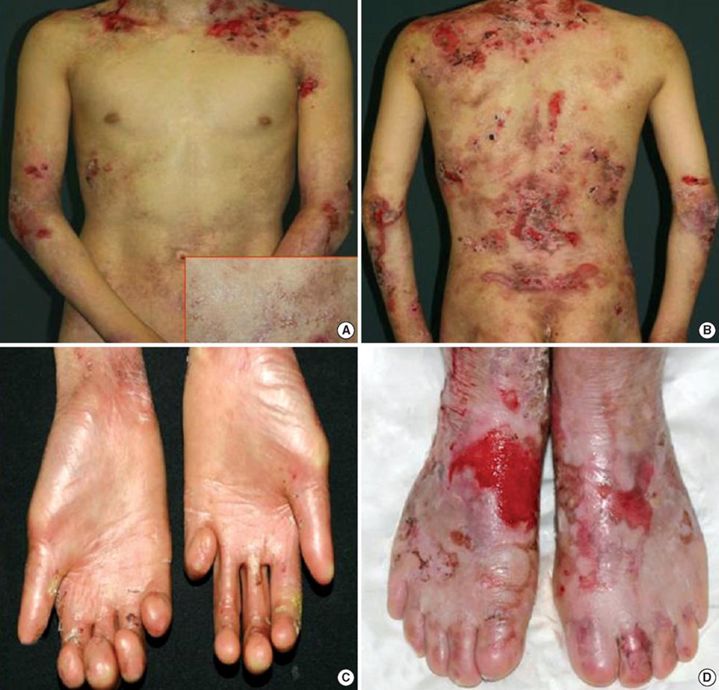
RDEB recessive dystrophic epidermolysis bullosa
Precancerous skin disease
Defect Collagen VII – epidermal incoherence
High morbidity and mortality
Not infrequent nonsense mutational cause
NMD active
Thomas Jefferson introduced to Amlexanox in 2014

Slide 22
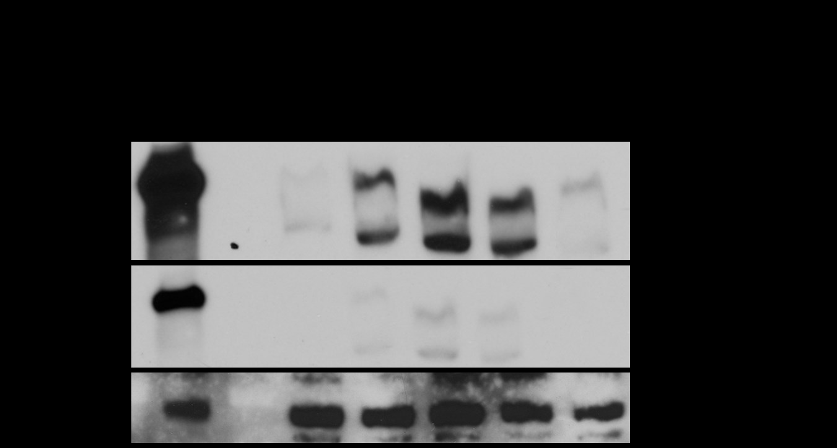
Treatment with amlexanox for 48h induces COlVII protein ex-pression in RDEB keratinocytes compared to non treated control (NT). The data show amlexanox to be more efficient at read through PTC as compared to gentamicin
Amlexanox
Gen

Slide 23
Lawrence Gardner, New York: Gardner laboratory - Cancer Res 2014
Introduced to Amlexanox in 2014 - keen to pursue as long history of acceptance
Comment: “I can see we’re on the same page for NMD inhibition/read through as cancer therapy!”

Slide 24
Oncokinases
Li et al 2014 Int J Cancer
“Selective TBK1/Ikki dual inhibitors with anti-cancer potency”
Three synthetic inhibitors to kinases (oncoKinases inhibit cancer cells: mammary carcinoma/mouth cancers.
SCC-9 human mouth cancer n nu/nu xenograft mouse model inhibited by dual oncokinase small molecular agent targeting
In vivo studies with human cancer model in mouse shows marked cancer inhibition
Novel way ahead for human cancer therapeutics

Slide 25
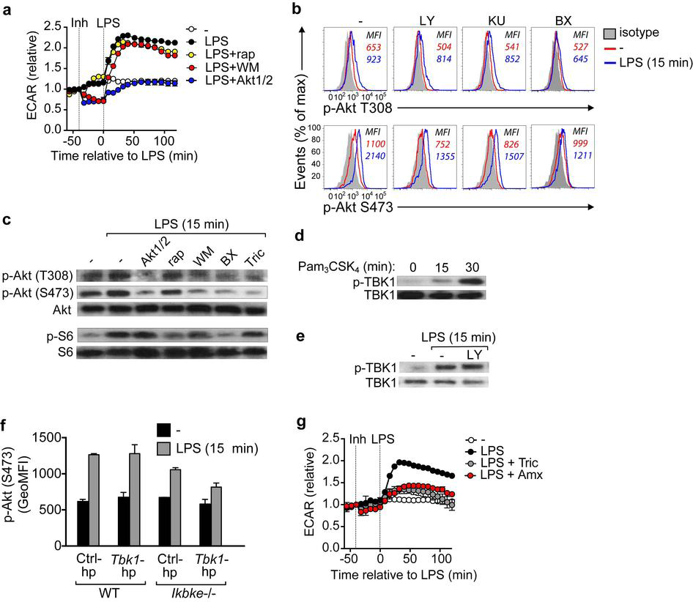
Amlexanox – a potent inhibitor of oncoKinases
(from studies in immunology – Everts et al 2014)

Slide 26
Conclusion = Amlexanox may be now readily repurposed as a broad oncoKinase inhibitor thus controling the dysregulated inflammatory response resulting in cancer cell growth/survival

Slide 27
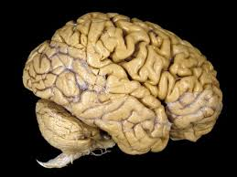
Neurology
Readthrough – genetic diseases/cancer/senses/
intelligence
Neuroinflammation – neurodegenerative diseases/intelligence/genetic diseases

Slide 28
Rett syndrome – devastating, neurodevelopmental - very complex genetic disease
MECP2 gene involved – methyl CpG binding protein – needed for correct neural development – both silences and activates coordinated genetic programmes –
X linked
In girls – mental incapacitation developing from early age – males do not survive
Attention behavour speech decline
Overtaps with Autism in phenotype

Slide 29
Clues from Nature - related flavonol Luteolin
Microglial cells rely on metabolic glycolytic reprogramming reflected by ECAR for activation on LPS stimulus J Neurosci Res 2014
Luteolin – a chromone compound, natural flavonol - Targets TBK1
Luteolin improves Rett phenotype in mouse and improves Autism spectrum disorders in human - Luteolin concluded to block microglia and mast cell activation [NeuroProtekTM] J Neuroimmunol 2015
Pathways are coincident with Amlexanox matching chemical structural features
Amlexanox predicted to work in a similar way in vivo
Long track record of safety and pharmacokinetics place Amlexanox ahead of GRAS compounds

Slide 30
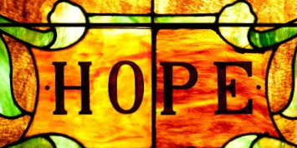
Clinical Trial – Amlexanox and Rett – Mexico
One helps or saves one person one helps or saves the World
- proverb from ancient Levant
Commenced January 8th 2015
4 year old girl with deteriorating Rett syndrome
Dose 150mg 50mg 3 x day SolfaTM Tablets -Takeda Japan
Increased dose to 300mg per day in July
After 8 weeks – “blinded” team of examiners noted imrpovements in speech/attention at her Special School
At late June, condition stabilised
Long term trial
So far, so good – all toxicology nil side effects (PSG EEG blood screening)

Slide 31
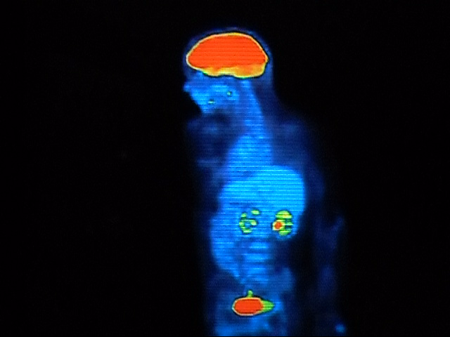
Biodistribution?
Cross BBB?
Dr Iwata Tokyo, examining Amlexanox in mouse models of glaucoma – assess ability to cross into CNS
Label like PET FDG radioisotopic means ???

Slide 32

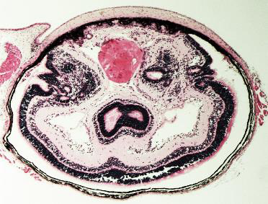
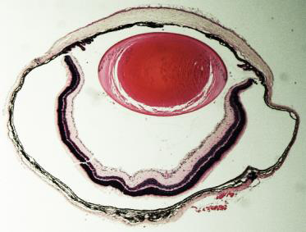
A
B
A = untreated Pax6
B = treated Pax6
Postnatal pups – daily subcutaneous injections of an aqueous solution of Gentamicin
Malformations of retina lens and cornea are normalised compared to untreated controls

Slide 33
UCL London – Dr Mike Cheetham
Retimitis pigmentosa – complex genetic degenerative eye disease
Many cases nonsense mutational linked – eg RP2 gene – X-linked so males often involved
UCL has already shown aminoglycosides and Ataluren rescues the defect in iPSC retinal derived patient cells - cellular phenotype reversed
Clinical application = VAST
Now – testing Amlexanox
ElicsTM – eye drops already clinically used for allergic conjunivitis (Japan)

Slide 34
Finally Werner Syndrome as a human ageing model
WRN nonsense mutated protein results in ML issues – epigenetics, telomeric stability, replication
Madrid trial n= 1 this yr with Amlexanox = standard dose

Slide 35
Ebola - Amlexanox
Many aspects here
Direct anti-viral (University Allahabad)
Targets host viral activating ‘machinery’ – TBK1/Ikkepsilon
Targets destructive host reaction – model is
GB virus C – Nature shows the ‘answer’

Slide 36
Other compounds -
Related compounds: target TBK1 and mast cells
Resveratrol – red wine - neuroprotective - GRAS
Rebamipide – not FDA approved
luteolin – GRAS
– not tested for readthrough

Slide 37
Part - 2
systemic manifestations of dental disease
The Paradox
The inflammatory homeostatic model - explaining the conundrum
Cardiology and neurology - applications
Use of Amlexanox to target dysregulated inflammatory response

Slide 38
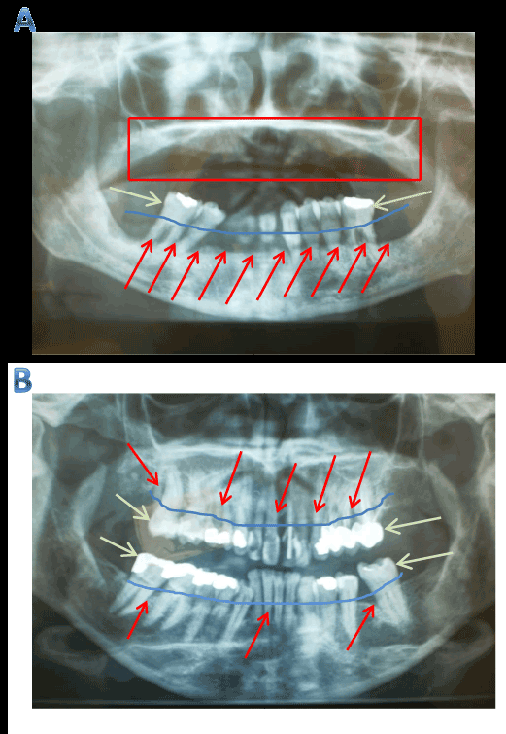

Slide 39

Dietrich et al J Periodontol –
2013 – The epidemiological evidence behind the association between periodontitis and incident atherosclerotic cardiovascular disease
----there is lacking evidence for relation between periodontal disease and incidence of secondary cardio-vascular events.
Cardiology/Neurology

Slide 40
Lockhart et al 2012 Circulation – quoted Evid Based Dent 2015
“In the meantime, statements that imply a causative association between PD and specific ASVD events or claim that therapeutic interventions may be useful on the basis of that assumption are unwarranted”

Slide 41
Background – cause vs association
Association
Bert
Christopher
Ann
Cause-effect
Cause-effect

Slide 42
Causal vs associations
Periodontal inflammation
C
Cardiac/cerebral ‘events’
B
Atheroma
A

Slide 43
Firstly, what is heart disease?
CAD alone? – if so, then PD and CAD – atheroma – yes, causal evidence
When does someone seek medical opinion?
Routine echocardiogram and workup not common – maybe high lipid profile with risk factor, obesity, diabetes family history (+++)….
Pain/shortness of breath/other symptoms

Slide 44
So, if PD may relate to atheroma and atheroma relates to ‘events’ – but why PD does not relate to ‘events’?
= somewhat of a paradox-conundrum

Slide 45
Track specifics – ‘events’ – myocardial damage or CNS damage or PVD – kidney et cetera organ damage - cell loss = a failure in cytoprotection

Slide 46
Inflammatory homeostasis model - J Loudon 2013 Jnl Bioanalysis Medicine the design of the body to deal with inflammation – we need inflammation to target microbial ‘attack’ but side effects of inflammation/infection need to be countered

Slide 47
LPS – TNF – il-6 – CRP = all products of inflammed periodontium – markers of systemic inflammatory burden

Slide 48
But – ? significance
Sukhija R et al Am J Cardiol 2007
States: “…we hypothesized that an increase in serum markers of inflammation (hs-CRP,il-6, and TNFalpha) might correlate with major adverse cardiac events(MACEs).”
MACE = MI/mortality/interventional revascularisation
Longitudinal prospective cohort – all patients admitted had acute chest pain c/w cardiac origin - 6 months study
Adjusted for CAD risk = age/gender/diabetes/HTN/smoking/cholesterol

Slide 49
Found
“There was no significant positive association between MACEs and hs-CRP, il-6, TNF in adjusted and unadjusted models.”
“In conclusion, in patients hospitalised with chest pain, we found no association of serum levels of hs-CRP, il-6 or TNF with …. MACEs at 6 months after adjustment for traditional CAD risk factors.”

Slide 50
Examples – LPS – heart
Yuan et al 2009 Am J physiol Heart Circ Physiol
LPS-induced autophagy is mediated by oxidative signaling in cardiomyocytes and is associated with cytoprotection –
autophagy is increased on exposure to LPS or TNFalpha
A reactive cytoprotective response

Slide 51
LPS – Heart cont.
Fan et al J Periodontal Res 2010
Preconditioning with Porphyromonas gingivalis LPS may confer cardioprotection and improve recovery of the electrically induced intracellular calcium transient during ischemia and reperfusion.
At 0.5 mg/kg in animal models P gingivalis LPS confers cardioprotection against I/R injury and improves cardiomyocyte contractile recovery
LPS = a therapeutic ☺

Slide 52
LPS and neuroprotection –
Xie et al Cell Mol Neurobiol 2015
LPS-primed release of HMGB-1 from cortical astrocytes is modulated tbrough PI3k/Akt pathway.
‘….flexible roles of astrocytes in mediating LPS-primed neuroprotection…”
LPS preconditioning – as a therapeutic in the context of neurology
LPS – neurology

Slide 53
TNF – heart
TNF – classic proinflammatory cytokine
The cytoprotective effects of tumour necrosis factor are conveyed through tumour necrosis factor receptor-associated factor 2 in the heart. Burchfield et al 2010 Circ Heart Fail
‘…these results suggest that TNF confers cytoprotection in the heart through TRAF2-mediated activation of nuclear factor-kappaB.”
NF-kappaB = a major prosurvival cancer prosurvival path

Slide 54
TNF and neurology
TNF and brain – Figiel 2008 Acta
Neurobiol Exp (Wars)
TNF-alpha as a neuroprotective
agent in the brain.
Volga et al J Neurochem 2008
TNF-alpha mediates neuroprotection against glutamate-induced excitotoxicity via NF-kappaB
Again, the prosurvival cancer NF-kappaB pathway.

Slide 55
Il-6 and heart
Fahmi et al Cell Signal. 2013
“…Erk1/2 and PI3k activation by il-6 are both necessary and sufficient for induced cardioprotection.”

Slide 56
Il-6 and neurology
Feng et al 2015 Exp Ther Med
Il-=6 in animal model of ischaemia is neuroprotective – inhibits neural apoptosis
Multiple mechanisms
Prosurvival cancer paths
Downtuning TNF production
Supports BBB
Proposed use as a therapeutic

Slide 57
Other risk factors in your patients – obesity
Obesity ‘epidemic’ – diabetes related
Fat tissue produces cytokines = adipokines
These are both neuro and cardiocytoprotective
For example: Visfatin
Neuroprotective to ischaemic insult –
CNS Neurosci Ther 2014
Cardioprotective: J Cell Physiol 2013 –
The adipocytokine visfatin protects against induced myocardial cell damage - a missing link between obesity and cardiovascular disease

Slide 58
Context - Diabetes
Periodontal inflammation
C
Cardiac/cerebral ‘events’
B
Atheroma
A

Slide 59
Diabetes
Alteration in cellular metabolism – more reliance on mitochondrial energy generation – glycolysis down - fatty acid use increase - REDOX challenge on cell physiology – damaging
Glycolysis is a cytoprotective feature
Inflammatory cytokines stimulate glucose uptake and glycolysis but reduce glucose oxidation (TCA cycle -mitochondrion) is reduced. For example - TNF appearing in the ciruclation on sepsis/inflammation – Circ Shock 1992
Seems to be countering (homeostasis) metabolic challehges

Slide 60
Inflammatory homeostasis
Periodontal inflammation
C
Cardiac/cerebral ‘events’
B
Atheroma
A

Slide 61
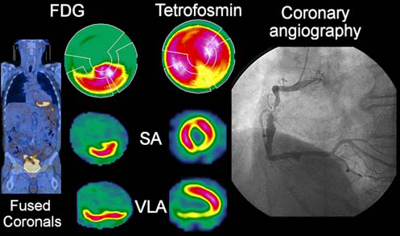
Glycolysis – cytoprotective – cross roads of pathology and physiology – J Loudon Oncol Res 2011

Slide 62
Interpretation of the ‘cross roads’
J Loudon CardioVasc Drugs Ther 2014
Cancer pathways are cytoprotective in the physiology context – as demonstrated for inflammatory cytokines
Biomarkers for cancer align with cardiac-neural markers of cytoprotection – risk assessment
Both sides of the cross roads predict each other - ‘crystal ball effect’
Too much of a good thing = a bad thing – excess prosurvival stimulus counters normal physiological atrophy/cell death = pathology such as HTN and hypertrophic changes

Slide 63
Inflammatory homeostatic model – dental HTN and hypertrophic cardiomyopathy – increases in arterial intimal/media thickness
Mechanisms for cardiac hypertrophy in the dental chronic inflammatory disease context not understood clearly – Int Heart J 2012
Dental HTN concept
Clue:
Oceandy et al 2009 Trends Cardiovasc Med
Close relation between pathways regulqting tumour growth and cardiac hypertrophy
Oncogenes relate to excessive progrowth simulus and suppressor proteins block progrowth paths in the heart
Interpreation c/w imbalance in cytokine levels that drive ‘too much survival’

Slide 64
Balance Act = homeostasis

Slide 65
Safe RANKL modulation – the ‘anti-rankl’ discussion
Need to modulate bone homeostasis – key in dentistry
Receptor activator of Nuclear Factor-kappaB (RANKL) - osteoprotegerin
Regulates osteoclast formation

Slide 66
RANKL-TBK1
TBK1 and RANKL
Lin et al Immunology 2014
Il-17 is a cytokine produced by T helper cells
Involved in PD and autoimmune diseases
Il-17 enhances RANKL levels and block OPG expression in human periodontal cells
= il-17 involved ni PD osteoclast formation
Notably, blocking NF-kappaB blocks RANKL
TBK1 is a critical signal factor for il-17 dependent RANKL regulation in human periodontium

Slide 67
TBK1 – a pivotal inflammation protein – Yu et al 2012 Mediators Inflamm.

Slide 68
RANKL – ikkbeta-TBK1 interaction
Osteoclastic activity relates also to downstream factors from TBK1 such as:
IKKbeta -a kinase also –
Ikkbeta needed for RANKL mediated osteoclastic formation and signal transductiin to inflammsatory bone loss via NF-kappaB activation
Ruocco et al J Exp Med 2005

Slide 69
Implantology RANKL
RANKL/OPG higher in peri-implantitis sites than healthy impl;ant sites
Li and Wang Implant Dent 2014
Peri implant crevicular fluid samples with peri imlantitis = higher RANKL OPG thus = biomarkers Rakic et al 2014 J Periodontol

Slide 70
In summary – novel repurposed therapy – Amlexanox
Common mutational basis for diseases – Amlexanox addresses this aspect - nonsense!
Targeting key cellular hubs: NF-kappaB
Inflammation the basis for many diseases – dysregulated homeostasis
Amlexanox should re-establish physiological homeostasis via inflammatory pathways – manage bone conditions including dental diseases

Slide 71
Sawbones no longer?
Stephen Hancocks, OBE, Ed-in-Chief, British Dental J. April 2012
The dental physician - into the wider World of Medicine we go!
Amlexanox – my collaboration’s flagship drug -does this – from dental to the broader medical World – the ‘bridge’ (not just dental one☺ )

Slide 72
Dental textbook – behavioural science and dental practice: who would have guessed a dental drug would rise to consider this level?
Dr C has recently received his doctor medicine degree….the project… will take from 5 to 10 years to complete…if successful, the project will lead to a cure for a crippling disease that leaves children blind and mentally retarded.

Slide 73
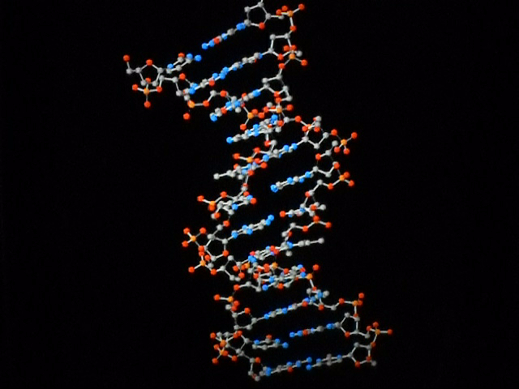
Sir Winston Churchill
Now this is not the end. It is not even the beginning of the end. But it is, perhaps, the end of the beginning.
Albert Einstein
Logic will get you from A to B. Imagination will take you everywhere.

Slide 74
Please Dentists
Concept design comes first and foremost – ‘de’-train your technical background
Work smart not hard and work hard at being Smart
J Loudon

Slide 75
May God Bless you
Thank you for listening ☺

Slide 76


`

