Slide 1
Localized Regulated Expression of IL-12 as a Gene Therapy Approach to Cancer Immunotherapy
John A. Barrett Ph.D.
Ziopharm Oncology, Boston MA 02129

Slide 2
Background & Rationale IL-12 in Oncology
Tumors grow & escape the immune system through the process of immunoediting. Thus, restoration of the immune system’s ability to detect the tumor should result in improved treatment outcomes.
Localized IL-12 administration has been shown to have antitumor activity that is mediated by direct tumor cell cytotoxicity, and enhancement of immuno-regulatory activities including activation of anti-tumor natural killer (NK) cells, CD4⁺ T cells and CD8⁺ T cells.

Slide 3
Inducible Gene Regulation: RheoSwitch Therapeutic System®
RheoSwitch Therapeutic System® (RTS®) is a 3-component transcriptional regulator
VP16
EcR
Activator Ligand
RXR
Gal4
Basal Transcription Proteins
RXR
VP16
Gal4
EcR
Inducible Gene Program
Inducible Gene Program
The Switch Components: The RTS® gene program includes 2 receptor protein fusions: VP16-RXR and Gal4-EcR. They form unstable and unproductive heterodimers in the absence of any ligand.
The Inducible Promoter: A customizable promoter to which basal transcription proteins are recruited and the target gene is transcribed.
The Activator Ligand (veledimex): An ecdysone analog, diacylhydrazine-based small molecule functions as an activator. In the presence of the ligand, the protein heterodimer changes to a stable conformation and binds to the inducible promoter.

Slide 4
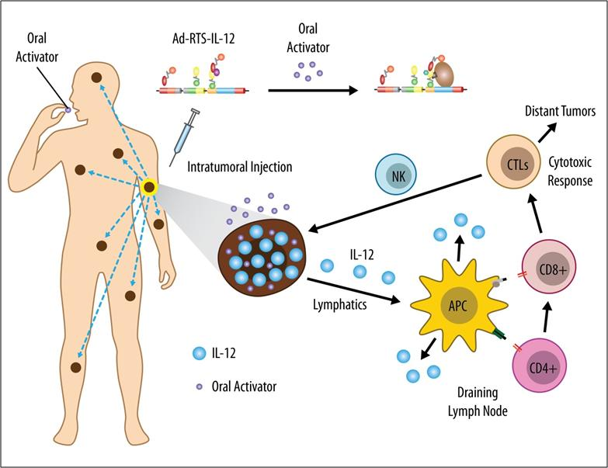
Regulated intratumoral expression of IL-12 promotes activation of TIL’s to drive a cytotoxic immune response against distant tumors

Slide 5
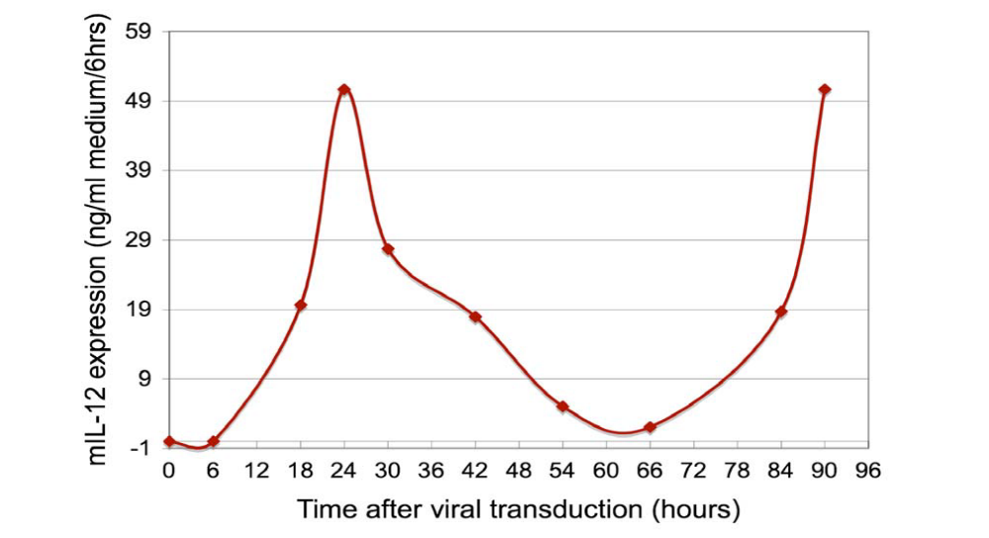
IL-12 Production is Modulated by Activator Ligand in
HT 1080 Cells
Off
AL=75nM
On
On
5

Slide 6
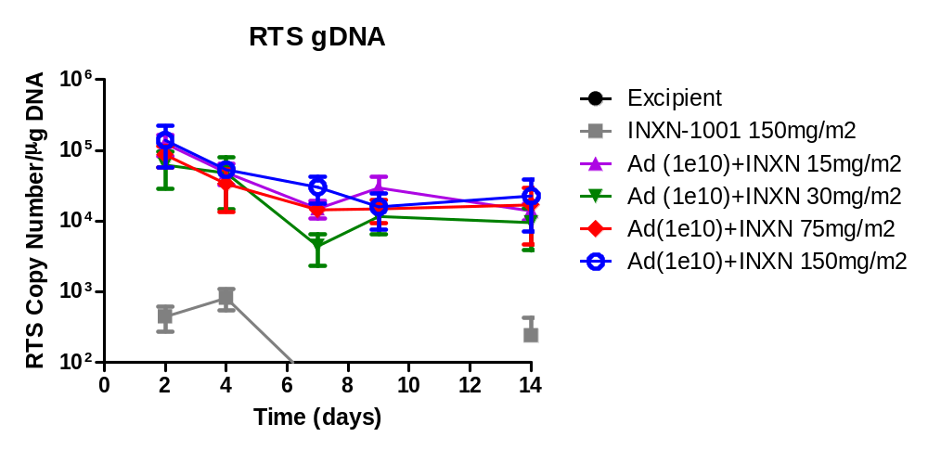
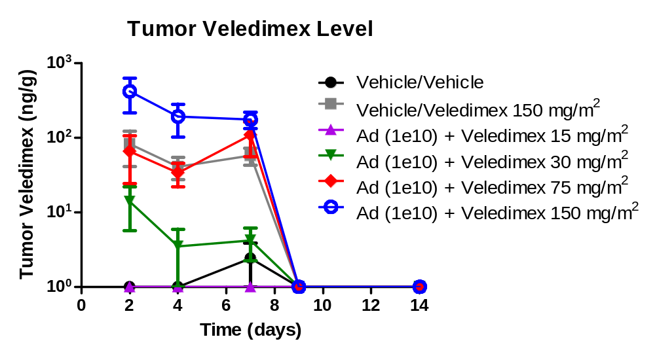
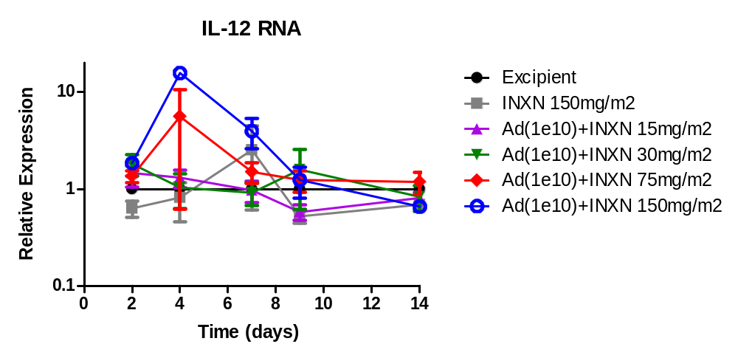
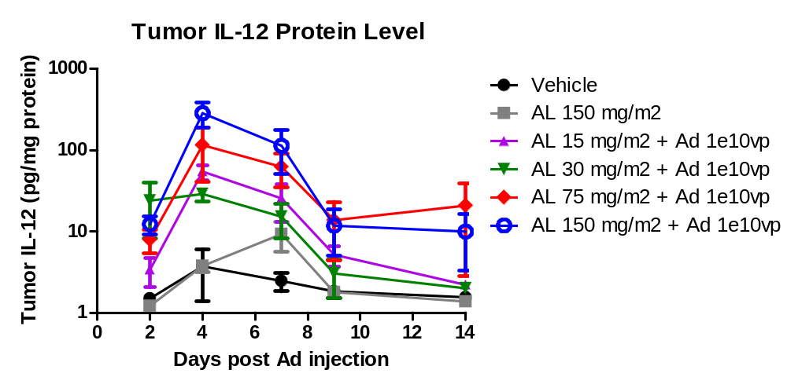
Dose-Dependent Increase in Expression of Tumor IL-12 mRNA & IL-12 Protein in Response to Veledimex

Slide 7
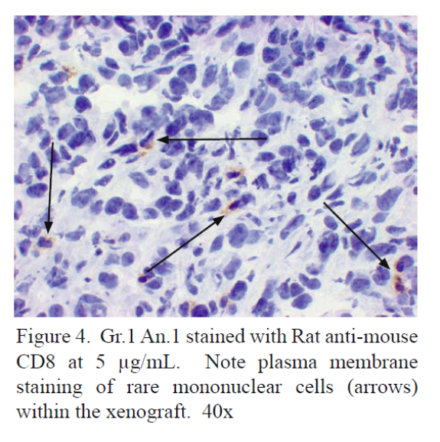
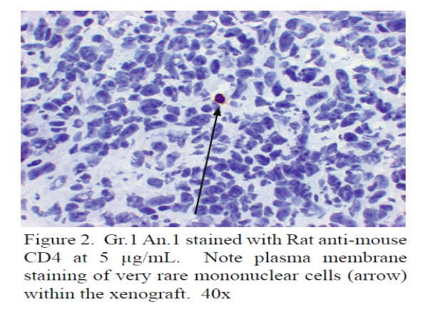
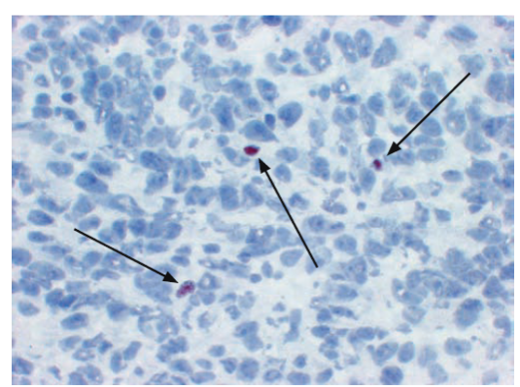
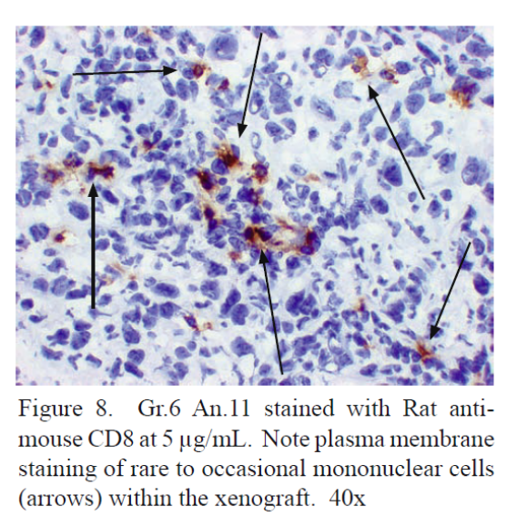
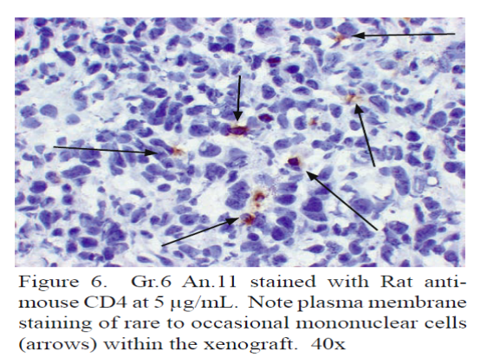
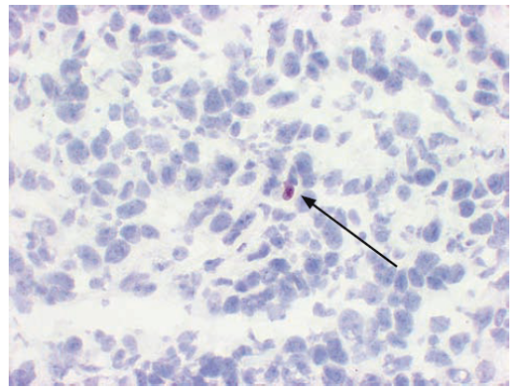
Ad-RTS-mIL-12 + Veledimex Increases Tumor CD8⁺ & CD4⁺ While Decreasing CD4⁺ Fox P3⁺ TILs in the 4T1 Syngeneic Mouse
CD8⁺
CD4⁺
CD4⁺ Fox P3⁺
Vehicle
Ad-RTS-mIL-12 1 x 10¹⁰ vp
+ Veledimex 150 mg/m²

Slide 8
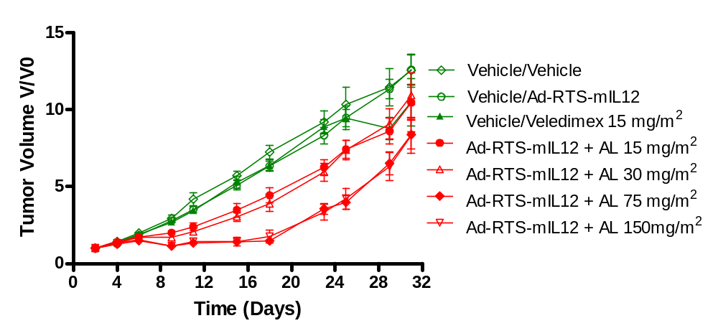
Dose-Dependent Anti-Tumor Activity of Ad-RTS-mIL-12 + Veledimex (AL) in Murine 4T1 Model
Start of treatment
Tumor volume reached 100-200 mm³

Slide 9
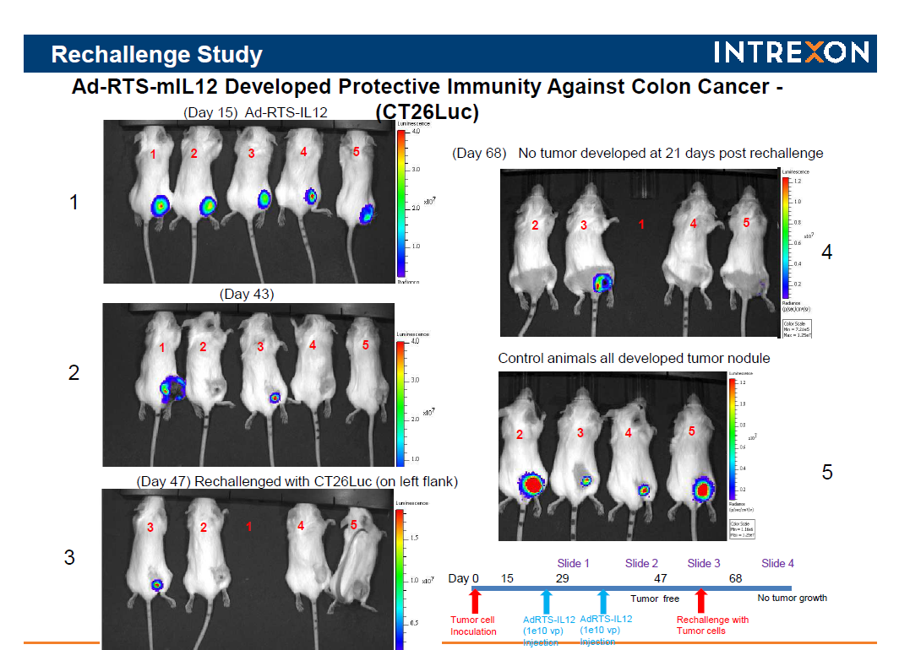
RIGHT Flank
LEFT Flank

Slide 10
Clinical Observations to Date
  We can control gene expression to achieve a systemic immune response
  High expression of IL-12 mRNA in tumors, tightly controlled by veledimex dose
  Tumor biopsies show increased tumor infiltrating lymphocytes in both injected and systemic non-injected lesions
  We have seen systemic and fully reversible toxicity
  Serious adverse events are mechanism-based and consistent with immunotherapy (Fever, N&V, leukopenia, increased LFTs, hyponatremia, cytokine release response)
  Serious adverse events reversed within days after stopping veledimex dosing
  Subjects who have had IL-12 expression turned “off” have been redosed, and IL-12 turned “on” again

Slide 11
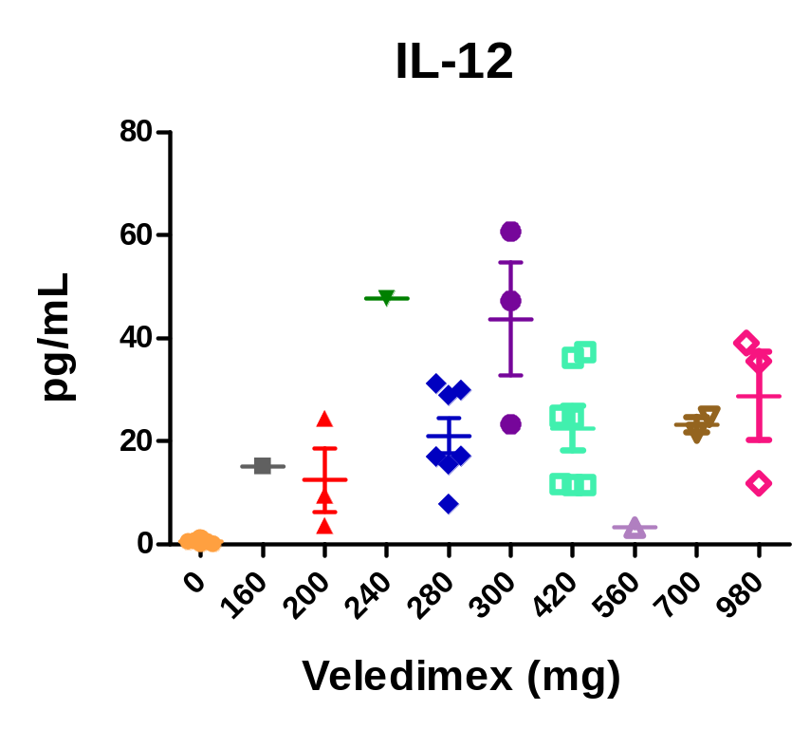
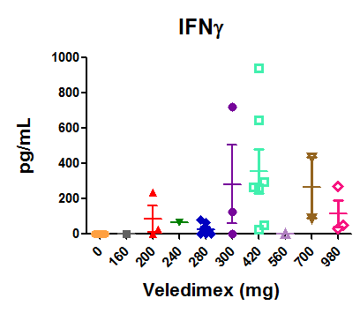
Increase in Patient Serum Cytokine Expression Cycle 1

Slide 12
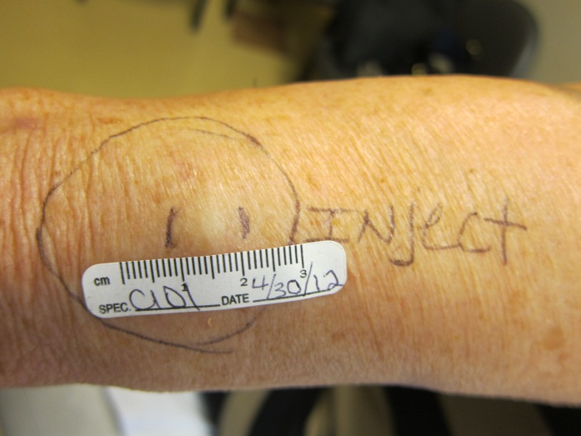
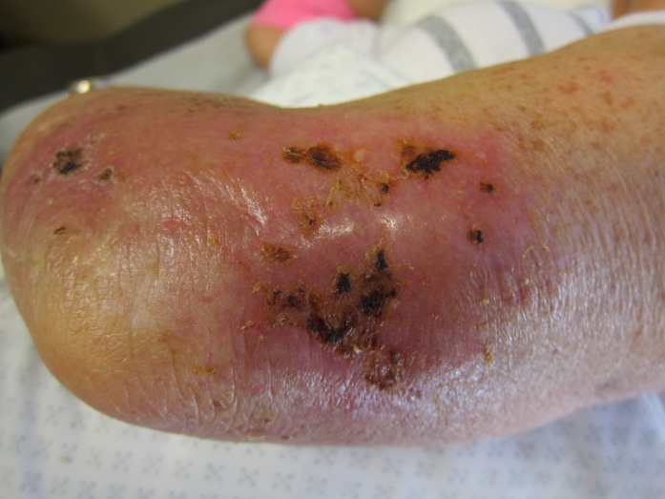
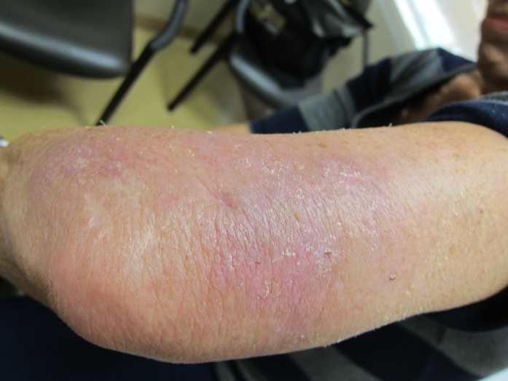
Effects of Ad-RTS-hIL-12 + Veledimex (AL) in Melanoma Patient
C1D1
C1D15
Day 30
Initial increase in lesion size due to inflammatory response seen at Cycle 1 Day 15
Lesion was undetectable at Day 30
Notes:
Complete clinical progression

Slide 13
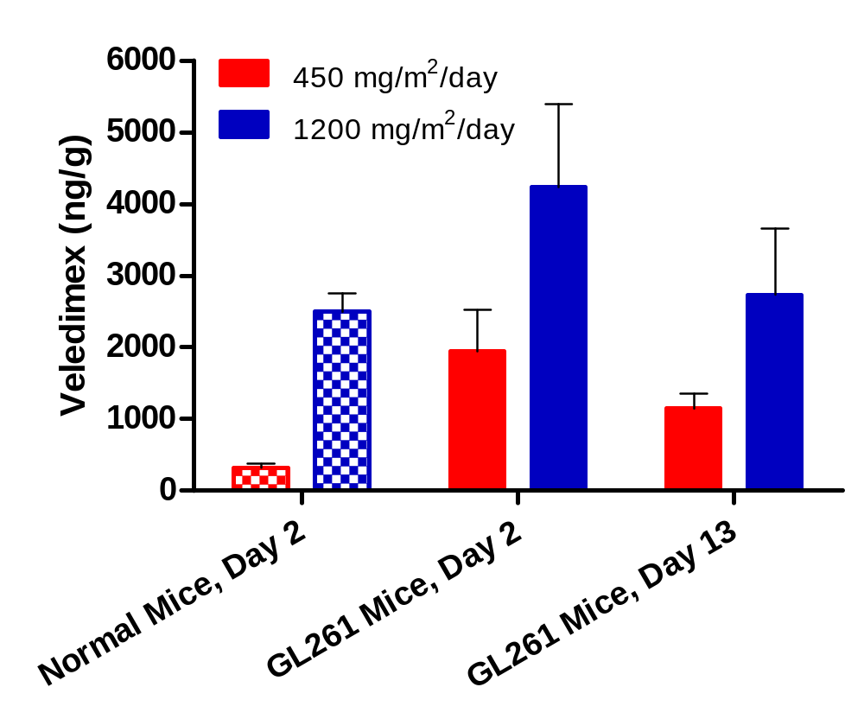
Higher Veledimex Levels Normal and in GL261 Orthotopic Glioma Mouse Brains
Veledimex levels at 24 hr posttreatment

Slide 14
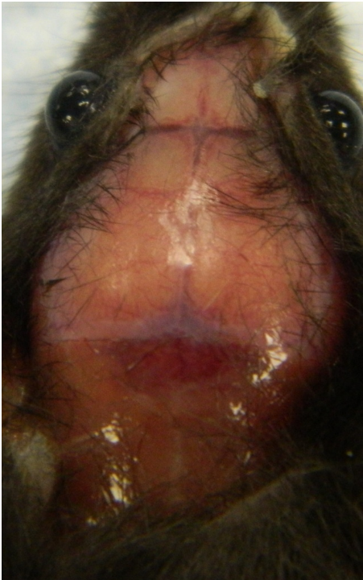
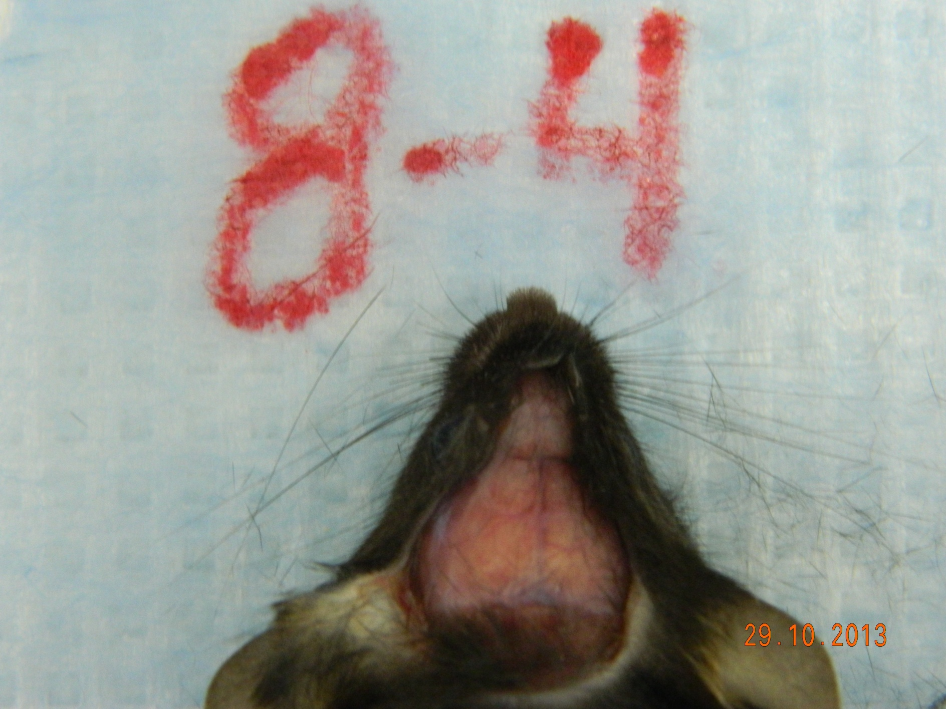

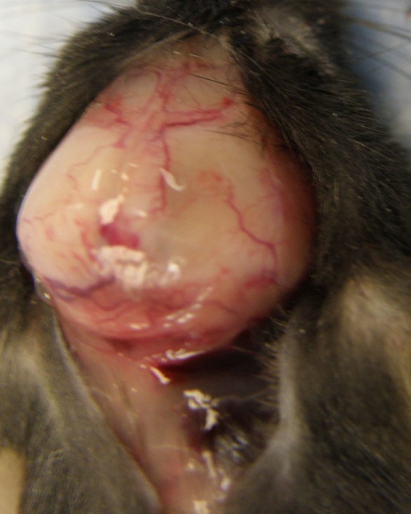

Effects of Ad-RTS-mIL-12 + Veledimex (AL) in the Orthotopic GL261 Mouse
Treatment For 14 days
Day 74 (end of study)
Normal Mouse
Control Day 20
Vehicle
BID x 14
Ad-RTS-mIL-12 1x10¹⁰vp
+ AL 450 mg/m²/day
BID x14

Slide 15
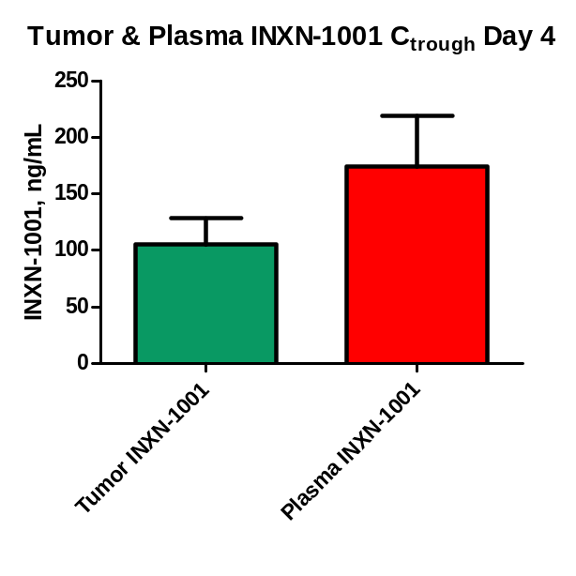
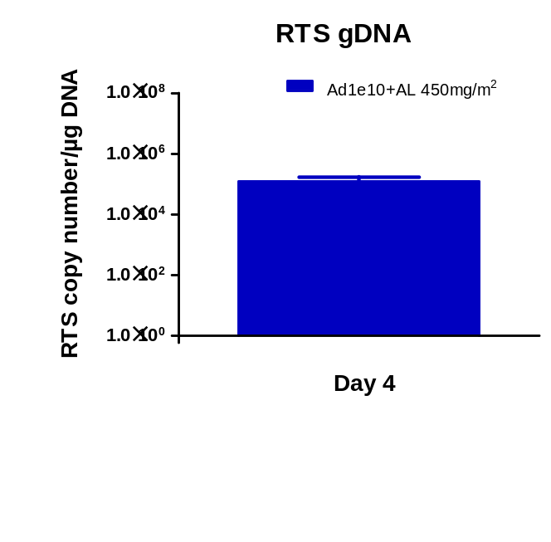
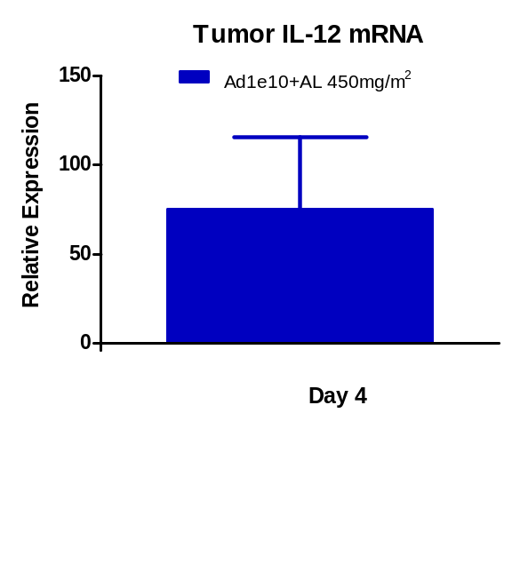
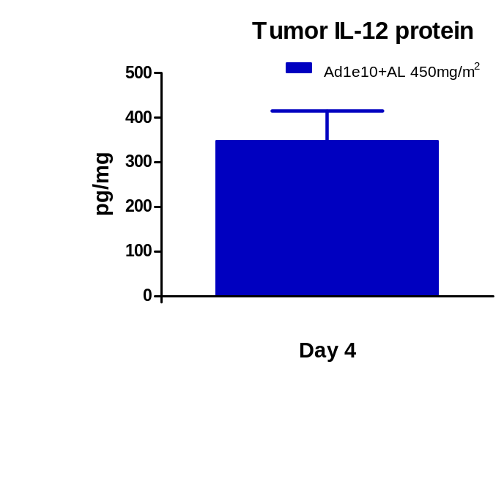
Increased Expression of Tumor IL-12 mRNA & IL-12 Protein in Response to Veledimex

Slide 16
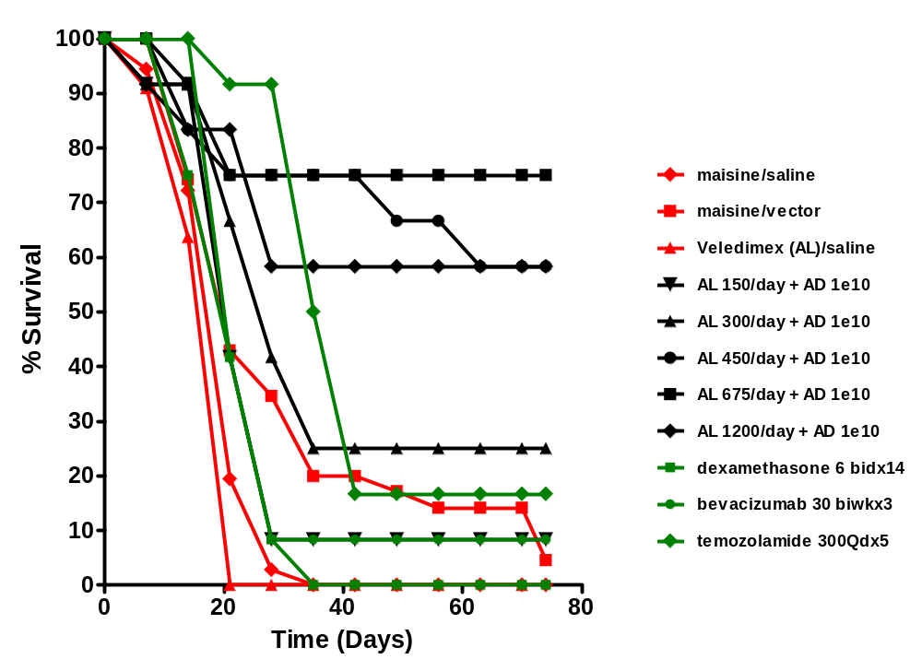
Ad-RTS-mIL-12 + Veledimex (AL) Results in Increased Survival When Compared to Control in the GL261 Orthotopic Glioma Mouse Model
Ad-RTS-mIL12 administered on Day 5 ; Veledimex (mg/m²) administered BID for 14 days from Day 5;

Slide 17
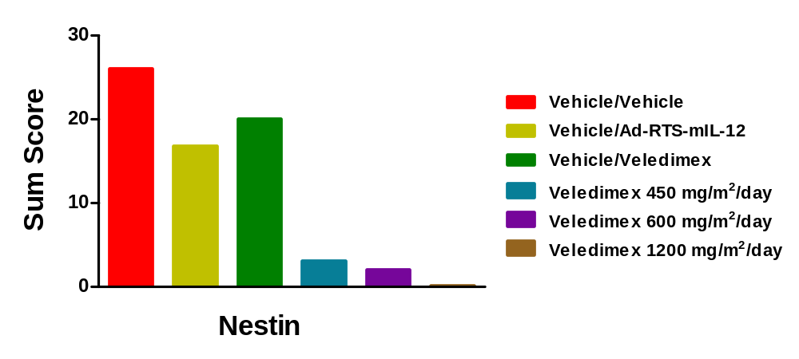
Ad-RTS-mIL-12 + veledimex significantly reduces brain cancer stem cells in GL-261 Orthotopic Glioma Model
Nestin levels (marker for cancer stem cells)
inverse correlation with survival (Pearson r= 0.92)

Slide 18
Conclusions
Ad-RTS-hIL-12 + veledimex PO exhibits controllable systemic immune activation in human subjects with melanoma and breast cancer.
Veledimex exhibits dose-related increases in plasma and brain tissue exposure with no accumulation in brain.
Ad-RTS-mIL-12 (1x10¹⁰ vp) + veledimex PO improves survival over temozolomide, dexamethasone and bevacizumab.
Ad-RTS-mIL-12 + veledimex significantly reduces brain cancer stem cells
These findings support the utility of localized, regulatable IL-12 production as an approach for the treatment of malignant glioma in human subjects.

