Slide 1
Localized Regulated Expression of IL-12 as a Gene Therapy Approach to Cancer Immunotherapy
John A. Barrett Ph.D.
Ziopharm Oncology, Boston MA 02129

Slide 2

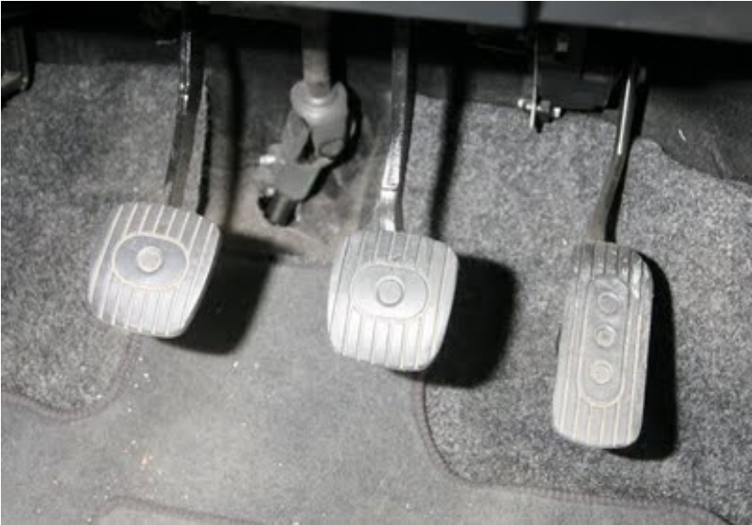
Immuno-oncology
CTLA4:Brakes
Proportionally Dampens CD8 activation
PD-1/PD-L1: Clutch
Regulates CD8 activity to lessen tissue damage
Local IL-12: Gas/GPS
Activates CD8, Decreases Tregs, Tcell homing
Immune Activation
Immune Suppression
PD-1/PD-L1
CTLA-4
IL-12

Slide 3
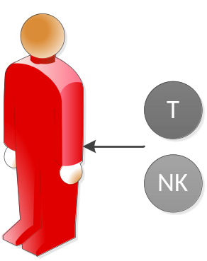
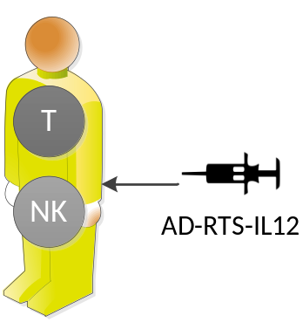
Immuno-oncology
Tumor resistance is a hallmark of cancer:
Many therapies, including combination
approaches, with different mechanisms of
action are needed to overcome tumor escape
Native immune response unable to treat cancer:
Because the endogenous programming
language within T cells and NK cells
is muted by cancer
Current Clinical Approaches
Administer modified immune cells to provide effective anti-tumor response
Administer IL-12 via controlled gene therapy to bolster endogenous immune response
T cells
NK cells
Cytokines
CAR
TCR
Ad-RTS-IL-12

Slide 4
Background & Rationale for Local IL-12
Interleukin-12 (IL-12)
  Pro-inflammatory cytokine
  Master regulator of cell-mediated immunity to pathogens and neoplastic transformation
  Produced by innate immune cells in response to pathogens
  Leads to production by T- and natural killer (NK) cells of
    Interferon gamma (INFγ)
    Tumor necrosis factor alpha (TNFα)
Local IL-12 results in the enhancement of immuno-regulatory activities including activation of anti-tumor natural killer (NK) cells, CD4⁺ T cells and CD8⁺ T cells.

Slide 5
Inducible Gene Regulation: RheoSwitch Therapeutic System®
RheoSwitch Therapeutic System® (RTS®) is a 3-component transcriptional regulator
VP16
EcR
Activator Ligand
RXR
Gal4
Basal Transcription Proteins
RXR
VP16
Gal4
EcR
Inducible Gene Program
Inducible Gene Program
The Switch Components: The RTS® gene program includes 2 receptor protein fusions: VP16-RXR and Gal4-EcR. They form unstable and unproductive heterodimers in the absence of any ligand.
The Inducible Promoter: A customizable promoter to which basal transcription proteins are recruited and the target gene is transcribed.
The Activator Ligand (veledimex): An ecdysone analog, diacylhydrazine-based small molecule functions as an activator. In the presence of the ligand, the protein heterodimer changes to a stable conformation and binds to the inducible promoter.

Slide 6
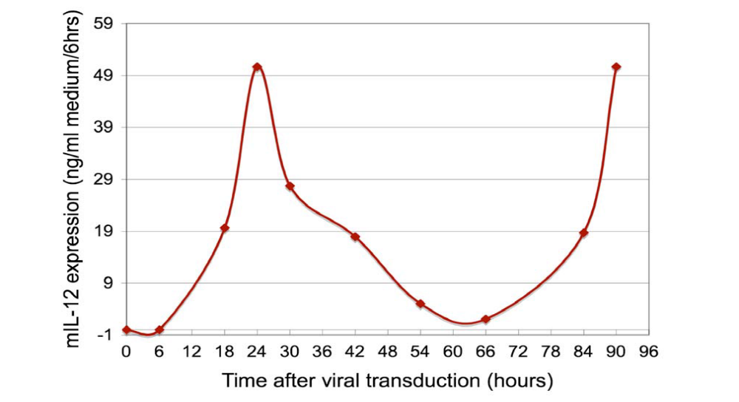
IL-12 Production is Modulated by Activator Ligand in
HT 1080 Cells
Off
AL=75nM
On
On
6

Slide 7
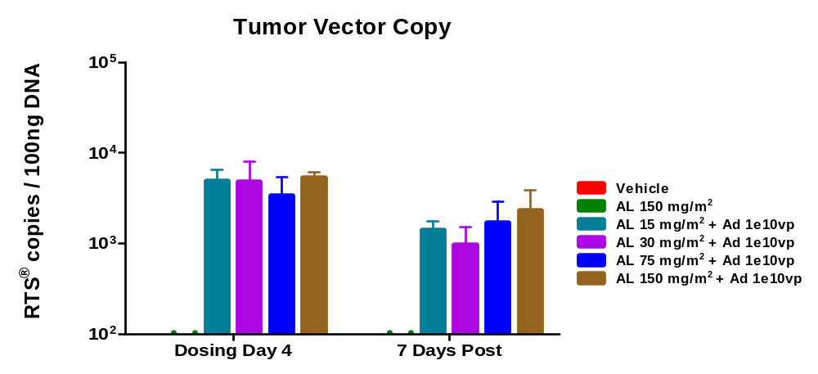
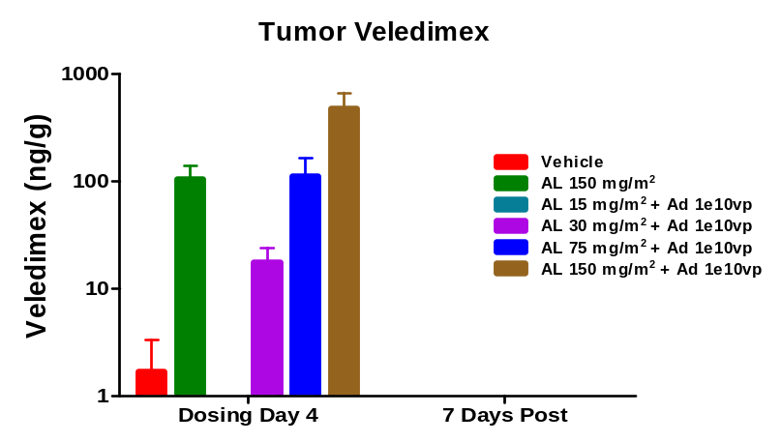
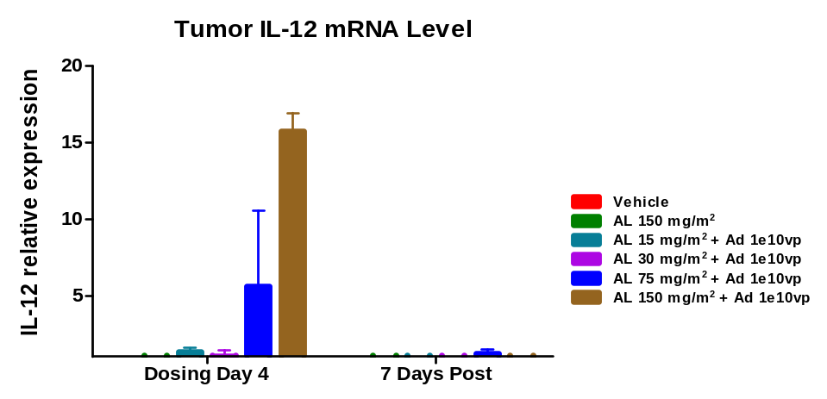
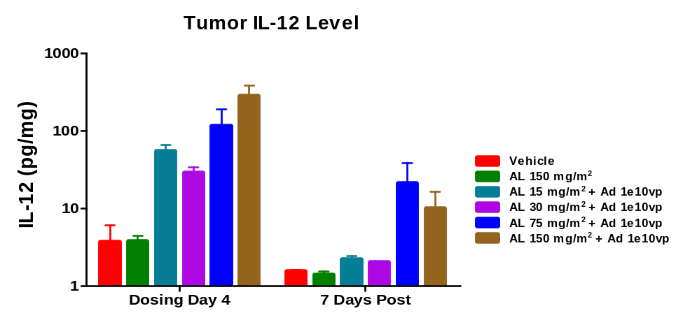
Dose-Dependent Increase in Expression of Tumor IL-12 mRNA & protein in Response to Veledimex in the 4T1 Syngeneic Mouse
Ad-RTS-mIL-12 administered IT on Day 1.
Veledimex administrated orally QDx7 starting Day 1.

Slide 8
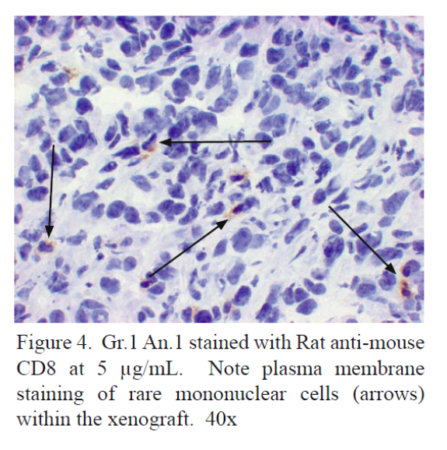
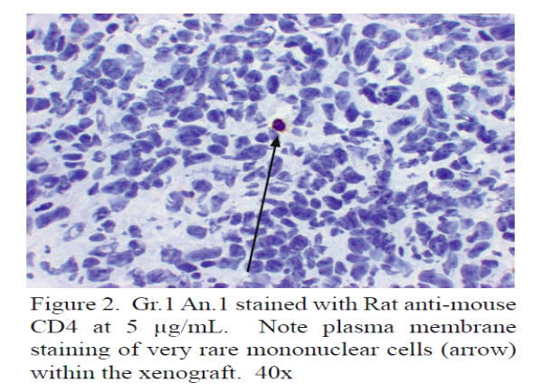
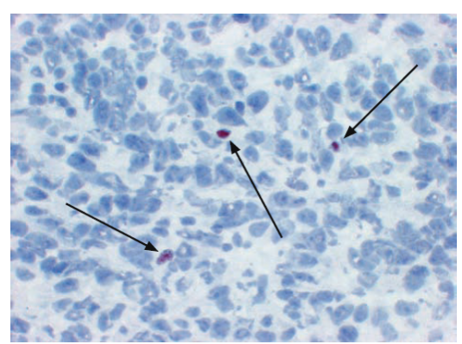
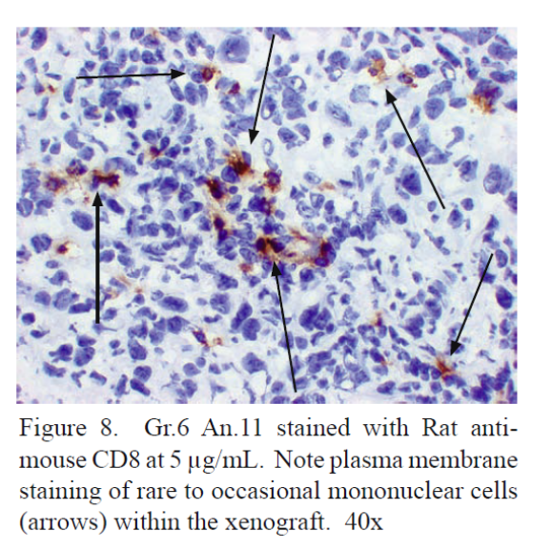
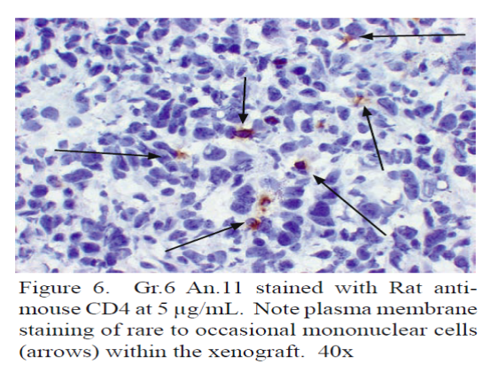
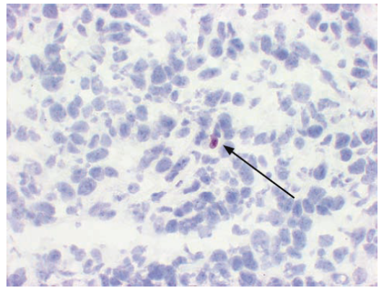
Ad-RTS-mIL-12 + Veledimex Increases Tumor CD8⁺ & CD4⁺ While Decreasing CD4⁺ Fox P3⁺ TILs in the 4T1 Syngeneic Mouse
CD8⁺
CD4⁺
CD4⁺ Fox P3⁺
Vehicle
Ad-RTS-mIL-12 1 x 10¹⁰ vp
+ Veledimex 150 mg/m²

Slide 9
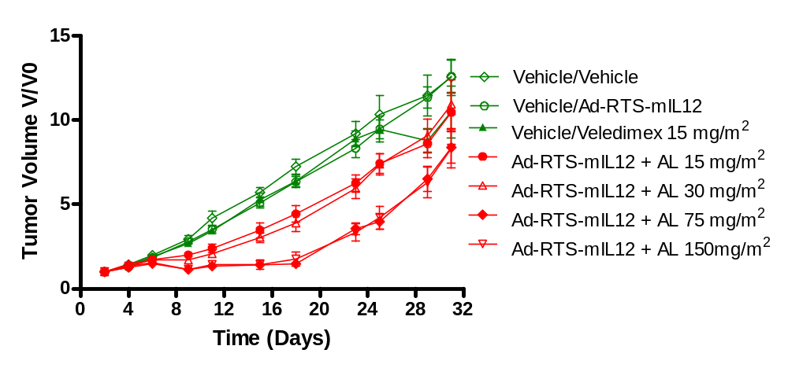
Dose-Dependent Anti-Tumor Activity of Ad-RTS-mIL-12 + Veledimex (AL) in Murine 4T1 Model
Start of treatment
Tumor volume reached 100-200 mm³

Slide 10
Breast Cancer: Phase 2, Recurrent/Metastatic Breast Cancer
12 subjects enrolled on 21 day cycle, for up to 6 cycles; intratumoral injection of Ad-RTS-hIL-12 occurred on Day 1 and oral veledimex (80-140 mg) daily on Days 1-7
9

Slide 11
Patient Demographics (Breast)
Patient Demographics and Baseline Characteristics | ATI001-201 Breast Cancer Study N= 12
Age in years - Median (Min, Max) | 63 (38-88)
Gender Male : Female | 1 : 11
Time Since Initial Diagnosis (months) Median (Min, Max) | 111 (8-264)
Stage at Study Entry IIIB IV Unknown | 1 10 1
Classification HER2 Breast Cancer HR status ER or PR Breast Cancer Triple-Negative Breast Cancer (TNBC) | 25% HER 2+; 67% HER 2-; 8% ND 58% HR+; 42% HR- 25% TNBC
ECOG Performance Status ≤1 | 12
Patients with Visceral Metastatic Sites | 92% (11/12)
Prior Therapy Mean | 13
10

Slide 12
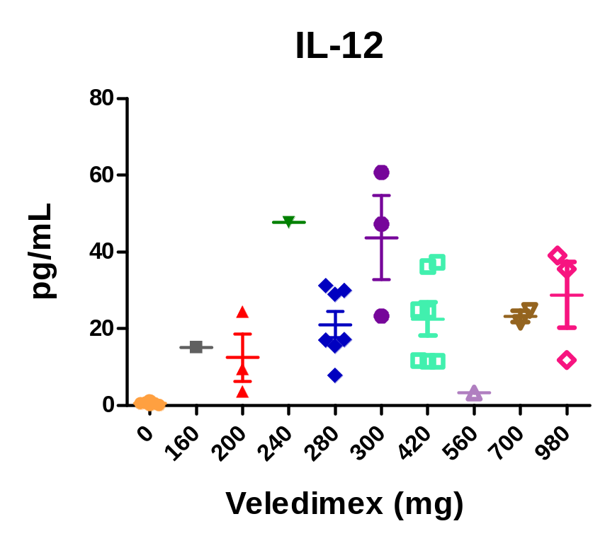
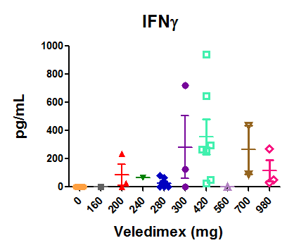
Increase in Patient Serum Cytokine Expression

Slide 13
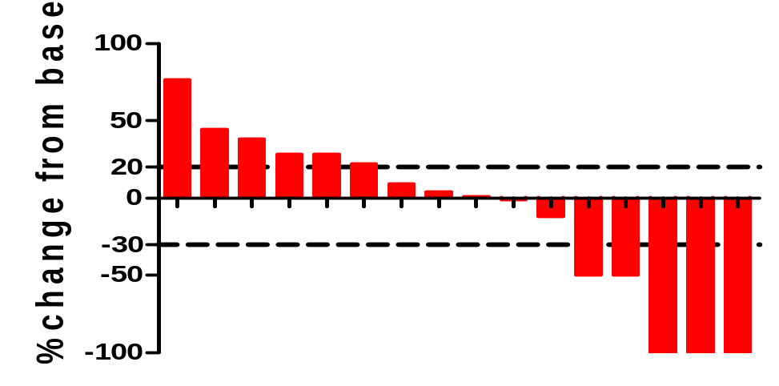
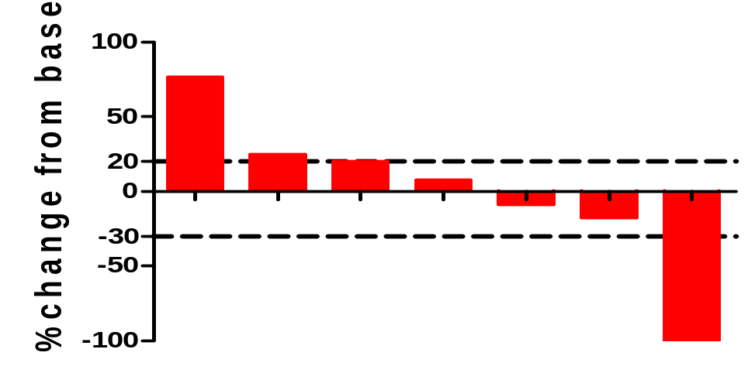
Best Overall Response from Noninjected Lesions and Total Tumor Burden in Evaluable Breast Cancer Subjects (N=7)
Lesion Diameter
Total Tumor Burden
*
Left Panel: waterfall plot of best overall response on a per lesion basis. On average there were 2 lesions per patient (range: 1-4). Lesions were measured per RECIST 1.1 guidance approximately 10 weeks after initiation of therapy. Right Panel: best overall response in total tumor burden on a per patient basis. In this study, total of 16 non-injected lesions in 7 breast cancer subjects were evaluated. * New lesion C6D7.
17

Slide 14
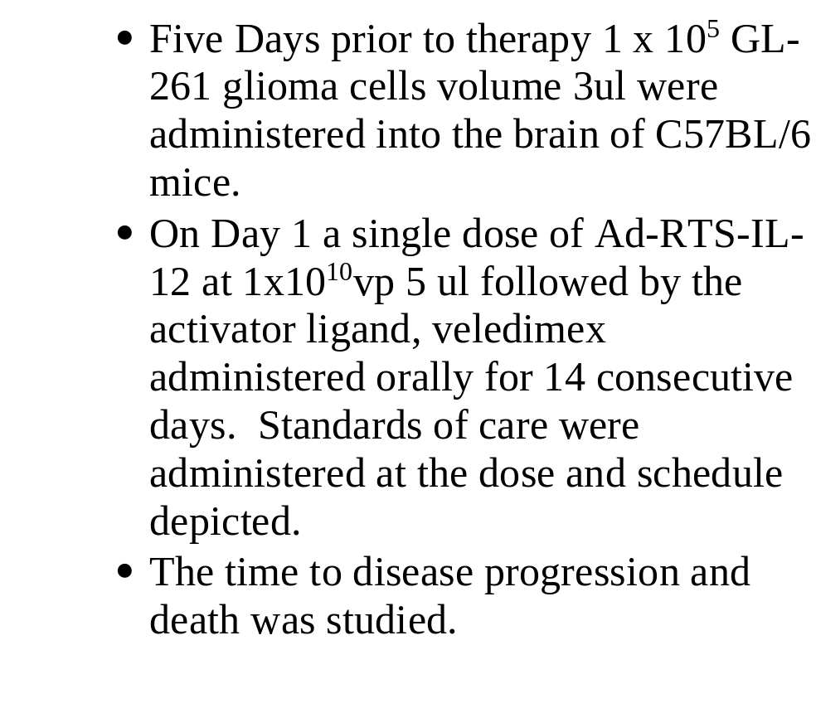
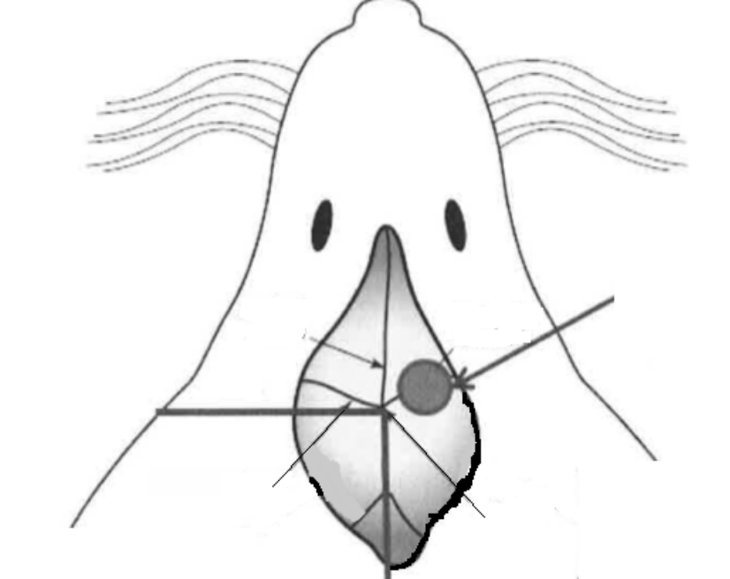
GL-261 Orthotopic Glioma Model
Burr hole
location
saggital
suture
coronal
suture
bregma

Slide 15
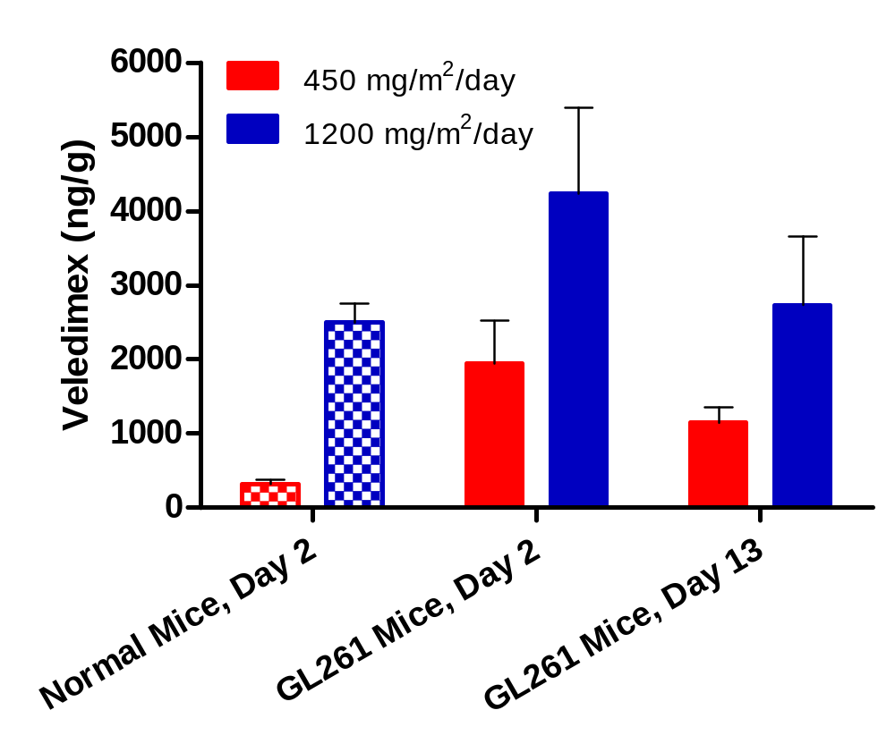
Higher Veledimex Levels Normal and in GL261 Orthotopic Glioma Mouse Brains
Veledimex levels at 24 hr posttreatment

Slide 16
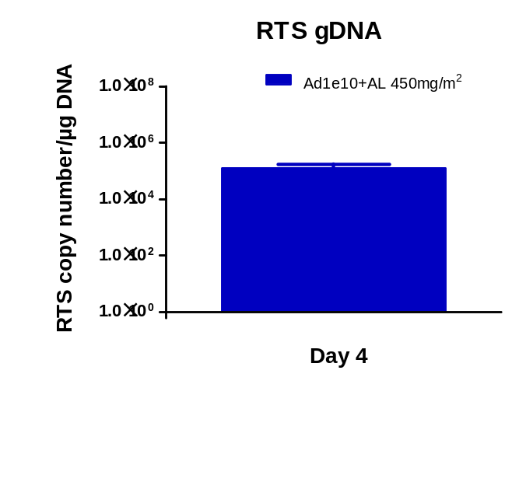
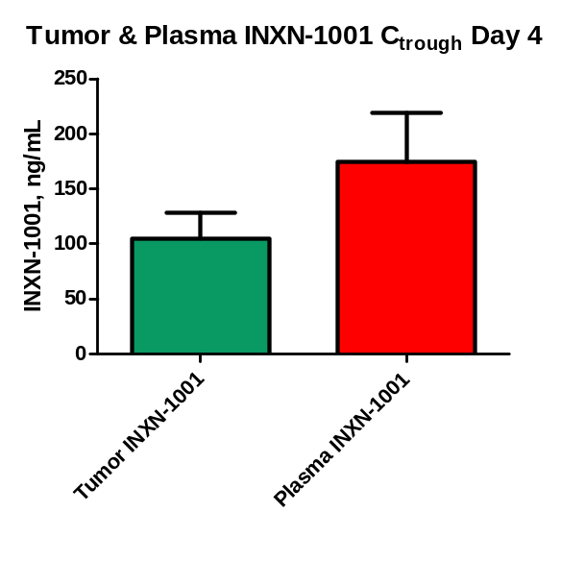
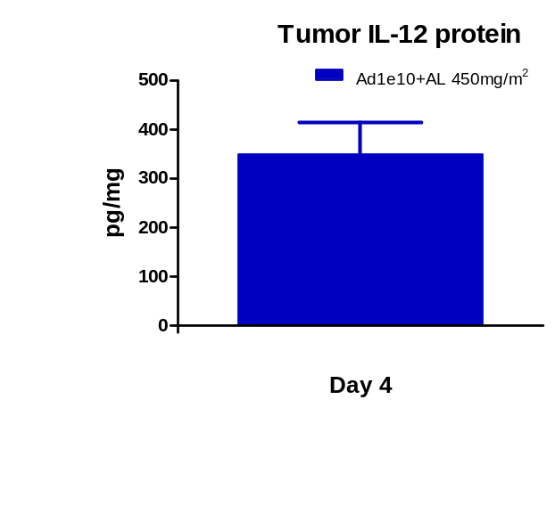
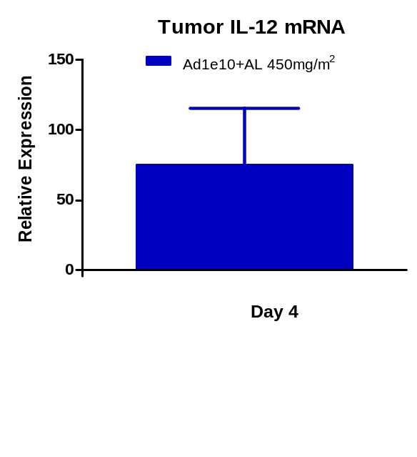
Increased Expression of Tumor IL-12 mRNA & IL-12 Protein in Response to Veledimex in GL-261 Mouse Model

Slide 17
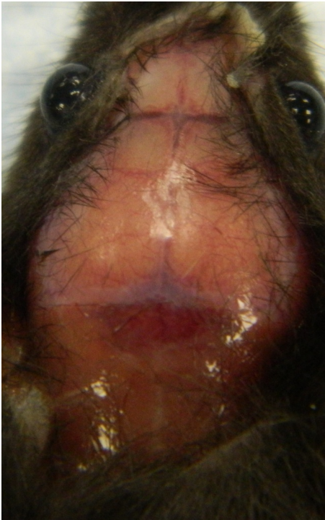
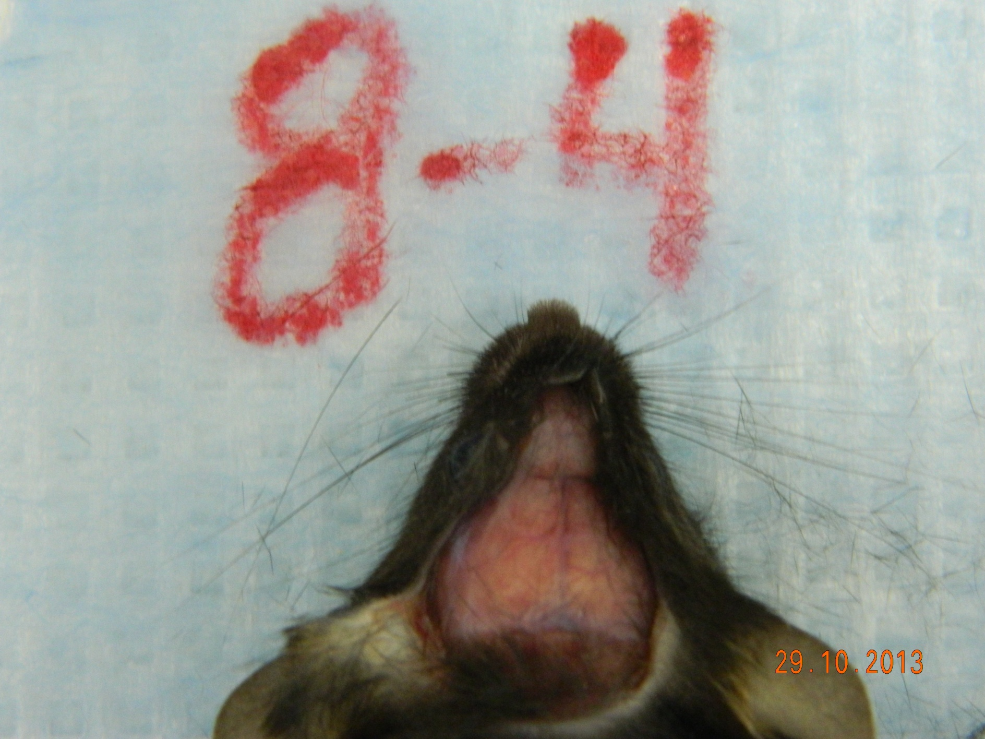

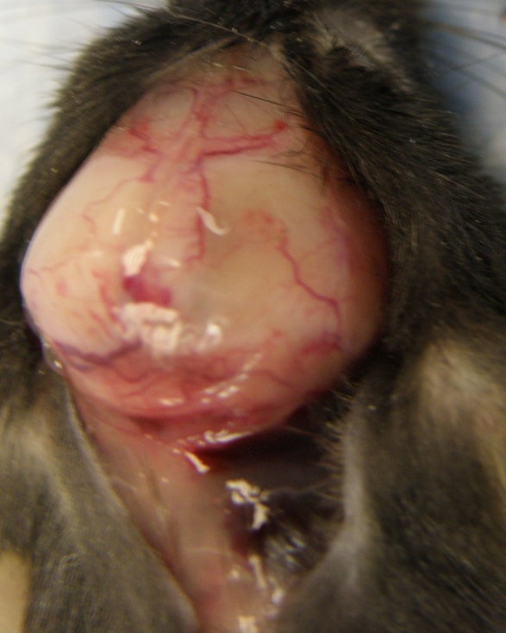

Effects of Ad-RTS-mIL-12 + Veledimex (AL) in the Orthotopic GL261 Mouse
Treatment For 14 days
Day 74 (end of study)
Normal Mouse
Control Day 20
Vehicle
BID x 14
Ad-RTS-mIL-12 1x10¹⁰vp
+ AL 450 mg/m²/day
BID x14

Slide 18
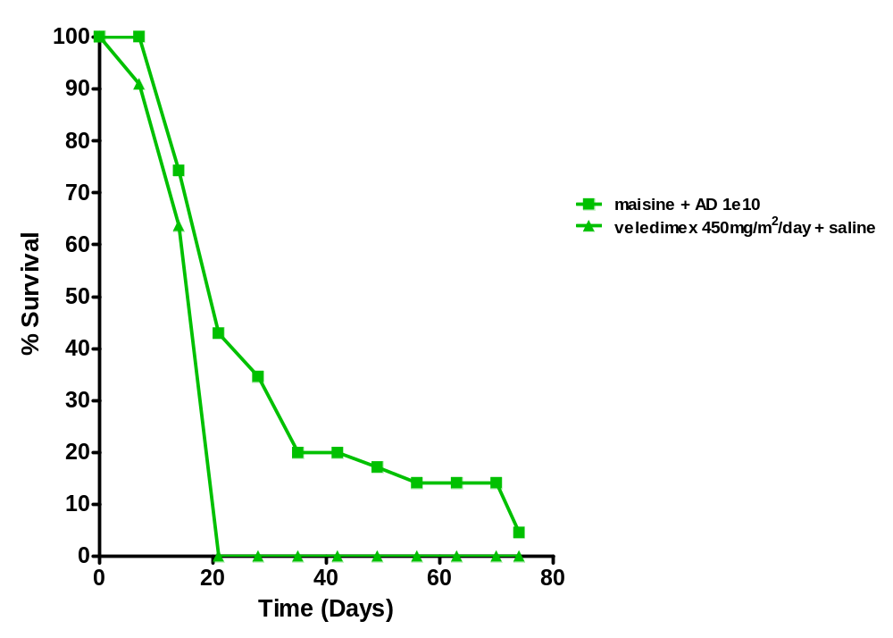
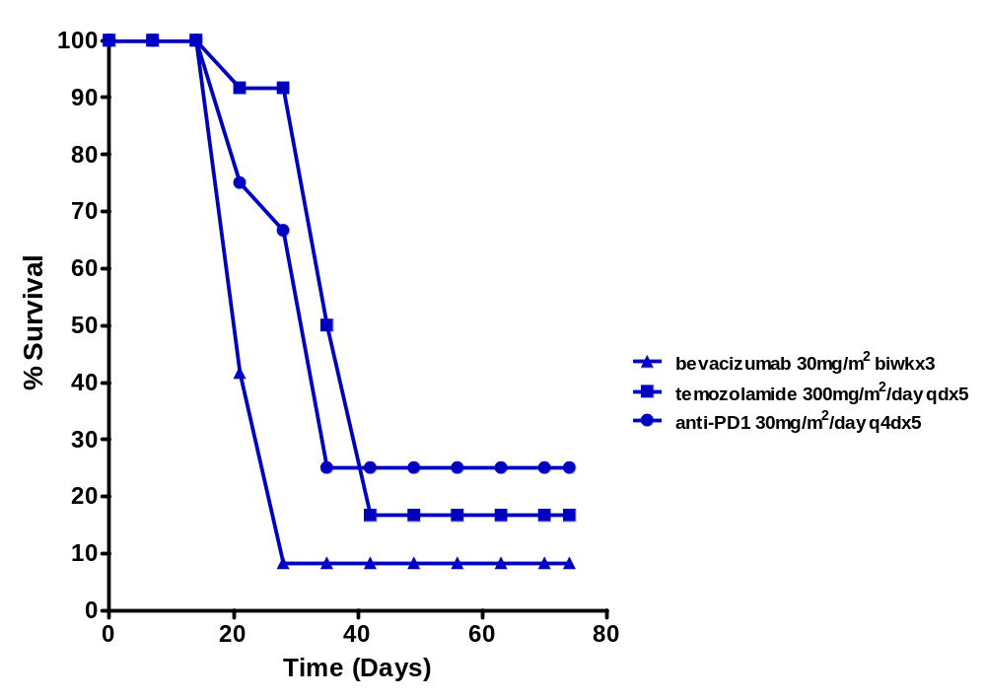
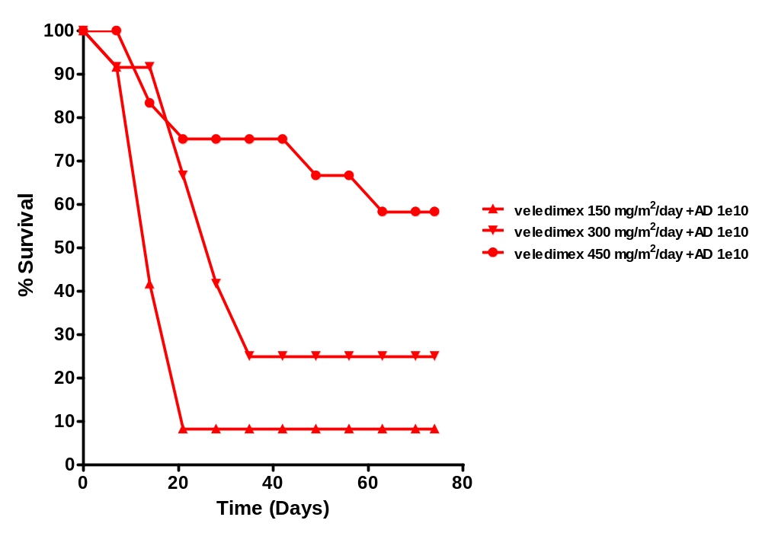
Ad-RTS-mIL-12 + Veledimex Results in Increased Survival in the GL261 Orthotopic Glioma Mouse Model

Slide 19
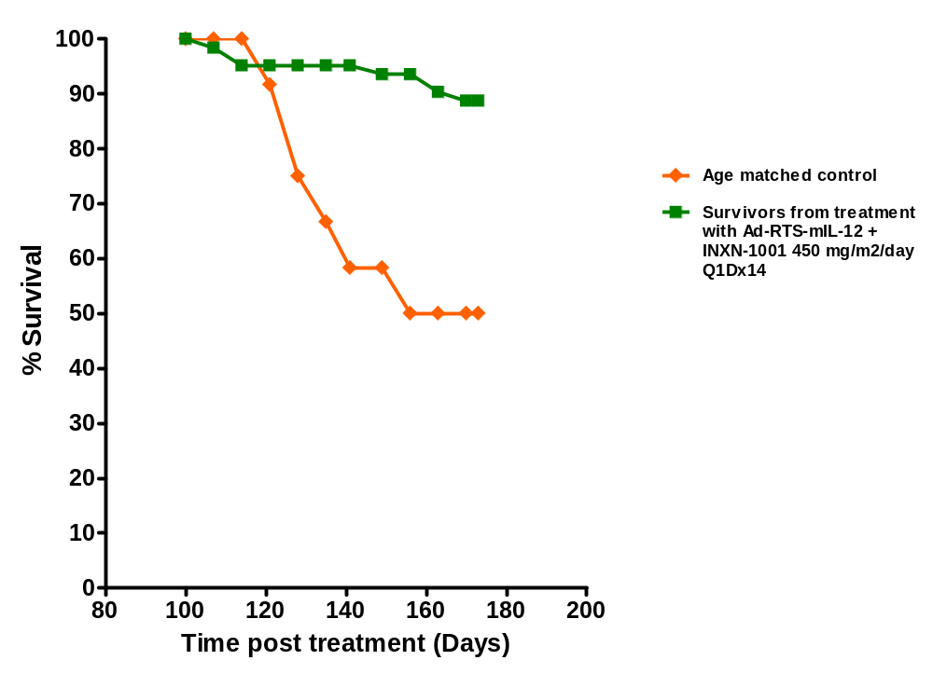
Ad-RTS-mIL-12+Veledimex Elicits Systemic Tumor Response in the GL261 Orthotopic Glioma Mouse Model

Slide 20
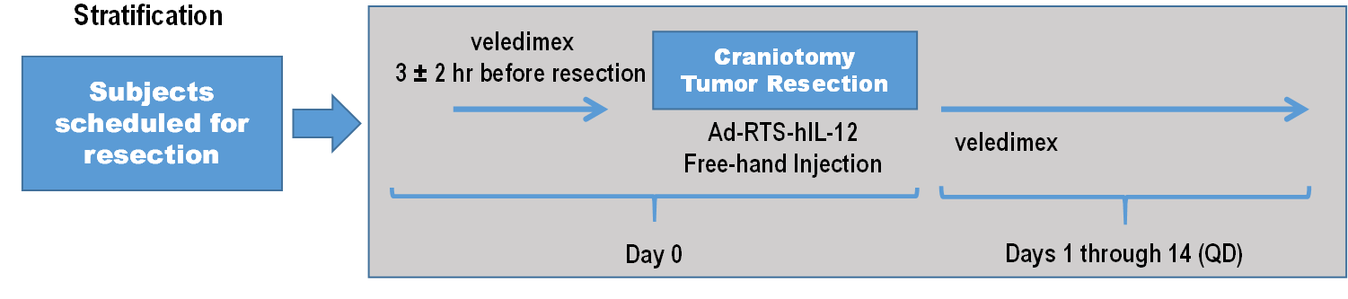
Patient Demographics
N=5
Phase 1 Dose Escalation Study of Ad-RTS-hIL-12 + Veledimex in Recurrent or Progressive Glioblastoma or Grade III Malignant Glioma
Preliminary Safety Profile
N=5
Age in years Median (Min, Max) | 40 (32, 58)
Gender Male : Female | 3 : 2
Time Since Initial Diagnosis (months) Median (Min, Max) | 42 Months (11, 66)
Grade at Study Entry | Grade III 2 Grade IV 3
Cohort 1: Ad-RTS-hIL-12 2x10¹¹ vp + veledimex 20mg (10mg/m²/day)
Most Common AEs
    Headache, Fever, Hyponatremia, Nausea/Vomiting
Related SAEs
    Aseptic Meningitis
    Neutropenia, Thrombocytopenia, Leukopenia

Slide 21
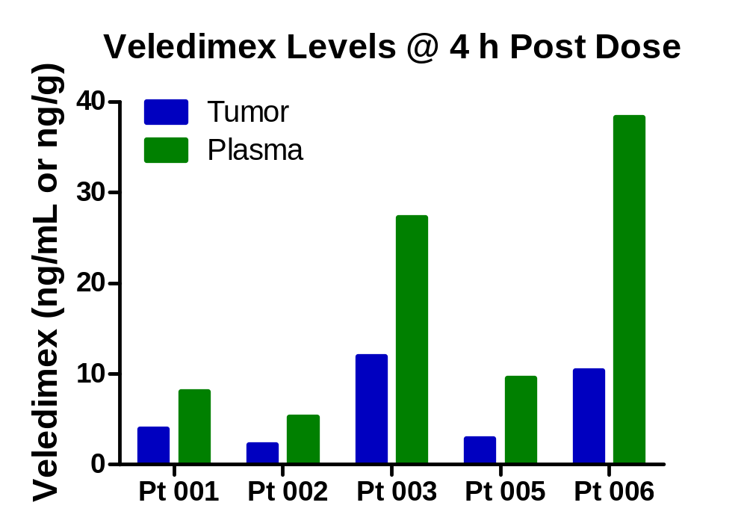
Veledimex Crosses the Blood Brain Barrier
Veledimex 20 mg (10 mg/m²/day); Pt 004 screen failure

Slide 22
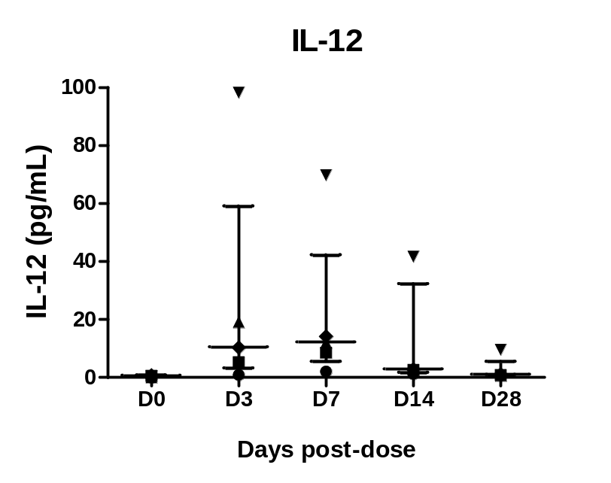
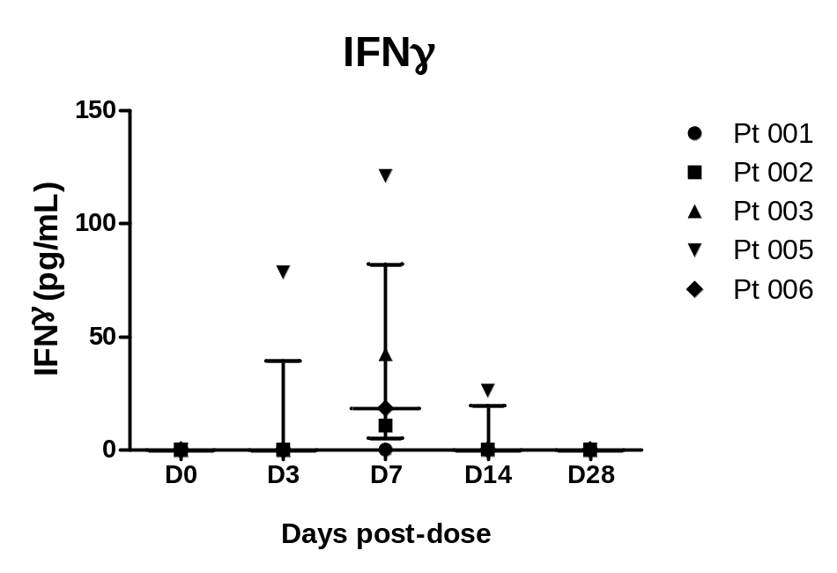
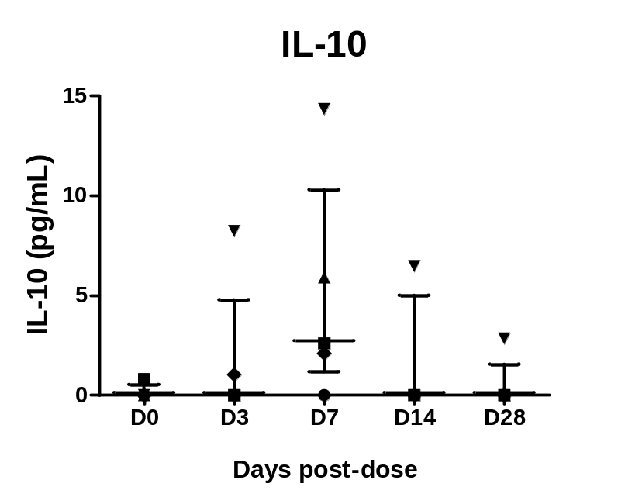
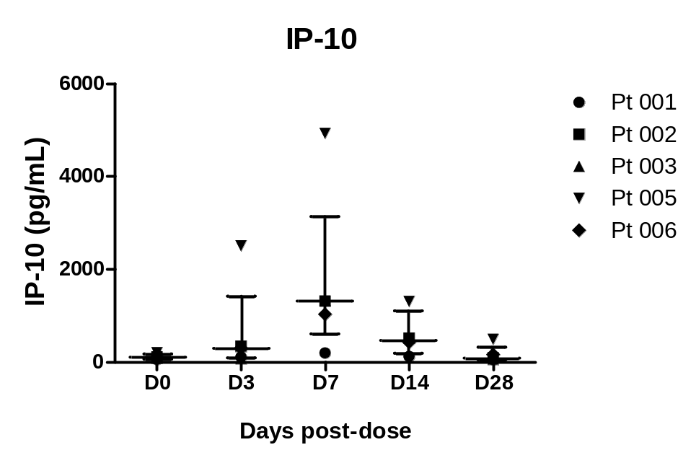
Intra-tumor Administration of Ad-RTS-IL-12 + Veledimex Results in Functional IL-12

Slide 23
Conclusions
Ad-RTS-hIL-12 + veledimex PO exhibits controllable systemic immune activation in human subjects with breast cancer and glioma.
Veledimex exhibits dose-related increases in plasma and brain tissue exposure with no accumulation in brain.
Ad-RTS-mIL-12 (1x10¹⁰ vp) + veledimex PO improves survival over current standards of care.
These findings support the utility of localized, regulatable IL-12 production as an approach for the treatment of malignant glioma in human subjects.

