Slide 1
Antioxidant Supplementation of Subfertile Men Improves Top Blastocyst Rate in Couples Undergoing IVF/ICSI
Nutrition & Food Sciences 2014
Valencia
Johannes Wogatzky, MD
IVF Centers Prof. Zech, Bregenz-Austria

Slide 2
IVF/ ICSI technique was first induced 1990. At first, it was thought that the success rates of ICSI are not related to basic semen parameters (Kupler 1995; Mansour 1995; Nagy 1995; Svalander 1996).
however:
In several cases of recurrent negative IVF results in conventional IVF and ICSI attempts the influence of the “PATERNAL Effect“ on early embryogenesis was suggested as a reason for IVF failure. (Vanderzwalmen 1991; Parinaud 1993; Shoukir 1998; Tesarik 2004; 2005).

Slide 3
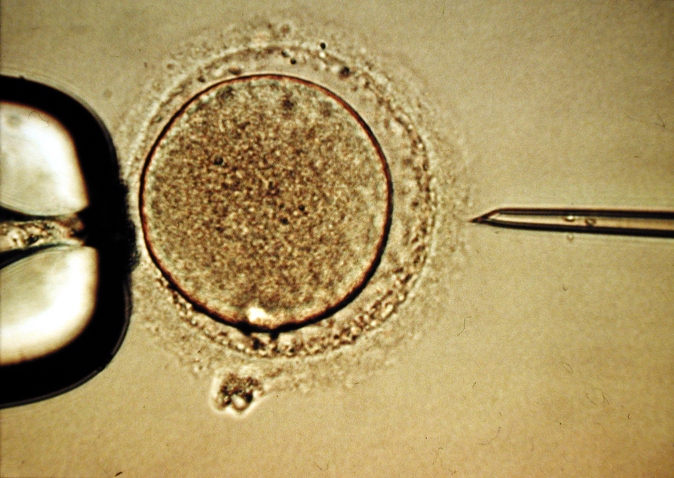
ICSI
Notes:
3

Slide 4
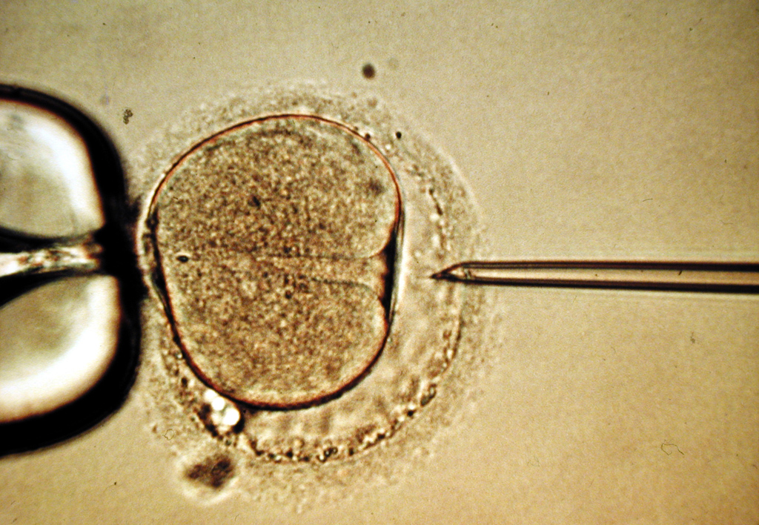
ICSI
Notes:
4

Slide 5
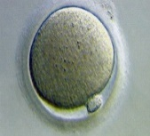
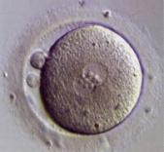
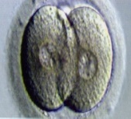
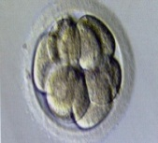
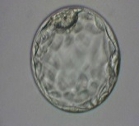
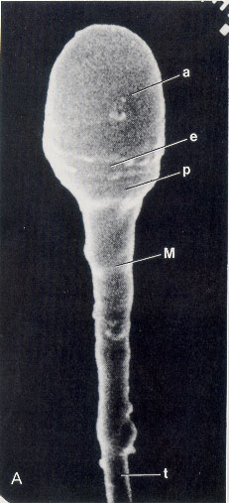
Early and Late Paternal Effects
on Embryo-Development
Day 0 1 2 3 4 5
abnormal development/ abortion
abnormal development
„Late paternal effects“
„Early paternal effects“
Sperm-Nuclear-Defects
Sperm Cytoplasmic Defects
Chromosomal aberrations
DNA fragmentation
Oocyte activation factor
Centriole

Slide 6
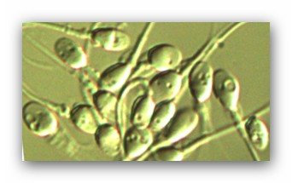
What is good semen quality?
Sperm analysis according to the WHO criteria is undergoing changes:
- Has been revised in 2010
- A so called „normal“ sperm sample according to the WHO criteria is not necessarily a good sperm sample
(e.g. a sperm sample with 5% normal morphology)
Which other criteria for sperm quality do we know ?
- Tests for DNA integration
(e.g. TUNEL-Assay, Comet assay, Halosperm)
- Tests for protamination
(e.g. Acritin orange)
- PICSI
- Subtle morphology (MSOME)

Slide 7
MSOME
Detailed examination of subtle sperm morphology by MSOME was first introduced by Bartoov et al. 10 years ago.
It allows the examination of the sperm’s fine morphology in vivo at high magnification (6000-12500x), thus providing the possibility of detailed sperm analyses, in particular assessment of the sperm head.
MSOME enabled the observation of so-called nuclear vacuoles, which cannot be detected by lower magnifications.
MSOME was subsequently applied to complement ICSI, and IMSI (intracytoplasmic morphologically selected sperm injection) was successfully established in ART.

Slide 8
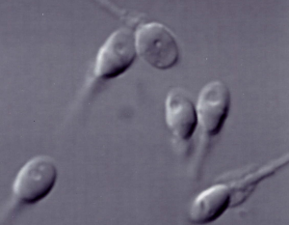
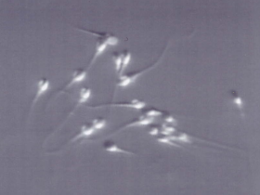
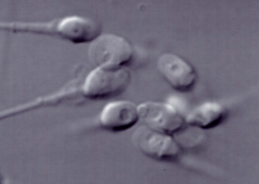
Average sperm magnification
X 300
1
MSOME
X 6000-10000
2

Slide 9
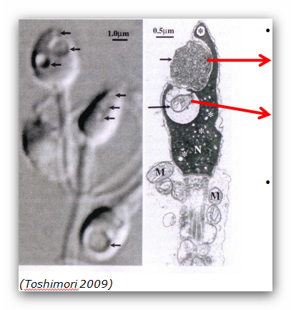
Vacuolisation?
Amorph substances ?
Membranous structures?
Small vesicles without inner structures?
Craters? (Westbroock, 2000),
Hollow? (Watanabe, 2009),
Vesicles?

Slide 10
Nature of Nuclear Vacuoles?
Franco et al. , observed 2008 a high level of denatured DNA in spermatozoa with large nuclear vacuoles
Oliveira et al showed 2010 a positive correlation between percentages of spermatozoa with nuclear vacuoles and those with DNA fragmentation.
Perdrix et al found 2011 that aneuploidy and chromatin condensation defects are important alterations observed in sperms exhibiting nuclear vacuoles

Slide 11
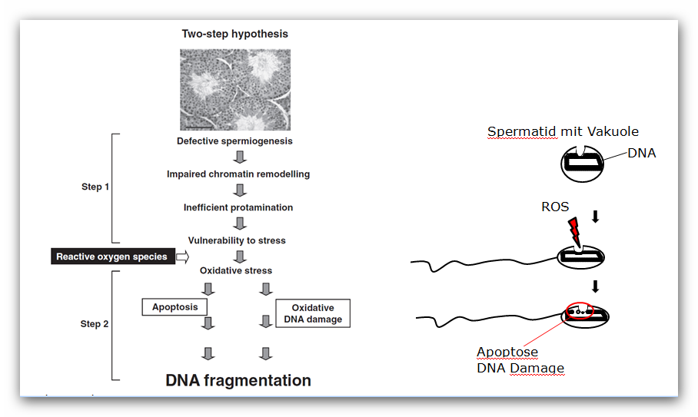
Two step hypothesis
Spermatid with vacuole
Aitken RJ, Smith TB, Jobling MS, Baker MA, De Iuliis GN. Oxidative stress and male reproductive health. Asian J Androl 2014;16:31-8
Notes:
In summary, the “in vivo” formation of large vacuoles appearing as non-membrane-bound areas may originate from spermiogenesis impairment through uneven processes of chromatin condensation. This results in anomalies of sperm chromatin packaging and abnormal chromatin remodeling during sperm maturation which, in its turn, may render spermatozoa more vulnerable to DNA damage.

Slide 12
Routine
In our center we use MSOME routinely to find best suitable sperm for ART (IMSI)
It involves the grading of spermatozoa at x6000-x12,500 magnification according to the presence of nuclear vacuoles (Vanderzwalmen et al., 2008)
class I: normal shaped sperm without vacuoles or with 1-2 small vacuoles <4% of the head length
class II: normal shaped sperm with one or more large vacuoles > 4% head area
class III: sperm with abnormal morphology with our without vacuoles.

Slide 13
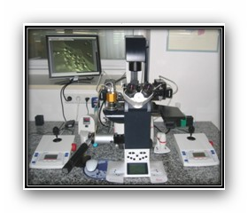
IMSI Unit Leica 6000

Slide 14
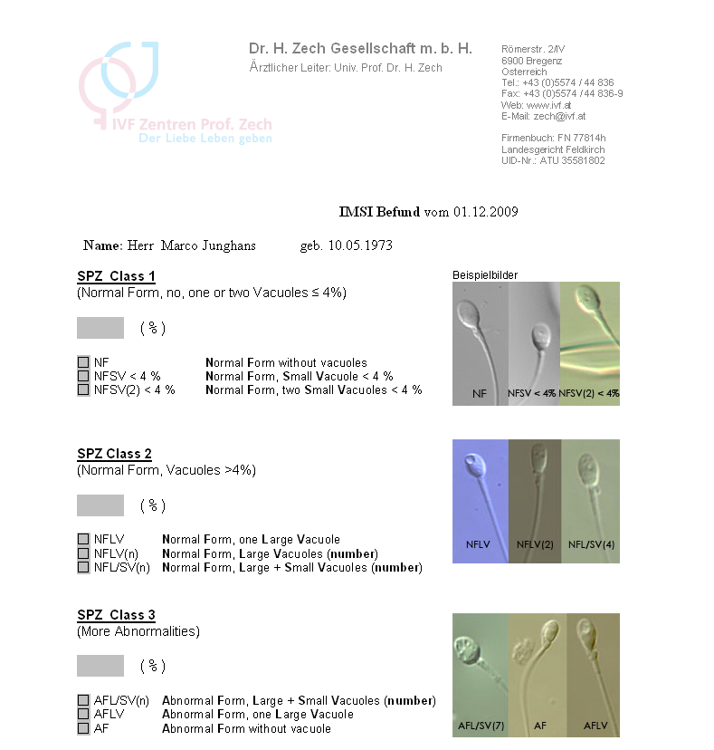
Report

Slide 15

So How to Get Class I Sperms?

Slide 16
Which Factors Impair
Semen Quality?
Drugs, e.g. chemotherapy
Varicocele
Genetic disorders (Klinefelter, AZF1 +2, mucoviscidosis and others)
Environmental factors such as xenooestrogens, PCBs, bisphosphates, radiation ...
Infections : Chlamydia, epididymitis, prostatitis
Age
Lifestyle factors such as BMI, ejaculation frequency and nutrition
Most of the factors described above contribute to generation of and/or exposure to oxidative stress

Slide 17
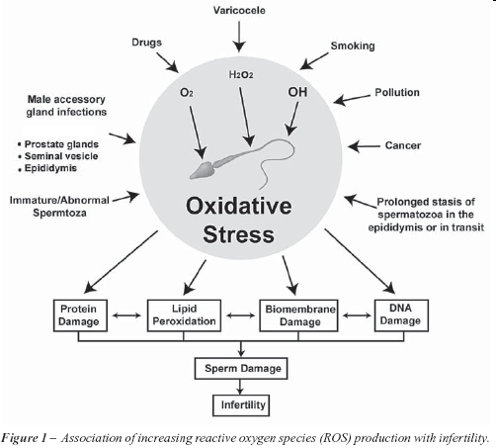
Marcello Corcuza- Int. braz j urol. vol.33 no.5 Rio de Janeiro Sept./Oct. 2007

Slide 18
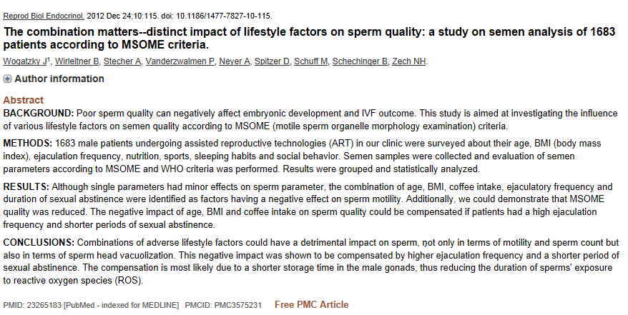

Slide 19
Proposed Strategies to Prevent
Impact on Sperm or Reduce Oxidative Stress
Minimize gonadotoxins and hyperthermia
  E.g. quit smoking, hot-tubs, occupational hazards
Antibiotics for semen or genital tract infection
  Reduction of leukocytes in semen diminishes the main producers of ROS
  Reduction of abacterial inflammation:-e.g. lycopene (antiinflam. feature)
Improvement of blood flow- e.g. l- citrullin ( precursor of l-arginine -NO donator)
Improvement of antioxidative enzyme activity- e.g. zinc, selenium improving the gluthation-peroxidase-enzyme-activity
Improvement of mitochondrial funtion- e.g. coenzyme Q10, l-carnitin
Distinct antioxidative supplementation- e.g. Vit C, Vit E, folic acid, glutathion, N-acetyl-cysteine as precursor of glutathione

Slide 20
Supplement Facts
Fertilovit®Mplus | Daily dose | % RDA *
Vitamin C (sustained rel.) | 100 mg | 125
Vitamin E | 100 mg | 833
Folic acid | 500 µg | 250
Zinc | 25 mg | 250
Selenium | 100 µg | 182
L-citrulline | 300 mg | -
L-carnitine | 300 mg | -
N-acetyl-L-cysteine | 50 mg | -
Glutathione, red. | 50 mg | -
Coenzyme Q10 | 15 mg | -
Lycopene | 4 mg | -
% of recommended daily allowance (according to EU-guidelines)

Slide 21
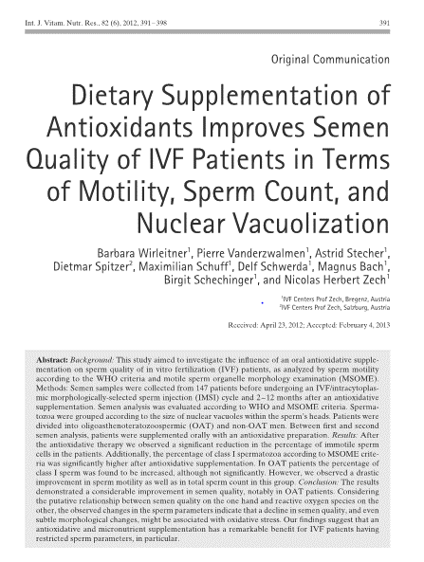
Can a supplemet improve sperm according to vacuolisation rate?
Yes!

Slide 22
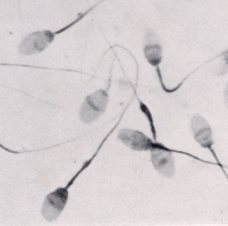
Can a Supplement also
Improve Blastocyst Quality?
The semen analyses and IVF/IMSI treatment outcomes of 92 subfertile male IVF patients and their partners were evaluated in two separate treatment cycles. One cycle was performed with no supplementation, the second cycle with an antioxidant supplementation ( Fertilovit Mplus).
Parameters analyzed with respect to semen quality:
Semen volume
Concentration
Motility
Morphology according to MSOME (motile sperm organelle morphology examination)
Treatment outcome:
2PN
Blastocysts
Top-Blastocysts
Fertilization rate
Pregnancy rate
Ongoing pregnancy rate
The Student’s t-test and chi square test were used to evaluate the significance of data.

Slide 23
Results
– Semen Quality
 | First cycle without Supplementation | Second cycle with Supplementation | p-value
Male characteristics
Male age (years) | 39.2 +/- 8.5 | 40.6 +/-8.5 | n.s
Male BMI (kg/m2) | 26.0+/-3.0 | 26.1+/-3.1 | n.s
Semen assessment
Sample volume (ml) | 2.9 +/- 1.5 | 2.3 +/- 1.4 | < 0.01
Total sperm count (TSC) | 44.3 +/- 49.5 | 49.4 +/- 41.5 | n.s
Concentration (Mio/ml) | 16.7 +/- 17.6 | 20.8 +/- 22.5 | n.s
Sperm motility (%)
Grade a | 3.9 +/- 6.3 | 4.0 +/- 6.5 | n.s
Grade b | 30.6 +/- 18.7 | 29.0 +/- 19.6 | n.s
Grade c | 14.9 +/- 14.7 | 21.4+/- 18.1 | < 0.05
Grade d | 50.6 +/- 24.2 | 45.6 +/- 22.1 | n.s
Progressive Motility (%) | 34.5 +/- 21.6 | 32.6 +/- 21.3 | n.s
MSOME criteria (%)
Class I | 3.8 +/- 4.9 | 6.0 +/- 5.8 | < 0.01
Class II | 38.9 +/- 16.7 | 41.9 +/- 14.5 | n.s
Class III | 57.3 +/- 19.3 | 52.1 +/- 18.0 | n.s

Slide 24
Results
– Treatment Outcome
 | First cycle without Supplementation | Second cycle with Supplementation | p-value
Female Age (years) | 36.8 +/- 4.2 | 38.1 +/- 3.9 | n.s
Stimulation dose (IU) | 2451 +/- 745 | 2647 +/- 764 | n.s.
Number of oocytes retrieved (total) | 1127 | 1092 | n.s.
Oocytes (mean) | 12.4 +/- 5.9 | 12.1 +/- 5.7
Number of 2PN (total) | 672 | 659
2PN (mean) | 7.3+/- 3.9 | 7.3 +/- 4.3
FR (%) | 59.6 | 60.4 | n.s.
Number of blastocysts (total) | 267 | 288 | .
Blastocysts (mean) | 2.9 +/- 2.4 | 3.1 +/- 2.7
Blastocyst Rate (%) | 39.7 | 43.7 | n.s.
Top-Blastocysts (mean) | 0.4 +/- 1.1 | 0.6 +/- 1.0
Top BR (%) (Nb. of top-blastocysts) | 5.5 (n= 37) | 8.5 (n= 56) | < 0.05
Embryos transferred | 1.9+/- 0.4 | 1.9+/- 0.3 | n.s.
PR | 34.8 | 44.5 | n.s.
cPR | 32.8 | 39.1 | n.s.

Slide 25
Fertilisation and Blastocyst Rates

Slide 26
Fertilisation and Blastocyst Rates

Slide 27
Pregnancy

Slide 28
Data Hints at an Positive Impact of the Compount Antioxidant
Treatment on Late Paternal Effects
Day 0 1 2 3 4 5
abnormal development/ abortion
abnormal development
„Late paternal effects“
„Early paternal defects“
Sperm-Nuclear-Defects
Sperm Cytoplasmic Defects
Chromosomal aberrations
DNA fragmentation
Oocyte activation factor
Centriole

Slide 29
Conclusion
In previous studies, we could show, that a specific supplementation ( Fertilovit®Mplus ) improved sperm quality significantly, not only on WHO criteria (as shown in a previous study), but also with respect to morphology as evaluated according to MSOME criteria.
In addition to this, in this study a significant impact on the top blastocyst rate as well as a marked improvement of pregnancy rate and ongoing pregnancy rate was observed.
This is consistent with other studies (Ross et al, 2010 and Showell et al, 2011) and the observed correlation between sperm head vacuolisation and success of fertility treatment and might hint at an influence of antioxidatives (Fertilovit®Mplus) on late paternal effects
We strongly believe, that the issue of sufficient antioxidant uptake should be addressed when counseling and treating ART-patients

Slide 30
Thanks to...
H.Zech
N.Zech
M.Murtinger
M.Schuff
B.Wierleitner
B.Schechinger
A.Stecher

Slide 31
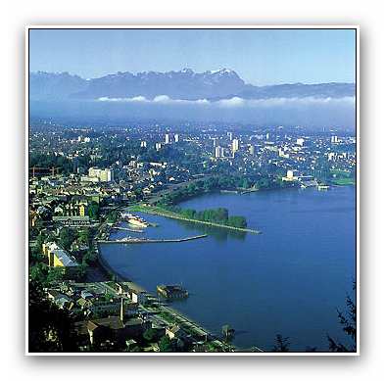
Thank you for your attention !

