Slide 1

A P53-Based Strategy to Reduce Hematological Toxicity of Chemotherapy: A Pilot Study
Presented by Joel E Michalek PhD
Department of Epidemiology and Biostatistics
5 November 2015

Slide 2
Authors
Chul Ha, UTHSCSA, CTRC
Joel Michalek, UTHSCSA
Richard Elledge, UTHSCSA
Kevin Kelly, UTHSCSA, CTRC
Suthakar Ganapathy, UTHSCA, CTRC
Hang Su, UTHSCSA, CTRC
Carol Jenkins, UTHSCSA, CTRC
Athanassios Argiris, UTHSCSA
Ronan Swords, UTHSCSA, CTRC
Tony Eng, UTHSCSA, CTRC
Anand Karnad, UTHSCSA, CTRC
Richard Crownover, UTHSCSA, CTRC
Gregory Swanson, UTSHCSA, CTRC
Brad Pollock, UC Davis
Zhi-Min Yuan, UTHSCSA, CTRC

Slide 3
Background
P53 activation is the primary mechanism underlying pathological responses to DNA-damaging agents such as chemotherapy and radiotherapy.
We recently showed in animal studies that low dose arsenic (LDA)-induced transient p53 inhibition selectively protected normal tissues from chemotherapy-induced toxicity.

Slide 4
Objectives
Define the lowest safe dose of arsenic trioxide that blocks p53 activation in patients
Assess the potential of LDA to decrease hematological toxicity from chemotherapy

Slide 5
Methods
Patients scheduled to receive a minimum of 4 cycles of myelosuppressive chemotherapy were eligible
For objective 1, dose escalation started at 0.005 mg/kg/day for 3 days. This dose satisfied objective 1
Subjects received this dose of LDA prior to cycles 2, 4 and 6 and no LDA prior to 1, 3, 5.

Slide 6
Methods
P53 level in peripheral lymphocytes was measured on day 1 of each cycle by ELISA.
Cycles 1, 3, 5 served as baseline for 2, 4, 6
If p53 activity for the subsequent cycle was lower than baseline then p53 was labelled ‘suppressed’ for the pair of cycles.
If higher, then ‘activated’.
p53 activity groups: suppressed, activated

Slide 7
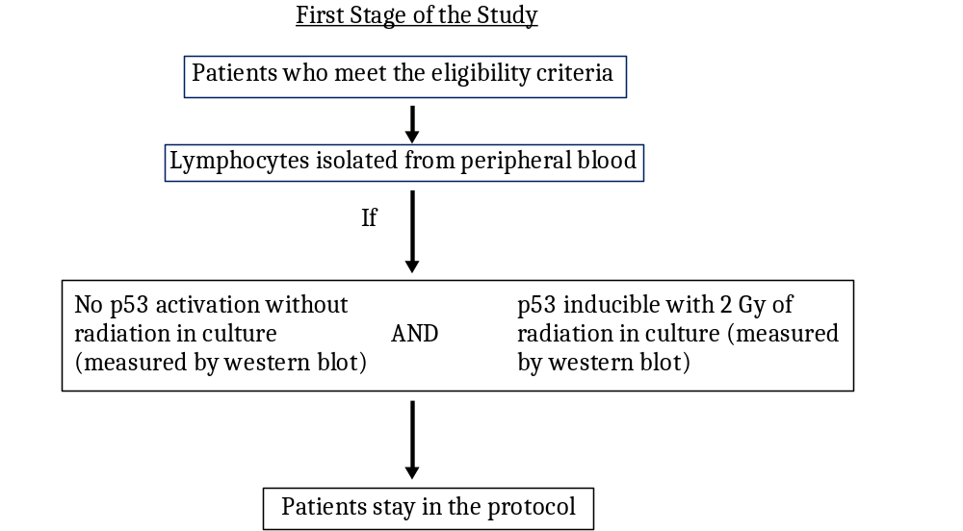
Study Diagram 1

Slide 8
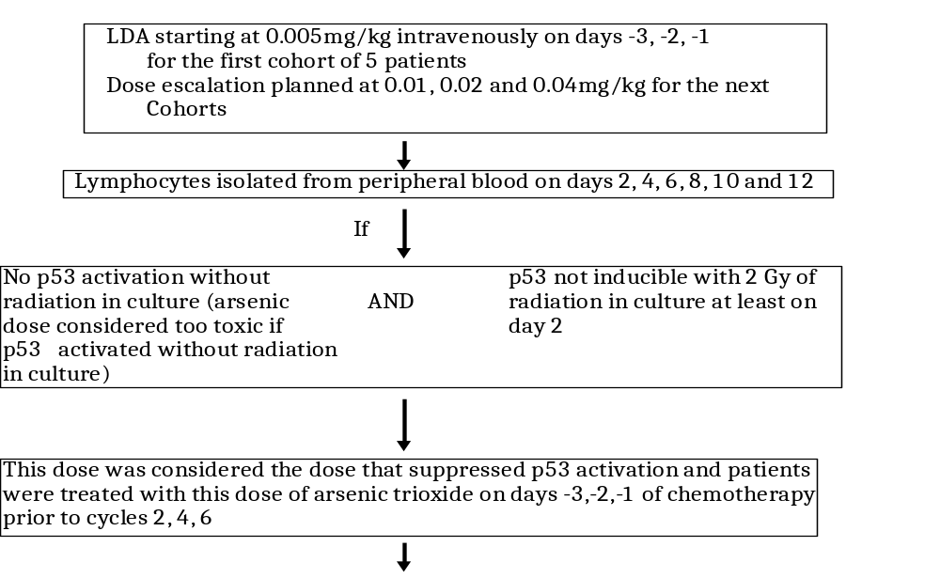
Study Diagram 2

Slide 9
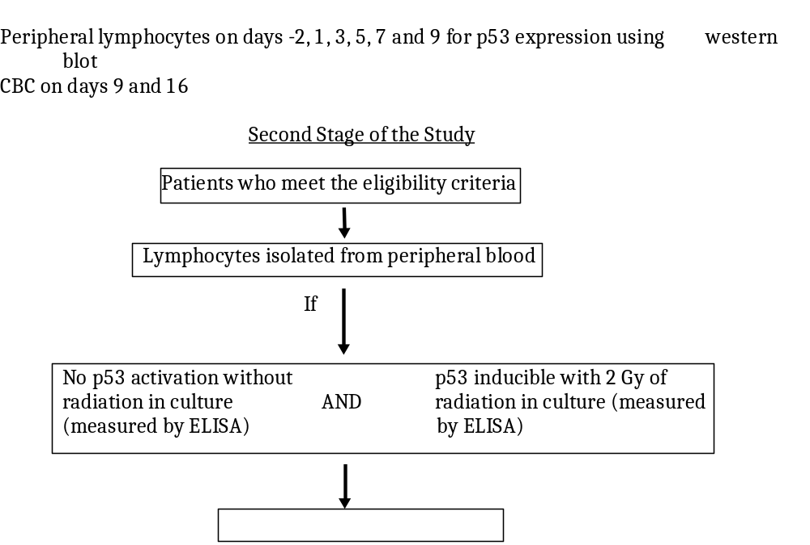
Study Diagram 3

Slide 10
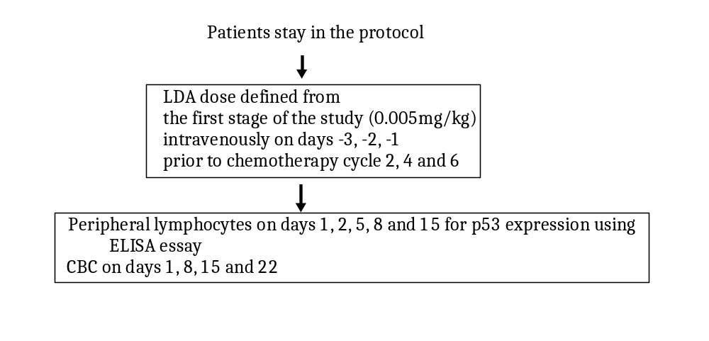
Study Diagram 4

Slide 11
Design
Cycle 1 Cycle 2 Cycle 3 Cycle 4
No Arsenic Arsenic No Arsenic Arsenic
1 8 15 1 8 15 1 8 15 1 8 15
Day

Slide 12
Methods
P53 activity groups were compared with regard to the Complete blood count (CBC)
  ANC
  Platelets
  WBC
  Hgb
Repeated measures linear models of CBC in terms of day, cycle, p53 activity, interactions were used.

Slide 13
Results

Slide 14
Dose Escalation
The first 5 patients accrued had suppression of p53 activation on days 2 and 4 at the starting dose of 0.005 mg/kg for 3 consecutive days
The suppression was temporary and reversed after day 4 for all 5 patients
This dose was determined to be the lowest safe dose of LDA that suppressed p53 activity
And was used to treat all subsequent patients

Slide 15
Excluded WBC and ANC
Six patients were treated with a total of 19 doses of filgrastim or pegfilgrastim.
We excluded the WBC counts and ANC during the cycles after the pegfilgrastim use.
No patient received packed red blood cell transfusions during the first 2 cycles of chemotherapy.

Slide 16
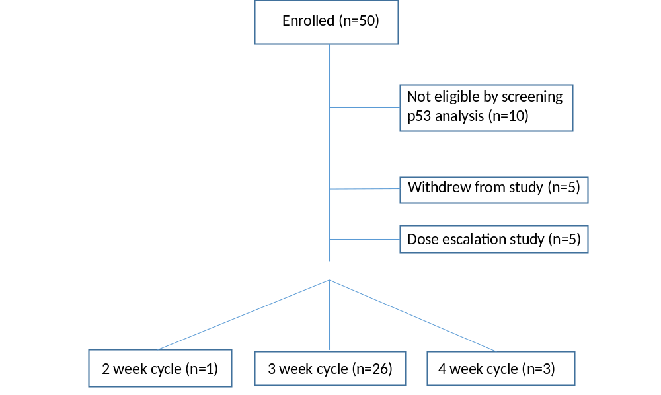
Consort Diagram

Slide 17
Demographics
Characteristic | Total (N = 26)
Age (years)
Mean±SD | 52.7±11.3
Gender
Female | 17 (65.4%)
Male | 9 (34.6%)
Total | 26
Current Diagnoses
Breast cancer | 14 (53.9%)
Diffuse large B cell lymphoma | 1 (3.9 %)
Lung cancer | 5 (19.2%)
Multiple myeloma | 1 (3.9%)
Prostate cancer | 4 (15.4%)
Rhabdomyosarcoma | 1 (3.9%)
Total | 26
Previous Treatments
Chemotherapy alone | 2 (7.7%)
Chemotherapy and radiation therapy | 6 (23.1%)
Radiation therapy alone | 4 (15.4%)
None | 14 (53.9%)
Total | 26

Slide 18
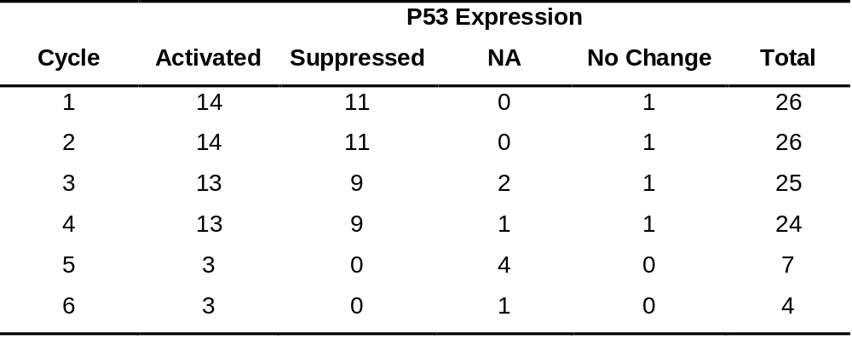
Sample sizes

Slide 19
CBC by p53 activation
Count |  | Activated | Suppressed | Contrast
WBC | Mean±SE | 1.13±0.055 | 1.41±0.068 | -0.28±0.088
 | 95% CI |  |  | -0.454, -0.106
 | p-value |  |  | 0.002
HgB | Mean±SE | 2.43±0.013 | 2.48±0.015 | -0.051±0.02
 | 95% CI |  |  | -0.091, -0.012
 | p-value |  |  | 0.012
Platelets | Mean±SE | 5.53±0.053 | 5.53±0.064 | 0.006±0.084
 | 95% CI |  |  | -0.161, 0.172
 | p-value |  |  | 0.945
ANC | Mean±SE | 7.36±0.08 | 7.61±0.1 | -0.26±0.13
 | 95% CI |  |  | -0.512, -0.004
 | p-value |  |  | 0.046

Slide 20
Chemotherapy Regimens
Regimen | N
Rituximab, doxorubicin, cyclophosphamide, vincristine, predisone Docetaxel, cyclophosamide Doxorubicin, cyclophosamide Carboplatin, bevacizumab, premetrexed Bortezombi, lenalidomide, dexamethasone Docetaxel, prednisone Doxorubicin, vincristine, etoposide, ifosfamide Carboplatin, etoposide Cisplatin, etoposide | 1 7 5 2 1 5 1 1 1

Slide 21
Safety
No adverse events attributable to arsenic
No patient was removed due to arsenic toxicity
No clinically significant changes in electrocardiograms, including the QT interval in any subject

Slide 22
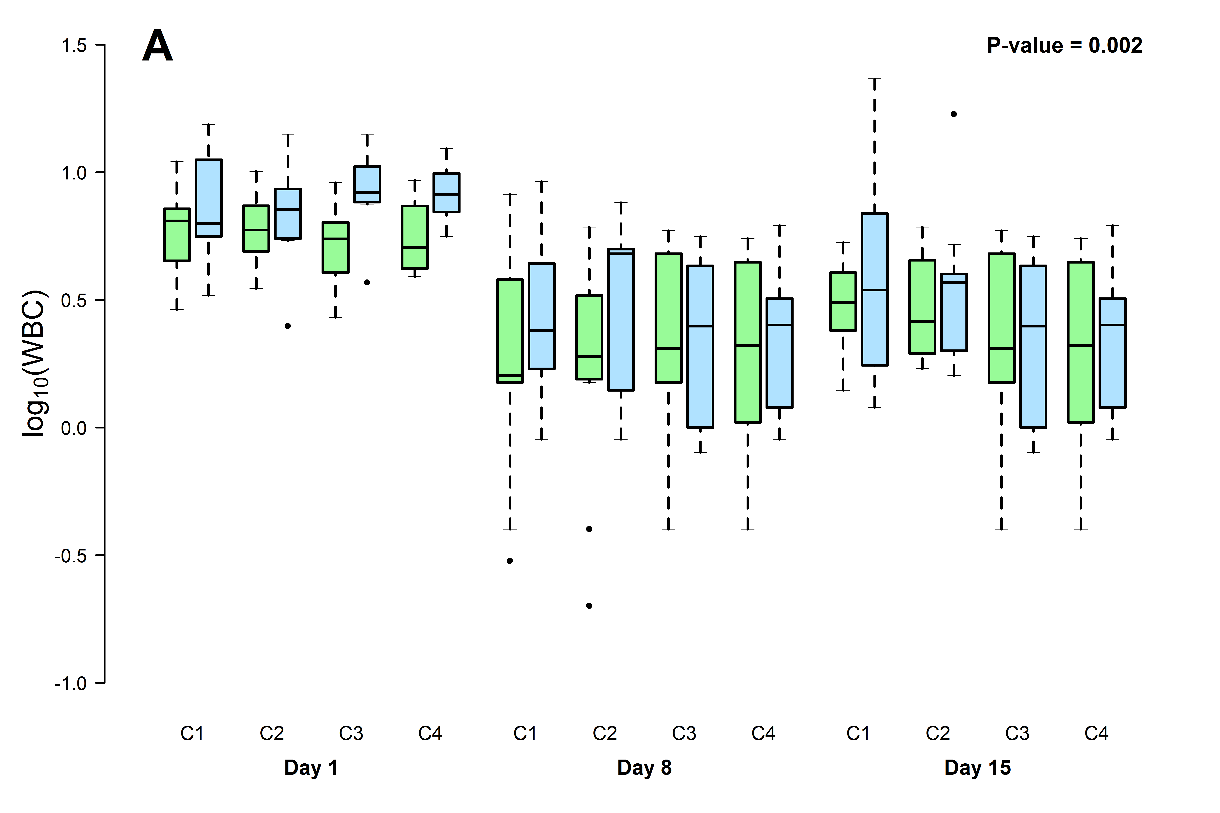
Figures
green: activated, blue: suppressed

Slide 23
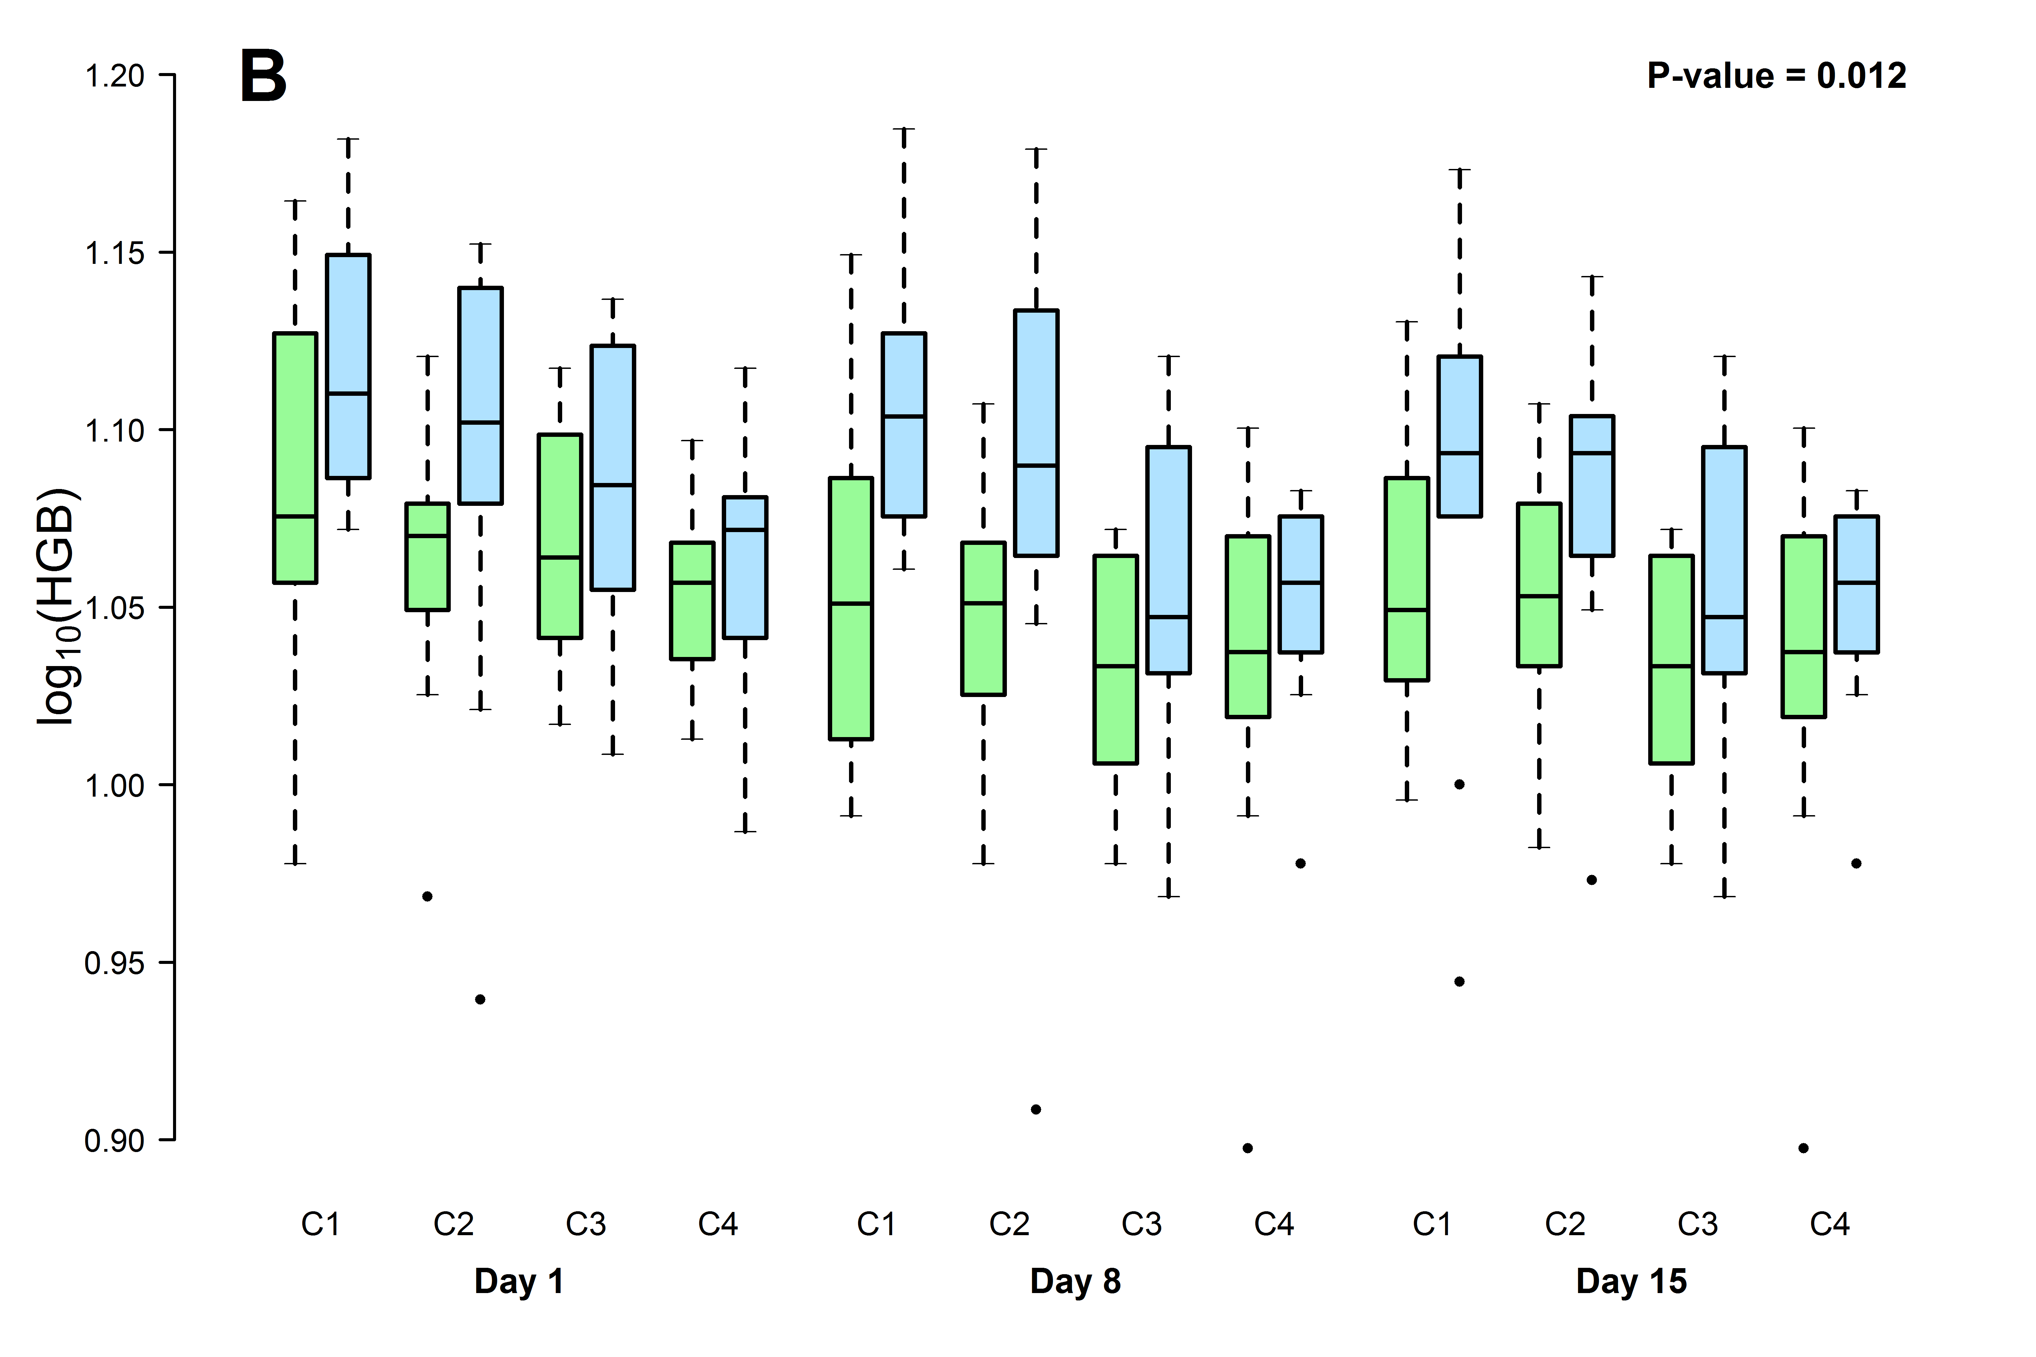
Figures
green: activated, blue: suppressed

Slide 24
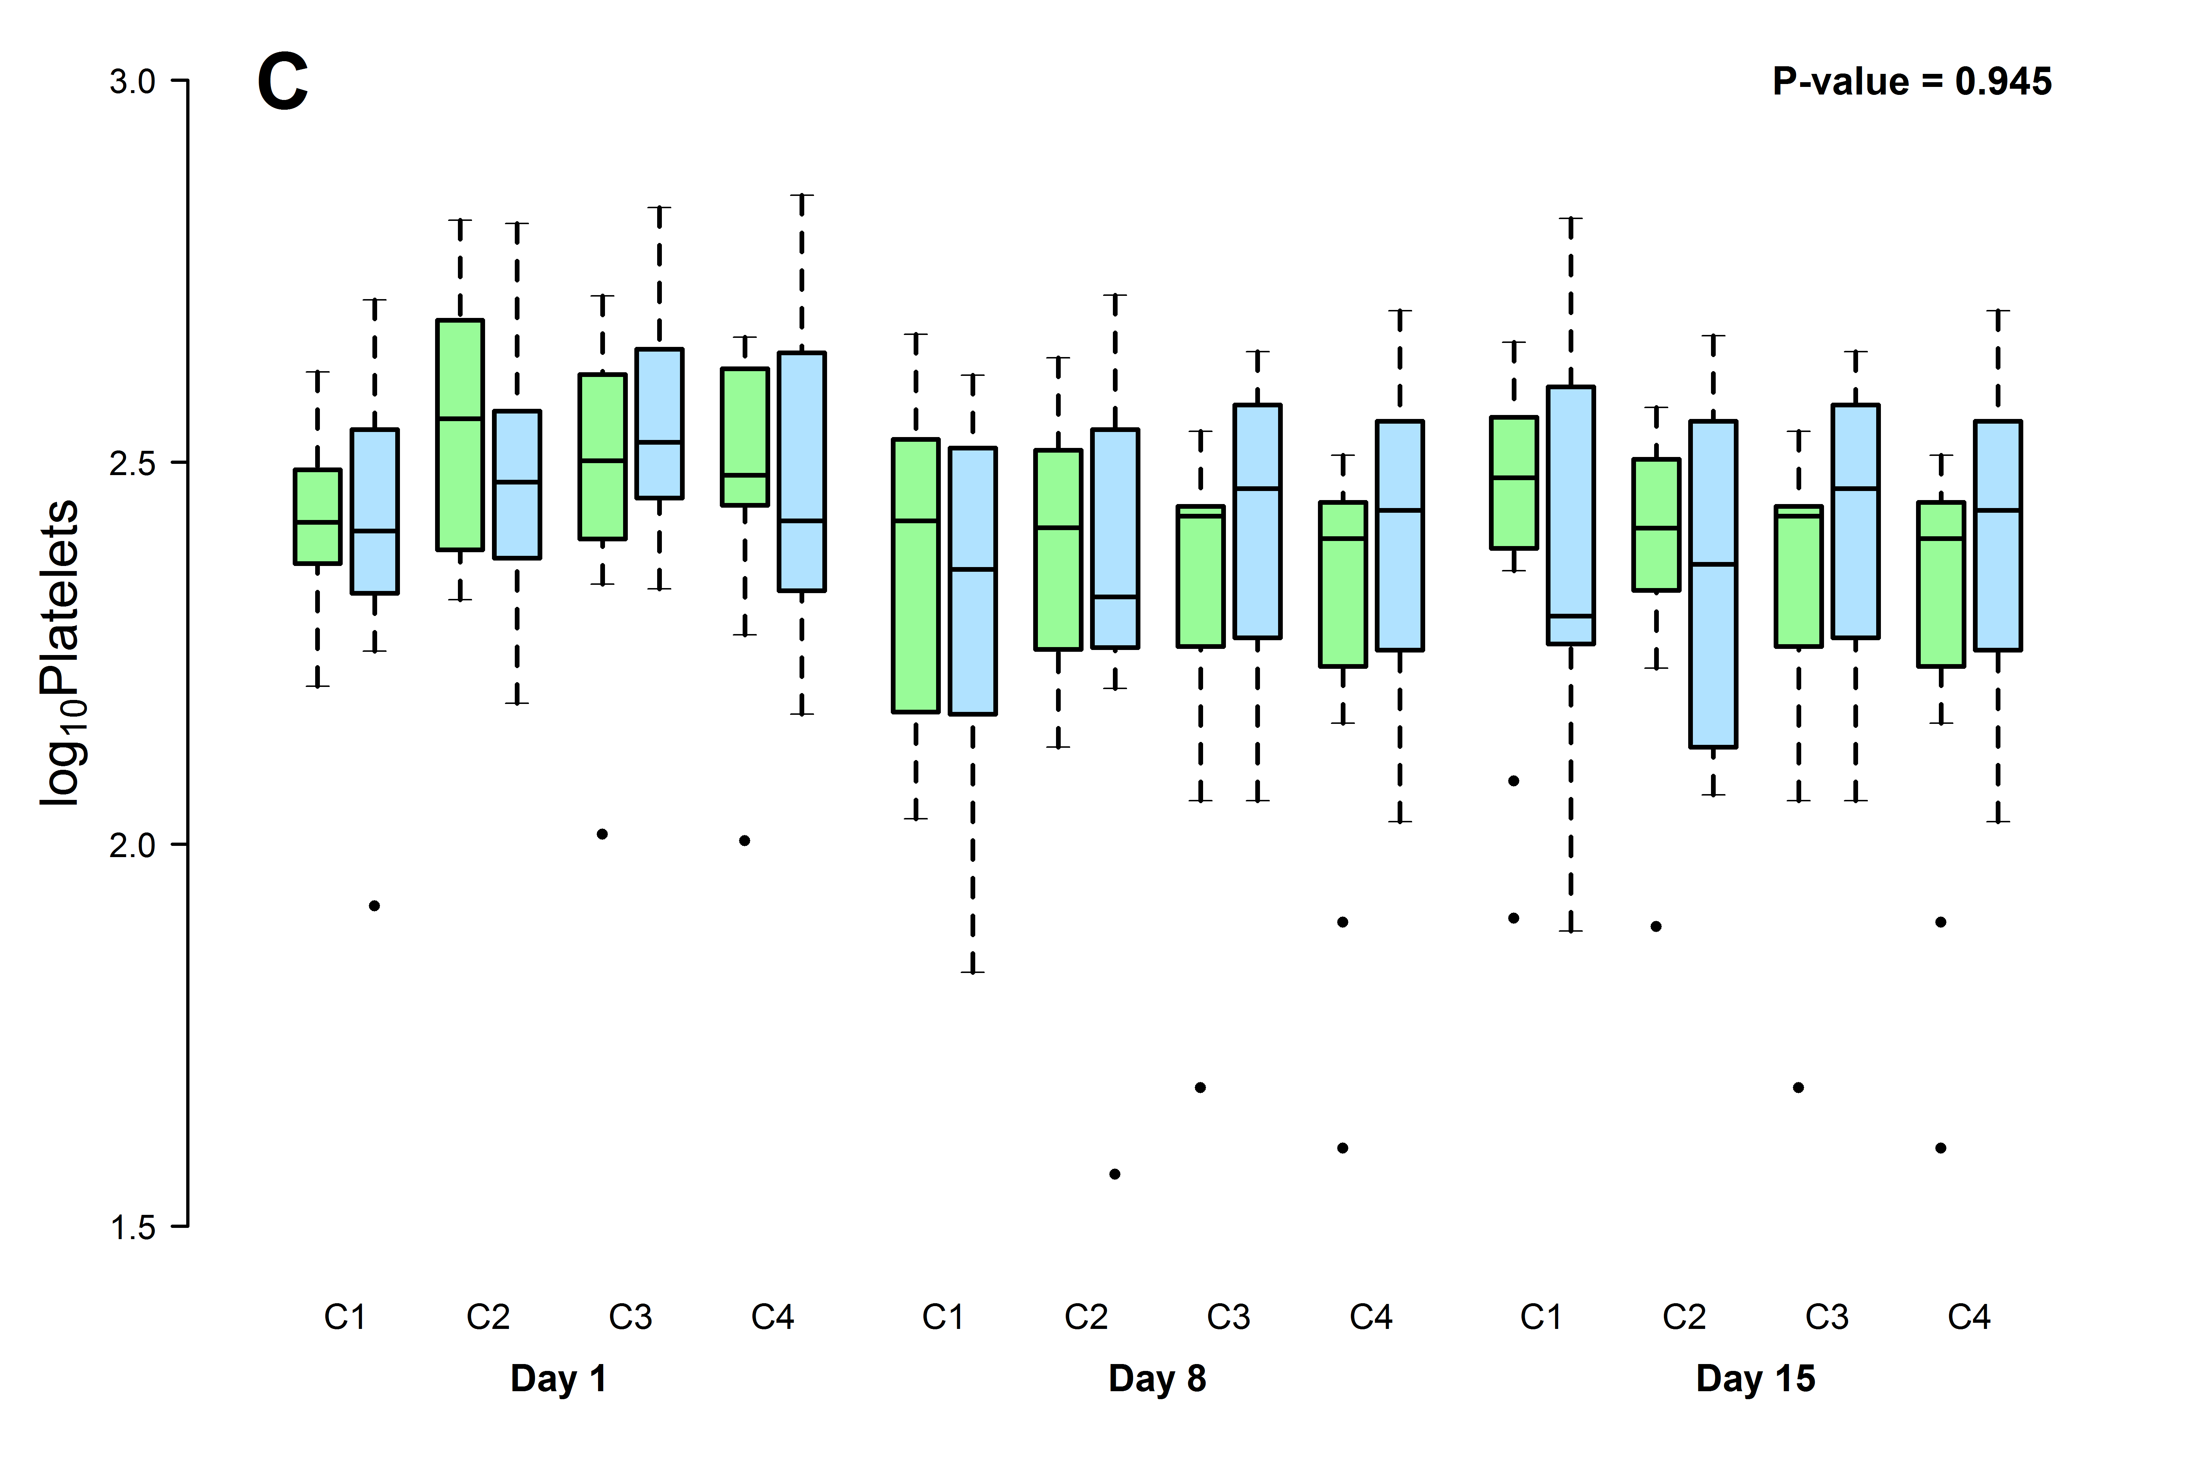
Figures
green: activated, blue: suppressed

Slide 25
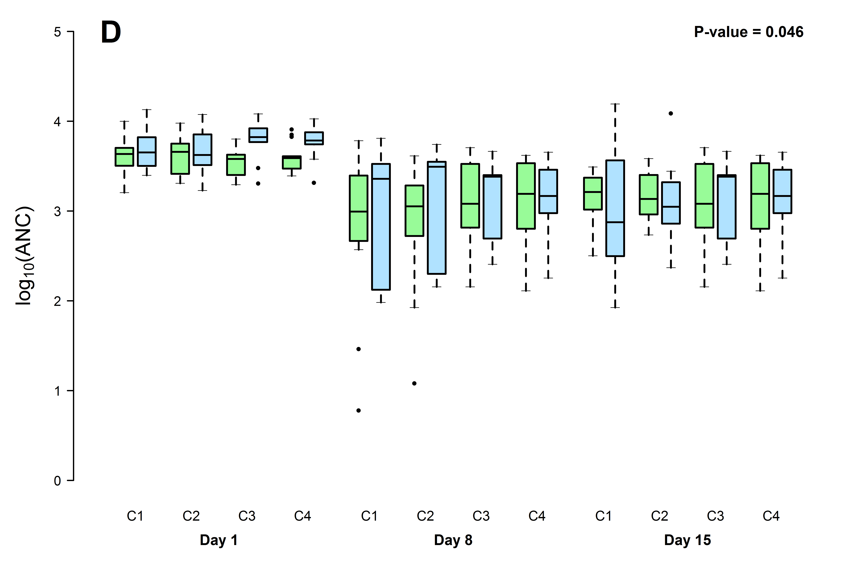
Figures
green: activated, blue: suppressed

Slide 26
Conclusion
These data support the proof of principle that suppression of p53 could lead to protection of bone marrow in patients receiving chemotherapy

Slide 27
The End
Questions?

