Slide 1

Implementation of Appropriate Particle Dynamics in CFD for Wet Compression
International Conference on
Power and Energy Engineering
September 29-30, 2016 London, UK
Presented by
Jobaidur Rahman Khan, PhD
University at Buffalo, NY, USA
September 29th, 2016

Slide 2
Outline
Introduction to Wet Compression
Different Droplet Dynamics (Starting with Navier Stokes Equastion)
  Droplet Evaporation
  Droplet Coalescence
  Droplet Breakup
  Droplet Heat Transfer and Mass Transfer
  Droplet Drag
  Erosion
Conclusions

Slide 3
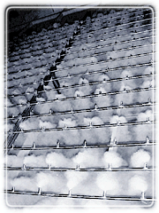
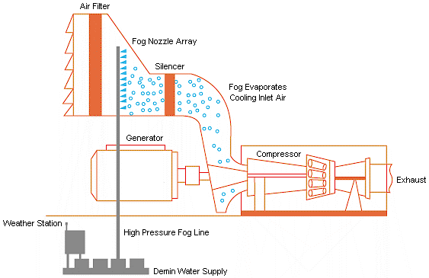
Motivation
Gas turbines suffer for output work in summer time. Elevated temperature makes the compressors work more, which reduces the net output work. Every 1°F raise of ambient temperature reduces gas turbine efficiency by 0.3-0.5%.
A several attempts are taken to recover the energy shortage, e.g. using a standby turbine to recover the shortage, intercooling by intercooler, refrigerated cooling, mist or fog cooling.
The following cost analysis shows mist cooling is preferred:
Standby Generator – $ 250–400 / KW
Refrigerated cooling system – $ 150–250 / KW
Mist Cooling – $ 35– 50 / KW
Courtesy of Mee Industries

Slide 4
Wet-Compression Theory
1→2: Isentropic Compression
2→3: Isobaric Heat Addition
3→4: Isentropic Expansion
4→1: Isobaric Heat Rejection
2
C.C.
3
Comp
Turb
1
4
T
P
2
2′
3
3
P
S
P
2′
S
S
2
4
S
P
1′
1′
4
1
1
P
S
v

Slide 5

Theory (Fog and Overspray)
P
1→2: Compression in ISO condition
2″′
2
2″
2′
1′→2′: Compression in elevated temp.
c
1′→1″: Effect of inlet fog cooling to saturation
1″→2″: Wet compression with zero overspray
1″→2″′: Wet compression with overspray
Area =
d
1′
1
1″
v

Slide 6
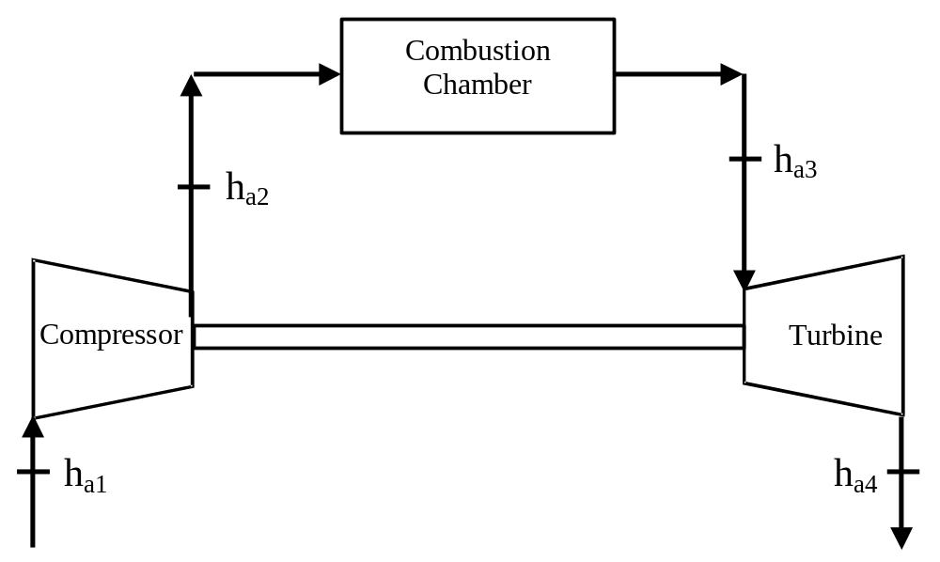
Turbine System (without fog cooling)

Slide 7
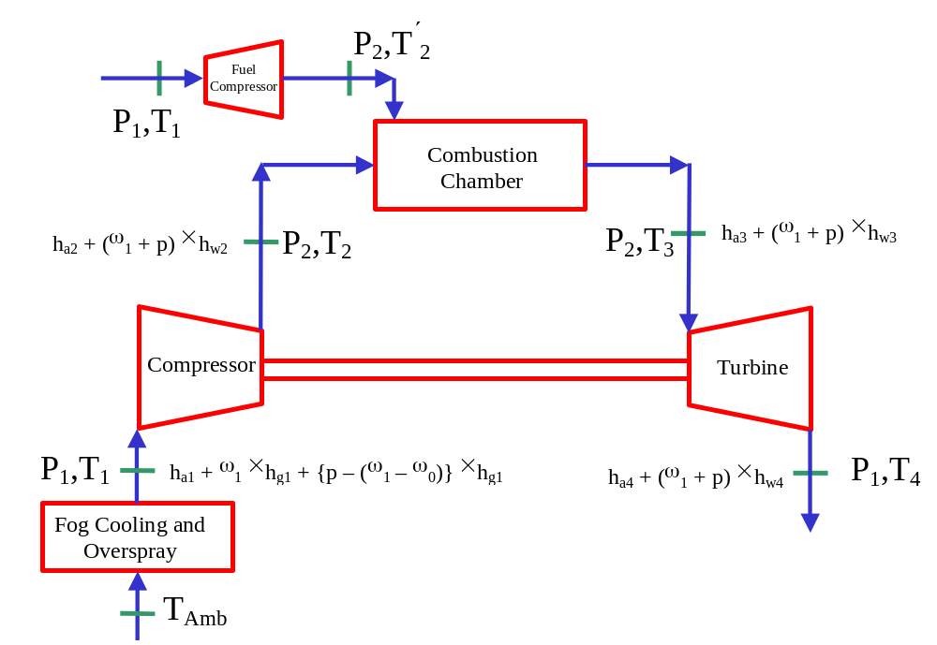
Turbine System (with fog cooling)

Slide 8
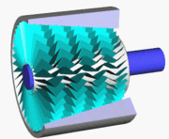
Turbine Blades and Droplets

Slide 9
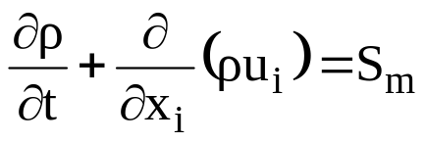
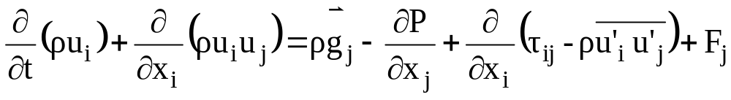
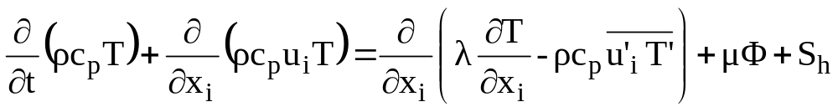
CFD Simulation of rotating frame for compressor for wet compression.
The time-averaged, unsteady state Navier-Stokes equations as well as equations for mass, energy and species transport are solved. The governing equations for conservation of mass, momentum, and energy are given as:

Slide 10
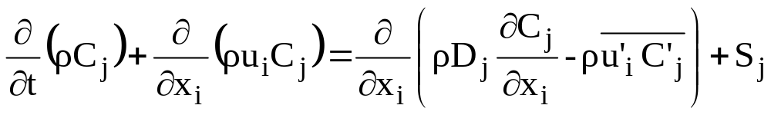
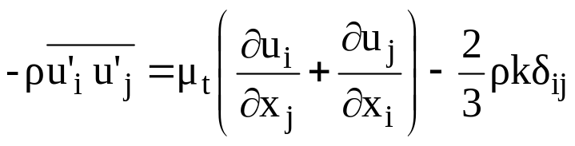
Conservation Equations
In wet compression with fog cooling, water droplets evaporate and the vapor diffuses into its surrounding flow. The flow mixture consists of three main components: water vapor (H₂O), oxygen (O₂) and nitrogen (N₂). The equation for species transport is
The standard k-ε model, which, based on the Boussinesq hypothesis, relates the Reynolds stresses to the mean velocity as

Slide 11
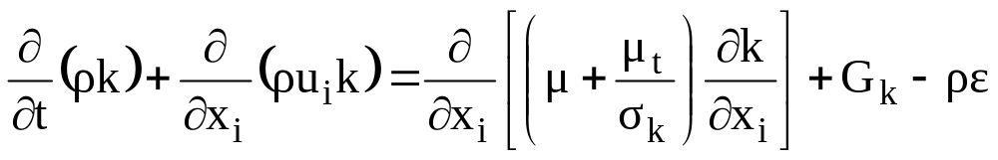
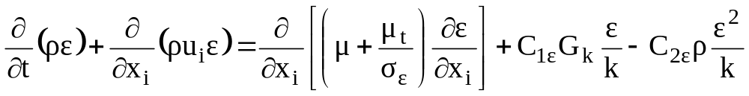
CFD Simulation (Equations)
The equations for the turbulent kinetic energy (k) and the dissipation rate (ε) are:

Slide 12
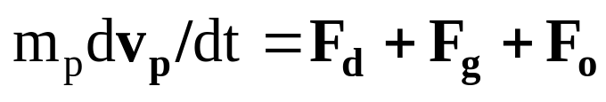
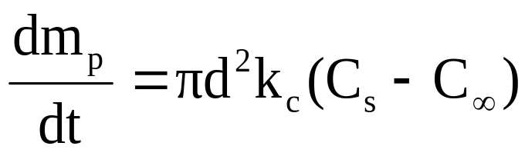
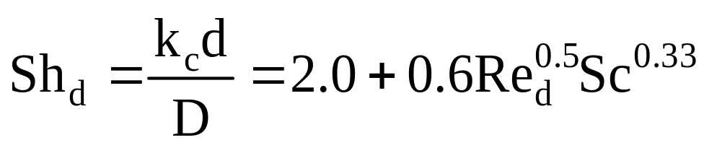
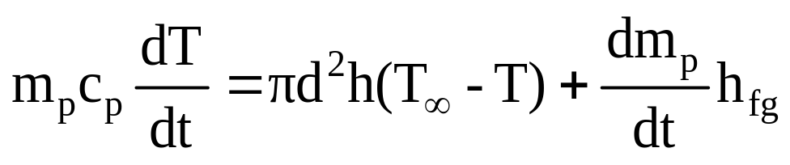
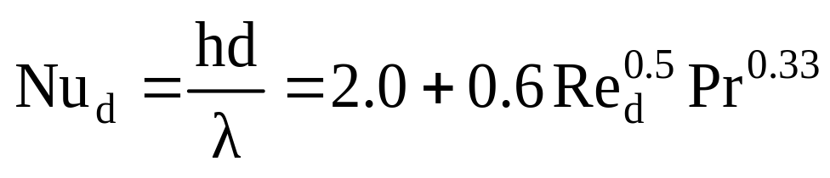
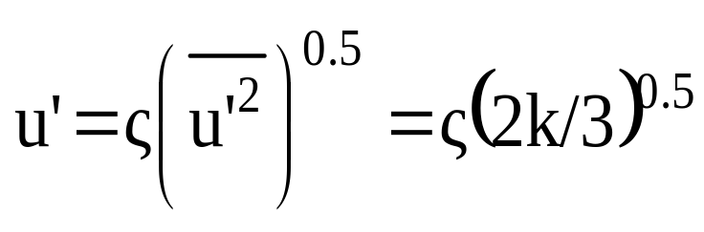
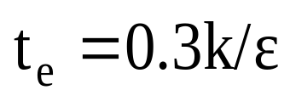
Equations for Discrete Phase of Droplet
Continuity
Mass transfer
Heat transfer
Stochastic method

Slide 13
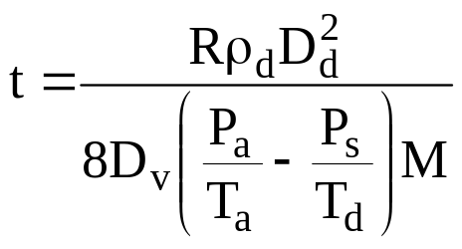
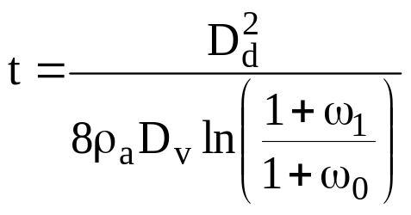
Theory (Evaporation time)
Evaporation time,
R = Universal Gas Constant (8.314Kj/Kmole-K)
ρ_{a} = Air Density (kg/m³), D_{d} = Droplet Dia.(m)
P_{a} = Air Press. (kPa), T_{a} = Air Temp.(K)
P_{s} = Sat. Press. (kPa), T_{d} = Droplet Temp.(K)
M = Molecular Wt.
[Ref: Zheng et. al.]
Evaporation time,
ω₀ = Specific Humidity (kg/kg Dry Air)
ω₁ = Specific Humidity (kg/kg Dry Air) at sat.
[Ref: White et. al.]

Slide 14
Governing Parameters of Evaporation
Ambient temperature is in the range of 20 – 30°C. So, if there is any reduction of pressure in some points, it may get wrong temperature due to the absence of correct data. The following table can help us understand this fact.
Temperature (°C) | Saturation Pressure (kPa) |  | Temperature (°C) | Saturation Pressure (kPa)
0.01 | 0.6117 |  | 30 | 4.2469
5 | 0.8725 |  | 35 | 5.6291
10 | 1.2281 |  | 40 | 7.3851
15 | 1.7057 |  | 45 | 9.5953
20 | 2.3392 |  | 50 | 12.352
25 | 3.1698

Slide 15
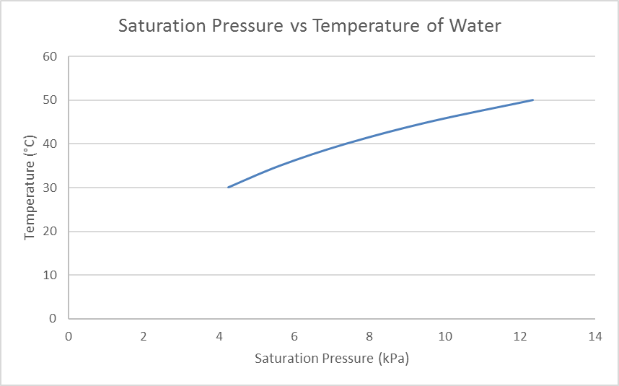
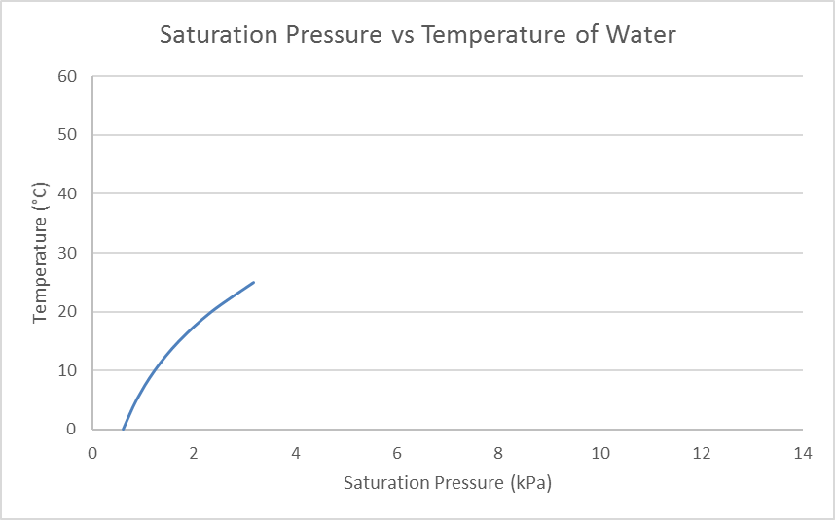
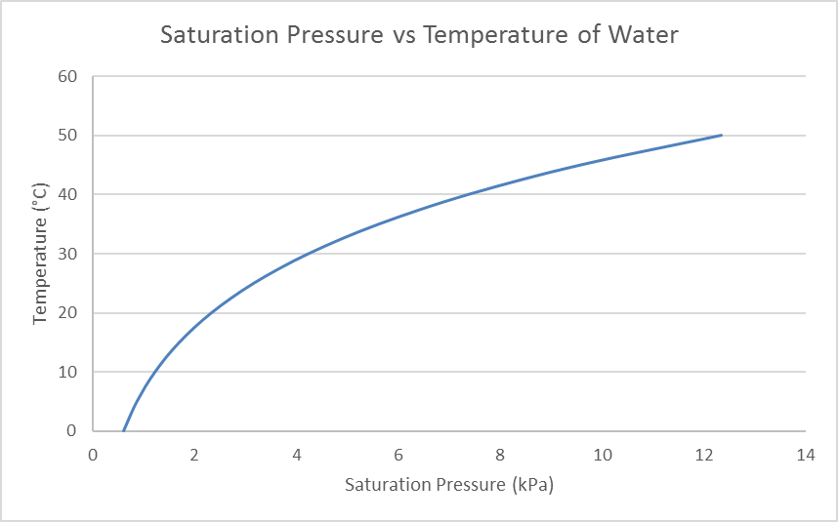
Source of Wrong Prediction

Slide 16
Droplet Coalescence
O'Rourke’s (1981) coalescence model is one of the most renowned one in this study.
(a) This model is dependent on mesh size.
So, in the figure, although droplets 1 and 2 are closer than 1 and 3, but 1 and 2 are not modeled to coalesce, while 1 and 3 will coalesce.
1
2
3

Slide 17
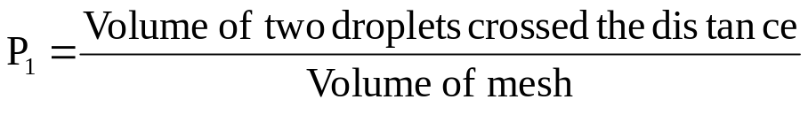
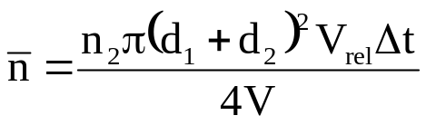
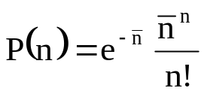
Droplet Coalescence
(b) The probability of the collision,
(c) The exponential distribution is used.
(d) Only head to head collision ends up with coalescence.
So, A will not have coalescence, but B will.
V_{rel}
V
¼π ( + )²
d₁
d₂
V_{rel} Δt
P₁=
d₂
V
A
d₁ + d₂
(Expected # of collision)
d₁
B
n = number of collisions

Slide 18
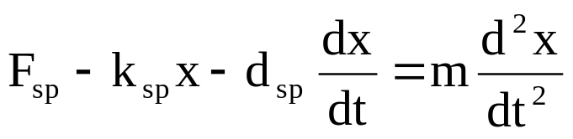
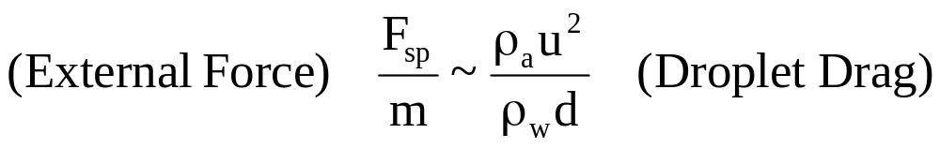
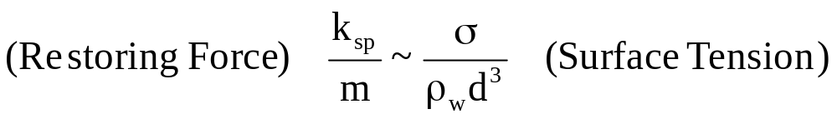
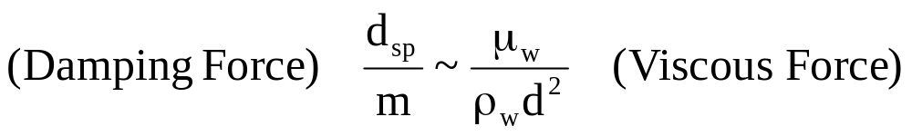
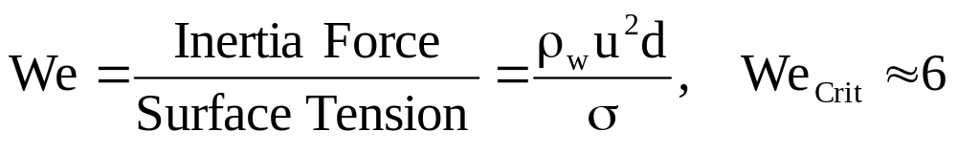
Break-up
The Taylor Analogy Break-up model [O’Rourkes and Amsden (1987)] is used in this study. This method is based upon Taylor's analogy between an oscillating and distorting droplet and a spring mass system as,
F_{sp}
Drag
Surface Tension
k_{sp}
d_{sp}
Viscous Force

Slide 19
Heat and Mass Transfer
Continuity
Mass transfer
Heat transfer

Slide 20


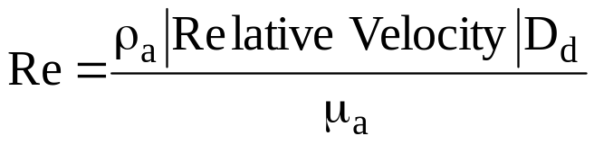
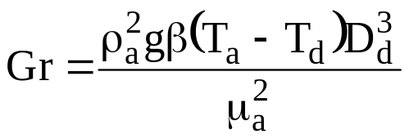
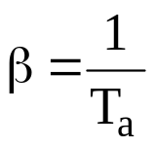
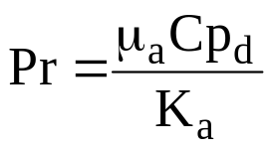
Heat Transfer
For natural convection (when the relative velocity of droplet with respect to main fluid is zero), the Nusselt Number,
For forced convection, the Nusselt Number,
Grashof number (Gr) is given by,
g = Grav. Accl. = 9.81m/s²
ρ_{a} = Air Density (kg/m³), D_{d} = Droplet Dia.(m)
T_{a} = Air Temp. (K), T_{d} = Droplet Temp.(K)
µ_{a} = 1.85×10⁻⁵ pa.sec, K_{a} = 0.024 W/m.K
For real gas,
Prandtl number (Pr) is given by,
[Ref: Mee et. al.]

Slide 21
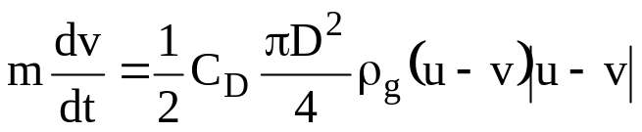
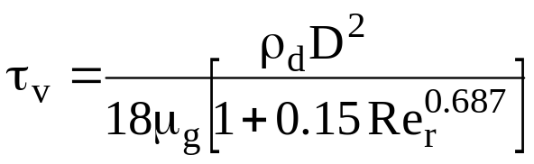
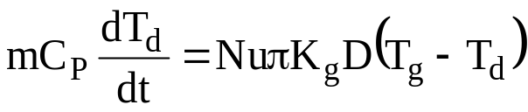
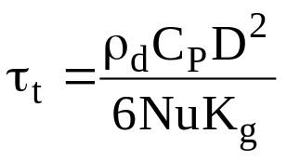
Drag Force
The momentum response time relates to the time required for a particle or droplet to respond to a change in velocity. The equation of motion for a spherical particle in a gas given by,
[Ref: Tsuji et. al.]
After some manipulation, we get, the response time,
[Ref: Schiller & Naumann model]
The equation for particle temperature, assuming the temperature is uniform throughout the particle and radiative effects are unimportant, is
[Ref: Tsuji et. al.]
After some manipulation, we get, the thermal response time,

Slide 22
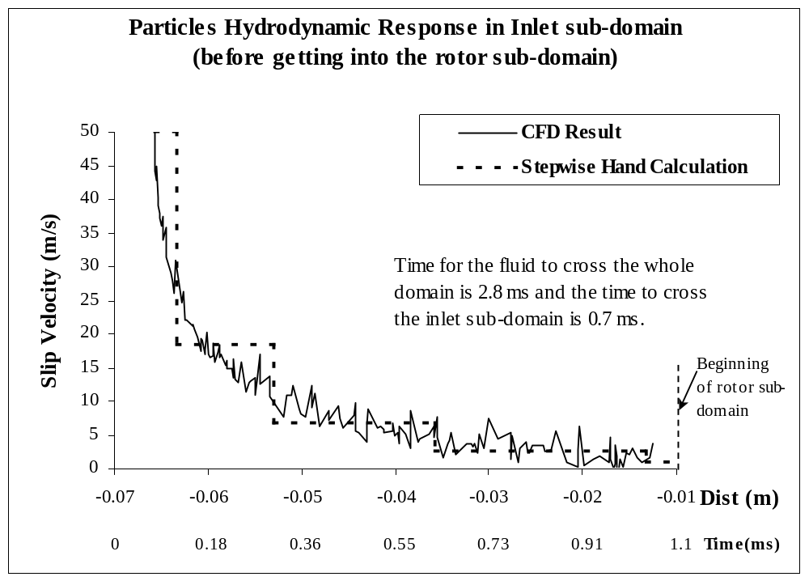
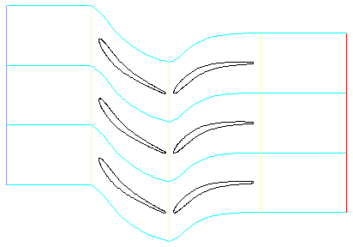
Particles’ Hydrodynamic Response

Slide 23
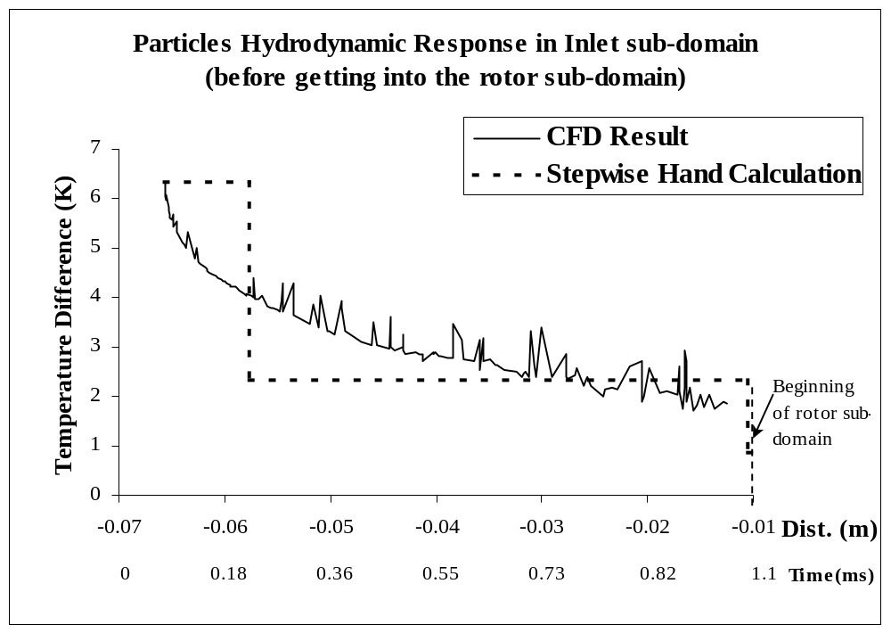
Particles’ Thermal Response

Slide 24
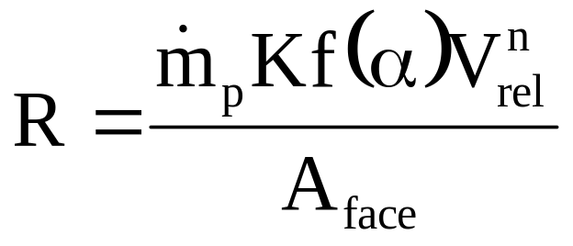
Erosion
Solid particle erosion was modeled in this study for liquid erosion by customizing the required values. This model was correlated by Haugen and Kvernvold et. al. (1995) as,
R = Erosion rate (kg/m²s) m_{p} = Particles mass flow rate (kg/s)
K = Diameter Function α = Angle of attack
f(α) = Function for angle of attack V_{rel} = Particle relative velocity (m/s)
n = Velocity function A_{face} = Erosion area (m²)
Haugen experimented a number of materials for erosion and found K and n values. The material used here is steel, for which K = 2×10⁻⁹ and n = 2.6.

Slide 25
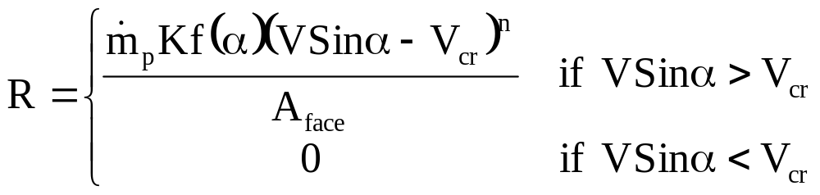
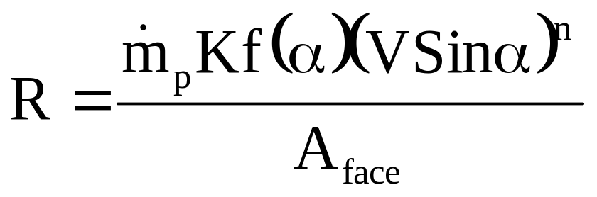
Erosion (Difference between solid and liquid erosion)
Properties | Solid Particle Erosion | Liquid Particle Erosion
Impact Time | Hundreds of microseconds | 2-3 microseconds (according to Bowden)
Responsible Velocity | Slant velocity is also responsible for erosion | Normal velocity is responsible for erosion
Critical Velocity | There is no need for critical velocity | It needs critical velocity to initiate erosion
According to Bowden, as the liquid particle impact time is 1/100 of solid particle impact time, the K has been selected as 2 × 10⁻¹¹.

Slide 26
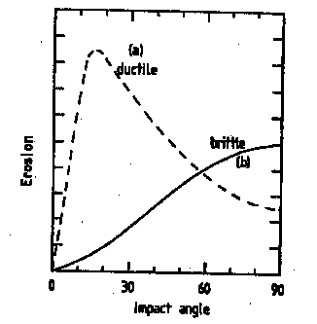
Erosion
According to cutting action theory of Tsuji and Crowe and also shown by Bowden, the maximum erosion occurs close to 20° of angle of attack for ductile material (e.g. Steel).
Source: Bowden and Field (1964)
So, f(α) is modeled by the piecewise linear approach between three data points: f(0°) = 0, f(20°) = 1.0, and f(90°) = 0.3.

Slide 27
Conclusion
The mentioned model have to be used to have complete analysis.
The evaporation model is very straight forward and only changes can be made there is putting more data from steam table.
Coalescence model can be changed, as there are a number of models in literature.
The droplet breakup model (TAB method) is very popular one and is almost un-parallel.

Slide 28
Conclusion (Cont ….)
The Heat transfer model is also very popular, but there are few more in literature, but they are not used much.
Droplet drag model is also a popular one.
Erosion model can be changed by the user, as there are a number of erosion model in literature.

Slide 29


