Slide 1



Nocturnal leg cramps
Sleep Medicine, 11th August 2015
Dr. Joannes M. Hallegraeff
Diagnosing, therapy and associations with other sleep related movement disorders.

Slide 2
Outline
Muscle cramps in general
Grouping of cramps
Diagnosing
Other sleep related movement disorders
Therapy
Conclusion
References
Notes:
NLC is a sleep related movement disorder according the International Classification of Sleep Disorders (ICSD-2) and is termed as sleep-related leg cramps

Slide 3
Muscle cramps in general
Involuntary, painful, visible contractions
Uncontrolled repetitive firing of motor unit action potentials
due to
hyperexcitability of intramuscular terminal motor axons by activation in the spinal cord
Notes:
Up till now it is not understood why intramuscular terminal motor axons are hyperexcitable.
Elecrolytical imbalance might be caused by diuretics, steroids, morphine, lithium. In research associatons have been found, no causal relationship.

Slide 4
Cramps in general
Pharmacologic treatments have a moderate interest because of the potential of toxicity (quinine sulfate)
or
Moderate / inconsistent effectiveness
Notes:
A specific cause is not known. Several potential mechanisms are studied: dehydration, electrolytical imbalance,

Slide 5
Cramps in general
Rule in or out the motor unit diseases (neuropathy, radiculopathy, plexopathy, neuromyotonia, and a cramp fasciculation syndrome which can preceded ALS)
Notes:
In clinic it is very important to recognize serious pathology if at hand. In clinical reasoning serious pathology must be ruled out to include non specific complaints such as NLC.

Slide 6
Cramps grouping
Exercise-associated cramps
Cramps secondary to disease
Iatrogenic cramps
Rest cramps: pregnancy-related cramps and nocturnal leg cramps
Notes:
This classification is proposed by Joekes et al in 1986 and in my opinion is still the best way to group several kinds of cramps.
For studying cramps and in particular NLC it is essential to have these classification in mind.

Slide 7
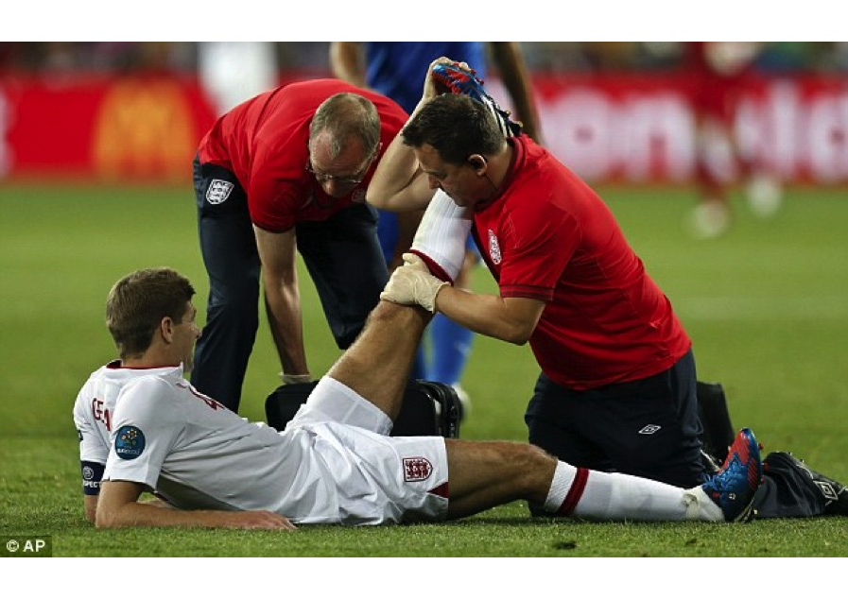
Notes:
Exercise-associated cramps. Even one of the best midfielders in the world do not escape cramp.

Slide 8
Cramps
Grouping
Cramps secondary to disease
Renal failure, liver diseases, vascular insufficiency
Only associations no causal relationship

Slide 9
Cramps
Grouping
Iatrogenic cramps
Cramps induced or associated by medication use: diuretics, steroids, lithium, morphine and statins are most known.
Haemodialysis!

Slide 10

Cramps
Grouping
Rest cramps: pregnancy-related cramps and nocturnal leg cramps
Notes:
In research both NLC and pregnancy related cramps are often mixed up. Besides: cramping in pregnant women must be localized in teh legs and not in the abdomen.

Slide 11
Diagnosing
Nocturnal leg cramps
High prevalent (0.70%) disorder
Painful
Sleep disruption
Decreased quality of life
At night or at rest
Muscle hardening
Notes:
More prevalent among women people with comorbidities especially those with vasculair and/or neurological diseases.
More commonly with advancing age.

Slide 12
Diagnosing
Nocturnal leg cramps
Criteria by patient history and not evidence based
Confusing with Restless Legs Syndrome and/or Periodic Limb Movement Disorder
Mostly not recognized by clinicians
Notes:
In clinic red flags, serious pathology must be ruled out. NLC is a non-specific disorder in contrast to serious pathology.

Slide 13
Diagnosing
Nocturnal leg cramps
Restless Leg Syndrome
Periodic Limb Movement Disorder
Notes:
These two other known sleep related movement disorders are usually disordered with NLC and not distinguished by clinicians.

Slide 14
Others
Restless Leg Syndrome
Uncomfortable and unpleasant sensations in the legs associated with an urge to move; relief of symptoms by moving the legs; sensations in feet or arms and always during rest; appearance in the evening or at night.
Notes:
Main criterium that distingiush NLC from RLS is pain.
IRLSSG study group approved the validity of a rating scale measuring intensity of RLS.

Slide 15
Others
PLMD
Idiopathic PLMD symptoms are repetitive jerking movements of the leg for a period of approximately 20-30 seconds during sleep or wakefulness and complaints during wakefulness is more intense than during sleep.
Notes:
PLMD and RLS are in a way associated. Prevalence of PLMD in association with RLS is high.
PLMD can be classified into mild, moderate and severe, measured by the Periodic Limb Movement Index mostly the sleep is not disturbed

Slide 16
Diagnosing
Nocturnal leg cramps
Systematic comprehensive review
Study aims:
To define characteristics for diagnosing NLC
Differentiation from RLS and PLMD
Notes:
Recently we conducted research to emphasize clinical characteristics of NLC due to ambiguity in diagnosing and differentiating NLC from two other sleep related movement disorders

Slide 17
Diagnosing
Nocturnal leg cramps
Inclusion
Electronically search
Prior 25 years
Exclusion
Non-English abstracts

Slide 18
Diagnosing
Nocturnal leg cramps
Describing diagnostic terms or classification criteria during night or sleep in the randomized clinical trials and observational studies
Delphi study to examine relevance of the revealed characteristics

Slide 19
Diagnosing
Nocturnal leg cramps
No diagnostic studies found
Systematic and narrative reviews
Extracted randomized trials and observational studies

Slide 20
Diagnosing
Nocturnal leg cramps
Ten criteria were identified which were used for differentiating NLC from RLS and PLMD
Decision tree

Slide 21
Therapy
Nocturnal leg cramps
Pharmacological:
Many side-effects
Medication benefits are limited
Inconsistent evidence
Notes:
Besides, the American Food and Drug Administration did not approved any medication for use in treating leg cramps.

Slide 22
Therapy
Nocturnal leg cramps
Quinine
Hydro-quinine
Less coffee
Pyramid under the bed
Natrium – Kalium – Vitamine B/E
Legs higher during the night
Stretching
Notes:
(Hydro) quinine is moderately effective reducing frequency and severity of NLC by decreasing the excitability of the motor endplate. However in US quinine won’t be prescribed anymore.
Side effects: high blood pressure, trombocytopenia, hepatitis, tinnitus. Therefore a trial period with monitoring of side-effects should be executed.

Slide 23
Therapy
Nocturnal leg cramps
Will a pre-sleep stretching regimen be effective in preventing NLC?
Notes:
Due to the positive effect of stretching when NLC occurs, we hypothesized that prohylactic stretching might be a usefull alternative.

Slide 24
Method
Randomized trial
n=80 (40-40)
Inclusion criteria: Exclusion criteria:
age > 55 medication use
frequency at least 1 week co morbidity
Notes:
At least once per week NLC. Participants were healthy older adults without medical conditions or injuries which might be causing cramps.

Slide 25
Method
Stretching protocol
Triceps surae
Hamstrings
Both
Each stretch 10 seconds with 10 seconds interval and perform three times

Slide 26
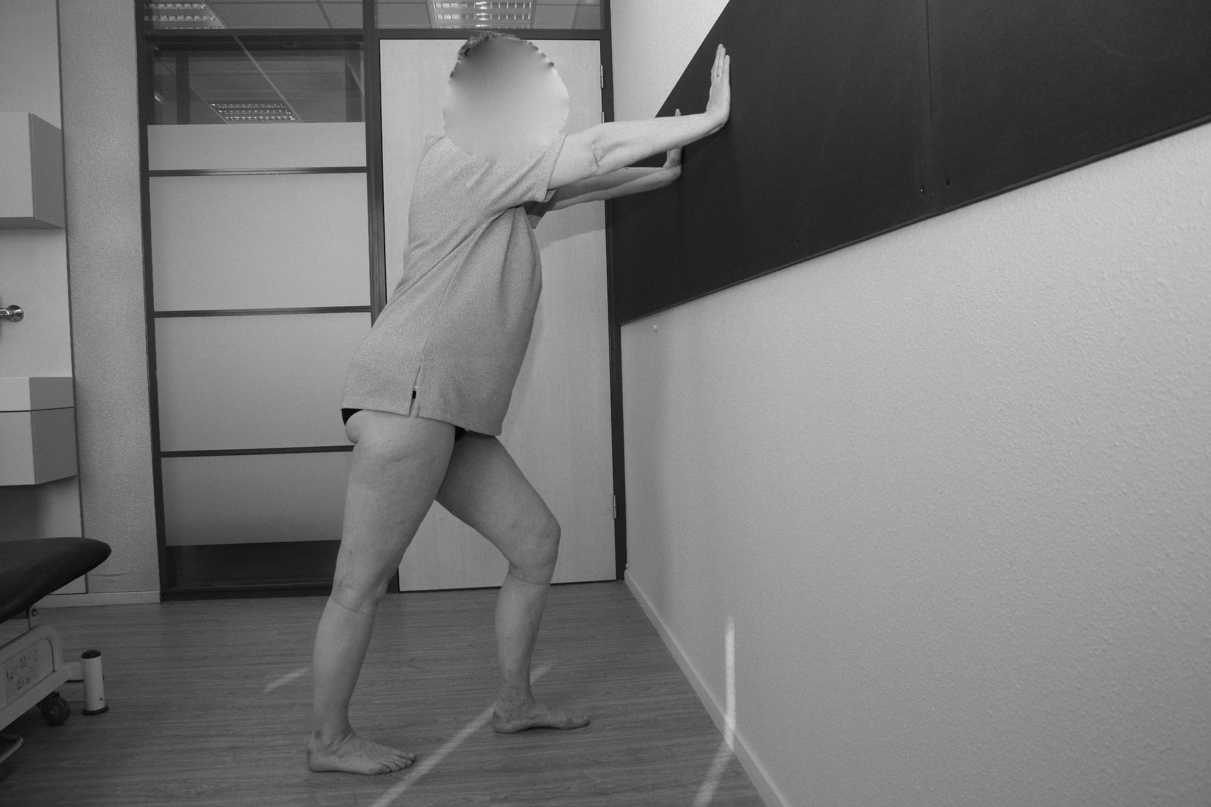
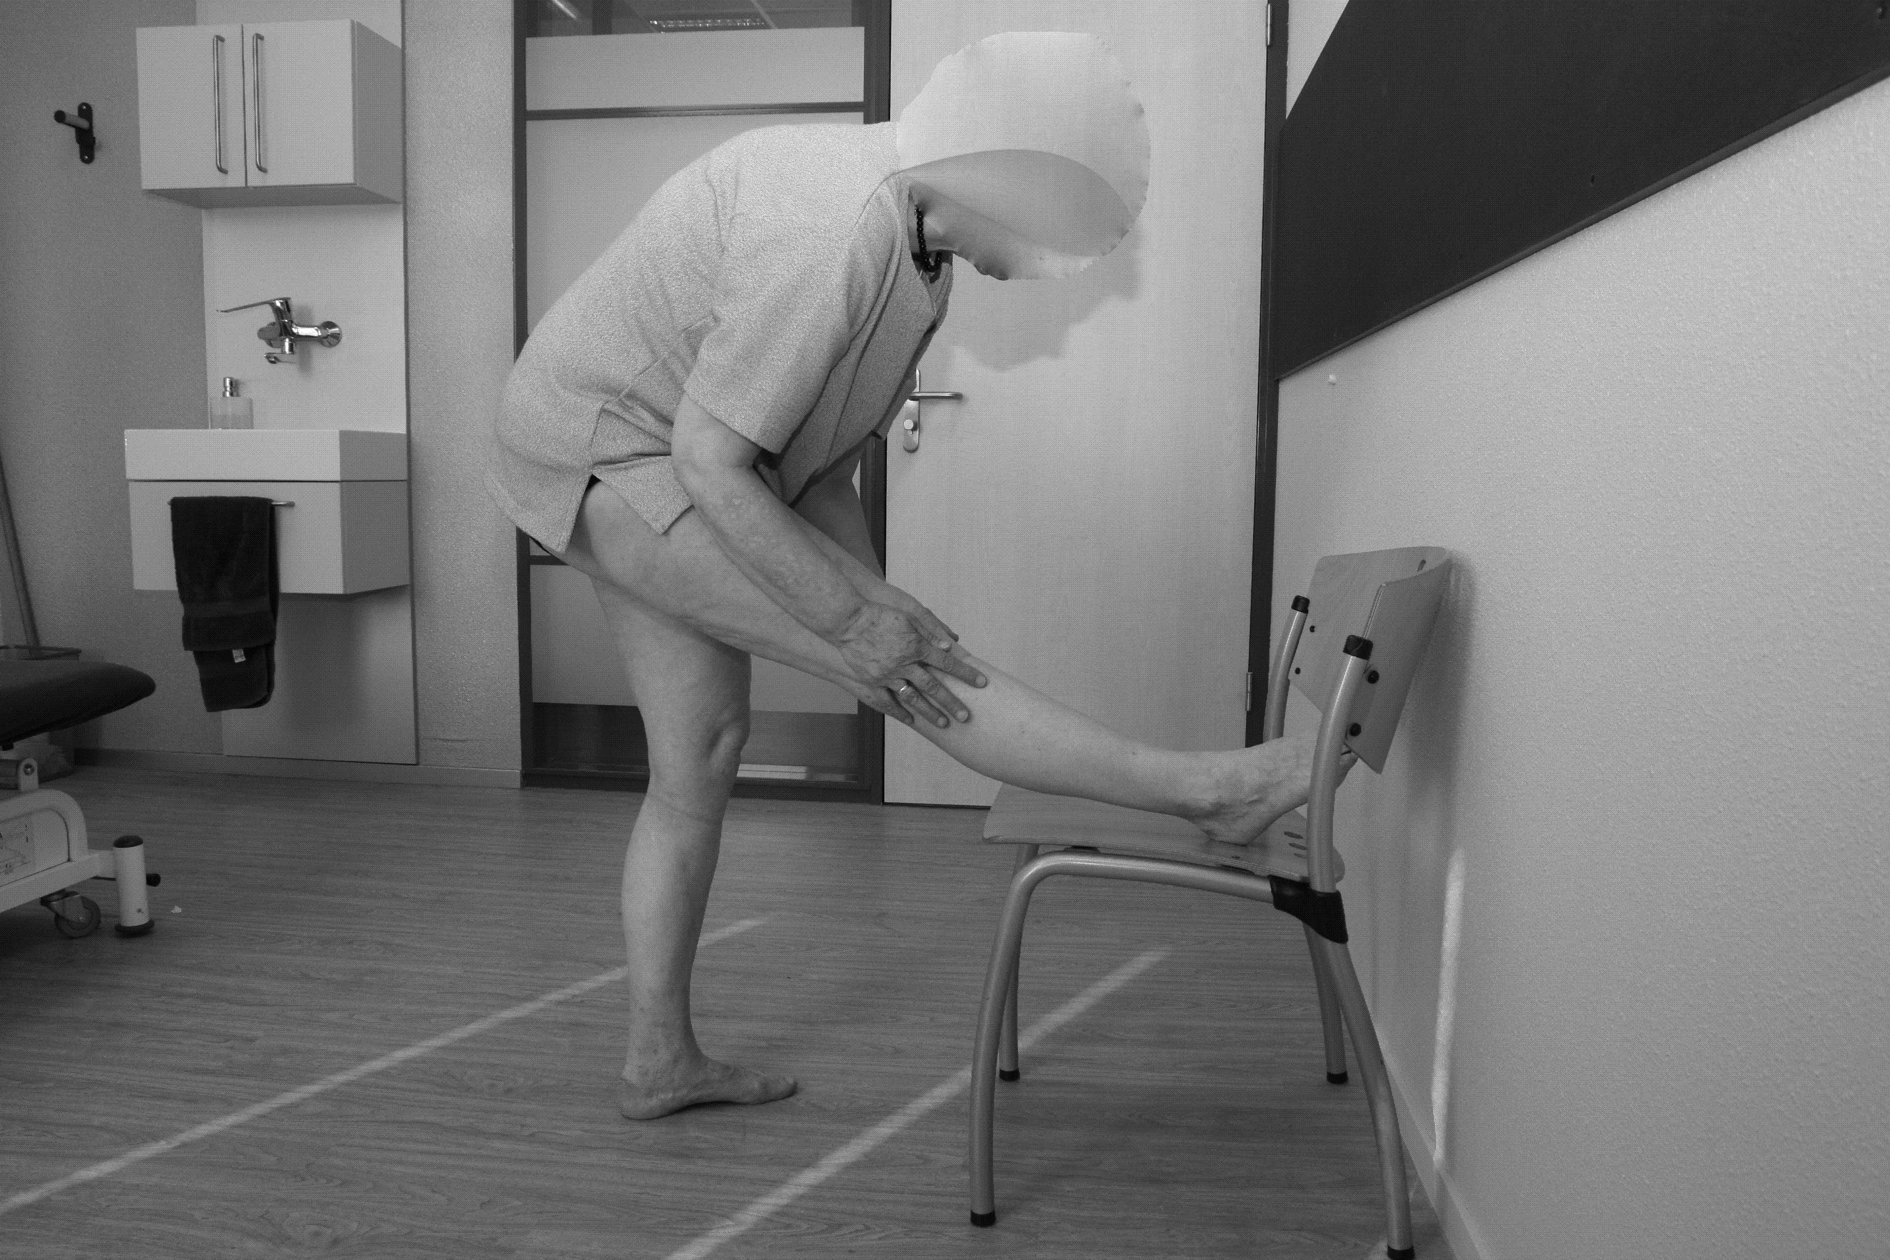
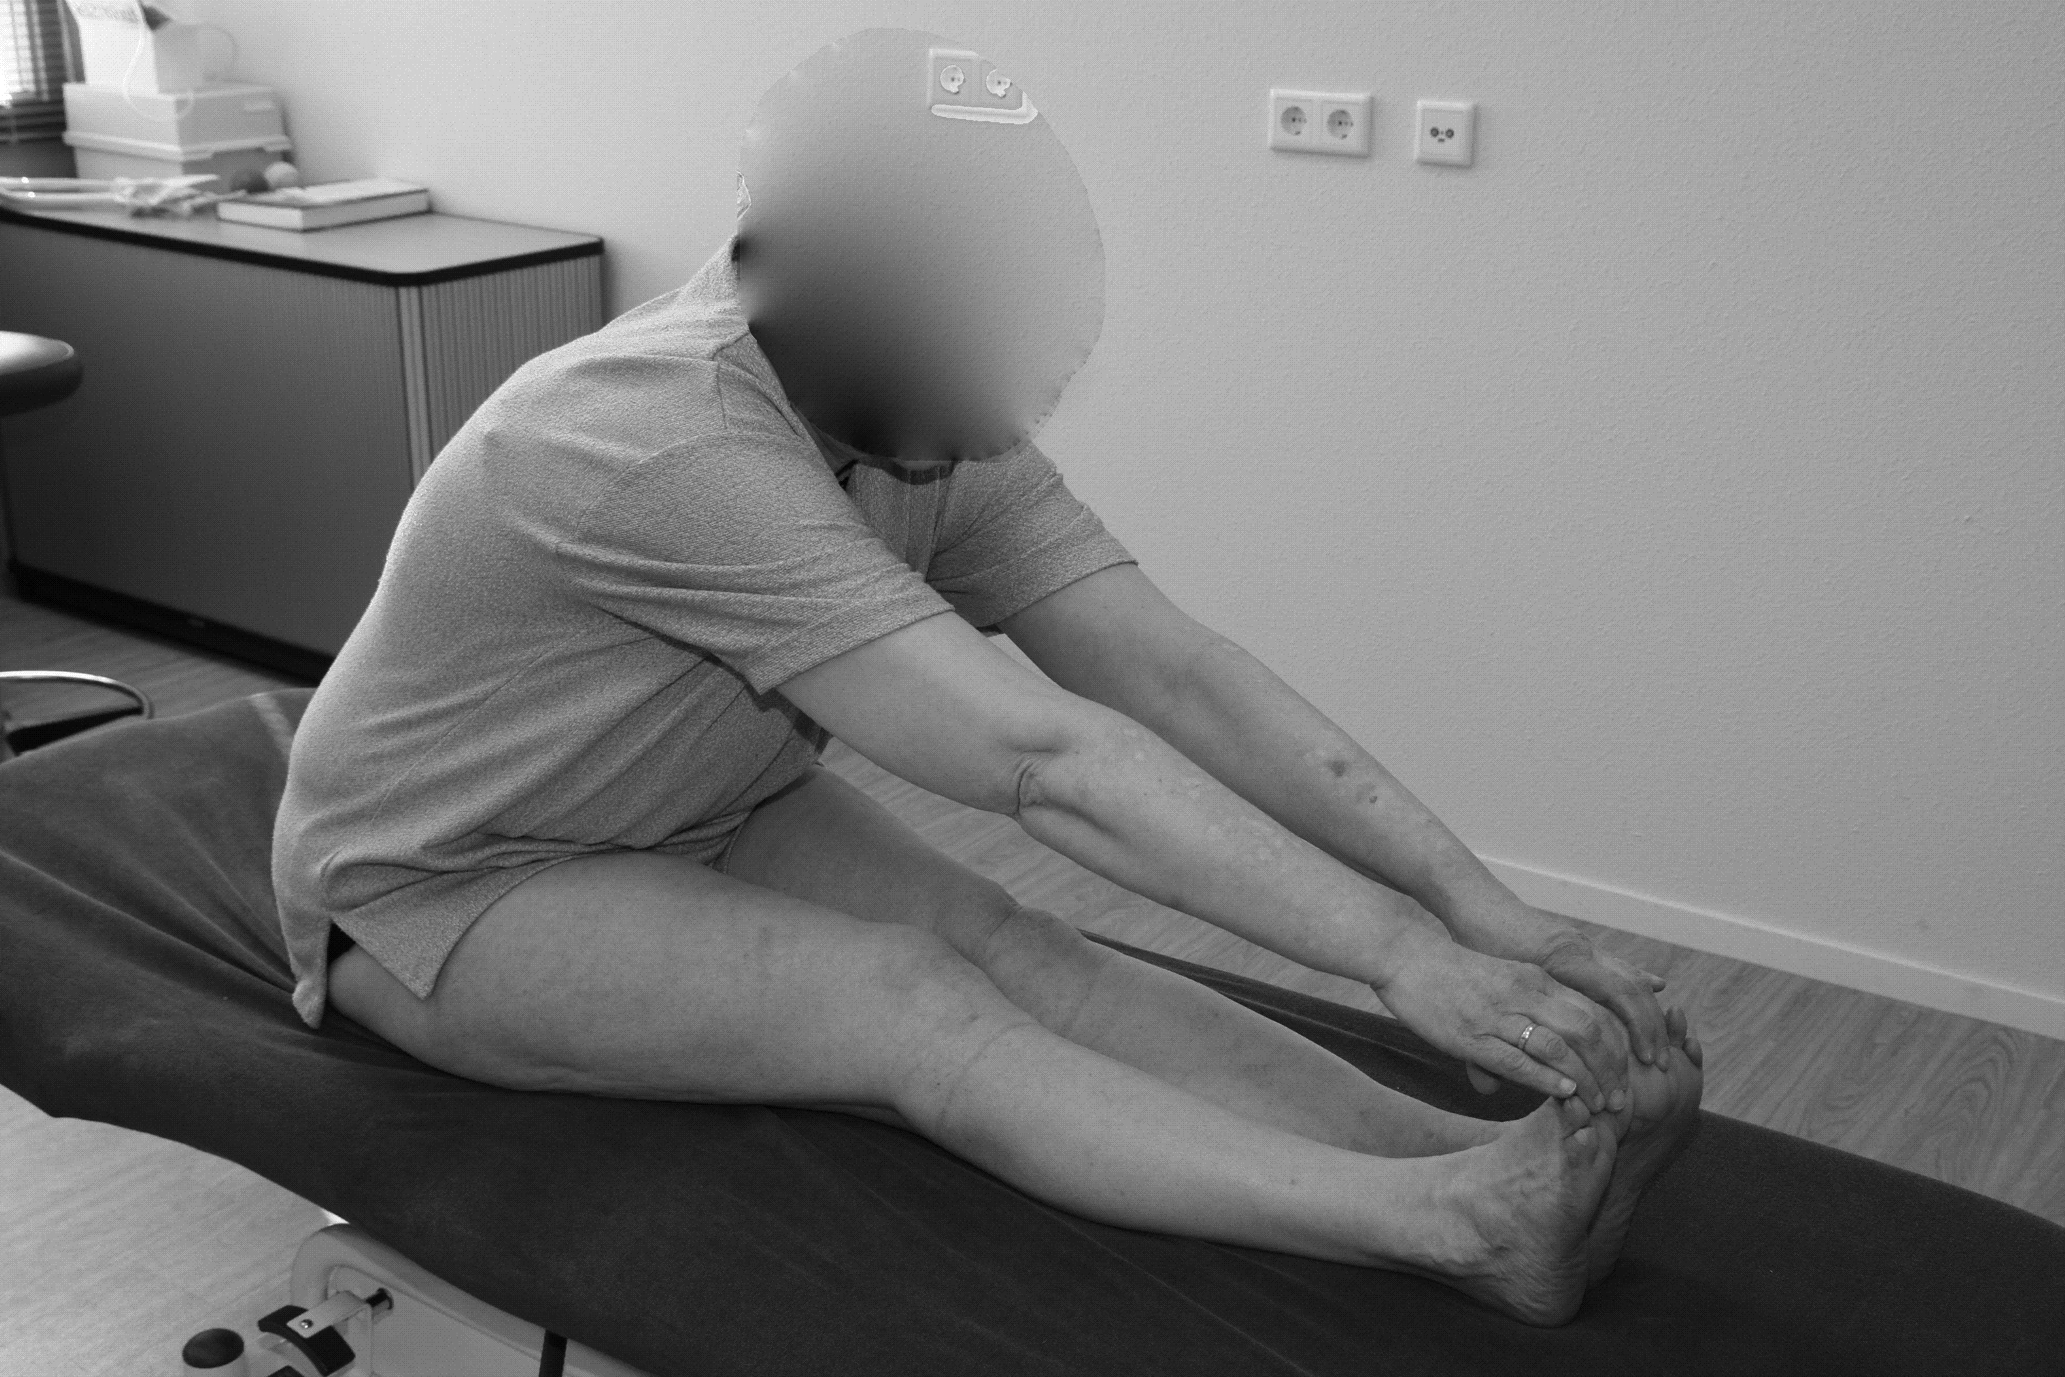
Method

Slide 27
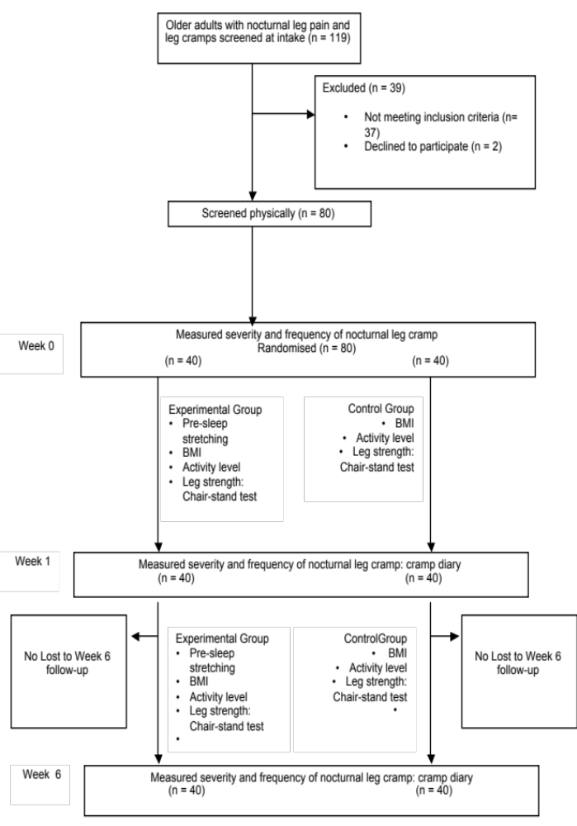
Method
Notes:
80 adults were included in concealed randomization procedure divided into two groups 40/40

Slide 28
Method
Outcome measures
Frequency
Intensity of pain (severity)
Notes:
Outcome was measured at six weeks. At four weeks of stretching the protocol was assessed by visiting the participants at home.
The control group was asked to continue daily activities as usual.

Slide 29
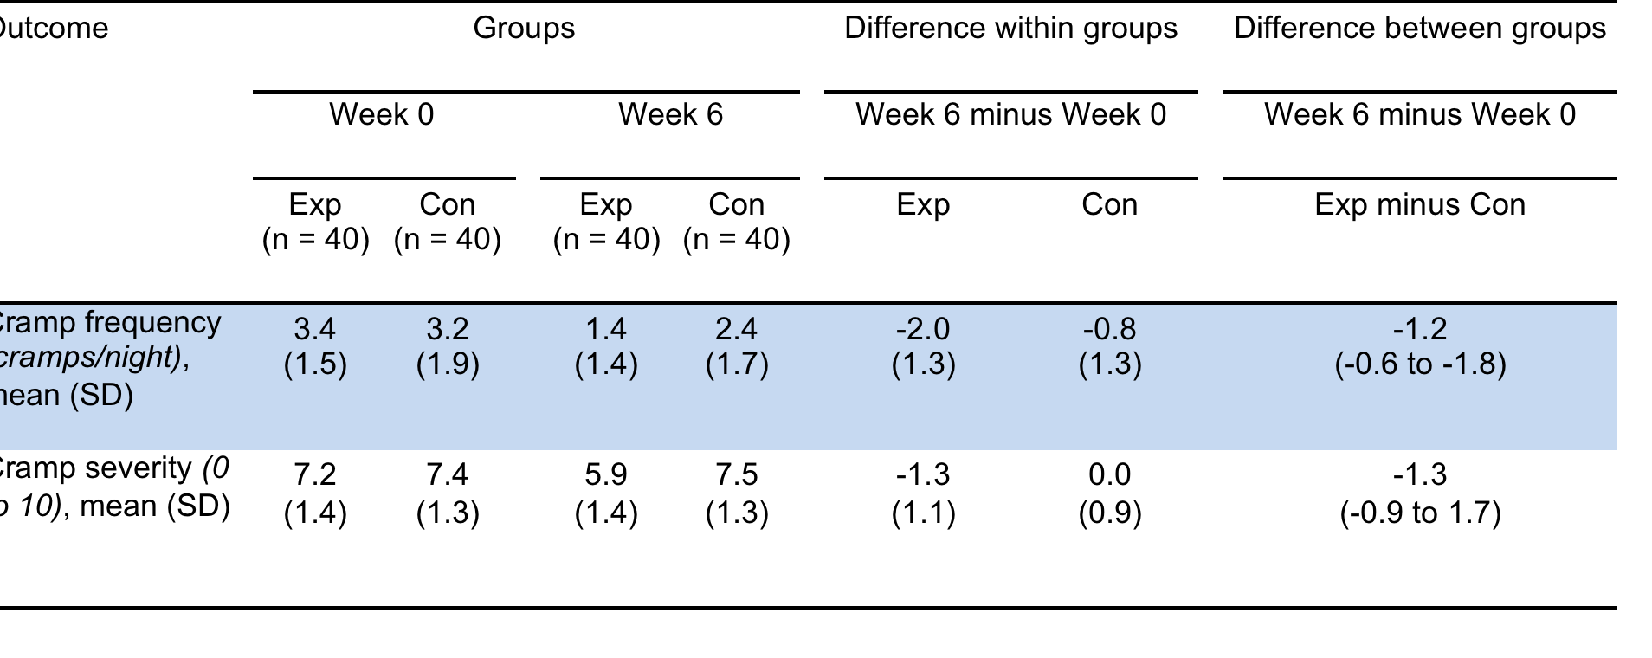
Results
Notes:
A decrease of 1.2 attacks each night was found to be significant and clinical relevant.

Slide 30
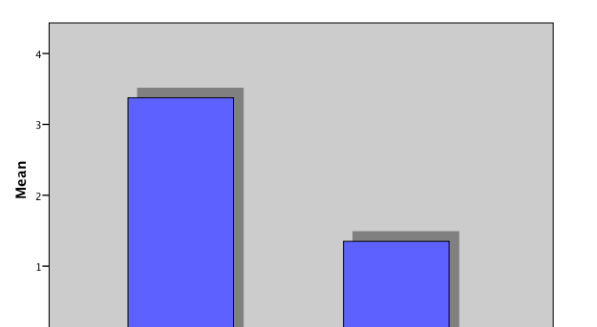
Results
Frequency
Notes:
3.4 to 1.4 decrease in the experimental group

Slide 31
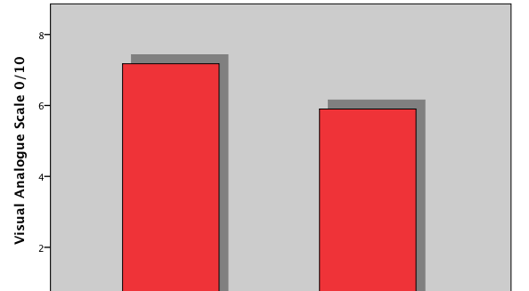
Results
Intensity of pain
Notes:
7.2 to 5.9 decrease of severity in the experimental group

Slide 32
Results
Take away message
Recognizing NLC
Rule out serious pathology
Differentiating NLC from RLS and PLMD
Physiotherapy consult might be useful
Stretching is effective, safe and without side effects
Notes:
A quick and easy to perform stretch protocol will help in improving sleep quality and therefore increase of well-being and quality of life.

Slide 33
Results
Take away message
Most important: no disruption of sleep!

Slide 34
References
Hallegraeff JM, et al. J Physiother 2014;60: 174-5.
Drouet A. et al. Rev Prat 2013;63: 619-23.
Hallegraeff JM, et al. J Physiother. 2013;59(4):279.
Hallegraeff JM et al. J Physiother. 2012; 58: 17–22.
Garrison SR, et al. Cochrane Database Syst Rev. 2012;9:CD009402.
Blyton F, et al. J Foot Ankle Res. 2012;5:7.
Merlino G, Gigli GL. Neurol Sci 2011;33: 491–513
Monderer RS et al. Curr Neurol Neurosci 2010;10: 53–59.
El-Tawil S, et al. Cochrane Database Syst Rev. 2010;12:CD005044
Coppin RJ, et al. Br J Gen Pract. 2005;55:186–191.
Naylor JR, et al. Age Ageing. 1994;23(5):418–420.
Sontag SJ, et al. Med Hypotheses. 1988;25(1):35–41.
Joekes MA. J. R. Soc. Of Med. 1982; (75).

