Slide 1
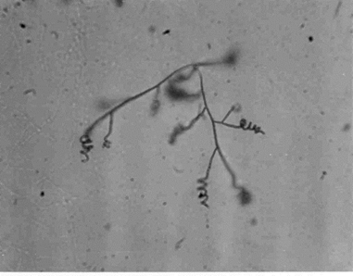
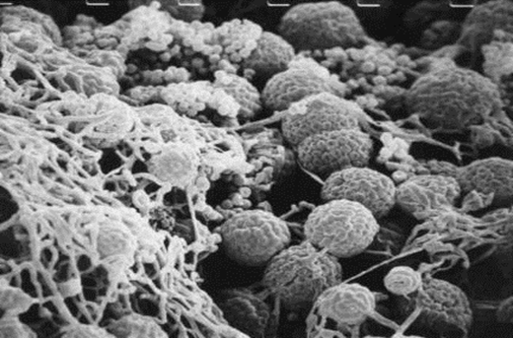
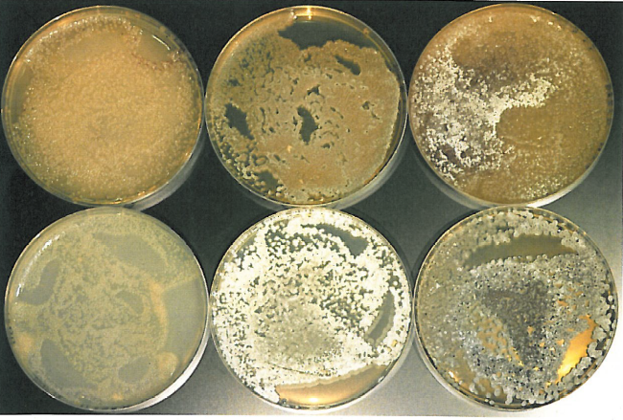
Do we need and can we find novel antibiotics from microorganisms?
PD Dr. Joachim Wink
Frankfurt, August 2015
ISBA 17
Joachim Wink

Slide 2
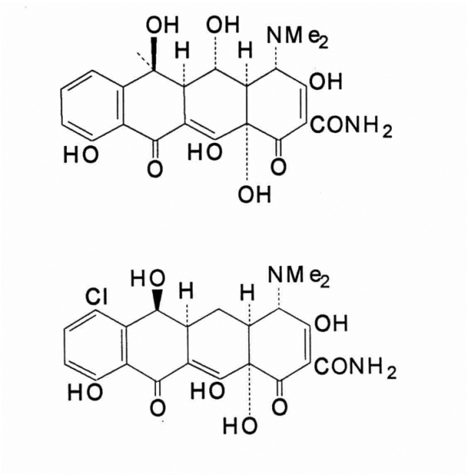
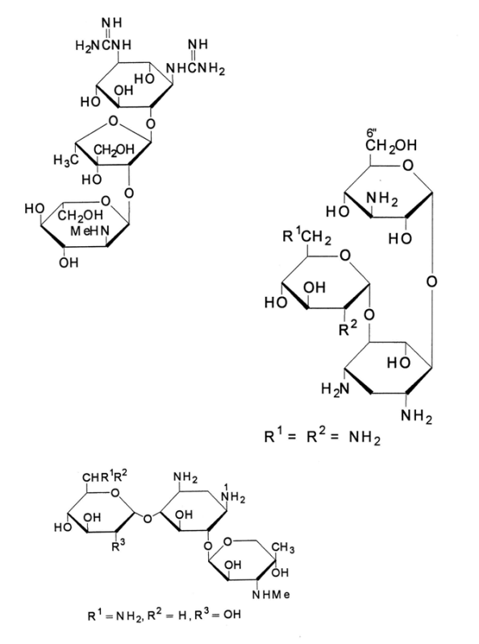
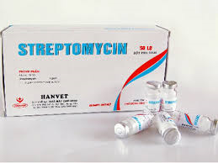
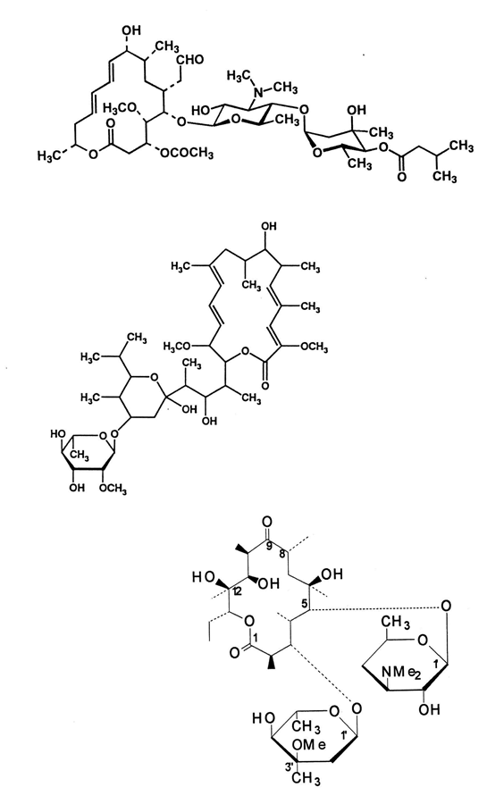
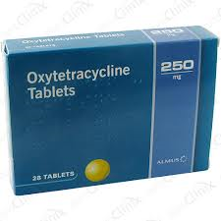
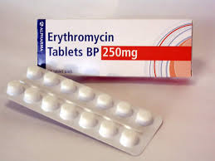
Macrolides
Mode of action:
Macrolides bind to the 23S
Ribosomal RNA in the 50S
subunit of the ribosom and
inhibit the translocation
in the proeteinsynthesis
Aminoglycosides
Mode of action:
Interruption of formylmethionin-tRNA
binding to ribosom, inhibition of correct initiation of proteinsynthesis by binding to protein S12 in the 30S subunit
Tetracyclines
Mode of action:
Binding to the 30S
subunit of the ribosoms and inhibition of t-RNA binding to the ribosomal complex

Slide 3
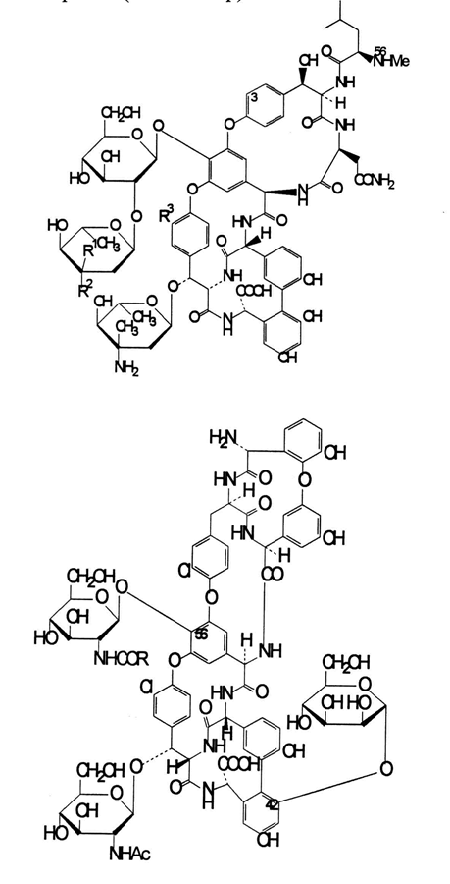
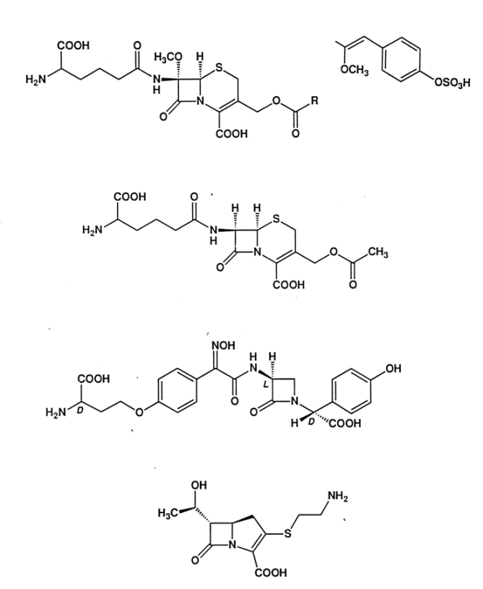
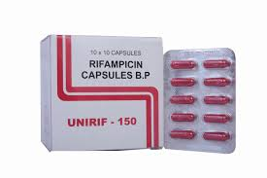
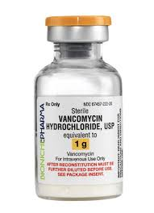
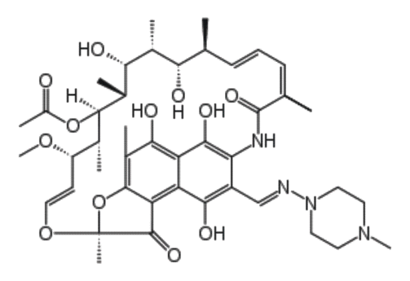
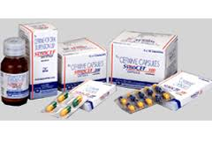
Rifampicin
Mode of action:
Binding to the ß-subunit
of the RNA polymerase
and specific inhibition
of the initiation
of the RNA synthesis
Cephalosporins
Mode of action:
Binding to PBP (Penicillin
Binding Proteins) and
inhibition of cell wall formation
Glycopeptides
Mode of action:
Inhibition of cell wall
biosynthesis by blocking of
glycopeptidpolymerisation

Slide 4
Eternal competition between pathogens and antibacterials
Discovery of
Antibacterial
classes
1950
Aminoclycosides
1987
Fluoroquinolones
1952
Macrolides
1936
Sulphonamides
1958
Glycopeptides
1962
Ansamycine
1996
Cabapenems
1928
Penicilin
1949
Tetracylines
1964
Cephalosporins
1999
Oxazolidinones
2001
Ketolides
?
1920s 1930s 1940s 1950s 1960s 1970s 1980s 1990s 2000s
Development of
Bacterial
resistance
1942
Sulphon-
amide
resistance
emerges
1950
Increasing
Beta-lactam
resistance
1958
Penicillin
resistance
1960s
MRSA
emerges
1968
Tetracycline
1972
Multidrug
resistance
S.typhi
Late 1980s
VRE
emerges
1990s
E.coli
Resistance
to Fluoro-
quinolones
Recognition
of
VISA
2001
first
resistance
to
Linezolid
Key:
MRSA – Methicillin resistant S.aureus
VRE – Vancomycin resistant Enterococcus
VISA – Vancomycin intermediant resistant S. aureus

Slide 5
Quo vadis?
Increase of resistance from S. pneumoniae
against Penicillin and Erythromycin
Increase of resistance from S. aureus
against Methicillin
Increase of „Multidrug“ resistance by
Pseudomonas aeruginosa
Increase of Vancomycin resistance by
enterococci
- Comeback of classical infection diseases
like tuberculosis
- Import of tropical infections by globalization
(e.g. nocardiosis)

Slide 6
Bioactive secondary metabolites in nature
Invertebrates
(Insects)
Vertebrates
(Mammals)
Animal
Kingdom
Marine animals
and plants
Microscopic
fungi
Symbionts
Yeasts
„rare“ actinos
Streptomyces
Slime
moulds
Endophytes
Lichens
Eubacteriales
Cyanobacteria
Basidiomyces
Higher (green)
plants
Algae
Myxobacteria
Plant
Kingdom
Lower plants
(Bryophyta)
János Bérdy, Microorganisms Producing Antibiotics, in Antibiotics ed. by S. Sánchez and A.L. Demain
Caister Academic Press, Norfolk, 2015

Slide 7
The advantages of natural products
Higher structural diversity and many chiral centres
Action on different targets and on whole enzyme families
Host compatibility
Lower risk factor for toxicity to the environment
„Nature is the best, most sophisticated, versatile
and energetic combinatorial chemist“
János Bérdy, Microorganisms Producing Antibiotics, in Antibiotics ed. by S. Sánchez and A.L. Demain
Caister Academic Press, Norfolk, 2015

Slide 8
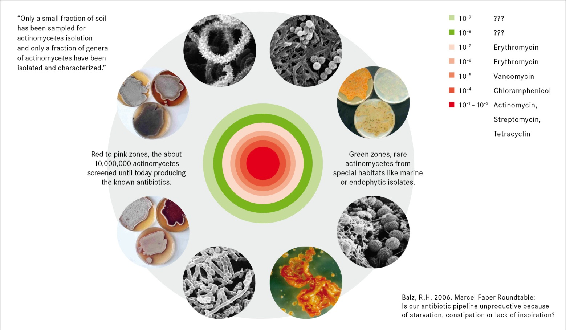
What should we screen?

