Slide 1
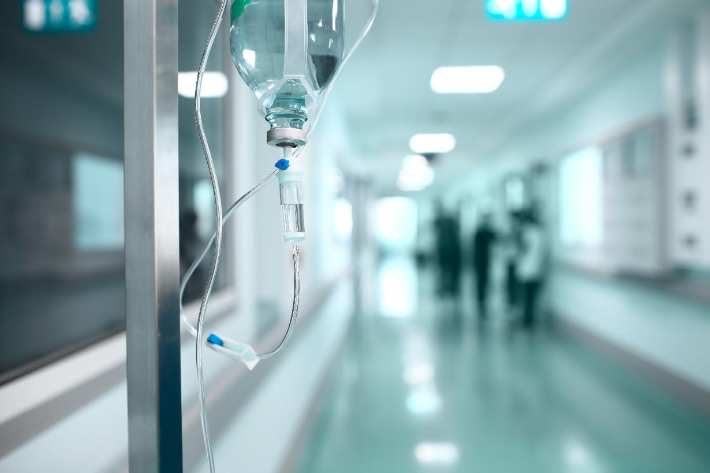


Pro-Enkephalin (penKid):
A novel plasma biomarker to assess renal impairment
Joachim Struck, PhD
Chief Research Officer
sphingotec GmbH (Hennigsdorf/Berlin, Germany)
das

Slide 2
sphingotec – Innovative Biomarkers
Acute Care Biomarker
Improve clinical decision making in acute care environments
„Medicine of the future“
Prediction of health risks in the general population
sphingotest® penKid
diagnosis & prediction of acute kidney injury and monitoring the change of risk
sphingotest® bio-ADM
prediction of septic shock & monitoring the change of risk of septic shock & guidance of vasopressor therapy
sphingotest® pro-NT
prediction of breast cancer risk & cardiovascular disease
sphingotest® pro-ENK
prediction of breast cancer risk & risk of chronic kidney disease
sphingotest® vr-hGH
prediction of cardiovascular risk
sphingotest® ApoE4
prediction of Alzheimer's disease risk

Slide 3
Novel biomarkers for sepsis management
management of ANTIBIOTIC THERAPY
Management of
ACUTE KIDNEY INJURY
Management of
SEPTIC SHOCK
PCT
penKid
bio-ADM
Early diagnosis of sepsis | Early diagnosis & prediction of acute kidney injury (AKI) | Early diagnosis & prediction of septic shock
Monitoring of antibacteria treatment in early sepsis | Monitoring the actual kidney status and change in risk | Supporting clinical decision on vasopressor use
Falling PCT levels (<24 hrs) indicate successful treatment | Prediction of change in creatinine | Supporting clinical decision on discharge from ICU

Slide 4
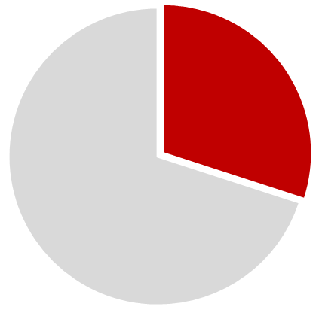

Early diagnosis of acute kidney injury (AKI) in critically ill patients is a substantial unmet need
AKI is a frequent complication that occurs in approx. 30% of ICU patients
30%
AKI occurs in 50% of patients with septic shock
50%
50%
The mortality rate of AKI is around 50%
Uchino et al. (2005) JAMA 294: 813–818.
Zarbock et al. (2014) Curr Opin Crit Care. 20(6):588-95.

Slide 5
Present day kidney biomarkers do not fulfill the requirements for use in critically ill patients
 | Sample matrix suitable for ED/ICU | Inflammation-independent | Kidney specific | Dynamic enough to assess actual kidney status
Creatinine | Plasma/Serum (+ Urine) |  | ^{x} | ^{c}
Cystatin C | Plasma/Serum (+ Urine) | ª | ^{f} | ^{j}
NGAL | Plasma/Serum (+ Urine) | ^{a, g} | ^{g} | ^{c}
KIM-1 | Plasma/Serum (+ Urine) | ^{h} | ^{h} | ^{e}
NephroCheckTM | Urine | ª | ^{d,c} | ^{b}
a) Bell M et al. Disease markers 2015. 2015:158658. b) Wetz AJ et al. Critical care 2015;19:3. c) Parikh CR et al., J Am Soc Nephrol. 2011 Sep;22(9):1748-57 d) Kellum JA et al. Nephrology, dialysis, transplantation: official publication of the European Dialysis and Transplant Association - European Renal Association 2015. e) Parikh CR et al. CJASN 2013;8:1079-88. f) Knight EL, et al., Kidney international 2004;65:1416-21. g) Martensson J, et al., Intensive care medicine 2010;36:1333-40. h) own data, unpublished i) Martensson J et al., British J of anaesthesia 2012;109:843-50. j) Koyner JL et al. American journal of kidney diseases 2013;61:730-8.

Slide 6
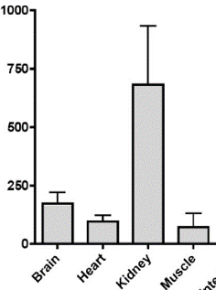
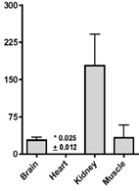
Enkephalin – a key regulator of kidney function and the cardiorenal axis
Enkephalin in the CNS:
endogenous opioid
not passing blood brain barrier
Enkephalin in non-CNS tissue:
mainly released by kidney and heart
Opioid (Enkephalin) receptors:
highest concentration in the kidney
Enkephalin
δ opioid receptor
μ opioid receptor
δ
μ
Rel. mRNA expression
Diuresis ↑
Natriuresis ↑
Denning et al. Peptides. 2008. 29(1):83-92.
Sezen et al. (1998) J Pharmacol Exp Ther. 287(1):238-45.

Slide 7
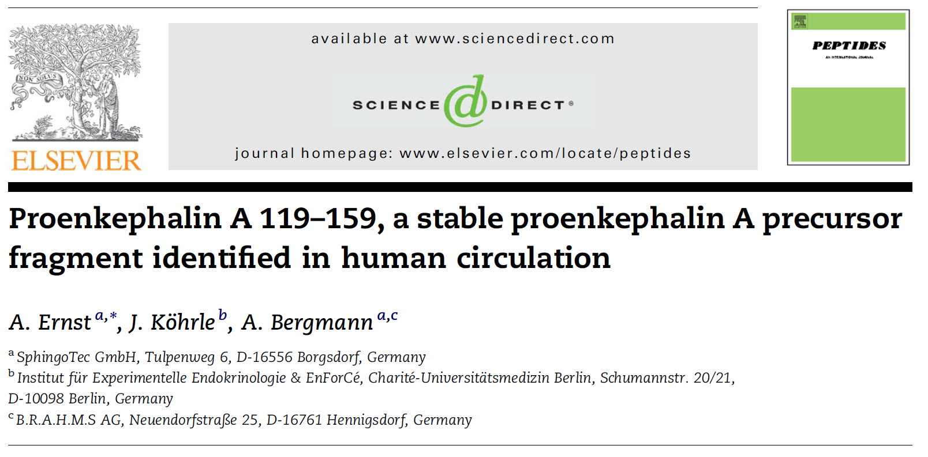

sphingotest® penKid – a stable surrogate for Enkephalin indicates the actual kidney function
penKid is a stable fragment of Proenkephalin (= Proenkephalin¹¹⁹⁻¹⁵⁹)
suitable surrogate marker for the release of unstable Enkephalin peptides
¹
¹¹⁹
¹⁵⁹
²³⁴
Proenkephalin
Enkephalin peptides
penKid
Proenkephalin¹¹⁹⁻¹⁵⁹
tracer
solid phase
Ernst A et al. Peptides. 2006. 27(7):1835-40.

Slide 8
  Clinical performance of penKid is broadly validated
Sepsis
Sepsis in ED¹ Hur (KR) monocentric n = 168
Sepsis in ED¹ Melander (SWE) monocentric n = 300
Sepsis in ED² Di Somma (IT) monocentric n = 101
Sepsis in ICU (Post-Surgical)³ Marx (GER) monocentric n = 56
FROG-ICU (ICU Sepsis+)⁴ Mebazaa (FR) multicentric (28) international (EU) n = 2,078
ALBIOS (Sepsis)¹ Gattinoni (IT) multicentric (35) n = 956
AdrenOSS (Sepsis)¹ Mebazaa (FR) multicentric (24) international (EU) prospective n = 600
Graft failure
Renal transplant recipients Bakker (NL) monocentric n = 664
Cardiovascular diseases
Acute Heart Failure⁴ Ng (UK) monocentric n = 1,077
PROTECT⁴ Voors (NL) multicentric international n = 2,000
BIOSTAT⁴ Voors (NL) multicentric international n = 2,400
⁴ Mebazaa (FR) monocentric n = 300
Basel V⁴ Müller (CH) multicentric n = 1,000
⁴ Collins (USA) monocentric national (USA) n = 246
⁴ Di Somma (IT) monocentric n = 200
Dyspnea Melander (SWE) monocentric n = 800
Acute Myocardial Infarction⁵ Ng (UK) multicentric n = 1,141
CABG⁸ Maisel (USA) monocentric national (USA) n = 92
ED all comers⁴ Di Somma (IT) monocentric n = 100
¹ ongoing ²Marino et al. J Nephrol. 2015 28(6):717-24.; ³ submitted;
⁴ under evaluation; ⁵ Ng et al. J Am Coll Cardiol. 2014. 28;63(3):280-9.

Slide 9
Clinical performance of penKid in ED/ICU

Slide 10

Pilot Study I
Sepsis in Emergency Departments (ED)
Di Somma (IT)
n = 101
Prof. Salvatore Di Somma
Inclusion Criteria:
Consecutive patients arriving in ED with diagnosis of sepsis
Enrollment within 12 hours
Daily blood draws
AKI defined by RIFLE criteria
Demographics
Gender - male | 60%
Age - median [IQR] | 78 [72-83]
Concomitant diseases
Cardiovascular - yes | 26%
Hypertensive - yes | 47%
Diabetes - yes | 35%
Cancer - yes | 13%
Routine laboratory variables
Creatinine clearance (mL/min) - median [IQR] | 48 [23-77]
PCT (ng/mL) - median [IQR] | 2.8 [0.6-10.7]
Other
APACHE II score (points) - median [IQR] | 16 [13-21]
Final diagnosis - severe sepsis or shock | 29%
Days hospitalized - median [IQR] | 5 [2-7]
Deaths within 28 days after presentation | 29%
Marino et al. Critical Care 2014, 18:R34

Slide 11
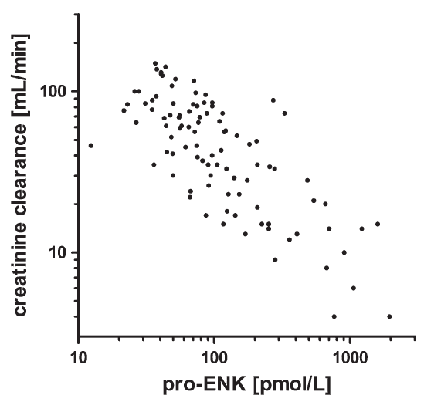
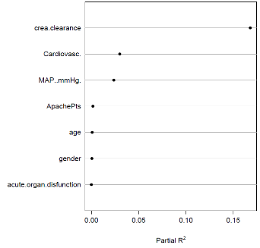
  Kidney function is the strongest determinant for penKid and negatively correlates with penKid level
Pilot Study I: Sepsis in ED
Di Somma (IT)
Multivariable linear regression predicting penKid*
r = - 0.72
Creatinine clearance
Cardiovasc.
MAP [mmHg]
APACHE II score
Age
Gender
Acute organ dysfunction
p < 0.0001
Partial R²
penKid [pmol/L]
* BP, creatinine, and urea left out due to high correlation with MAP or creatinine clearance
Marino et al. (2015) J Nephrol. 28(6): 717-24.

Slide 12
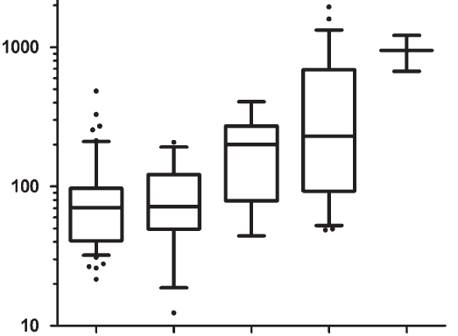
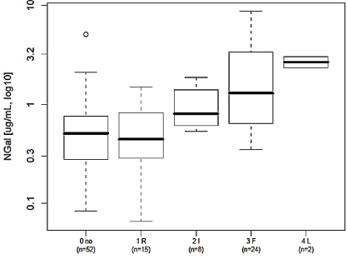
  penKid correlates with severity of acute kidney injury (AKI) and is independent of inflammation
Pilot Study I: Sepsis in ED
Di Somma (IT)
penKid is in normal range in septic patients
NGAL is elevated above normal
in septic patients
penKid [pmol/L]
NGAL [µg/ml]
normal range
normal range
0
R
I
F
L
0
R
I
F
L
Marino et al. (2015) J Nephrol. 28(6): 717-24.

Slide 13
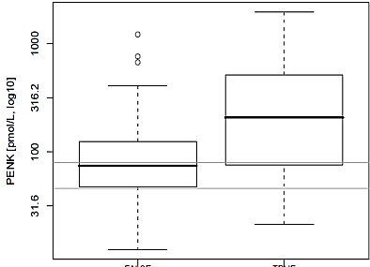
  penKid is a predictor of mortality stronger than creatinine clearance in emergency departments
Pilot Study I: Sepsis in ED
Di Somma (IT)
penKid [pmol/L]
 | 7 day survivors (n=73) | deaths within 7 days (n=28) | p-value
penKid (pmol/L) | 75 [47-124] | 209 [77-499] | <0.001
Creatinine clearance (mL/min) | 56 [29-81] | 33 [15-69] | 0.071
Marino et al. (2015) J Nephrol. 28(6): 717-24.

Slide 14
  penKid – a highly dynamic biomarker
Patient 1 died
Patient 2 survived
penKid [pmol/L]
penKid [pmol/L]
normal range
normal range
Patient 3 died
Patient 4 survived
penKid [pmol/L]
penKid [pmol/L]
normal range
normal range

Slide 15
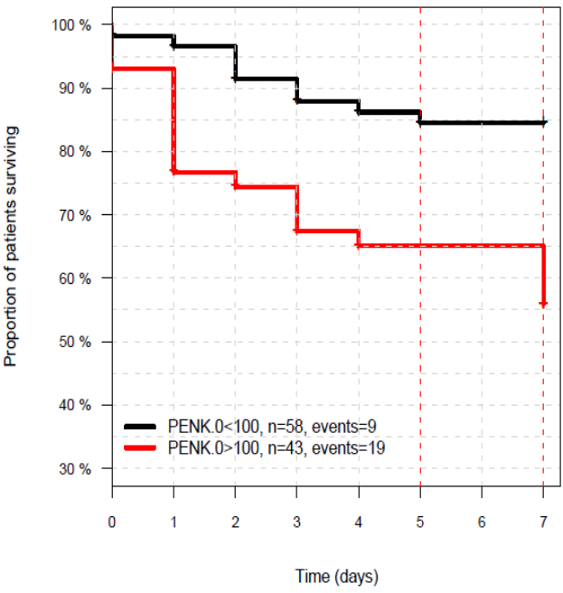
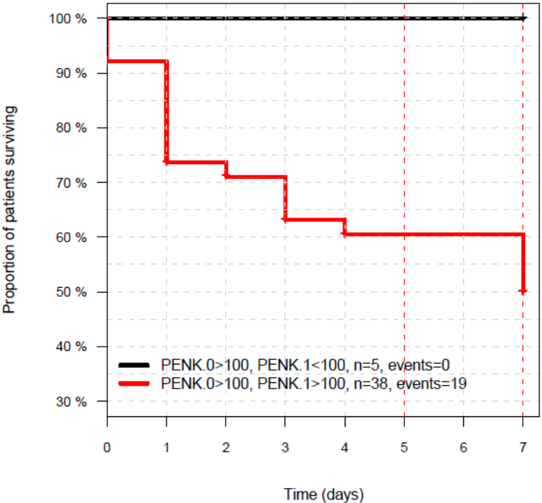
  Rising and falling penKid levels allow monitoring the change in risk of mortality
Pilot Study I: Sepsis in ED
Di Somma (IT)
penKid levels at admission
low vs. high (cut-off: 100 pmol/L)
Subgroup high
measured again after 24 hrs
100 %
100 %
high/low
low
86%
survival rate
high
high/high
56%
50 %
50%
Time (days)
Time (days)
Marino et al. (2015) J Nephrol. 28(6): 717-24.

Slide 16

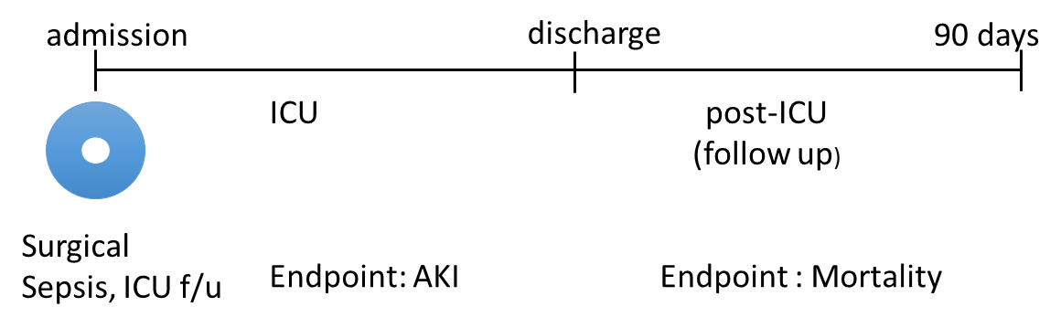
Pilot Study II
Sepsis in surgical ICU patients
Marx (GER)
n = 56
Prof. Gernot Marx
Dr. Tobias Schürholz
42 consecutive ICU patients after major surgery with clinical signs of sepsis and 14 patients admitted routinely to the ICU after major surgery
Plasma samples: drawn within 16 hrs after diagnosis of sepsis
Survival status: determined 90 days after onset of sepsis
Patients
Gender: 66% male
Age: 70 years (IQR 18-91)
BMI: 26.2kg/m² (IQR 19.5-46.1)
Stay in ICU: 6 days (IQR 2-18)
Stay in hospital: 18 days (IQR 11-26)
Control: n = 14
Sepsis: n = 8
Severe Sepsis: n = 19
Septic shock: n = 15
Doemmig et al. (2015) Intensive Care Medicine Experimental. 3 (Suppl 1):A256.

Slide 17
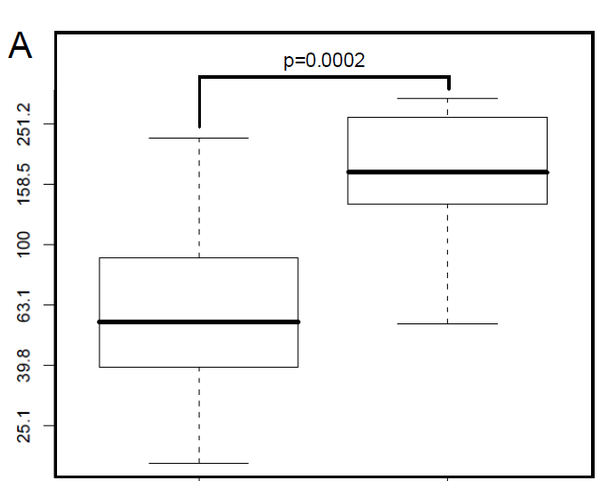
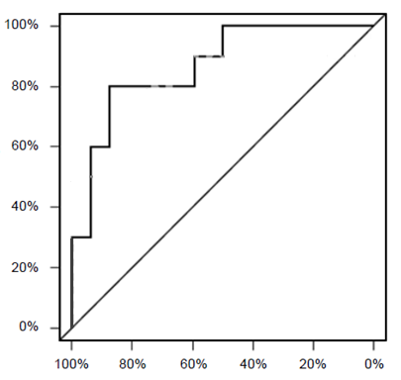
  penKid is a diagnostic marker for renal dysfunction
Pilot study II: Sepsis in surgical ICU patients
Marx (GER)
ROC curve
(renal dysfunction vs. no renal dysfunction)
Renal dysfunction*
penKid
yes
penKid [pmol/L]
no
normal range
AUC: 0.87 (!)
* = acute oliguria (urine output <0.5 ml/kg/h for at least 2h despite adequate fluid resuscitation)
Doemmig et al. (2015) Intensive Care Medicine Experimental. 3 (Suppl 1):A256.

Slide 18

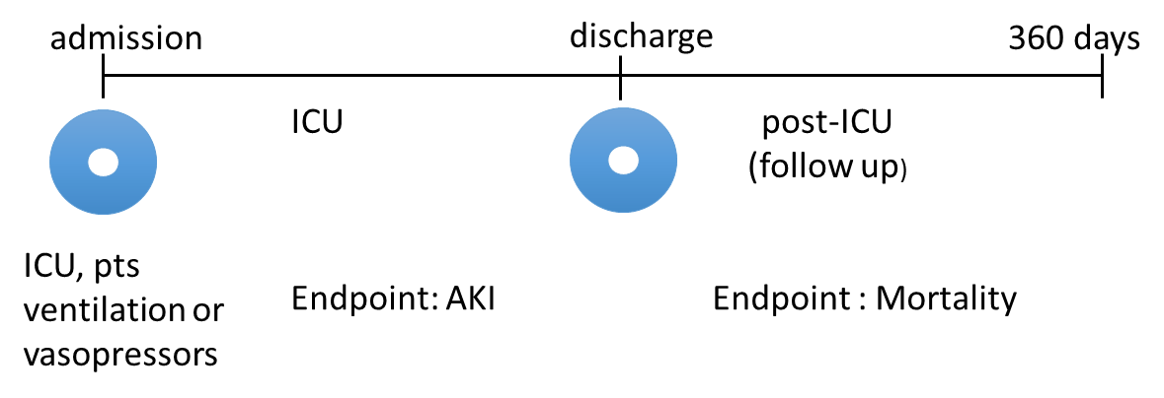
The French and euRopean Outcome reGistry in Intensive Care Units (FROG-ICU) observational study
FROG-ICU
Mebazaa (FR)
n = 2,078
Multicenter (28) | International (EU)
Confirmational Study
  Observational study on consecutive patients discharged alive from ICU who needed mechanical ventilation >24h or vasopressors/ inotropes >24h during ICU stay
  Main endpoint: 1-year all-cause mortality for ICU-survivors
Male gender [n (%)] | 1361 (65.2)
Age (years) | 63 (51-74)
Cause of admission
out-of-hospital cardiac arrest [n (%)] | 179 (8.6)
septic shock [n (%)] | 488 (23.4)
acute respiratory failure [n (%)] | 394 (18.9)
SOFA score at admission | 8 (5-10)
SAPS-II at admission | 49 (36-63)
eGFR at admission [mL/min/1.73 m²] | 76.3 (37.1-104.2)
in-ICU mortality [n (%)] | 452 (21.7)
One-year mortality [n (%)] | 785 (37.6)
Mebazaa et al. (2015) BMC Anesthesiology 15:143.
Legrand et al. (2016) Poster AKI/CRRT congress 2016, San Diego

Slide 19
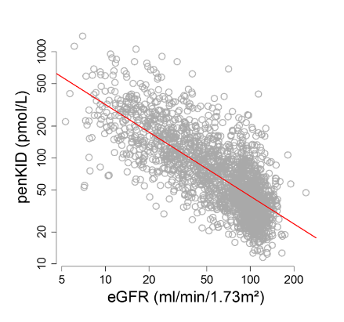
  penKid is strongly related to kidney dysfunction in ICU patients (FROG-ICU)
FROG-ICU Study
Mebazaa (FR)
r = ‒0.75
Mebazaa et al. (2015) BMC Anesthesiology 15:143.
Legrand et al. (2016) Poster AKI/CRRT congress 2016, San Diego

Slide 20
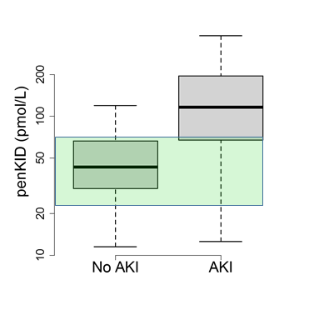
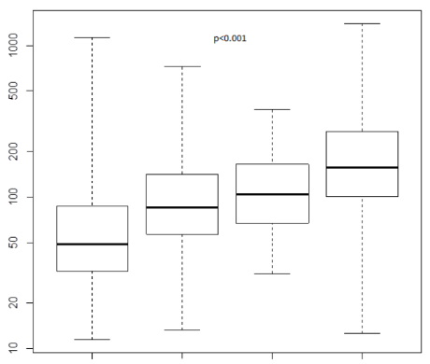
  penKid level predicts severity of acute kidney injury in ICU patients (FROG-ICU)
FROG-ICU Study
Mebazaa (FR)
AKI severity (RIFLE criteria)
AUC 0.81
penKid [pmol/L]
normal range
p<0.001
p<0.001
0 R I F
Mebazaa et al. (2015) BMC Anesthesiology 15:143.
Legrand et al. (2016) Poster AKI/CRRT congress 2016, San Diego

Slide 21
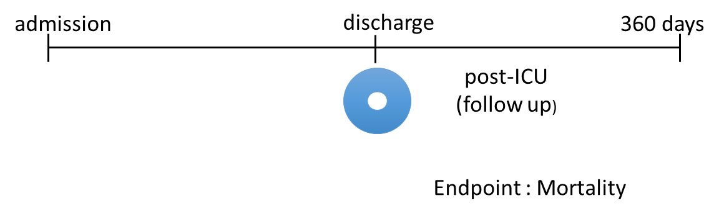
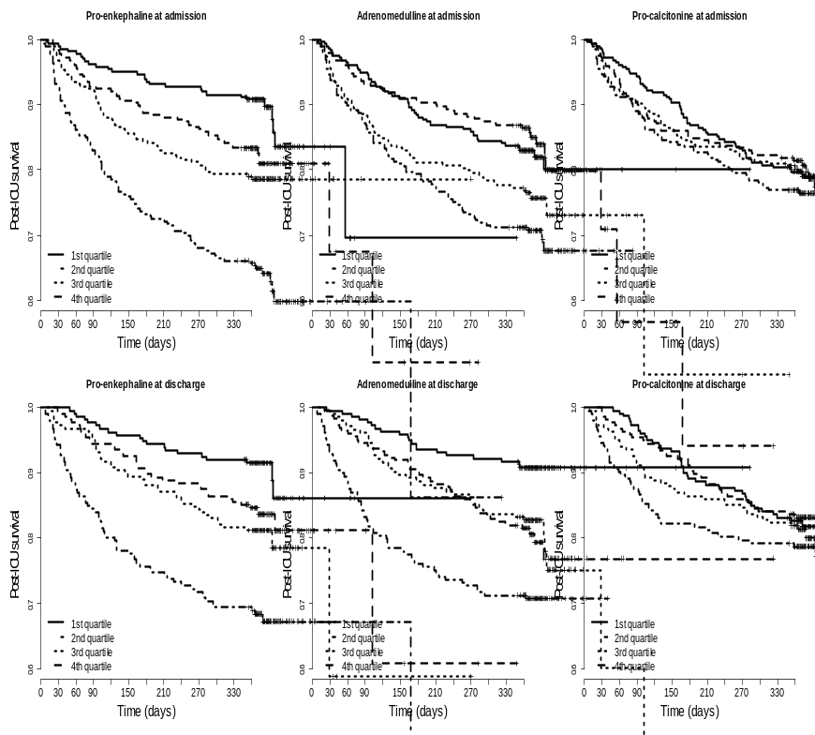
  penKid supports discharge decision by predicting post-ICU mortality
FROG-ICU Study
Mebazaa (FR)
Quartiles of penKid at discharge
Death (1 year)
HR_{Q4/Q1}: 4.3
Q1
Q2
Post-ICU survival
Q3
Q4
p < 0.0001
Time (days)
Mebazaa et al. (2015) BMC Anesthesiology 15:143.
Legrand et al. (2016) Poster AKI/CRRT congress 2016, San Diego

Slide 22


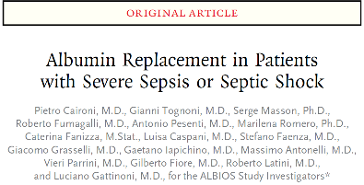
Albumin Italian Outcome Sepsis (ALBIOS) study
ALBIOS
Gattinoni (IT)
n = 956
Multicenter (35)
Confirmational Study – Sepsis & Septic shock
Multicenter, open-label, randomized trial
Patients with severe sepsis or septic shock enrolled between 2008-2012
follow-up: 90 days
20% albumin vs. crystalloid: no significant difference for 28 d and 90 d survival
  Age (median) 70 years [57-78]
  58.7% males
  BMI 26.4 ± 5.5
  90 day survival: 61.2% (369 deaths)
  bio-ADM available at day 1, 2 and 7
Masson et al. (2016) Abstract AKI & CRRT 2016
[manuscript in preparation]

Slide 23
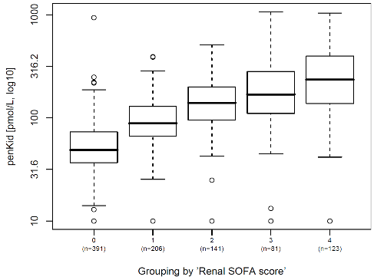
  Association of penKid level with Renal SOFA score enables early diagnosis of AKI
ALBIOS (Sepsis & Septic shock)
Gattinoni (IT)
Association of penKid with Renal SOFA score
penKid [pmol/L]
normal range
p<0.0001
0
(n=391)
1
(n=206)
2
(n=141)
3
(n=81)
4
(n=123)
Grouping by ‘renal SOFA score‘
Masson et al. (2016) Abstract AKI & CRRT 2016
[manuscript in preparation]

Slide 24
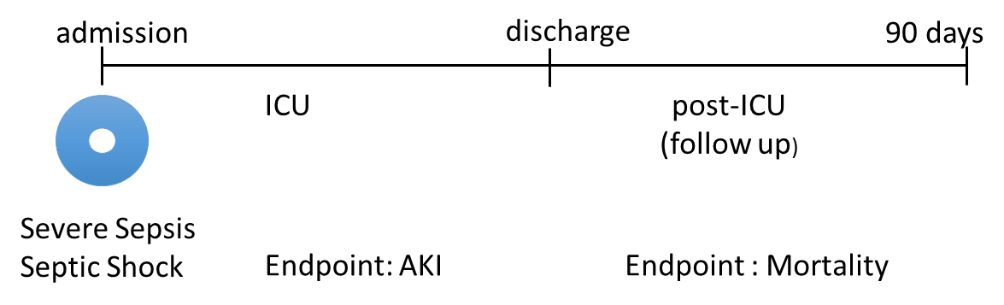
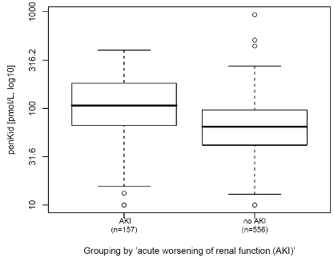
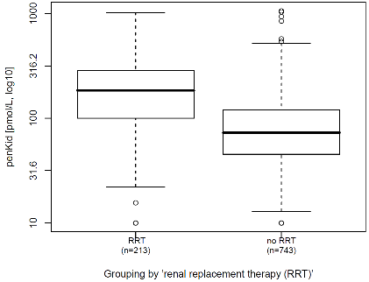
  penKid enables early diagnosis of AKI and indicates need for renal replacement therapy
ALBIOS (Sepsis & Septic shock)
Gattinoni (IT)
Acute kidney injury (AKI)
Renal replacement therapy (RRT)
AUC=0.70
AUC=0.77
p<0.0001
p<0.0001
yes
no
yes
no
Masson et al. (2016) Abstract AKI & CRRT 2016
[manuscript in preparation]

Slide 25
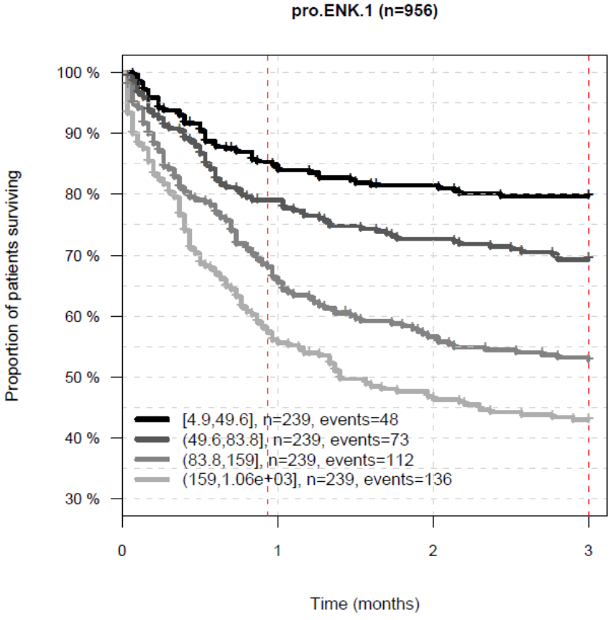
  penKid admission level independently predicts mortality of septic patients
ALBIOS Sepsis Study
Gattinoni (IT)
Death (3 months)
HR (Q4/Q1): 2.85
Q1
HR [95%CI]
Univariate
1.8 [1.6-2.1]
Q2
Survival rate
Adjusted*
1.6 [1.3-2.0]
Q3
p<0.0001
Q4
1.0
1.5
2.0
HR [95%CI]
p<0.0001
*Cox multivariable models adjusted for age, sex, BMI, MAP, FiO₂, diuresis, serum creatinine, pre-existing liver disease or COPD or chronic renal failure or immunodeficiency or congestive / ischemic heart disease. HR [95%CI] for an increment of 1 IQR of penKid.
Time (months)
Masson et al. (2016) Abstract AKI & CRRT 2016
[manuscript in preparation]
Notes:
Penkid independent

Slide 26
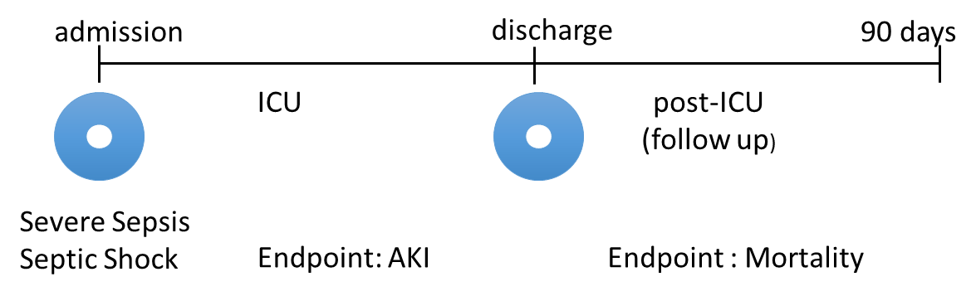
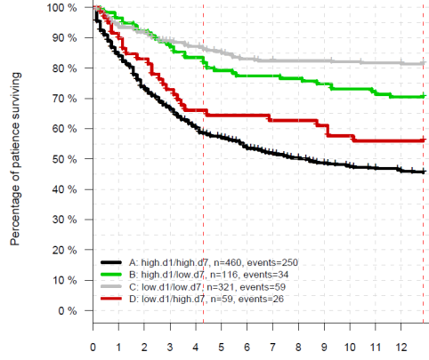
  Rising and falling of the kidney function marker penKid reflects the change in mortality risk
ALBIOS (Sepsis & Septic shock)
Gattinoni (IT)
low/low
high/low
low/high
Proportion of patients surviving
high/high
penKid measured on day 1 and 7
cut-off: 80 pmol/L
n = 956
Time (weeks)
Masson et al. (2016) Abstract AKI & CRRT 2016
[manuscript in preparation]

Slide 27

Clinical performance of penKid in CV disease

Slide 28

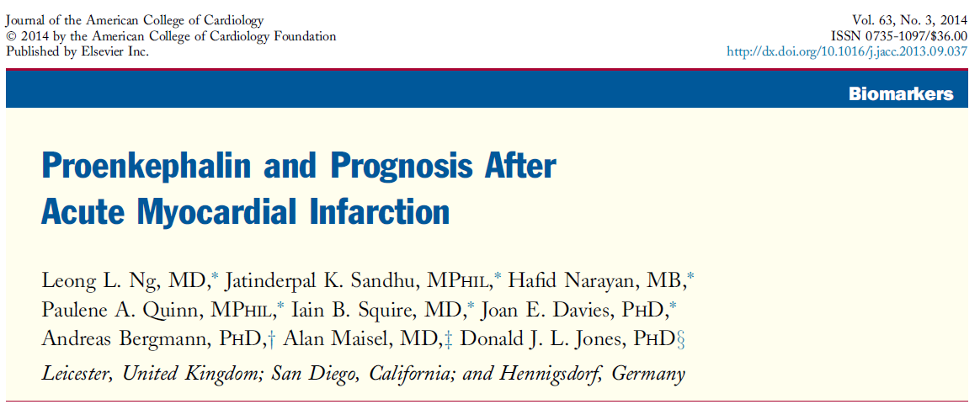

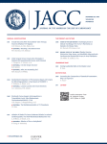
Acute myocardial infarction (AMI)
Prof. Leong L. Ng (UK)
1,141 cases of acute myocardial infarction (AMI) admitted to University Hospitals of Leicester between August 2004 and April 2007
Blood samples: taken on admission (36 hours after symptom onset the latest)
Follow up: at least 2 years
323 Major Adverse Cardiac Events (MACE) within 2 year period
MACE = all-cause mortality, HF hospitalization or re-AMI
Ng LL et al. (2014) J Am Coll Cardiol. 63(3):280-9.

Slide 29
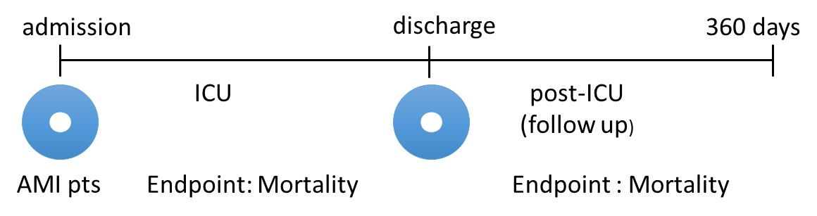
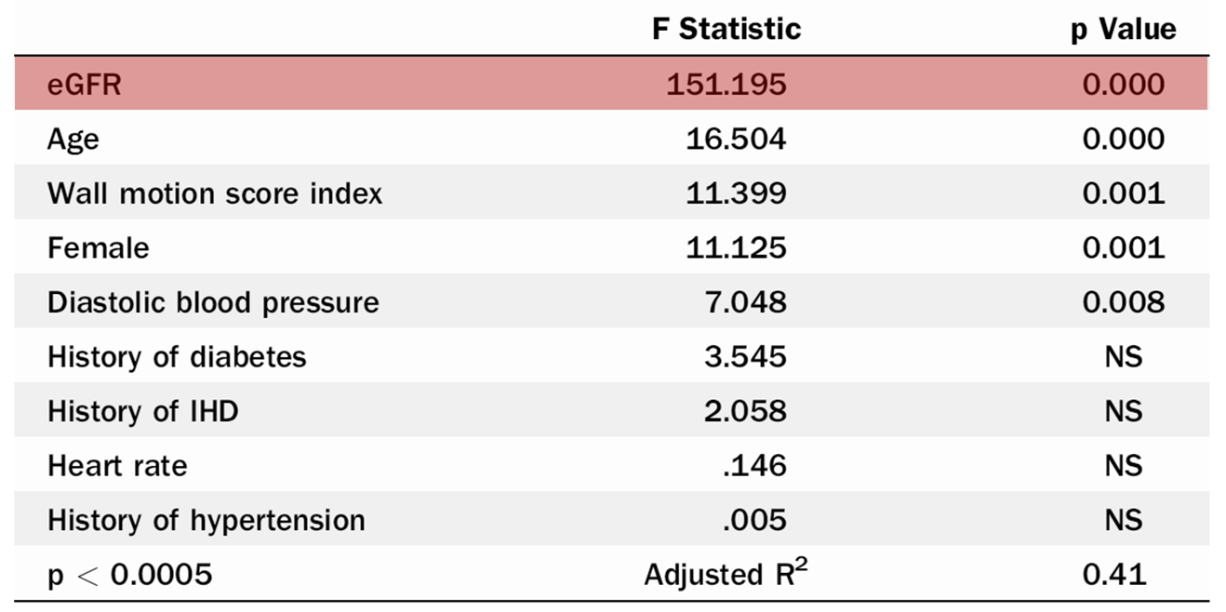
  Kidney dysfunction is the major determinant for penKid in acute myocardial infarction
Acute myocardial infarction
Ng (UK)
n = 1,141
Ng LL et al. (2014) J Am Coll Cardiol. 63(3):280-9.

Slide 30
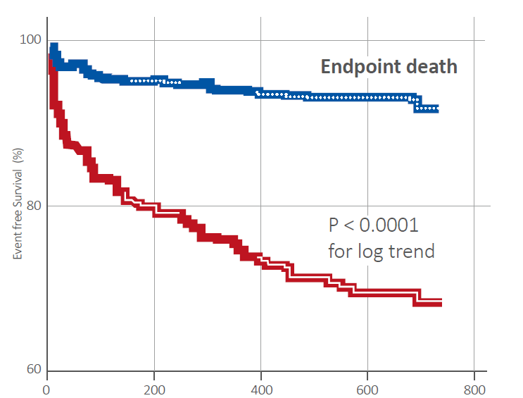
  Kidney dysfunction detected by penKid strongly predicts 2-year mortality in patients with AMI
Acute myocardial infarction
Ng (UK)
n = 1,141
Event free portion for patients with penKid levels above or below the cut-off (99th percentile of normal range)
Event free survival (%)
Event free survival (%)
Time to death (days)
Ng LL et al. (2014) J Am Coll Cardiol. 63(3):280-9.

Slide 31

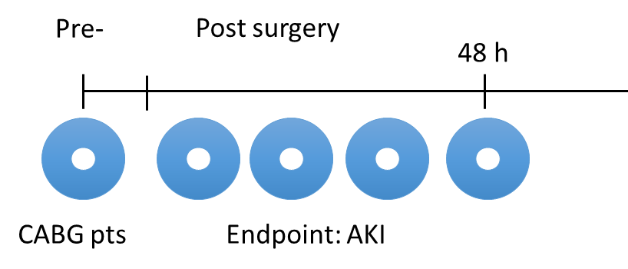
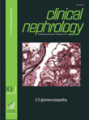
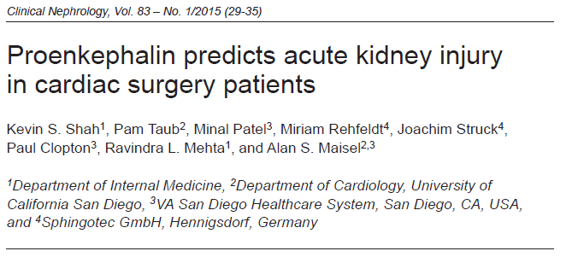
Coronary Artery Bypass Graft (CABG) surgery
  92 patients undergoing Coronary Artery Bypass Graft (CABG) surgery at the Veterans Affairs San Diego Healthcare System
  20 subjects developed AKI post-operatively
  Plasma samples taken:
    Pre-OP
    Post-OP: 2 h, 6 h, 12 h, 24 h, 48 h
Prof. Alan S Maisel (USA)
Shah et al. (2015) Clin Nephrol. 83(1):29-35.

Slide 32
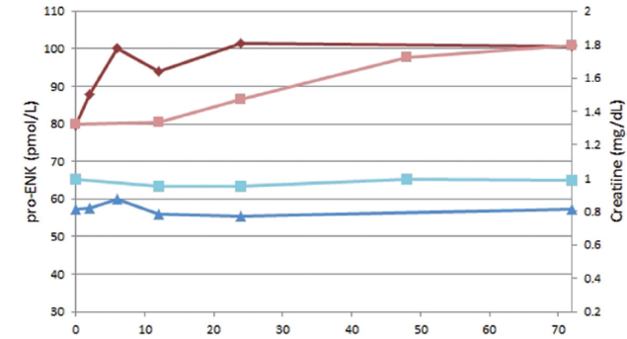
  penKid levels are significantly elevated in cardiac surgery patients who developed AKI
Coronary Artery Bypass surgery
Maisel (USA)
n = 92
penKid (AKI)
penKid increases quicker than creatinine
Creatinine (AKI)
penKid [pmol/L]
Creatinine (no AKI)
Creatinine [mg/dL]
penKid (no AKI)
Time (hrs) post surgery
Shah et al. (2015) Clin Nephrol. 83(1):29-35.

Slide 33
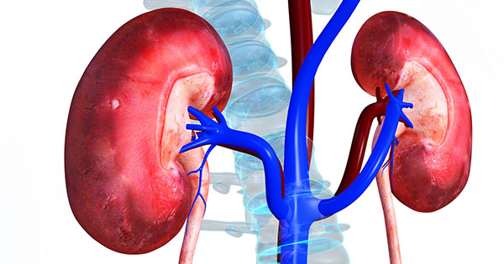
Clinical performance of penKid in graft failure

Slide 34

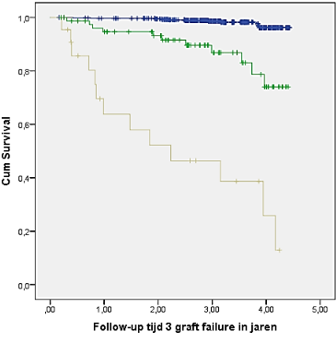
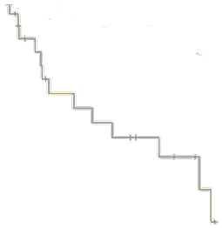
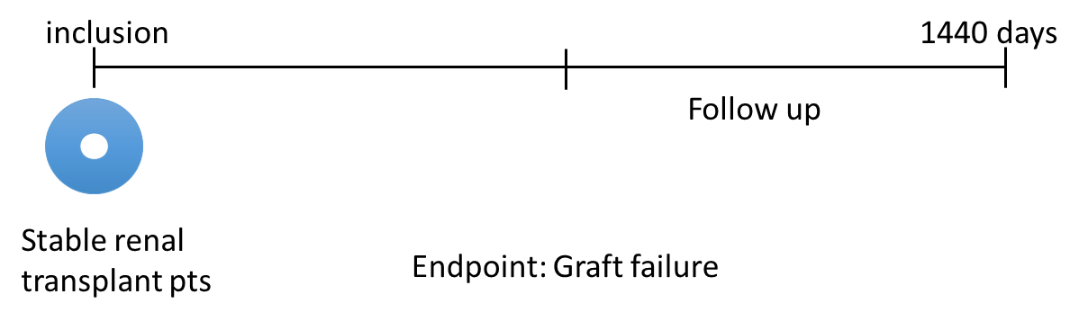
  penKid strongly predicts risk of graft failure in renal transplant recipients
Prediction of long-term outcome in renal transplant recipients
Prof. Stephan J.L. Bakker
Prof. Ron Gansevort (NL)
T1
T2
  707 stable renal transplant recipients
  ≥1 year post transplantation
  Visits between 2008 and 2011
  Biomarker subset: n=664
% free of graft failure
T3
Time to graft failure (years)
Kieneker et al. (2016) Abstract AKI & CRRT 2016
[manuscript in preparation]

Slide 35




penKid – a novel biomarker for acute kidney injury designed for acute care environments
Plasma as sample matrix ✓
» urine is less available in ED & ICU
Early Diagnosis
of acute kidney injury
Dynamic kinetic ✓
» timely diagnosis & monitoring
Prediction
of acute kidney injury
Simple cut-off value ✓
» unambigious results & clear decisions
Monitoring
the change of risk
Highly sensitive ✓
» precise & reliable measurement
Prediction
of change in creatinine
Independent of inflammation ✓
» suitable for septic patients

Slide 36

Thank you very much
for your attention
struck@sphingotec.de

