Slide 1
CMO’s Challenges and Strategies in Aseptic Manufacturing
Jixing Wang, Ph.D.
GMP Summit 2014
September 25-26, 2014
Valencia Convention Centre, Spain

Slide 2
Overview
Introduction
Concepts of Aseptic Manufacturing
Basic Flow of Aseptic Processing
Regulatory Requirements
Quality Expectations
Challenges
Strategies
Turn Key Solutions – 2 examples

Slide 3
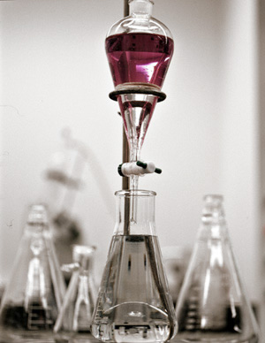
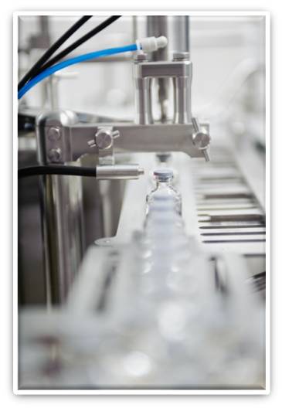
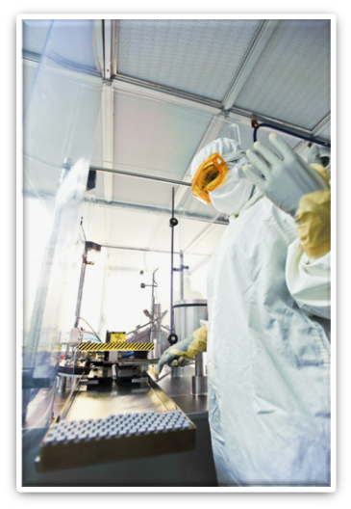
Introduction - Dalton Pharma Services
Founded in 1986 in Toronto, Canada
Started with challenging chemical synthesis to support local researchers
Expanded to meet customer needs in drug discovery, development and manufacturing
Including custom synthesis, clinical supply manufacturing, and commercial products
First Commercial Product Launched in 2012
One of the core business is sterile/aseptic manufacturing of investigational drug products.

Slide 4
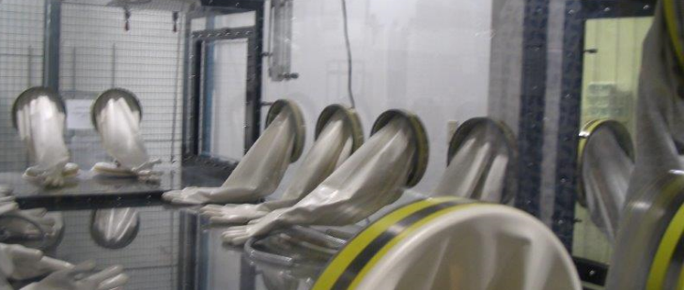
Concepts of Sterile/Aseptic Processing
Sterile: Free from living organism
Aseptic: Absence of pathogenic microorganism or technique used to prevent microbial and particulate contamination
Aseptic Processing (John W Levchuk, CBER, FDA): The product and all of its contact parts are sterilized separately and brought together under exposed conditions where, if not properly controlled, could result in contamination

Slide 5
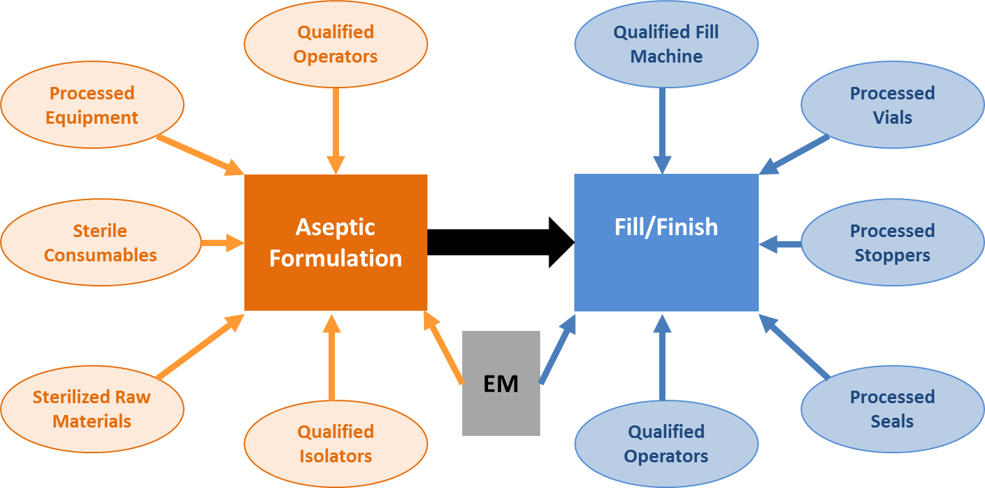
Basic Flow of Aseptic Processing

Slide 6



Regulatory Requirements
FDA: Sterile Drug Products Produced by Aseptic Processing — Current Good Manufacturing Practice, September 2004
Health Canada: Process Validation: Aseptic Processes for Pharmaceuticals, June 1st, 2003
EMA: GMP, Annex 1 Manufacture of Sterile Medicinal Products, 25 November 2008
Common expectations?

Slide 7

Quality Expectations
Validation of aseptic processing for investigational medicinal products are very similar to the standards for products theorized for marketing
Qualification: 3 runs for initial validation
Re-qualification: 1 run annually
System View: Validation of all inputs, components, sub-processes and sub-systems
Media fill alone cannot validate the whole aseptic process

Slide 8

Challenges for CMO
When manufacturing investigational sterile products, CMO facing challenges on major factors, such as cost, cycle time, and flexibility
Cost | Cycle Time
High validation cost: similar to commercial products | Long validation time: similar to commercial products
Low production demand: 1-3 batches/year | Unique project requirements Unique processes
Small batch size: < 10,000 units | Less defined expectations, especially at beginning
Multiple validations to support 1 production batch | Require flexibility and responsiveness

Slide 9

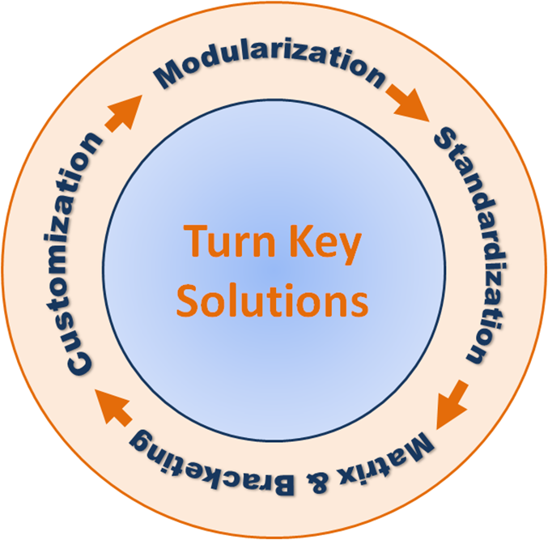

Strategies
Think ahead
Plan (QbD)
Implement/Manage
Reduce Cost
Shorten Cycle Time
Increase Flexibility

Slide 10

Modularization
Breaking the aseptic process down and organizing it into unique modules, for standardization and flexibility
Sub-process: sterilization of components, processing equipment, fill/finish process
Sub-system: formulation setup, isolator,
fill machine

Slide 11
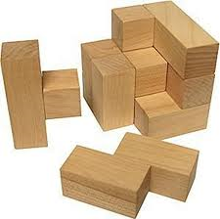
Standardization
Developing and implementing common technical standards and requirements to the individual modules
Process standards: loads and loading patterns of depyrogenation runs, vial fill and finish procedure
System standards: formulation & reaction vessels, isolators, vial configurations

Slide 12
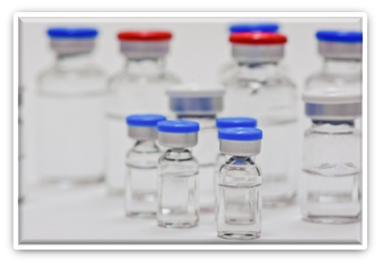
Matrix & Bracketing
Performing initial qualifications for all systems and processes, then rotating them for annual re-qualification or simplifying qualification of new configurations using risk based analysis on matrix & bracketing
Examples: Fill/Finish line for
2, 3, 5, 10 and 20 mL vials.
Media fills

Slide 13

Customization – Towards Turn Key Solutions
Using the standardized, pre-qualified modules to form customized system to meet unique project requirements, the advantages are:
Shorter cycle time: the overall qualification time is reduced by using the standardized, pre-qualified modules
Lower cost: the overall cost is shared among projects, i.e. instead of applying qualification cost to a single project, only applying a portion of the cost (e.g. access fees) for the pre-qualified modules
Higher flexibility: more responsive
to changes, especially at later stage
of a project
Disadvantages/Risks: CMO investments

Slide 14
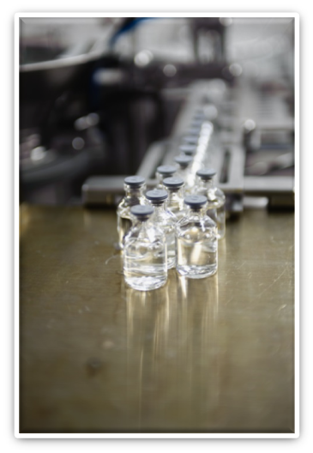
Turn Key Solutions – Case #1
Project: Aseptic formulation plus fill/finish of a injection
Pre-qualification
Formulation setup
Sterile filtration setup
Sterilization of components
Fill/Finish configuration and process
Customization
Sterilization of raw materials
Aseptic formulation process

Slide 15
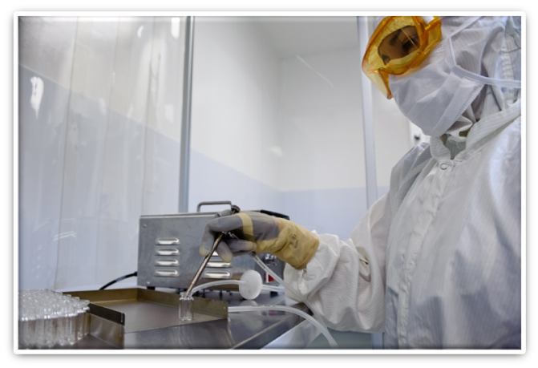
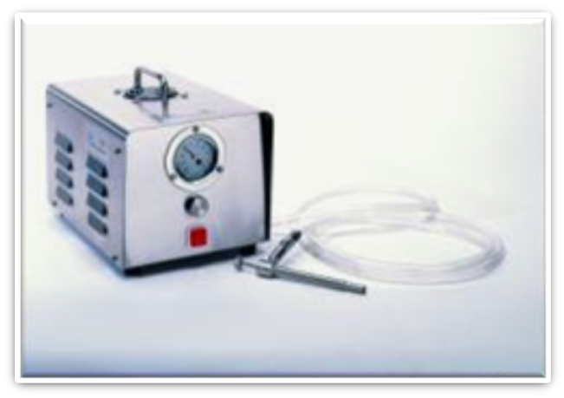
Turn Key Solutions – Case #2
Project: Aseptic fill/finish of powder in vials
Pre-qualification
Filler – LM14
Aseptic processing, setup
Vial configurations
Sterilization of components
Customization
Drug substance
Fill weight
Batch size

Slide 16

Jixing Wang, Ph.D., MBA
Director of GMP Operations
349 Wildcat Road,
Toronto, ON
M3J 2S3
email: jwang@dalton.com
Tel: 416.661.2102
Fax: 416.661.2108
www.dalton.com
Thank you!
DISCOVER DEVELOP MANUFACTURE

