Slide 1

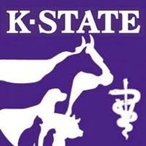
Novel
vaccine adjuvants for
infectious diseases
aninal
Jishu Shi, DVM, PhD
Professor of Vaccine Immunology Director,
U.S.-China Center for Animal Health College
of Veterinary Medicine
Kansas State University
Manhattan, KS 66506

Slide 2
Presentation
Outline
➢ Vaccines for animals
➢ Development of adjuvants for animal
vaccines

Slide 3
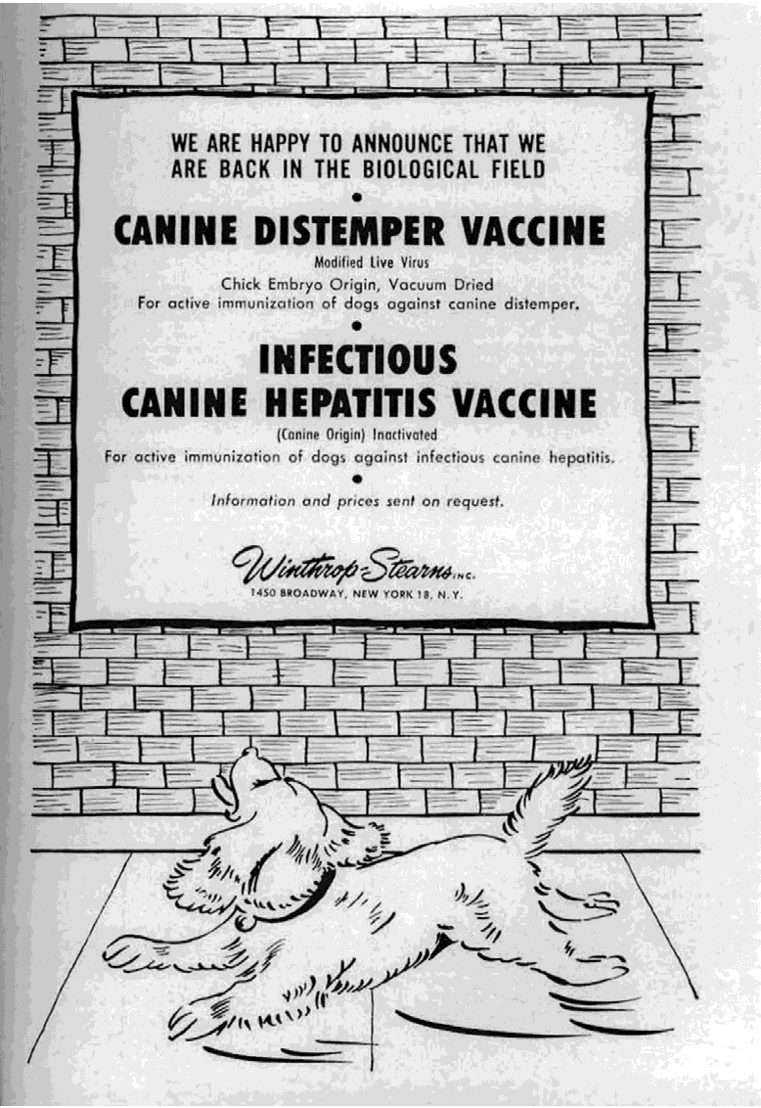
Animal vaccines are for the Herd,
Not the individual (human vaccines)
The efficacy of animal vaccines can
be: high, moderate, or
questionable
Vaccine label claims:
1.
2.
3.
4.
5.
Prevention of infection
Prevention of disease
Aid in disease prevention
Aid in disease control
Other
Examples of biologicals available in as
published in the Journal of the American
Veterinary Medical Association in 1955.

Slide 4
Various Types of Animal
Vaccines
1.
Modified live virus
2.
Inactivated virus
3.
Bacterin (inactivated or attenuated)
4.
Recombinant (vectored)
5.
DNA
6.
Subunit

Slide 5
Animal Vaccine Production Technologies
in a short time
Need technologies to produce millions doses of pure, safe, and potent vaccines
➢
Development of primary and clean cell lines
➢
High-volume roller bottle culture / Large-scale bioreactors
➢
Secure and closed systems for antigen production and storage
➢
Inactivation technologies (cyclized binary ethyleneimines)
➢
Purification and concentration of antigens
➢
Storage of bulk antigens
➢
Adjuvants (improved aluminum gels and oil suspensions)

Slide 6
What is an adjuvant and why do we need
it?
An adjuvant is a substance that is able to increase the
immunogenicity of co-administered antigens
❖
Immune potentiators (TLR agonists)
❖
➢
➢
➢
➢
➢
➢
Antigen-delivery systems (emulsions or microparticles attractive to APC)
Make existing inactivated vaccines more potent
Antigen sparing (reduce the cost to produce more Ag)
More rapid seroprotection
Stimulation of T cell immunity (vaccine-specific adjuvant)
Enhancement of protection in neonates and the elderly
Stimulation of longer-lasting protective immunity

Slide 7
Special considerations
for
animal
vaccines
Cheap
Efficacious
Relatively safe
Species specific
Rapid response
(short production
cycle)
Duration of immunity (cost reduction)

Slide 8
The slow
process
of
adjuvant
discovery
Europe
MF59
MPL+Alum
AS03
Alum
1920
1940
1960
1980
2000
Alum
AS04
U.S.A.

Slide 9
OW-14: a novel oil-in-water emulsion adjuvant
for swine influenza virus and Mycoplasma
hyopneumoniae vaccines

Slide 10
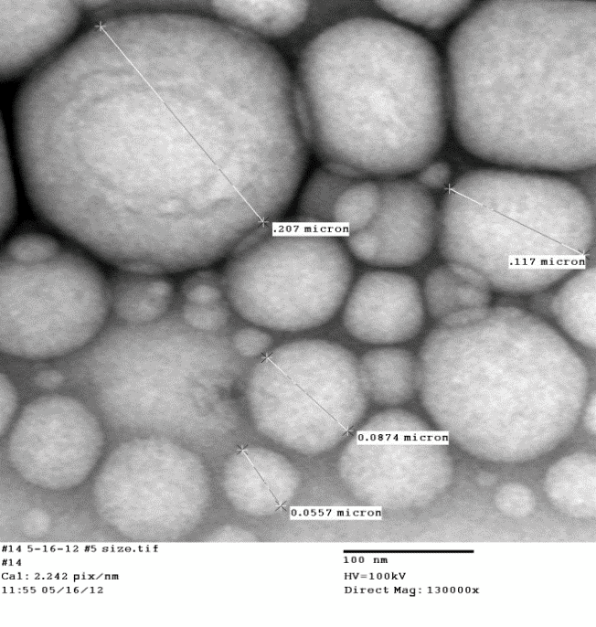
OW-14: a stable oil-in-water emulsion using a plant-based, food-grade emulsifier
400
1 day
3 months
3 years
300
Particle Size (nm)
200
100
0
Room Temp
4 C
0
1 day
3 months
3 years
-20
Zeta Potential (mV)
-40
-60
Room Temp
4 C

Slide 11
OW-14 emulsion acts as a potent adjuvant for M.
Hyo
pigs
and
potentiates prolonged
antibody
responses
in
Day 0
3 weeks
5 weeks
1.5
2 months
1.0
4 months
5 months
Mycoplasma ELISA
(S/P ratio)
0.5
0.0
(-)
Ag only
Adj only
OW-14
Respisure

Slide 12
OW-14 emulsion acts as a potent adjuvant for swine influenza
and
potentiates prolonged
antibody
responses
in
pigs
Day 0
900
3
weeks
5 weeks
2 months
4 months
600
HI Titer
300
0
(-)
Ag only
Adj only
OW-14
FluSure

Slide 13
OW-14 exposed to high temperatures is still an effective
adjuvant
for
swine
influenza
and
Mycoplasma
vaccines
Day
Day
Day
0
21
35
1200
800
HI Titer
400
0
(-)
FluSure
4C
RT
40C

Slide 14
OW-14 exposed to high temperatures is still an effective
adjuvant
for
swine
influenza
and
Mycoplasma
vaccines
Day
Day
Day
0
21
35
1.5
1.0
Mycoplasma ELISA
(S/P ratio)
0.5
0.0
(-)
Respisure
4C
RT
40C

Slide 15
OW-14 adjuvant induces robust antibody
production
even
at
lower
antigen
doses
1.5
1.0
ratio)
Mycoplasma ELISA
(S/P
0.5
0.0
PBS
Ag
Ag
Ag
Antigen only
100%
50%
25%

Slide 16
OW-14 adjuvant induces robust antibody
production
even
at
lower
antigen
doses
1500
1000
Titer
HI
500
0
PBS
Ag
Ag
Ag
Antigen only
100%
50%
25%

Slide 17
Conclusions
We have created a stable oil-in-water emulsion (OW-14) using
cost-effective emulsifiers and oils.
Animals vaccinated with OW-14-formulated vaccines had high
antigen-specific antibodies titers, which were higher and lasted
longer than commercially available vaccines.
We also found that vaccines formulated with lower antigen
doses also produced a high antibody response.
OW-14 could be cheaper and more effective adjuvant for use
in animal vaccines.

Slide 18
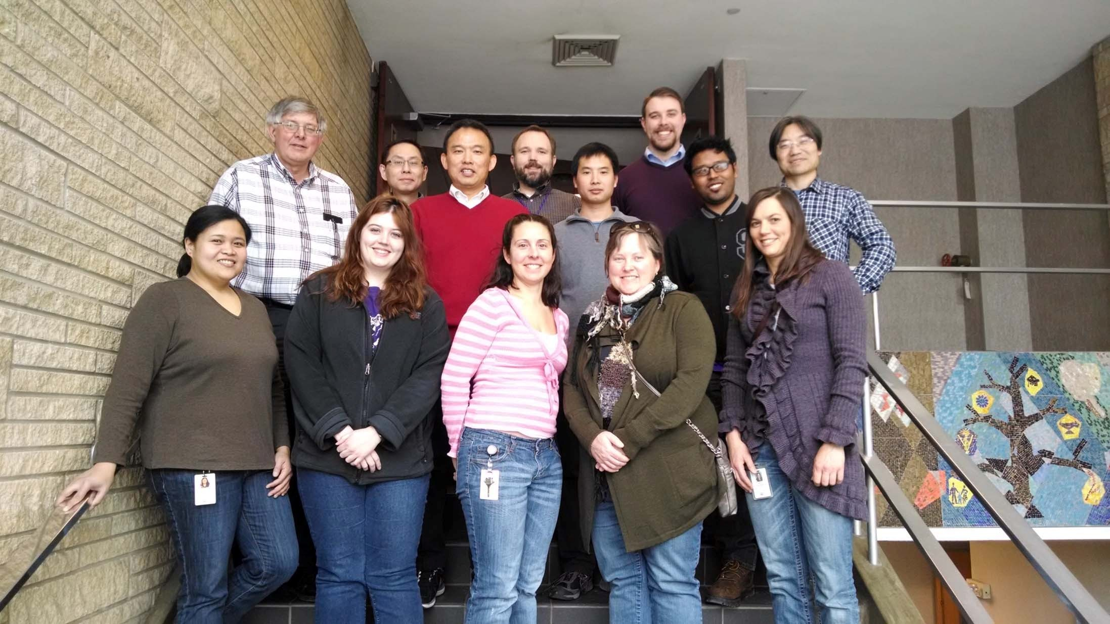
Thanks

