Slide 1
Cyber performances, technical and artistic collaboration across Internet
Jiri Navratil¹, Sven Ubik ¹, Jiri Melnikov ¹,
CESNET Czech Republic
Computer Graphics and Animation 2016,
November 7th, Las Vegas, US

Slide 2
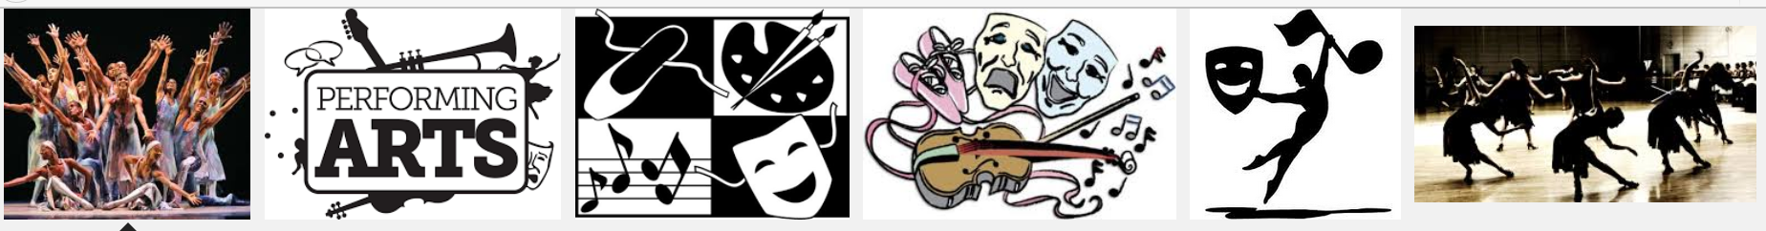
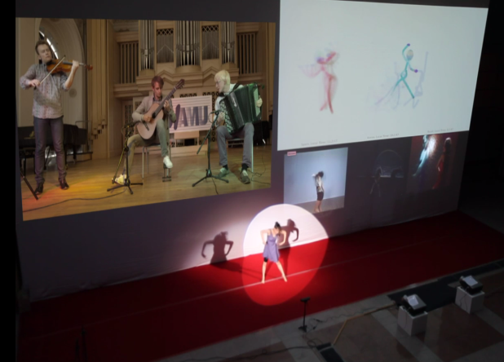
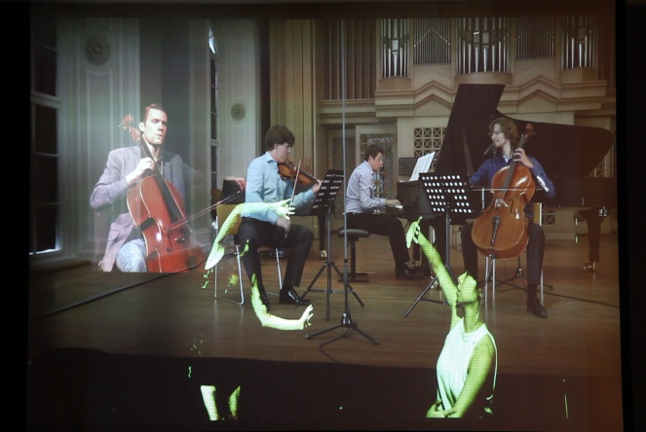
Live Digital Performance
Digital Performance is a very wide category filled with a range of productions.
It is a generic performance with an extra elements
incorporating and integrating computer technologies and techniques.
Usually its incorporate multimedia into any type of performance
whether it is live on a theatre stage or in the street.
The performance became a live demonstartion
using advanced conference systems, streaming media and high speed networks.
Distributed environment
can support creativity of scenic arts, especially theatre, dance and performance

Slide 3
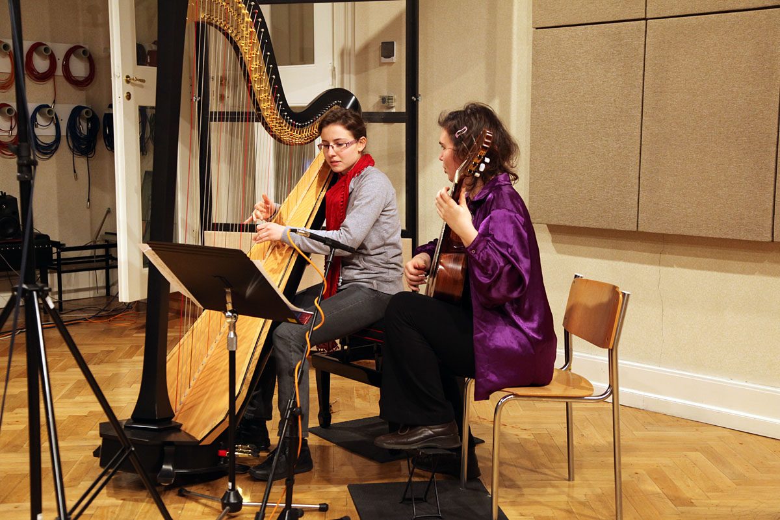
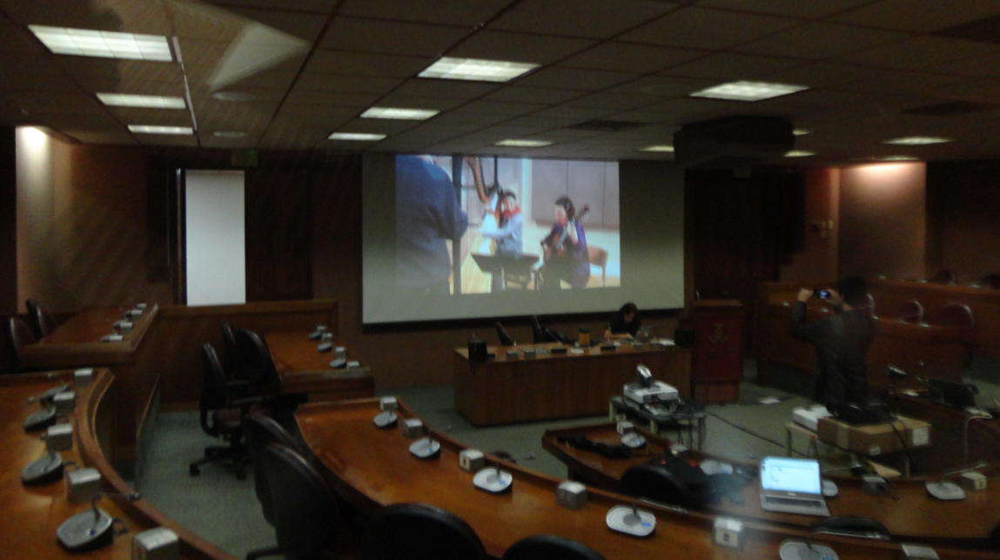
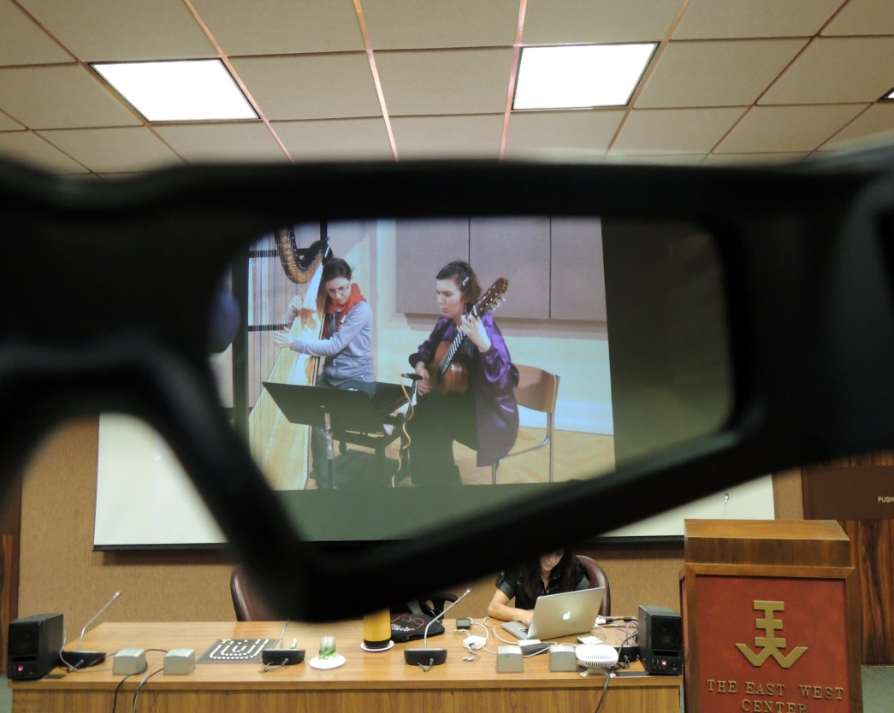
Concert in HAMU recording studio at Prague
Presented in 3D in Honolulu

Slide 4
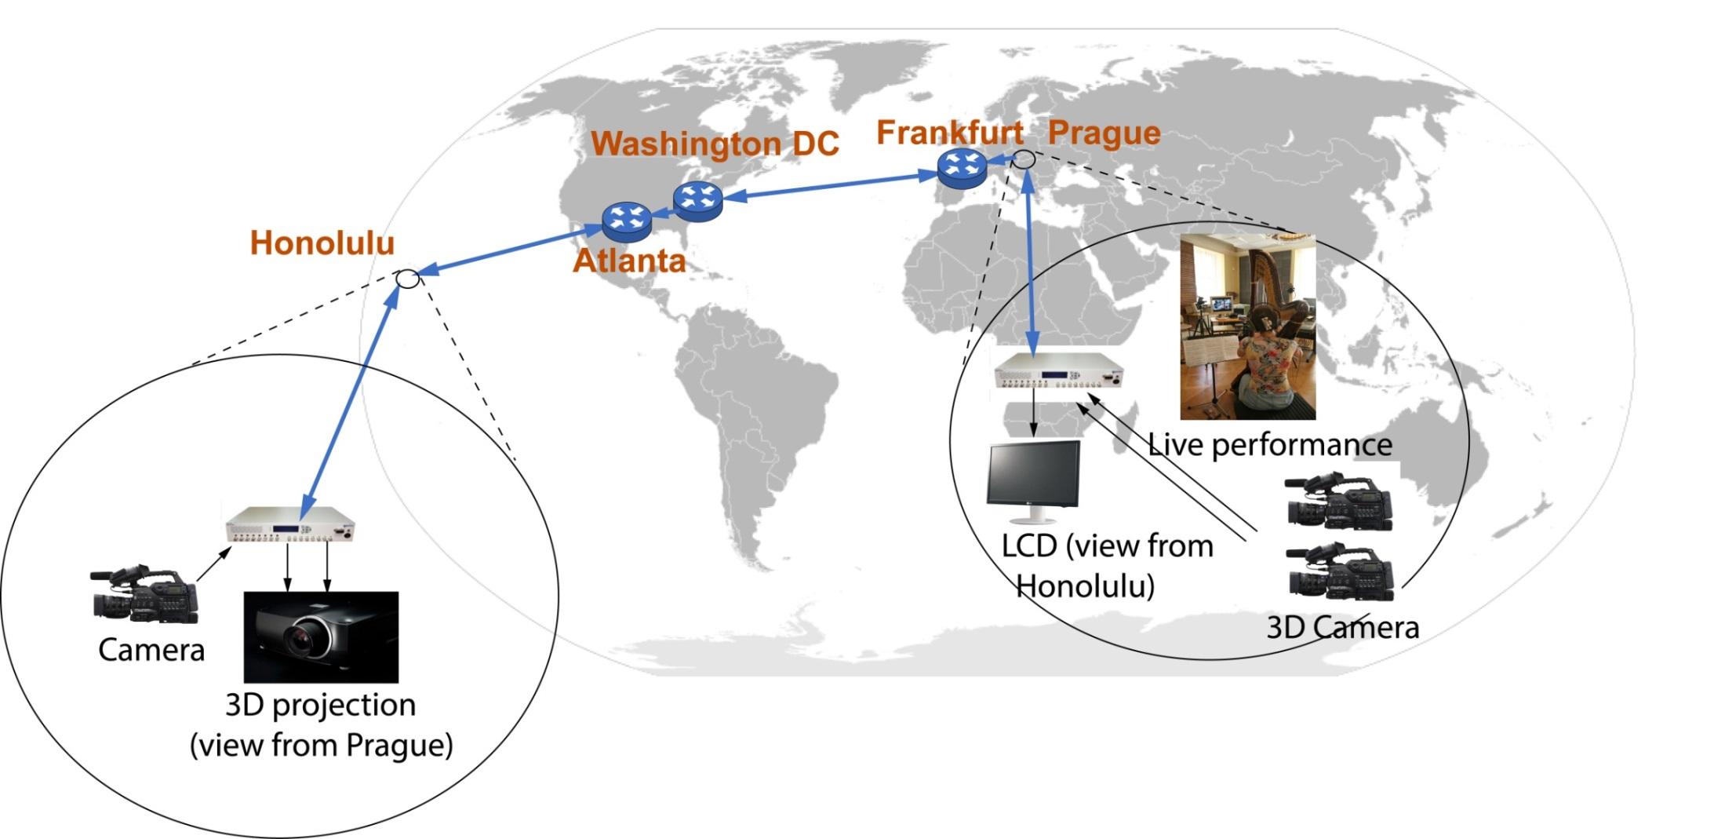






The Chamber Concert in 3D
(from HAMU Prague to Hawaii University Honolulu)
TIP2013 – APAN35
Network VLAN in several domaines
Distance approx.
16000 km (10000 miles)
35th APAN
Culture working group session
http://meetings.internet2.edu/2013-01-jt/
HD video
Networking partners

Slide 5
Interactive DEMO is based on several interdisciplinary fundaments:
Project
Virtual Walking in Historical Prague
one of the examples how
we can present preserved cultural exhibits
Langweill historical model of old Prague
Advanced IT - Virtual Reality tools as CAVE and the applications for modeling of architectural objects
Extreme fast networks and tools for to transporting huge volume of data in real time
3D visualization

Slide 6
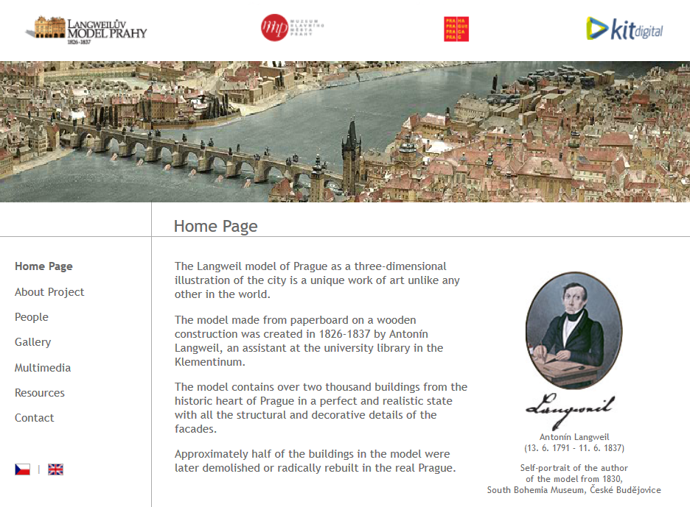
Langweill model of Prague

Slide 7
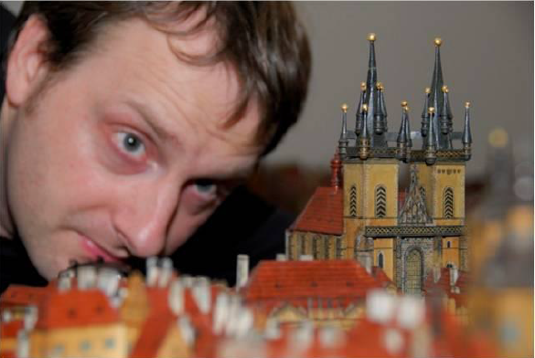
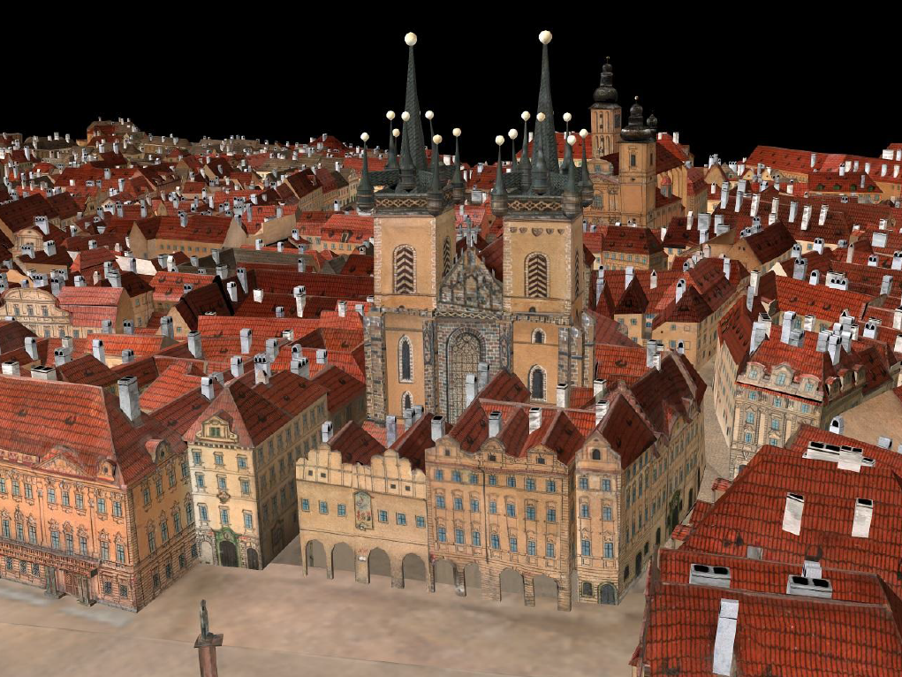
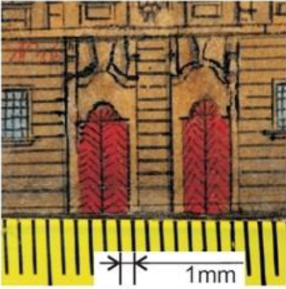
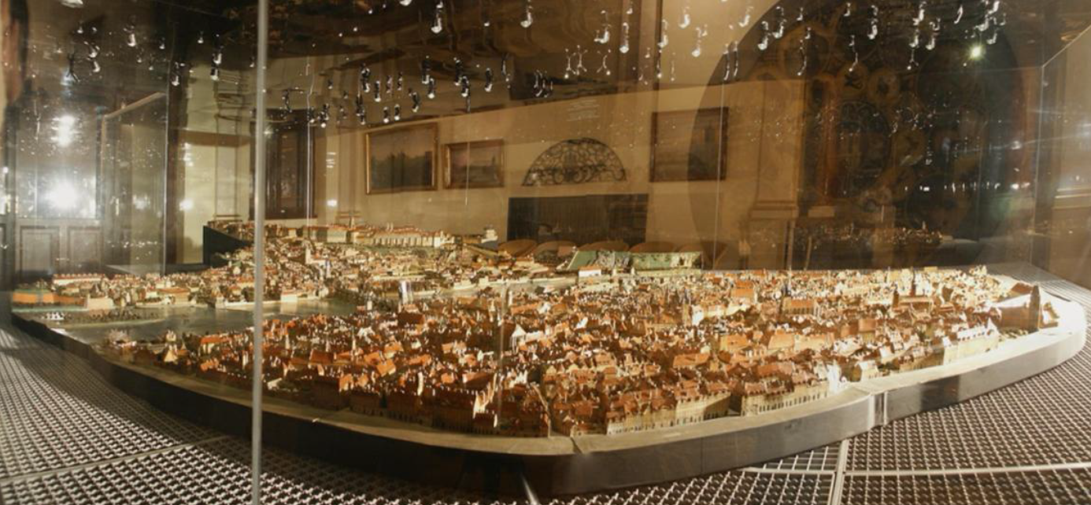
Few details of paperboard model

Slide 8
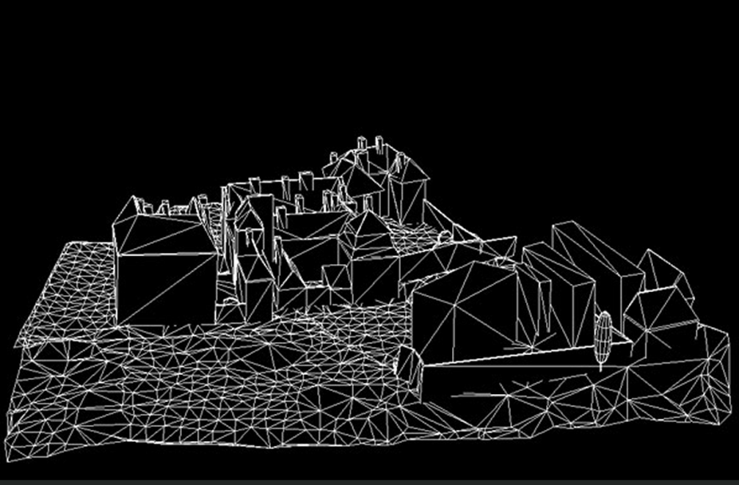
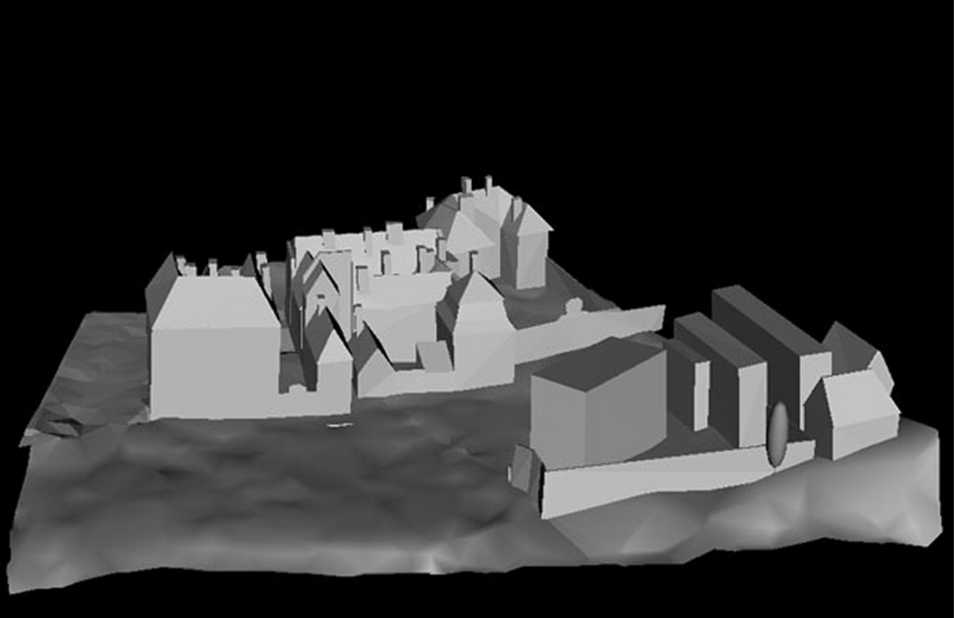
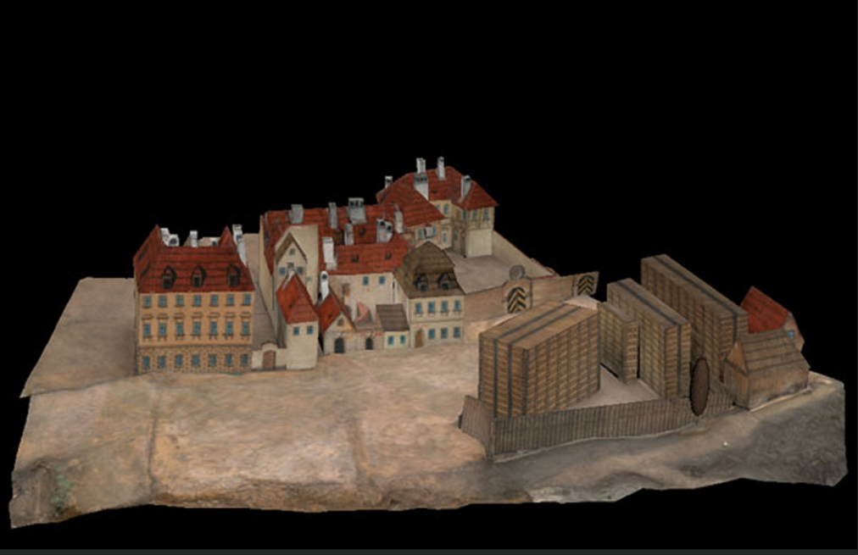
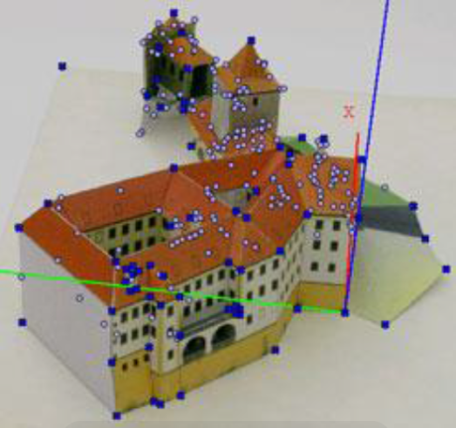
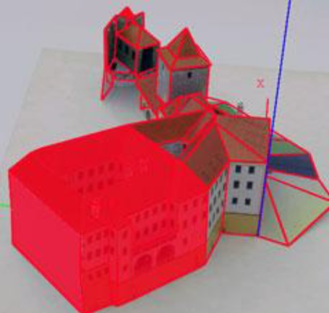
Digital model
Digital model was created by
KIT digital Czech a.s.
with collaboration of CTU at Prague
Faculty of Electro Engineering
The result of the photography process was approx. 250,000 photos with 16 Mpix resolution.
The total capacity of the stored
rough data exceeded 6 TB.
The details can be found:
http://cipa.icomos.org/fileadmin/template/doc/PRAGUE/030.pdf

Slide 9
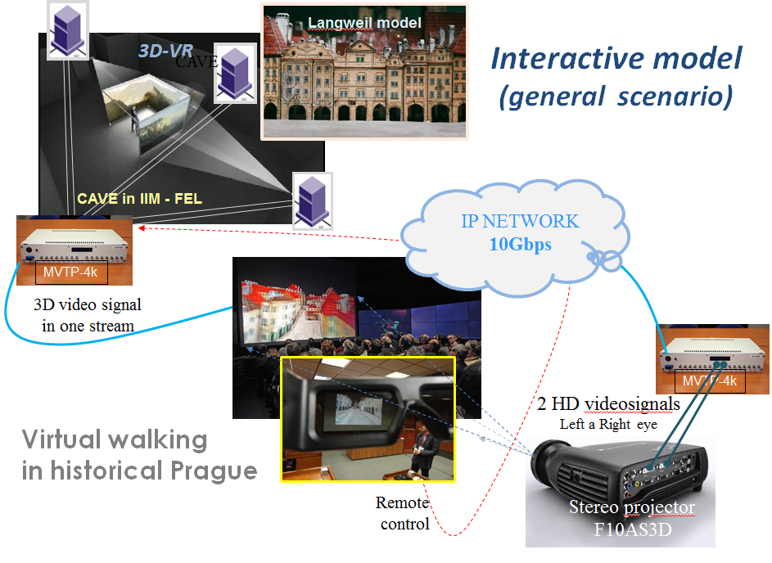

Slide 10
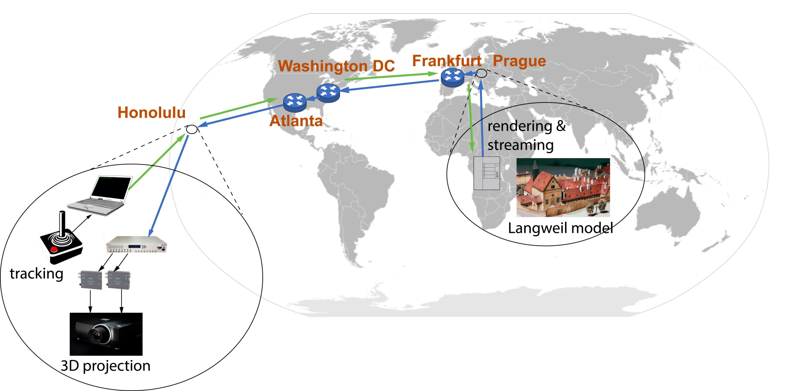

DEMO on IP network with 2,5 Gbps traffic
Rtt 217 ms
Networking partners

Slide 11
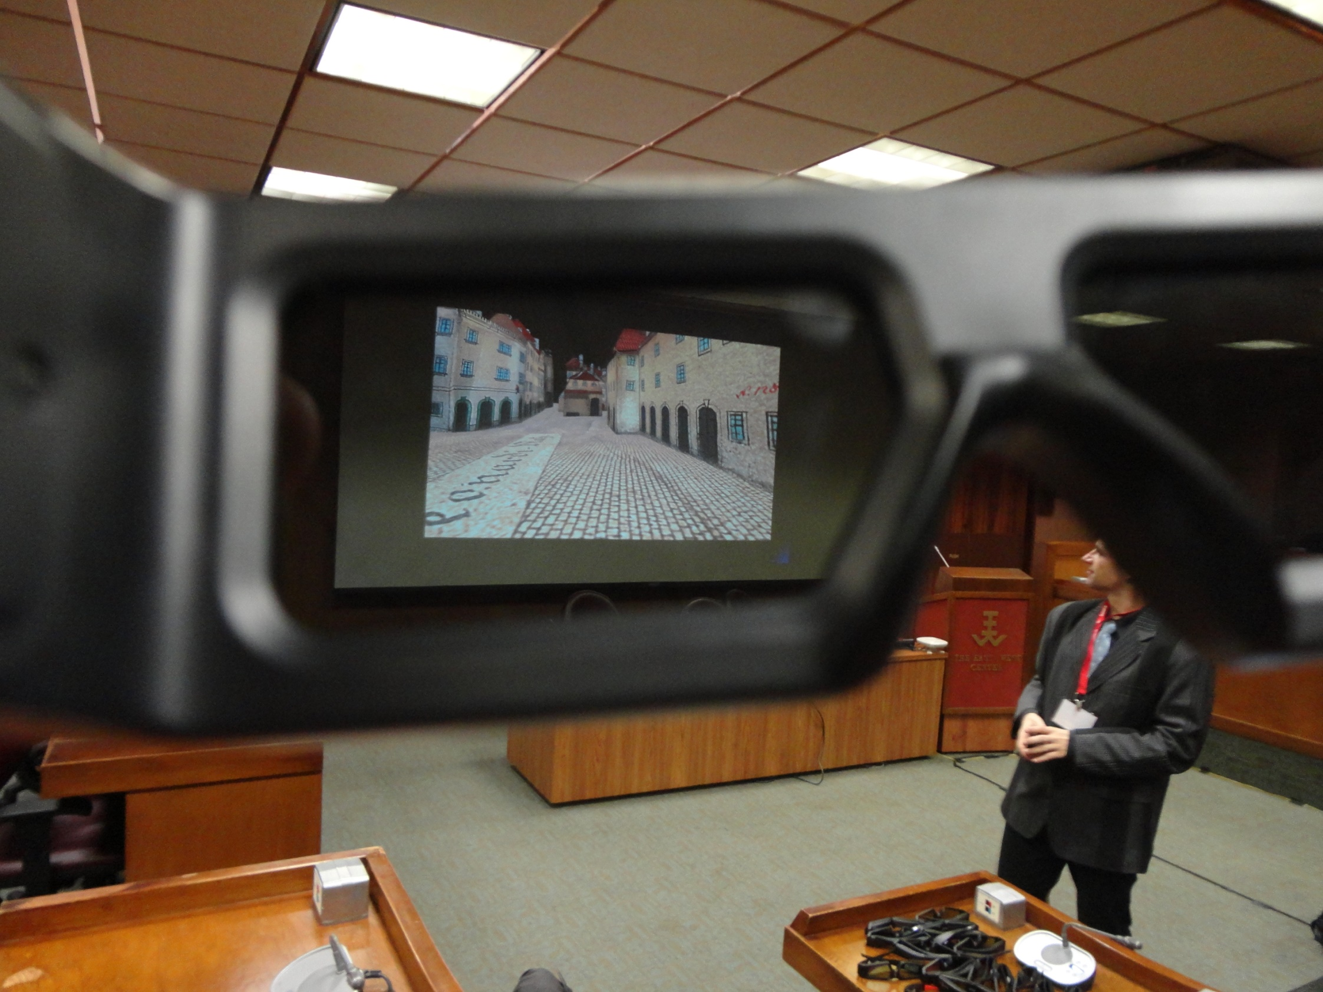

Slide 12
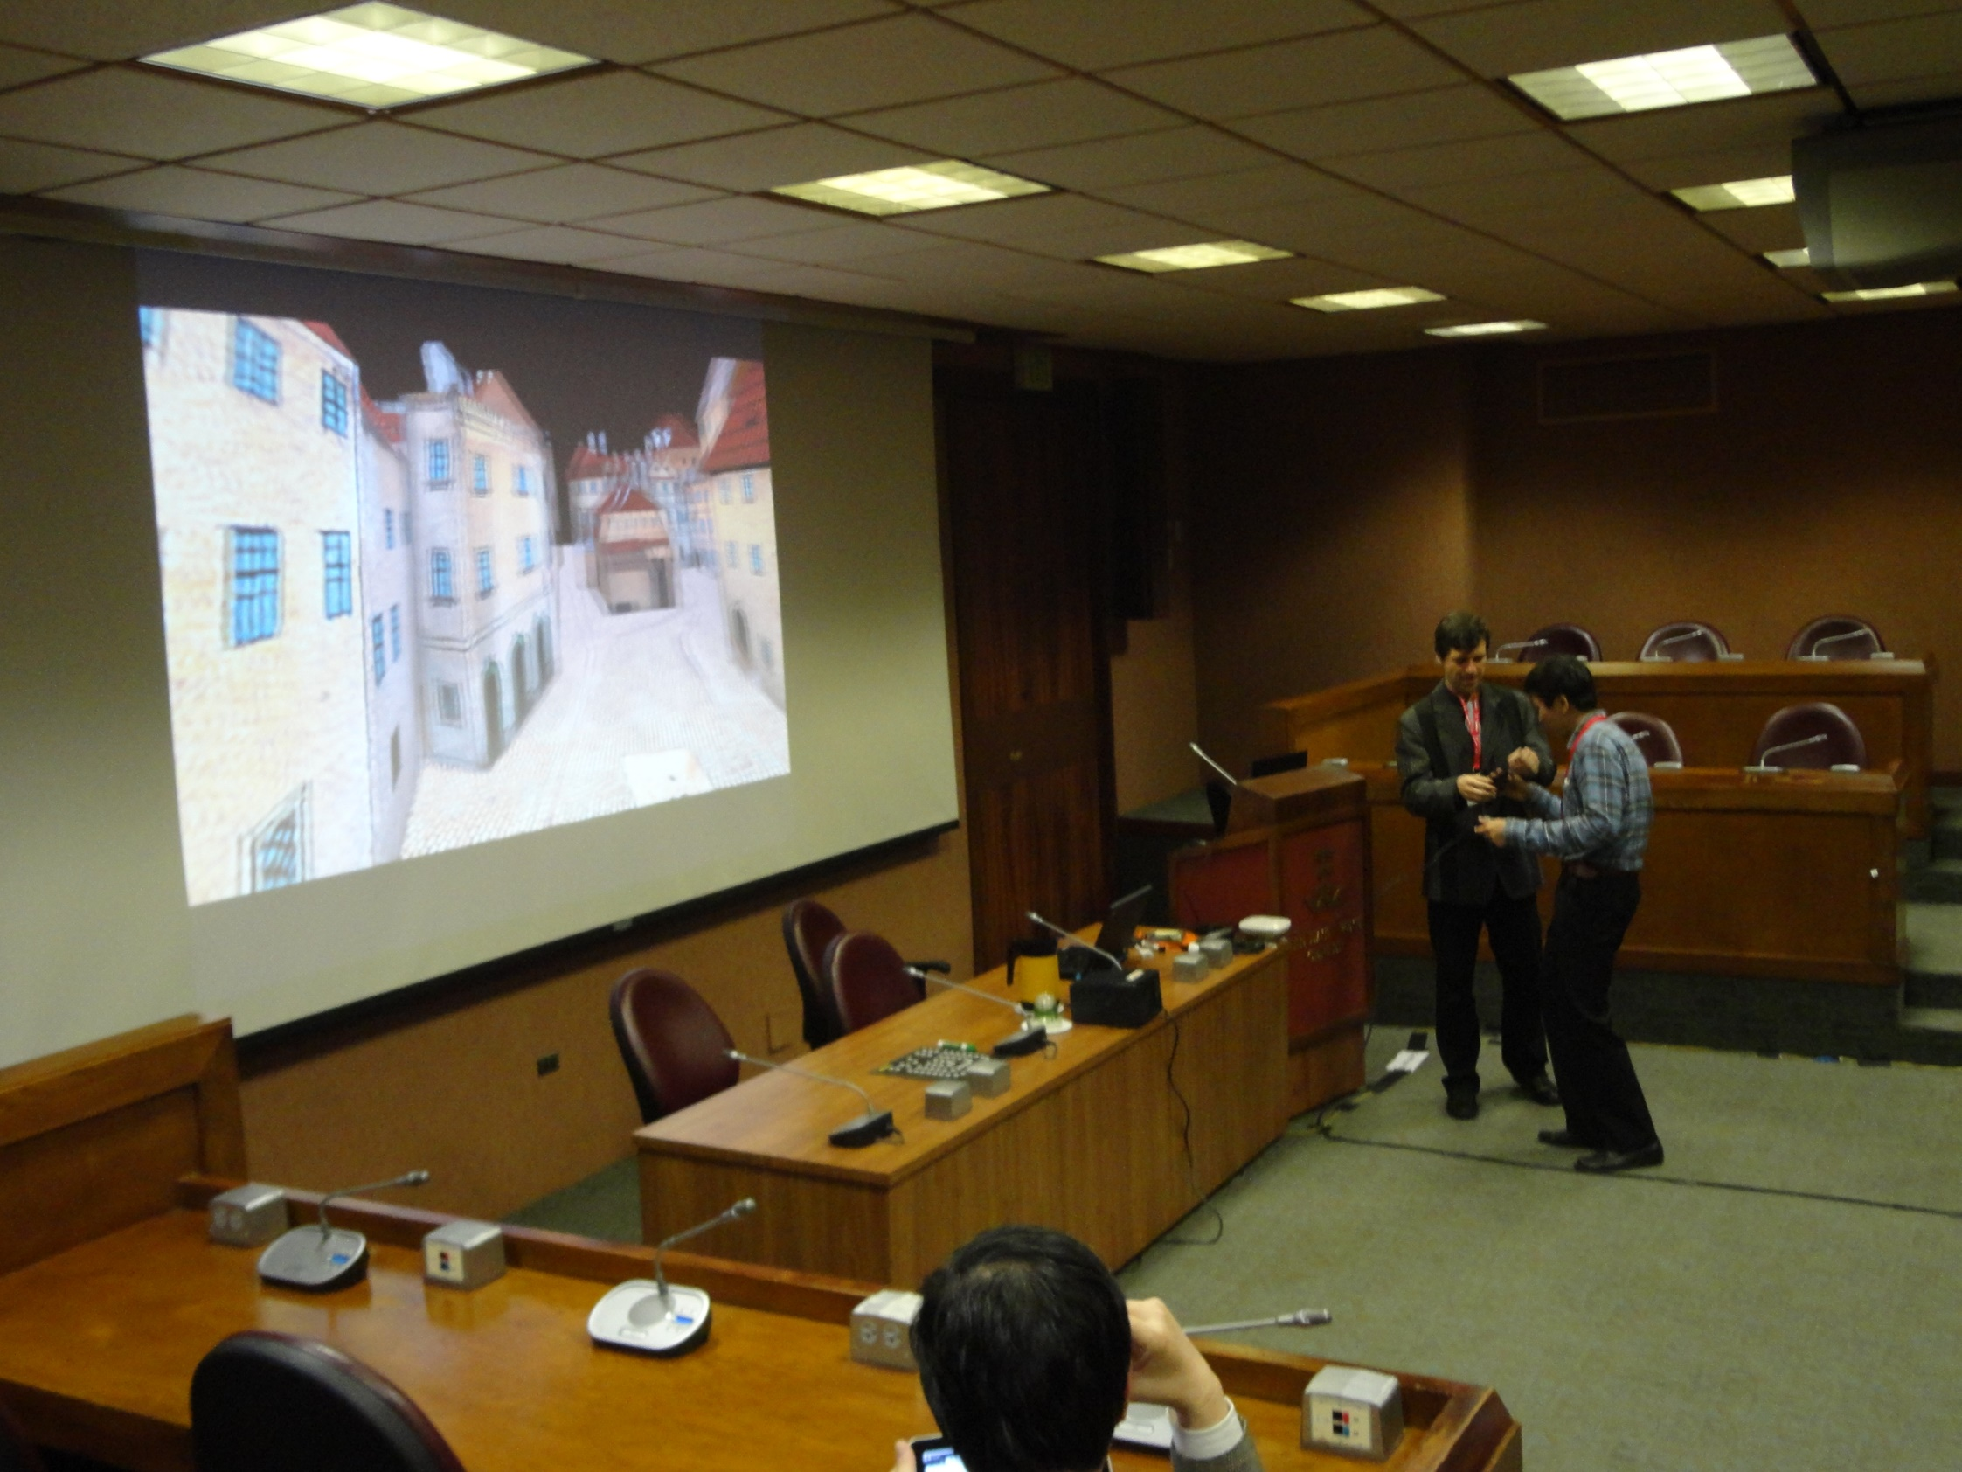
Presentation on APAN meeting in Honolulu
in cultural section dedicated to Preservation of National Heritage

Slide 13
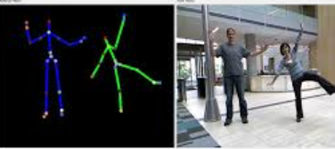
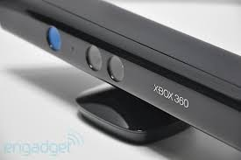

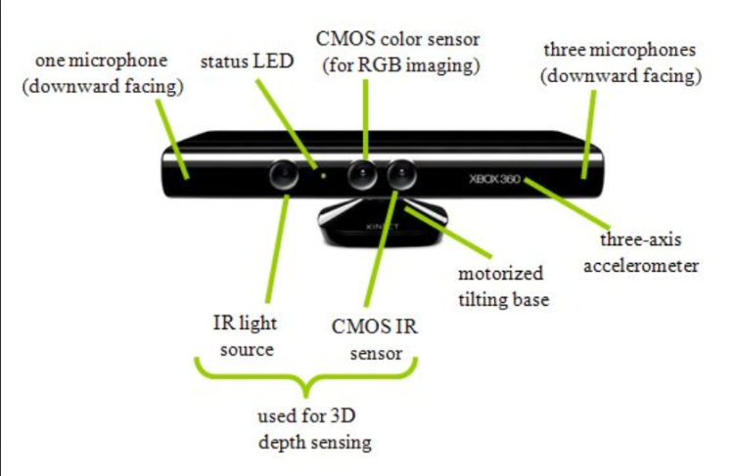
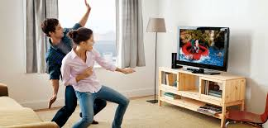
Popularity of Xbox
Inspiration for Cyberperformance
Dance of AVATARS”
Motion sensing input device

Slide 14

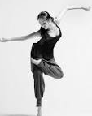


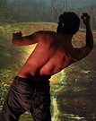

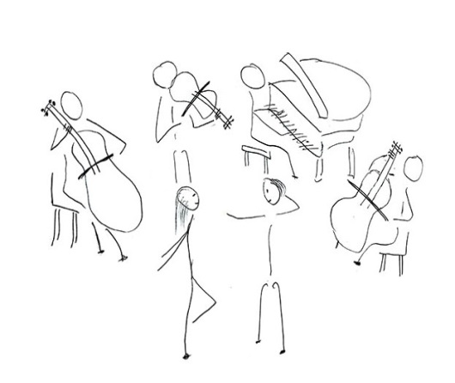
Dance of AVATARs
Original Idea
remote site
A
remote site
B
Kinect
Kinect
remote site
C
SD
SD
Kinect
SD
AVATAR
performance
music

Slide 15
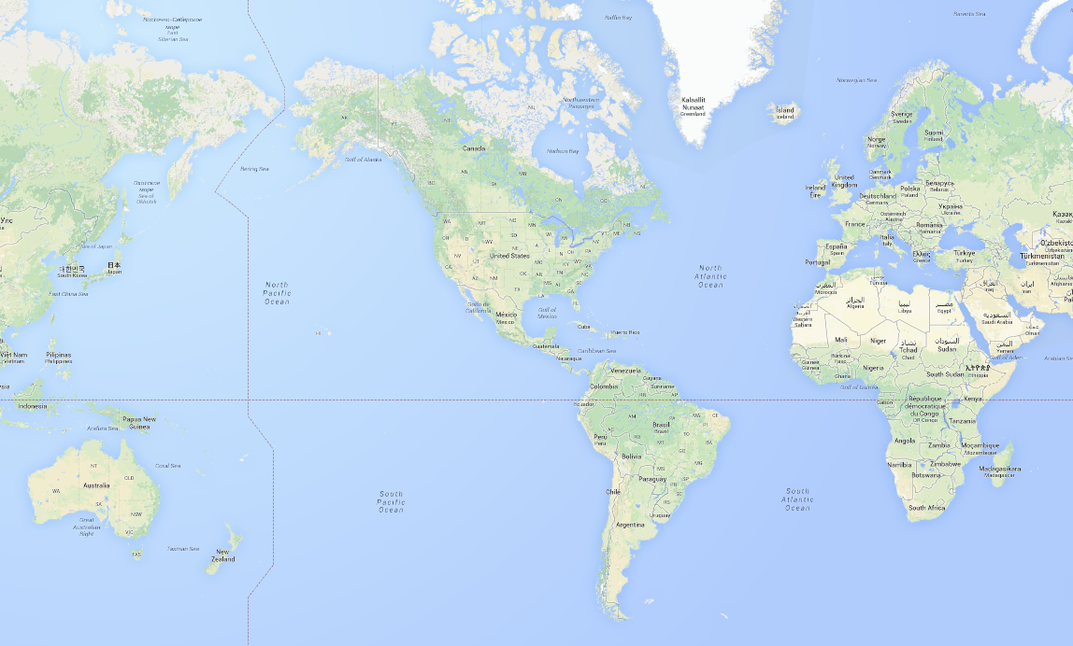
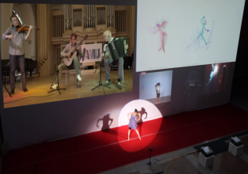
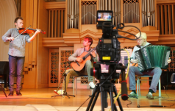
APAN-36 Global Cyber Performance
Three continents networked music and dance performance
Stage video
music
APAN
stage
Music in 4K format
CZ
Prague
KR
Daejeon
APAN 36TH
ES
Barcelona
Stage video ES
dancer
dancer
BR
Salvador
Stage video BR
dancer

Slide 16
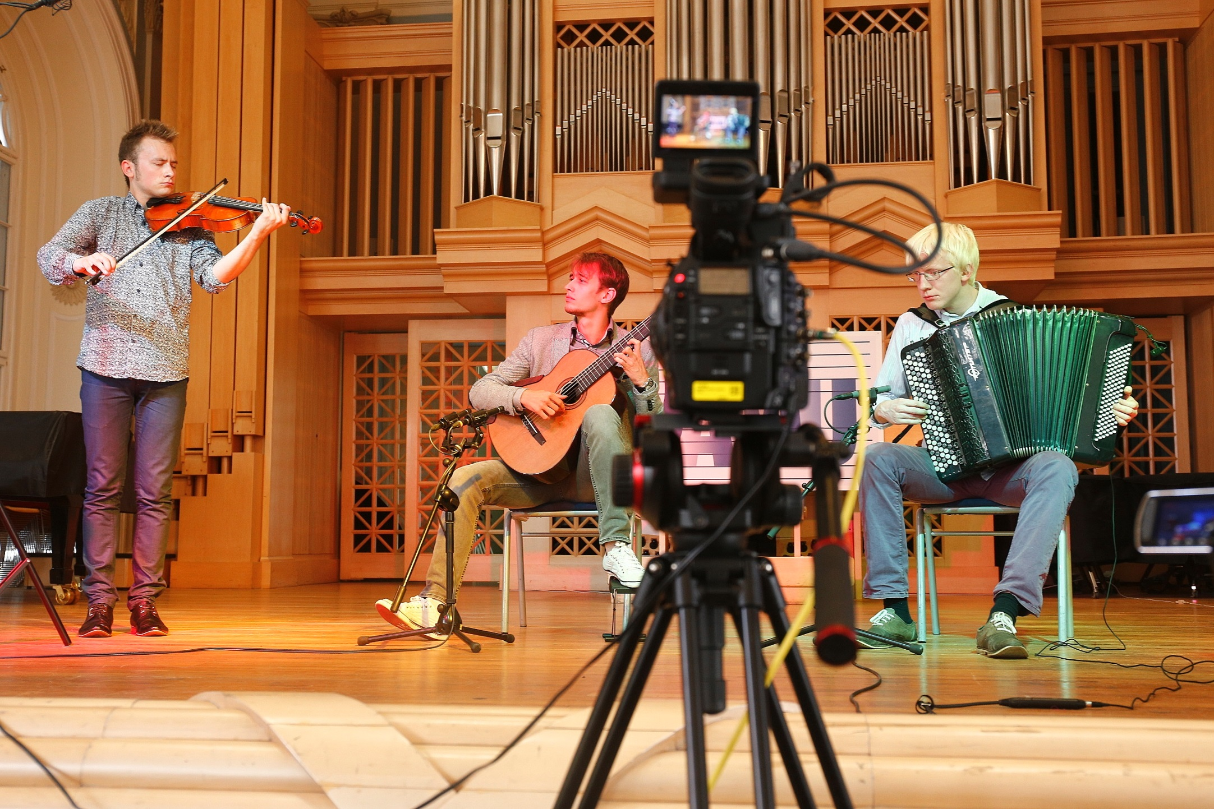
Musicians
in Prague
4K camera

Slide 17
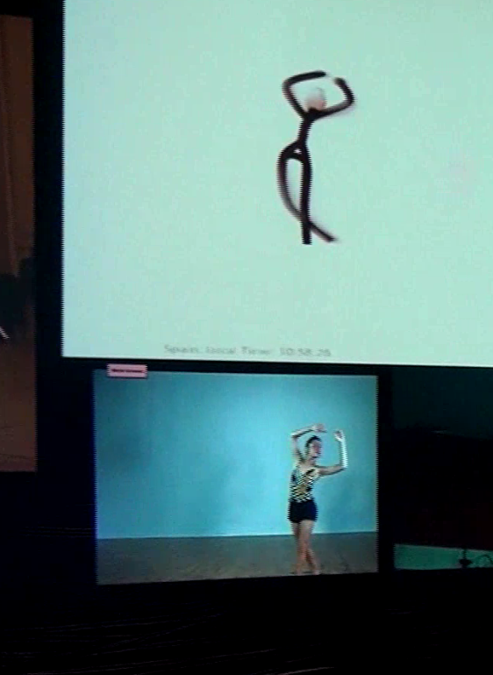
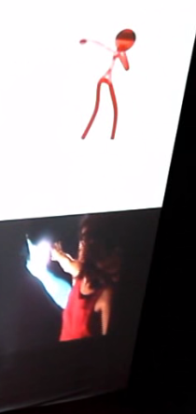
Converted into Avatars
Converted into Avatars
Dancers
in
Barcelona (ES), Salvador (BR) and Daejeon (KR)

Slide 18
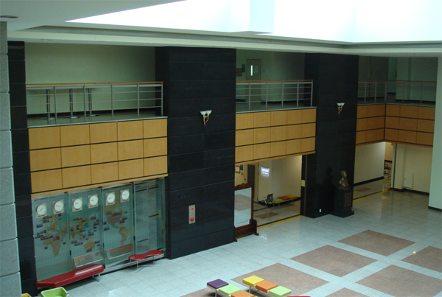
Stage
Daejeon (KR) the APAN venue (lobby)
Big screen
16m
6.5m
Audience

Slide 19
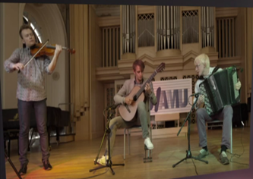

Composition plan
Screen
16m
6.5m
ES
KR
BR
Ground Floor
Stage
Dancer
3m
9m
10m
Kinect
2nd Floor
Control Desk
Lighting
4K
4,000 Ansi
Lighting
15,000 Ansi(Avatar)

Slide 20


Aug. 21st, 2013

Slide 21
Prague
Avatar dance
Video from
Santiago
Barcelona
Daejeon
real
APAN-36 Performance across continents
https://www.youtube.com/watch?v=H4CHDYGvuvo

Slide 22





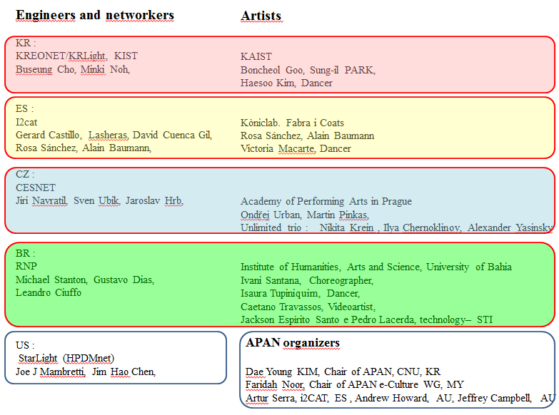













The partners of
APAN e-Culture WG

Slide 23
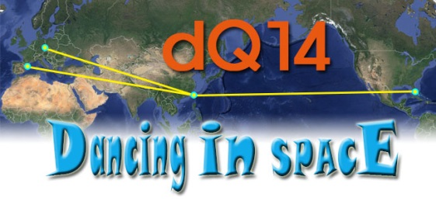
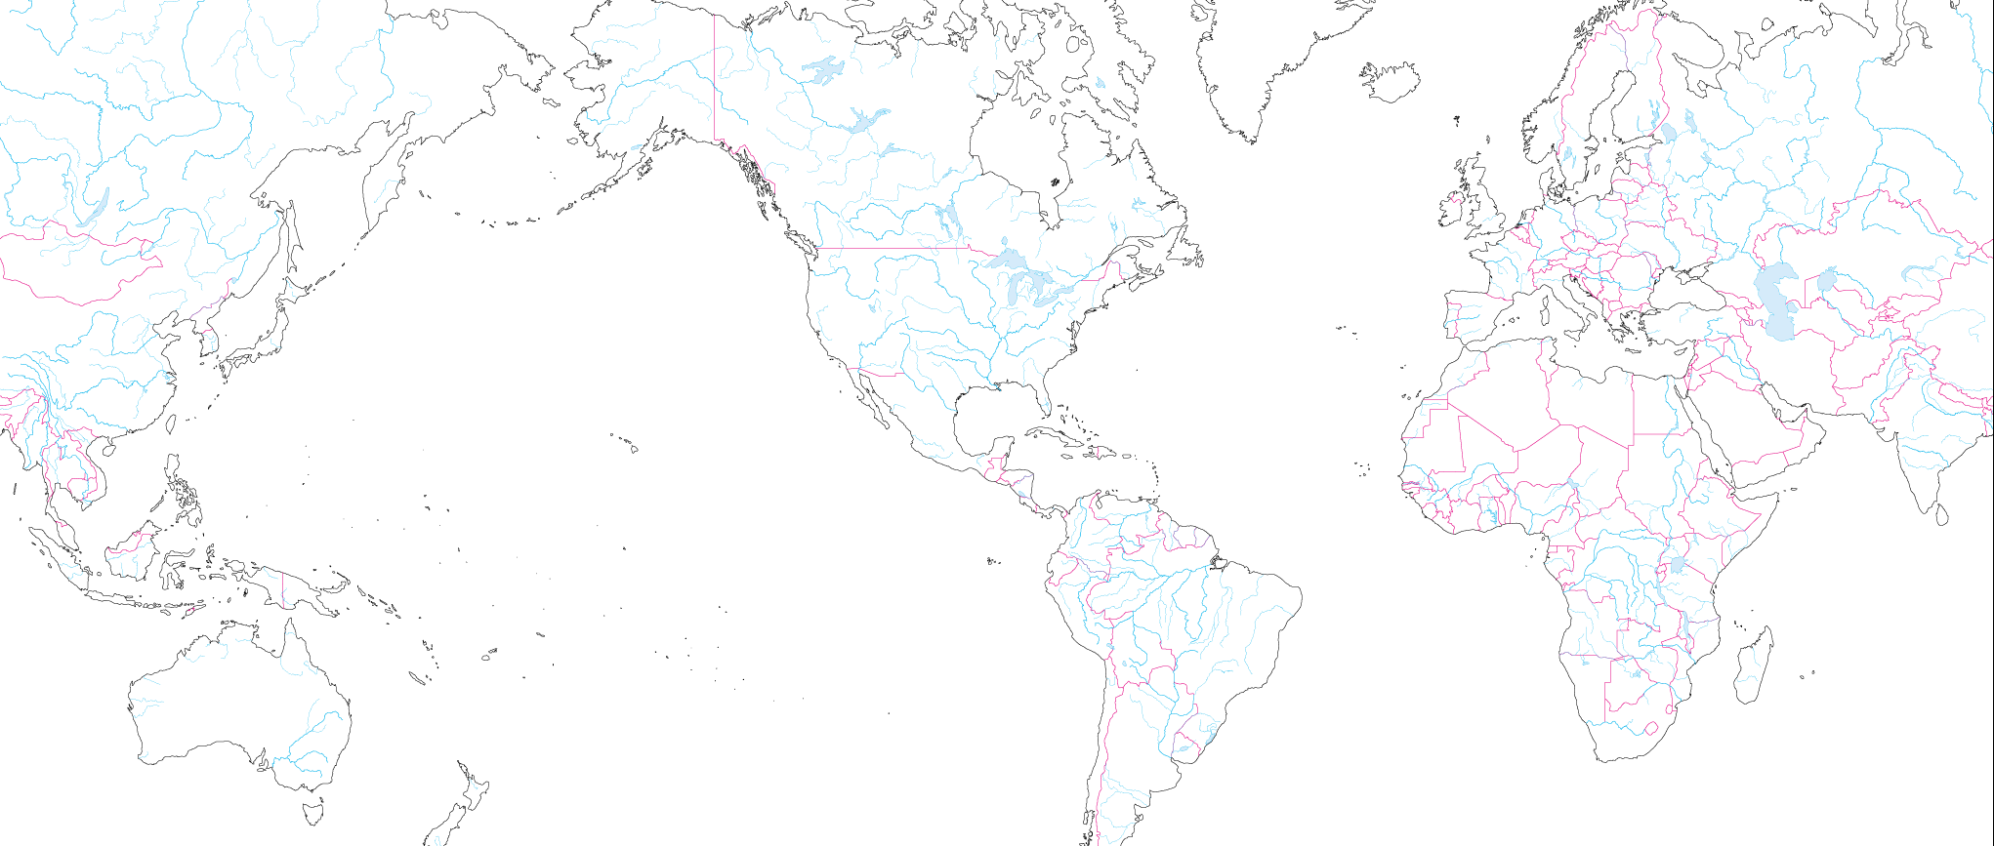

Dancing with synchronized music
APAN-38 Network Topology
Amsterdam
20G
10G
To be filled
Chicago
10G
Prague
APAN38
NanTou
20G
10G
Barcelona
Miami
Taipei
∙ ASGCNet
∙ CESTNET
∙ GEANT
∙ Internet2
∙ KREONet2
∙ TWAREN
10G
20G
NanTou

Slide 24

Dancing with synchronized music
Result: illusion of one scene
Prague
Miami
Nantou
Barcelona
APAN 38 Nantou Taiwan - Closing Ceremony
https://www.youtube.com/watch?v=mvCc7_U93cA

Slide 25

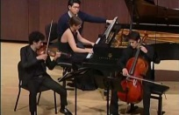
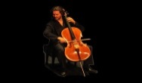







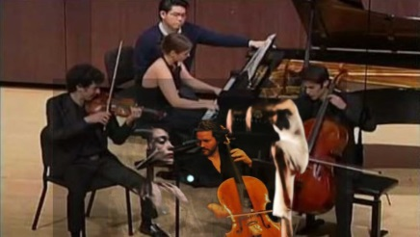
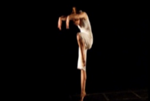

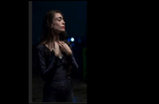








dQ14 - CESNET video transporting tools used on all sites
4KGateway and Ultragrid for video
JackTrip for audio
Piano Trio
network
audio
Miami
video
JackTrip
Prague
140ms
JackTrip
UltraGrid
4K GW
Nantou TW
30ms
320ms
220ms
Barcelona
JackTrip
4K GW
Sync
Control
HDP2
Audio Mixer
330ms
UltraGrid
UltraGrid

Slide 26
The newest events
NPAP - Network Prerforming Arts Production Workshops
Regular meetings of technical specialists and artists.
Workshop focus on the technology
requirements for performing arts education, multi-site performance events and
high quality netcasting over advanced research networks.
CESNET regularly participate on this workshop with technical lessons
about developed tools for video transmission Ultragrid and MVTP4K which
are frequently used by this community and demonstrate life demo
2015 Violin from Prague and piano in London
2016 Organ in Brno and trumpet in Miami

Slide 27
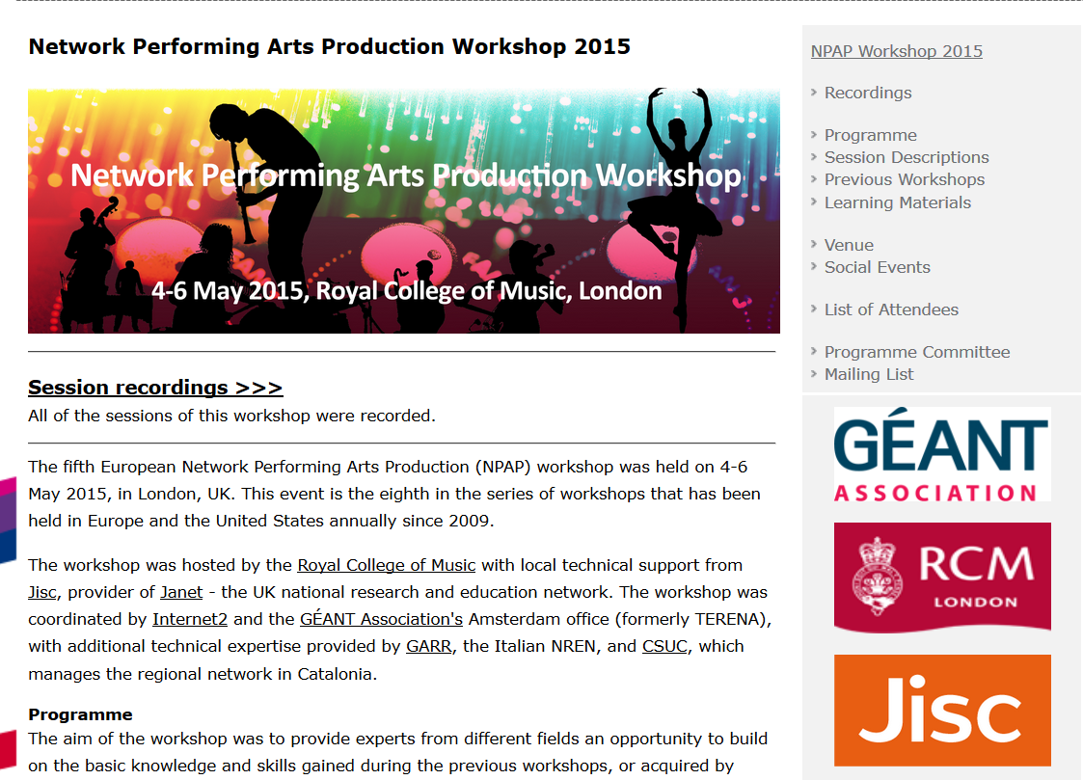

Slide 28
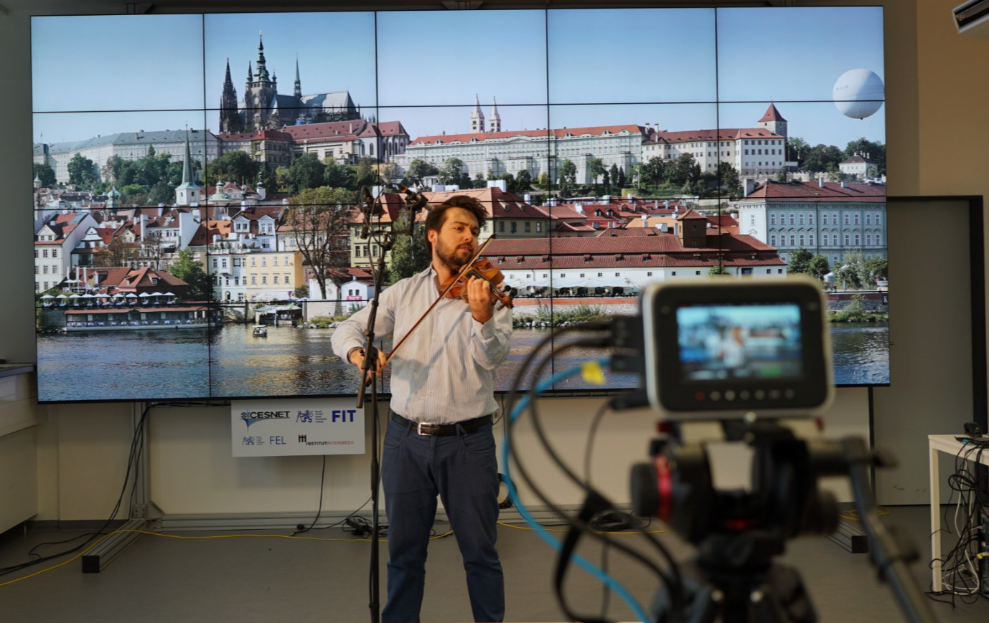
Thank you for attention
Matouš Pěruška (HAMU student ) in CESNET lab at Prague

Slide 29
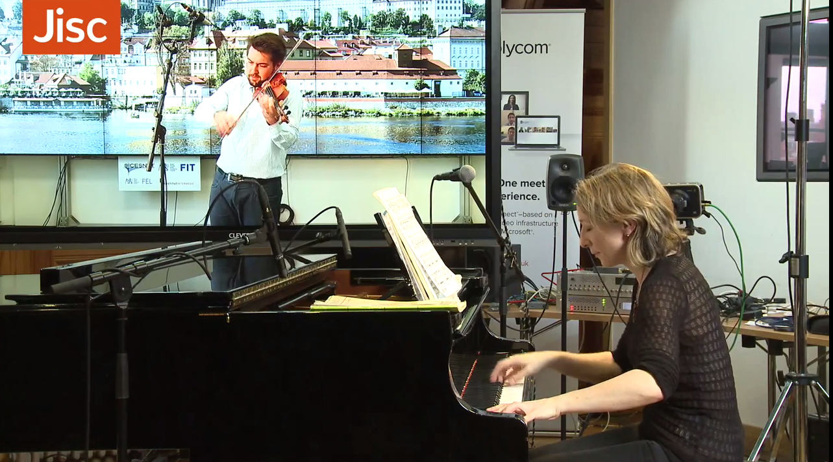
Matouš Pěruška, violin, Prague
Alison Rhind, piano, London
Recording is on YouTube and on JISC web pages of NPAP workshop
https://www.youtube.com/watch?v=euyM7zkKFkQ

Slide 30
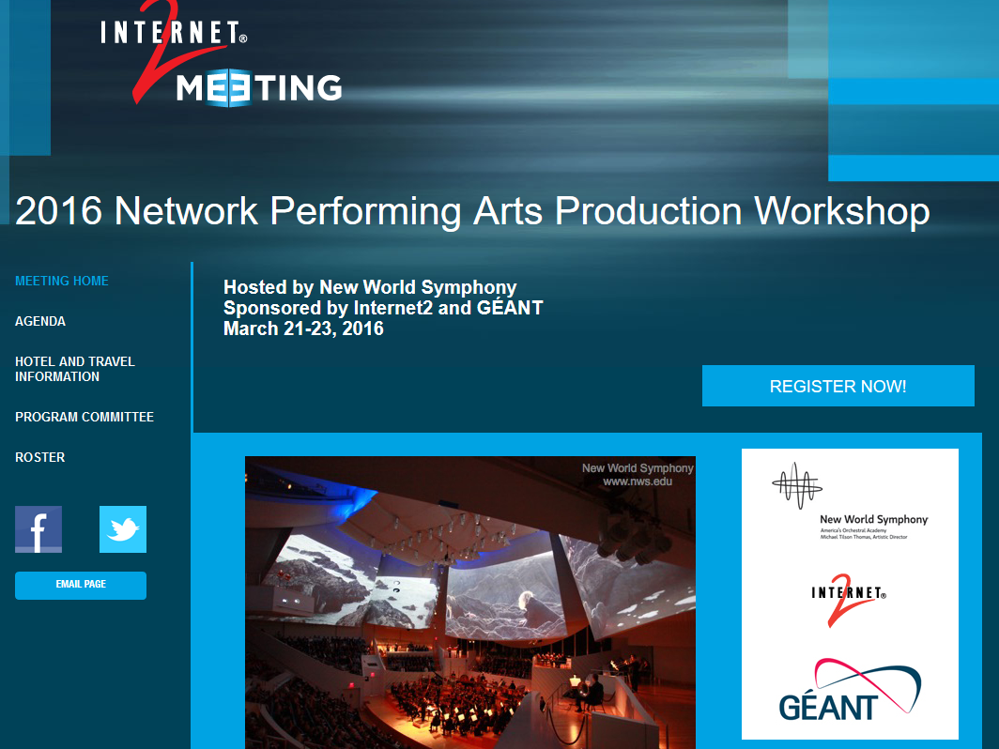

Slide 31
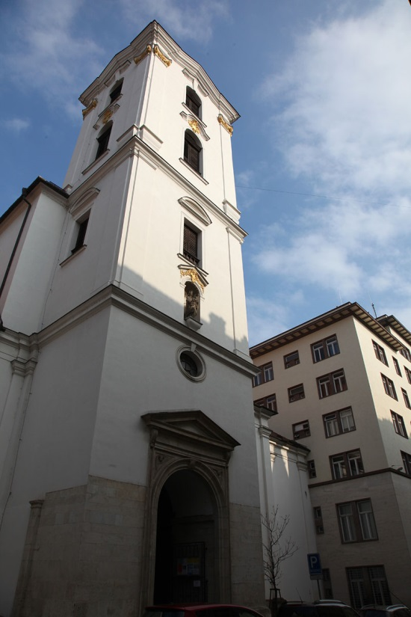
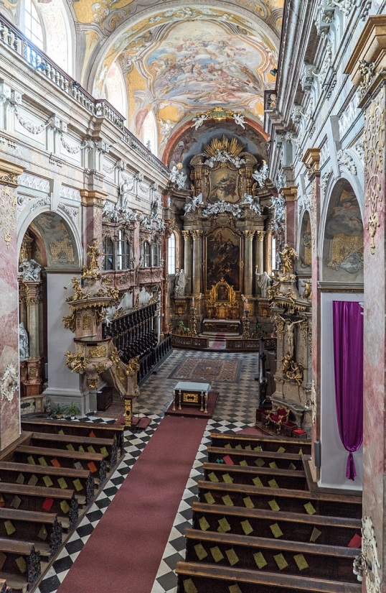


Organ in Brno
The Church of the Assumption of Virgin Mary built in 1602
Organ from Mathis installed in 2014

Slide 32

Video from Brno church
New World Symphony stage at Miami
https://www.youtube.com/watch?v=eRi6u9Wo0xk

Slide 33


TNC16 in Prague

Slide 34


Geant Academic Network

Slide 35




Trondheim
Virtual Network
for concert
Oslo
Network delay ~27 ms
Total audio delay ~40 ms
(all equipment)
Conference Hall
In Prague
Amsterdam
London
Prague
Brno
Frankfurt

Slide 36

Concert transmitted by Czech radio on Internet
Recording is available on YouTube or on CESNET web
https://www.youtube.com/watch?v=6CGd9I5d6nc
https://www.cesnet.cz/sdruzeni/akce/distribuovany-koncert-pro-varhany/

Slide 37
Thank you
for your attention

