Slide 1



WSC remobilization to grain under drought in wheat
Colleagues involved at Murdoch University:
Jingjuan Zhang, Bernard Dell, Xinmin Zhang, Nusrat Khan, Hao Luo, Rudi Appels
Colleagues involved in collaboration:
KU Leuven: Wim Van den Ende, Rudy Vergauwen, Mr. Timmy Reijnders
North West Agricultural & Forest University: Wei Chen
Yangzhou University: Yunji Xu
DAFWA: Michelle Murfit, Ben Biddulph, Adrian Cox, David Allen, Grantley Stainer

Slide 2
Contents
Background of drought
Stem WSC remobilization
Molecular tools for wheat drought tolerant breeding
WSC remobilization in different stem segments
WSC contribution in roots

Slide 3
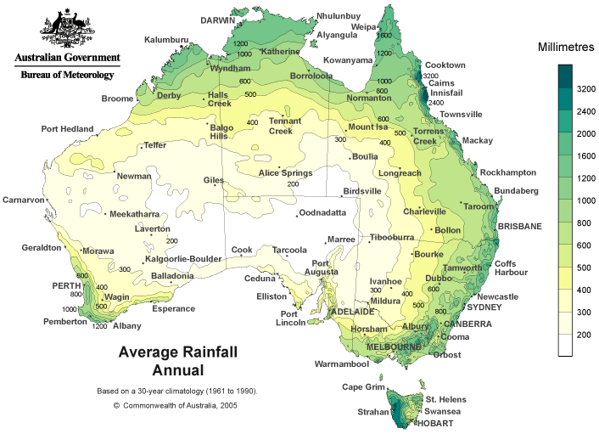
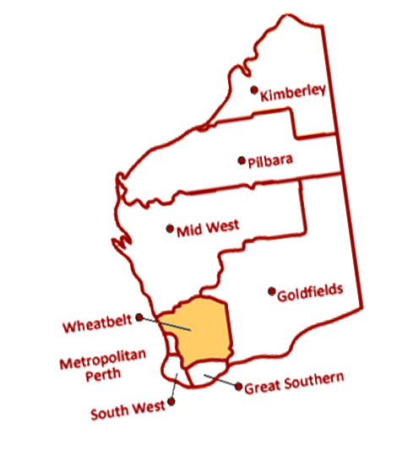
Drought in Australia
35%
3.2% , 13%
80%
50%

Slide 4
Wheat production in WA associated with rainfall
2.2
0.9
The cost of drought (2002/03) in terms of lost production was approximately $ 1.0 billion (AUD) in WA (Setter & Waters, 2003).

Slide 5
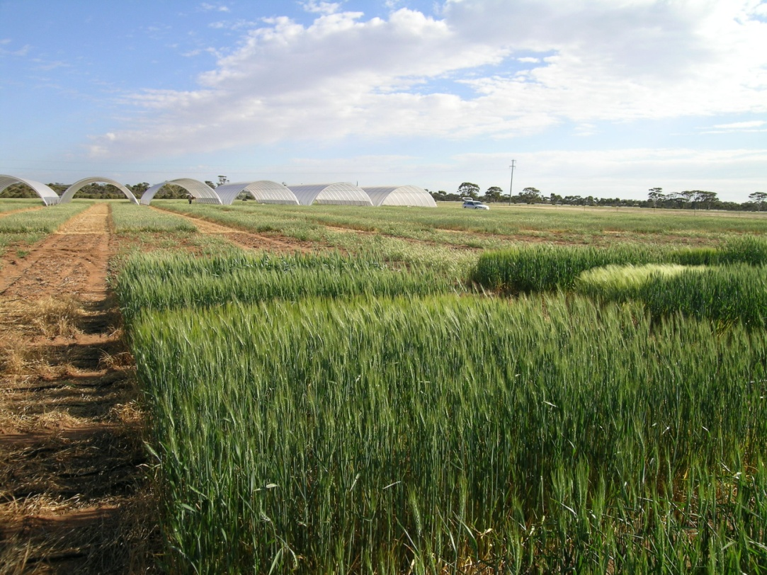
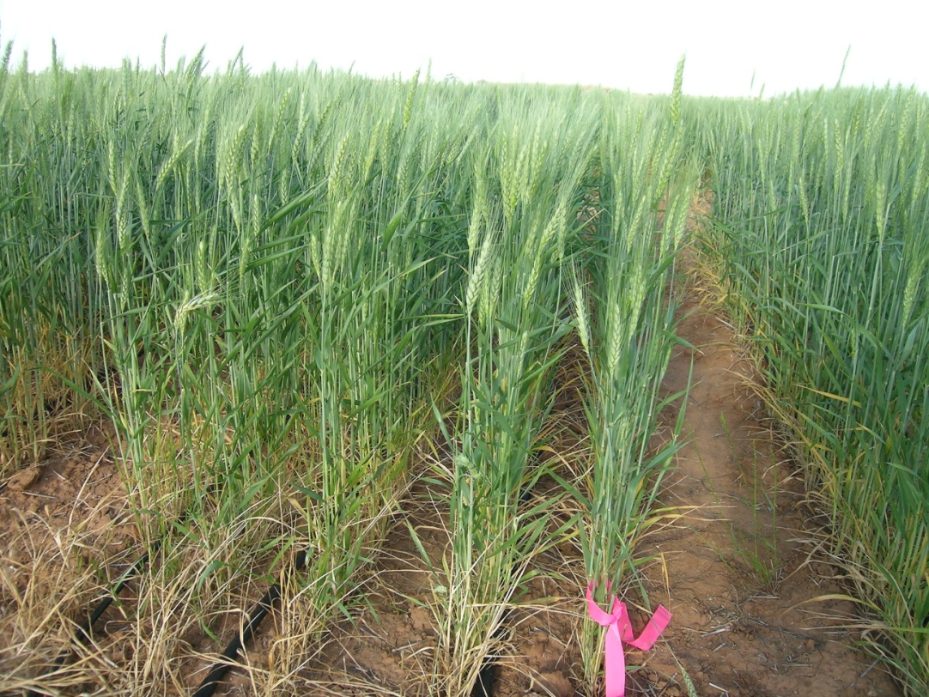
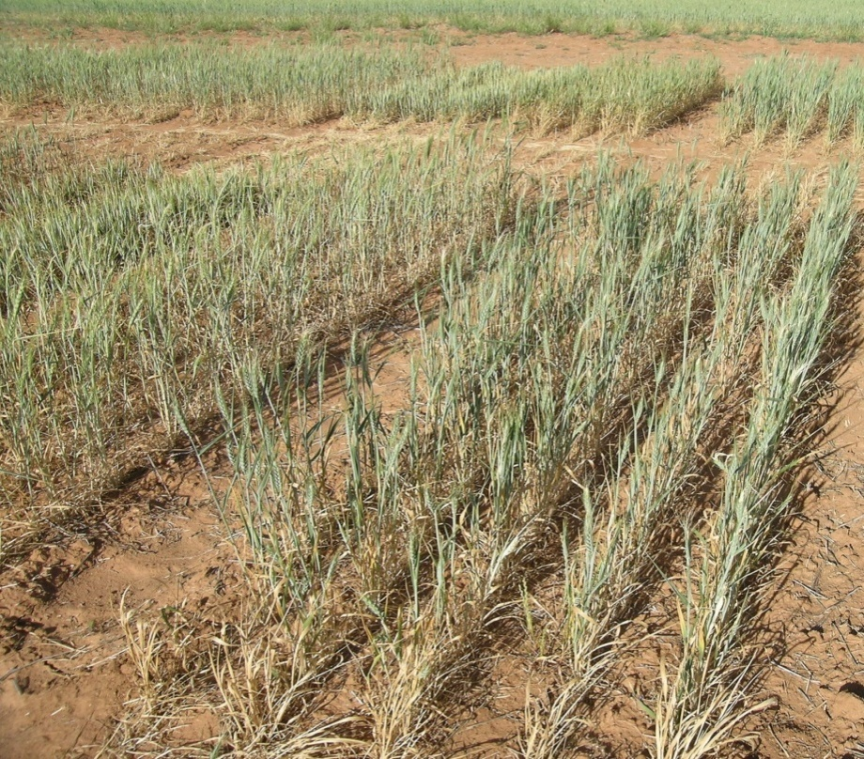
Managed Environment Facilities (MEF)
Merredin, 2010
Without irrigation
With irrigation

Slide 6
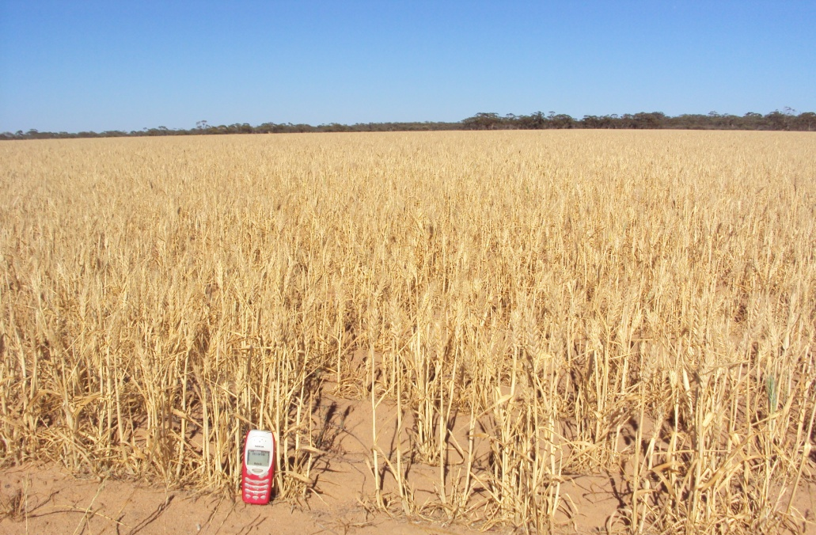
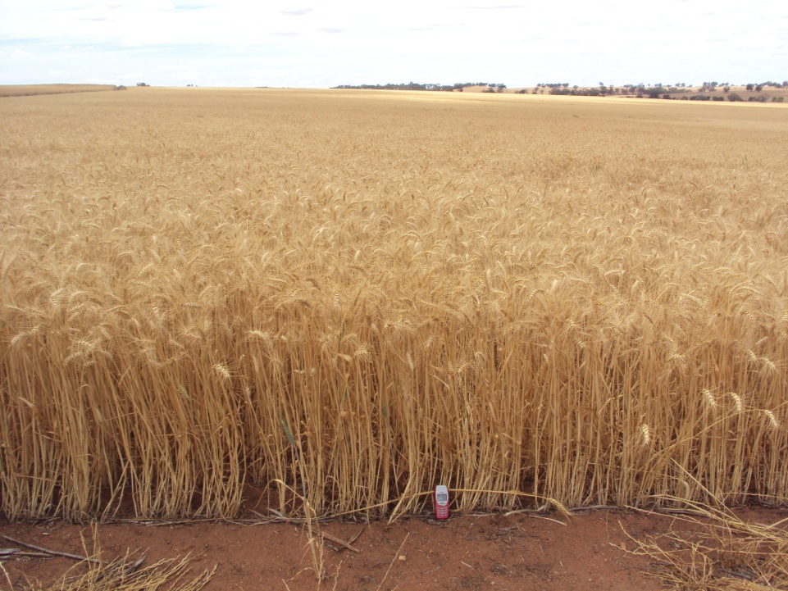
Effect of drought in wheat growth (2012)
Merredin (31.5° S, 118.3° E)
York (31.9° S, 116.8° E)

Slide 7
Aim of the research:
Provide an efficient screening approach (markers) of drought tolerant lines
Develop drought tolerant lines for wheat breeding.

Slide 8
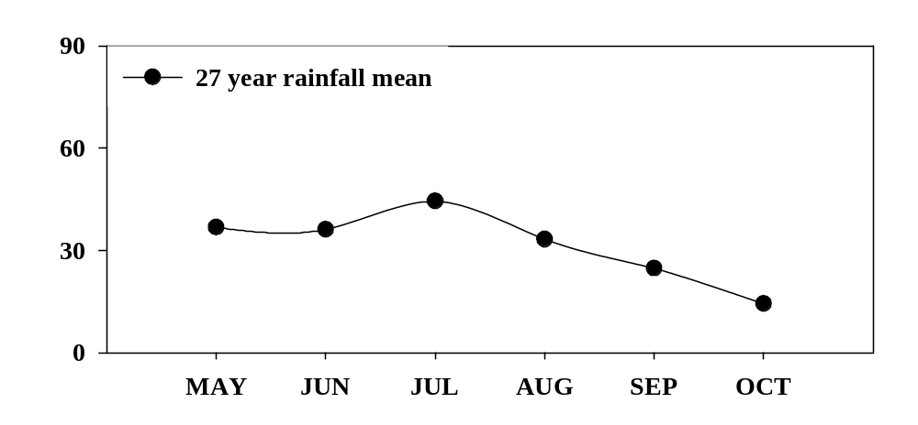
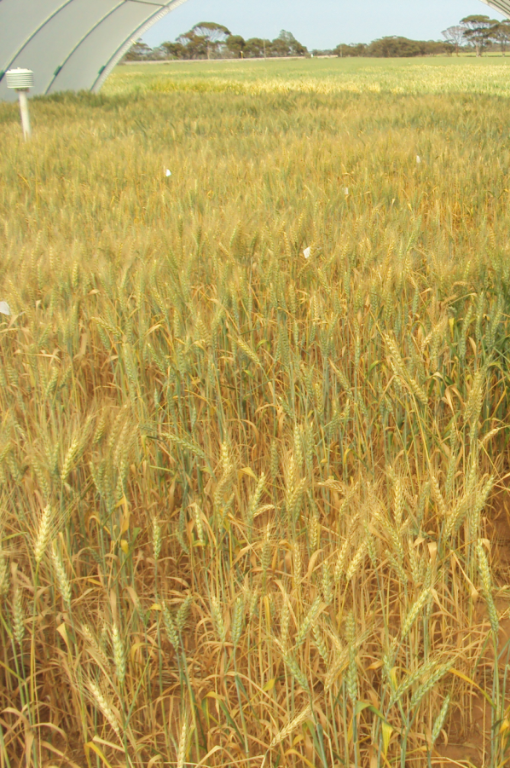
Materials and Methods
Plants under drought
Average rain fall in Merredin
Water deficit plant:
Stem reserves (WSC, 50% of drywt) becomes the important carbon source for grain filling and small solutes for maintaining turgor.
70% of stem WSC is Fructan

Slide 9
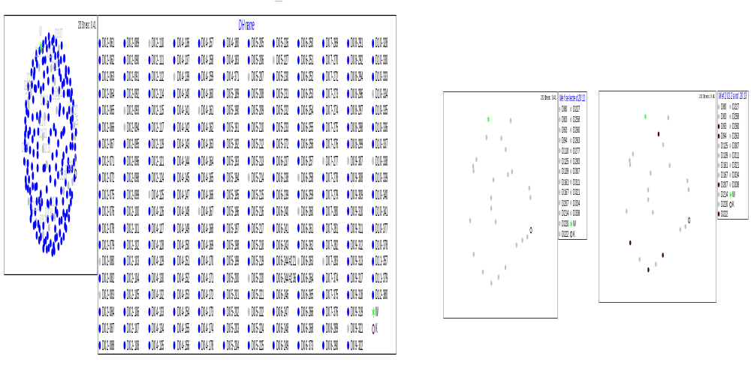
Materials and Methods
Using materials: Westonia and Kauz and the derived 24 DH lines
The non-metric multi-dimensional scaling of 225 DH lines of Westonia and Kauz

Slide 10
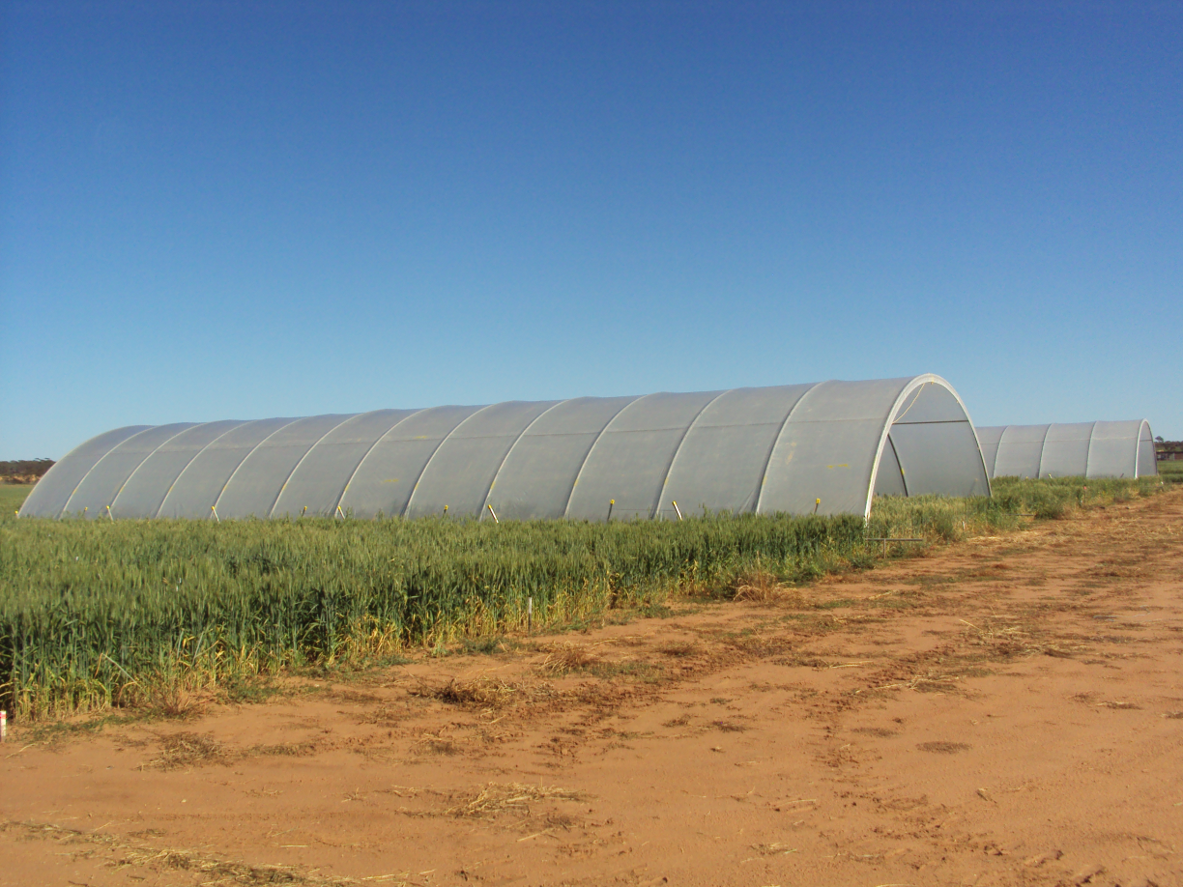
Materials and Methods
Drought experiment set up:
Drought
Inside the shelter
Rainfall and irrigated

Slide 11
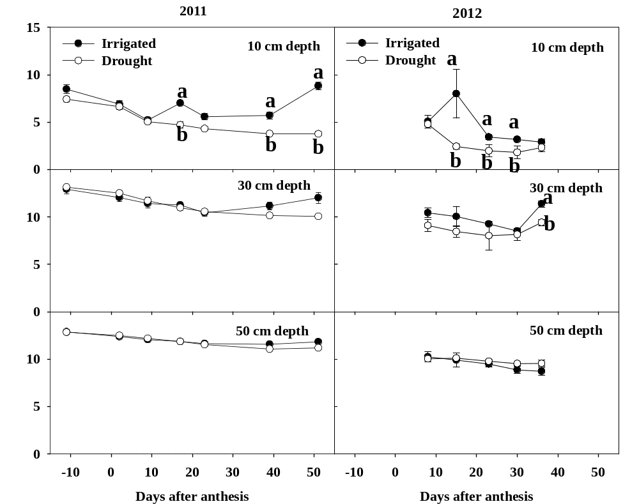
Soil water content
Soil water content reduced significantly at 10 cm depth

Slide 12
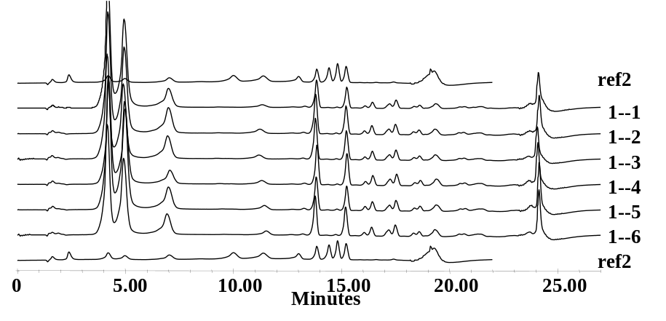
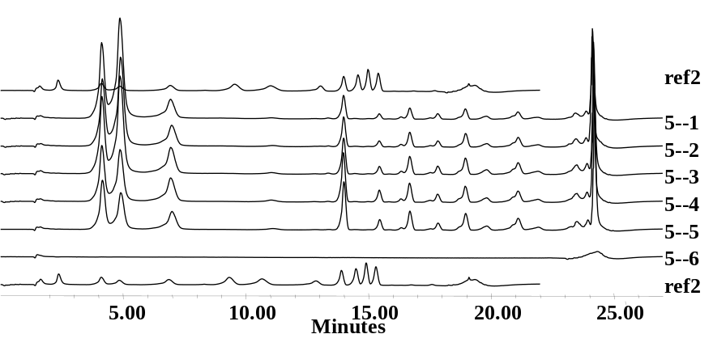
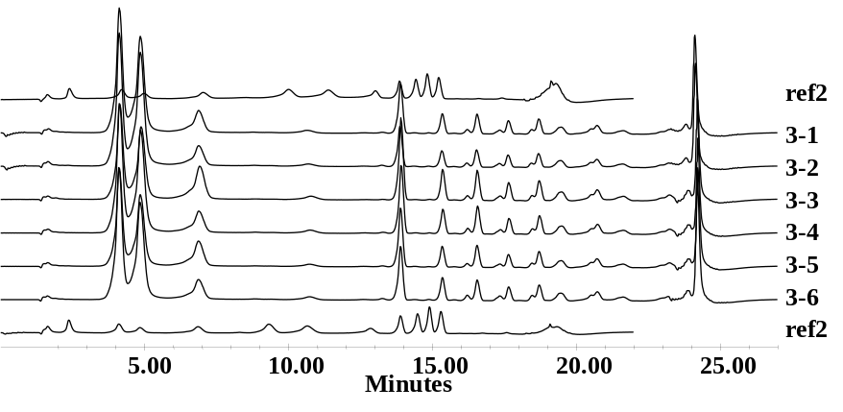
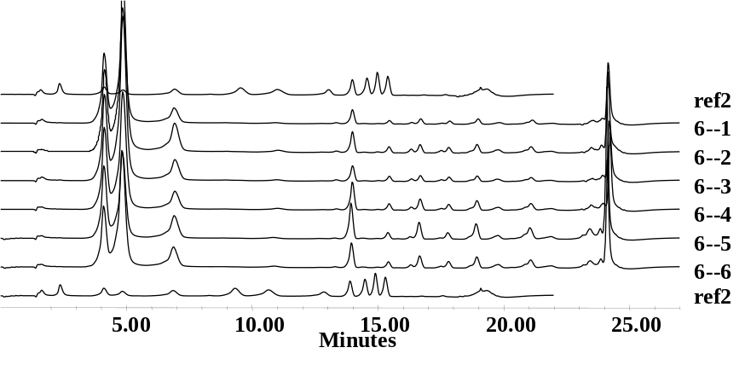
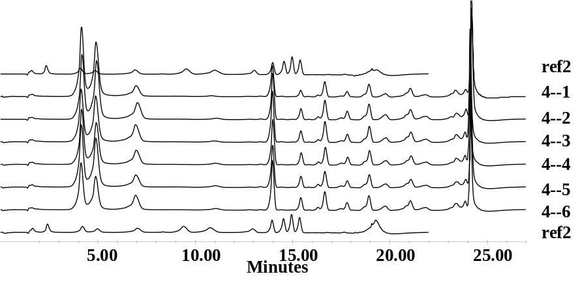
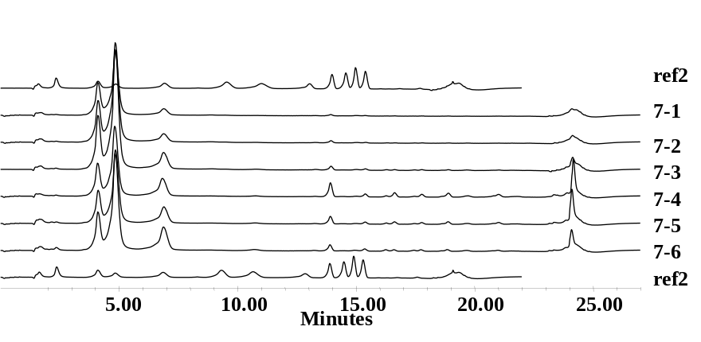
Stem WSC remobilization
Glucose
Fructan degradation
Fructose
6-Kestose
Neo-Kestose
Nystose
bifurcose
Fructan accumulation
Sucrose
1-Kestose
Rafinose
Maltose
Bifurcose less accumulation
Fructan degradation faster under drought

Slide 13
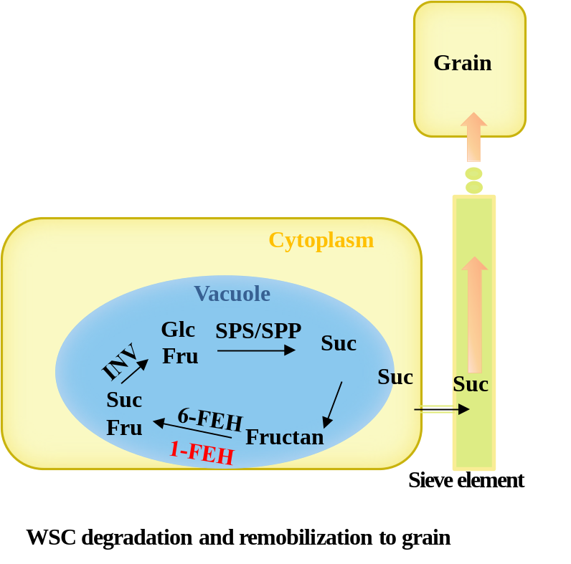
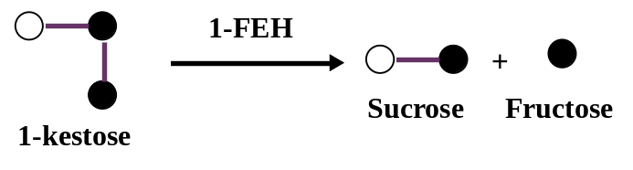
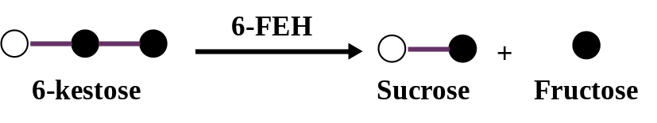
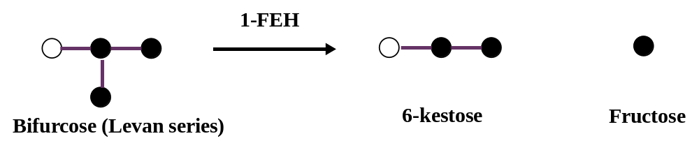
Stem WSC remobilization
WSC remobilization by 1-FEH or 6-FEH

Slide 14
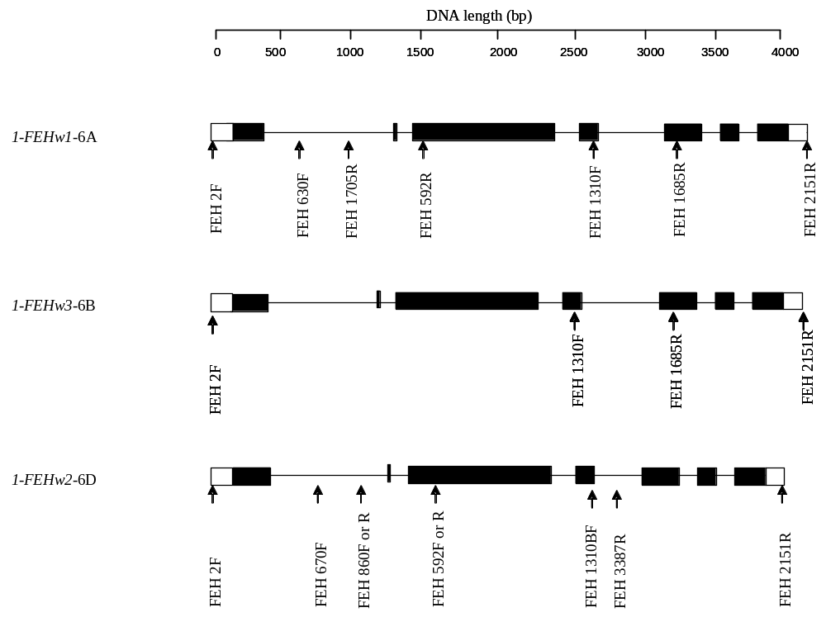
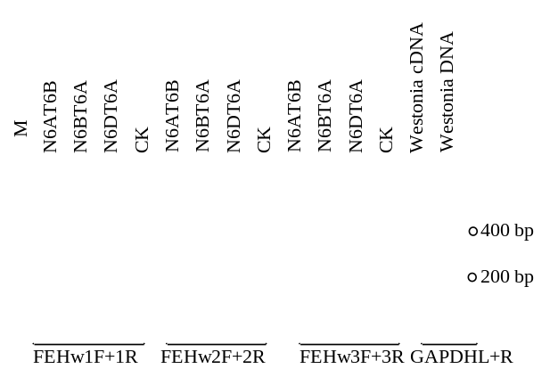
1-FEH genes isolated from 6A, 6B and 6D
Zhang et al. 2008

Slide 15
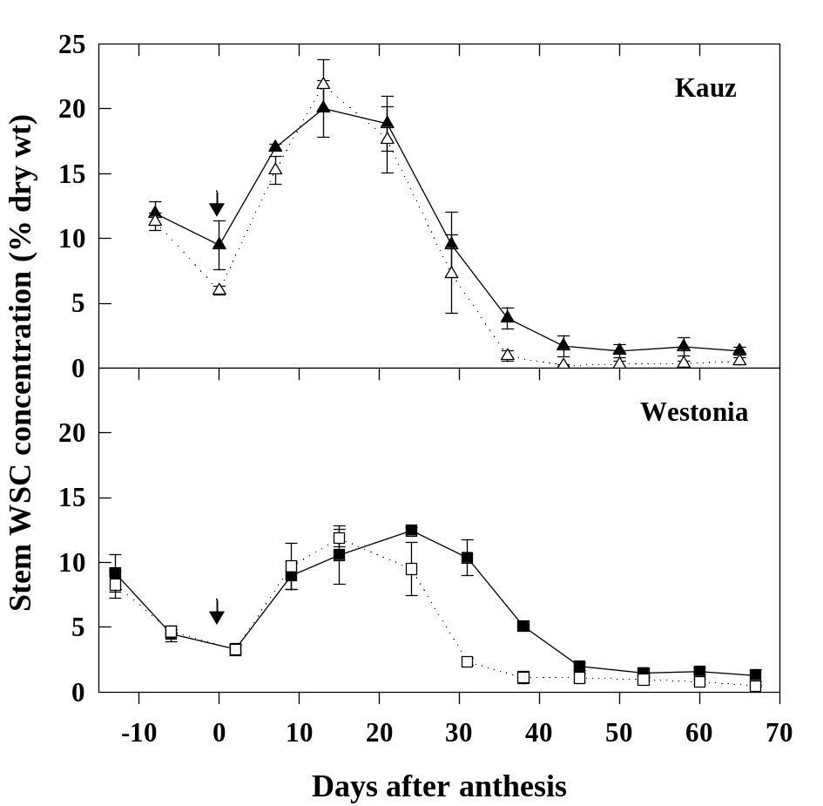
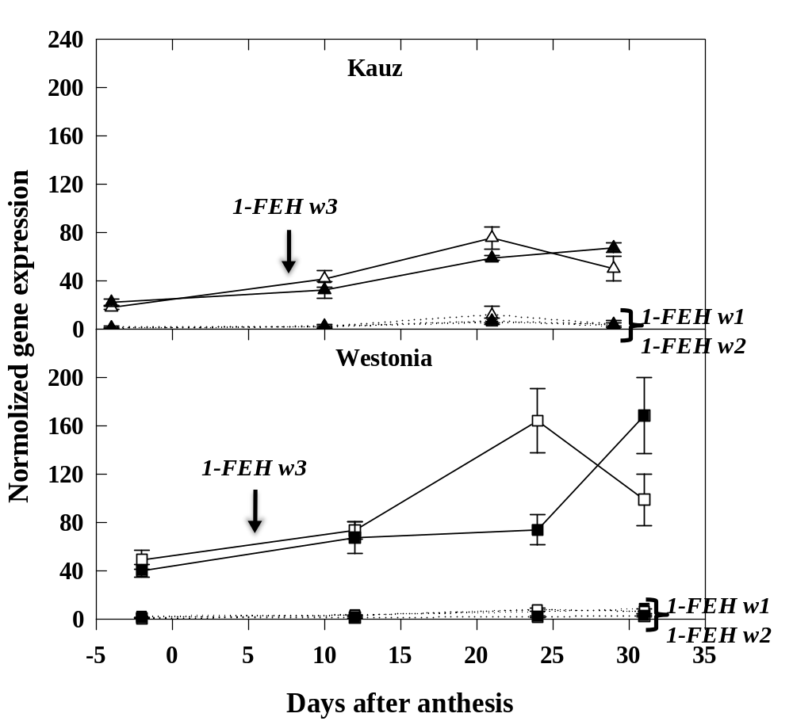
1-FEH and stem WSC
Transcript levels of 1-FEH w3 were consistent with a key role in WSC mobilization
Zhang et al., 2009

Slide 16
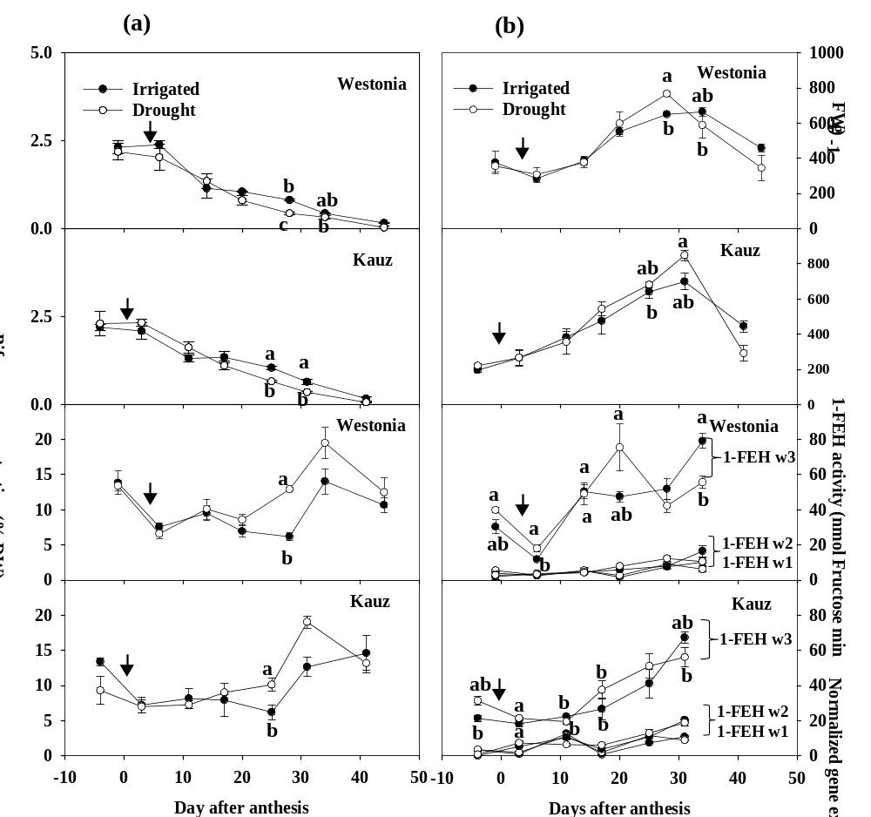
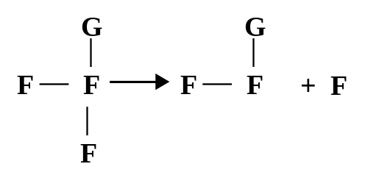
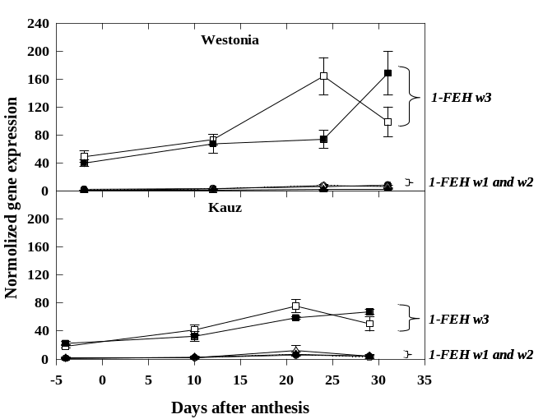
1-FEH genes contribute to fructan remobilization
1-FEH
Bifurcose
6-kestose
Fructose
1-FEH enzyme activity: high
1-FEHw3 expression: high,
especially in Westonia
Zhang et al. 2015a
Zhang et al. 2009

Slide 17
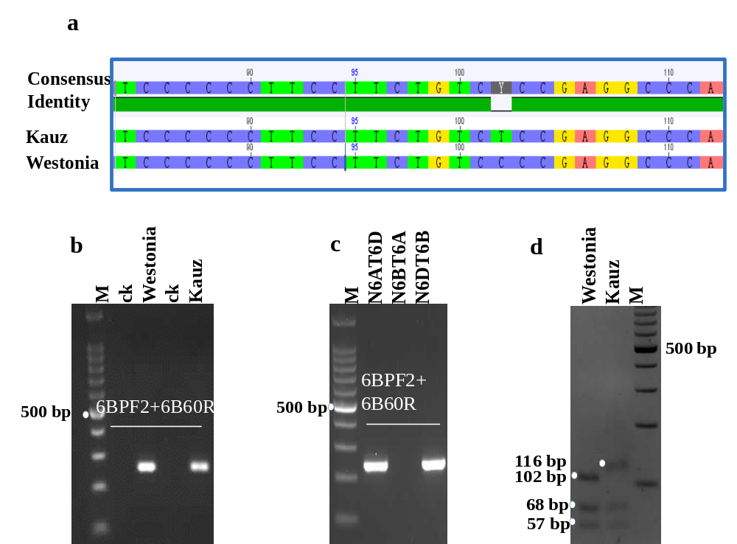
One SNP in 1-FEH w3 gene promoter region
Enzyme cutting site BsoB1
One SNP found in the promoter region
  TGTCTC (Kauz allele) was an auxin response element (AuxRE) bound by auxin response factors (ARFs)
  TGTCCC (Westonia allele)
A CAP marker generated
Zhang et al. 2015a

Slide 18
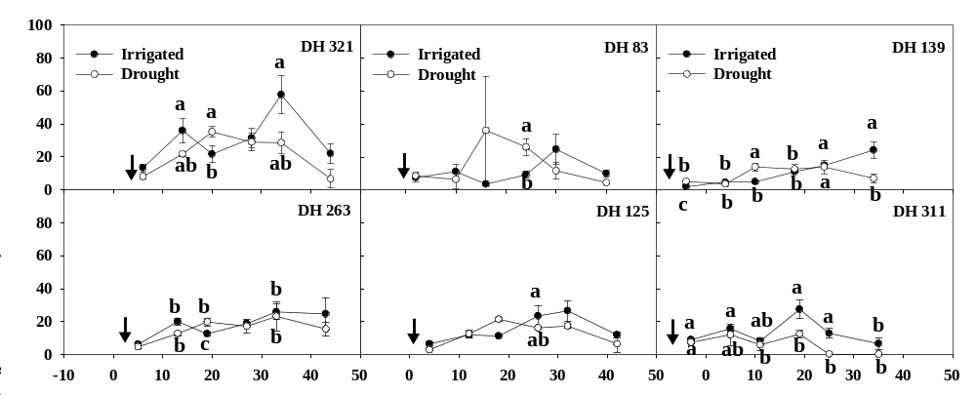
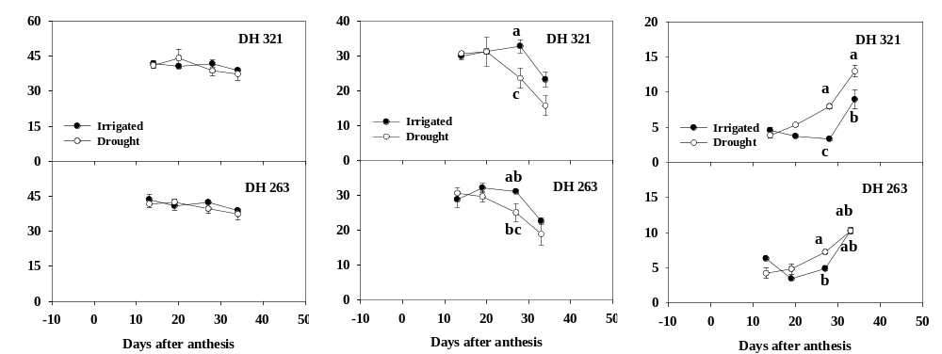
1-FEH w3 gene expression and associated fructan degradation in DH lines
Westonia alleles
Kauz alleles
Zhang et al. 2015b

Slide 19
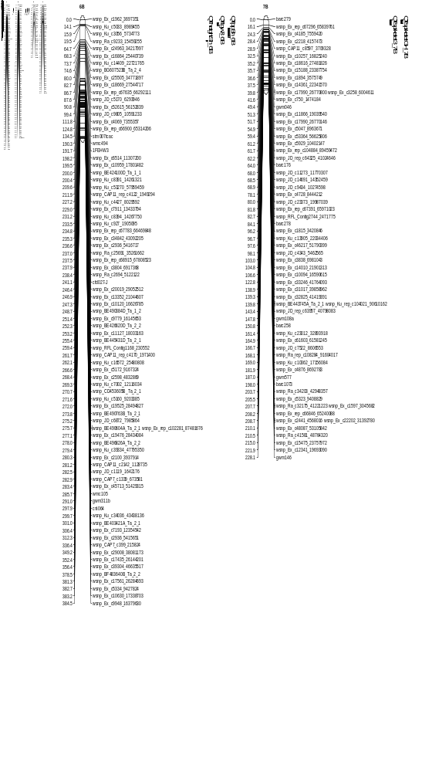
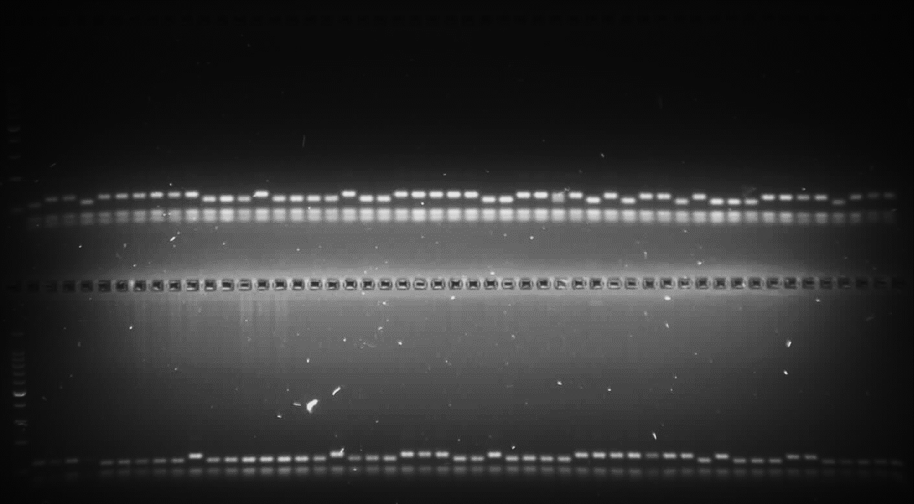
1-FEH w3 gene location and associated QTL
DH line polymorphism
1-FEH w3 mapped to the short arm of 6B
Associated with the QTL of TGW
Zhang et al. 2015

Slide 20
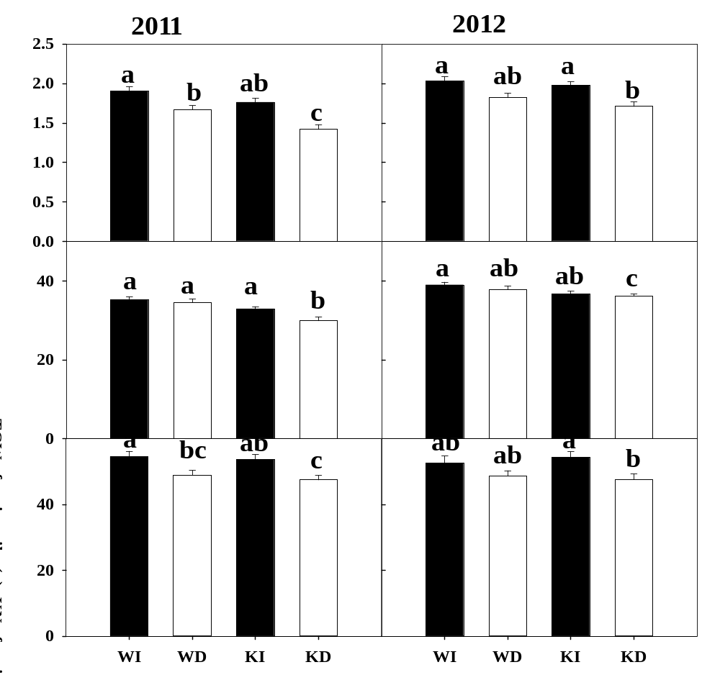
The SNP marker is associated with core phenotypes
I: Irrigated
D: drought
W: 1-FEH w3 Westonia allele
K: 1-FEH w3 Kauz allele
GW and TGW higher in Westonia allele in both treatments.
GW was significantly higher in W allele under drought 2011.
TGW was significantly higher in W allele under drought 2011 and 2012
KN reduced under drought in 2011 and 2012, no difference between genotypes.
Zhang et al. 2015b

Slide 21
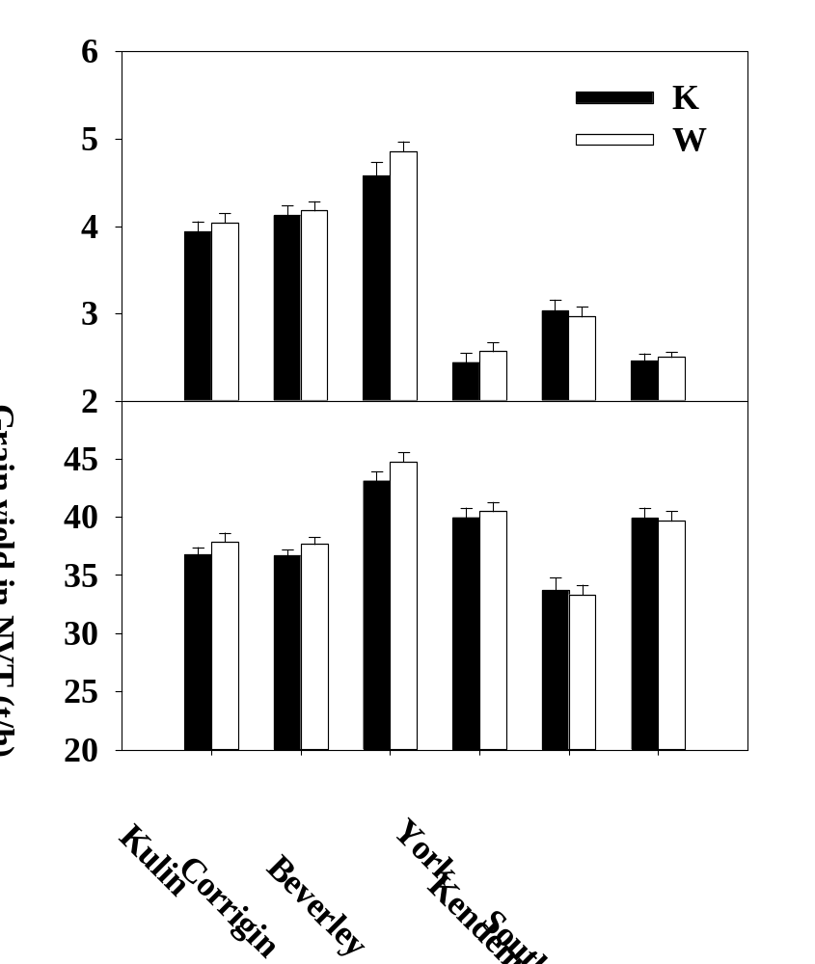
The SNP marker is associated with core phenotypes
6.0%
1.4%
2.5%
-2.2%
5.2%
1.7%
3.8%
2.7%
1.3%
-0.6%
3.0%
-1.0%
High rainfall area
Note: 21 commercial varieties in NVT trial in 2014
Westonia (11) and Kauz (10).

Slide 22
Summary: marker for WSC remobilization
1-FEH w3, degrades 2-1 linkage fructan, is important in the remobilization of WSC to the grain.
A marker generated is associated with high grain weight under drought
1-FEH w3 gene have the contribution to remobilization efficiency under salt stress and reduce the negative impact of salinity on grain yield (Sharbatkhari et al. 2016, Planta 244:191-202)

Slide 23
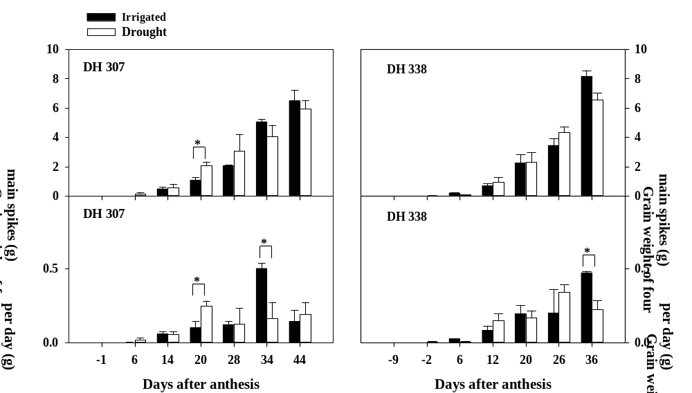
WSC remobilization-segment analysis
GW assimilated faster in the flower earlier line
Zhang et al. 2015c

Slide 24
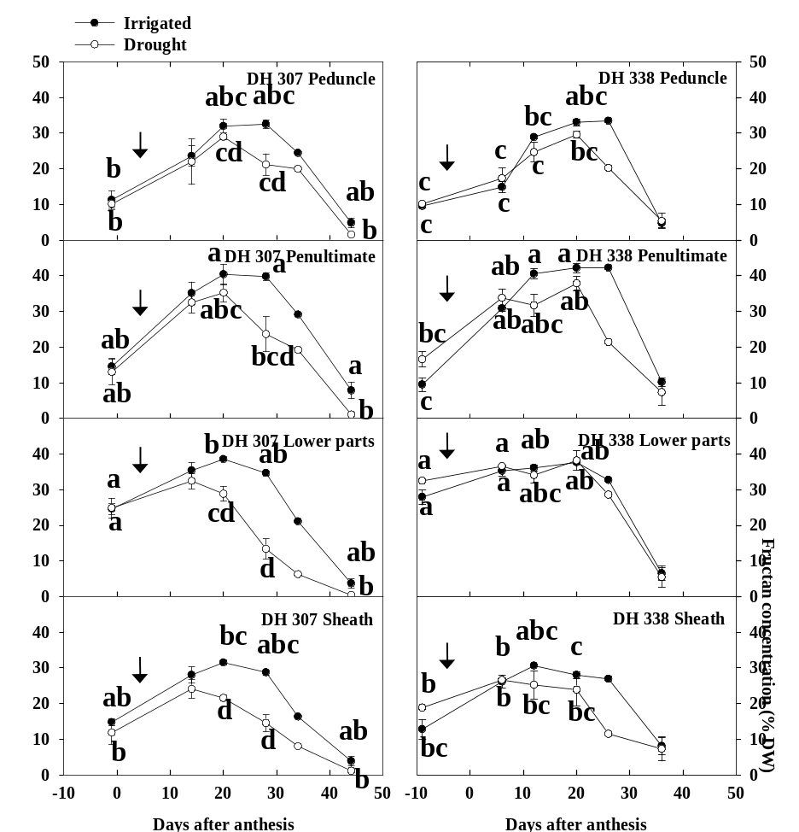
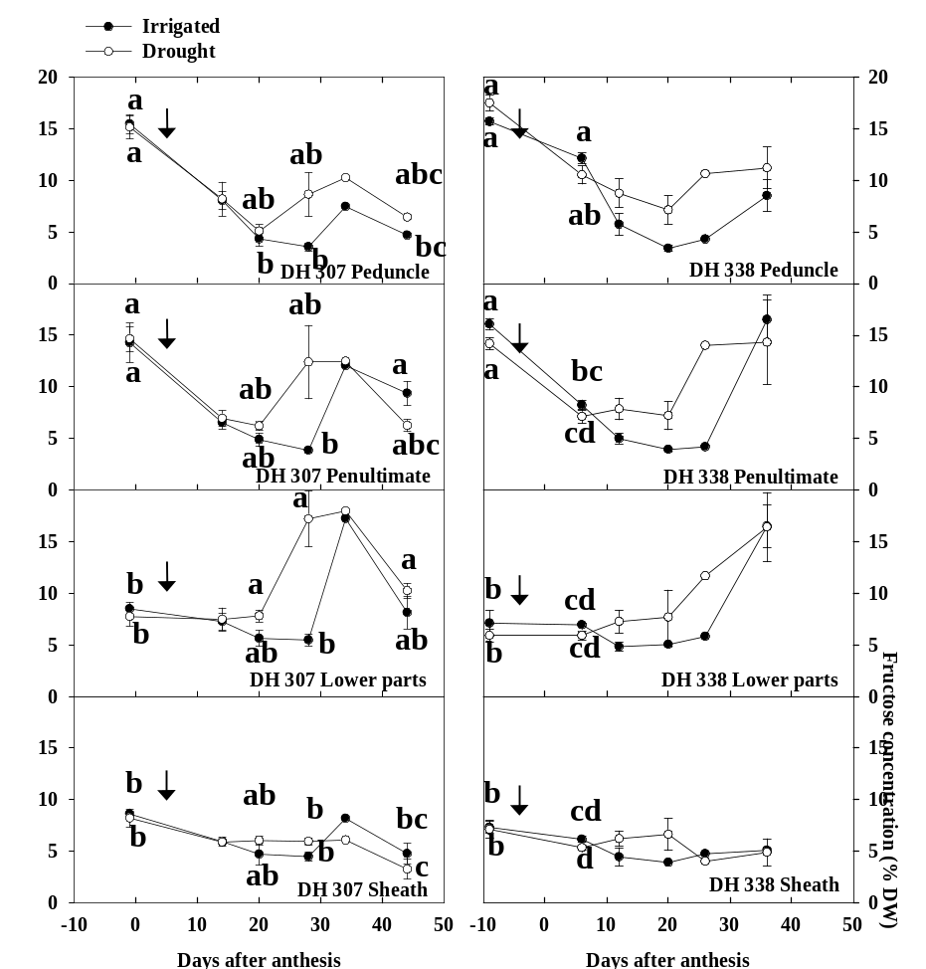
WSC remobilization-segment analysis
Fructan degraded earlier in stem lower parts in the flower earlier line, associated with large fructose concentration under drought.
Zhang et al. 2015c

Slide 25
Summary: WSC remobilization in segments
Genetic variation: Under drought, WSC degraded faster in early flower line - DH 307.
The high amount of Fructose in the stem may contribute to drought tolerance.

Slide 26
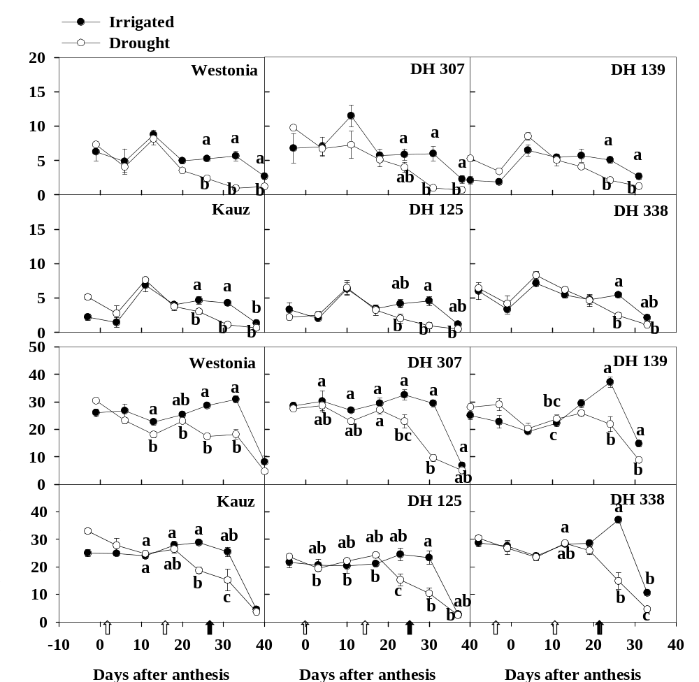
WSC contribution-roots
1/3 of stem
Patterns similar
Fructan degradation parallel with GW assimilation
Zhang et al. 2016

Slide 27
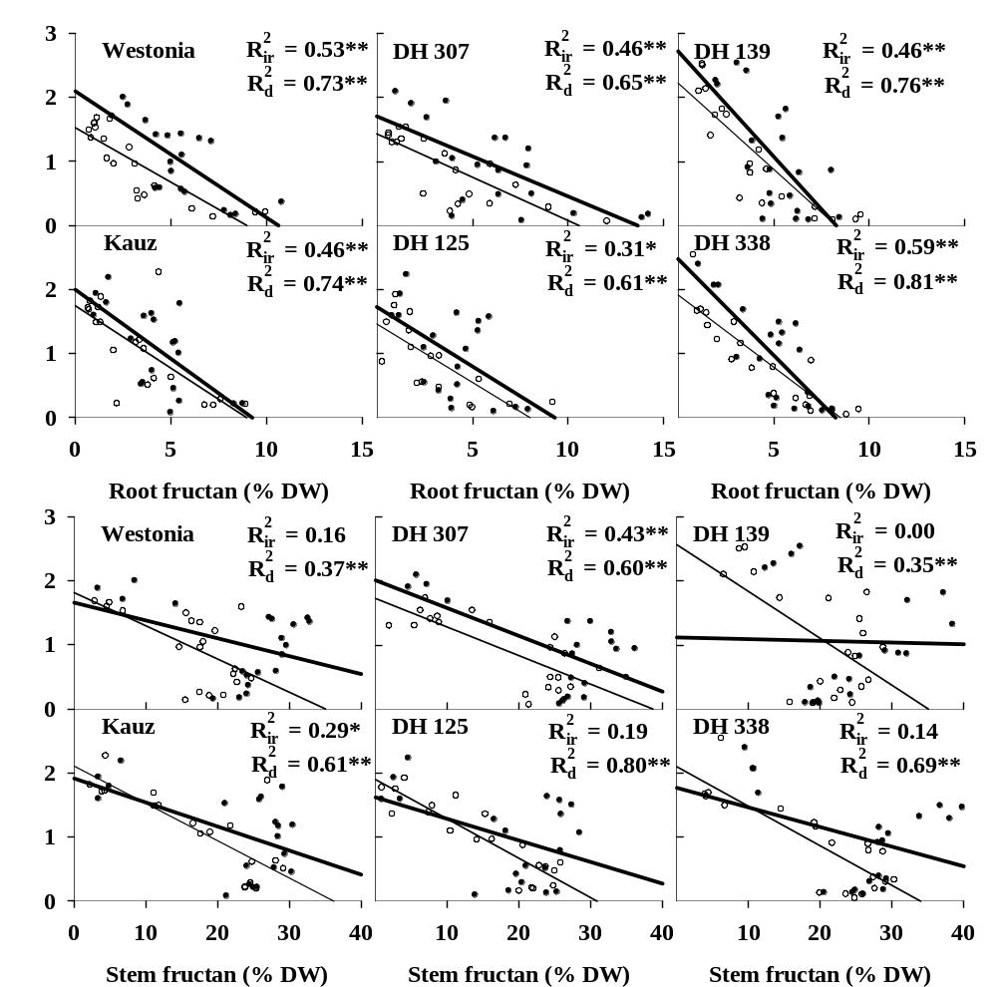
WSC remobilization-roots
Significant correlations with GW.
Under irrigated, stem WSC may not contribute to grain too much.
Zhang et al. 2016

Slide 28
Summary: WSC contributions in roots
Root fructan is 1/3 of stem.
The degradation of fructan in roots were similar to stem.
WSC contributions in roots most likely to grain filling under terminal drought.

Slide 29
Acknowledgement
Management team:
Prof. Rudi Appels
Prof. Bernard Dell
Prof. Wujun Ma
Murdoch University:
PhD student: Nusrat Khan
Dr. Xinmin Zhang
Dr. Hao Luo
Dr. Damian Laid
Mr. Andrew Foreman
Mrs. Tina Oteri
DAFWA:
Mrs. Michelle Murfit
Mr. Glen Riethmuller
Mr. Matthew Mills
Mr. Glenn McDonald
Dr. Ben Biddulph
Mr. Adrian Cox
Mr. David Allen,
Mr. Grantley Stainer
Mr. Mike Baker
Dr. Bob French
KU Leuven (Belgium):
Prof. Wim Van den Ende
Dr. Rudy Vergauwen
Mr. Timmy Reijnders
Yangzhou University:
PhD student: Yunji Xu
North West Agricultural & Forest University:
PhD student: Wei Chen
AGT:
Dr. Dion Bennett

