Slide 1
Cyclosporin A restricts rotavirus infection by enhancing type 1 interferon response in infected epithelial cells in vitro and in vivo
Jintao Li
Institute of Tropical Medicine
Third Military Medical University
Chongqing, P.R.China
2014-9-26

Slide 2
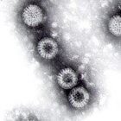
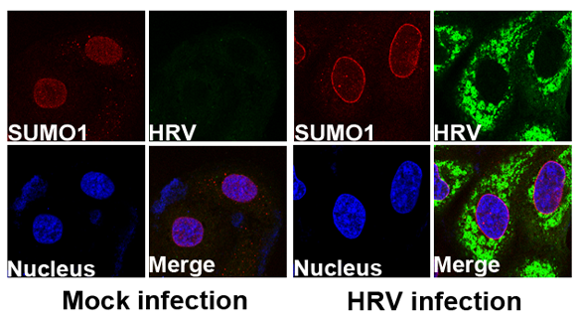
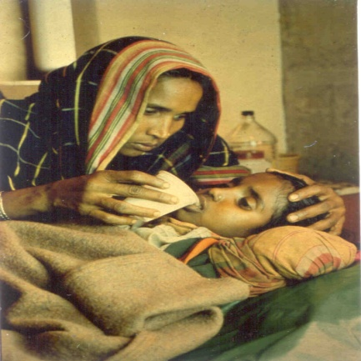
Introduction
Rotavirus infection is the major cause of deadly diarrhea of infants below 5 years old all over the world
RV vaccines are neither globally distributed nor highly effective in some developing countries
To date, no specific anti-rotavirus drug is available
Cyclosporin A (CsA) has long been known to be a powerful immunosuppressive agent
CsA can inhibit virus replication such HCV through a Cyclosphilin A dependent way

Slide 3
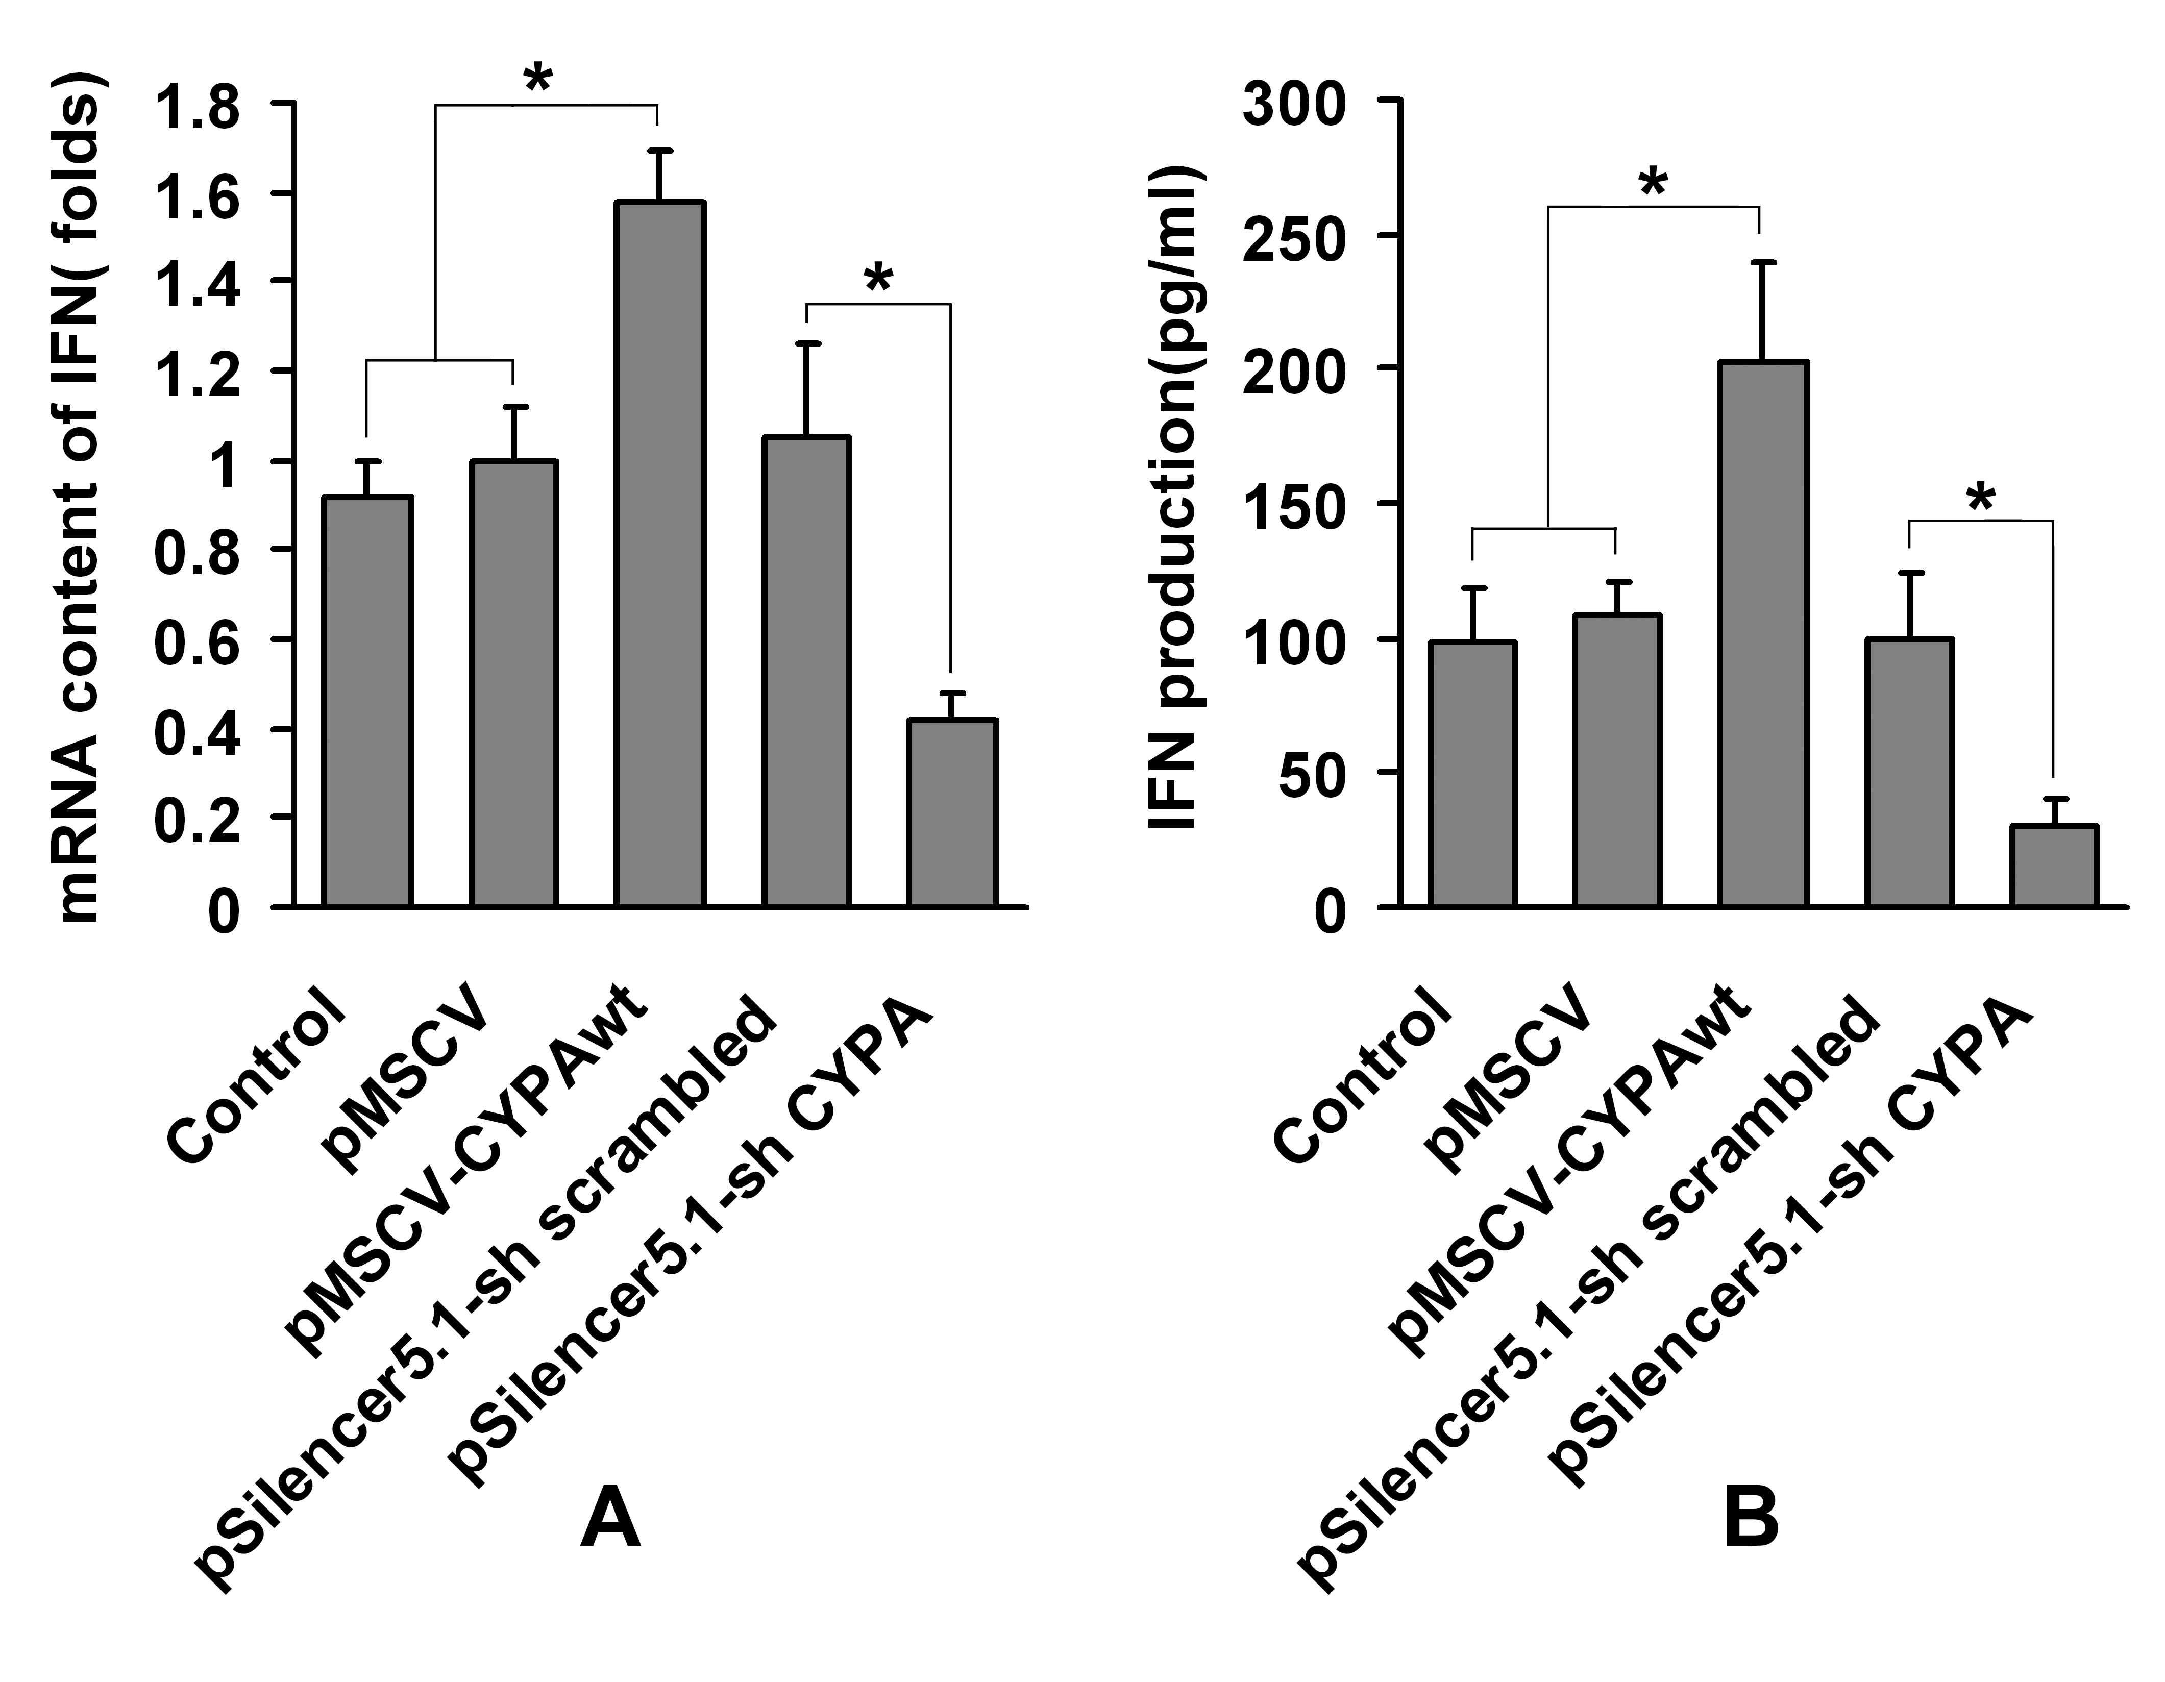
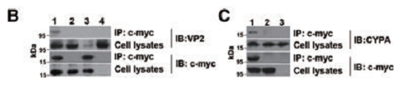
Our previous studies showed that cyclophilin A (CYPA) play a critical role for rotavirus in subverting host cells IFN-β production
CsA, the CYPA Prolyl isomerase inhibitor, can interact with CYPA through inhibiting CYPA PPIase activity
Thus we hypothesized that CsA may be able to suppress rotavirus replication through IFN-β signaling pathway, and therefore reduce diarrhea
He, HY, et al. 2013 Proteomics,
He, HY, et al. 2012, BBRC

Slide 4
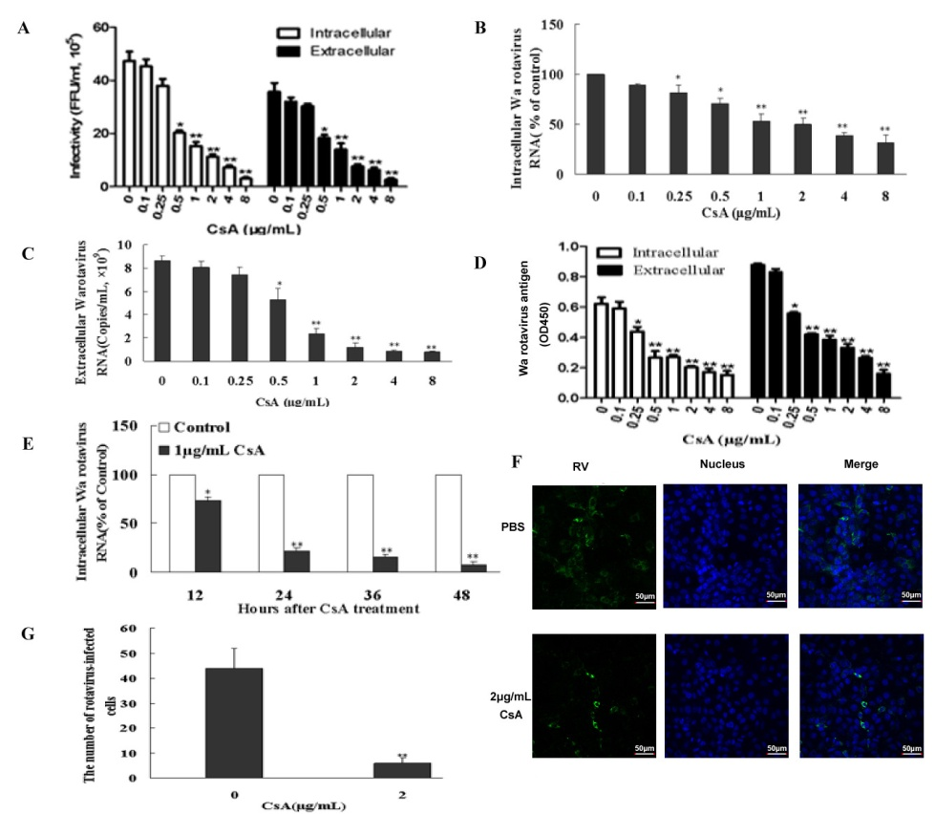
Cyclosporin A (CsA) can efficiently inhibit Wa rotavirus replication in vitro

Slide 5
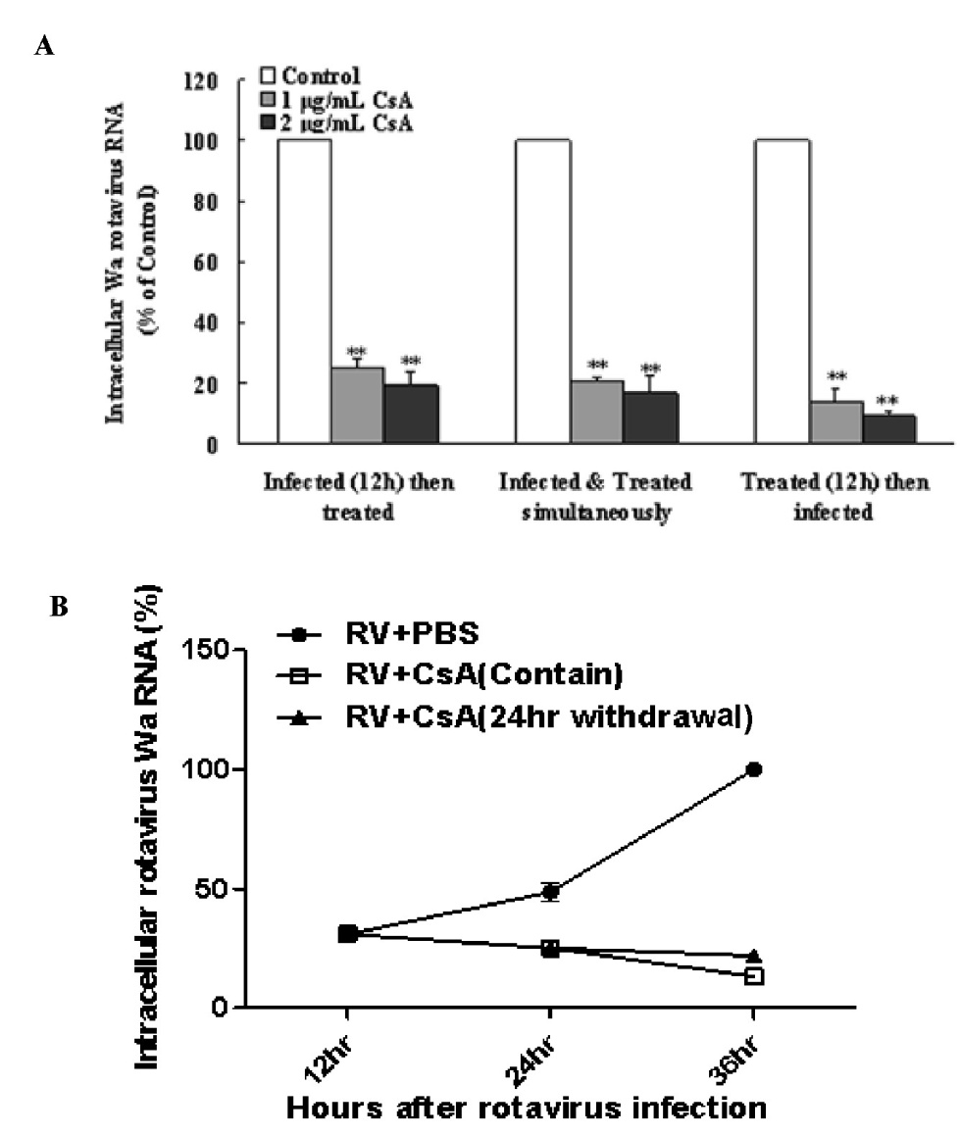
Cyclosporin A (CsA) can inhibit Wa rotavirus replication under various conditions

Slide 6
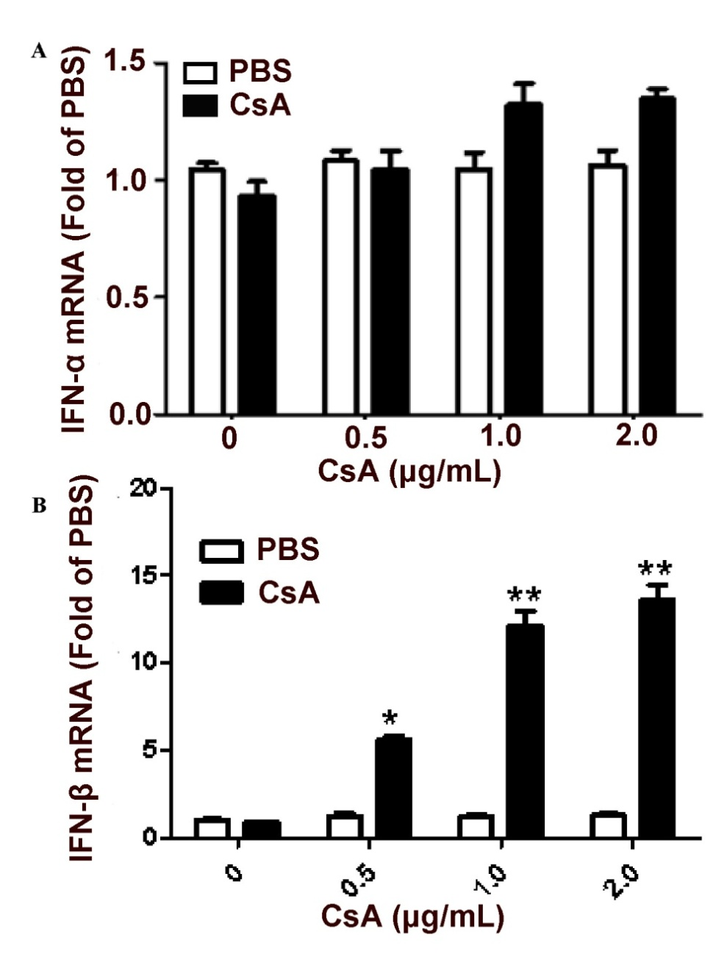
cyclosporin A (CsA) can promote IFN-β but not IFN-α expression

Slide 7
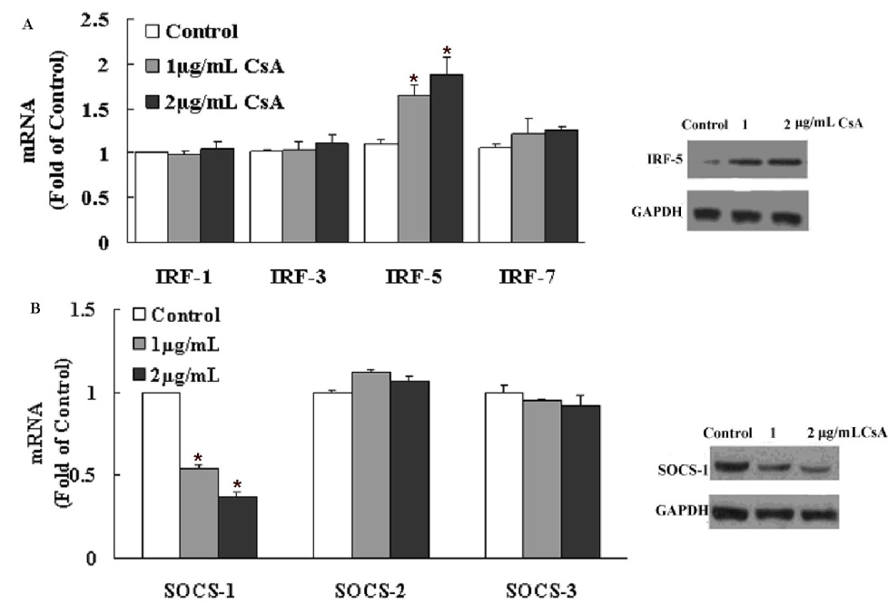
Effect of cyclosporin A (CsA) on the expression of the typeⅠinterferon (IFN) signaling pathway regulators

Slide 8
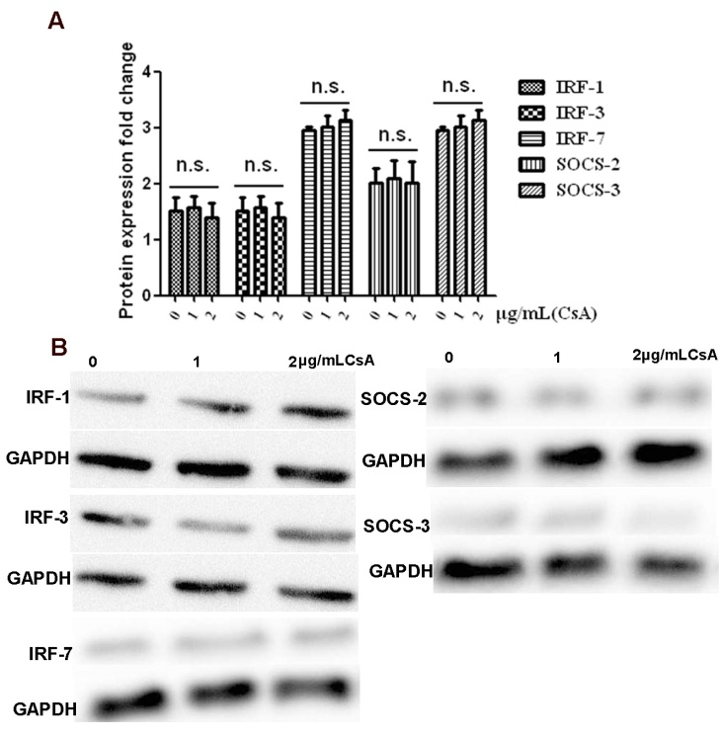
Effect of cyclosporin A (CsA) on the expression of the typeⅠinterferon (IFN) signaling pathway regulators

Slide 9
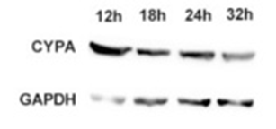
Expression patterns of CYPA in Wa rotavirus infected HT-29 cells with treated with CsA

Slide 10
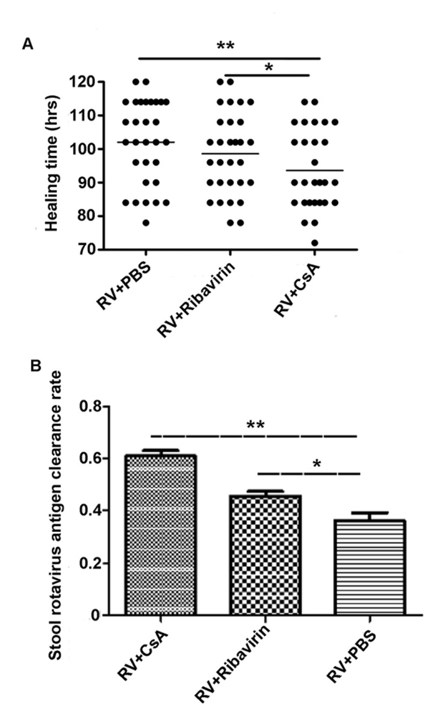
Effect of CsA on SA11 rotavirus-infected neonatal mouse model

Slide 11
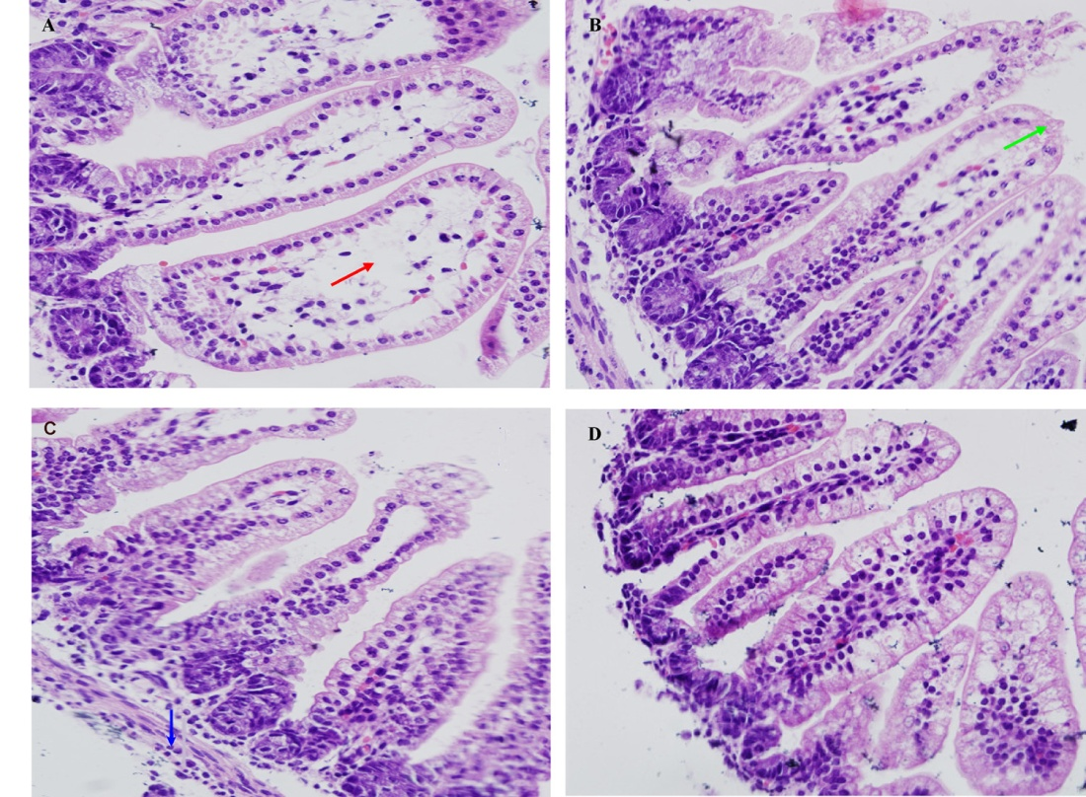
Jejunum changes as assessed by histology using a light microscope
(A) RV+PBS group
(B) RV+Ribavirin group
(C) RV+CsA group
(D) PBS group

Slide 12
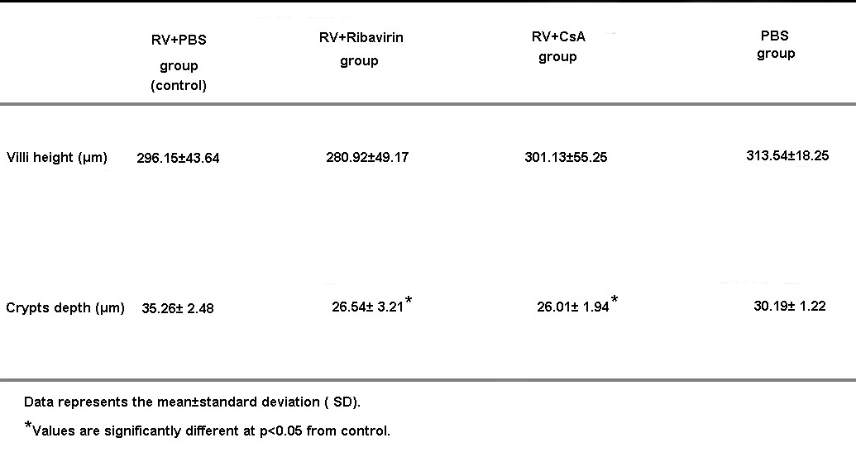

Slide 13
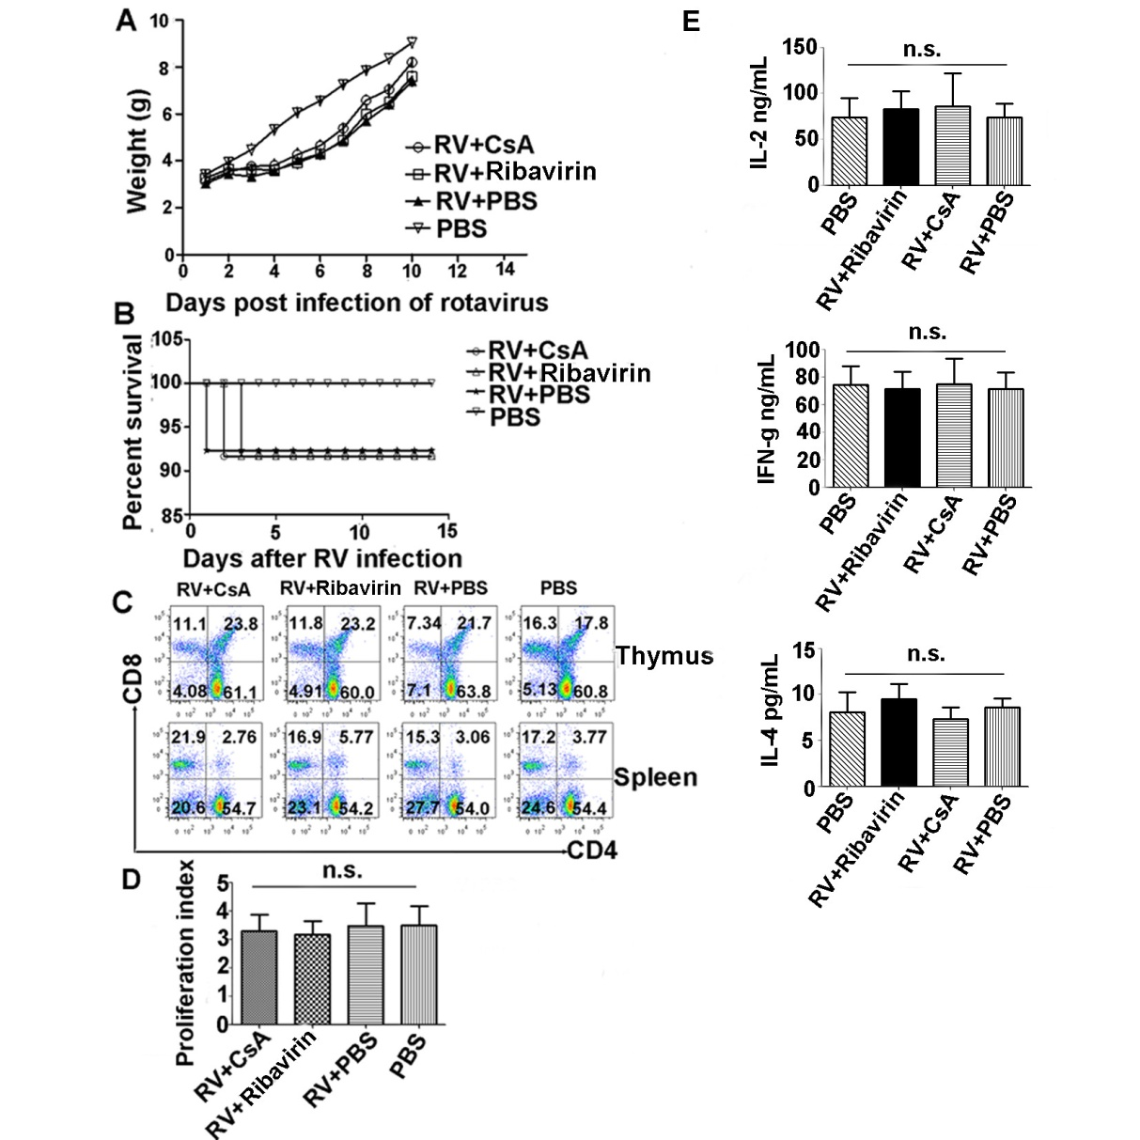
CsA toxicity analysis in the animal model

Slide 14
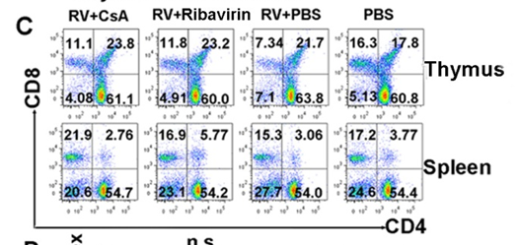
CsA toxicity analysis in the animal model

Slide 15
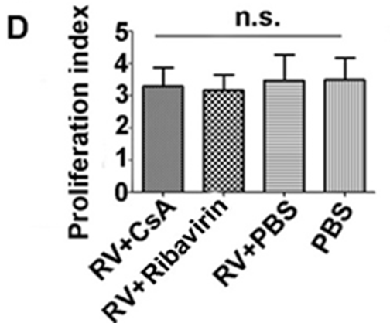
CsA toxicity analysis in the animal model

Slide 16
Conclusions
CsA treatment of HT-29 cells in vitro suppresses Wa rotavirus infection. Furthermore, CsA inhibited Wa rotavirus replication
CsA treatment restores IFN-β expression through suppressing Wa rotavirus and its proteins, not IFN-α and/or IFN-β regulatory genes
CsA promoted Interferon Regulatory Factor-5 (IRF-5) expression, but not IRF-1, IRF-3, or IRF-7. Additionally, CsA inhibited SOCS-1 expression, but not SOCS-2 or SOCS-3

Slide 17
The antiviral effect of CsA was confirmed in an RV-infected neonatal mouse model by evaluation of antigen clearance and assessment of changes in intestinal tissue pathology
Also, there was no significant toxicity in the dose range we used in the experiments both in vitro and in vivo. Such as no differences in T cell frequency or proliferation between the CsA- and vehicle-treated groups were observed,
CsA may be a useful candidate to develop a new anti-RV strategy, although further evaluation and characterization of CsA on RV-induced diarrhea are warranted.

Slide 18

You are always welcome to ask me any questions once you have
Thank You!
Jintao Li
1307342953@qq.com

