Slide 1
Iterative Use of Modeling & Simulation (M&S) and Test & Evaluation (T&E) in Engineering and Manufacturing Environments
Jim Sellers, IEEE Senior Member
Independent Mechatronics Systems Engineering Consultant
Black Mountain, NC USA 28711
www.linkedin.com/pub/jim-sellers-msee-bsee/20/55/8a8/
Notes:
As computers and processors have become more powerful, faster, and smaller over the years, their applications in engineering, manufacturing, and industrial environments have proliferated dramatically in recent years. These characteristics allow many complex processes to be controlled via embedded digital code. Cleverly-designed interfaces allow multiple processors to be used, and these capabilities also provide output that can be monitored and adaptively modified in real-time to produce desired system performance. As the computational capabilities of computers and processors have increased dramatically, the capabilities of modeling, simulation, analysis, and design software applications have also increased in like manner. Many large-scale design and development programs now rely more and more on Modeling and Simulation (M&S) efforts, and less and less on Test and Evaluation (T&E) efforts due to the prohibitive time and cost factors associated with T&E efforts. This treatise discusses the important aspects of this trending change in many industries.
As an introduction to the problem, a short discussion of the evolution of various computing systems, simulation processes and toolsets, and their capabilities and limitations, is presented to give the reader a top-level understanding and appreciation of the uses of various computing systems as they are applied to supporting T&E and M&S activities. The Matlab computational environment is presented as the de facto standard for scientific computing across a breadth of industries and academic disciplines. A discussion of the uses of Matlab, Simulink, and various toolboxes and blocksets as applied to the solution of T&E and M&S technical approaches is presented.

Slide 2
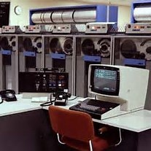
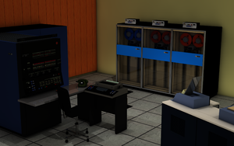
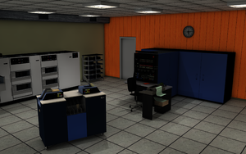
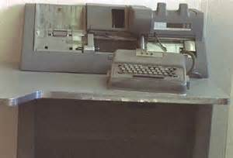
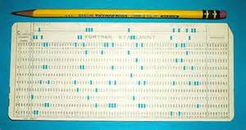
Early Computing Technologies
Typical IBM 370 Mainframe Components (Courtesy IBM)
Keypunch Machine and Keypunch Card (Courtesy Bing)
Notes:
When I was in engineering school in the 1970s, we had the following computing facilities for student and faculty use: an IBM 370 mainframe computer hosting the FORTRAN computing language and accessed by keypunched cards submitted via a batch station, and

Slide 3
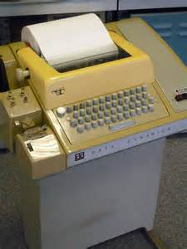
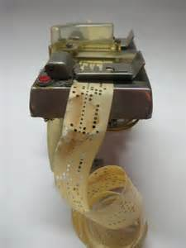
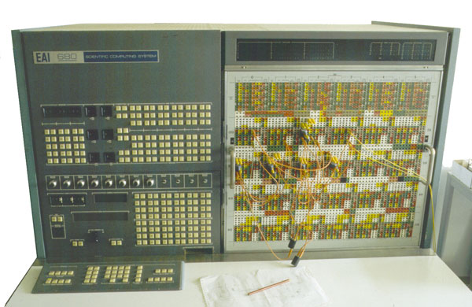
Early Computing Technologies
BASIC Terminal and Paper Tape Punch (Courtesy Bing)
Electronic Associates Incorporated (EAI) Hybrid Computer (Courtesy Bing)
Notes:
a machine hosting the BASIC computing language and using time-share terminals available on a first-come, first-served basis, and analog/hybrid computers such as the EAI 580 using patch panels to access operational amplifiers built into the unit.

Slide 4
Historical Chronology of Modeling and Simulation
Custom FORTRAN and BASIC Code
Continuous Systems Modeling Program (CSMP)
Advanced Continuous Systems Language (ACSL)
Engineering Analysis System (EASY5)
Matrix_{x} and Xmath
Matlab and Simulink – de facto standards now
Maple and Mathcad
Mathematica
Minitab statistical analysis toolset
Notes:
The “better way” to do M&S activities is for the industry needing such support on a frequent basis to acquire and implement “canned” modeling, simulation, and analysis programs which have already perfected and validated the data input/output (I/O) methods, the numerical integration routines, and the simulation output display and plotting capabilities.

Slide 5
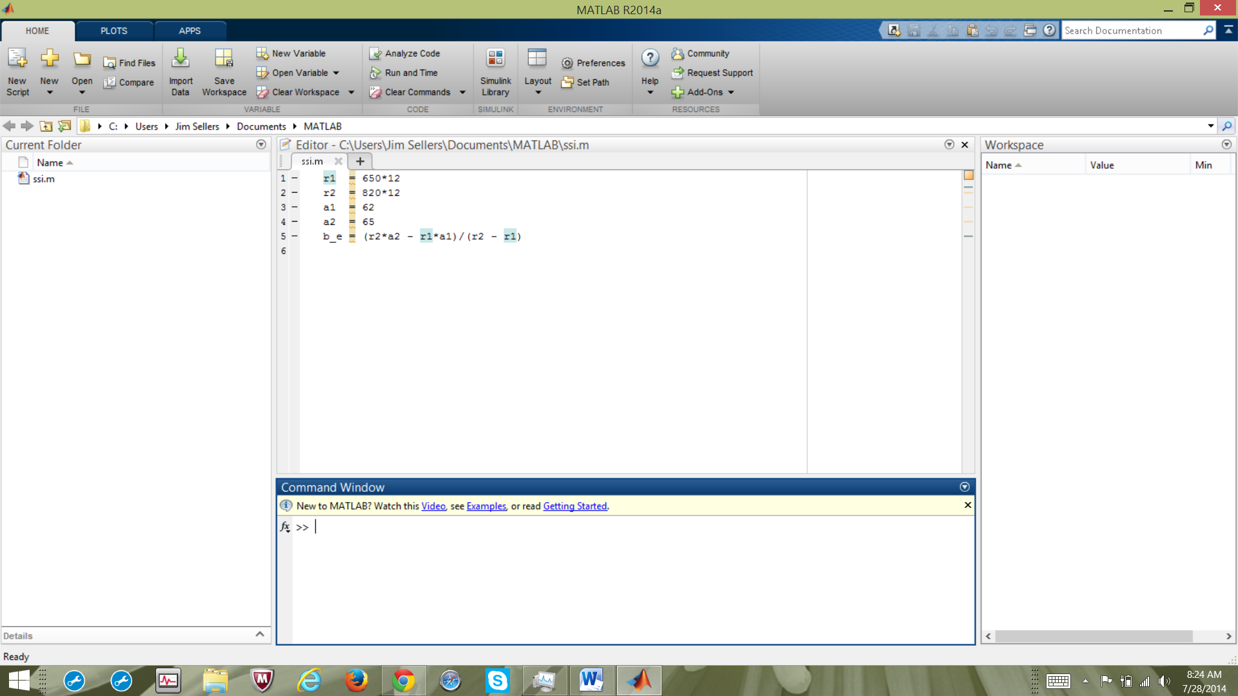
Matlab Workspace
Notes:
I use Matlab and Simulink together whenever possible to set up simulation structures that employ the best features of both tools to maximize the capabilities of my model and simulation development.

Slide 6
Modeling and Simulation Toolsets
Electronics
  PSpice
  OrCAD
  Labview
  Multisim
Mechanical
  ProENGINEER
  Solidworks
Drafting
  I-DEAS
  AutoCAD
Notes:
Mainstays for electronics and mechanical design and analysis, as well as drafting.

Slide 7
Integration Of Modeling, Simulation, Design Toolsets
Leuven Measurement Systems (LMS) International (Belgium)
  Developed Dynamic Analysis and Design System (DADS)
  Morphed Into Virtual Lab
  Interfaces With Simulink To Create Rapid Prototyping Environment
  Bought By Siemens in 2012
Simscape family Of Products Developed By Matlab To Compete With This Technology Advances
  SimMechanics
  SimElectronics
  SimPowerSystems
  SimDriveline

Slide 8
Model-Based Systems Engineering
MBSE is a term that predicates the use of modelling to analyze and document key aspects of the Systems Engineering Lifecycle. It is broad in scope, spanning the SE lifecycle and covering levels from System of Systems to individual components. MBSE is a model-centric approach providing a single point of truth which is reflected in a set of living artifacts (Courtesy of INCOSE).
http://www.incoseonline.org.uk/Documents/zGuides/Z9_model_based_WEB.pdf

Slide 9
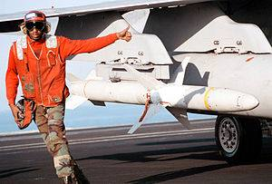
AGM-88: High-Speed Anti-Radiation Missile (HARM)

Slide 10
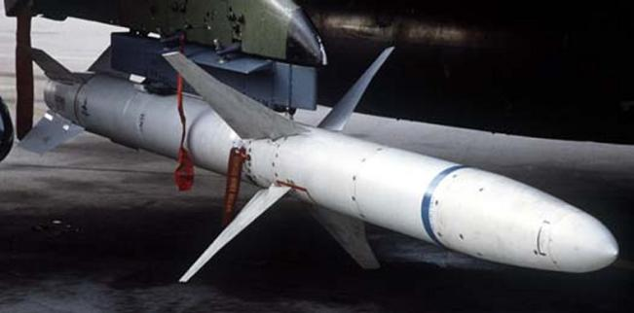
AGM-88: High-Speed Anti-Radiation Missile (HARM)

Slide 11
AGM-88: High-Speed Anti-Radiation Missile (HARM)
Problem
  SAM sites power down if HARM is known to be in area
  Have to be able to prosecute all SAM sites at all times
Solution
  Add GPS receiver and Inertial Measurement Unit (IMU) to missile control section
  Improve flight code and nav software to accommodate lack of GPS information and other abnormalities.
Concerns
  Range time for test and evaluation is expensive
  Assess effects of any changes in mass properties

Slide 12
AGM-88: High-Speed Anti-Radiation Missile (HARM)
Approach
  Use all data from old testing and lab evaluations as a starting point
  Use present navigation and flight control software as baseline
  Determine new mass properties, etc.
  Set up 6DOF simulation to assess benchmark cases
  Refine simulation with data from lab testing and flight tests at Edwards AFB
  Iterate the uses of M&S and T&E to refine model and simulation until its results match test results

Slide 13
Conclusions
In the early part of my career, T&E was dominant with respect to M&S activities due to simulation capabilities, limitations, and turn-around times
As computers improved in capabilities and speed and accuracy and ease of access, M&S activities gained importance to the point that they were more advantageous at time that was T&E
  T&E efforts took a lot of long-range planning and coordination with lab access and range flight schedules
Model-Based Systems Engineering (MBSE) is the best approach that is used now
December 2006: HARM scores direct hit on simulated emitter at Edwards AFB ➔ Team of the Quarter

