Slide 1
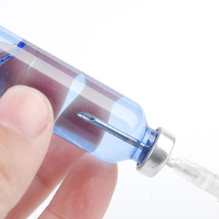
About OMICS Group
OMICS Group is an amalgamation of Open Access Publications and worldwide international science conferences and events. Established in the year 2007 with the sole aim of making the information on Sciences and technology ‘Open Access’, OMICS Group publishes 700+ online open access scholarly journals in all aspects of Science, Engineering, Management and Technology journals. OMICS Group has been instrumental in taking the knowledge on Science & technology to the doorsteps of ordinary men and women. Research Scholars, Students, Libraries, Educational Institutions, Research centers and the industry are main stakeholders that benefitted greatly from this knowledge dissemination. OMICS Group also organizes 1000+ International conferences annually across the globe, where knowledge transfer takes place through debates, round table discussions, poster presentations, workshops, symposia and exhibitions.

Slide 2

OMICS International Conferences
OMICS International is a pioneer and leading science event organizer, which publishes around 700+ open access journals and conducts over 500 Medical, Clinical, Engineering, Life Sciences, Pharma scientific conferences all over the globe annually with the support of more than 1000 scientific associations and 30,000 editorial board members and 3.5 million followers to its credit.
OMICS Group has organized 1000+ conferences, workshops and national symposiums across the major cities including San Francisco, Las Vegas, San Antonio, Omaha, Orlando, Raleigh, Santa Clara, Chicago, Philadelphia, Baltimore, United Kingdom, Valencia, Dubai, Beijing, Hyderabad, Bengaluru and Mumbai.

Slide 3

Case Studies of Human Flora and Spore Contamination in Cleanrooms
Jim Polarine MA.
August 17, 2015

Slide 4
Agenda
Case Studies in Bioburden Control
Starting Up a New Cleanroom

Slide 5
Bioburden Agenda
Operator Contamination
Fungal Spore Contamination
Bacterial Spore Contamination

Slide 6
Operator contamination
Staphylococcus
Propionibacterium acnes

Slide 7
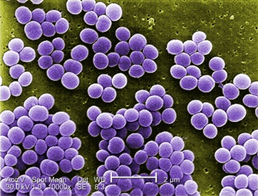
Human Skin Flora
Staphylococcus cleanroom outbreak
  Source
    Gowning Material
    Traced back to one operator
    Skin infection
    Another case was from a Tongue Stud
    Non-sterile drug product
Courtesy Ann Larson

Slide 8
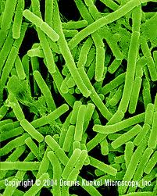
Propionibacterium acnes
Gowning room
  BSL Hood
  Sources
    Operator with acne
      Solution
        Antimicrobial Handwash
        Antimicrobial Bodywash
Courtesy Ann Larson

Slide 9
Agenda
Operator Contamination
Fungal Spore Contamination
Bacterial Spore Contamination

Slide 10
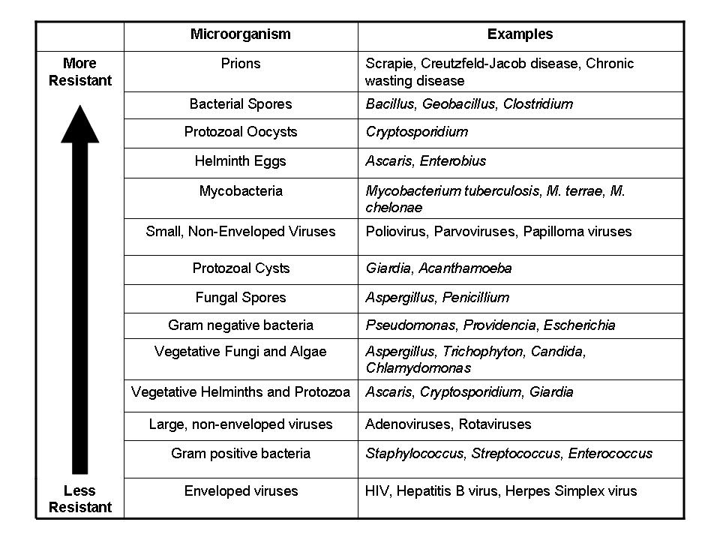
VALIDATION – Microorganism Selection
From McDonnell, “Antisepsis, Disinfection, and Sterilization: Types, Action, and Resistance” 2007, ASM Press

Slide 11
Fungal Spores
Penicillium
Aspergillus
Cladosporium

Slide 12
Common sources of Spores
Items brought into the Cleanroom
  Bags, Boxes, Intervention Equipment, Pallets, Pallet Jacks, Scrubbers, Cart Wheels, Shoes, Shoe Covers
  Raw Materials

Slide 13
Penicillium
ISO-7 Cleanrooms
Action Levels of 10 and picking up >100
  Engineering Investigating
  HVAC
  Duct Work
  HEPA Filters
  Cooling Coils
  Wall Coverings
  Airflow Vents

Slide 14
Penicillium Investigation
Entry and Exit Procedures
Gowning Procedure
Cart Wheels
Construction
  Further Investigation
  Use of Sporicides
  Containers in the Cleanroom
  Coldroom Cleaning Procedures
  Documentation
  Assignable Cause

Slide 15
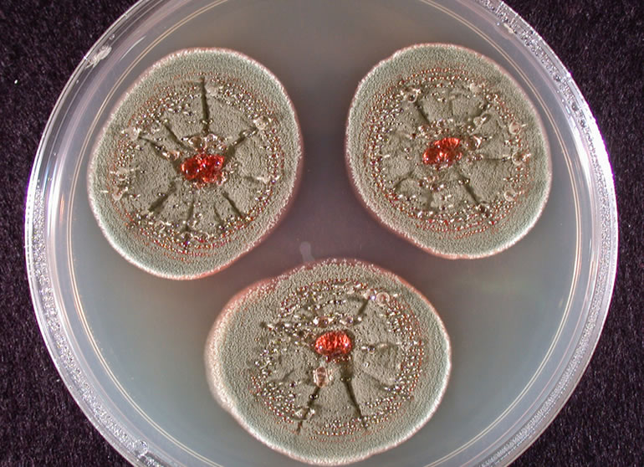
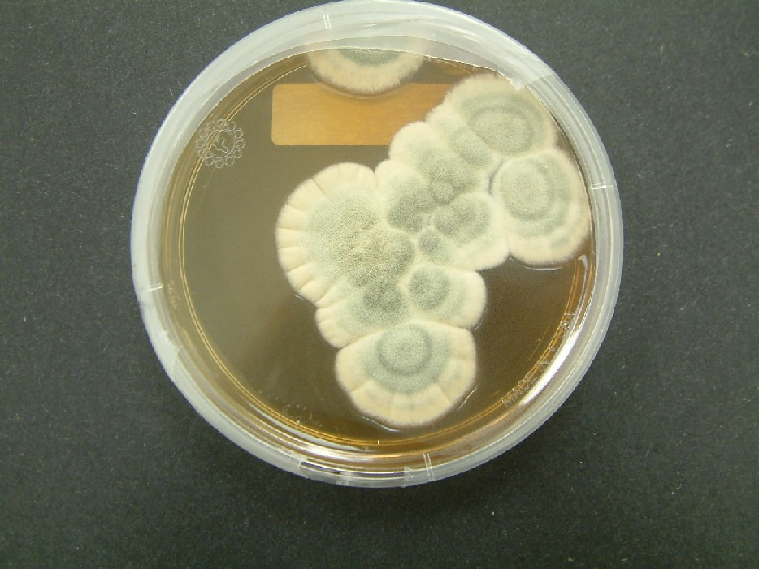
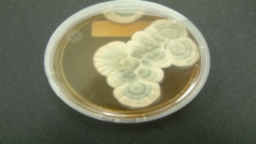
Penicillium
Courtesy Ann Larson

Slide 16
Aspergillus
ISO-5 Cleanroom
  Source
    Door Kick Plate
    High Impingement Spraying Device
Exceeding Limits in ISO-7 areas
  Dock Doors proximal to ISO-7 cleanroom
  Storage room with limited control
  No limits for mold spores
  Limited control for incoming and outgoing items

Slide 17
Aspergillus Investigation
Sporicidal usage in pass thru
Clean and dirty area on the Dock
Better control of gowning area
Cart Wheel control
Better gowning control

Slide 18
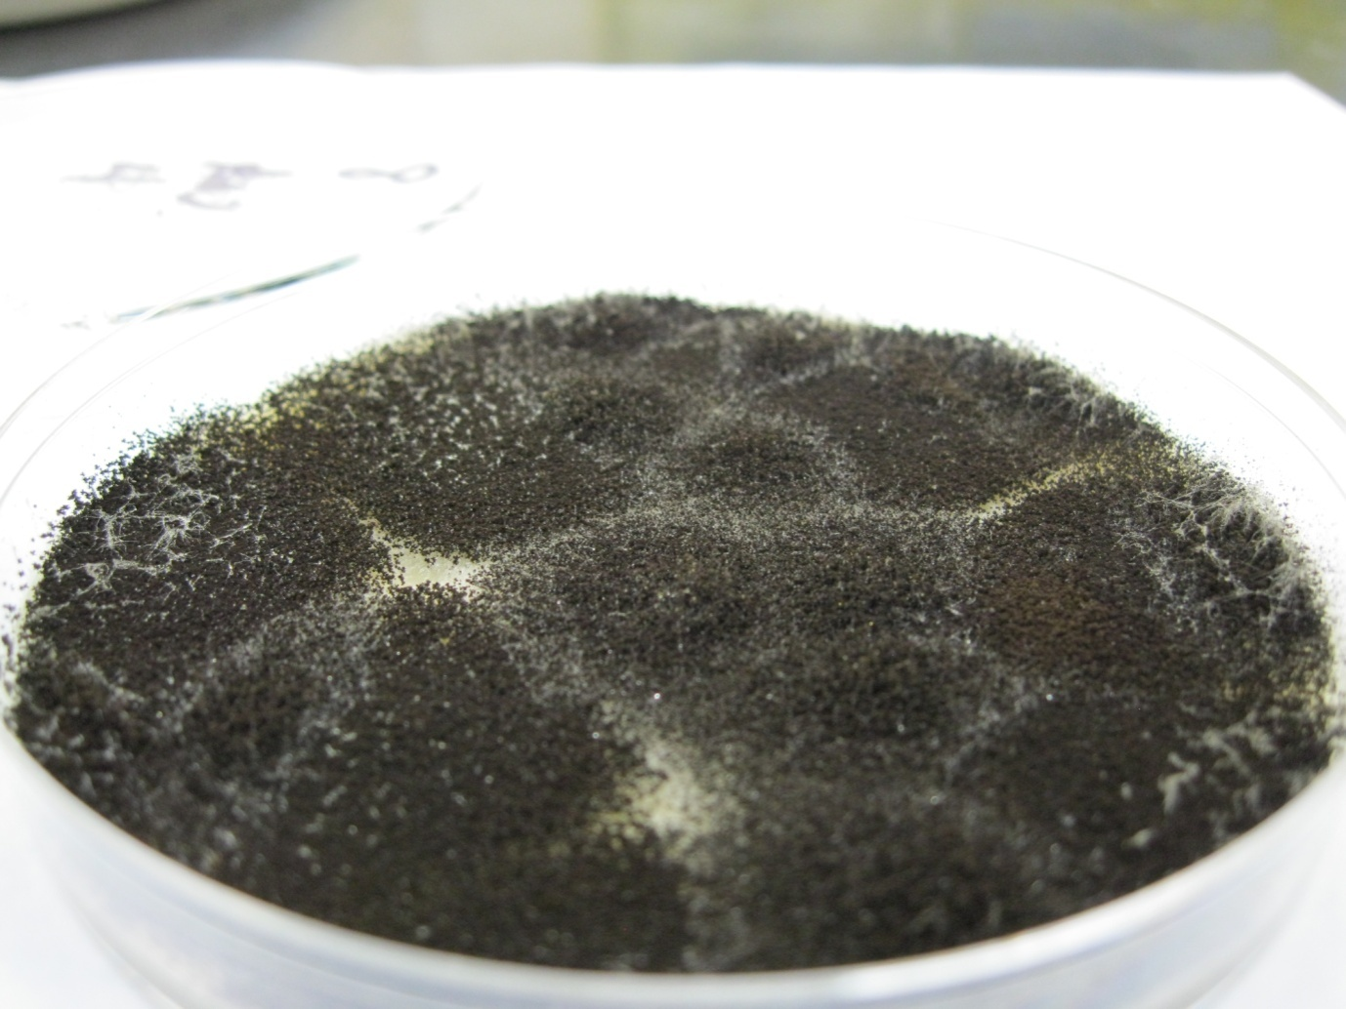
Fungi
Courtesy Dan Klein

Slide 19
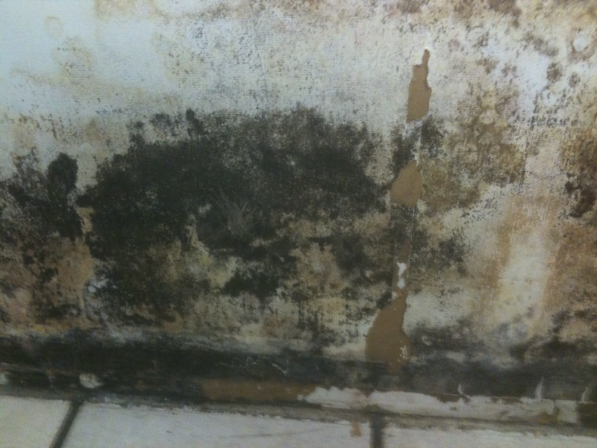
Cleanroom Fungi
Courtesy Dan Klein

Slide 20

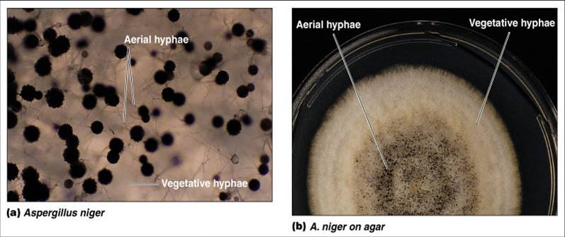
Inoculum Preparation—Fungal Spores
Cultures need to be incubated for a sufficient length of time before harvesting spores
Courtesy Dan Klein

Slide 21
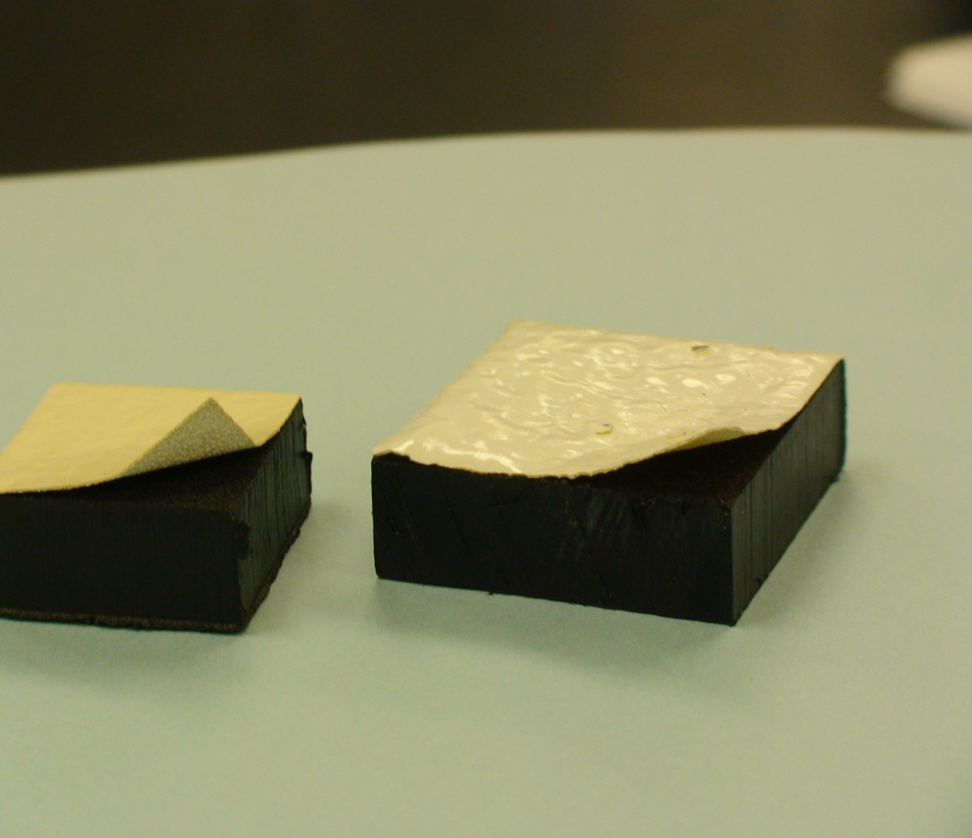
Surface Preparation
Autoclaving may not be acceptable for some surfaces (Saniflex)
Courtesy Carol Bartnett

Slide 22
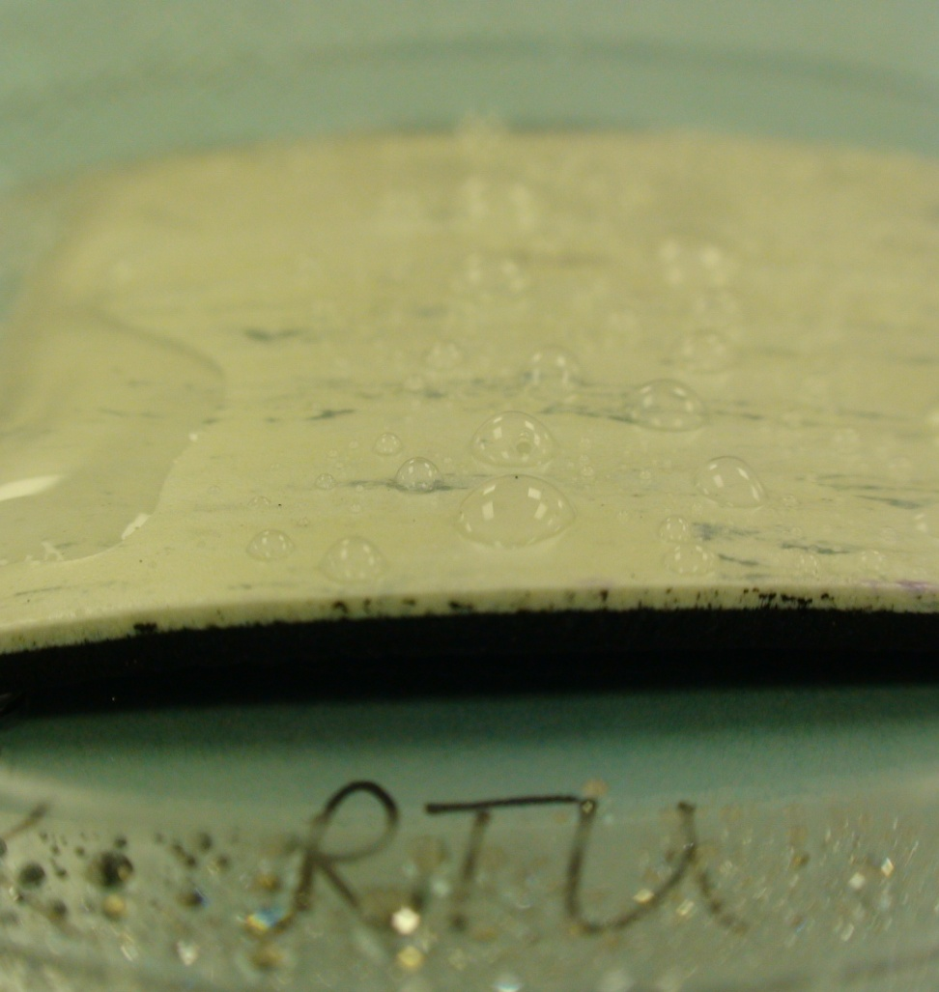
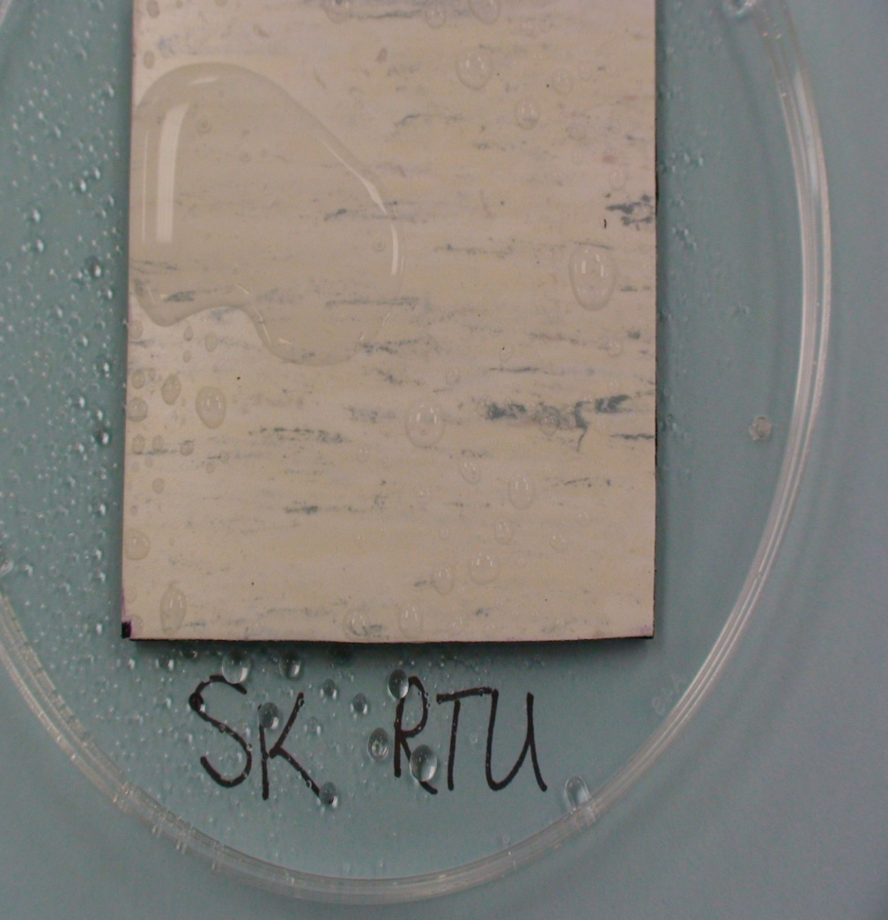
Surface Tension Issue

Slide 23
Cladosporium
Elevated levels in Puerto Rico
Common in Southern CA
  Increase Sporicide Usage
  Sources
    Humidity and temperature
    Burning of Sugar Cane fields

Slide 24
Case Study on Substrates
Efficacy (log reduction) of Low pH phenolic (Environ LpH se) : (1:256 Dilution) against test microorganisms on representative surfaces
Surface | Staphylococcus epidermidis | Pseudomonas aeruginosa | Corynebacterium glutamicum | Candida albicans | Aspergillus niger | Penicillium chrysogenum
Stainless Steel | 6.62 | >6.10 ^{b} | 4.18 | >4.31 ^{b} | <3.00^{c} | 4.95
Glass | 6.85 | 6.42 | 5.26 | >5.80 ^{b} | 2.98 | 5.11
Aluminum | 6.35 | 5.69 | 5.14 | >3.93 ^{b} | <3.00^{c} | 3.48
Epoxy | 4.36 | 4.45 | 4.48 | 3.19 | <3.00^{c} | <3.00^{c}
Enamel | >6.05^{b} | >5.72 ^{b} | 5.45 | >3.92 ^{b} | <3.00^{c} | 2.83
Acrylic | 4.53 | 6.06 | 4.49 | 2.92 | <3.00^{c} | <3.0 ^{c}
Mipolam | 4.36 | 3.87 | 4.29 | 4.37 | <3.00^{c} | 3.25
Vinyl | 4.08 | 3.68 | 3.93 | 2.61 | <3.00^{c} | 2.1
Hardwood | 5.18 | >4.54 ^{b} | 5.26 | 3.2 | <3.00^{c} | 2.59
Melamine Covered Wood | >5.38 ^{b} | >5.64 ^{b} | >5.09 ^{b} | >5.12 ^{b} | 3.65 | 3.95
Plastic | >5.73 ^{b} | >5.32 ^{b} | >5.05 ^{b} | >4.04 ^{b} | <3.00^{c} | 2.44
Plexiglas | >5.90 ^{b} | 5.62 | 4.83 | >4.40 ^{b} | <3.00^{c} | 3.85
Print | 5.85 | 5.86 | 5.74 | 4.51 | <3.00^{c} | 3.38
Chromium | 6.55 | 5.95 | 6.63 | 4.08 | <3.00^{c} | 2.61
ª Disinfectant Efficacy = (Log MSP_{(positive control)} - Log MSP_{(test coupons)}), where MSP_{(Positive Control)}= Mean surviving population on positive control coupons; MSP_{(test coupon)} = Mean surviving population on test coupons after disinfectant treatment; ^{b} Each of triplicate coupons showed no growth after disinfectant treatment; ^{c} Each of triplicate coupons showed TNTC growth

Slide 25
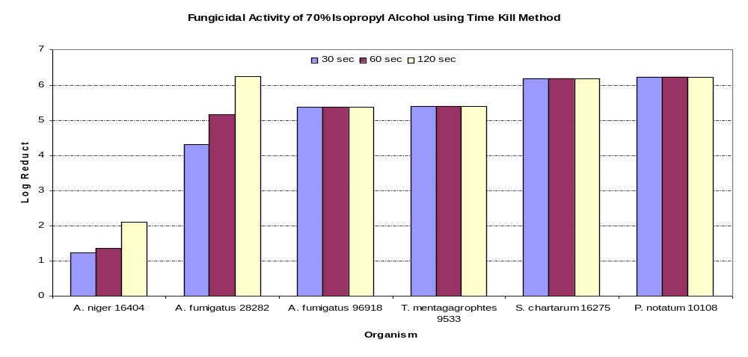
70% IPA Efficacy Against Molds

Slide 26
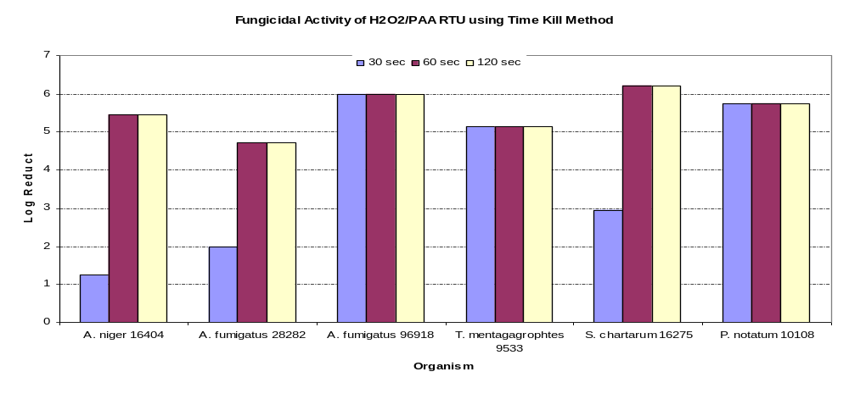
H2O2/PAA RTU Against Molds

Slide 27
Agenda
Operator Contamination
Fungal Spore Contamination
Bacterial Spore Contamination

Slide 28
Bacterial Spores
Bacillus cereus
Bacillus circulans

Slide 29
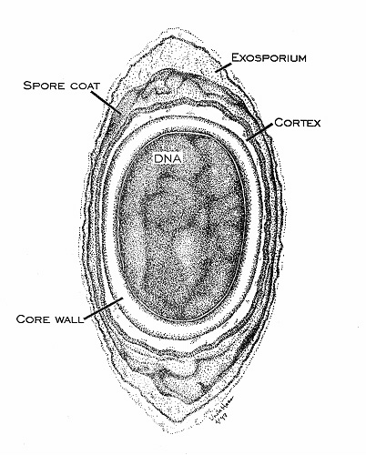
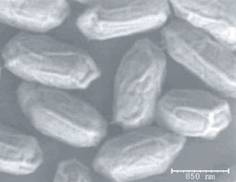
Bacterial Endospore
Courtesy Dan Klein

Slide 30
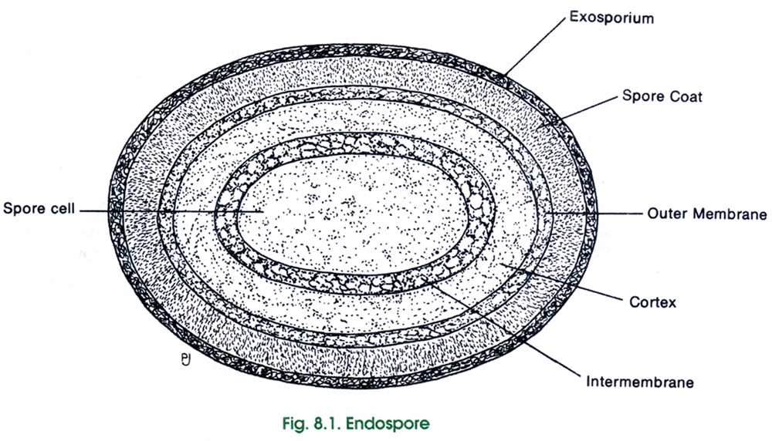
Bacterial Endospore
Bacterial Spore Structure

Slide 31
Bacillus cereus
ISO-7 and ISO-8 cleanrooms
Process Vessels
  Source Locations
    Cleanroom Shoe Cover
    Fermentor
    Process Vessels
    The Source was a Raw Material

Slide 32
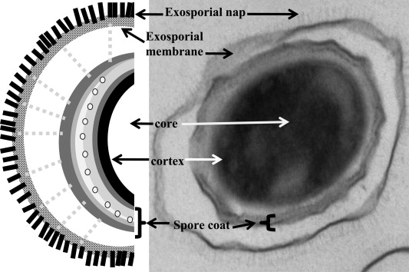
Exosporium – B. anthracis
Cote CK et al. 2011. Microbes and Infection 13(14-15):1146-55.

Slide 33
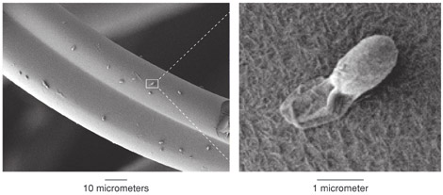
Exosporium – B. anthracis
Hydrophobicity helps adhere to fibers
https://www.llnl.gov/str/Sep06/Velsko.html

Slide 34
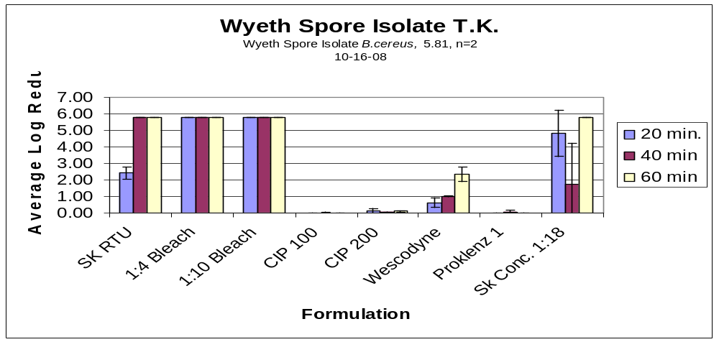
Bacillus Testing
1:4 Bleach
Iodine Product
H202/PAA RTU
1:10 Bleach
Alkaline Cleaner
Acidic Cleaner
H202/PAA 1:18
Aklaline Cleaner-2

Slide 35
Bacillus circulans
Efficacy Testing Failures (different test methods)
  Vinyl surfaces
    Sent out for ID
      Paenibacillus

Slide 36
Case Study: Construction Event at Biotech Site
Worst Case Events
9X Clean [1X Sporicide + 2X Phenolic (day 1) 2X Phenolic +1X Sporicide (day 2), 2X Phenolic +1X Sporicide (day 3)]
Fogging
VHP
Triple Clean
  Defined 3X Disinfectants and Sporicide
  EM frequency (Static and Dynamic)
  Release of the room

Slide 37

Cleaning and Disinfection Efficacy

Slide 38
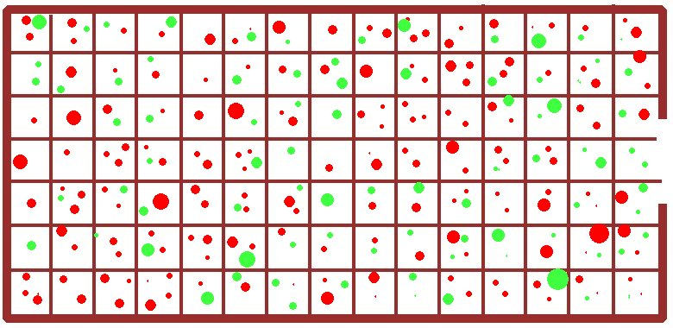
Time 0
Red = Sporeformers Green = Other

Slide 39
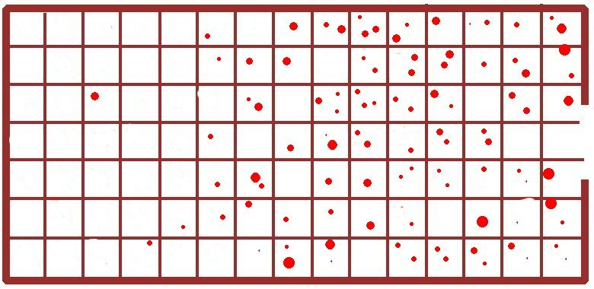
After 1X Cleaning - NO Sporicide

Slide 40
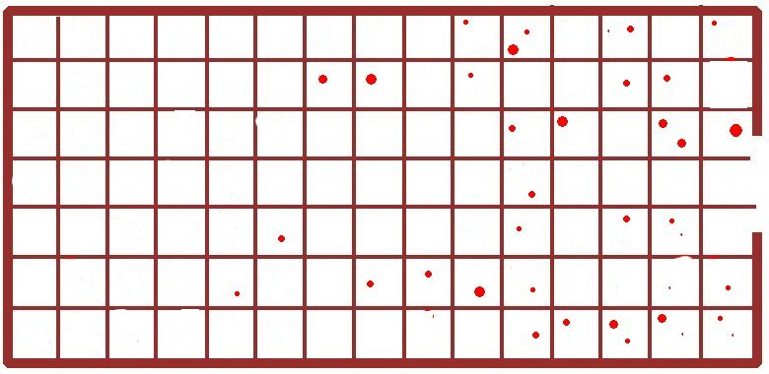
After 2X Cleaning – NO Sporicide

Slide 41

After 3X Cleaning - No Sporicide

Slide 42
After Sporicide

Slide 43
Bioburden Agenda
Operator Contamination
Fungal Spore Contamination
Bacterial Spore Contamination

Slide 44
Summary
Case Studies in Bioburden Control
Starting up a New Cleanroom

Slide 45
Thank You for Your Time
Jim Polarine Jr. MA.
jim_polarine@steris.com

Slide 46
Let us meet again..
We welcome you all to our future conferences of OMICS International
2nd International Conference and Expo
on
Parenterals and Injectables
On
October 24-26, 2016 at Istanbul, Turkey
http://parenterals-injectables.pharmaceuticalconferences.com/

