Slide 1


Development of Prostatic Exosomal Protein Lateral Flow Chromatographic Strips for Detection of Chronic Prostatitis
Jiao Zhang MD, PhD.
The Brody School of Medicine
East Carolina University
Greenville, NC 27834
Email: zhangj15@ecu.edu
Prostate Cancer
June 22-24, 2015 Florida, USA

Slide 2
Background
Chronic prostatitis/chronic pelvic pain syndrome (CP/CPPS) is a common condition in urological practice, may be linked to an increased risk of prostate cancer, yet proper diagnosis and treatments are still lacking.
Traditional diagnoses are based primarily on the clinical symptoms and signs, routine urine test, bacterial culture as well as the expressed prostatic secretion (EPS) indexes.
There are no gold-standard or objective diagnostic surrogates for non-bacterial CP/CPPS.

Slide 3
Recently, PSEP (Prostatic exosomal protein) ELISA methodology was developed to be used as a potential indicator of CP/CPPS.
Multi-center clinical trials performed in China demonstrated that CP/CPPS patients present elevated PSEP in the void urine when compared to that of the healthy men.
Our current study is designed to further develop a PSEP point-of-care (POC) platform for large-scale screening of CP/CPPS patients.

Slide 4
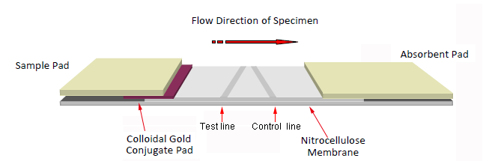
Objective
Here we try to set up a rapid and simple immunodiagnostic assay for CP/CPPS detection
-----lateral flow chromatographic strips (sandwich assay)

Slide 5
Research Design
PSEP Antibody production
Development of Lateral-Flow Test Device
  Preparation of Colloidal Gold Particles
  Preparation of Colloidal Gold Labeled mAb
  Preparation of Nitrocellulose Capture Membranes
  Test Procedure and Principle
Determination of Performance
  Sensitivity of the Test Strip
  Detection of Urine Sample

Slide 6
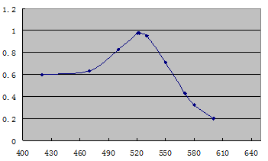
  Preparation of Colloidal Gold Particles
Cholorauric acid and trisodium citrate were used to prepare colloidal gold solution.
TEM data showed that the colloidal gold particles had a nearly uniform particle size of 20 nm.
The UV-visible spectra characterized the maximum absorbance peak at 522 nm.

Slide 7
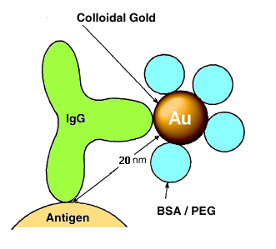
  Preparation of Colloidal Gold Labeled mAb and pad
1. Adjusted pH to 7.0 using 0.1 M K₂CO₃
PSEP mAb added to the solution drop wise
50 min
0.5% (w/v) BSA (1 mL) was added to block the extra conjugate sites
Gold-labelled PSEP was collected after gradient centrifuge
Colloidal-Gold Labeled mAb was sprayed onto a glass fiber membrane to prepare the conjugate pad.

Slide 8
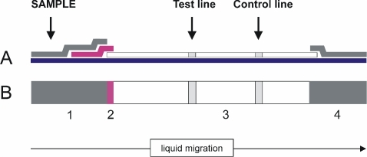
  Preparation of Nitrocellulose Capture Membranes
Test antibody(pAb) and goat anti-mouse IgG were used as the test line and control line.
Test antibody and goal anti-mouse IgG coatings were sprayed onto the nitrocellulose (NC) membrane at 1 μl/cm and dried at 37 ˚C for 30min.
Nitrocellulose Membrane

Slide 9
The NC membrane coated with capture reagents was pasted on the center of the plastic backing plate (polyvinylchloride (PVC))
Then, gold-conjugate pad (glass fiber), sample pad and absorbent pad were laminated and pasted onto the back plate.
sample pad
gold-conjugate pad
PVC back Plate
absorbent pad

Slide 10
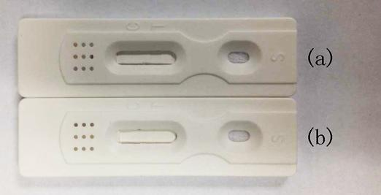
Finally the plate was cut into 3-mm-wide strips and assembled in a predesigned cassette.

Slide 11
  Test Procedure and Principle
Urine sample (100 μL) was added to the sample pad. Due to the capillary action, the solutions could flow in the direction to the absorbent pad.
If PSEP exists in the sample, it will form PSEP-mAb-gold-conjugates complex. Then the complex will move towards the NC capture membrane and conjugate with the anti-PSEP pAb which is embedded in the test line for the finite amount.
Then, the test line will show red color.

Slide 12
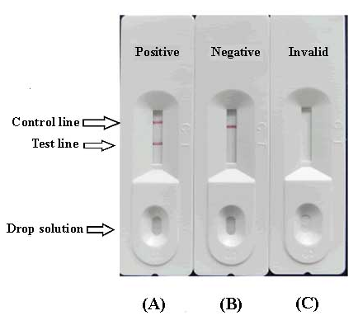

Therefore, the more PSEP is present in the sample, the stronger the color of the test line will become.

Slide 13
Determination of Performance
  Sensitivity of the Test Strips
  PSEP was diluted at concentrations of 0, 0.2, 0.5 1, 2, 5, and 10 ng/mL in 0.01 M PBS (pH 7.4).
  The sensitivity of the test strip was determined by testing PSEP reference spiked samples.
  Three minutes later, the lower detection limit (LDL) with naked eyes was defined at the certain amount of PSEP concentration which produce a clearly visible test line on the test device compare with the blank sample(0 ng/mL ).

Slide 14
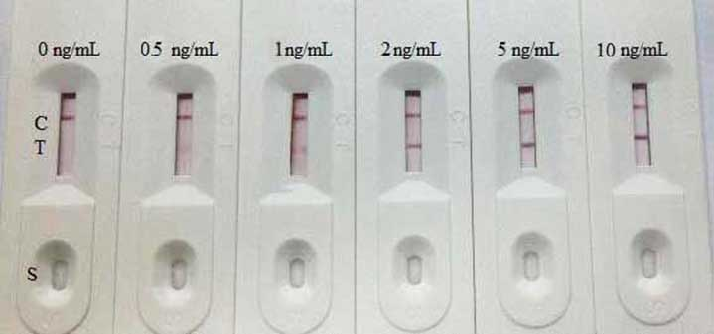
The sandwich assay with PSEP-colloidal gold particles enabled the lower detection limit of PSEP levels around 2ng/ml, supporting its utility to assay clinical relevant PSEP concentrations in clinical practice.

Slide 15
  Detection of Urine Sample
All the samples were detected using lateral-flow chromatographic strips, and using PSEP (Prostatic exosomal protein) ELISA kit as parallel control.
Three replicates were performed for each urine sample using the test strips.

Slide 16
PSEP kit Gold strips | positive | negative | Total
positive | 16 | 24 | 40
negative | 14 | 29 | 43
Total | 30 | 53 | 83
Sensitivity | 53.33% | 34.33% ~ 71.66%
Specificity | 54.72% | 40.45% ~ 68.44%

Slide 17
Above result indicated that :
The test device enabled the detection level of PSEP as low as 2ng/ml.
These lateral flow chromatographic strips showed potential value in assisting CP/CPPS POC diagnosis.

Slide 18
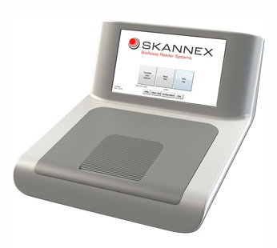
Research ongoing
Based on these results, we are working on setting up a density reader to recorded the color intensity of the test zone on the strips so that we can further qualify and analyze different PSEP level for the CP assisting diagnosis.

Slide 19
Thanks!

Slide 20
