Slide 1
Prognostic microRNA Signature of Triple-Negative Breast Cancer Identified by Cross-Validated Cox Model Development
Jianying Zhang, PhD
Charles Shapiro, MD
Center for Biostatistics
Department of Biomedical Informatics
Ohio State University, Columbus, OH
Jianying.Zhang@osumc.edu

Slide 2
Background - TNBC
ER (estrogen), PR (progesterone), HER2/neu (epidermal growth factor receptor) all negative
Annually 170K new TNBC diagnoses per year (worldwide), accounting for 12-24% of all breast cancers
Poor prognosis: chemo-resistance and early recurrence
Limited treatment options

Slide 3
Background - microRNA
Small (19-25 nucleotide), non-coding RNAs
Regulatory role: reduce the abundance and translational efficiency of mRNAs
microRNAs play key roles in cancer progression and drug resistance
oncomiRs regulate tumor suppressor genes
microRNA signature is necessary and predictive for prognosis of TNBC

Slide 4
Research Goal
Identify a miR signature for good prognosis of TNBC over time, especially within 2-5 years
Dichotomization of patients into high vs low risk groups
Primary endpoint:
time-to-progression (recurrence/death)

Slide 5
TNBC Cohort
159 TNBCs from the Wexner Medical Center of the Ohio State University with first diagnosis from 1985-2005 (4 before 1995)
Both survival/recurrence data and valid miRNA profiling were available
Demographic/pathologic/clinic outcome data were collected from Information Warehouse

Slide 6
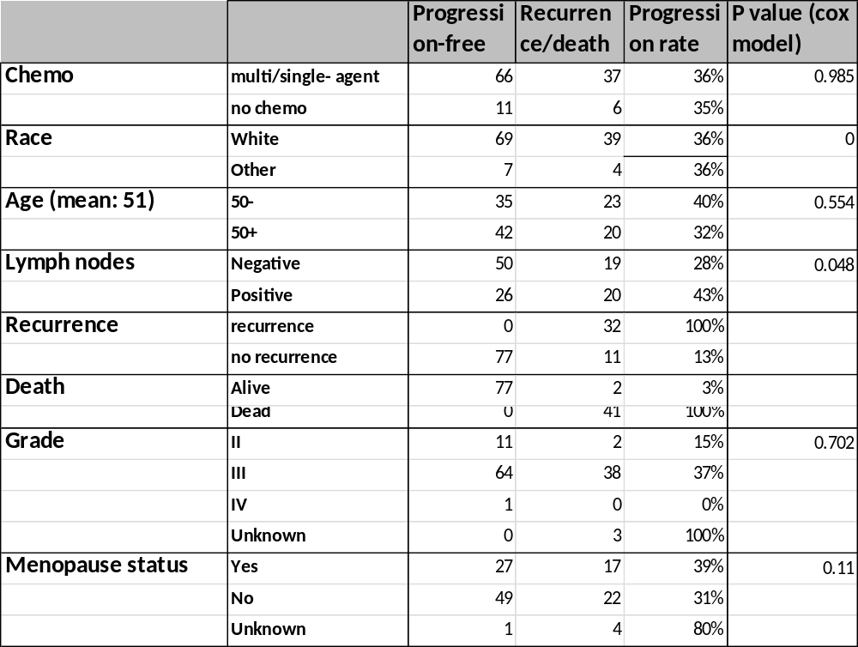
Clinical Data Summary

Slide 7
miRNA Profiling
Patient primary tumor tissues at diagnosis/surgery
Nano String nCounter platform for miR profiling
6 positive controls, 8 negative controls, 5 housekeeping controls, and 734 miRs
Technical Normalization by normalization factor (NF) calculated from positive controls
Samples with outbound NF were excluded
Filtering low-expressed miRs by negative control threshold (398 miRs remained).
Global normalization – Quantile Normalization

Slide 8
Statistical Challenges/Pitfalls
Model over-fitting: a model fitting the training data too well while fitting the test data poorly.
Reasons:
Too many more-than-necessary predictors were selected
High-dimensional data: sample size n >> p (#predictors)
Same data used to develop the model and assess the performance
Training set/data is too small or too noisy

Slide 9
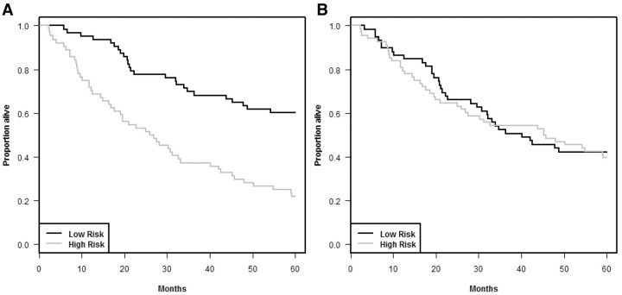
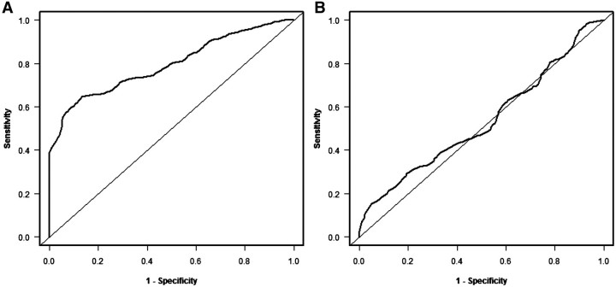
(A) Re-substitution estimates and (B) cross-validated estimates.
Simon et al 2011

Slide 10
Solution: Cross-Validation (CV)
K-fold CV
Training data is split into K partitions equally at random
Each partition (1 to K) is left as the test set role in turns
Remaining K-1 partitions plays the train set role: build the model
Model prediction (risk score for Cox) is evaluated on test set
After all K folds run, overall model performance is evaluated: cross-validated AUC, ROC, survival curves (KM), etc.
Repeat above K-fold CV many times (e.g. 100 times)
Simon et al 2011

Slide 11
Model Building – Cox Regression
Feature Screening/Selection (FS)
Univariate cox regression
Univariate two-group comparison
Clustering
Principle component analysis (PCA)
Linear discriminant analysis (LDA)
Model Selection (MS)
- Traditional stepwise selection
Penalized likelihood or shrinkage methods (Lasso/Ridge, etc.)
Machine learning

Slide 12
Cox Proportional Hazard Model
Semi-parametric:
For observation i at time t
h_{i}(t) = h₀(t) exp(β₁X_{i1} + β2X_{i2} + … + βpX_{ip}) _{p: # of predictors}
Linear model:
f(x_{i}) = log(h_{i}(t)/h₀(t)) = β₁X_{i1} + β2X_{i2} + … + βpX_{ip}
h_{i}(t)/h₀(t): proportional hazard
f(x) = B’X is called linear risk score function
where B = (β_{1,} β_{2, …,}βp) for p predictors

Slide 13
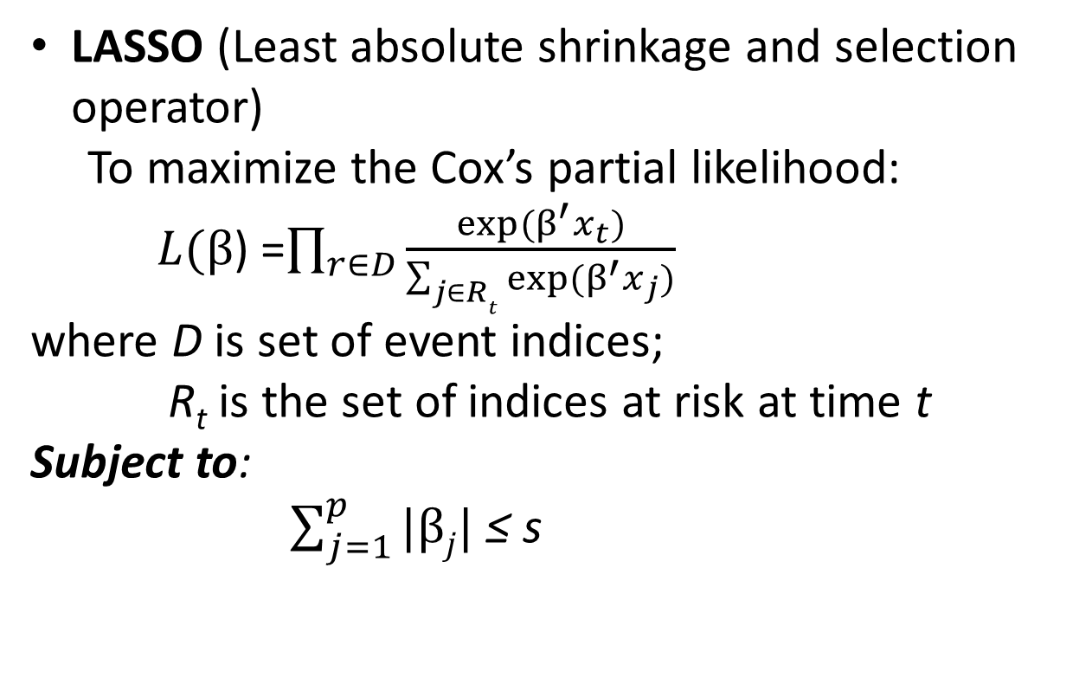

Parameter Estimate
OLS (Ordinary Least Square)
To minimize: $\sum_{i=1}^{n}{\left(f\left(x_{i}\right)−{x_{i}}^{′}β\right)}$²
LASSO (Least absolute shrinkage and selection operator)
To maximize the Cox’s partial likelihood:
$L(β$) =$\prod_{r∈D}{\frac{exp⁡(β^{′}x_{t})}{\sum_{j∈Rt}{exp⁡(}β^{′}x_{j})}}$
where D is set of event indices;
R_{t} is the set of indices at risk at time t
Subject to:
$\sum_{j=1}^{p}{|βj|}$ ≤ s

Slide 14
Model/Variable Selection
Forward (AIC)
Backward (AIC)
Stepwise (AIC)
Penalized or shrinkage method (Lasso)
Cross-Validation is used to find the optimal tuning parameter (maximum likelihood)

Slide 15
Model Assessment (MA)
Continuous response:
Mean-square error: bias² + variance
Binary/categorical response:
AUC-area under the curve (ROC)
Sensitivity/specificity
Time-to-event response:
Time-dependent ROC/AUC (Heagetty et al, 2000)

Slide 16
Time-Dependent ROC
ROC and AUC are estimated in terms of landmark time t
Sensitivity: Pr[M ≥ c | T ≤ t]
Specificity: Pr[M < c | T > t]
T: survival time;
M: test value (risk score)
C: threshold of positivity
Two methods:
KM – Kaplan Meier
NNE – Nearest Neighbor Estimate
Heagerty et al 2000

Slide 17
CV Modeling on TNBC Data
N=159
5 exclusions: older than 80 or no PF
N=154
Training Set (N=120)
Validation Set (N=34)
5-fold CV
Final model
100 iterations
FS
MS
Other covariates (NODES Positive)
MA
FS0: No FS
FS1: Univariate Cox
FS2: progression vs progression-free
MS1: CV stepwise
MS2: CV Lasso
Time-dependent ROC/AUC
Risk classification
Risk score prediction
Add
Skip
Cross-validated ROC/AUC/risk classification

Slide 18
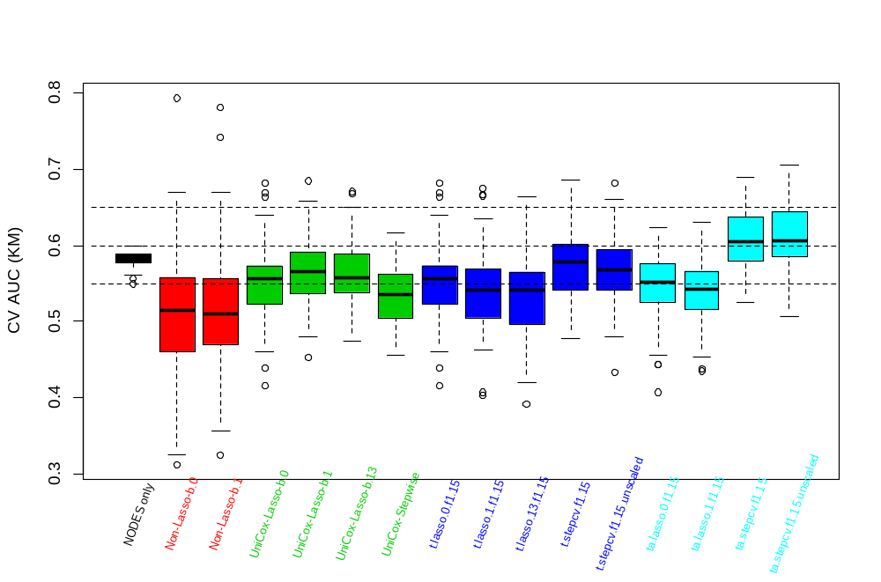
Cross-validated AUC by KM (100 runs)
FS0
FS1
FS2
FS2 + NODES

Slide 19
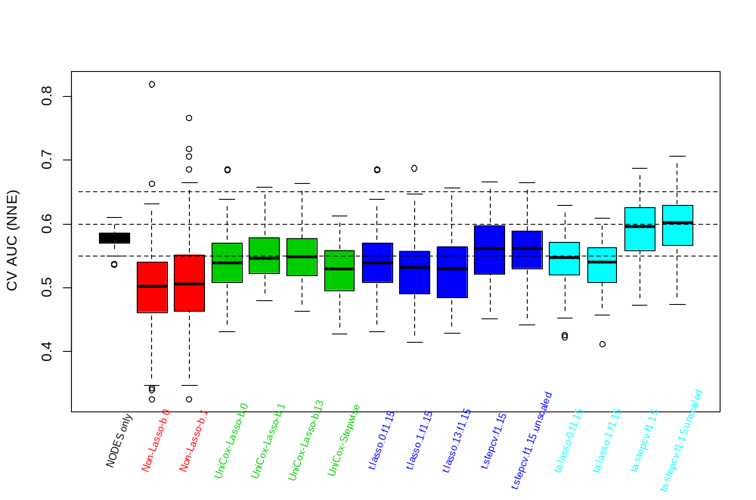
Cross-validated AUC by NNE (100 runs)
FS0
FS1
FS2
FS2 + NODES

Slide 20
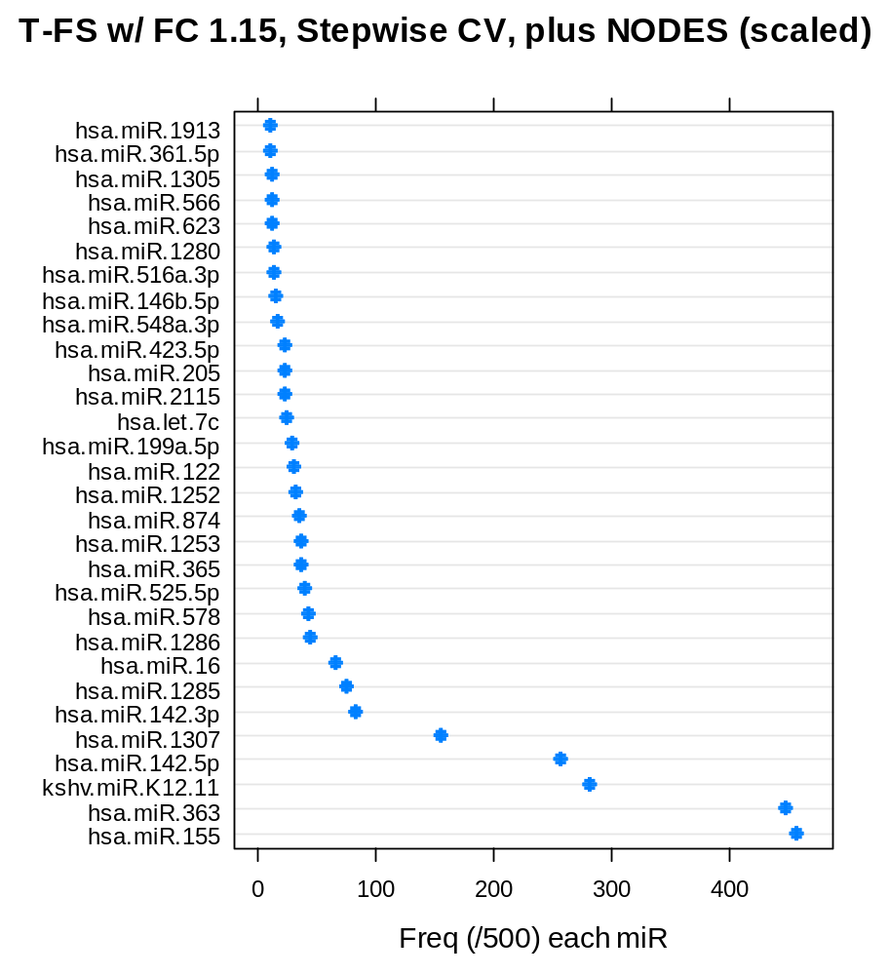
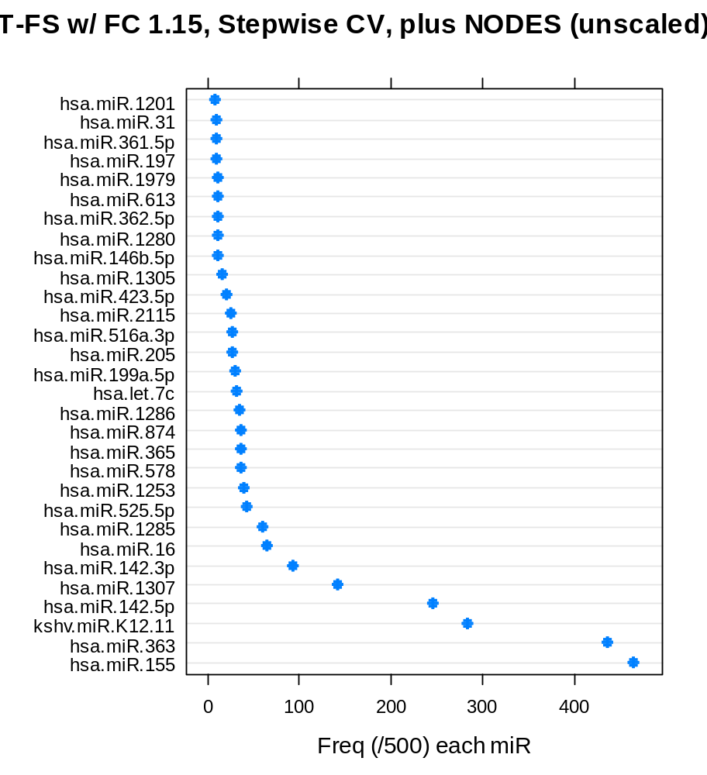
High-Frequency miRs

Slide 21
Significance Test of the AUC
Hypothesis: AUC = 0.5 vs AUC > 0.5
500 random permutations of the time-to-event and event status
Five-fold cross-validated AUC was calculated within each permutation based on the candidate model development procedures
For example, for the procedure with the highest mean AUC:
P(AUC>= 0.61) = 0.05
P(AUC >= 0.63) = 0.04
P(AUC>= 0.68) = 0.032

Slide 22
Optimal Model
Full training set (n=120) was used for modeling
Feature selection/screening by comparing progression vs progression-free with FC>1.15 and P<0.06
5-fold cross-validated stepwise cox regression was used for model selection.
Above 5-fold CV stepwise was repeated 100 times to pick the most frequent model
The miRs in the most frequent model plus NODES to fit the final cox model
Evaluate the final cox model on validation data set

Slide 23
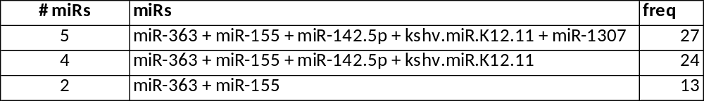
Final model – Full train set
Five miRs were selected
miR-363
miR-155
miR-142.5p
kshv.miR.K12.11
miR-1307

Slide 24
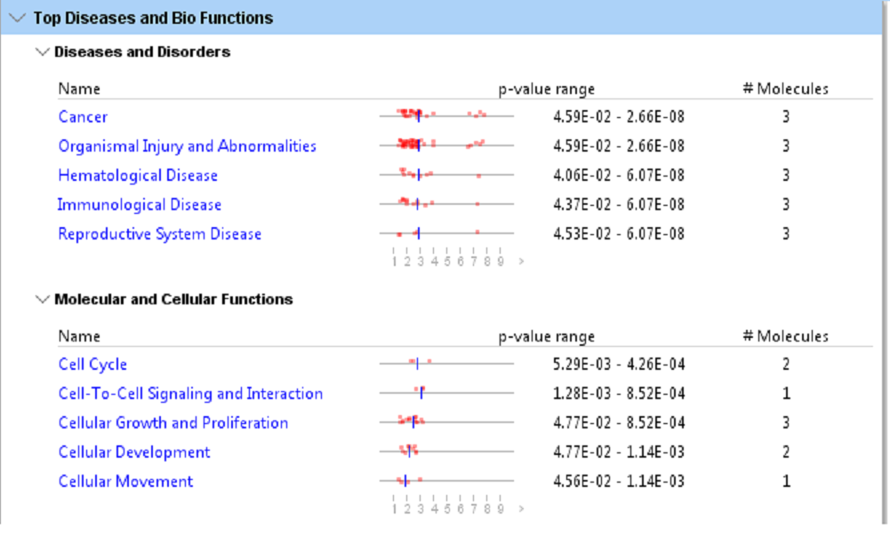
IPA Enrichment Pathway Analysis

Slide 25
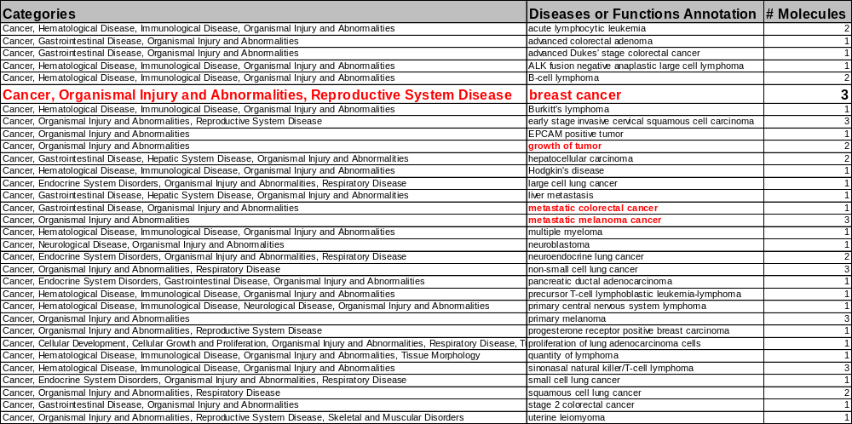
IPA – Diseases or Functions

Slide 26
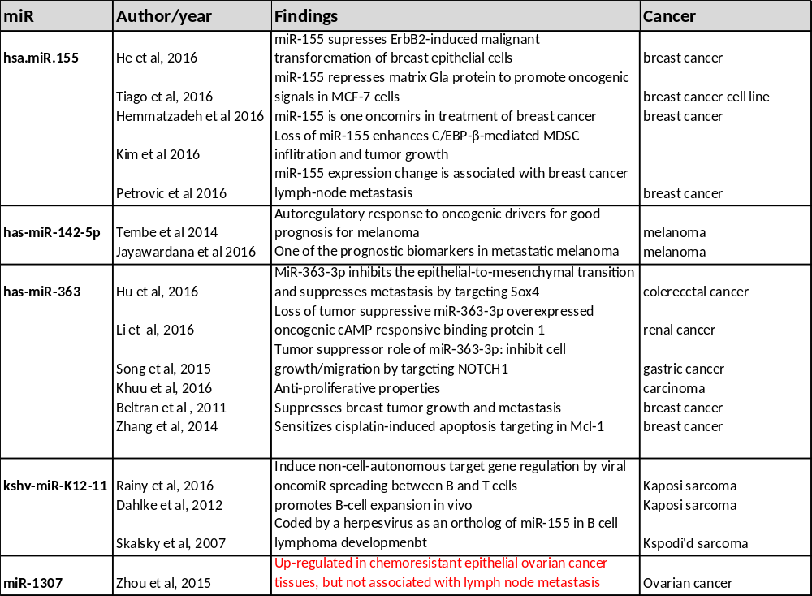
Recent Published Evidence

Slide 27
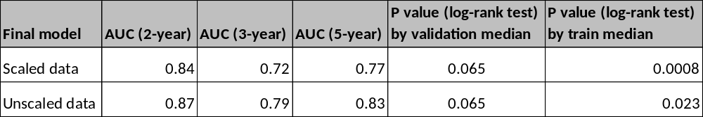
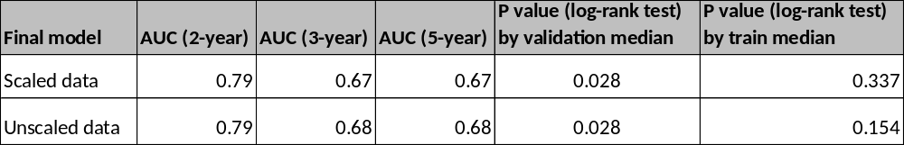
Final Model Validation (n=34)
Event: Recurrence/death
Event: Recurrence

Slide 28
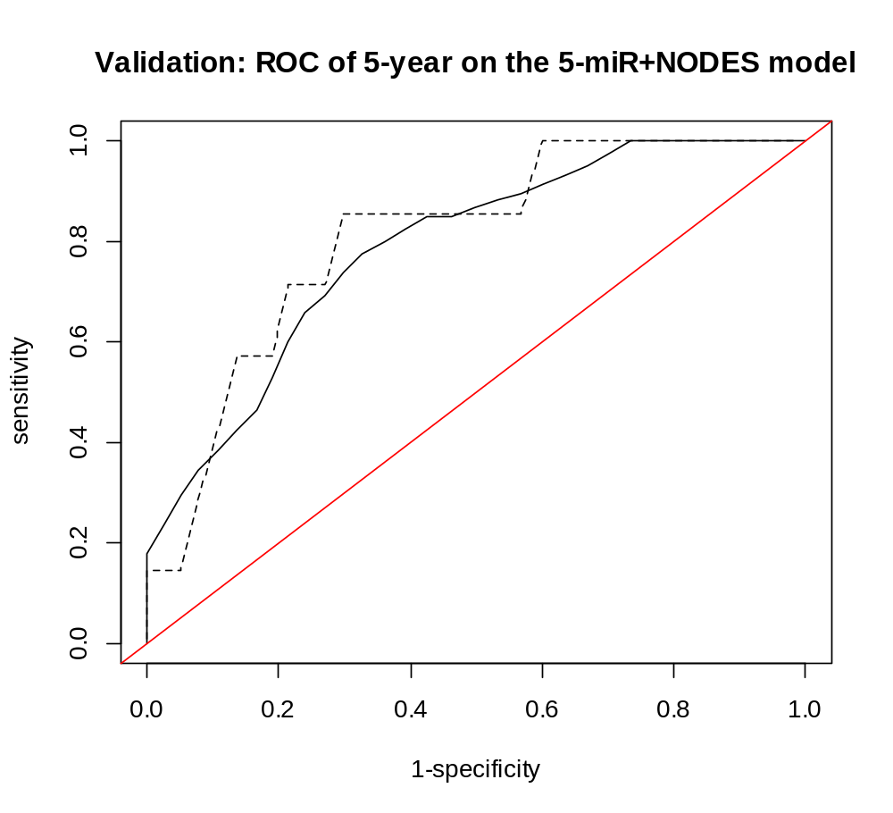
AUC=0.79
Sensitivity: P(high risk | event at time t);
Specificity = P(low risk | event-free at time t);
By cutoff of risk score = -0.04, sensitivity=80% and specificity = 64%.

Slide 29
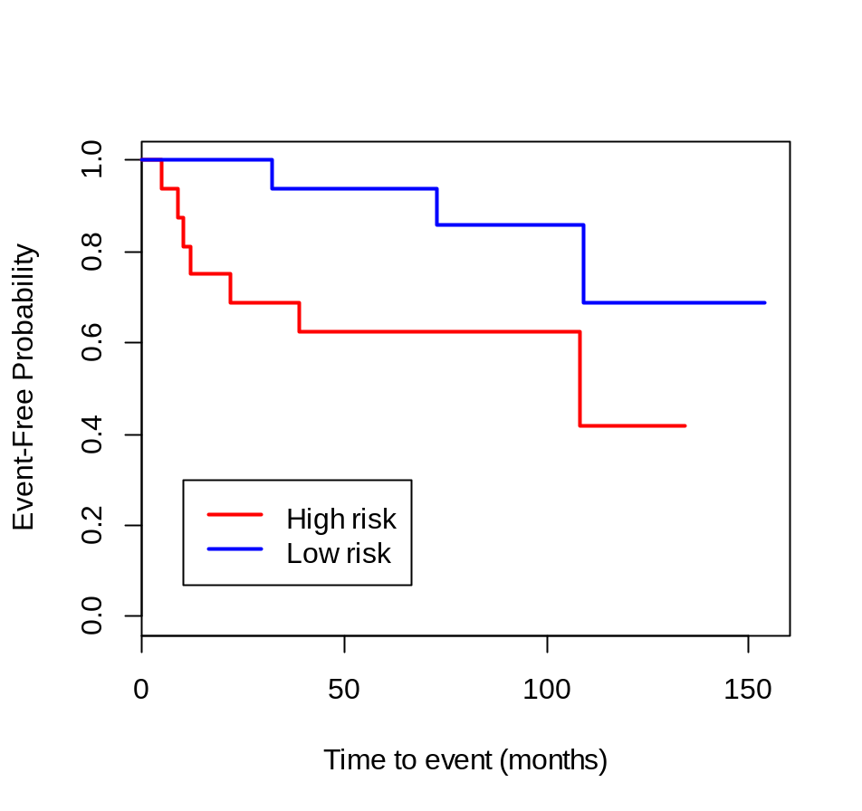
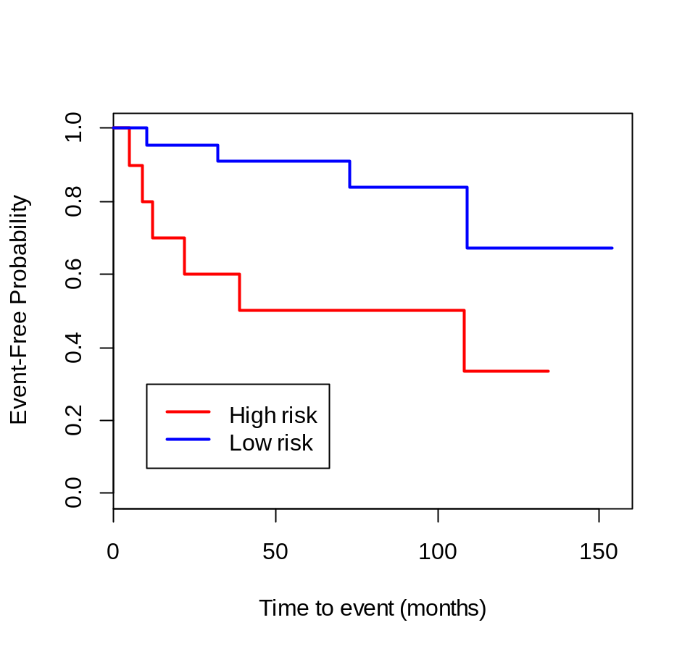
Validation Set
Cutoff: median of validation risk score
Cutoff: median of train risk score
P = 0.065
P = 0.023

Slide 30
Ongoing …
Any other predictive covariates missing?
Non-molecule predictors parallel to miRNA predictors?
Any covariates competing with miRNA biomarkers?
Covariates forced into the model, or involving in variable/selection?
Does the “final” model still need further variable selection in terms of their parameter estimate and P values?
More model selection methods?
Will the recommended model comparison procedure work for other public/published data?
Can the proposed miRNA signature be validated in other independent studies?

Slide 31
Reference
Heagerty PJ, Lumley T, Pepe MS. Time dependent ROC curves for censored survival data and a diagnostic marker. Biometrics 2000; 56: 337-44.
Simon RM, Subramanian J, Li MC, Menezes S. Using cross-validation to evaluate predictive accuracy of survival risk classifiers based on high-dimensional data. Briefings in Bioinformatics. 2011; 12(3): 203-214.
Tibshirani R. The lasso method for variable selection in the Cox model. Statist. Med.. 1997; 16: 385-395.
He XH, Zhu W, Yuan P, Jiang S, Li D, Zhang HW, Liu MF. miR-155 downregulates ErbB2 and suppresses ErbB2-induced malignant transformation of breast epithelial cells. Oncogene. 2016 Nov 17;35(46):6015-6025.
Tiago DM, Conceição N, Caiado H, Laizé V, Cancela ML. Matrix Gla protein repression by miR-155 promotes oncogenic signals in breast cancer MCF-7 cells. FEBS Lett. 2016 Apr;590(8):1234-41.
Hemmatzadeh M, Mohammadi H, Jadidi-Niaragh F, Asghari F, Yousefi M. The role of oncomirs in the pathogenesis and treatment of breast cancer. Biomed Pharmacother. 2016 Mar;78:129-39.
Kim S, Song JH, Kim S, Qu P, Martin BK, Sehareen WS, Haines DC, Lin PC, Sharan SK, Chang S. Loss of oncogenic miR-155 in tumor cells promotes tumor growth by enhancing C/EBP-β-mediated MDSC infiltration. Oncotarget. 2016 Mar 8;7(10):11094-112.
Petrović N, Kolaković A, Stanković A, Lukić S, Řami A, Ivković M, Mandušić V. MiR-155 expression level changes might be associated with initial phases of breast cancer pathogenesis and lymph-node metastasis. Cancer Biomark. 2016;16(3):385-94.
V. Tembe, S.-J. Schramm, M.S. Stark, et al. microRNA and mRNA expression profiling in metastatic melanoma reveal associations with BRAF mutation and patient prognosis Pigment Cell Melanoma Res, 28 (2014), pp. 254–266.
Jayawardana K, Schramm SJ, Tembe V, Mueller S, Thompson JF, Scolyer RA, Mann GJ, Yang J. Identification, Review, and Systematic Cross-Validation of microRNA Prognostic Signatures in Metastatic Melanoma. J Invest Dermatol. 2016 Jan;136(1):245-54.
Zhang R, Li Y, Dong X, Peng L, Nie X. MiR-363 sensitizes cisplatin-induced apoptosis targeting in Mcl-1 in breast cancer. Med Oncol. 2014 Dec;31(12):347.
Beltran AS, Russo A, Lara H, Fan C, Lizardi PM, Blancafort P.Suppression of breast tumor growth and metastasis by an engineered transcription factor. PLoS One. 2011;6(9):e24595.

Slide 32
Reference
13. Hu F, Min J, Cao X, Liu L, Ge Z, Hu J, Li X. MiR-363-3p inhibits the epithelial-to-mesenchymal transition and suppresses metastasis in colorectal cancer by targeting Sox4. Biochem Biophys Res Commun. 2016 May 20;474(1):35-42..
13. Khuu C, Sehic A, Eide L, Osmundsen H. Anti-proliferative properties of miR-20b and miR-363 from the miR-106a-363 cluster on human carcinoma cells. Microrna. 2016 Mar 22.
14. Song B, Yan J, Liu C, Zhou H, Zheng Y. Tumor Suppressor Role of miR-363-3p in Gastric Cancer. Med Sci Monit. 2015 Dec 28;21:4074-80.
15. Li Y, Chen D, Li Y, Jin L, Liu J, Su Z, Qi Z, Shi M, Jiang Z, Ni L, Yang S, Gui Y, Mao X, Chen Y, Lai Y. Oncogenic cAMP responsive element binding protein 1 is overexpressed upon loss of tumor suppressive miR-10b-5p and miR-363-3p in renal cancer. Oncol Rep. 2016 Apr;35(4):1967-78.
16. Rainy N, Zayoud M, Kloog Y, Rechavi O, Goldstein I. Viral oncomiR spreading between B and T cells is employed by Kaposi's sarcoma herpesvirus to induce non-cell-autonomous target gene regulation. Oncotarget. 2016 Jul 5;7(27):41870-41884.
17. Dahlke C, Maul K, Christalla T, Walz N, Schult P, Stocking C, Grundhoff A. A microRNA encoded by Kaposi sarcoma-associated herpesvirus promotes B-cell expansion in vivo. PLoS One. 2012;7(11):e49435.
18. Skalsky RL, Samols MA, Plaisance KB, Boss IW, Riva A, Lopez MC, Baker HV, Renne R. Kaposi's sarcoma-associated herpesvirus encodes an ortholog of miR-155. J Virol. 2007 Dec;81(23):12836-45.
19. Zhou Y, Wang M, Wu J, Jie Z, Chang S, Shuang T. The clinicopathological significance of miR-1307 in chemotherapy resistant epithelial ovarian cancer. J Ovarian Res. 2015 Apr 9;8:23.
20. Shimomura A, Shiino S, Kawauchi J, Takizawa S, Sakamoto H, Matsuzaki J, Ono M, Takeshita F, Niida S, Shimizu C, Fujiwara Y, Kinoshita T, Tamura K, Ochiya T. Novel combination of serum microRNA for detecting breast cancer in the early stage. Cancer Sci. 2016 Mar;107(3):326-34.
21. Cordero F, Ferrero G, Polidoro S, Fiorito G, Campanella G, Sacerdote C, Mattiello A, Masala G, Agnoli C, Frasca G, Panico S, Palli D, Krogh V, Tumino R, Vineis P, Naccarati A. Differentially methylated microRNAs in prediagnostic samples of subjects who developed breast cancer in the European Prospective Investigation into Nutrition and Cancer (EPIC-Italy) cohort. Carcinogenesis. 2015 Oct;36(10):1144-53.

Slide 33
Thanks to:
Dr. Charles L. Shapiro
Medicine, Hematology and Medical Oncology
Mount Sinai Health System
New York, NY
James Cancer Hospital and Solove Resarch Institute
The Ohio State University
Columbus, OH

