Slide 1

BIODIESEL APPLICATION AND BIODIESEL STANDARDIZATION IN CHINA
Research Institute of Petroleum Processing SINOPEC
Dec.6, 2016
1

Slide 2
CONTENT
1 Status and Development Trend of Biodiesel in China
2 Application Technology Study
3 Biodiesel Standardization in China
4 Predictions and Suggestions
2

Slide 3
1
Status and Development Trend of Biodiesel in China
3

Slide 4
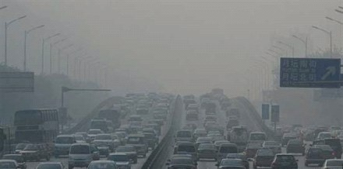
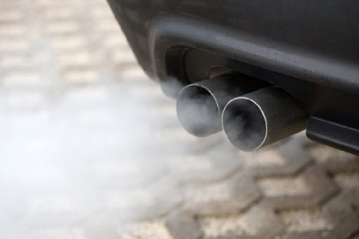
Particulate matter (PM) emission from diesel fuel vehicles makes great contribution to smog
At the mercy of the winds?

Slide 5
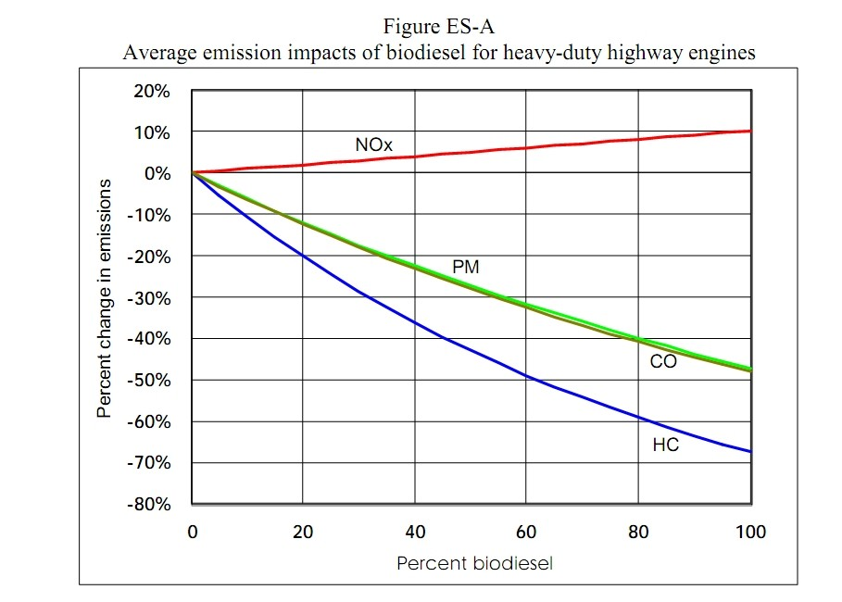
Biodiesel can decrease PM emission enormously , EPA’s report
source:http://www.epa.gov/otaq/models/analysis/biodsl/p02001.pdf.

Slide 6


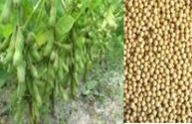

BIODIESEL：Fatty Acid Methyl Esters (FAME)
CH₂OCOR' CHOCOR"
CH₂OH CHOH
催化剂
R'COOCH₃
cat
³ CH₃OH
R"COOCH
3
CH₂OCOR'"'
Vegetable oil or Animal fat
（triglycerides ）
CH₂OH
R"'COOCH₃
Methanol
KOH glycerin
FAME
Material of biodiesel：
EU
R_{R}a_{a}p_{p}e_{e}s_{s}e_{e}e_{e}d_{d}o_{o}i_{i}l_{l}
US
S_{S}o_{o}y_{y}b_{b}e_{e}a_{a}n_{n}o_{o}i_{i}l_{l}

Slide 7




Other Advantages of Biodiesel
Alternative for fossil fuels
Lowering the greenhouse gas emissions
High flash point
Reducing the import of petroleum
Safely reuse waste oil
_{Renewable}
_{Environmentally}
_{-friendly}
Biodiesel
_{Safe to use}
Increasing diesel
production
Food security

Slide 8
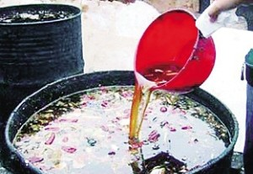
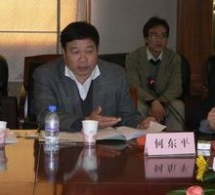
3 million tons of gutter oil is eaten yearly in China
Source: Prof. He Dongping from Wuhan Polytechnic University

Slide 9
China Biodiesel Feedstock: Waste oil
4 kinds of waste oil in China
Acidified oil
Byproducts of vegetable oil company. COFCO, China’s leading vegetable oil producer, has 400,000~500,000 t/y
Sewage oil
Oil recovered from restaurants kitchen sewage system
(3) Leftover oil
Oil recovered from the leftovers of restaurants
50 million tons/year
(4) Used cooking oil
Frying oil from some food processing plants and certain kinds of restaurants such as KFC and McDonalds
9

Slide 10
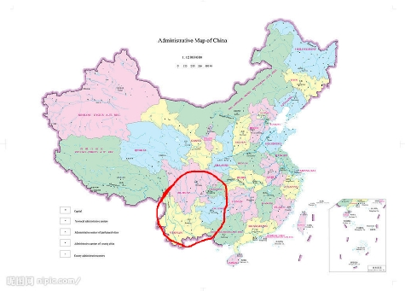
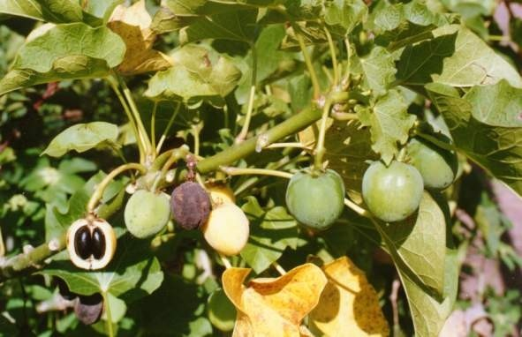
China Biodiesel Feedstock: wood-plant oil
Jatrophaa (麻风树）
Yunnan, Guizhou, Sichuan
10

Slide 11
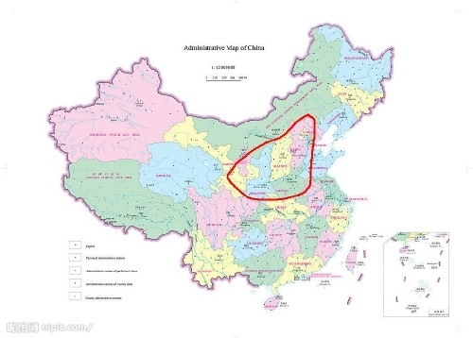
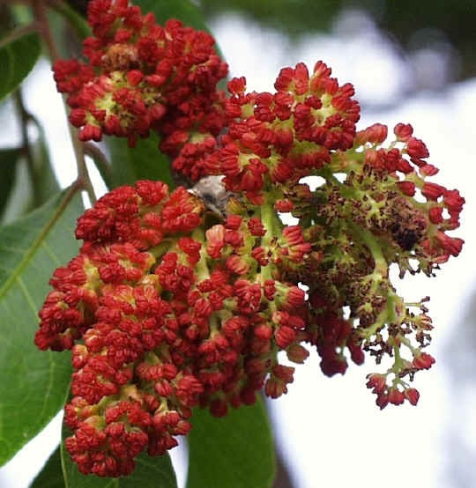
China Biodiesel Feedstock: wood-plant oil
Pistacia Chinesis Bunge（黄连木）
Hebei, Shanxi, Henan, Shannxi
11

Slide 12
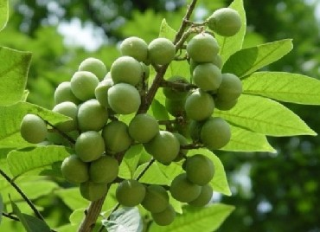
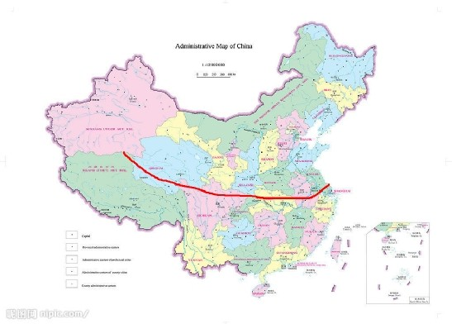

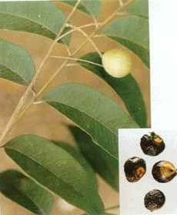
China Biodiesel Feedstock: wood-plant oil
Sapindus mukorossi Gaerth (Chinese Soapberry Seed，无患子 )
South Part of China
12

Slide 13
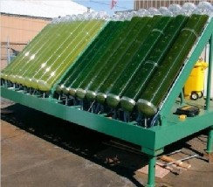




China Biodiesel Feedstock: algae
13

Slide 14






Government Support
producers
Law
Renewable Energy Law
2006
Consumption tax
Tax Exemptions
Subsidies
>70%
waste oil as
feedstock
Value-added tax
Investment
subsidy
20%
investment
Ministry of Finance
14

Slide 15


2015 Biodiesel Production
19,600, 2%
Production 800,000 tons
y
182,000, 23%
87,000, 11%
507,000, 64%
Production Capacit 2,584,000 tons
Sewage oil Leftover oil Acidified oil others
Source: http://www.chinabd.org.cn/
15

Slide 16














Production and Development Trend
Production |  | Capacity
93,000 tons
150,000 tons
140,000 tons
150,000 tons
80,000 tons
80,000 tons
60,000 tons
100,000 tons
40,000 tons
60,000 tons
Source: http://www.chinabd.org.cn/
16

Slide 17
Main Obstacles
Lack of raw materials
Lack of mandatory standards
Both of BD100 and B5 are voluntary standards at present
Technical obstacles
oxidation stability material compatibility
17

Slide 18
Application Technology Study
2
18

Slide 19




Main Projects
National 863 scheme
Projects from Sinopec
Projects from SAC
Projecs from NEA

Slide 20


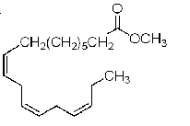
Study Examples
Oxidation and antioxidants Why?
Methyl oleate
Methyl linoleate
Methyl linolenate
Unsaturated FAME
How to do?
We developed a series of antioxidants
We applied 33 patents including PCT, USP,and EP

Slide 21
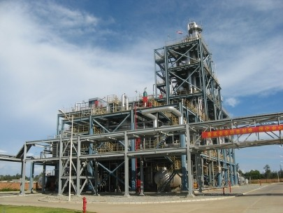
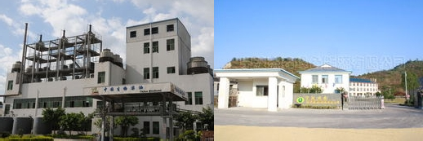
Antioxidant S-1403
10tons used in CNOOC’s Hainan biodiesel plant
industrial test in Zhuoyue Biodiesel Co. in Fujian and Jiesen Biodiesel Co. in Zhejiang
CNOOC, Hainan plant
21

Slide 22
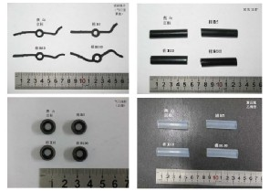

Material Compatibility Study
Metal corrosion of biodiesel and biodiesel blends
Swelling property of rubber and plastics
Results and suggestions
Change some kinds of metals and rubbers
Blend less than 10% biodiesel into diesel fuels

Slide 23







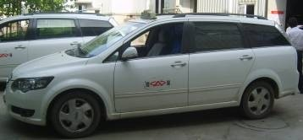

Field Test of Biodiesel
Nanjing IVECO Co.
Chery Automobile Co
B5
B10
B5
B10
B20
B20
Conclusion
No negative effect when biodiesel content is no more than 10%

Slide 24
3
Biodiesel Standardization in China

Slide 25
Biodiesel National Specification
Introduction of the project
Sponsored by SAC
(Standardization Administration of the People's Republic of China ) and SINOPEC
Organized by SAC/TC280/SC1
(TC280:Technical Committee 280 on Petroleum Products and Lubricants; SC1:Subcommittee 1 on Petroleum Fuels and Lubricants)
Two standards for the two products of biodiesel BD100
B5
25

Slide 26
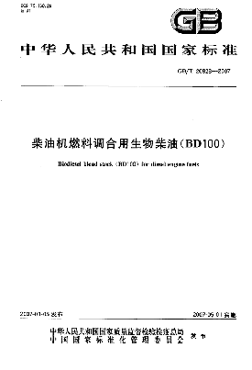
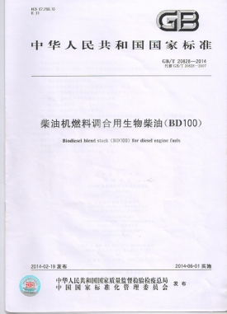
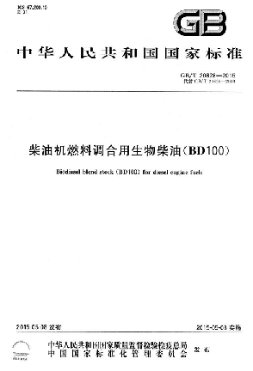
BD100 Specification of China
Standard No. GB/T 20828
Reversion of BD100 is still going on
26

Slide 27
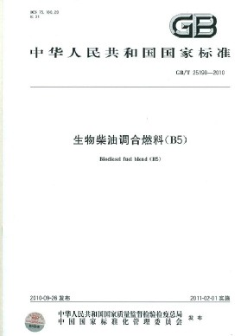
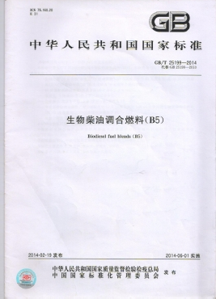
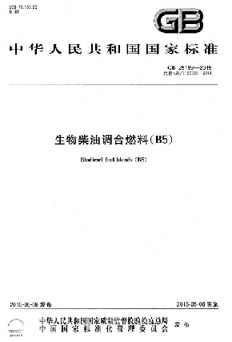
B5 Specification of China
Standard No. GB/T 25199
Reversion of B5 is still going on
27

Slide 28
•Test Methods Standardization of Biodiesel in China
Oxidation Stability of Biodiesel Test Method Standard
Based on EN 14112:2003(Rancimat)
As a petrochemical standard (NB/SH/T 0825-2010)
FAME Content in Middle Distillates Test Method Standard
Based on EN 14078:2003(Infrared spectrometry) As a national standard (GB/T 23801-2009)

Slide 29
•Test Methods Standardization of Biodiesel in China
Oxidation Stability of Biodiesel Blend Test Method Standard
Based on EN 15751:2009
As a petrochemical standard (NB/SH/T 0873-2013)
Oxidation Stability of Biodiesel Blend Test Method Standard
Based on ASTM D7462-11
As a petrochemical standard (NB/SH/T XXXX)

Slide 30
4
Predictions and Suggestions

Slide 31
Chinese government will continue supporting biodiesel industries because of the severe air pollution
Biodiesel productivities are decreasing due to the price of crude oil
Public transportations in big cities should use biodiesel as demos
Developing new profitable products with biodiesel

Slide 32
Thank You for Your Attention!
Questions and Suggestions?
32

