Slide 1
Can we improve MRI detection sensitivity by 2 to 3 orders?
Jiani Hu, Ph.D
Wayne State University
Detroit, Michigan
(313) 993-7947
jianihu@yahoo.com
jhu@med.wayne.edu

Slide 2
MRI is a favorable imaging modality:
non-invasiveness
excellent soft-tissue contrast
morphological imaging
functional imaging

Slide 3
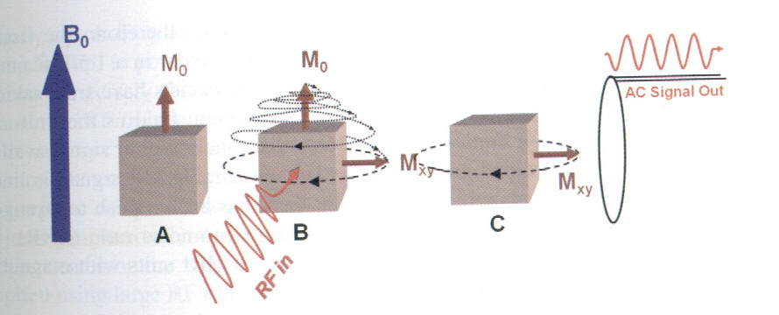
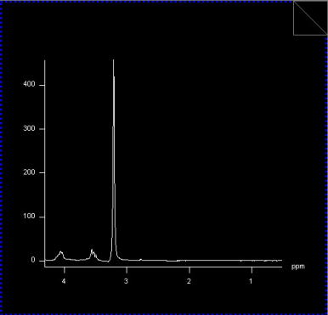
B
o
M_{o}
net magnetic moment is positive
ω=γB
Very small %1H behave like small magnet => NMR, MRI

Slide 4
MRI is fundamentally a low-sensitivity technique:
Information from a few ppm of water.
Disadvantage of low sensitivity:
long scan times
low resolution imaging
expensive equipment

Slide 5
Improving detection sensitivity -- a constant topic
Increase the static magnetic field -- linearly, expensive;
Multi-channel/multi-coils -- small coil improving sensitivity;
Lowering coil temperature -- reducing noise level;
Lowering temperature of sample -- 100,000 times;
Hyperpolarized gas (³He and ¹²⁹Xe) MRI -- 0.1million times
magnetic resonance force microscopy -- 100 million times

Slide 6
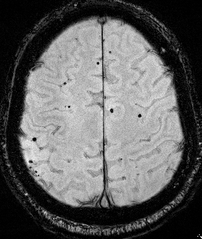
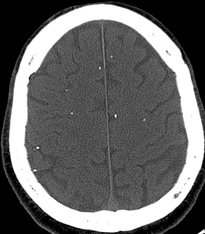
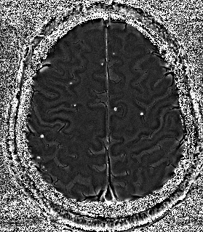
Common feature of current methods:
Modification of hardware
Our hypothesis: MRI detection sensitivity can be improved by combining phase information and high susceptibility without any hardware modification to an existing MRI scanner.
Cysticercosis
SWI B. CT C. Phase image

Slide 7
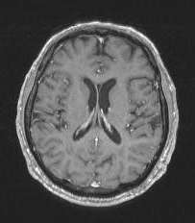
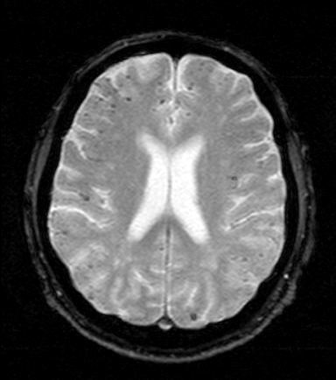
MRI blooming effect?
A: T1-MRI B:T2*-MRI
cerebral amyloid angiopathy (CAA) patient.

Slide 8
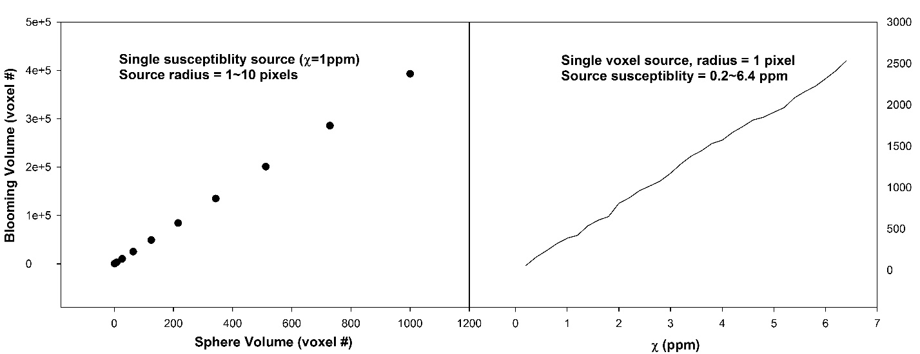
Hypothesize: phase blooming effect can improve detection sensitivity by 100 to 1000 times without any new hardware.
Computer Simulation:
(a)
(b)
Relationship between the source susceptibility level and the blooming effects. With a 1ppm and 3ppm susceptibility value, the volume of the blooming effect are about 300 and 1000 times that of the original object size, respectively.

Slide 9
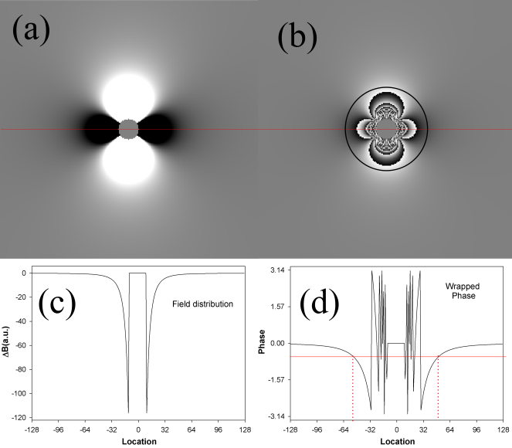
Computer Simulation: A 614-fold increase in 3D volume by phase blooming effect
Field distribution (a) and phase map (b) of simulation, and the responding signal profiles (c&d).
Circle: SNR = 3
TE : 20 ms
Susceptibility = 5ppm
The size of the phase blooming effect was about 8.5 times the sphere in term of radius along one single dimension => a 614-fold increase in 3D volume detection sensitivity.

Slide 10
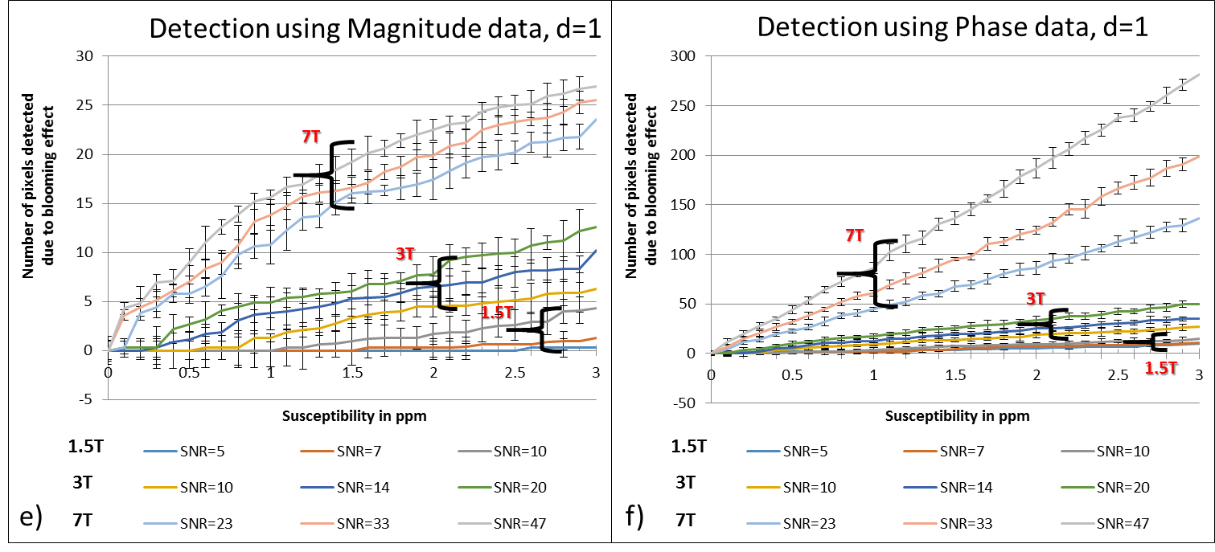

Slide 11
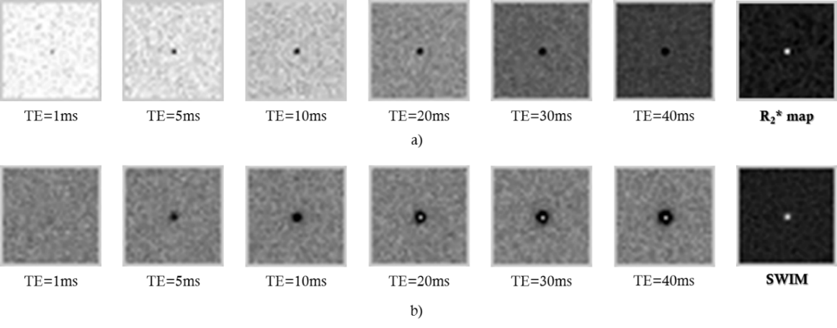
Appearance of a 1 voxelCMB at 3T for magnitude and phase images as the product of susceptibility (=3 here)*TE.
a) Simulated magnitude images and b) simulated phase images at different TEs. R2* maps and susceptibility maps (SWIM) appear at the end of rows one and two, respectively

Slide 12
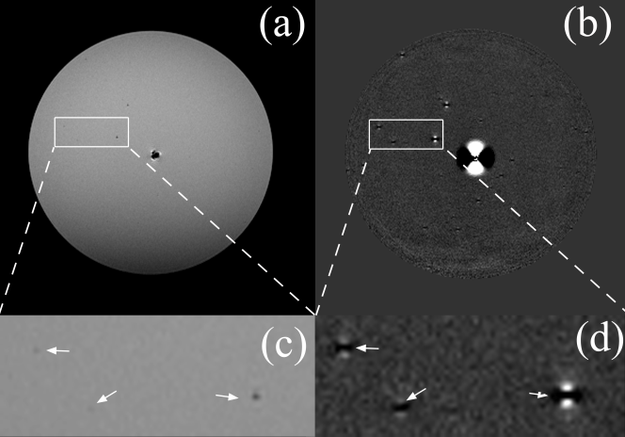
Phantom study
Blooming effect was about 8.0 times larger in radius for the ferritin filled straw. (c) and (d) show the zoomed regions from (a) and (b) respectively. There are about 14 such small bubbles in this single slice that are visible in the phase image but only two can be positively identified in magnitude image while the others were either barely visible or not seen at all.

Slide 13
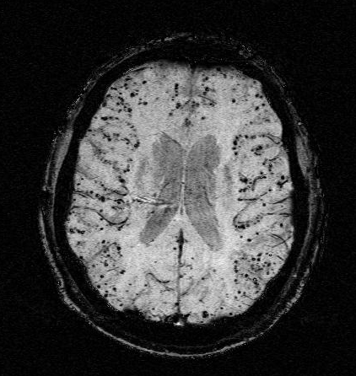
MRI blooming effect?
A: T1-MRI B:T2*-MRI Phase-SWI
cerebral amyloid angiopathy (CAA) patient.

Slide 14
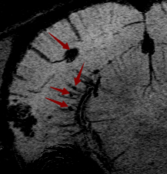
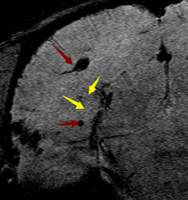
MRI blooming effect
Phase-SWI at week 10 after bleeding
T2* at week 10 after bleeding
Illustration of the capability of SWI to precisely pinpoint damaged vessels in SHRSP rats. SWI at week 10, show one big, one small and two micro-bleeds ( the 4 red arrows); and T2*-MRI with the same TE=2.72ms as qSWI at week 10, showing one big and one small bleeds (the 2 red arrows). In SWI, for each bleed, there is a vessel directly connecting to it. While in T2*-MRI , there is no visible vessels connecting to small or micro-bleeds.

Slide 15
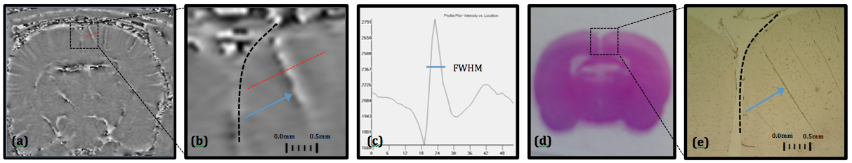
Illustration of a 1000-fold increase in 3D volume by phase blooming effect in Sprague-Dawley rat using P904 contrast agent. A) post contrast SWI phase image with a TE of 2.72 ms acquired at a 7T preclinical scanner; B) zoomed region of interest; C) the phase intensity profile of the red line in (b); D) corresponding histological slice of (a) at 10x magnification; E) region of interest zoomed to 40x magnification. Vessel of interest is labeled in (b) and (e) with blue arrow.

Slide 16
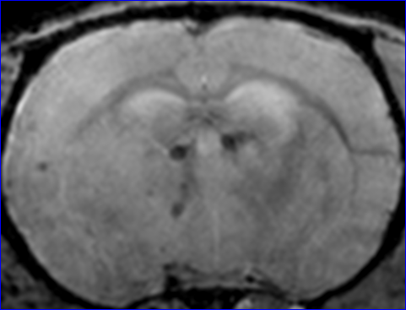
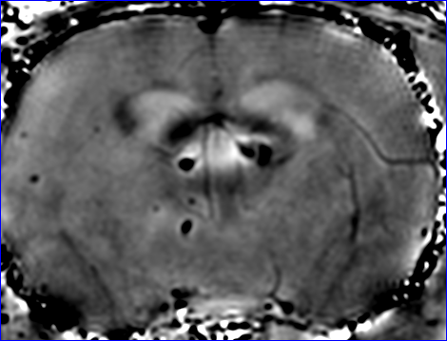
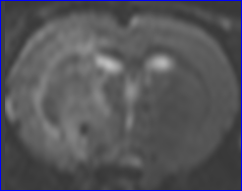
Cellular MRI
T2*-magnitude Phase T2-MRI
Neural progenitor cells (NPCs, Theradigm Inc) were labeled with a Ferrumoxide-protamine sulfate complex [Arbab, 2004, Blood 104:1217]. Male wistar rats (n=4) weighing 270~300 g were employed in our experiments. Two hours of middle cerebral artery (MCA) occlusion was induced using a method of intraluminal vascular occlusion. 1x10⁶ NPCs in 1 ml total fluid volume of PBS were injected intravenously 24 hours after stroke. MRI measurements were performed using a Bruker 7 T. Three dimensional gradient echo images were obtained with TR of 40 ms, TE of 10 ms, 30° of flip angle, and a 32x32x16 mm field of view. The 256x192x64 voxel matrix was interpolated to 256x256x64 voxel (0.125x0.125x0.25 mm) for analysis.

Slide 17
The potential: cellular, molecular imaging
If current MRI detection threshold is 100,000 cells, the "new" detection sensitivity could be improved to 100 cells.
Such capability could change the paradigm of how we acquire cellular/ molecular MRI today.
Early cancer detection using targeted delivery of iron-based contrast agent:
Stem cells
Nanoparticle based delivery system.
The clinical significance

Slide 18
Acknowledgments
Horea Calimente
E. Mark Haacke
Quan Jiang
Zhengang Zhang
Zach Dell
Tianwu Chen
Qing Lu
Haoyu Wang
Mattew Amans
Wenzheng Feng
Zahid Latif
Yimin Shen
Yang Xuan
Kui Luo
Jiajun Wang
Guojun Wu
Yongquan Ye
Zhifeng Kou
Chuanming Li
Hong Li
Lianmin Wu
Wanlong Pan
Xinghui Li
Yanwei Miao
Bisher Tarabishy
Yanming Yu

