Slide 1
Strategic Partnerships
for Biologics RD
James Yang, Ph.D.
International Conference on
Biologics and Biosimilars
Beijing, August 10-12 2017

Slide 2
Forward-Looking Statements
This document contains forward-looking statements. All statements other than statements of historical facts
contained in this document, including statements regarding possible or assumed future results of operations,
business strategies, development plans, regulatory activities, competitive position, potential growth opportunities,
use of proceeds and the effects of competition are forward-looking statements. These statements involve known
and unknown risks, uncertainties and other important factors that may cause the actual results, performance or
achievements of Abpro Corporation (the “Company”) to be materially different from any future results,
performance or achievements expressed or implied by the forward-looking statements. In some cases, you can
identify forward-looking statements by terms such as “may,” “will,” “should,” “expect,” “plan,” “aim,” “anticipate,”
“could,” “intend,” “target,” “project,” “contemplate,” “believe,” “estimate,” “predict,” “potential” or “continue” or the
negative of these terms or other similar expressions. The forward-looking statements in this presentation are only predictions. The Company has based these forward-looking statements largely on its current expectations and projections about future events and financial trends that it believes may affect the Company’s business, financial condition and results of operations. These forward-looking statements speak only as of the date of this presentation and are subject to a number of risks, uncertainties and assumptions, some of which cannot be predicted or quantified and some of which are beyond the Company’s control. The events and circumstances reflected in the Company’s forward-looking statements may not be achieved or occur, and actual results could differ materially from those projected in the forward-looking statements. Moreover, the Company operates in a dynamic industry and economy. New risk factors and uncertainties may emerge from time to time, and it is not possible for management to predict all risk factors and uncertainties that the Company may face. Except as required by applicable law, the Company does not plan to publicly update or revise any forward-looking statements contained herein, whether as a result of any new information, future events, changed circumstances or otherwise.

Slide 3
Outline
Overview
Strategic Partnership for Success
Future Trends

Slide 4
I. Overview
Global Biologics Market
In next two years
  50% top drugs ( out of 100 ) to be biologics
  World wide sales for biologics: $215B
  Biologics to grow at 300% rate (vs chemical drugs)

Slide 5
Trend for Marked Drugs
Status
Future Trend
Small molecule
(Chemicals)
(~90%)
Small Molecules
(Chemicals)
(50%)
Large Molecules
(Biologics)
(50%)
Large Molecule
(Biologics)
(~10%)

Slide 6
Biologics Trends
Tremendous unmet medical needs
Projected strong about 20% annual growth through 2020
mAb and recombinants protein biologics grow faster than other type drugs
Oncology and immunology accounting for most of mAb market
Biologics capability improving and growing-up partnership opportunities
Hurdles remain and competition intensifying
  Global high prices
  Speed to market
  Internal imbalanced biologic RD capability
  Regulatory process– product quality standard higher

Slide 7
II. Strategic Partnership for Success
Why needs Partnership for ?
Biologics Development – Complex system
Diverse Expertise needs
No single biopharma company does everything
Timeline and high competition
History successful examples in biologics

Slide 8
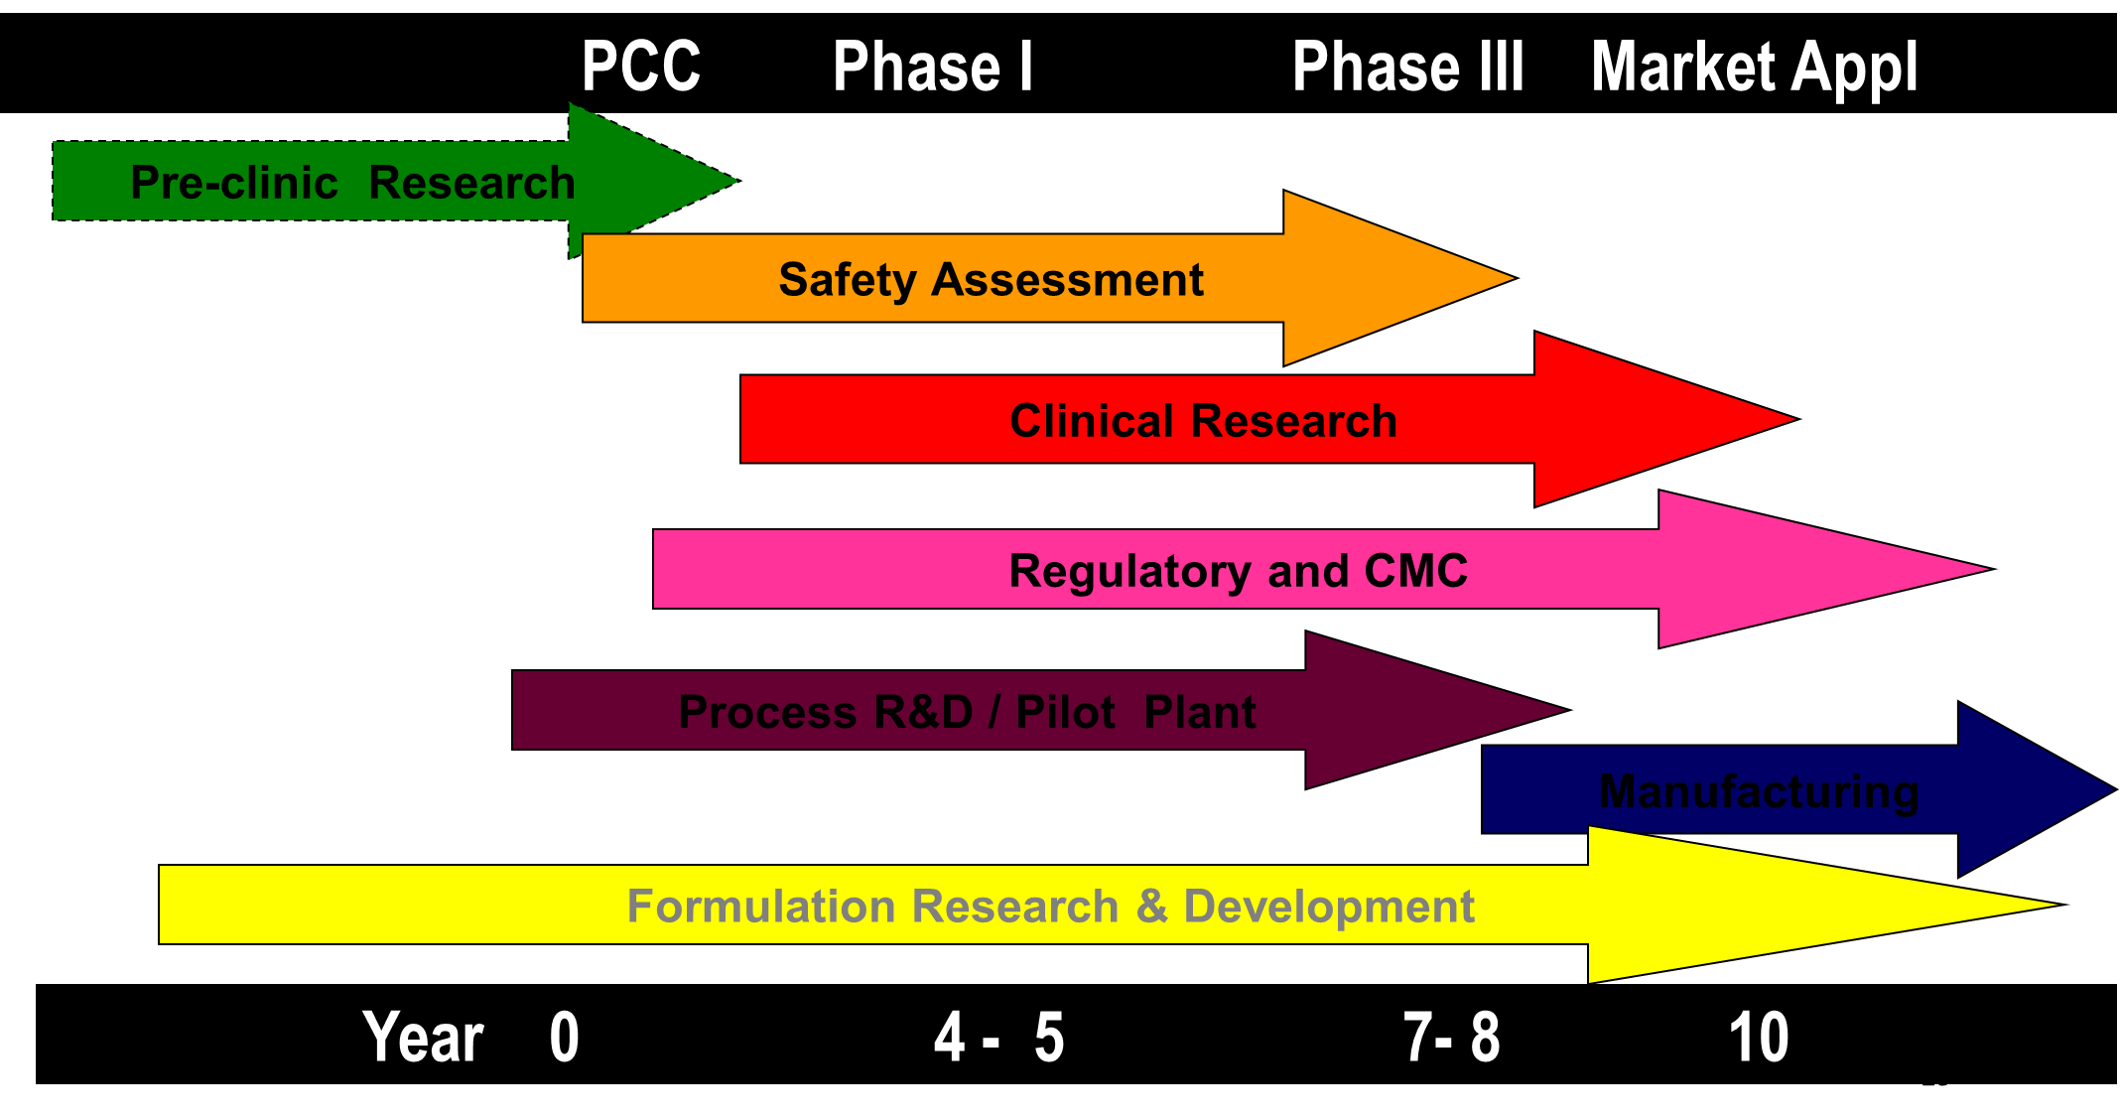
Biologic Drug Development
Co-development or partnership can be at any stage

Slide 9
Partnership for Biologic Drug RD
Biotech for drug discovery
Academics
CRO and CMO
Big pharma for drug development and Commercial
Hospitals for clinic trial site
Drugs on Market

Slide 10
Types of Partnerships
Co-Development
Biotech / biopharma
Different drug development stage
Outsourcing Partnerships
Biopharma / CRO or CMO
Multiple stages
Company and University
University for early discovery and biopharma for later stage /commercialization
Very popular in US pharma industry RD
Biopharma for discovery and University for later stage ( rare case: MassBiologics– only University owns for CMO for biopharma, in US)

Slide 11
Fast Biologic Development Pathway
Collaboration with Small biotech
for Pre-clinic Development
External CMO
(if internal resources limited)
Development ( internal)
IND filing

Slide 12
Historical Success Examples in Biologics
  Tysabri: Dveloped by Biogen and Elan
  Eylea （fusion protein： Vegf-trap) : development by Regeneron and Bayer
  Campth : developed by ILEX / Berlex, but later purchased by Genzyme ( now Sanofi)
  Humira: Antibody was discovered by partnership between BASF Bioscience ( a unit of BASF) and Cambridge Antibody Technology ( now AZ) , and then, BASF pharma ( BASF Knoll) further developed the antibody as Humira drug, and then, Abbott lab acquired BASF Pharma in 2000 ( now AbbVie owns)
  Sygnagis: Medimmune ( now AZ) developed, and Abbott labs did initial launched on market as partnership for a few years

Slide 13
Abpro Partnership Strategies
Co-development:
  Abpro: discover innovative therapeutic antibody molecules
  Partners: pre-clinic study, phase 1 to 3 , and commercialization
Licensing:
  Partners license-in Abpro later stage antibody projects (near IND) for clinics and commercialization
Partnership during clinical trials:
  Abpro and Partners: Phase 1-3 and commercialization
Others:
  Any combinations with above three ways

Slide 14
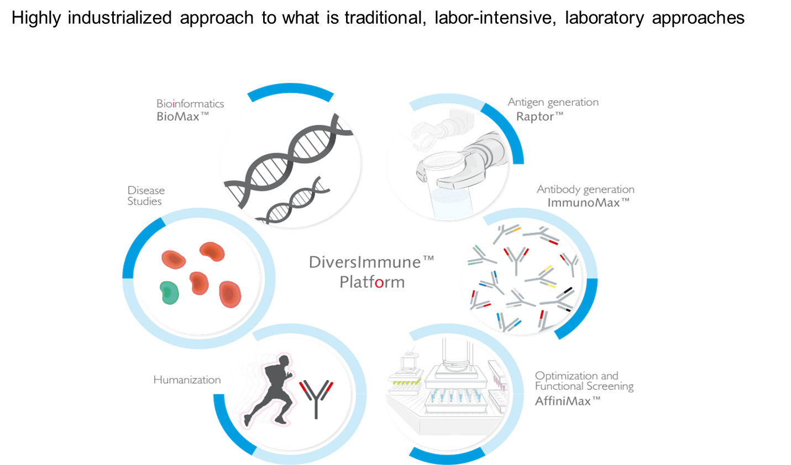
Abpro Antibody Platform

Slide 15
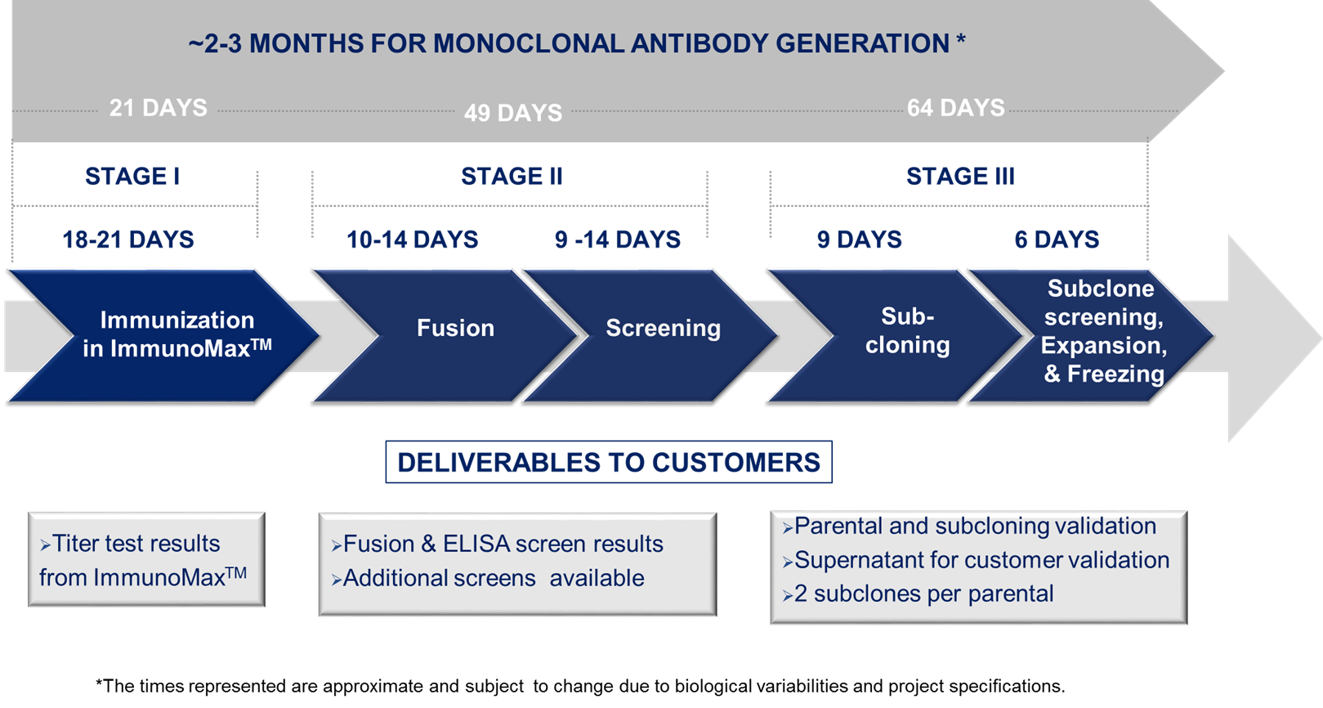
Accelerates mAb Generation

Slide 16
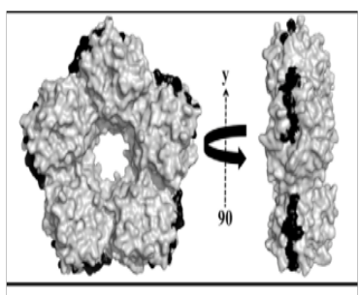
Partnership Example 1
(Nature 468, 93-97, 2010)
Project objective:
  Produce an IgG2a monoclonal antibody that binds to human
  serum amyloid P component (SAP) in vitro and in vivo
Target antibody meets criteria:
  Monoclonal IgG2a, Abp1, recognizes
  conformational specific epitope in human SAP (black) -
  Affinity K_{D} at 1-5 x 10⁻⁹ M
  Efficacy proven -
AMYLOID SCORE
(median, range)
Group (treatment, Size)
Spleen
Liver
1) Negative control
4.08, 1.5-4.50
2.42, 2.0-2.67
2) Positive control
1.17, 1.0-1.5
1.0, 0.67-1.17
3) Abp1
1.25, 1.0-2.0
1.0, 1.0-1.33
Anti-SAP antibody was successfully used on phase 1 clinic study

Slide 17
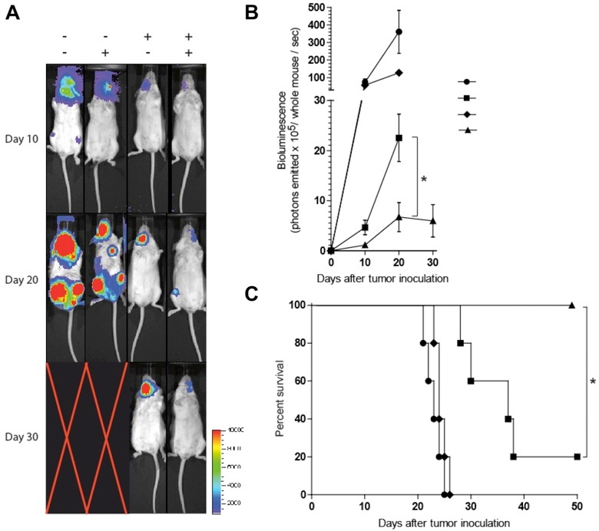
Partnership Example 2
Case Study 2: Project X1 in Vivo
Abpro Project X1
mAb1
mAb2
no treatment
mAb1
mAb2
Bispecific Ab
$10B Market Size
Synergistic effects
Increased survival
Bispecific antibody
This bispecific antibody is on phase 1 clinic study by pharma partner

Slide 18
More Partnerships on Antibody Drug RD
MedImmune and Abpro Enter Into a Collaborative Agreement for a Novel Bispecific Antibody
GAITHERSBURG, Maryland and WOBURN, Massachusetts, November 29, 2016 /PRNewswire/ --
Agreement to Result in New Spin Out Company, AbMed, as Subsidiary of Abpro
MedImmune, the global biologics research and development arm of AstraZeneca, and Abpro, an integrated life sciences company at the forefront of synthetic biology, today announced they have entered into a collaborative agreement to advance the development of a preclinical, novel bispecific antibody targeting angiopoietin-2 and vascular endothelial growth factor (Ang2-VEGF). The agreement is structured as a spin out, benefiting from both companies' scientific expertise and Abpro's day-to-day leadership as it oversees the new company, AbMed.
Abpro Announces Agreements with Two Boston Hospitals to Co-develop Therapeutics for Inflammation, Autoimmunity, Fibrosis and Oncology
BUSINESS WIRE MAY 19, 2016 5:02 AM
WOBURN, Mass.–(BUSINESS WIRE)–May 19, 2016–
Abpro, an integrated life science company at the forefront of synthetic biology, today announced co-development agreements with Massachusetts General Hospital (MGH) and Brigham and Women’s Hospital (BWH), two of the country’s leading academic medical centers. By leveraging Abpro’s DiversImmune™ platform, Abpro will co-develop multiple monoclonal antibodies with MGH for use in its oncology and inflammation and autoimmunity research programs and with BWH for its fibrosis research, according to these independent and separate agreements.
Abpro Announces Investment and Partnership with Essex Bio for Development of Antibody Therapeutics
April 06, 2016 08:00 AM Eastern Daylight Time
WOBURN, Mass.--(BUSINESS WIRE)--Abpro, an integrated life science company at the forefront of synthetic biology, today announced a partnership with Essex Bio, a China-based biopharmaceutical company. Abpro and Essex will co-develop multiple monoclonal antibodies in immuno-oncology and ophthalmology by leveraging Abpro’s DiversImmune™ platform. Abpro received a $3.5M equity investment from Essex Bio and an undisclosed amount from affiliates, as part of the agreement.

Slide 19
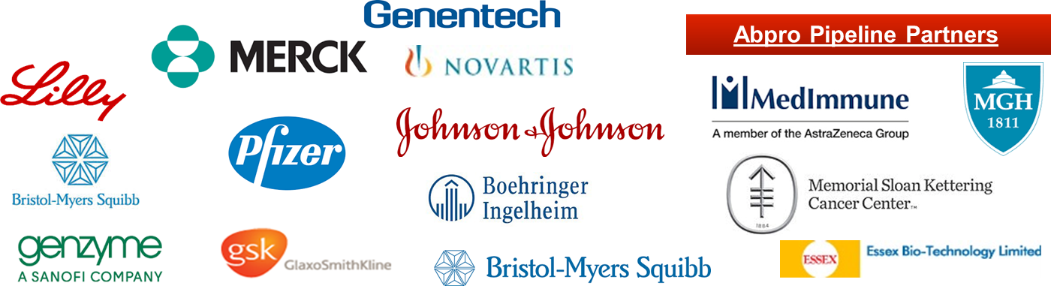
Abpro Partners

Slide 20
III. Future Trends
Highly challenged in biologics industry will drive more dynamic partnerships in biologics market
Academics and company collaboration on early biologic drug discovery will be very popular trend
All biopharma companies have to be partnered somehow for biologics development
A company to develop biologics by internal source ONLY will be behind in biologics industry
Abpro, one of top biotech companies, as an ideal partner for innovative antibody drug development
Strategic partnership will be a key for success in Biologics

Slide 21
Thank You

