Slide 1

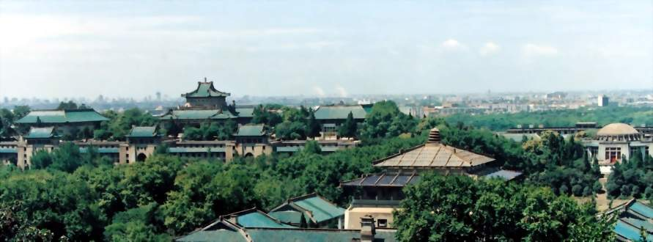
The 2nd International Conference on Transcriptomics
Gene Expression Changes in Rice
Developing Ovule, Embryo and Endosperm
Jianbo Wang
Wuhan University, China

Slide 2
Outline
Background
Materials and methods
Gene expression in developing ovules of rice
Gene expression in developing embryos of rice
Gene expression in developing endosperm of rice

Slide 3
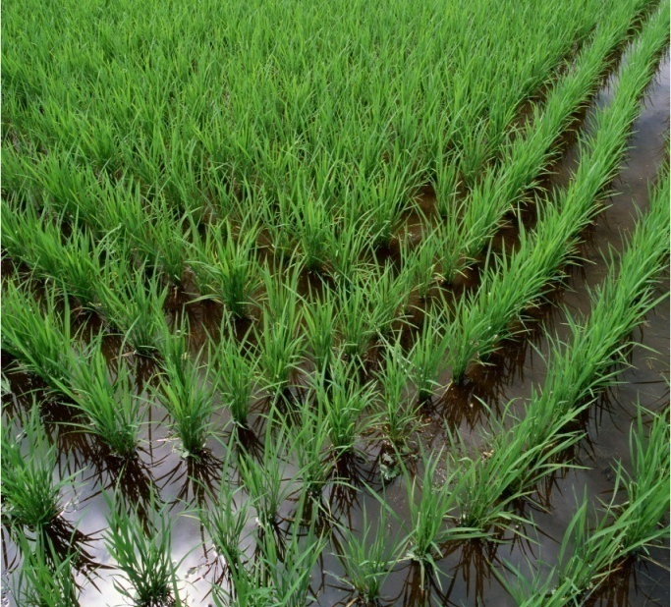
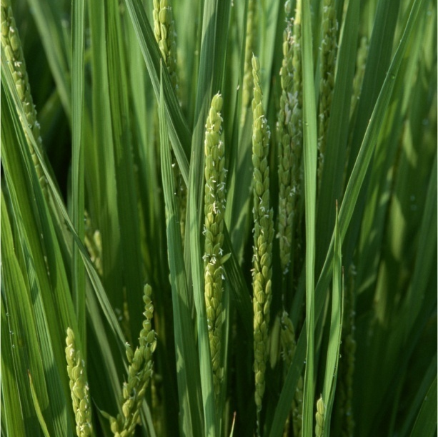
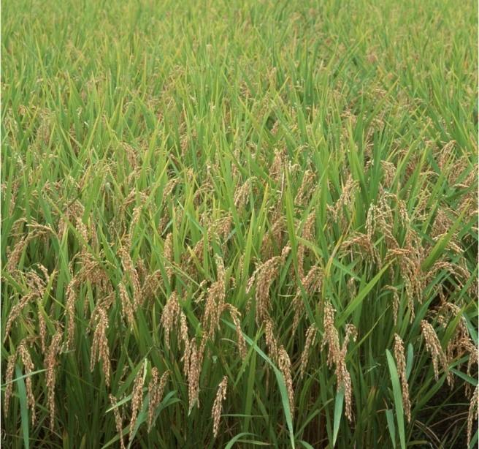
1. Background
 Rice (Oryza sativa L.) is one of the most important crops.
 Studies on the molecular mechanisms for rice reproductive development is necessary for biology and rice yield improvement.

Slide 4
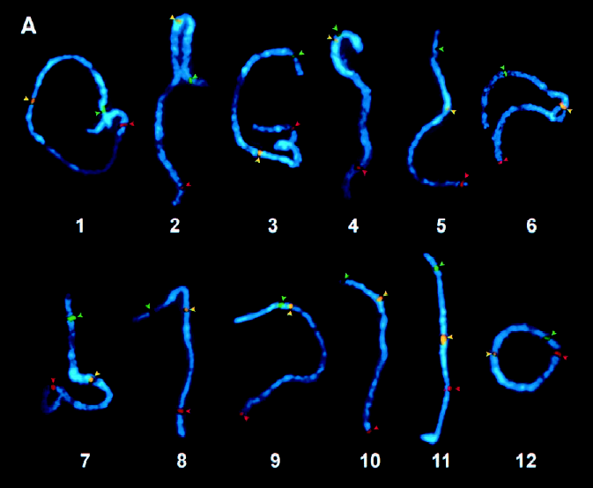
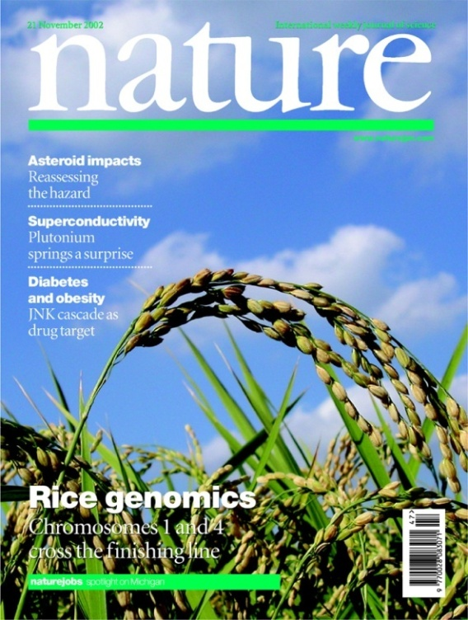
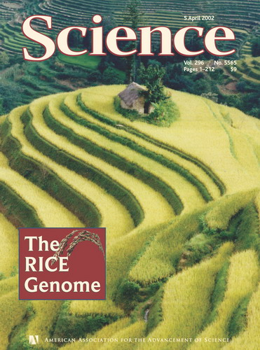
Rice is also one of the most important model plants.
Chromosome number 12
Genome size ~ 430 Mb
Gene number ~50,000

Slide 5
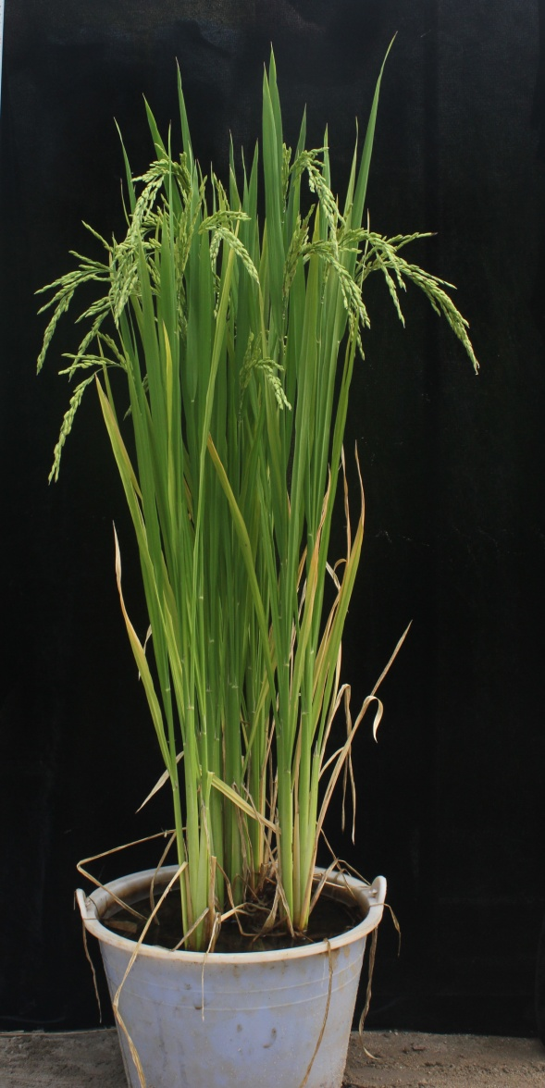
2
Materials and methods
Materials: Rice
Oryza sativa L.ssp. indica cv. 9311

Slide 6
RNA-seq flowchart
Total RNA extraction
Sequencing
Enriched mRNA
200nt mRNA fragments
cDNA library
PCR amplification
Illumina sequencing

Slide 7
Bioinformatics analysis
Raw date
Clean reads
Mapping to reference genome
Rice genome
Sequencing evaluation
Statistics of gene expression
Distribution of reads on
genome
Distribution of reads on genes
Saturation analysis
Screen of
DEG
Repeatability analysis
Cluster analysis of expression pattern
Gene ontology analysis
Pathway
analysis

Slide 8
3
Gene expression changes in developing ovules of rice

Slide 9
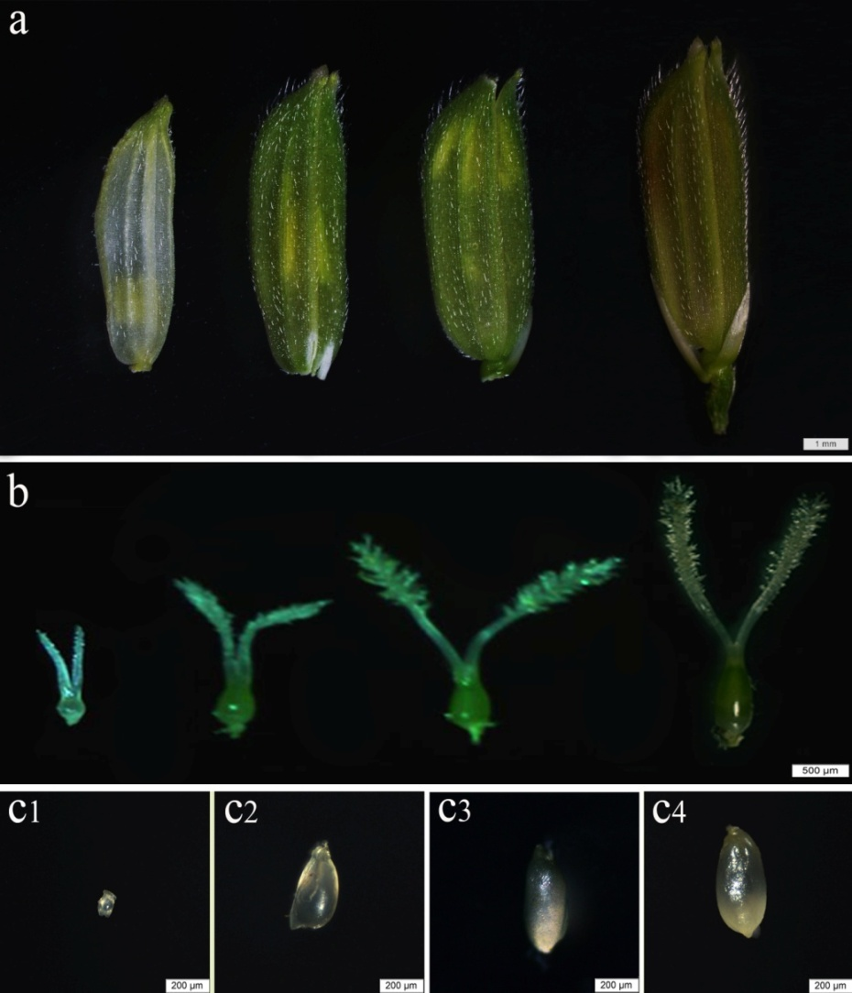
Plant materials: developing ovules
A. Florets at four stages.
B. Pistils at four stages.
C1. Ovule containing MMC in
meiotic process, OVR1
C2. Ovule at megaspore mitosis,
OVR2
C3. Ovule containing mature
embryo sac, OVR3
C4. Ovule of two days after
fertilization, OVR4
LEAF. Boot leaf, vegetative tissue

Slide 10
Number of reads matched to rice genome
 | OVR1 | OVR2 | OVR3 | OVR4
Total reads | 7433271 (100%) | 7044517 (100%) | 7586725 (100%) | 7185948 (100%)
Mapped reads | 6299385 (84.75%) | 5867534 (83.29%) | 6313602 (83.22%) | 6039335 (84.04%)
Unique match | 5878909 (70.09%) | 5471801 (77.67%) | 5910889 (77.91%) | 5646056 (78.57%)
Multi-position match | 420476 (5.66%) | 395733 (5.62%) | 402713 (5.31%) | 393279 (5.47%)
Unmapped reads | 1133886 (15.25%) | 1176983 (16.71%) | 1273123 (16.78%) | 1146613 (15.96%)

Slide 11
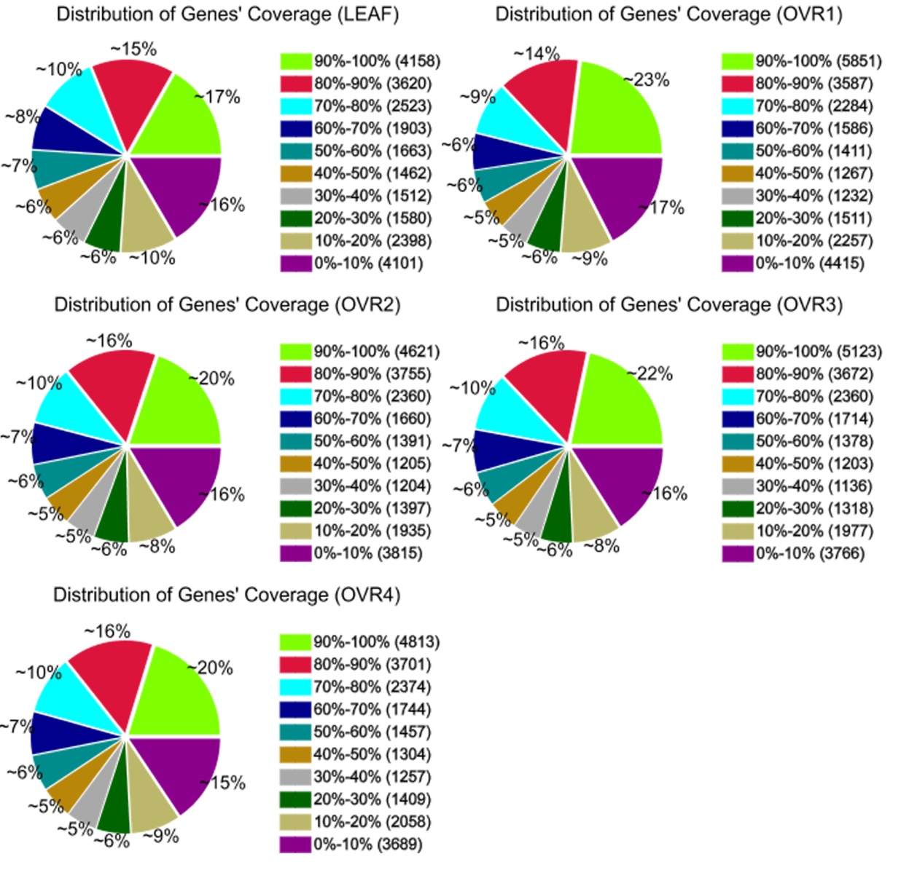
The different read coverage of genes in four libraries

Slide 12
Sequence length distribution of the all 30,858 detected genes in the leaf and four developmental stages of ovules.
Gene length（bp） | Gene number | Percentage
100-500 | 2099 | 6.80%
500-1000 | 5264 | 17.06%
1000-1500 | 6260 | 20.29%
1500-2000 | 6181 | 20.03%
≥2000 | 11054 | 35.82%
Total | 30858 | 100%

Slide 13
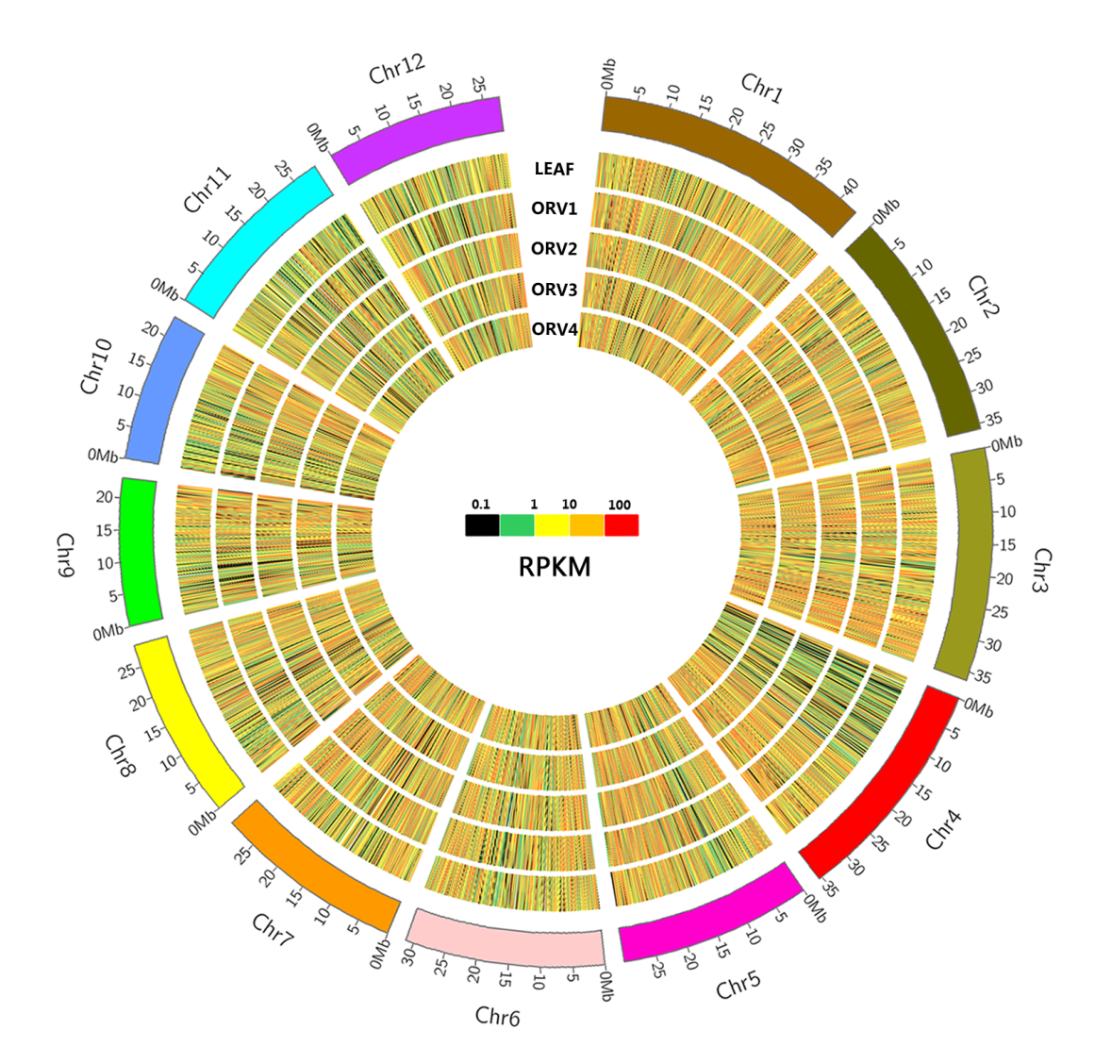
Circos diagram depicting the gene expression in leaf and ovules of four developmental stages.

Slide 14
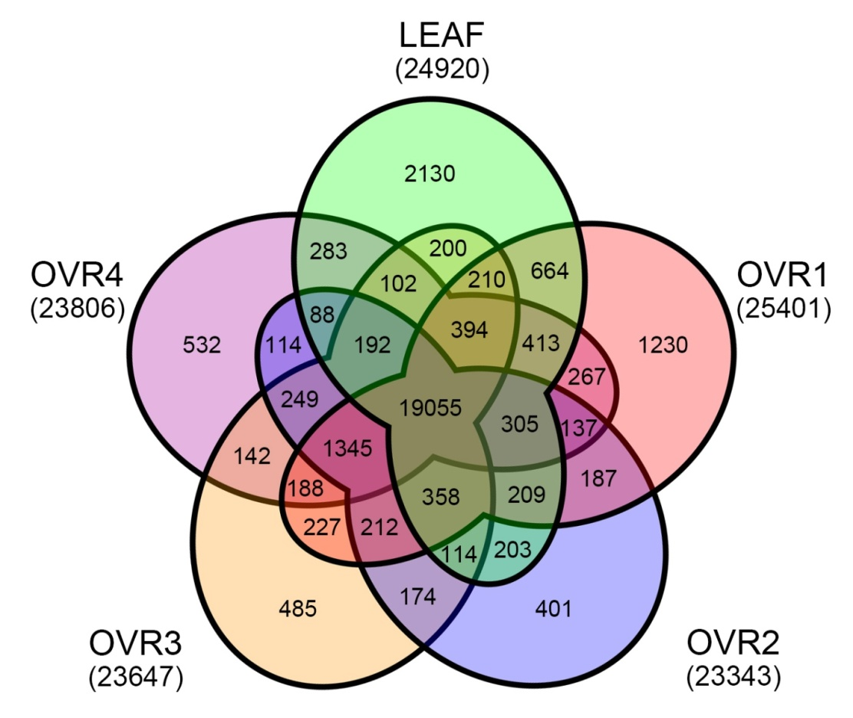
Comparison of expressed genes in leaf and developing ovule of rice
Total expressed genes: 30858

Slide 15
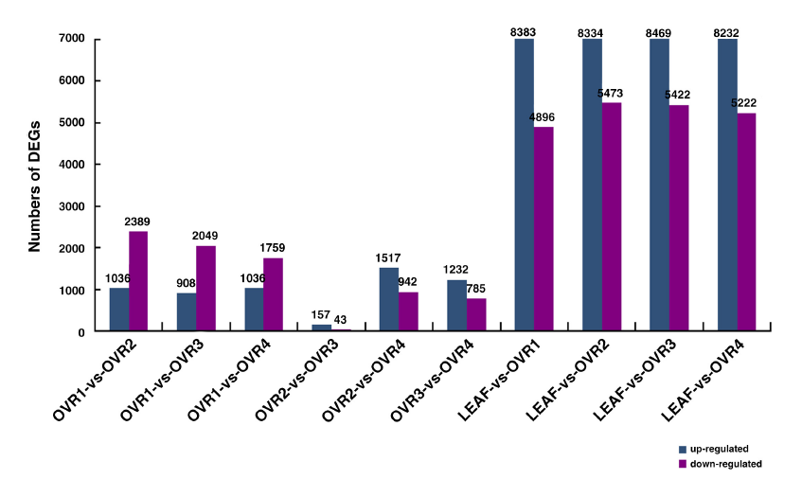
Analysis of differential expressed genes (DEGs)
Differential expressed genes identified between 10 comparisons.

Slide 16
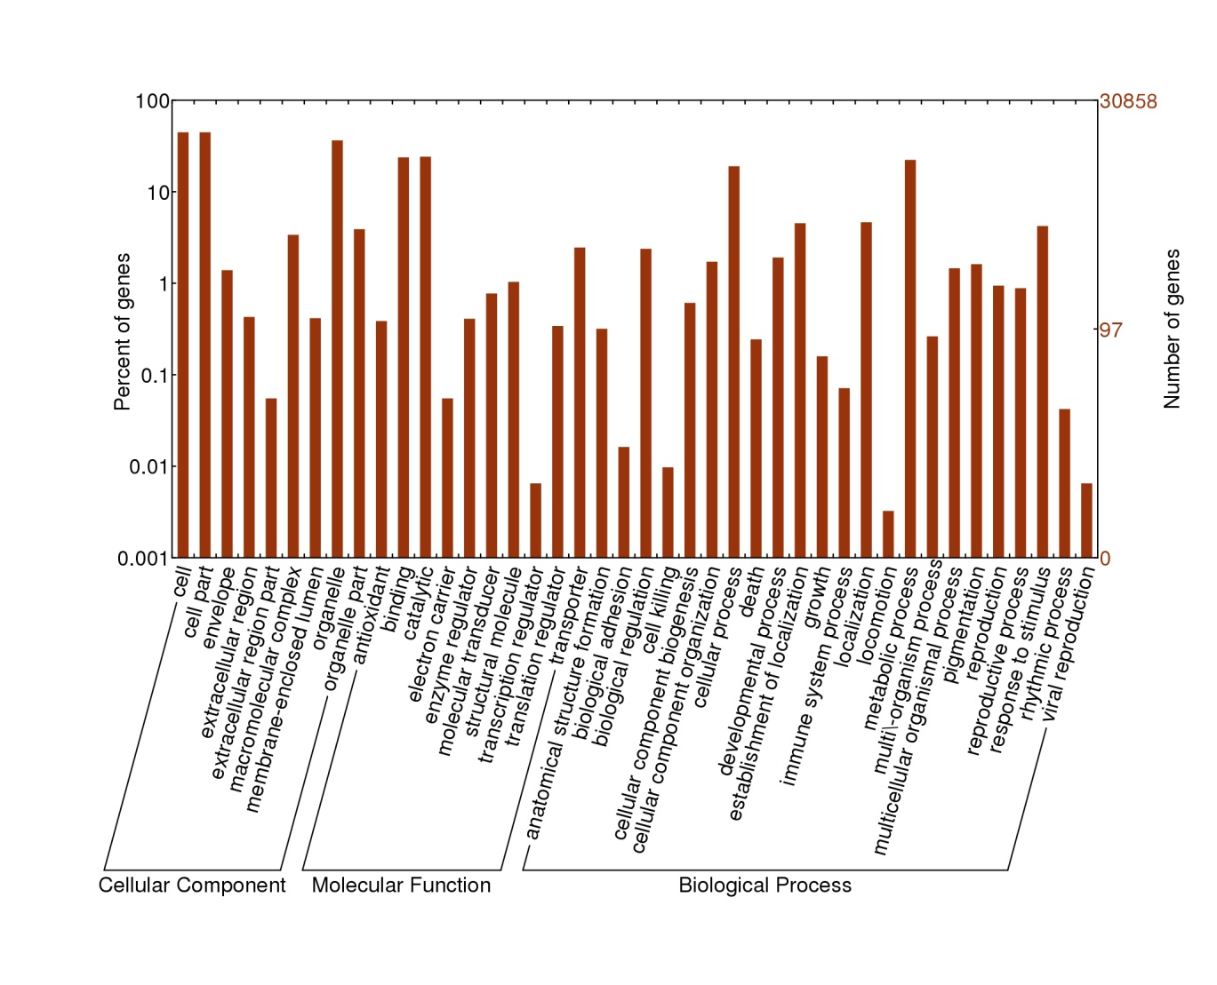
GO analysis of all detected genes and DEGs among the ovule developmental stages
GO classification of all 30,858 genes in leaf and four developmental stages of ovule.
The results are summarized in three main GO categories.

Slide 17
GO classification of DEGs among the adjacent development stages of ovule.

Slide 18
KEGG pathway analysis of DEGs in ovule development
By mapping to the KEGG pathways, all DEGs between ovule developmental stages were assigned to 125 pathways. The number of pathways significantly enriched with DEGs in the three comparisons (OVR1-vs-OVR2, OVR2-vs-OVR3 and OVR3-vs-OVR4) was 14, 3 and 4, respectively.
In OVR1-vs-OVR2, plant hormone signal transduction, plant-pathogen interaction, starch and sucrose metabolism were significantly enriched pathways.
In OVR2-vs-OVR3, the genes were significantly enriched in the pathways of pentose and glucuronate inter-conversion, plant hormone signal transduction, and starch metabolism.
In OVR3-vs-OVR4, plant hormone signal transduction, starch and sucrose metabolism, amino sugar and nucleotide sugar metabolism and plant-pathogen interaction were significantly enriched by DEGs.

Slide 19
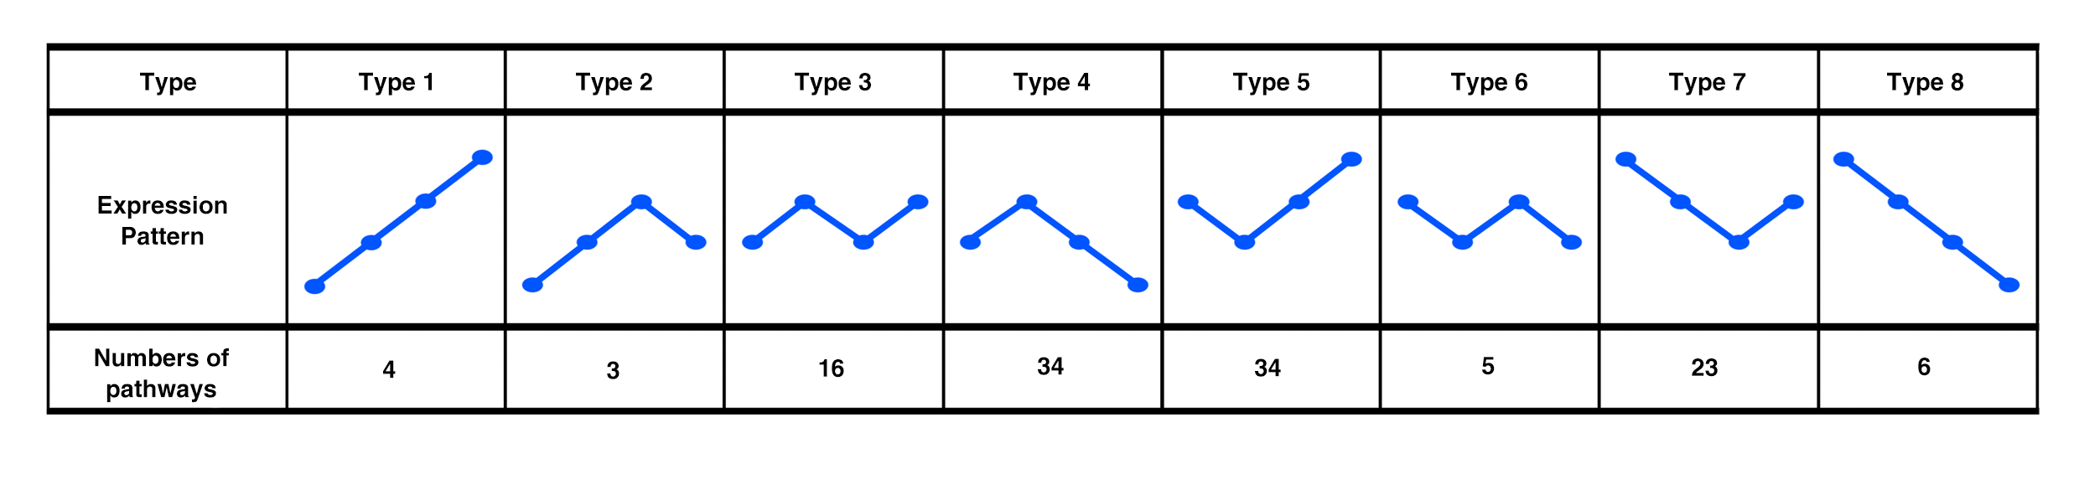
Pathway expression types
Based on the total RPKM value of the pathway genes at four different developmental stages, we identified eight expression types among all pathways

Slide 20
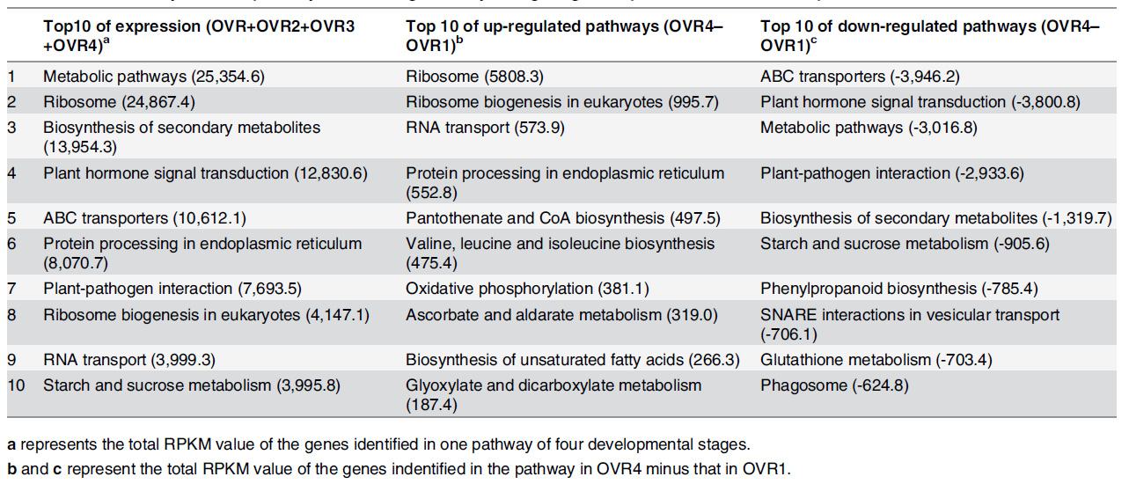
Summary of KEGG pathways with the significantly change of gene expression in ovule development.
Notes:
.

Slide 21
MapMan pathway analysis
MapMan overview of cellular metabolism (a) and regulation (b) in OVR1-vs-OVR4.Each square represented a gene. Red meant down-regulation of the gene, and blue color meant up-regulation.

Slide 22
Expression of plant hormone-related genes in rice ovule
Plant hormones regulate many aspects of plant life. As the messenger of cross-talk between sporophyte and female gametophyte in the ovule, plant hormones, especially auxin and cytokinin,are important during the regulation of developmental processes.
We focused on these two important plant hormone-related genes, which encode proteins participating in the biosynthesis, transport, perception and response of these hormones.
In total, 135 auxin-related genes and 43 cytokinin-related genes were identified during ovule development

Slide 23
Auxin (IAA) -related genes in rice ovule
Auxin regulates cell division, elongation and differentiation in plants. We found 27 auxin-related genes were related to the efflux of auxin; and the majority of the others were related to auxin response.
Most genes related to the biosynthesis of auxin were expressed at the initial developmental stage of the ovule and then showed down-regulation.
The genes related to the transport of auxin showed an expression pattern similar to that of the auxin biosynthesis-related genes, while the genes related to the response regulator showed relatively constant expression.
The expression of these genes at various developmental stages suggests that auxin may act as a signal molecule between sporophytic ovule tissue and the female gametophyte in the developing ovule.

Slide 24
Cytokinin-related genes in rice ovule
Cytokinin is another plant hormone signal involved in cross-talk between sporophyte and female gametophyte during the ovule development.
Among the 43 identified cytokinin related genes, 33 genes were related to the modification of cytokinin, which may regulate its activity.
According to the statistical data, the genes related to the biosynthesis of cytokinin exhibited higher expression in OVR1 and OVR2, and the genes related to cytokinin transport showed a similar expression pattern.
Cytokinin may have potential roles in regulating female gamete development in ovule.

Slide 25
Summary for Part 3
Transcriptomic analysis produced sufficient data for the investigation of rice ovule development, and DEGs among the four stages indicated their potential roles in ovule development.
GO and KEGG analysis showed that genes related to cellular component biogenesis, membrane-bounded organelles and reproductive regulation were highly expressed during ovule development.
Genes expressed in ovule sporophytic tissue may play important roles in its cross-talk with female gametophyte, by plant hormone-related genes and nutrition-related genes.
The transcriptome data will facilitate further studies of the complex regulation of rice ovule development, especially female gametophyte development process.

Slide 26
4
Gene expression changes in developing embryo of rice

Slide 27
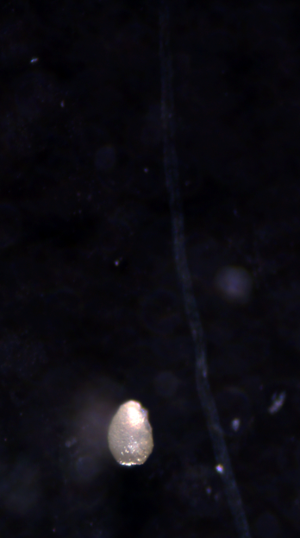
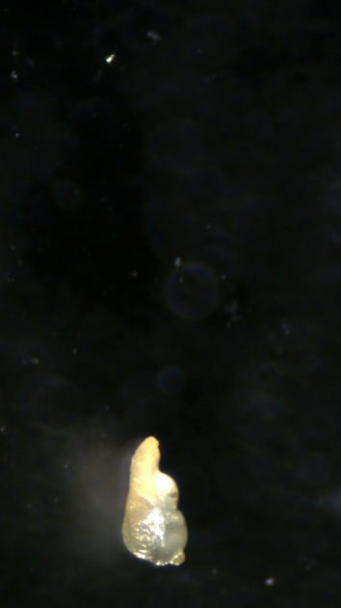
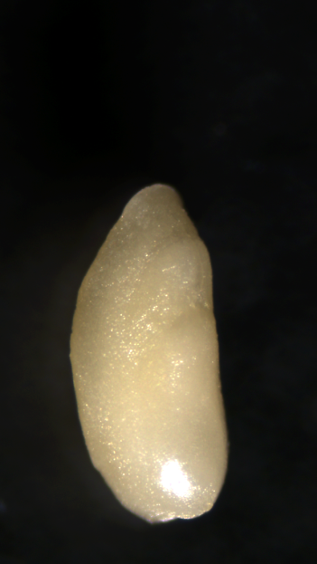
Embryo development process in rice
Embryo development stages
Proembryo（3 days after pollination, 3 DAP）
Differentiating beginning embryo（5 DAP）
Differentiating embryo（7 DAP）
3DAP
5DAP
7DAP
Notes:
根据整个发育过程中胚胎的形态学特征，可将水稻胚胎发育过程划分为几个阶段。水稻在开花之后马上完成授粉，这个过程在夏季的中午大约只需要15分钟。授精在授粉后几个小时内完成。之后大约一直到授粉后3天（3 DAP），合子一直重复进行着细胞分裂，胚胎尚未出现器官分化，属于原胚期。然后，胚胎经历一个非常重要的分化发育过程，第一片叶原基出现在5 DAP，第二片叶原基出现在大约7 DAP时，接下来各部分胚器官逐渐形成，到大约授粉后14天（14 DAP）左右，胚胎达到形态学上的成熟。随后，胚胎各部分器官继续增大，一些储藏物质开始在胚胎内累积。约从21 DAP起，胚胎体积开始逐渐变小，转入脱水干燥阶段，至30 DAP时，成为干燥休眠的成熟胚

Slide 28
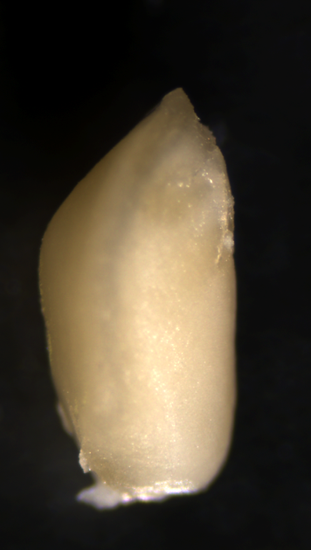
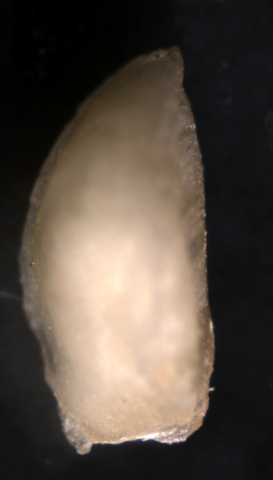
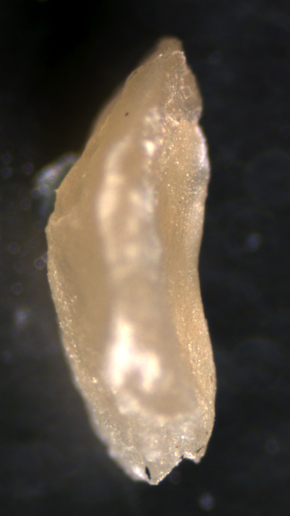
(4) Morphological maturity embryo (14 DAP)
(5) Nutrient accumulation stage （21 DAP）
(6) Dehydration and dormancy stage (30 DAP)
14DAP
21DAP
30DAP

Slide 29
Plant materials
Gene expression of developing embryos at three stages were analyzed, including:
1) Globular embryo（R1） 3 DAP
2) Differentiating embryo（R2） 7 DAP
3) Morphological maturity embryo （R3） 14 DAP

Slide 30
Number of reads matched to rice genome
 | R1(3-5 DAP) | R2(7 DAP) | R3(14 DAP)
Total reads | 6,035,714 | 5,720,176 | 6,000,001
Mapped reads | 4,995,740(82.77%) | 4,777,902(83.53%) | 5,013,883(83.56%)
Unique match | 4,622,547(76.59%) | 4,461,088(77.99%) | 4,681,906(78.03%)
Multi-position match | 373,193(6.18%) | 316,814(5.54%) | 331,977(5.53%)
Unmapped reads | 1,039,974(17.23%) | 942,274(16.47%) | 986,117(16.44%)

Slide 31
Sequence length distribution of the all detected genes
in the three developmental stages of embryos.
Gene Length (bp) | Gene Number | Percentage
100-500 | 1239 | 4.56%
500-1000 | 3963 | 14.57%
1000-1500 | 5608 | 20.63%
1500-2000 | 5779 | 21.25%
≥2000 | 10601 | 38.99%
Total | 27190 | 100%

Slide 32
Venn diagram showing the genes expressed in each of the three stages of rice embryo development.

Slide 33
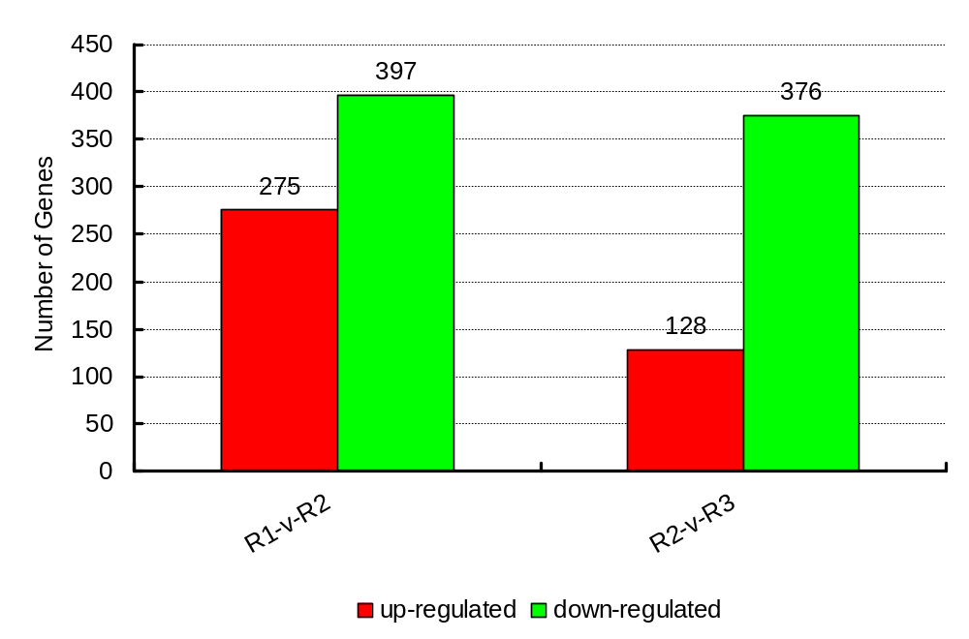
Changes in gene expression profile among the different stages.

Slide 34
Histogram presentation of gene ontology (GO) classification.
Notes:
34

Slide 35
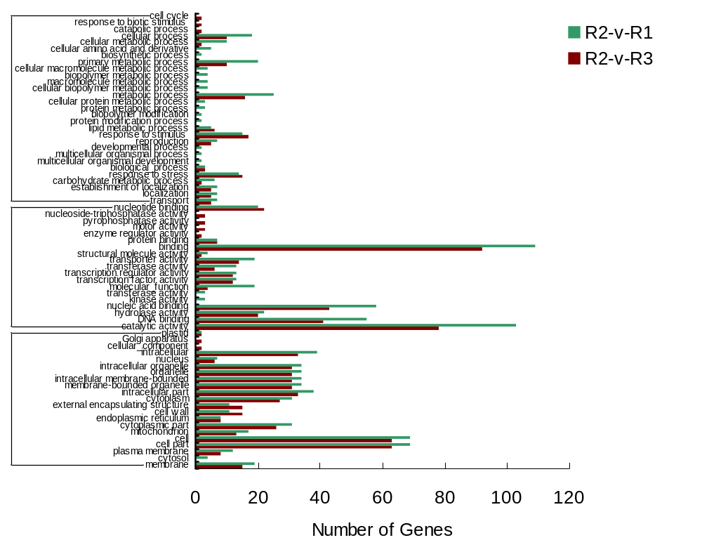
Biological process
Molecular function
Cellular component
Functional analysis of differentially expressed genes (DEGs) .

Slide 36
Some important DEGs in rice embryo development
Transcription factor genes
Transcription factor families | Number of genes
AP2 transcription factor | 8
MYB transcription factor | 8
WRKY transcription factor | 4
bZIP transcription factor | 3
bHLH transcription factor | 1
NAC transcription factor | 1

Slide 37
AP2 transcription factor gene family
Gene ID | R1-RPKM | R2-RPKM | R3-RPKM | Description | Cluster | FDR
LOC_Os10g41330 | 13.3026 | 3.010873 | 2.56687 | AP2 domain containing protein, expressed | C1 | 3.19E-07
LOC_Os08g36920 | 37.04258 | 15.31261 | 10.28442 | AP2 domain containing protein, expressed | C1 | 4.72E-11
LOC_Os05g41760 | 56.32786 | 24.67459 | 15.41427 | AP2 domain containing protein, expressed | C1 | 1.95E-12
LOC_Os09g28440 | 26.77855 | 12.95223 | 4.41689 | AP2 domain containing protein, expressed | C1 | 5.31E-06
LOC_Os03g08470 | 12.130546 | 11.76552 | 5.85619 | AP2 domain containing protein, expressed | C1 | 3.35E-05
LOC_Os08g45110 | 7.871742 | 27.72292 | 52.02676 | AP2 domain containing protein, expressed | C2 | 1.54E-14
LOC_Os07g47790 | 17.14927 | 30.38059 | 9.31227 | AP2 domain containing protein, expressed | C3 | 2.66E-12
LOC_Os05g41780 | 257.4623 | 124.2295 | 132.3927 | AP2 domain containing protein, expressed | C4 | 0

Slide 38
Auxin-realted genes
Gene ID | R1-RPKM | R2-RPKM | R3-RPKM | Description | Cluster | FDR
LOC_Os08g44750 | 16.92188 | 8.085173 | 1.065539 | auxin-induced protein 5NG4, putative, expressed | C1 | 8.40E-06
LOC_Os04g45370 | 14.72843 | 6.069563 | 1.278939 | OsSAUR19 - Auxin-responsive SAUR gene family member, expressed | C1 | 0.00086
LOC_Os08g35190 | 12.62655 | 5.300806 | 1.252177 | auxin-repressed protein, putative, expressed | C1 | 3.29E-05
LOC_Os03g22270 | 125.2101 | 57.55092 | 1.121439 | auxin-repressed protein, putative, expressed | C1 | 0
LOC_Os05g44810 | 0.86714 | 1.200695 | 4.930506 | OsIAA18 - Auxin-responsive Aux/IAA gene family member, expressed | C2 | 0.00096

Slide 39
Summary for Part 4
RNA-Seq data from developing rice embryos provided abundant data for the analysis of rice embryogenesis.
Stage-specifically expressed genes were identified from three embryonic developmental stages, and some potential regulators of embryogenesis have been identified.
In the early and middle stages, a large number of genes corresponding to amino acid, lipid, nucleic acid replication, signal transduction and transcriptional regulation were found.
Protein biosynthesis-related genes and other components of the translation machinery were highly expressed at middle stage.
Genes for protein modification and starch metabolism were highly expressed in later middle and late stages.

Slide 40
5
Gene expression changes in developing endosperm of rice

Slide 41
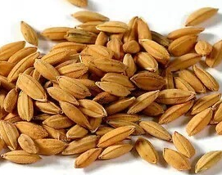
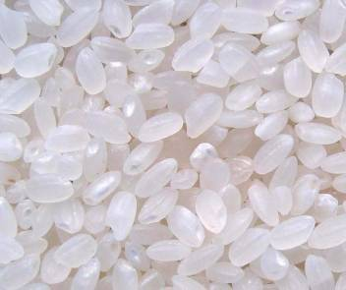
Endosperm development in rice
Four stages for rice endosperm development:
Free nuclear stage: the fertilized polar nuclei undergo numerous cycles of mitosis without cellularization until 3 DAP.
Cellularization stage: The mitosis in the peripheral syncytium ceases and cellularization proceeds until 6–7 DAP.
Storage material accumulation stage: the cells of the endosperm are specialized in storage material accumulation. Starch and protein in the endosperm peaks at 12 DAP.
Mature endosperm stage: beginning with 20 DAP, the seed enters the desiccation phase.

Slide 42
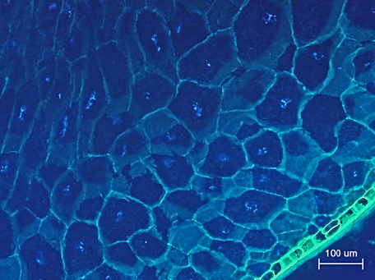
Programmed cell death (PCD)
PCD is another important feature of endosperm development in rice. This process, begins with nucleus degeneration at 7 DAP , and most of the nuclei of endosperm cells degraded at 13 DAP, resulted in cell death in mature endosperm cells.
Transverse section of the mature starchy endosperm of rice.
Koyabashi et al. 2013

Slide 43
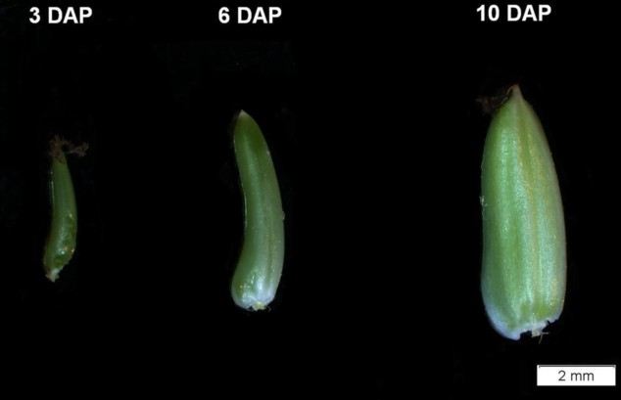
Materials: Endosperm in developing seeds
The developing caryopsis were harvested at 3 DAP, 6 DAP, 10 DAP. Endosperm is the major part of the developing caryopsis.
Notes:
胚乳是其中的主要部分。

Slide 44
Reads number in three libraries of rice endosperm development
 | R1 (3 DAP) | R2 (6 DAP) | R3 (10 DAP)
Total clean reads | 11,736,566 | 11,942,017 | 12,187,011
Mapped reads | 10,251,902 (87.35%) | 9,969,854 (83.49%) | 10,625,564 (87.19%)
Perfect match reads | 8,856,768 (75.46%) | 8,632,529 (72.29%) | 9,218,588 (75.64%)
≤2bp mismatch reads | 1,395,134 (11.89%) | 1,337,325 (11.20%) | 1,406,976 (11.54%)
Unmapped reads | 1,484,664 (12.65%) | 1,972,163 (16.51%) | 1,561,447 (12.81%)

Slide 45
Length distribution of all 23,836 genes in rice endosperm
Gene length (bp) | Gene number | Percentage (%)
100-500 | 3,759 | 15.8
500-1000 | 6,597 | 27.7
1000-1500 | 5,982 | 25.1
1500-2000 | 3,421 | 14.3
≥2000 | 4,077 | 17.1
Total | 23,836 | 100

Slide 46
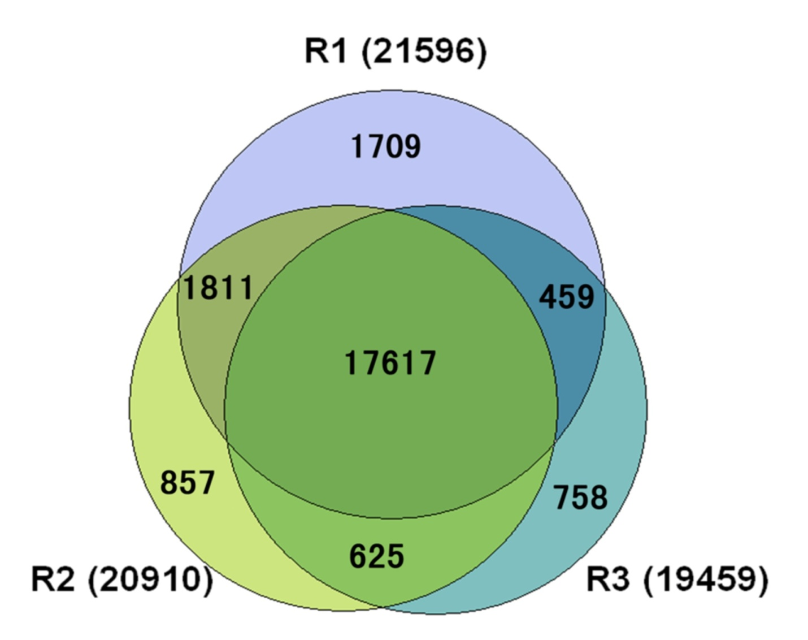
Venn diagram showing the genes expressed in each of the three stages of rice endosperm development.

Slide 47
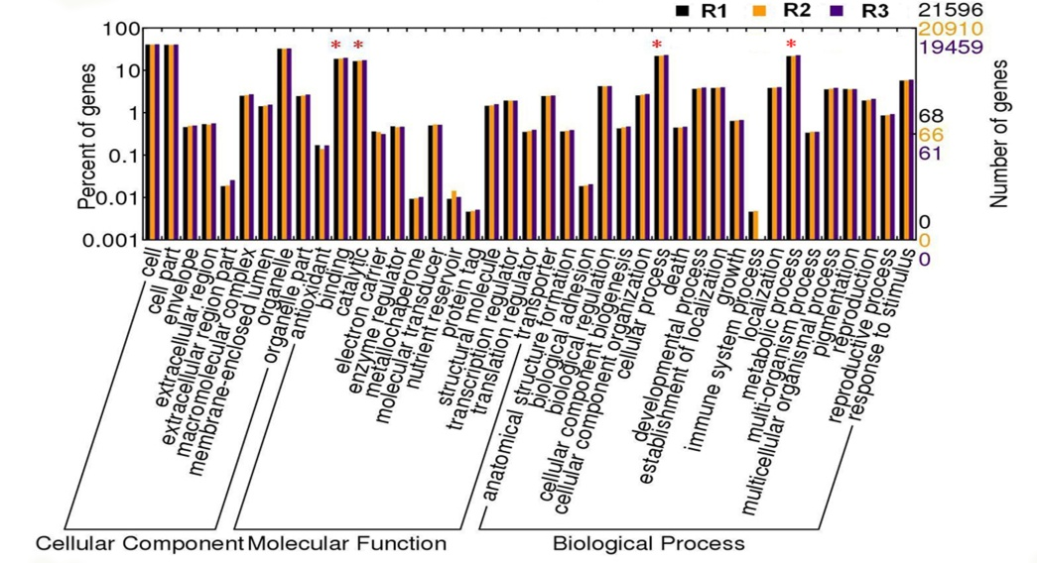
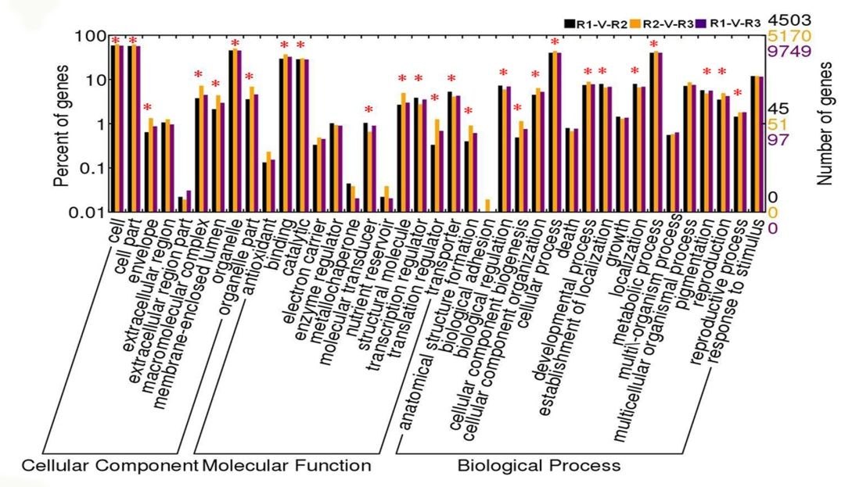
GO classifications of genes. The results are summarized in three main categories

Slide 48
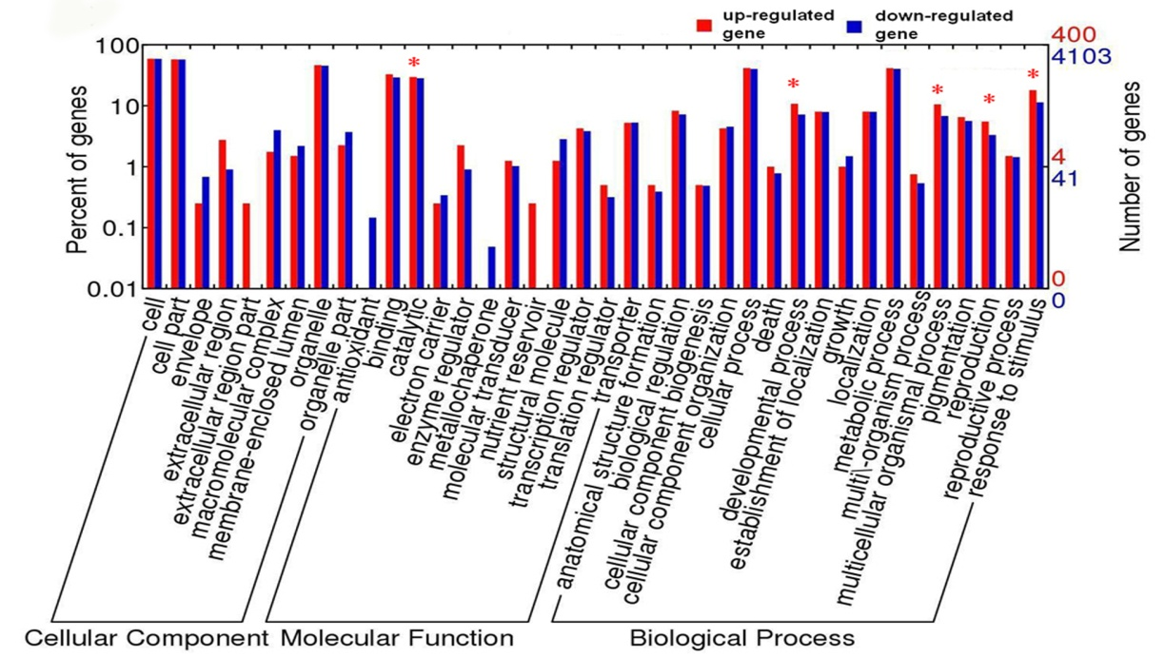
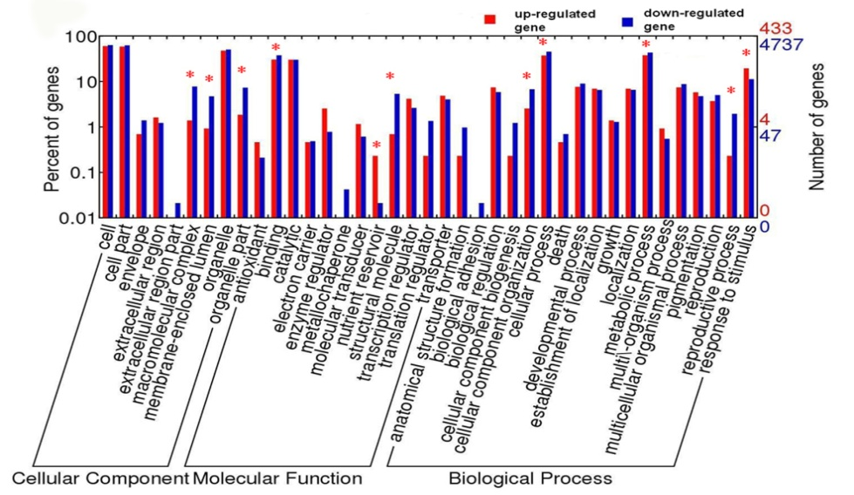
GO classifications of genes. The results are summarized in three main categories

Slide 49
Summary of considerably changed KEGG pathways analysis
 | Top10 of expression (R1+R2+R3) | Top 10 of member quantity | Top 10 of average value (expression/quantity) | Top 10 of down-regulated pathways (R3-R1) | Top 10 of up-regulated pathways (R3-R1)
1 | Ribosome (372266) | Metabolic pathways (15.93% of all DEGs) | Ribosome (1315.4) | Metabolic pathways (-23634.5) | Starch and sucrose metabolism (20861.1)
2 | Metabolic pathways (288297.4) | Plant-pathogen interaction (5.86% of all DEGs) | Starch and sucrose metabolism (780.7) | Spliceosome (-22723.7) | Amino sugar and nucleotide sugar metabolism (8551.1)
3 | Starch and sucrose metabolism (106181.9) | Ribosome (3.89% of all DEGs) | Carbon fixation in photosynthetic organisms (705.8) | Ribosome (-187735) | Carbon fixation in photosynthetic organisms (4624.8)
4 | Spliceosome (67612.6) | Spliceosome (3.65% of all DEGs) | Amino sugar and nucleotide sugar metabolism (669.9) | Biosynthesis of plant hormones (-15771.2) | Alanine, aspartate and glutamate metabolism (3738.6)
5 | Biosynthesis of plant hormones (60664.1) | Biosynthesis of plant hormones (3.40% of all DEGs) | Isoquinoline alkaloid biosynthesi (553.4) | Biosynthesis of alkaloids derived from terpenoid and polyketide (-13058.9) | Isoquinoline alkaloid biosynthesis (1730.483)

Slide 50
6 | Biosynthesis of alkaloids derived from lysine and nicotinic acid (55744.5) | Biosynthesis of phenylpropanoids (2.86% of all DEGs) | Pyruvate metabolism (424.9) | Biosynthesis of terpenoids and steroids (-11289.3) | Phenylalanine metabolism (1240.8)
7 | Biosynthesis of phenylpropanoids (52005.1) | Biosynthesis of alkaloids derived from shikimate pathway (2.28% of all DEGs) | Alanine, aspartate and glutamate metabolism (405.3) | Biosynthesis of alkaloids derived from histidine and purine (-11157.4) | Phenylalanine, tyrosine and tryptophan biosynthesis (996.9)
8 | Amino sugar and nucleotide sugar metabolism (50243.6) | Biosynthesis of terpenoids and steroids (2.26% of all DEGs) | Citrate cycle (TCA cycle) (360.3) | Biosynthesis of alkaloids derived from shikimate pathway (-10021.5) | Tyrosine metabolism (932.7)
9 | Biosynthesis of alkaloids derived from histidine and purine (48615.3) | Biosynthesis of alkaloids derived from ornithine, lysine and nicotinic acid (2.16% of all DEGs) | Biosynthesis of alkaloids derived from ornithine, lysine and nicotinic acid (355) | Biosynthesis of phenylpropanoids (-9272.4) | Galactose metabolism (330.5)
10 | Biosynthesis of alkaloids derived from terpenoid and polyketide (48568) | Biosynthesis of alkaloids derived from terpenoid and polyketide (2.09% of all DEGs) | Oxidative phosphorylation (350.1) | Purine metabolism (-8036.96) | Inositol phosphate metabolism (330.5342)

Slide 51
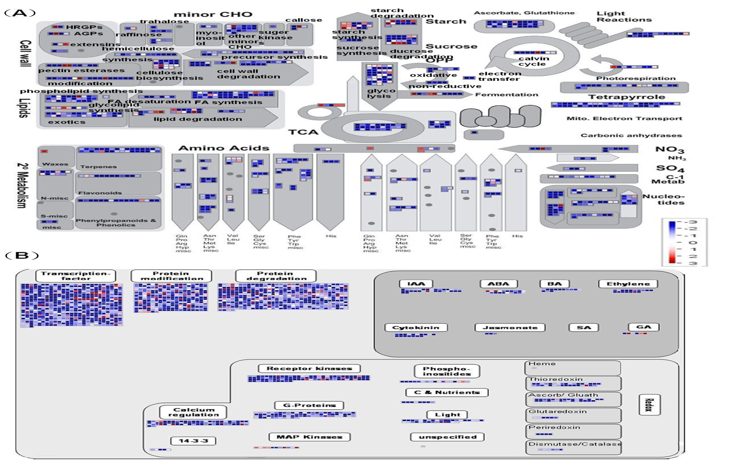
MapMan pathway analyses
MapMan overview of cellular metabolism (a) and regulation (b) showing all DEGs between R1 and R3.
Individual genes are represented
by small squares. The color key
represents RPKM normalized
log₂ transformed counts. Red
represents up-regulation and
blue represents down-regulation between R1 and R3

Slide 52
Summary for Part 5
Differently expressed genes during the endosperm three developmental stages were identified, and suggested the occurrence of various metabolic/cellular processes during endosperm development.
A large number of genes related to purine metabolism, ribosomes, oxidative phosphorylation were detected in early and middle stages.
Expression of some genes was increased significantly during the middle stage, such as those related to plant hormones, glycolysis and carbon fixation in photosynthetic process.
During the middle and late stages, genes related to defense against disease or the response to stress, and starch and sucrose metabolism, were expressed strongly.
Althrough some pathways were positively modulated throughout endosperm development, such as auxin metabolism and biotic stress, the majority of pathways were down-regulated, and support molecular evidences related to PCD in rice endosperm development.

Slide 53
Acknowledgement
 Hong Xu, Ph.D., WHU
Yi Gao, Ph.D., WHU
Ya Wu, Ph.D., WHU
 The State Key Basic Research and Development Plan of China (2013CB126900).

Slide 54
Thanks for your attention !

