Slide 1






http://www.gepea.fr/
7th Asia Pacific Biotech Congress
Kinetics of biomass and hydrocarbon oils production
of microalgae Botryococcus braunii in continuous culture
Jian JIN, Catherine DUPRE, Jack LEGRAND, Dominique GRIZEAU *
GEPEA, Université de Nantes, CNRS, UMR 6144,
CRTT, 37 bd de l’Université, BP 406, 44602 Saint-Nazaire Cedex, France
13-15 July 2015– Beijing

Slide 2
Summary
1. Background and review
2. Continuous culture setup
3. Results and discussion
4. Conclusions and perspectives

Slide 3
1. Background and review

Slide 4

Background and review：
Petroleum crisis, biofuel and bio-hydrocarbon
➔ Sustainable production of bio-fuel
3rd generation biofuel = microalgae
efficient & no competition with food
Triacylglycerol for biodiesel
➔ But also bio-hydrocarbons
Advantages of bio-hydrocarbon = main components of fossil fuels
  High caloric value
  Without oxygen
  Jet fuel & Compatible with existing combustion engine
Alternative bioresource to produce bio-hydrocarbon ?

Slide 5
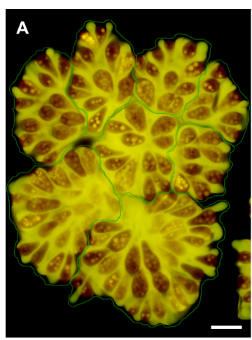
Background and review ：
Hydrocarbons present in many organisms
Most organisms = hypo-producers
Organism | Content (%) | Reference
Animal | 0.0064-0.01 | Gołębiowski et al., 2011
Plant | 0.001-0.35 | Huang et al., 2011
Bacteria | 0.008-2.7 | Jones, 1969
Fungi | 0.004-0.7 | Ladygina et al., 2006
A few organisms = hyper-producers
Bar: 10µm (Suzuki et al. , 2013)
Organism | Content (%) | Type | Reference
Aurantiochytrium sp. | 19 | Heterotroph | Kaya et al., 2011
Vibrio furnissii | 60 | Heterotroph | Derber et al., 2011
Botryococcus braunii | 61 | Autotroph | Metzger et al., 2005
An outstanding
microalga
Botryococcus braunii

Slide 6
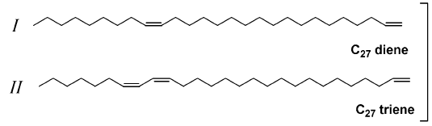
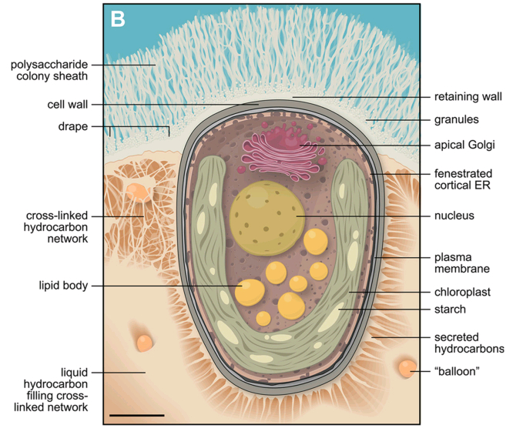
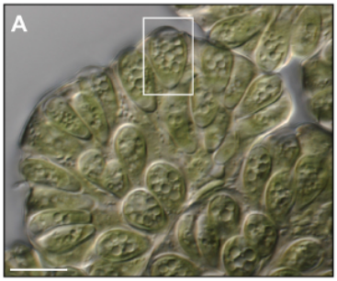
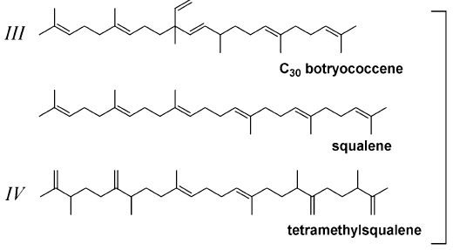
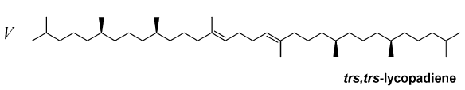
Background and review：
Colonies, extracellular matrix and diversity
Biological model = B. braunii
Race
A
Race
B
Race
L
Bar: 2 µm
Hydrocarbon
Race
S
Colony :
Cells aggregation
➔ easy for harvest
Extracellular matrix :
HC accumulation
➔ milking for extraction
HC diversity:
>60 strains and 4 races
➔strain selection ( Bot 22 )
Potential but under-studied cell factory
e.g. hydrocarbon productivity and N-limitation ?
e.g. hydrocarbon productivity and environmental pH?

Slide 7
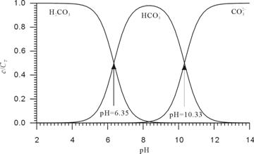
Background and review：
Studies of pH effects on B. braunii
pH
H₂CO₃
HCO₃⁻
CO₃²⁻
pH and enzymatic activities
pH and inorganic carbon speciation
pH and macromolecules transportation between cell and its extracellular environment (Guo et al., 2006)
2 4 6 8 10 12 14
pH
Previous studies of pH effects on B. braunii
In Erlenmeyer but not in controlled photobioreactor (PBR)
Initial pH adjustment without continuous pH control
  ➔ pH increased during cultivation (Dayananda et al., 2006 & 2007)

Slide 8
1. Background and review：
Other studies in pH controlled photobioreactors
Only two studies
with pH control in PBR
in batch cultures
Strain | Race | pH control | Biomass productivity (g L⁻¹ d⁻¹) | Hydrocarbon productivity (g L⁻¹ d⁻¹) | Total lipids productivity (g L⁻¹ d⁻¹) | Reference
GUBIOTJTBB1 | - | 7.5 | 13 | 6.8 | 7.4 | Talukdar et al., 2013
SAG 30.81 | A | 7.2 | 207 | - | 68 | Sydney et al., 2010
However No report of pH effects on B. braunii in continuous culture

Slide 9
2. Continuous culture setup

Slide 10
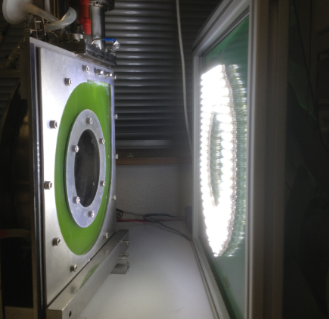
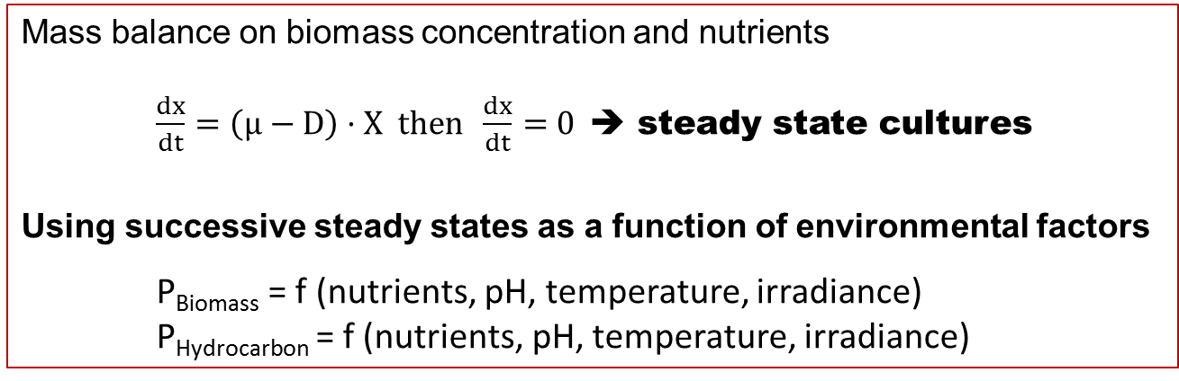
2. Continuous culture setup ：
Methodology
Continuous cultures
➔homogenous datasets
    more reproducible and reliable results
(Hoskisson et al., 2005)
Photobioreactor
Mass balance on biomass concentration and nutrients
$\frac{dx}{dt}=\left(µ−D\right)·X then \frac{dx}{dt}$ = 0 ➔ steady state cultures
Using successive steady states as a function of environmental factors
P_{Biomass} = f (nutrients, pH, temperature, irradiance)
P_{Hydrocarbon} = f (nutrients, pH, temperature, irradiance)

Slide 11
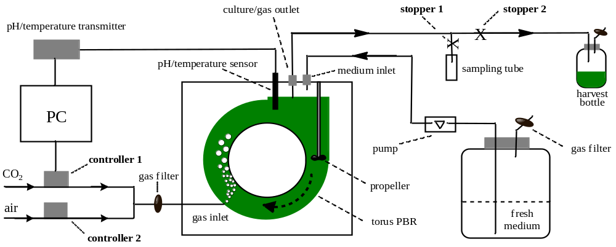
2. Continuous culture setup ：
Strain and parameters
pH ±0.1 U pH
Strain ➔ SAG 30.81 pH ➔ 5.5-8.0 Medium ➔ AF-6
Chemostat ➔ at constant dilution rate D= 0.2 d⁻¹

Slide 12
3. Results and discussion

Slide 13
3. Results and discussion：
Biomass and crude hydrocarbon production
AF-6 culture medium
Dilution rate = 0.2 d⁻¹
T = 23 ±1 °C
Biomass productivity relatively unaffected by pH between 6,0 and 8,0
(except at pH 5.5)
Crude hydrocarbon significantly increased from pH 7.5 to 6.5

Slide 14
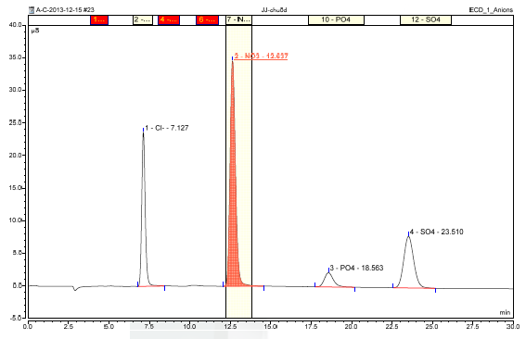
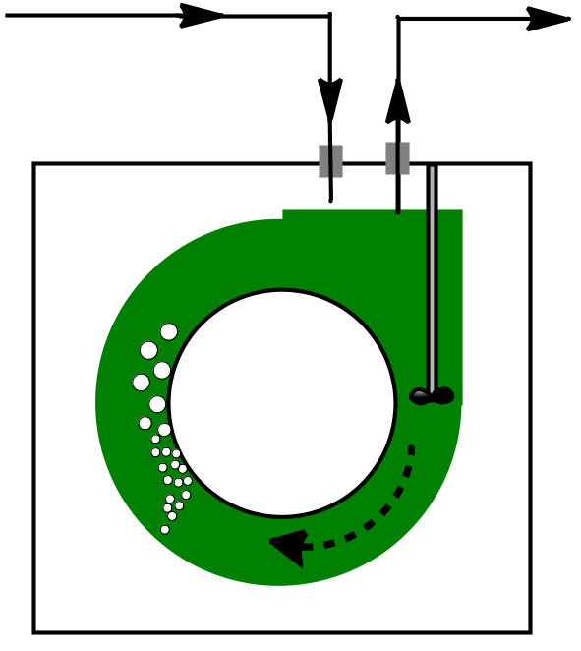
3. Results and discussion ：
NO₃⁻ balance analysis in each steady states
S_{in}
[NO₃⁻] _{in}
S_{out}
[NO₃⁻] _{out}
Ion
Chromatography
AF-6
130 mg L⁻¹
Undetectable ➔ NO₃⁻ limitation
N-rich AF-6 300 mg L⁻¹
>10 mg L⁻¹ ➔ NO₃⁻ No-limitation
Experiments:
Condition：N limitation & No-limitation
pH: 6.5 & 7.5

Slide 15
3. Results and discussion ：
Purified hydrocarbon at pH 6.5 & 7.5 under two NO₃⁻ conditions
Biomass
Hydrocarbon
Purified hydrocarbon productivity at pH 6.5 higher than at pH 7.5
Purified hydrocarbon productivity increased under N-sufficient conditions

Slide 16
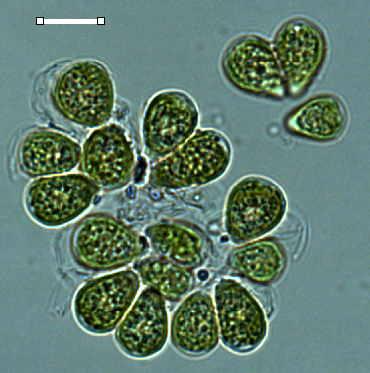
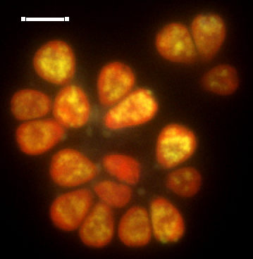
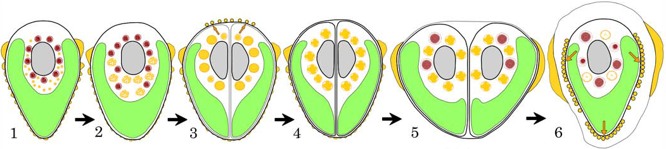
3. Results and discussion ：
Microscopy and fluorescence observations
More hydrocarbon excreted from lipid bodies to matrix at
pH 6.5
pH 6.5
More hydrocarbon accumulated in lipid bodies at
pH 7.5
pH 7.5
Bar : 10µm
Hydrocarbon
excretion process
➔ pH-dependent?

Slide 17
4. Conclusions and perspectives

Slide 18
4. Conclusions and perspectives
Continuous cultures
➔ efficient method to investigate effects of factors on hydrocarbon productivity
No-limitation nitrogen condition
➔ increase biomass and hydrocarbon productivities
pH 6.0-7.0
➔ optimal pH range for hydrocarbon productivity in B. braunii SAG 30.81 cultures
      pH-dependent excretion process?
      Extracellular carbonic anhydrase activity？
      inorganic carbon assimilation
      Strain or race-dependent?
further study on race B in collaboration with Tsukuba University

Slide 19
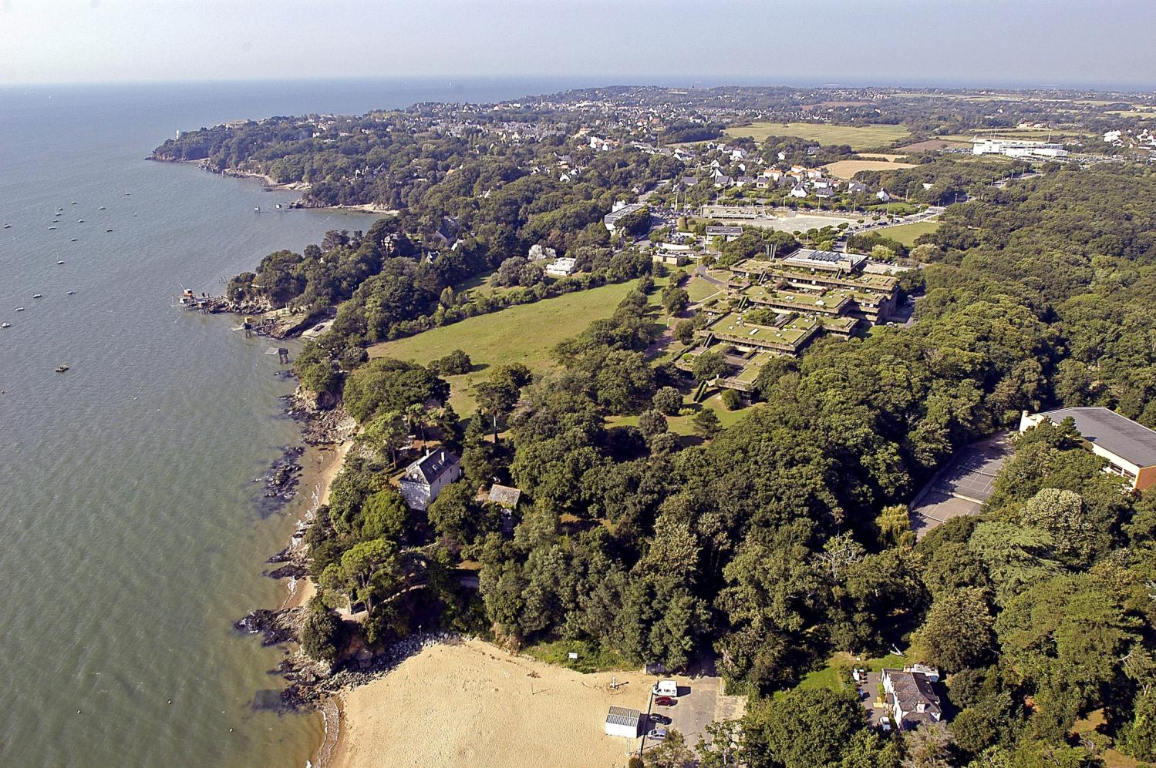
Thank you for your kind attention
JIN et al., 2015 submitted to Process Biochemistry
Program supported by CAER (alternative fuel for aeronautics), Nantes University, CSC (N° 201308430233)

Slide 21
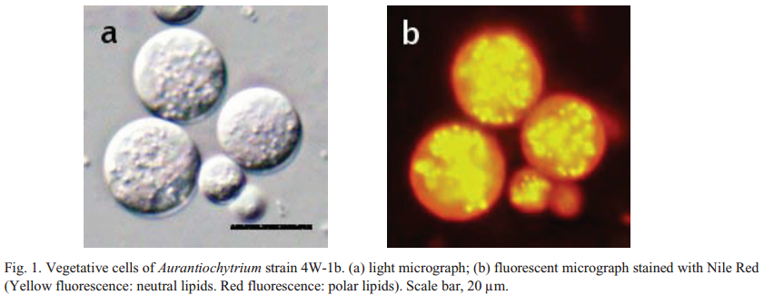
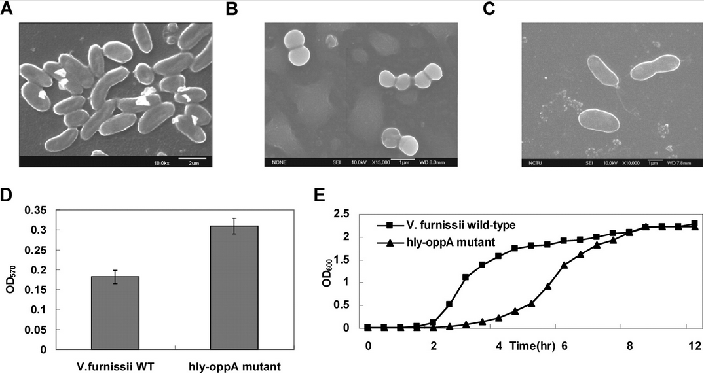
Aurantiochytrium sp.
(Labyrinthulomycetes)
Nakazawa et al., 2012
Vibrio furnissii
(Bacteria)
Wu et al., 2007

Slide 22
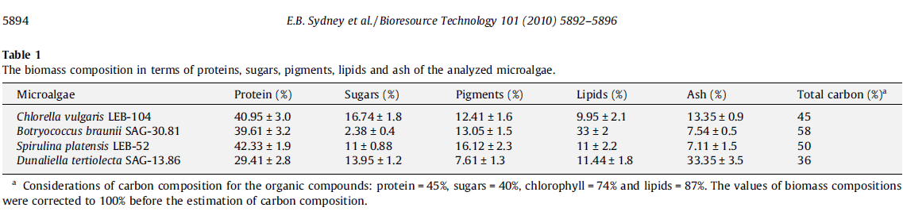
Sydney et al., 2010

Slide 23
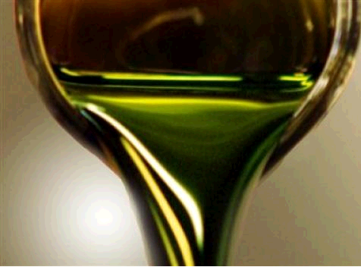
B. braunii oil is suitable for alternative fuels
Comparison of different fuels
Oil | Kinematic viscosity (mm² s⁻¹) | Density (kg m⁻³) | Cetane number | Acid number (mg KOH g⁻¹) | HHV (MJ Kg⁻¹) | Reference
B. braunii oil | 4.3-5.52 | 850-853 | 55.4 | 0.49 | 40.4 | Ashokkumar et al., 2014
Other microalgae oil* | 4.5 | 881 | 54.7 | 0.6 | 38.4 | Mallick et al., 2012
Diesel fuel | 1.3-4.1 | 850 | 40-55 | <0.5 | 40-45 | Amin, 2009
Jet fuel | 1.3-3.0 | 780-820 | 43.4-67.1 | 0-0.02 | 43.6-44.5 | Cramer et al., 2009
*, Oils as biodiesel from Chlorella vulgaris; N/A, no data available.

