Slide 1

Inexpensive and Accurate – Novel Computational Methods for Prediction of Toxicity of Nanomaterials
Jerzy Leszczynski
Department of Chemistry and Biochemistry, Jackson State University
Jackson, MS 39217, USA

Slide 2



Acknowledgements
  Dr. Bakhtiyor Rasulev
  Dr. Dinadayalane Tandabany
  Dr. Malakhat Turabekova
  Mrs. Lucky Ahmed
  Dr. Agnieszka Gajewicz
  Dr. Tomasz Puzyn
Dr. Xiaoke Hu
Mrs. Thabitha Dasari
Dr. Huey-Min Hwang
Mrs. Nicole Schaeublin
Dr. Saber Hussain

Slide 3
Total Nano Products Listed
Nano Product Categories
Number of Nano Products
Number of Nano Products
Source: http://www.nanotechproject.org/inventories/consumer/analysis_draft/

Slide 4
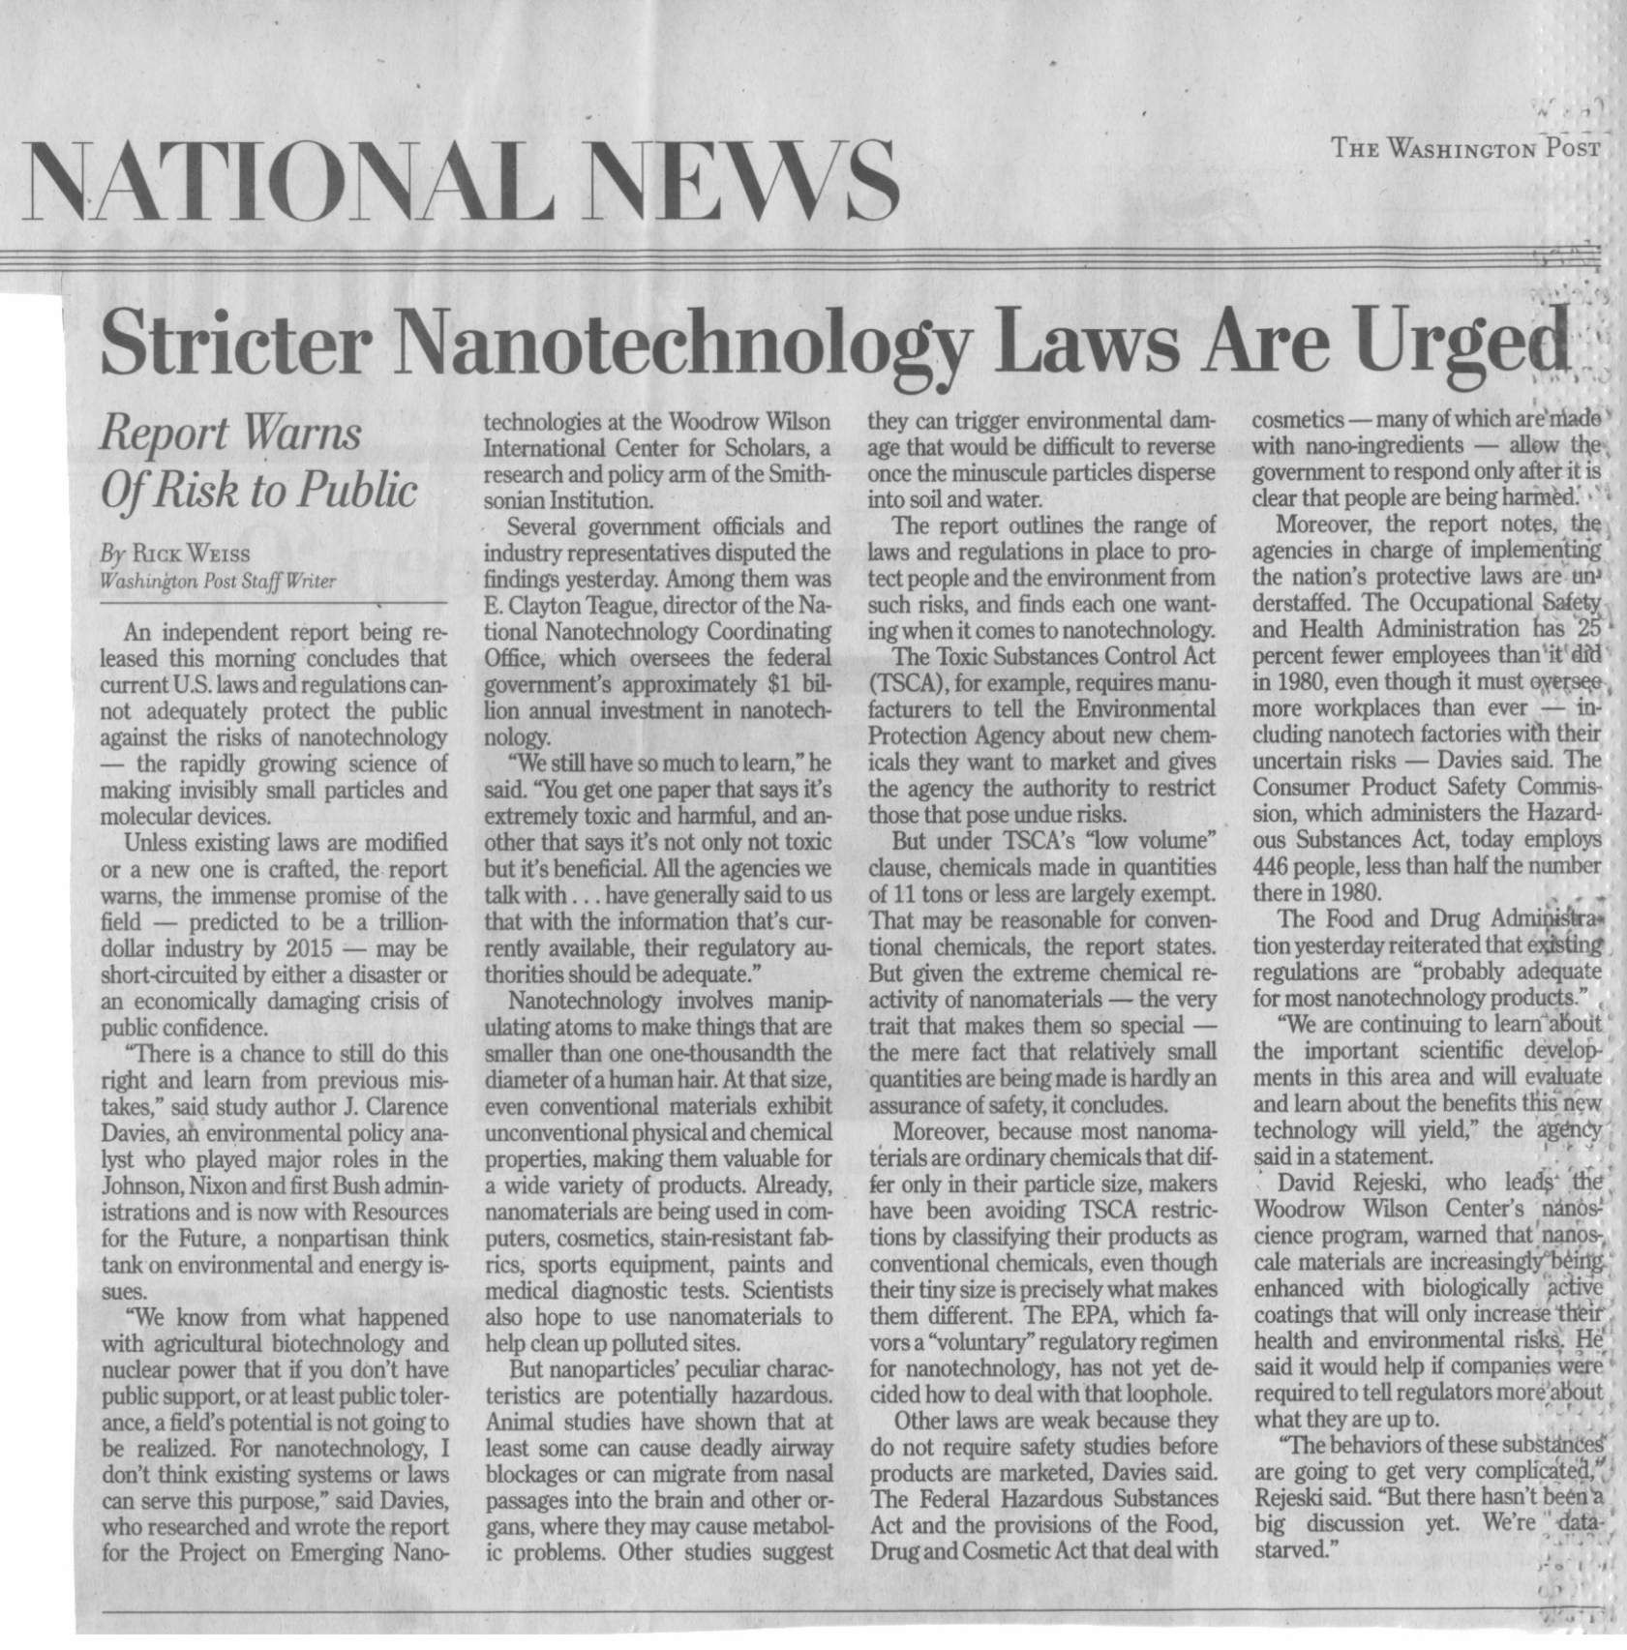

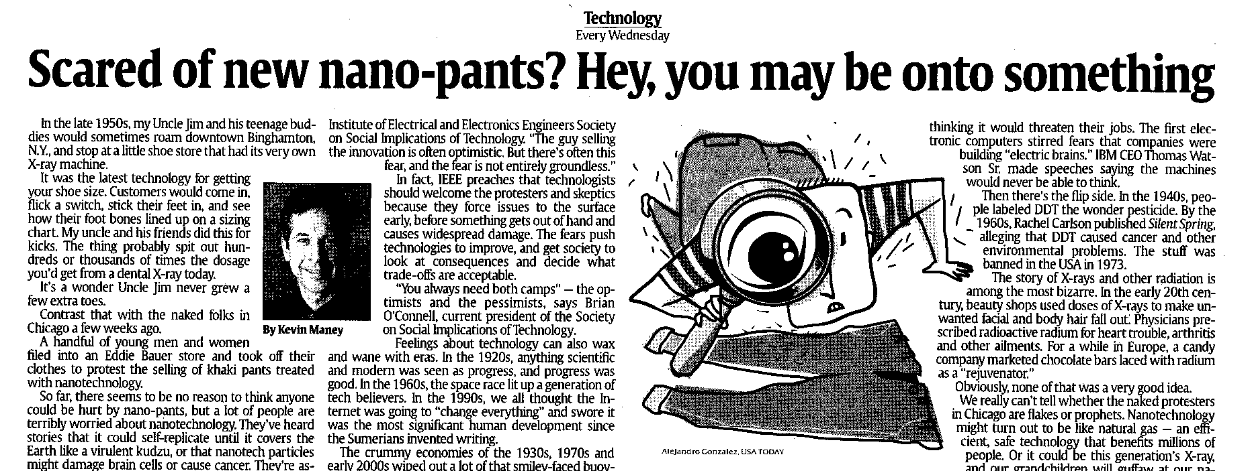
“What effect does it have on the environment? What happens if they don’t break down? How do we get rid of them? We don’t want to find out in 20 years that it causes cancer.”
“[Nanotechnology] could create weapons worse than nuclear.”
“I have reservations as far as its use in food, animals, in the chain that we eat.”
Respondents from Survey – Woodrow Wilson International Center for Scholars
Notes:
Although the developments of nanotechnology are very exciting, there is some concern regarding the human and environmental effects of these materials.
In a recent study by the woodrow wilson center, many of these concerns were documented. As well, you can find these concerns in the news, and literature.

Slide 5
Chemical Inventory and Toxicological Testing in USA
In USA, National Toxicology Program (NTP) is responsible to evaluate chemical agents having public health concern.
Other agencies e.g. Environmental Protection Agency (EPA) and National Institute of Occupational Safety and Health (NIOSH) also have an important role.
There are about 82000 chemicals currently registered in USA for commercial use.
Only 350 have undergone long-term and 70 short-term testing by NTP.
Testing of each bioassay costs $2-4 million and over 3 years to complete test.
Thus, in total about $160-320 billion and 240 thousand years total time will be needed to test chemicals currently in use.

Slide 6
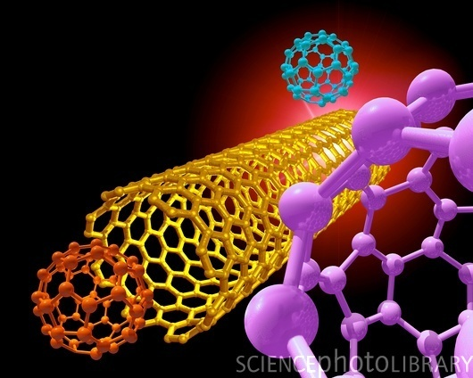
Challenges of Nanomaterials:
Are we on the way to comprehend their toxicity?

Slide 7
Postulated mechanisms of NPs’ toxicity
Release of NPs constituents
Linkov et al. (2009) J. Nanopart. Res. 11: 513-527.
Physical effects of size and shape
Effects on membranes
Effects on gene expression
Inflammatory response
Other contaminants
Effects on macro-molecules
Effects on enzyme activity
Vector for other contaminants
Surface reactivity

Slide 8
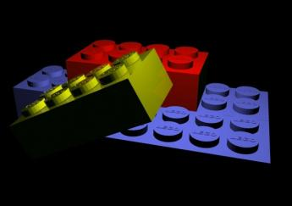
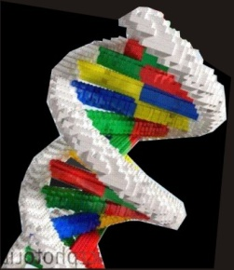
Reality and Models
in silico
↕
in vivo

Slide 9
One More Step
in silico
↕
in vitro
↕
in vivo

Slide 10
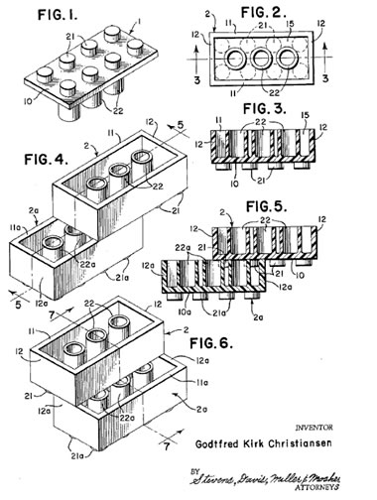
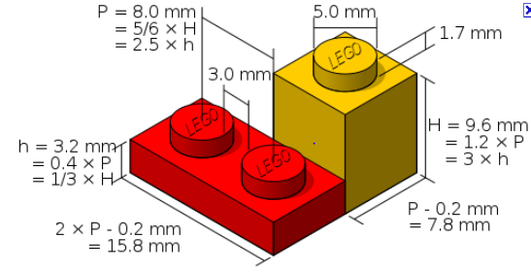
Does it Fit?

Slide 11

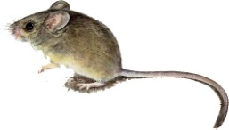
Computational approaches
Molecular Modeling
Quantum-Chemical Approaches
QSARs: Quantitative Structure-Activity Relationships
Physical
Properties
Toxicity
Biokinetic
Parameters
Environmental
Distribution

Slide 12
The Steps Towards Modeling of Nanoparticles’ Properties and Toxicity:
Development of nanomaterials inventory (database) – collecting the data on experimental physicochemical properties, toxicity endpoints
Identification of structural descriptors suitable for modeling nanoparticle reactivity
Modeling the interaction of nanoparticles with biological systems - by means of computational approaches including quantum chemistry methods, molecular modeling and protein-ligand docking techniques
QSAR modeling - exploring the relationships between structure and properties (for example, solubility), toxicity, using multivariate data analysis techniques

Slide 13
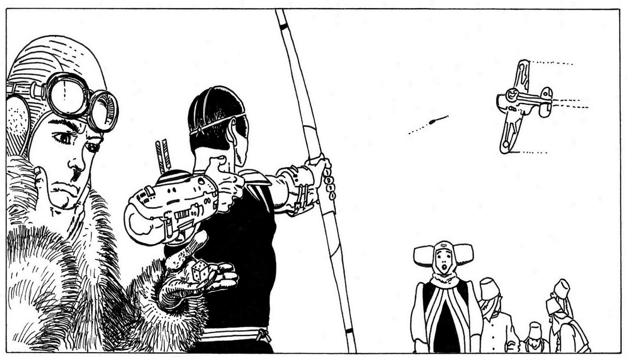
Nano: Is It Just the Size that Matters?
WAIT! STOP!
It’s 101 nm!!!

Slide 14


(Q)SAR
=
(Quantitative) Structure-Activity
Relationship
IN SILICO
= f ( )
E. Benfenati ©
Notes:
The methods called quantitative structure-activity relationship (QSAR) are based on the assumption that the activity of a certain chemical compound is related to its structure. More precisely, this approach says that the activity, or the property, for instance the toxic effect, is related to the chemical structure through a certain mathematical algorithm, or rule.
QSAR models are also called in silico methods, which actually refer to a somehow broader set of methods.

Slide 15
Basic Concept of QSAR Modeling
Endpoint
(experimentally measured)
Structural descriptors
QSAR model
y = f(X)
(eg. y = b₀+b₁x₁+b₂x₂)
?
Linear Regression (LR)
Multiple Linear Regression (MLR)
Partial Least Squares (PLS)
Artificial Neural Networks (ANN)
…
y
X
Dipole moment
Polarizability
HOMO, LUMO
Topological indexes
Number of specific atoms/groups
…
Activity (EC₅₀)
Phys/Chem property (K_{OW}, t_{1/2})
Retention parameters (t_{R})
Toxicity (LD₅₀, LC₅₀)
…

Slide 16
Experimentalists vs. QSAR modelers
Nanoparticles
Nanoparticles
Endpoints
Endpoints
Data for QSAR
Data from experiments

Slide 17
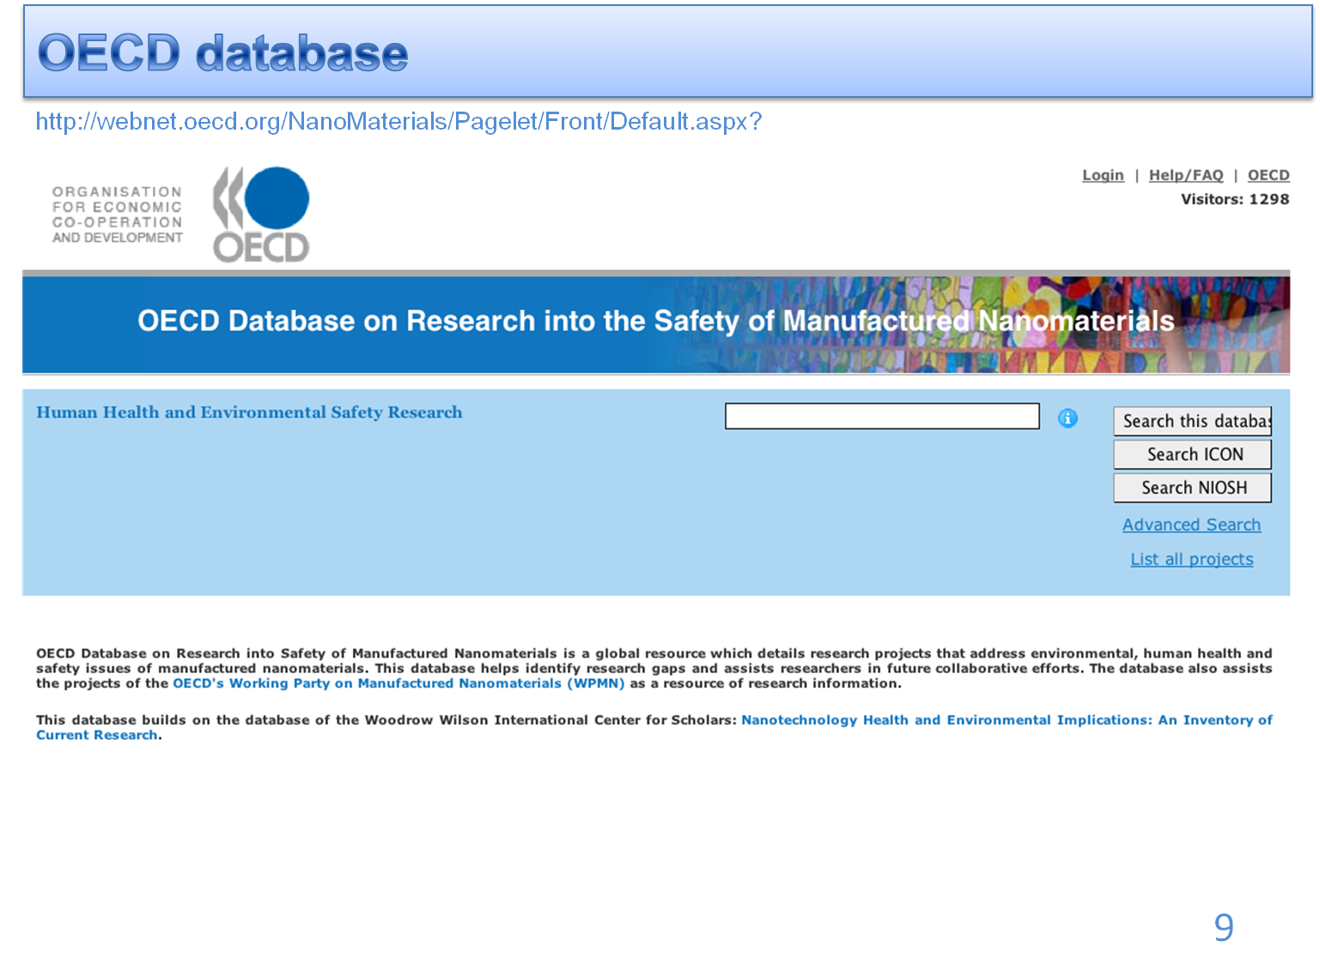
Existing databases

Slide 18
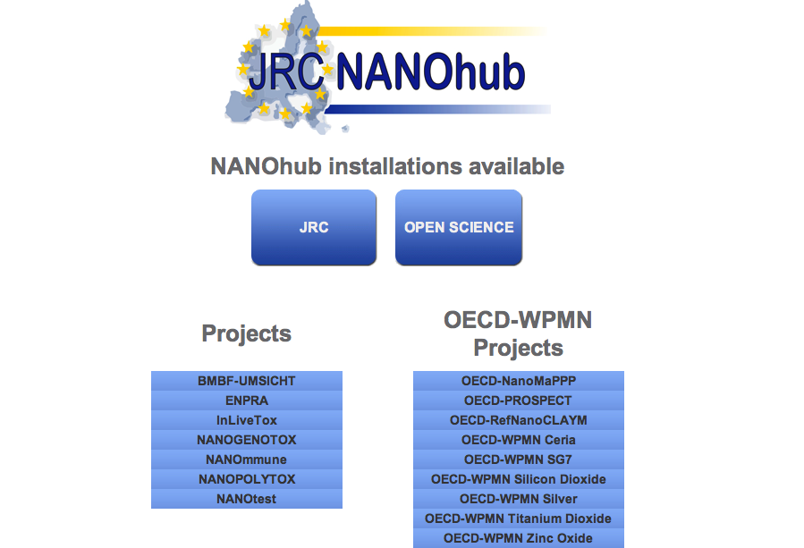
JRC NANOhub database (http://www.napira.eu)

Slide 19
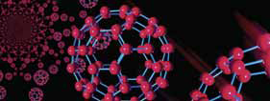
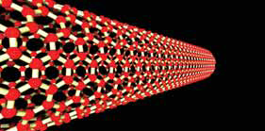
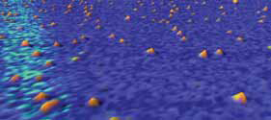
Specific structural features of NPs
Oberdörster et al. Particle and Fibre Toxicol. 2: 8.
Toxicity of NPs can be related to:
  size
  size distribution
  agglomeration state
  shape
  porosity
  surface area
  chemical composition
  structure-dependent electronic configuration
  surface chemistry
  surface charge
  crystal structure

Slide 20
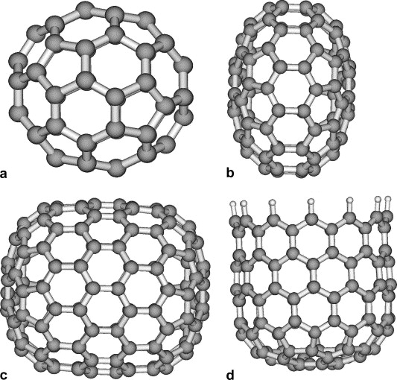
Calculating 3D descriptors based on the whole system
Shukla, Leszczynski (2006) Chem. Phys. Lett. 428: 317-320.
Calculations performed at the Density Functional Theory (DFT) level: B3LYP/6-31G(d)
a
b
# | Structure | HOMO-LUMO gap [eV] | IP [eV] | EA [eV]
a | Fullerene C₆₀ | 2.77 | 7.24 | 1.75
b | Disk C₉₆ | 1.53 | 6.46 | 2.98
c | Capsule C₁₄₄ | 1.25 | 6.72 | 3.46
d | Bowl C₁₂₀H₁₂ | 0.46 | 5.19 | 3.75
c
d

Slide 21
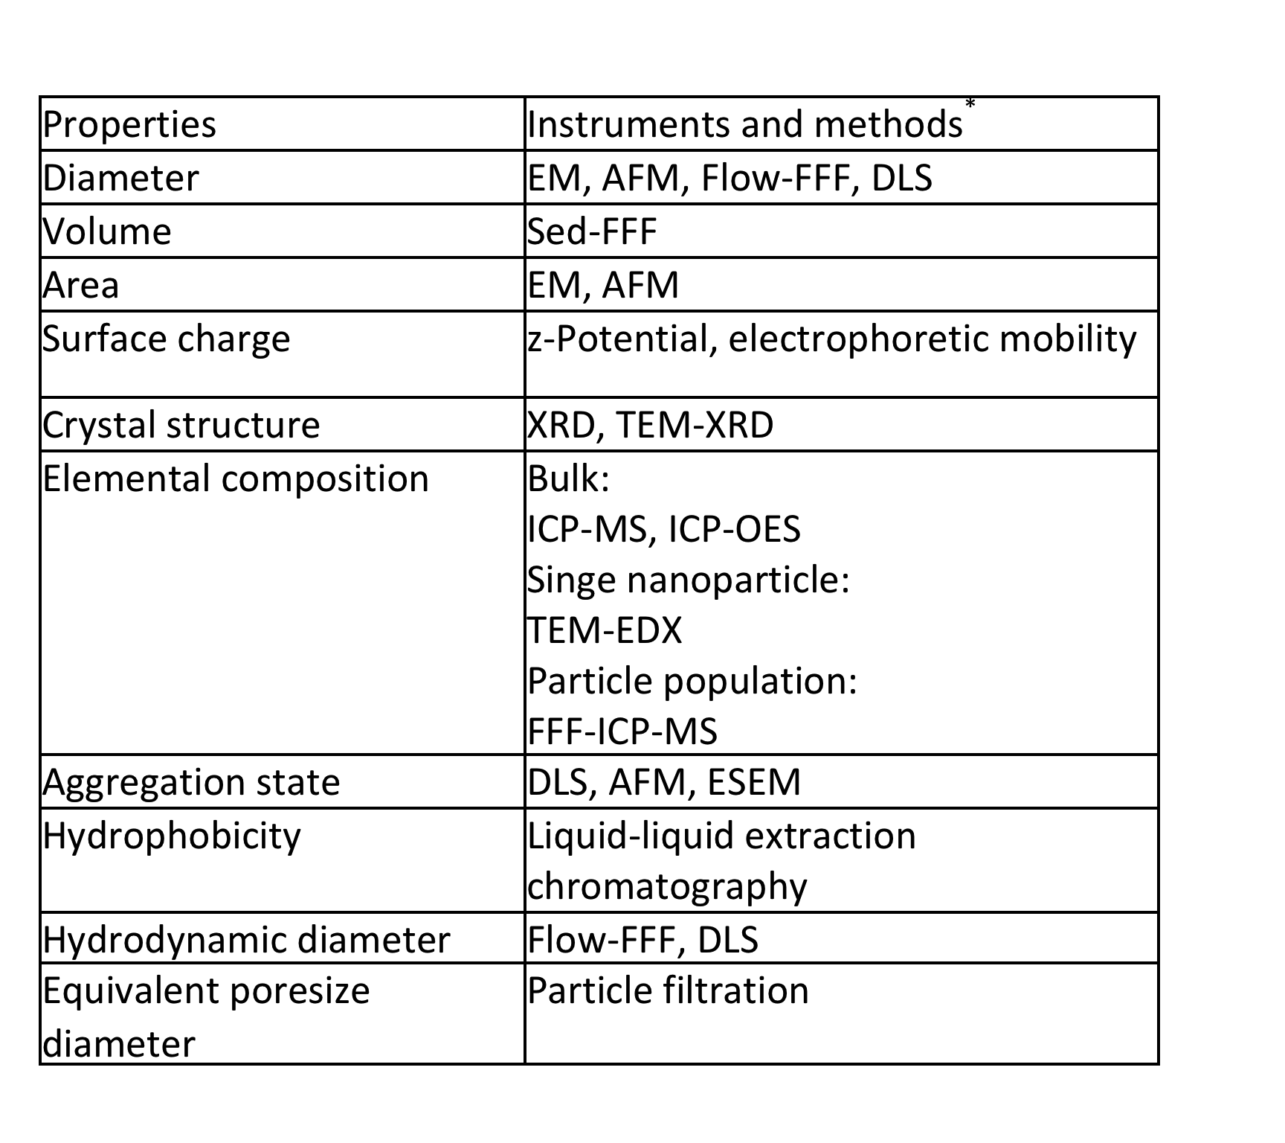
Experimental techniques that can be used to obtain nano-descriptors
Haselov et al. (2008) Ecotoxicology 17: 344-361.
Abbreviations:
EM- electronic microscopy,
AFM - atomic force microscopy,
FFF- field flow filtration,
DLS - dynamic light scattering,
LC- liquid chromatography,
XRD - X-ray diffraction,
TEM - transmission electron
microscopy,
ICP-MS - inductively coupled
plasma mass spectrometry,
ICP-OES - inductively coupled
plasma emission spectroscopy,
EDX - energy dispersive X-ray
spectrometry,
ESEM - environmental scanning
electron microscopy.

Slide 22
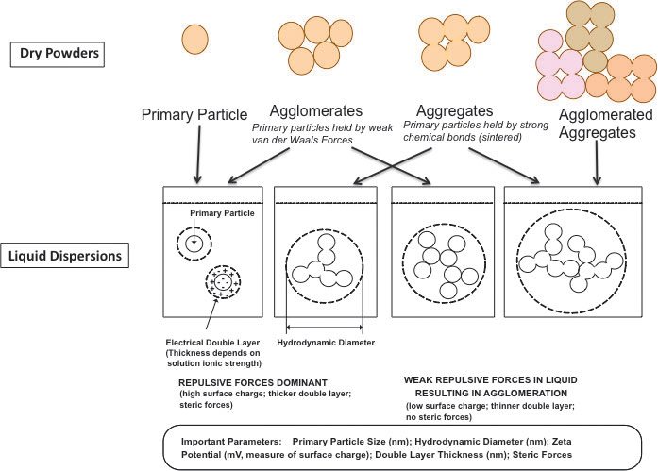
Agglomeration and aggregation of NPs
Jiang (2009) J. Nanopart. Res. 11: 77-89.

Slide 23
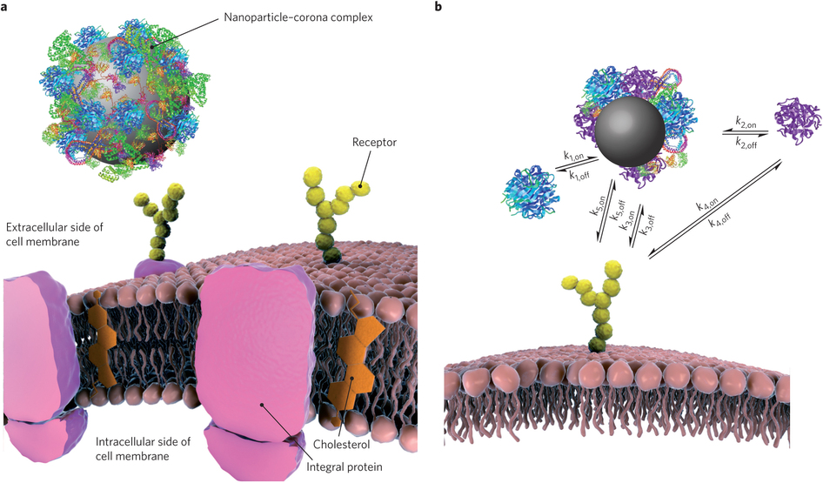
Formation of Protein Coronas
Marco Monopoli, Christoffer Åberg, Anna Salvati & Kenneth Dawson, Nature Nanotechnology, 7, 779–786 (2012)

Slide 24
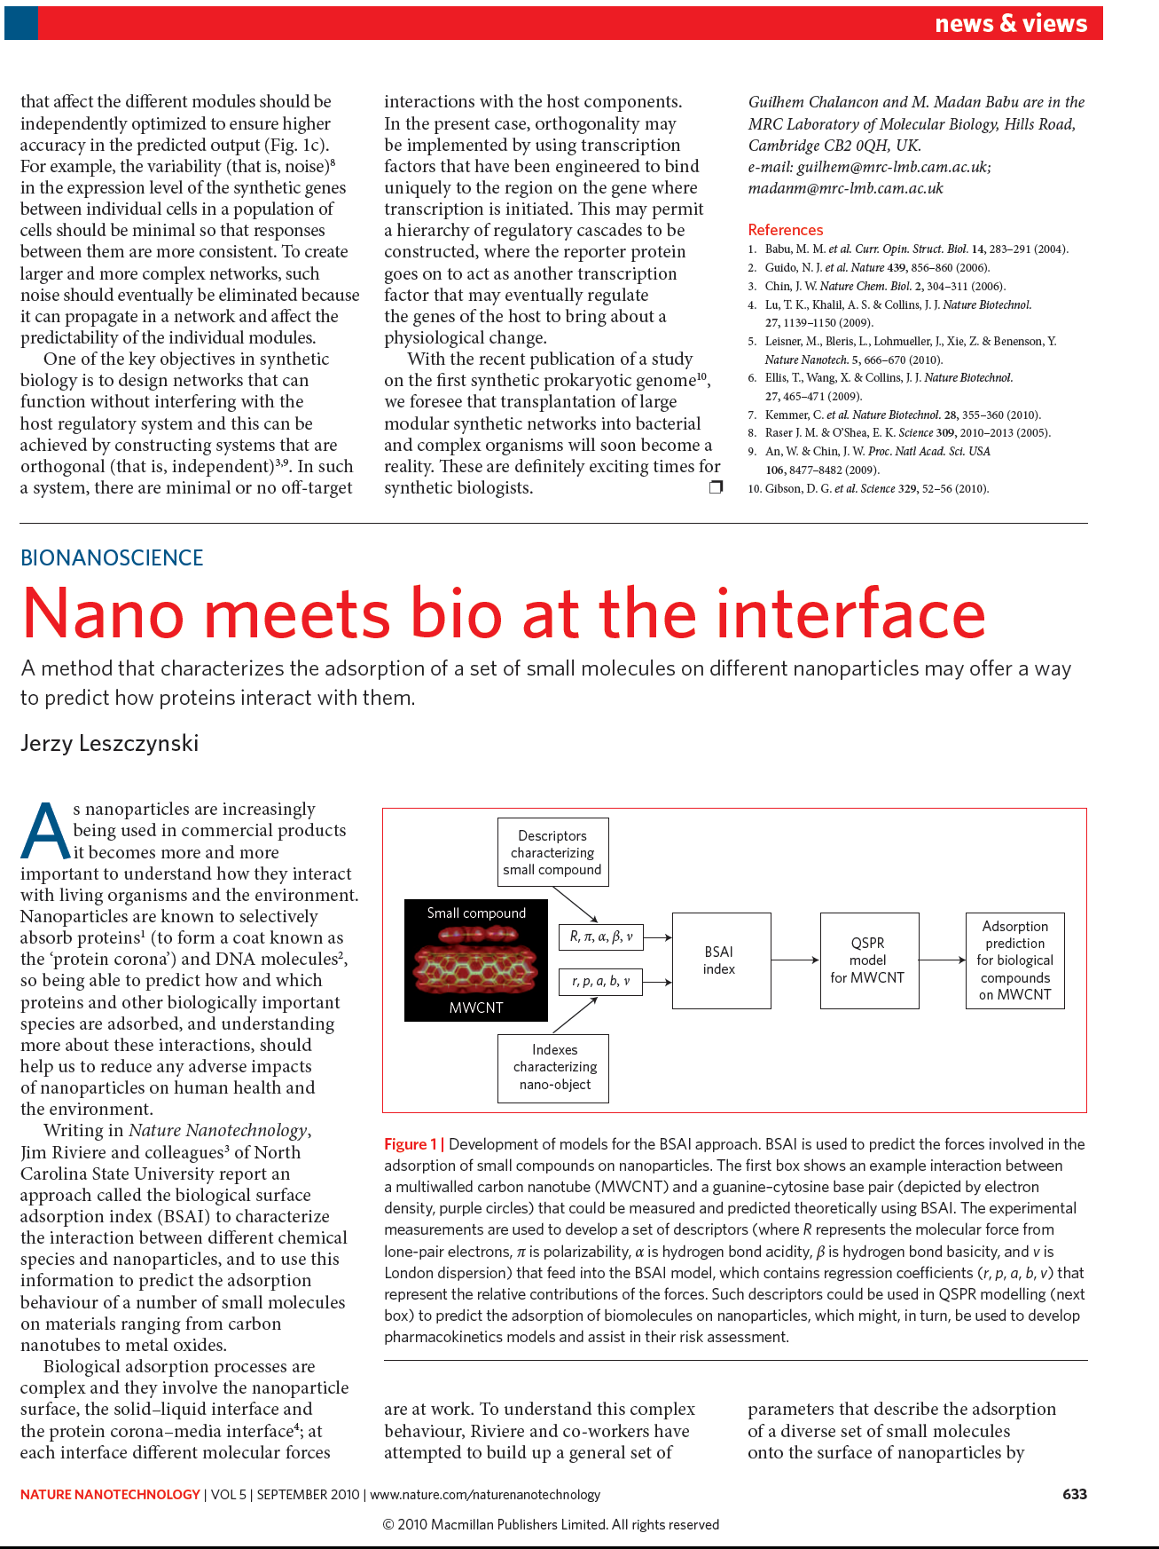

Slide 25
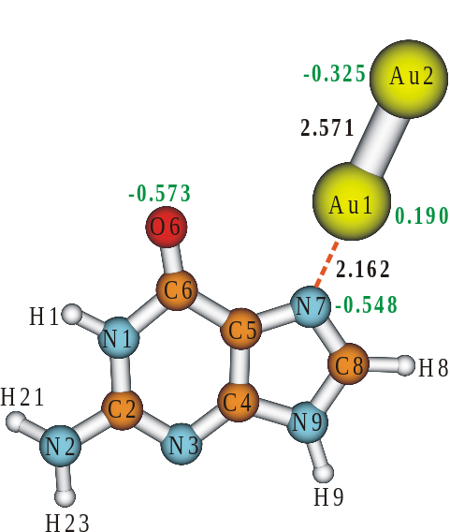
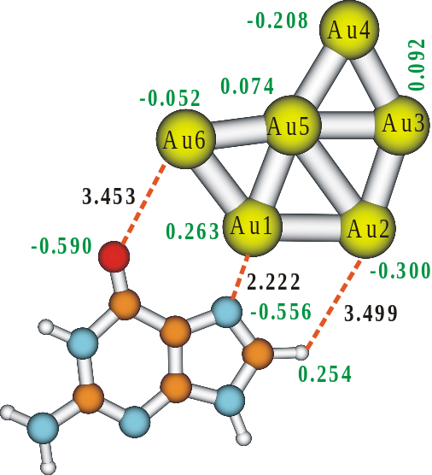
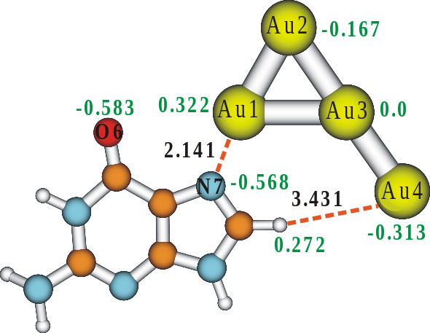
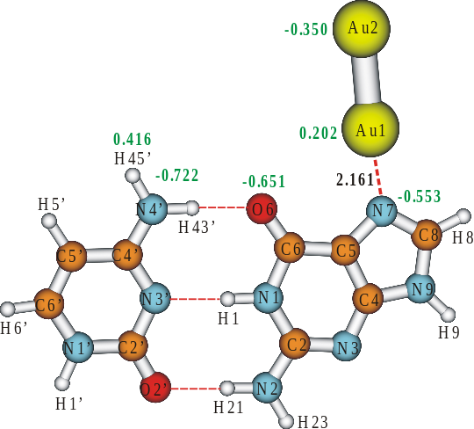
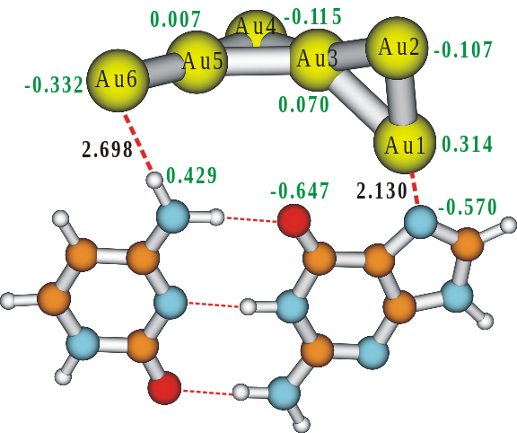
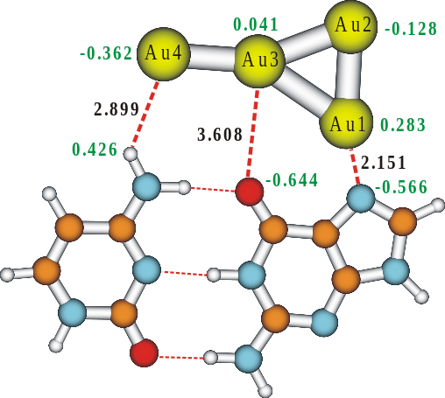
Back to QM - Optimized Structures of G-Au_{n} & GC-Au_{n}
M.Shukla, M.Dubey, E. Zakar J.Leszczynski, (2009), JPCC,113, 3960.
G-Au₂
G-Au₄
G-Au₆
GC-Au₂
GC-Au₄
GC-Au₆
NBO charges for selected atoms are given in green color while selected gold atoms and base distances are in Å.

Slide 26
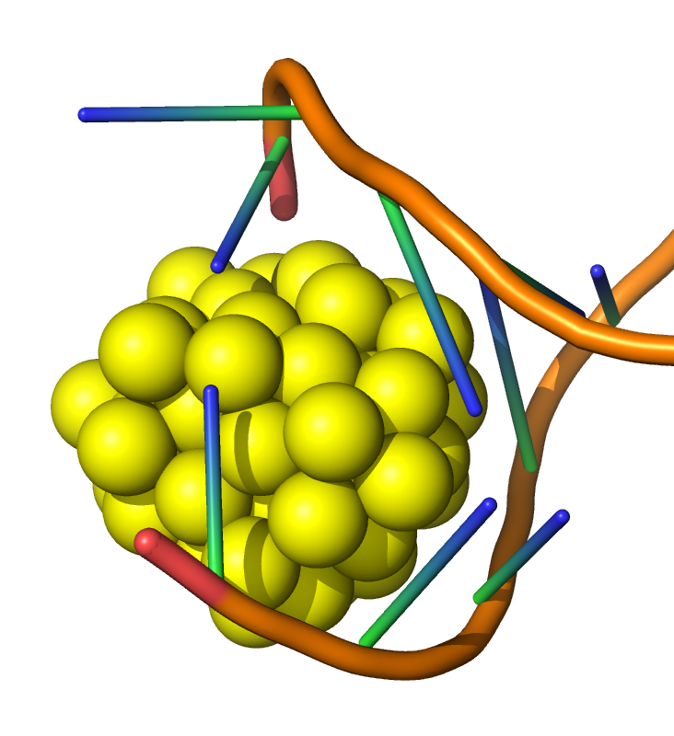
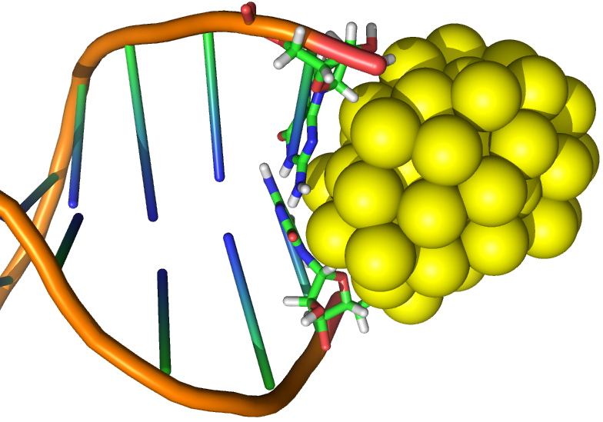
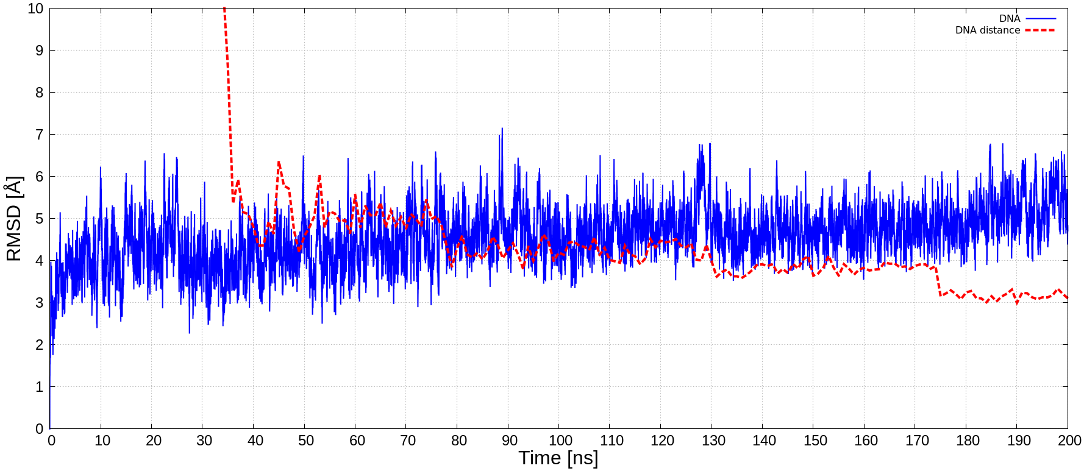
Structure at 35 ns
Structure at 200 ns

Slide 27
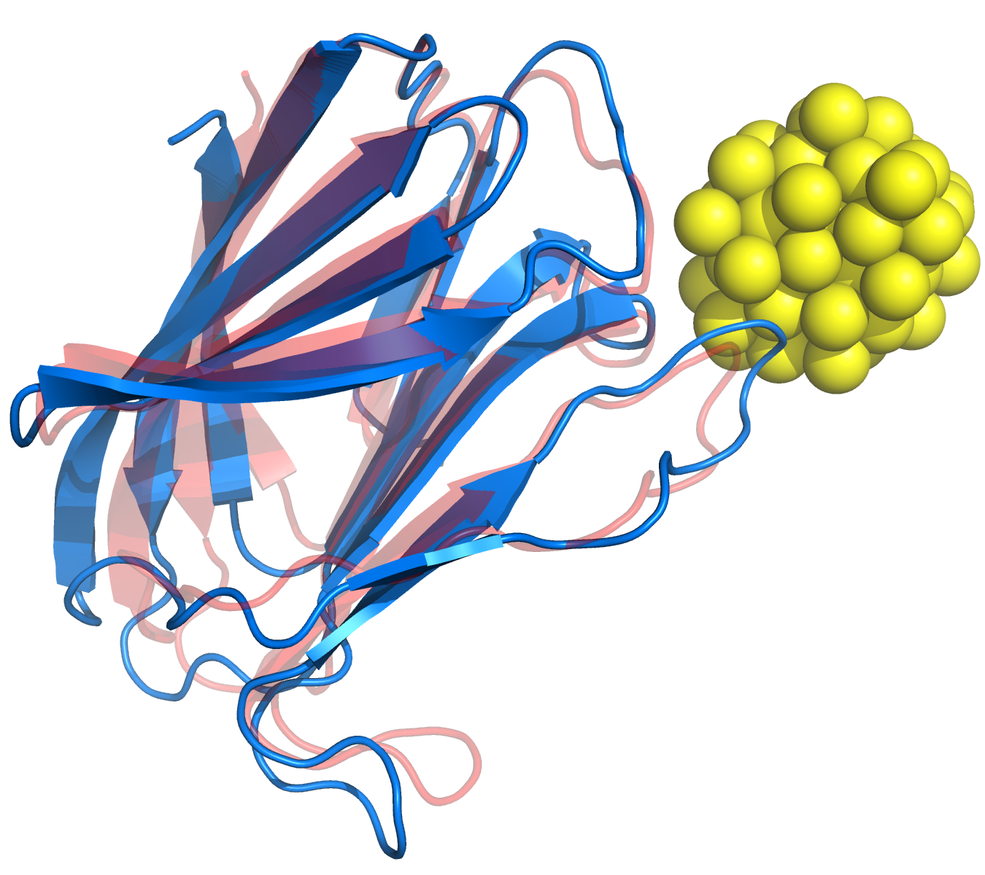
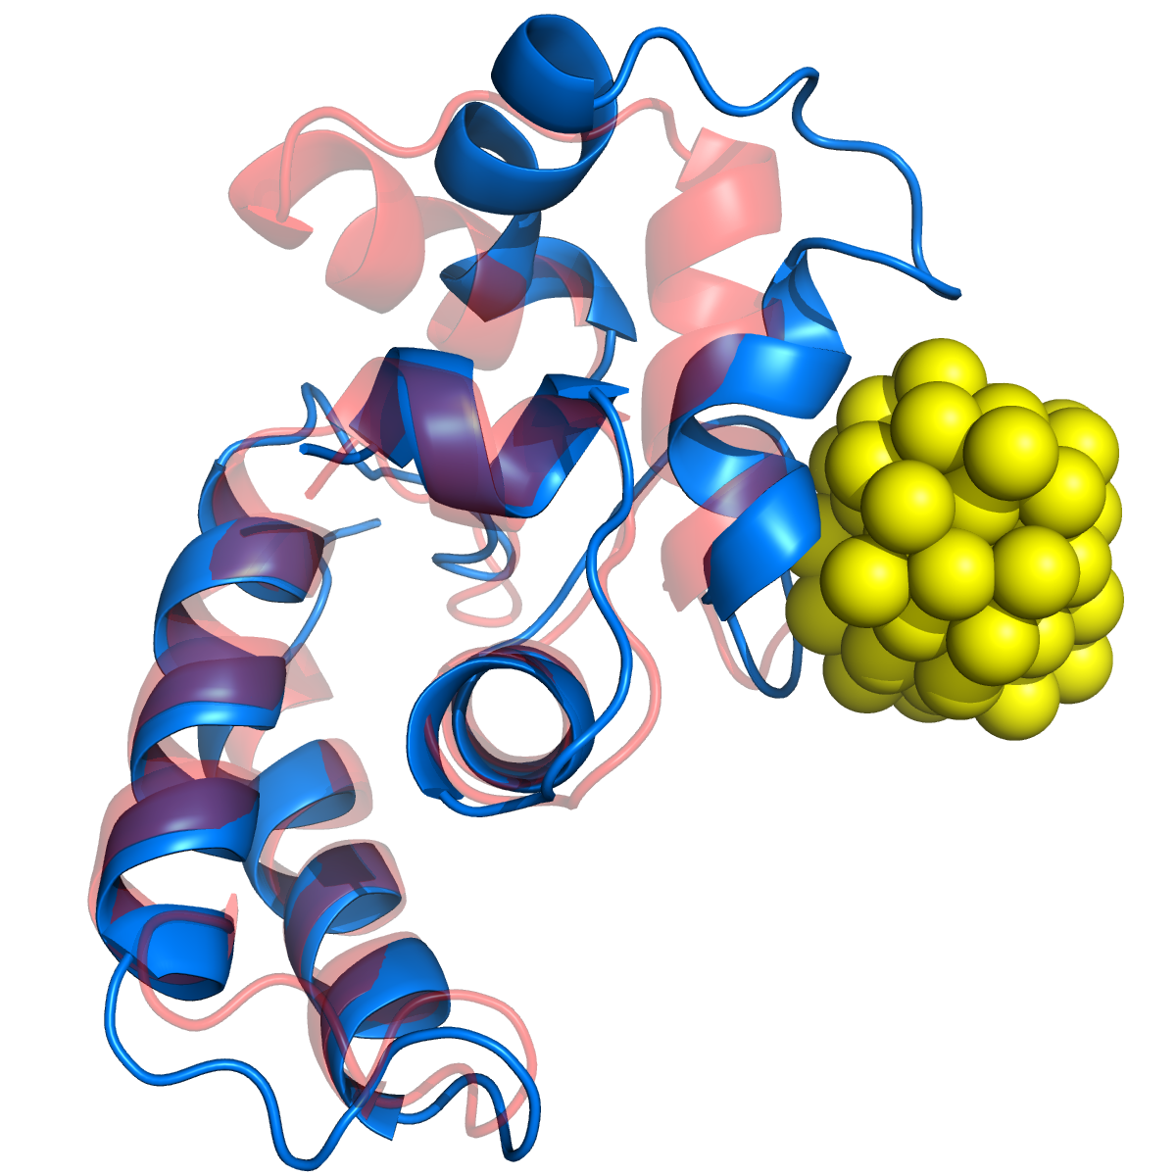
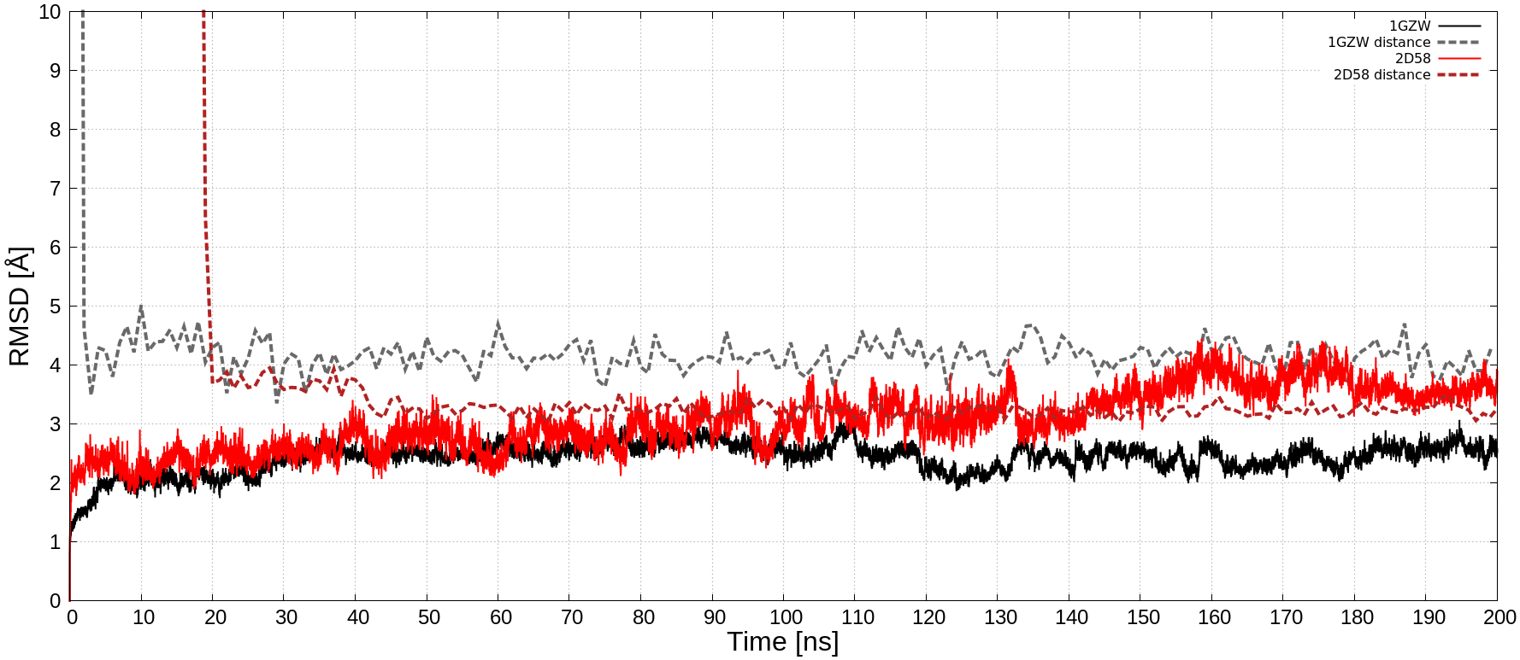
MD Simulations
1GZW
2D58

Slide 28
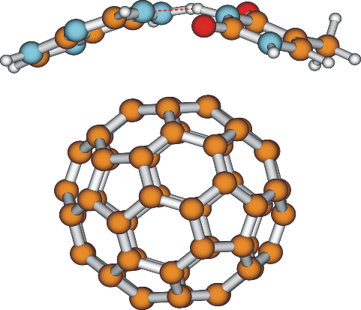
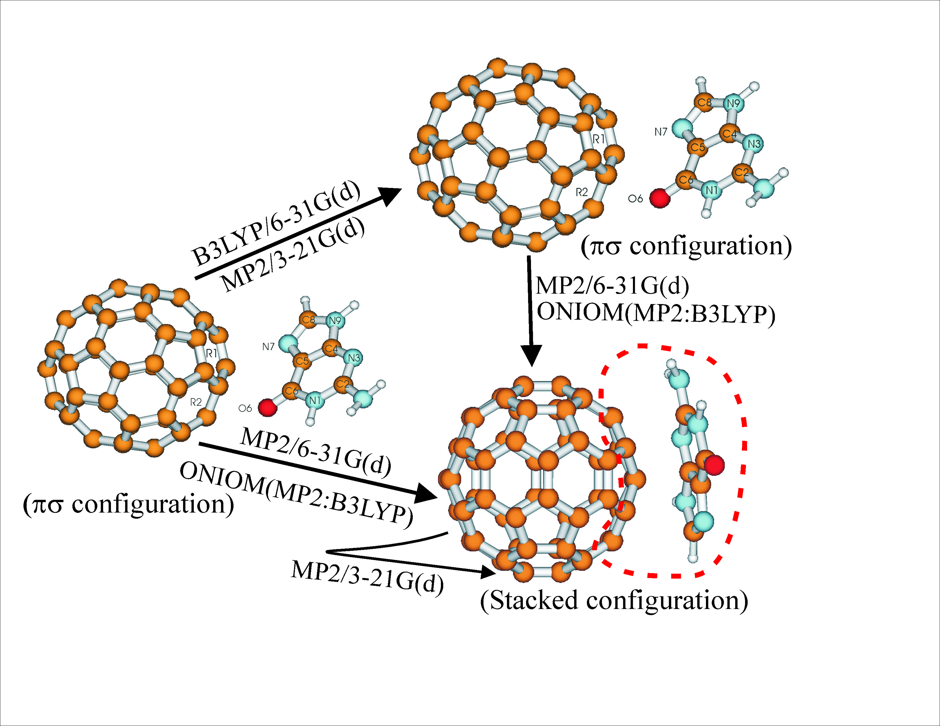
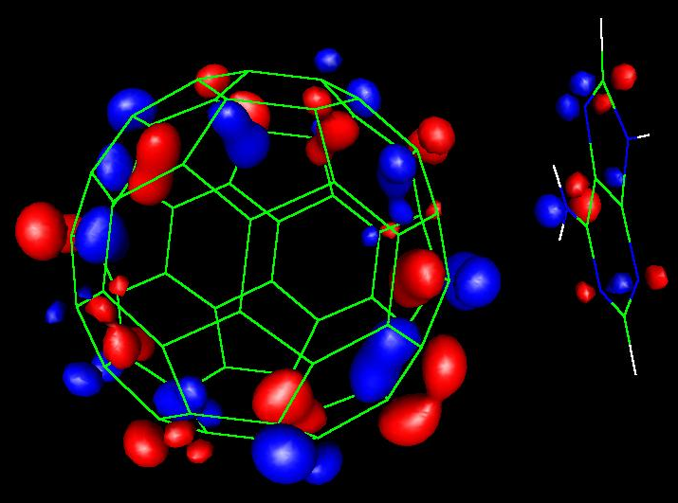
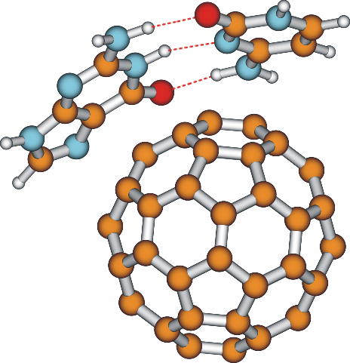
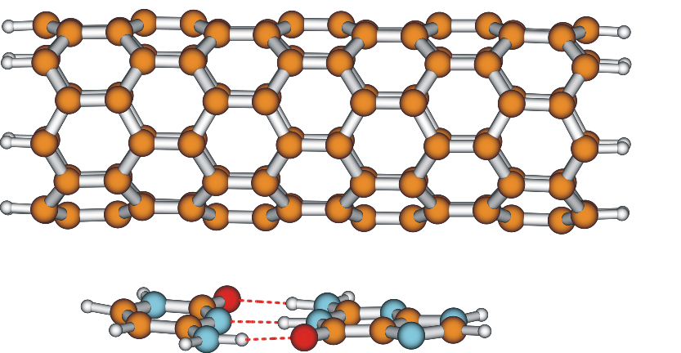
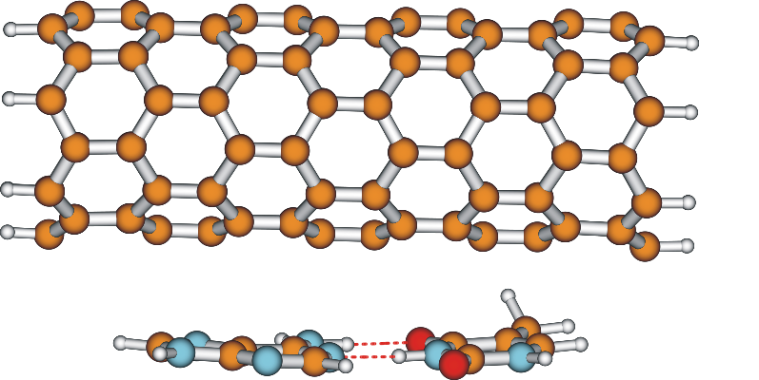
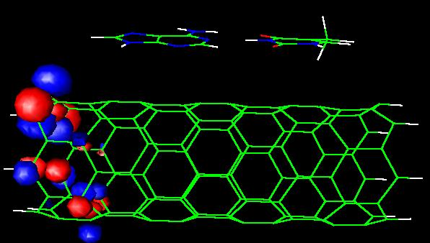
Interactions of G, GC and AT with C60 and SWNT
M.Shukla, J.Leszczynski, (2009), CPL, 469, 27; ibid (2010), 493,126; ibid (2010), 496, 130

Slide 29

Proteins and Fullerenes

Slide 30
Collaboration Within „Classic” QSAR Studies
QSAR
Experimental toxicology

Slide 31
What we Need to Develop Nano-QSARs?
Experimental structure characterization
Experimental toxicology
Nano-QSAR

Slide 32
Data for „Classic” QSAR and Nano-QSAR Studies
Size
Chemicals
Chemicals
Descriptors / Properties
Descriptors / Properties
„Classic” QSAR
Nano-QSAR

Slide 33

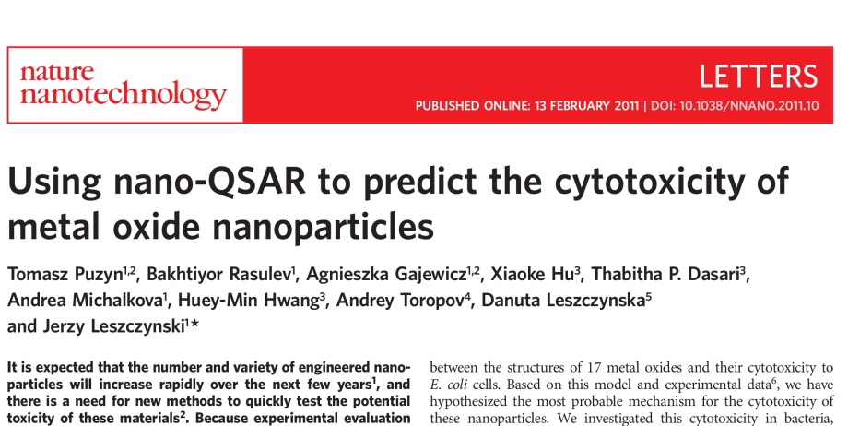
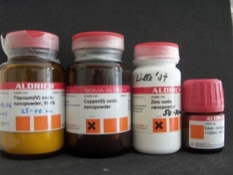
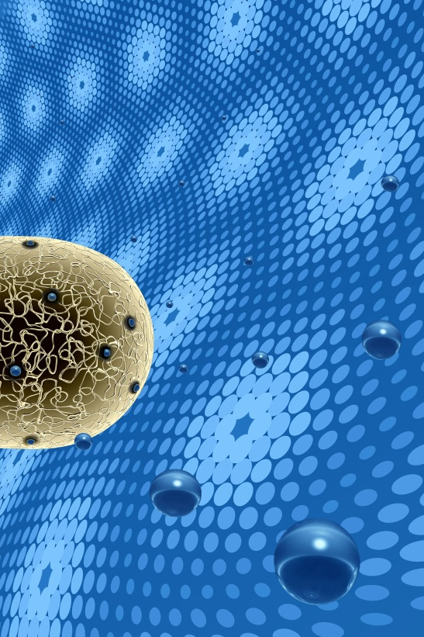
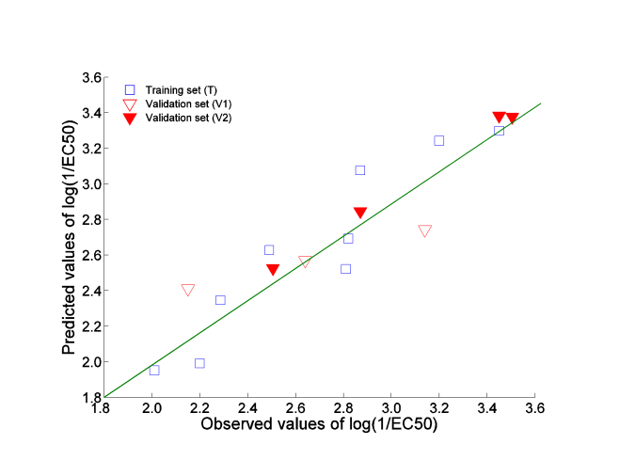
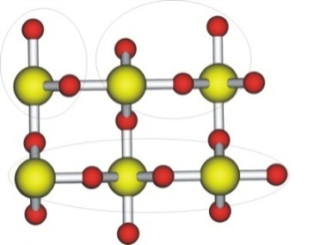
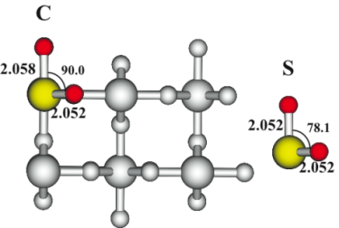
Nano-QSAR
Toxicity of Nanomaterials
Nano-QSAR model, which successfully predicted the cytotoxicity of the metal oxide nanoparticles
log(1/EC₅₀)= 2.59 - 0.50·∆H_{Me+}
Structural, Physical
and Quantum-Chemical
Properties
QSAR
model
Predicting
the activity for
untested
compounds
Modeling
Experiment
In vitro data
Training Set | Validation set 1 | Validation Set 2
ZnO CuO Y₂O₃ Bi₂O₃ In₂O₃ Al₂O₃ Fe₂O₃ SiO₂ SnO₂ TiO₂ | V₂O₃ Sb₂O₃ ZrO₂ | CoO NiO Cr₂O₃ La₂O₃
E. coli and
nanoparticle surface

Slide 34
Postulated mechanisms of NPs’ toxicity
Release of NPs constituents
Linkov et al. (2009) J. Nanopart. Res. 11: 513-527.
Physical effects of size and shape
Effects on membranes
Effects on gene expression
Inflammatory response
Other contaminants
Effects on macro-molecules
Effects on enzyme activity
Vector for other contaminants
Surface reactivity

Slide 35
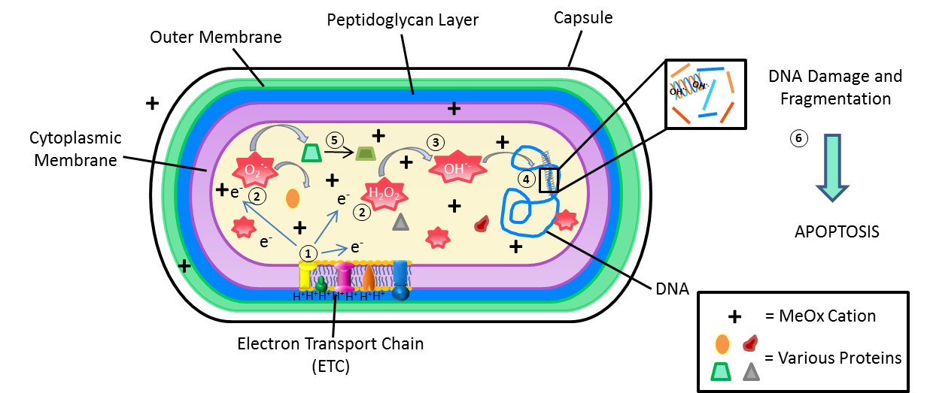
Proposed Mechanism of Bacterial Cell Death
1. Electrons leak from ETC during respiration. 2. The free electrons interact with various molecules in the cell to produce free radicals. 3. MeOx cations in the cell increase the production of free radicals, particularly the OH˙⁻ . 4. The OH˙⁻ attacks the DNA, producing single and double strand breaks and blocks replication of DNA. 5. Proteins are attacked by free radicals and oxidized, which impairs their function. This leads to a more inefficient ETC which then produces more free radicals. 6. The vicious cycle continues until there is too much DNA damage in the cell and apoptosis occurs.
Gajewicz A., Schaeublin N., Rasulev B., Hussain S., Leszczynska D., Puzyn T. and Leszczynski J., Towards Understanding Mechanisms Governing Cytotoxicity of Metal Oxides Nanoparticles: Hints from Nano-QSAR Studies, Nanotoxicology, 2014, in press

Slide 36
Towards More Complex Systems:
HaCaT Human Cell Line
The developed two-variable predictive model for 18 metal nanooxides can be expressed as:
log (EC₅₀)⁻¹ = 2.466 + 0.244 ΔH_{f}^{c} + 0.394 χ^{c}
where: ΔH_{f}^{c} is the enthalpy of formation of metal oxide nanocluster representing fragment of the surface and χ^{c} - the Mulliken’s electronegativity of the cluster.
F = 44.6, p = 1x10⁻⁴, n = 18, R² = 0.93, RMSE_{C} = 0.12, Q²_{CV} = 0.86,
RMSE_{CV} = 0.16, Q²_{Ext} = 0.83, RMSE_{P} = 0.13
Gajewicz A., Schaeublin N., Rasulev B., Hussain S., Leszczynska D., Puzyn T. and Leszczynski J., Towards Understanding Mechanisms Governing Cytotoxicity of Metal Oxides Nanoparticles: Hints from Nano-QSAR Studies, Nanotoxicology, 2014, in press

Slide 37
Summary Table of Characterization Data, Selected Parameters and Computational Results
 | Experimental data |  |  |  | Computational data
Metal Oxide Nanoparticles | Average Particle Size, (nm) | LC₅₀ (µg/mL) | Average Particle Size in media (nm) | Zeta Potential (mV) | ΔH_{f}^{c} [kcal/mol] | χ^{c} [eV] | Observed log(LC₅₀)⁻¹ [molar] | Set | Predicted log(LC₅₀)⁻¹ [molar] | Residuals | Leverages
Titanium IV oxide | 42.3 | 1389 | 1307.0 ± 313.7 | -9.6 ± 0.2 | -1492.0 | 4.91 | 1.76 | T | 1.78 | -0.02 | 0.71
Aluminum III oxide | 44 | 1439 | 372.3 ± 17.9 | -20.2 ± 5.2 | -600.0 | 3.44 | 1.85 | V | 1.90 | -0.05 | 0.28
Zirconium IV oxide | 46.7 | 1188 | 661.4 ± 14.4 | -8.5 ± 1.1 | -638.1 | 4.95 | 2.02 | T | 2.25 | -0.23 | 0.13
Iron III oxide | 32 | 1483 | 297.6 ± 6.9 | -18.1 ± 7.4 | -378.5 | 4.21 | 2.05 | V | 2.21 | -0.16 | 0.17
Silicon IV dioxide | 15 | 453 | 809.7 ± 97.4 | -8.1 ± 1.0 | -618.3 | 3.81 | 2.12 | T | 1.99 | 0.13 | 0.23
Yttrium III oxide | 38 | 1390 | 1222.9 ± 351.7 | -10.7 ± 1.5 | -135.3 | 3.35 | 2.21 | V | 2.14 | 0.07 | 0.33
Vanadium III oxide | NIA | 855 | 433.9 ± 40.1 | -22.8 ± 0 | -139.5 | 3.24 | 2.24 | T | 2.11 | 0.13 | 0.35
Chromium III oxide | 60 | 755 | 616.8 ± 118 | 5.7 ± 3.6 | -235.3 | 4.36 | 2.30 | V | 2.33 | -0.03 | 0.17
Antimony III oxide | 90-210 | 1429 | 640.3 ± 77. 9 | -13.3 ± 0.8 | -206.7 | 4.46 | 2.31 | T | 2.37 | -0.06 | 0.17
Nickel II oxide | 20 | 242 | 223.5 ± 33.2 | -12.1 ± 2.1 | 68.0 | 4.47 | 2.49 | V | 2.52 | -0.03 | 0.29
Bismuth III oxide | 90 | 1489 | 2029 ± 150.7 | -2.3 ± 1.8 | -148.5 | 5.34 | 2.50 | T | 2.62 | -0.12 | 0.16
Tungsten VI oxide | 30-70 | 634 | 179.6 ± 63.2 | -9.1 ± 2.0 | -715.4 | 6.73 | 2.56 | V | 2.65 | -0.09 | 0.20
Manganese III oxide | 29.8 | 362 | 291.1 ± 7.5 | -3 ± 2.3 | -96.3 | 5.00 | 2.64 | T | 2.56 | 0.08 | 0.18
Tin IV oxide | 46.1 | 322 | 264.9 ± 64.9 | -10.5 ± 1.1 | -266.6 | 4.57 | 2.67 | V | 2.36 | 0.31 | 0.15
Cobalt II oxide | <100 | 110 | 257 ± 11.9 | -3.4 ± 1.1 | -786.8 | 7.44 | 2.83 | T | 2.78 | 0.05 | 0.32
Lanthanum III oxide | 45.6 | 443 | 672.9 ± 79.1 | -12.8 ± 1.3 | -157.7 | 6.45 | 2.87 | V | 2.88 | -0.01 | 0.20
Indium III oxide | 29.8 | 332 | 224.3 ± 63.1 | -9.6 ± 1.5 | -52.1 | 6.78 | 2.92 | T | 3.02 | -0.10 | 0.28
Zinc II oxide | 71 | 39 | 188.9 ± 37.2 | -10.8 ± 1.5 | -449.4 | 8.33 | 3.32 | T | 3.18 | 0.14 | 0.46
Copper II oxide | - | - | - | - | -76.32 | 4.25 | - | P | 2.39 | - | 0.24
Iron II oxide | - | - | - | - | -883.2 | 5.88 | - | P | 2.35 | - | 0.20
Gadolinium III oxide | - | - | - | - | -234.07 | 5.91 | - | P | 2.71 | - | 0.14
Lead II oxide | - | - | - | - | -306.31 | 5.12 | - | P | 2.48 | - | 0.12
Lead IV oxide | - | - | - | - | -269.54 | 6.13 | - | P | 2.74 | - | 0.14
Gajewicz A., Schaeublin N., Rasulev B., Hussain S., Leszczynska D., Puzyn T. and Leszczynski J., Towards Understanding Mechanisms Governing Cytotoxicity of Metal Oxides Nanoparticles: Hints from Nano-QSAR Studies, Nanotoxicology, 2014, in press

Slide 38
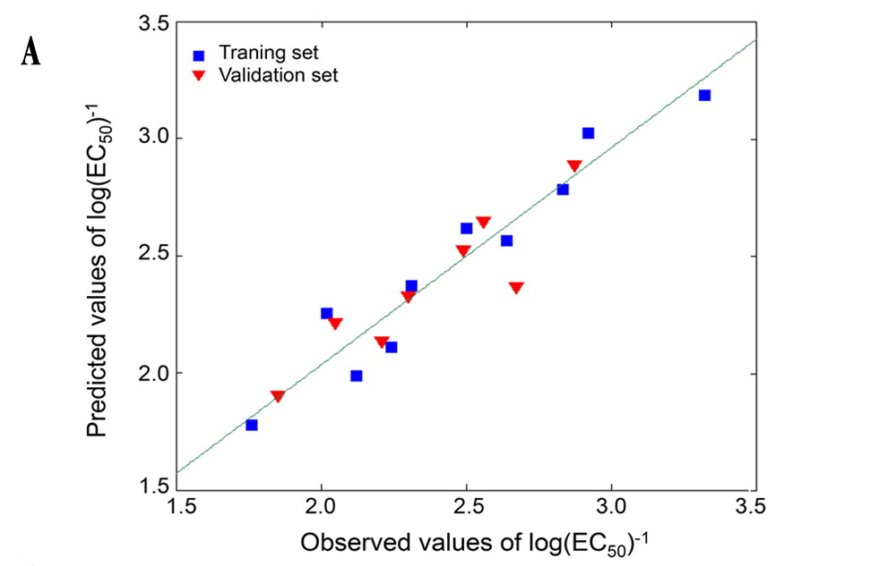
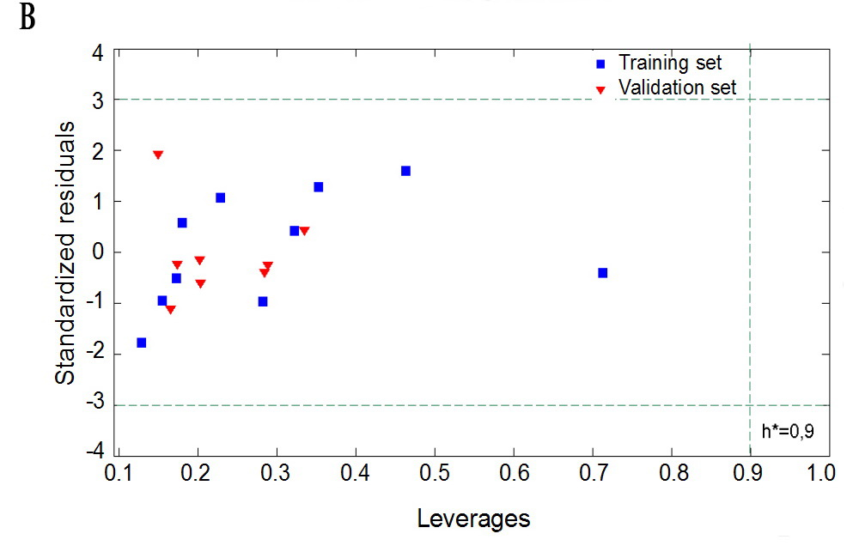
Figure 2. A.
Plot of experimentally determined (observed) versus predicted
log values of 1/EC₅₀.
The straight line represents perfect agreement between
experimental and calculated values. Squares represent values
predicted for the metal oxides from the training set;
triangles represent data calculated for metal oxides
from the validation sets.
The distance of each symbol from the green line corresponds
to its deviation from the related experimental value.
Figure 2. B.
Williams plot describing applicability domains of GA-MLR model.
Solid lines represent the residual threshold
(0 ± 3 standard deviation units), and dashed line represents
the critical leverage value (h*).

Slide 39
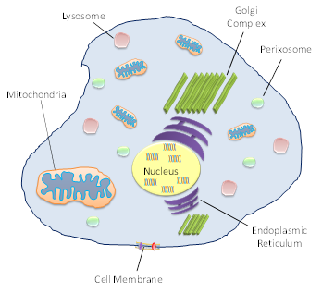
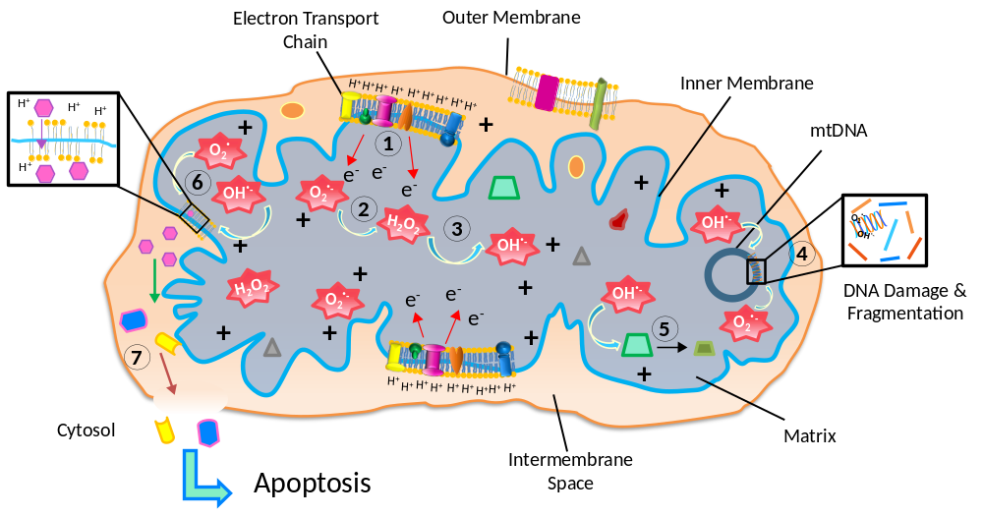
+
= MeOx Cation
= Ca⁺⁺
= Matrix Proteins
= Caspases and apoptotic proteins
Figure 5. Proposed Mechanism of Eukaryotic Cell Death
1. Electrons leak from ETC during respiration. 2. The free electrons interact with various molecules in the cell to produce free radicals. 3. MeOx cations in the cell increase the production of free radicals, particularly the OH˙⁻ . 4. The OH˙⁻ and O₂˙⁻ attack the mtDNA, producing single and double strand breaks and blocking replication of DNA. 5. Proteins are attacked by free radicals and oxidized, which impairs their function. This leads to a more inefficient ETC which then produces more free radicals. 6. The protonated form of O₂˙, OH˙⁻ , and MeOx cause autocatalytic lipid peroxidation. This decreases the fluidity of the membrane which leads to a loss of mitochondrial membrane potential and causes the contents of the matrix to spill into the inner membrane. 7. The release of Ca⁺⁺ and other proteins activates caspases and turns on the mitochondrial apoptosis pathway.

Slide 40
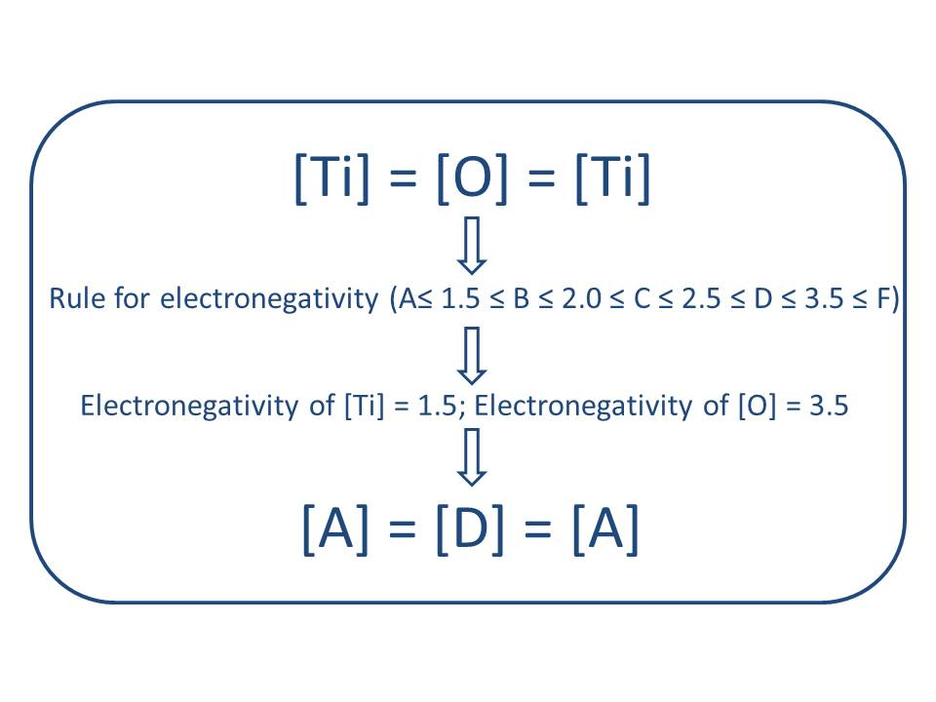


Nano-QSAR Based on SiRMS and “Liquid Drop Model” Techniques
E.Coli and HaCaT cells
SiRMS – Simplex Representation
of Molecular Structure
Classification modeling
“Liquid Drop Model” descriptor representation
Novoselska N., Rasulev B., Gajewicz A., Kuz’min V., Puzyn T., Leszczynski J. Predictive Classification Models for HaCaT and E.coli
Cells Toxicity of Metal Oxide Nanoparticles, Nanoscale, 6, 13986, 2014.

Slide 41
Nano-QSAR Based on SiRMS and “Liquid Drop Model” Techniques
Diagram of relative contribution (%) of certain descriptors to toxicity
E.Coli cell toxicity
HaCaT cells toxicity
Novoselska N., Rasulev B., Gajewicz A., Kuz’min V., Puzyn T., Leszczynski J. Predictive Classification Models for HaCaT and E.coli
Cells Toxicity of Metal Oxide Nanoparticles, Nanoscale, 6, 13986, 2014.

Slide 42


Slide 43



Slide 44

Thank you
for your attention!

