Slide 1
Quantifying air-surface exchange of elemental mercury vapor using enclosure and micrometeorological methods
C. Jerry Lin^{1,2}, W. Zhu², J. Sommar² & X. Feng²
¹Lamar University and ²CAS Institute of Geochemistry
Data Collection, Analysis and Application of
Speciated Atmospheric Mercury
3rd International Conference on Earth Science & Climate Change
July 29, 2014

Slide 2
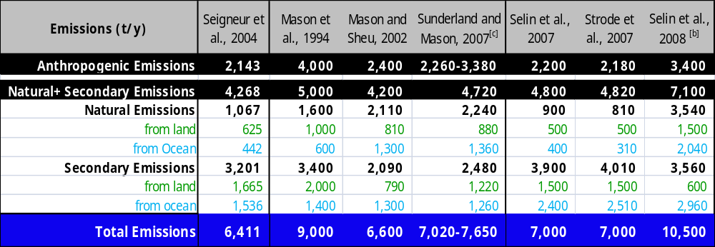
Anthropogenic vs. Natural/Secondary
 | Anthropogenic | Natural | Secondary
Mean | 2,735(787) | 1,752(972) | 3,234(714)
Total | 7,752(1653) t/y

Slide 3
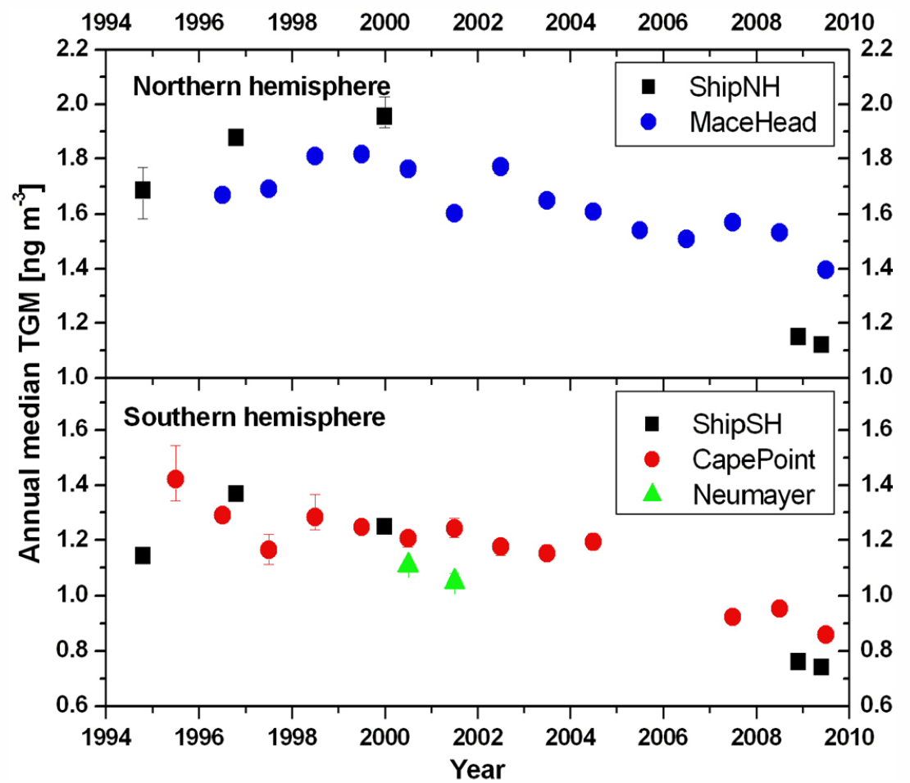
Background Hg Trend
Slemr et al. (2011)

Slide 4
Objectives
Review the micro-meteorological and enclosure methods for quantifying Hg⁰ air-surface exchange
Compare the characteristics of Hg exchange fluxes measured by different methods
Evaluate the uncertainty of each flux quantification method

Slide 5
Flux Measurement Approaches
Enclosure methods
  Static flux chamber
  Flow-through (dynamic) flux chamber
Flux gradient methods
  Modified Bowen ratio
  Aerodynamic gradient
Relaxed eddy accumulation (REA) method
Differential absorption LIDAR
Eddy covariance method (EC) ???

Slide 6
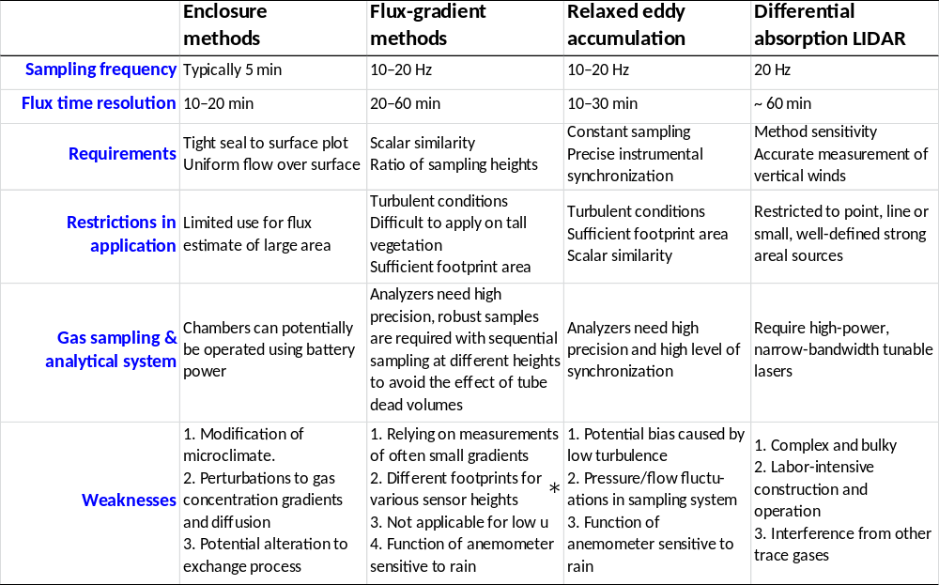
Quick Comparison

Slide 7
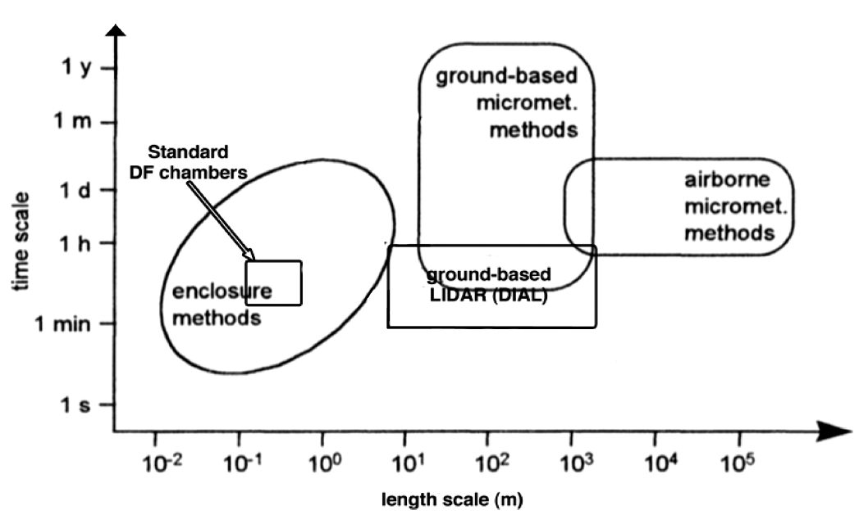
Time and Spatial Scales
Sommar et al. (2012)

Slide 8
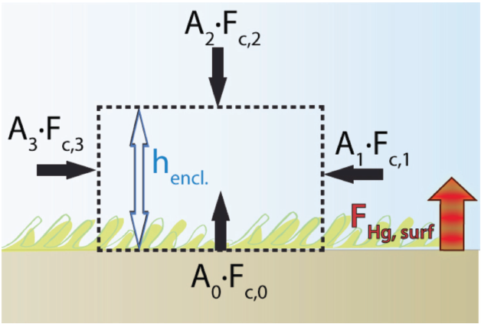

Chamber Methods

Slide 9
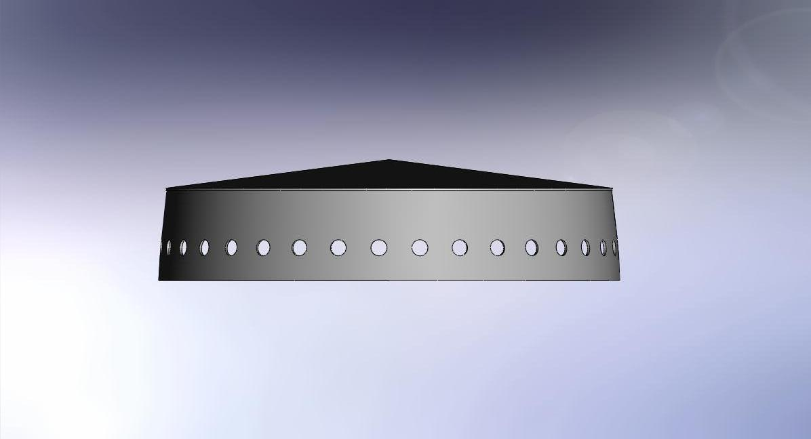
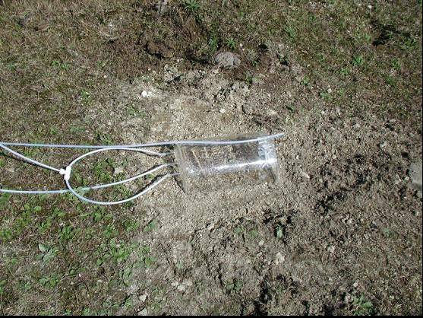

Dynamic Flux Chambers
Gustin (1999)
X. Feng (2005)

Slide 10
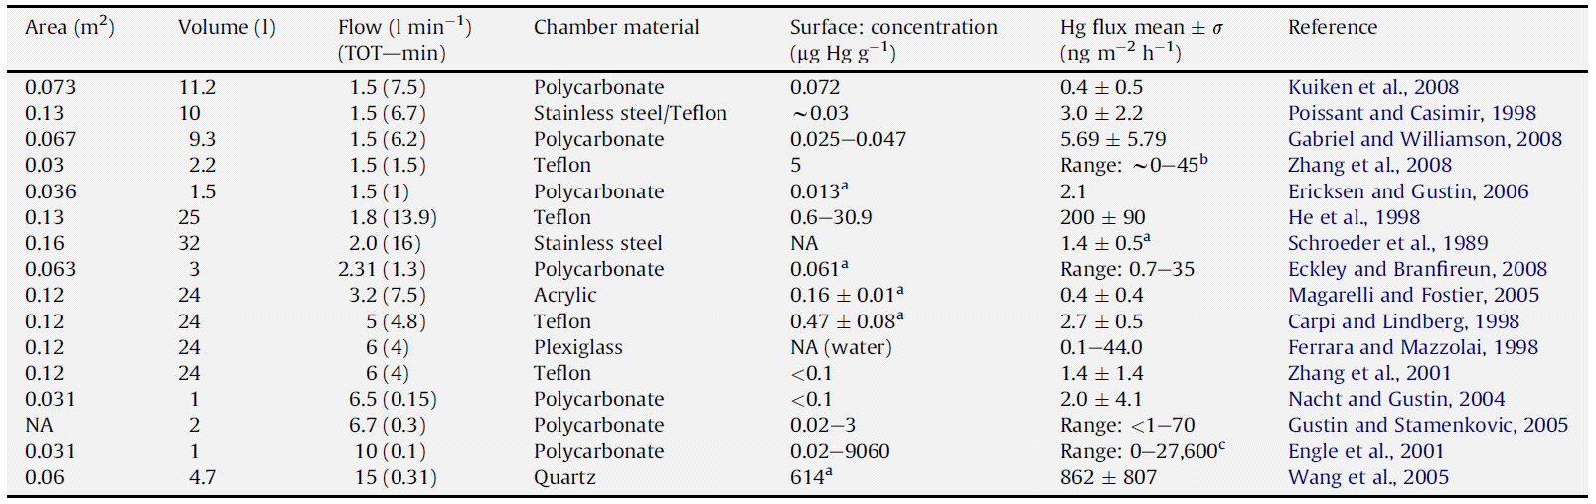
Chamber Methods
Eckley et al. (2010)

Slide 11
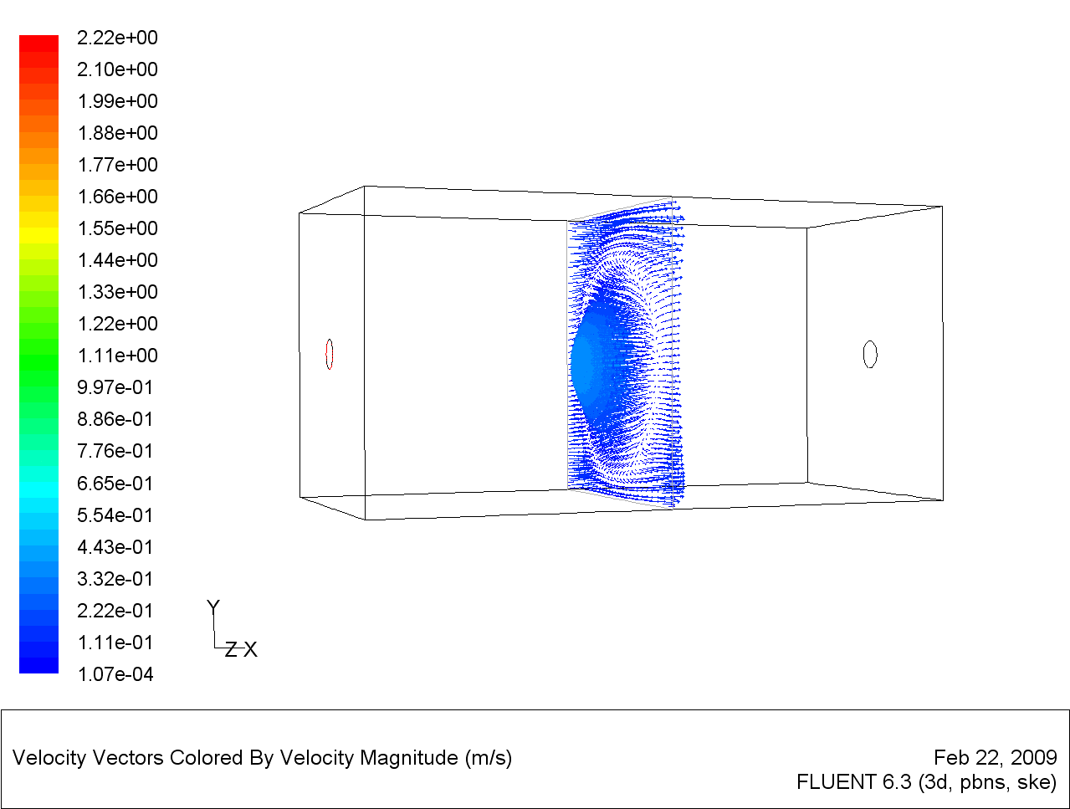
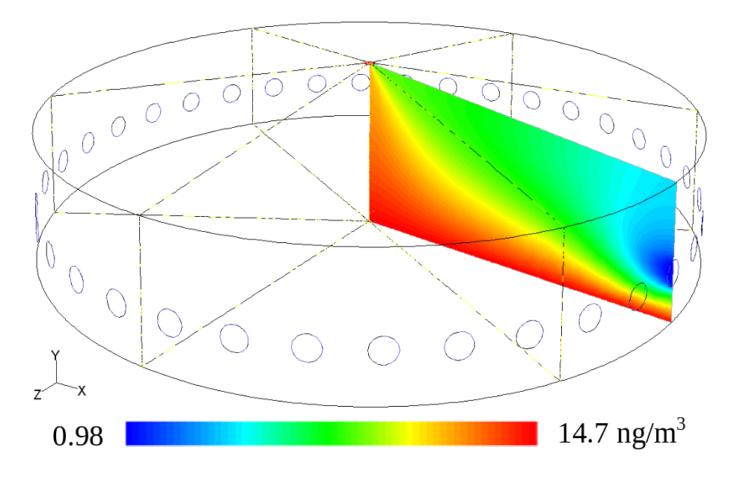
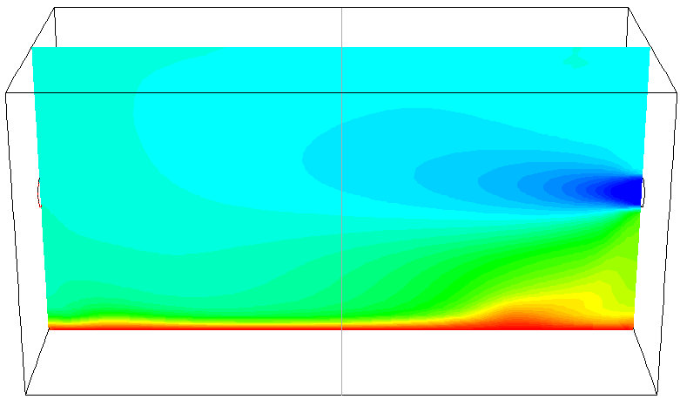
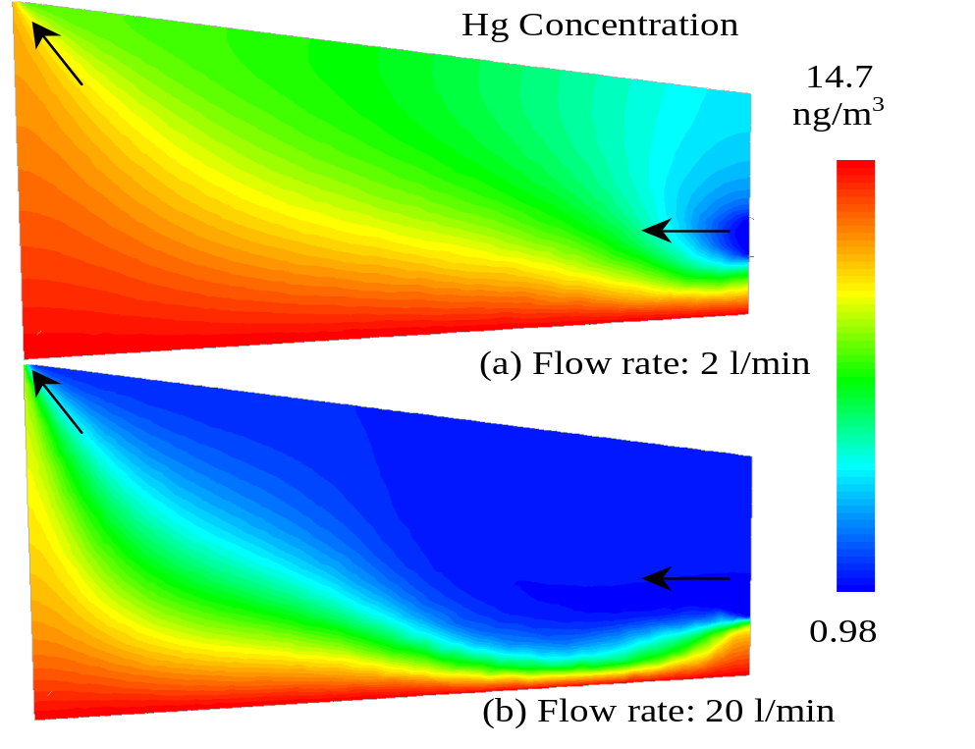
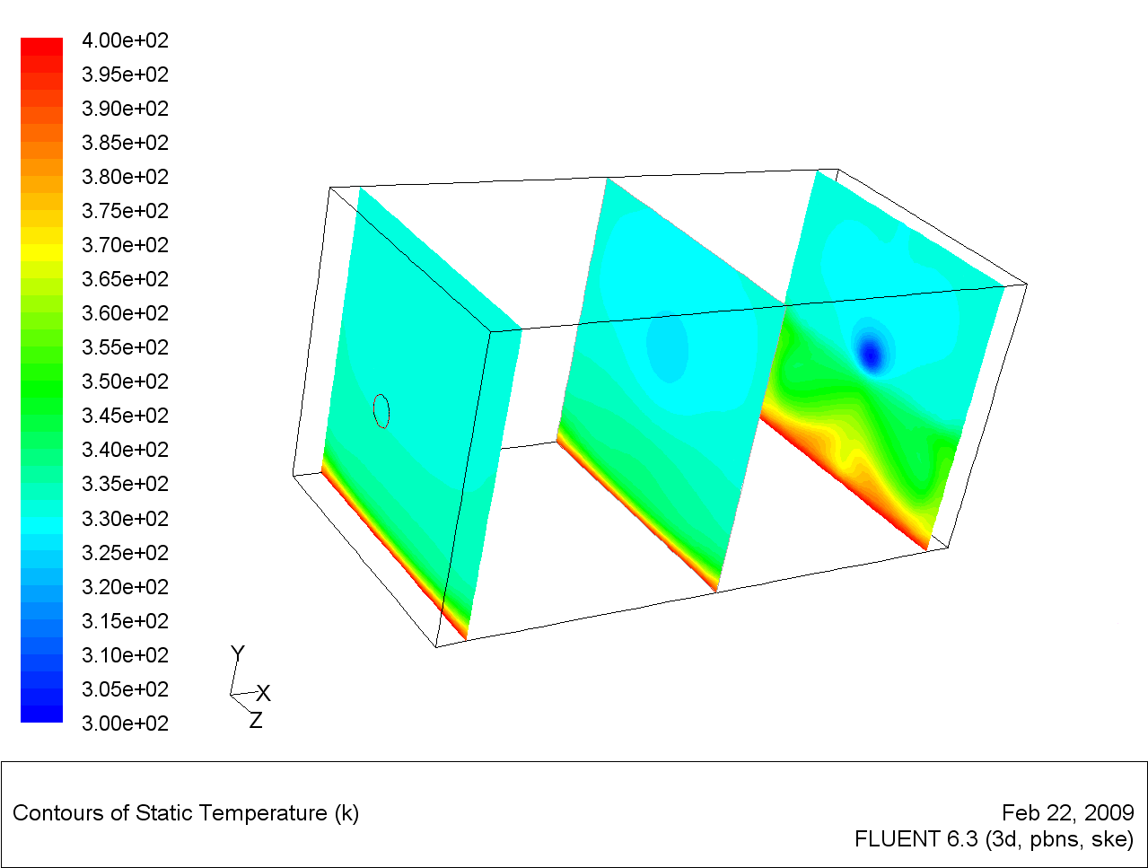
Notes:
In earlier studies, it was typically assumed that the concentration distribution of Hg within a DFC is well mixed. This slide shows that the two mainstream designs do not produce uniform Hg concentration within the chambers based on computational fluidic dynamics (CFD) calculations. On the right hand side of the slide, it also shows that varying the flow rate changes the concentration distribution of Hg in the chamber, causing very different measured fluxes over the same soil surface (next slide).
11

Slide 12
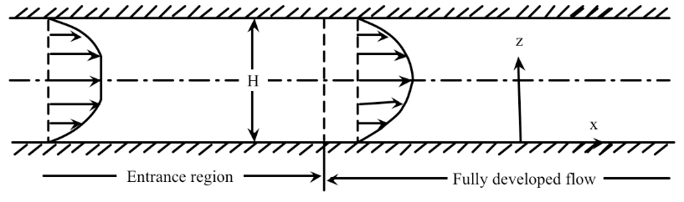
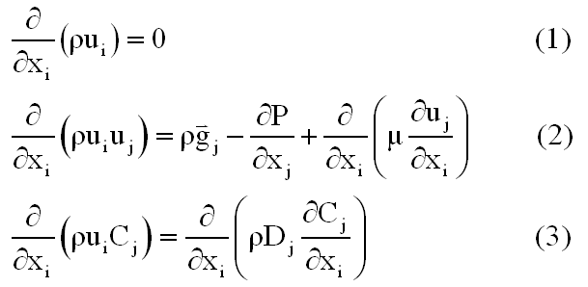
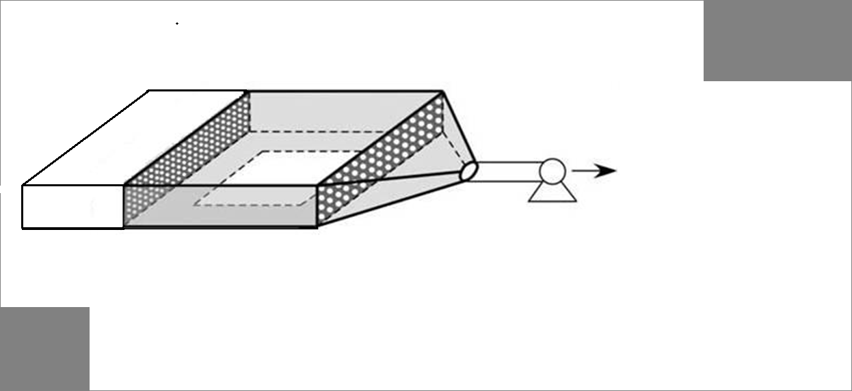
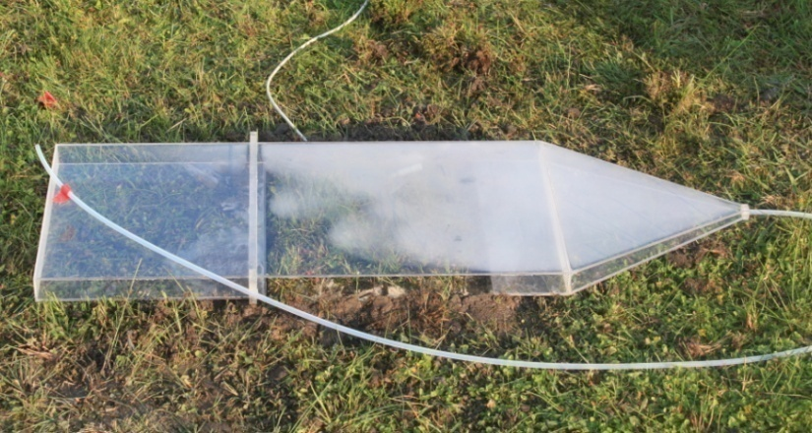
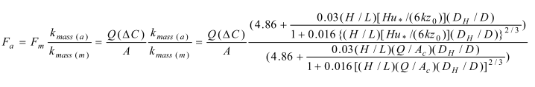
DFC with Turbulence Correction
Uniform
Flow field
Lin et al. (2012)

Slide 13
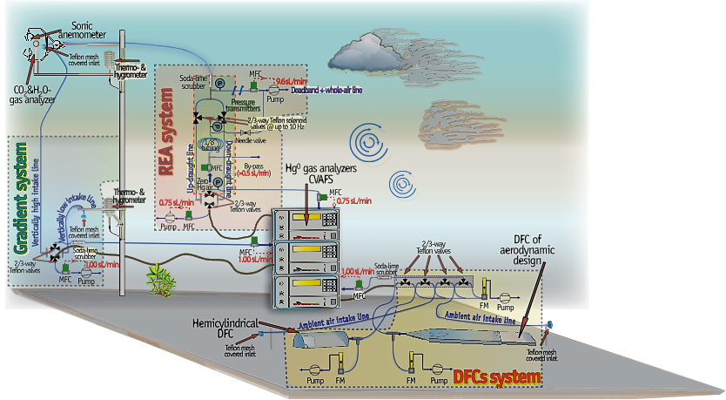


Flux Gradient Methods
Aerodynamic gradient (AGM) method
Modified Bowen-ratio (MBR) method

Slide 14
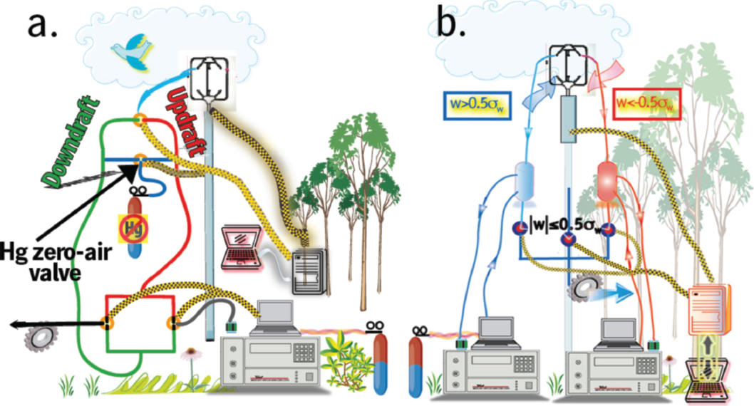

Relaxed Eddy Accumulation Method
Single Tekran Configuration
Dual Tekran Configuration

Slide 15
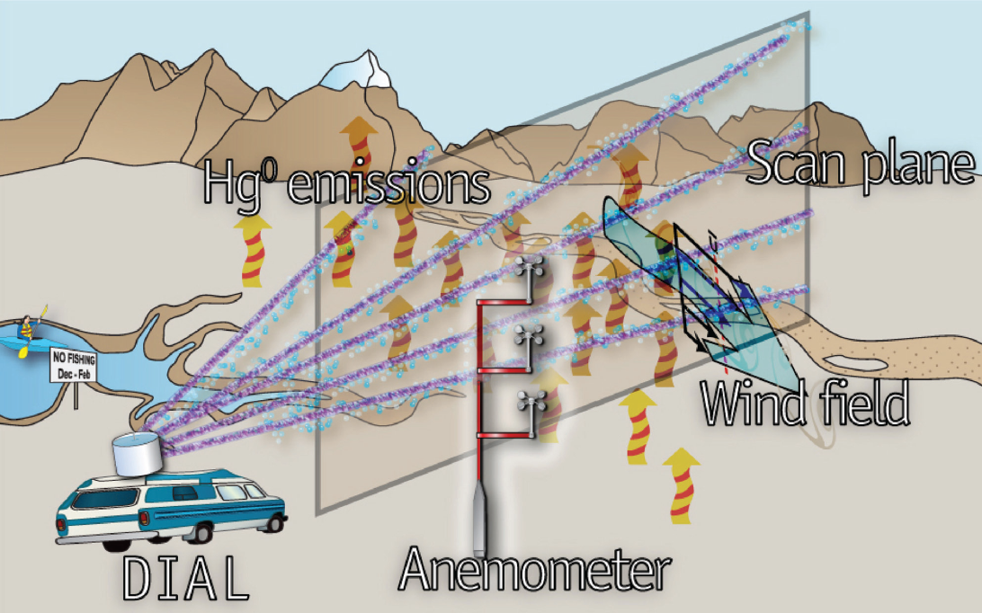

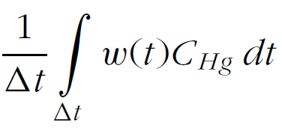
Differential LIDAR Method

Slide 16
5 Collocated Flux Measurements
Relaxed Eddy
Accumulation
Two Dynamic Flux
Chamber Methods:
Conventional vs.
Aerodynamic
Modified Bowen Ratio &
Aerodynamic Gradient
Methods

Slide 17
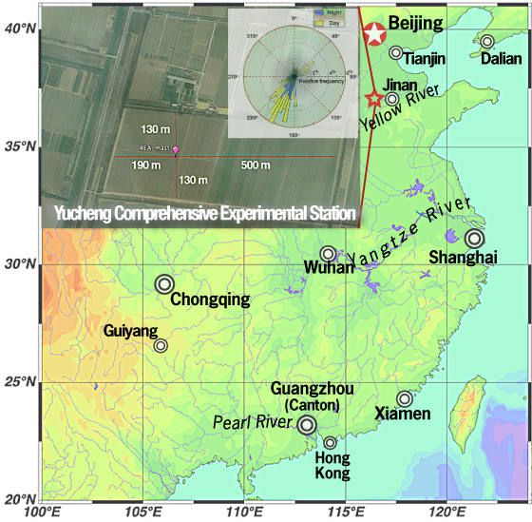
Field Measurement Site
Wheat-corn agricultural field
Flat surface
Homogeneous soil THg
Two Campaigns:
Autumn 2012 over bear soils
Spring 2013 over canopy
Samples | Total mercury (HgT, µg kg⁻¹)
 | Minimum | Maximum | Mean | Std. dev
Surface soils (n=27) | 39 | 52 | 45 | 3.9
6
Notes:
So. In this studied, we evaluated all 5 above mentioned techniques.
Our research consisted of two integrated field intercomparion campaigns over both bare and canopy surface. The site is located in North China Plain as shown in this map which ungergoing wheat-corn rotation agriculratural activities.
The site is evolution from fluvial alluvial effect with large area of flat natural surface.
From the lower panel table, we can see that soil Hg is relatively homogeneous distributed.

Slide 18
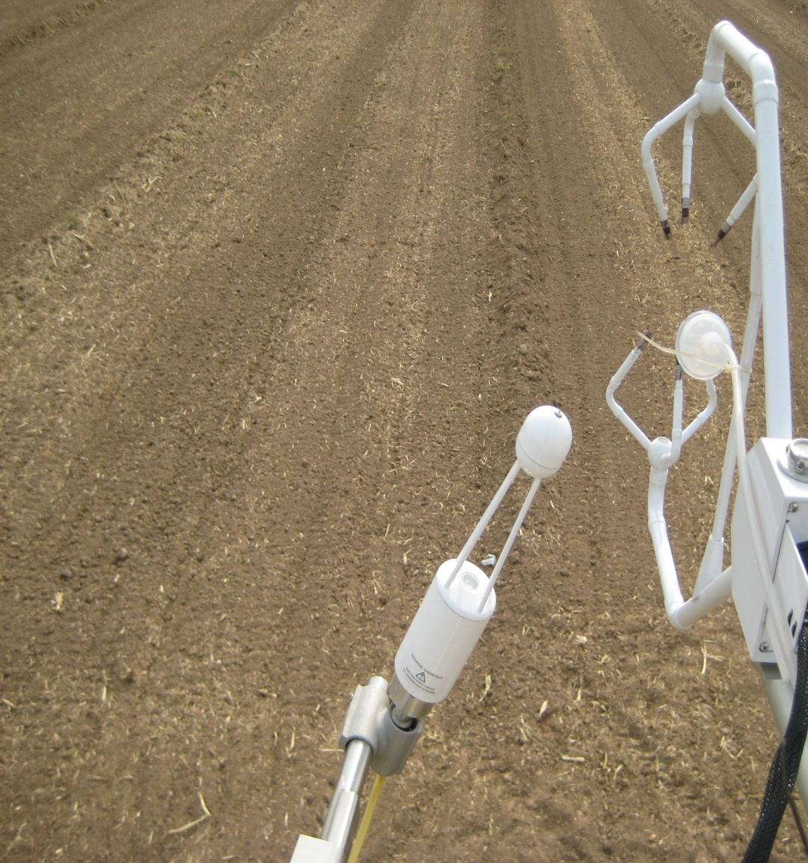
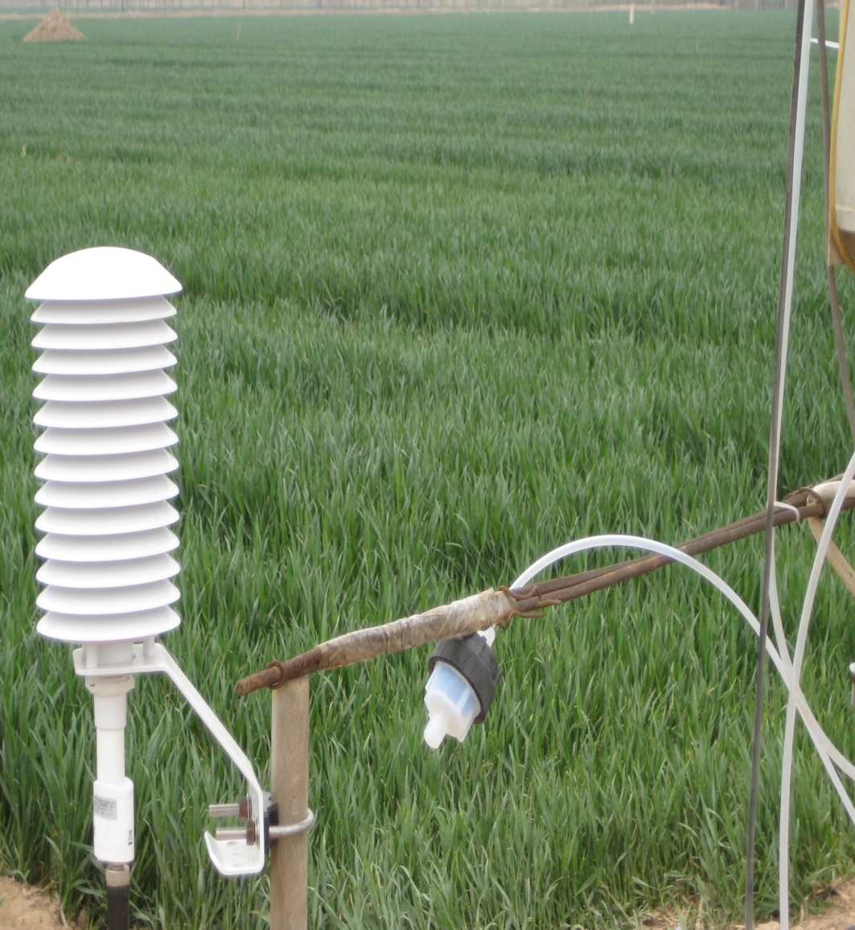
Site Views

Slide 19
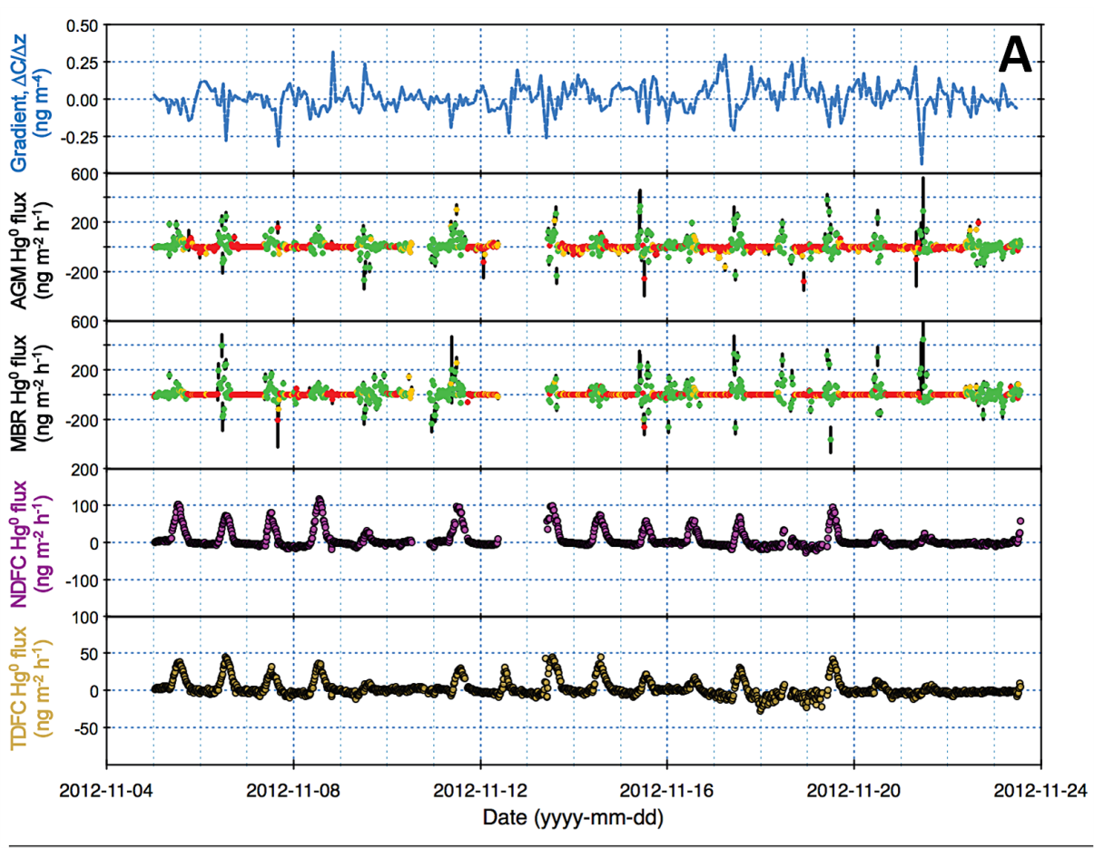
Flux Over Soil
Notes:
This slide shows the process and the main algorithms for estimating air-surface exchange of mercury. It is important to point out that the we will have the measurement data to calibrate the model parameters.

Slide 20
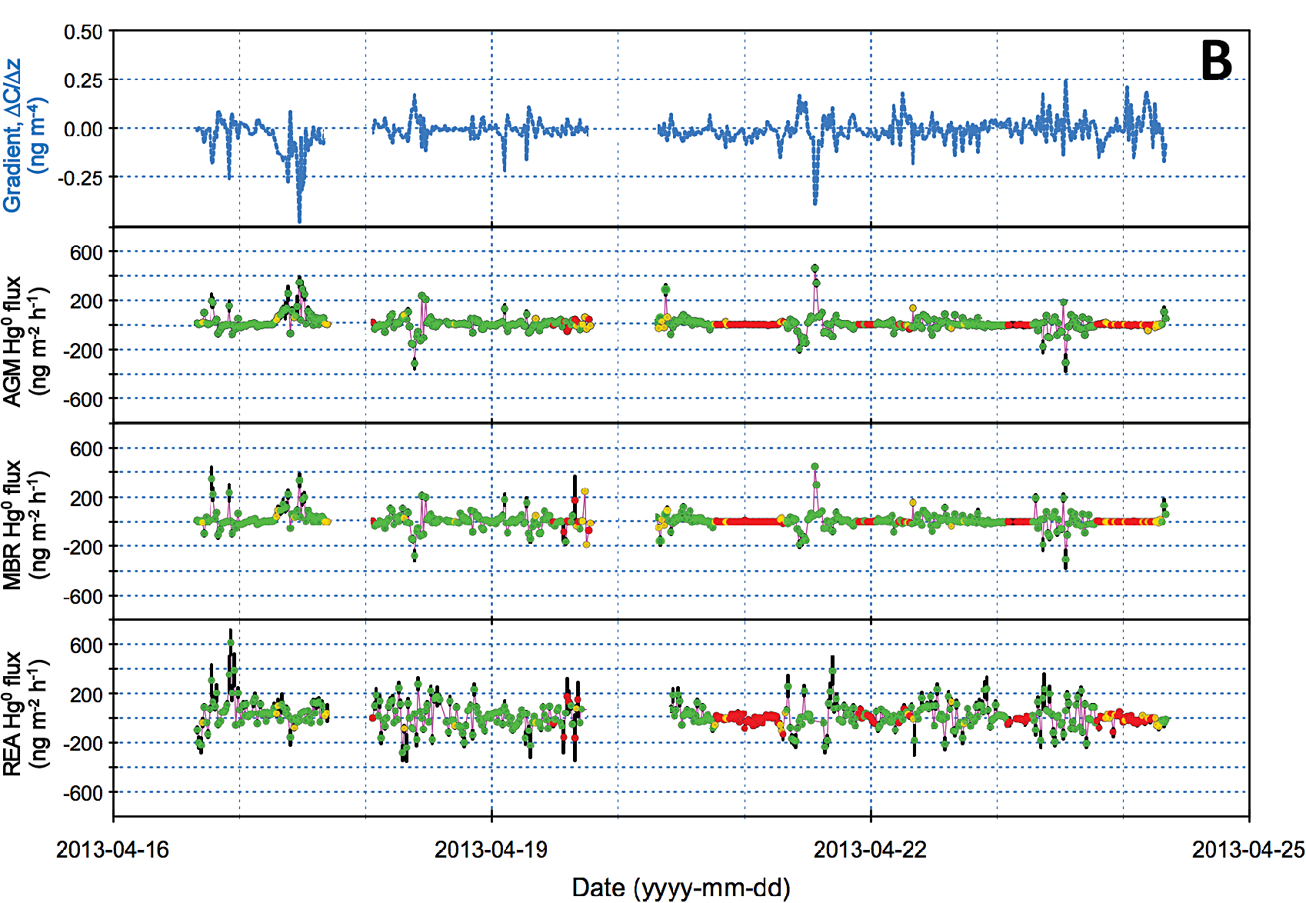
Flux Over Wheat Canopy
Notes:
This slide shows the process and the main algorithms for estimating air-surface exchange of mercury. It is important to point out that the we will have the measurement data to calibrate the model parameters.

Slide 21
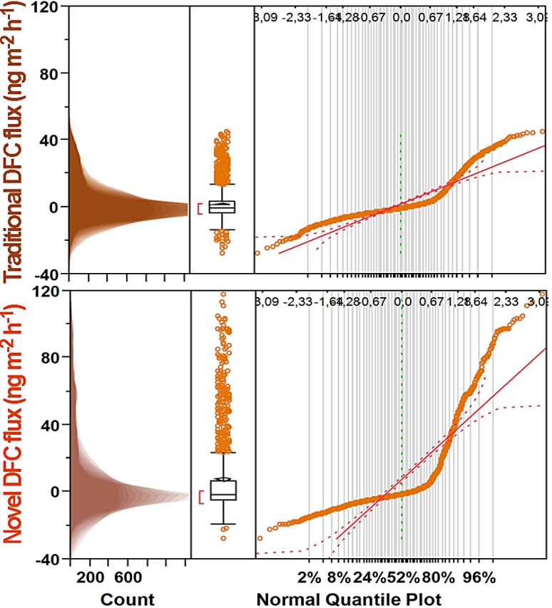
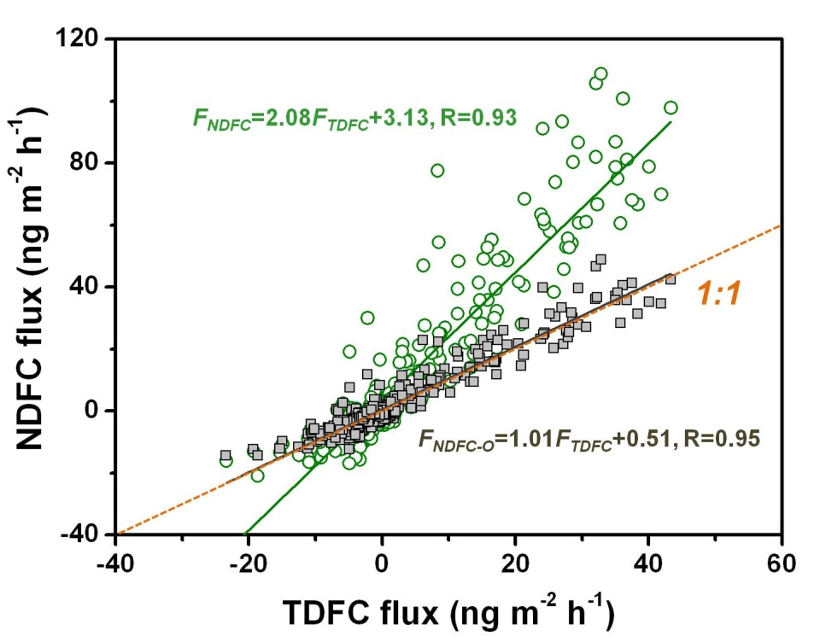
Comparison of DFC Fluxes
Correction of mass transfer coefficient changes flux magnitude by 25-100% depending on friction velocity.

Slide 22
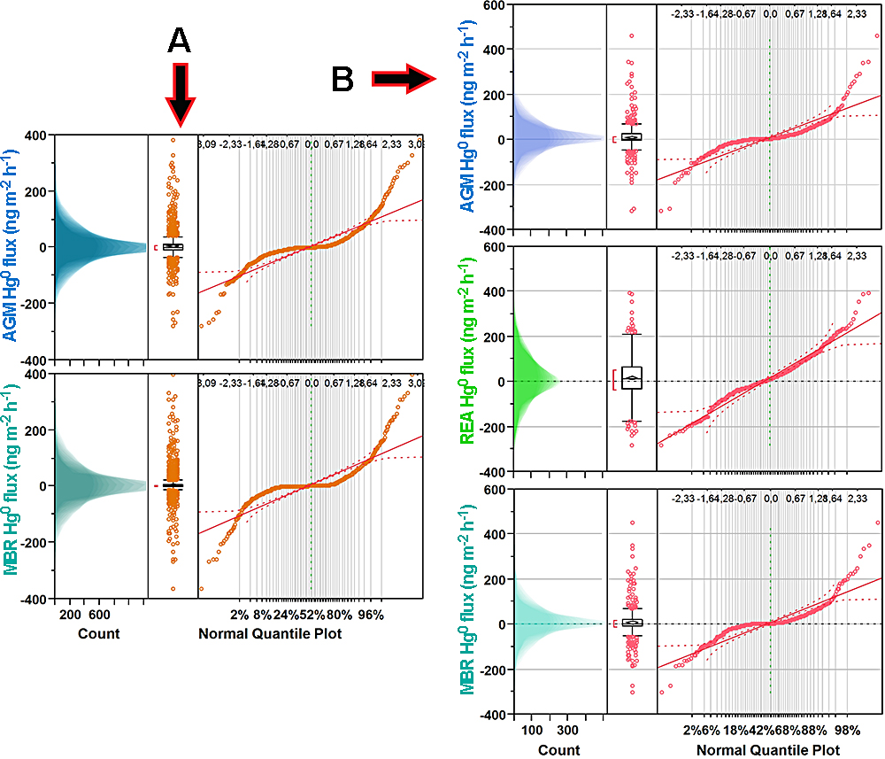
Comparison of Micromet Fluxes
Soil
Canopy
Median fluxes are not significantly different from each other!

Slide 23
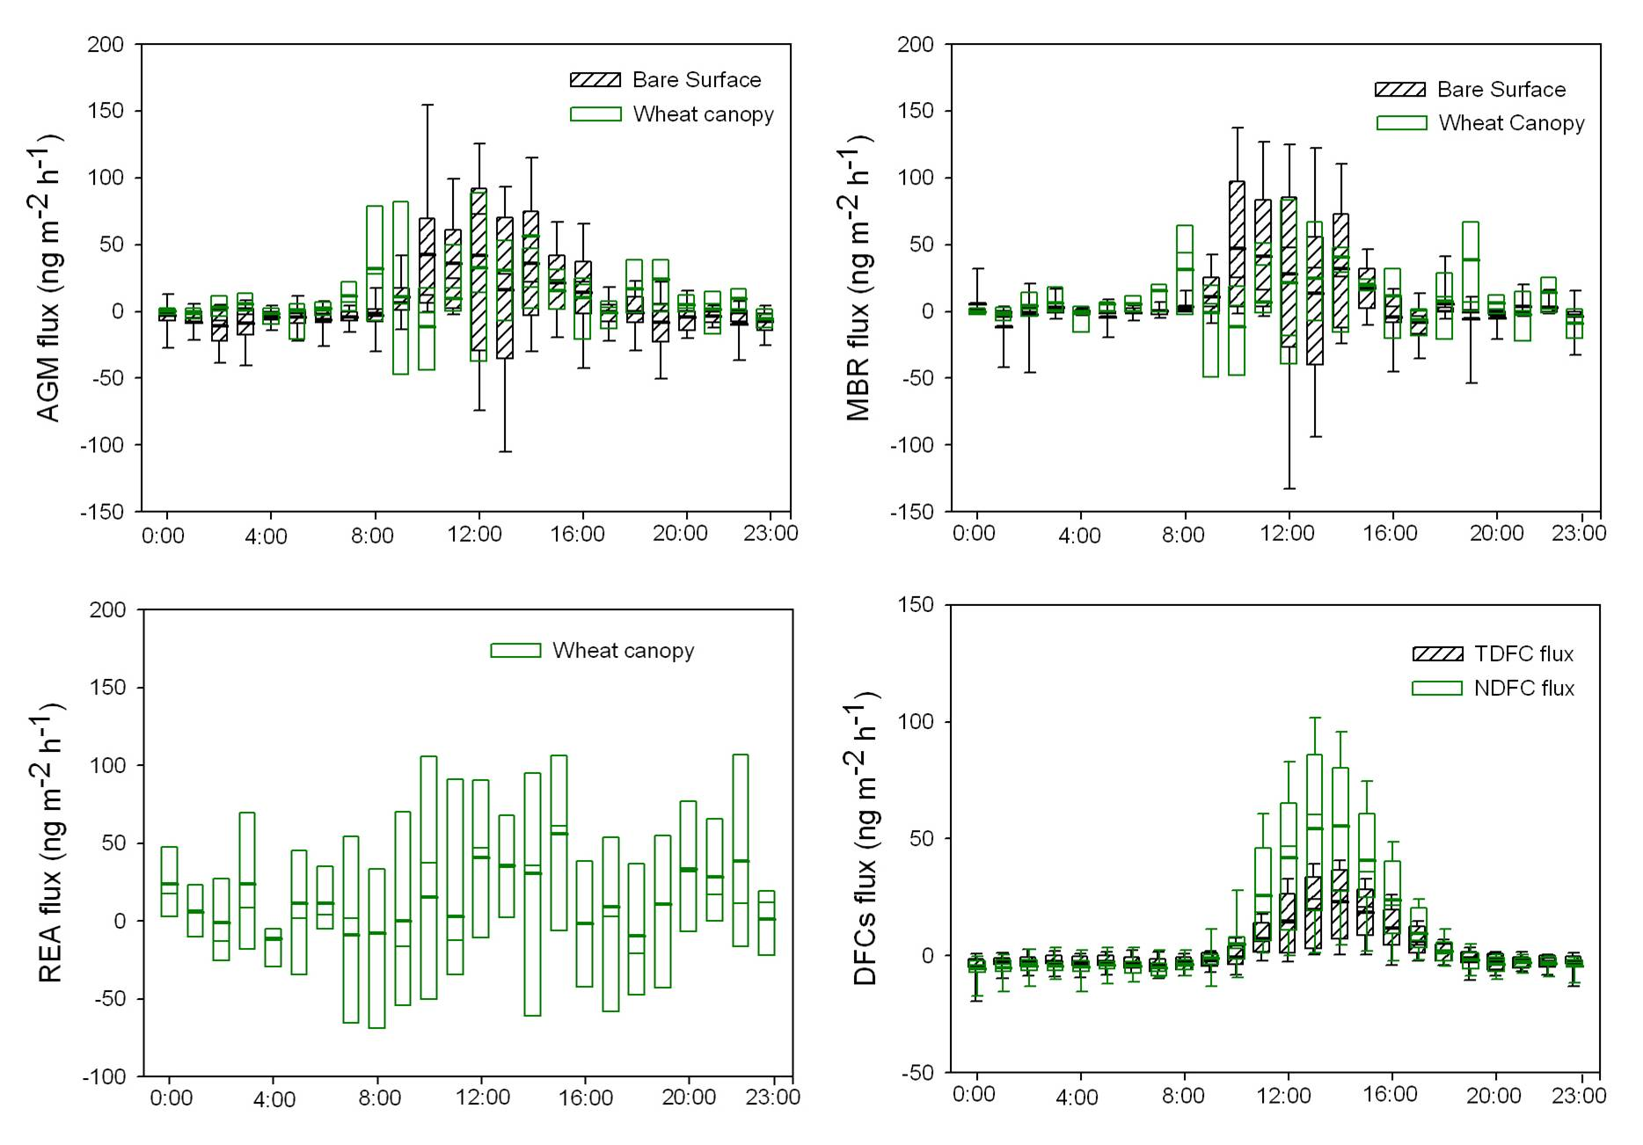
Flux Diurnal Variation

Slide 24
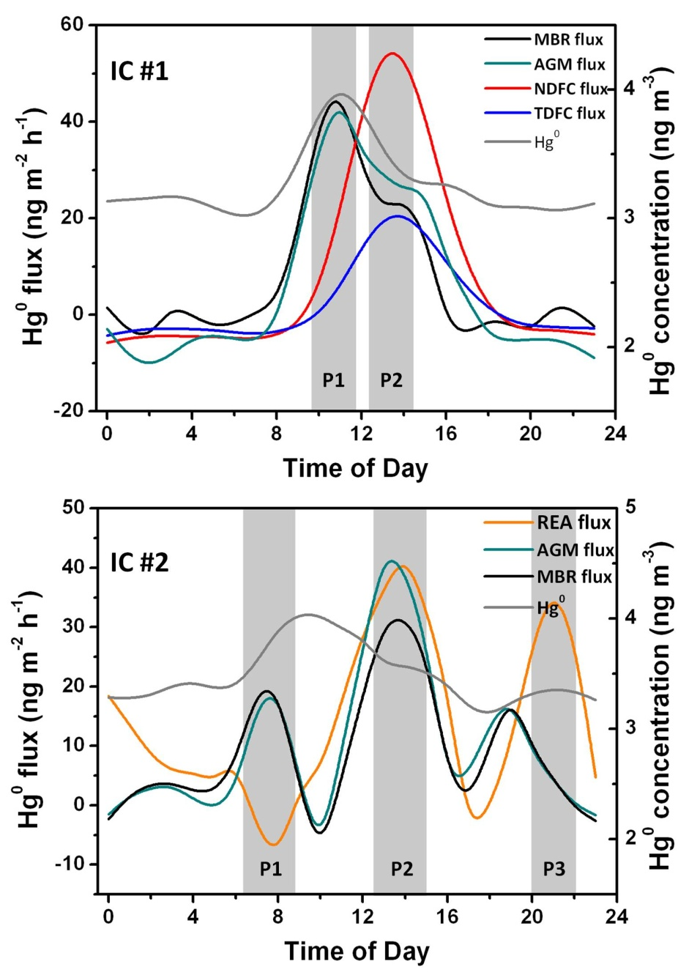
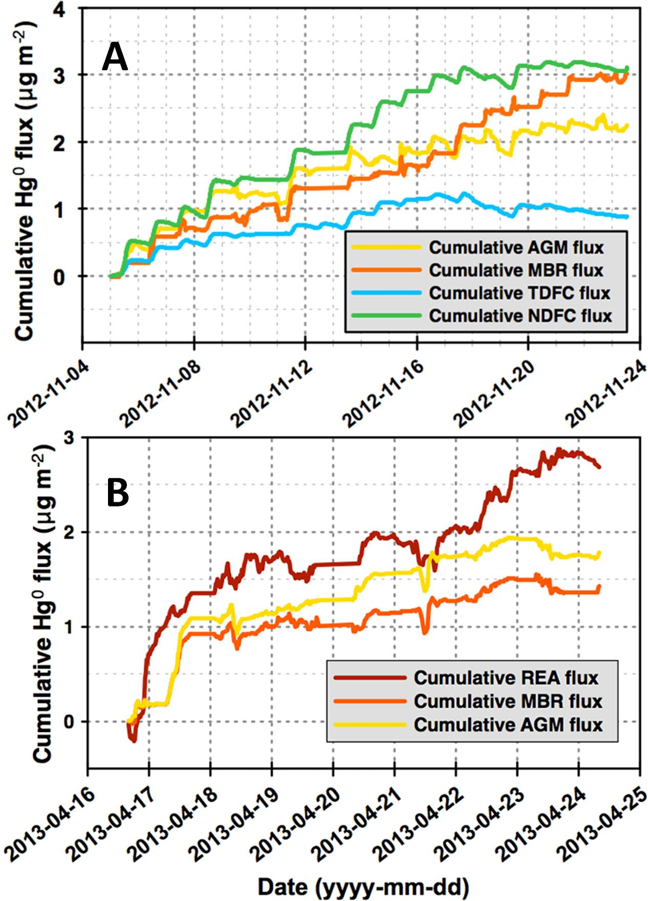
Temporal Trend & Cumulative Flux

Slide 25
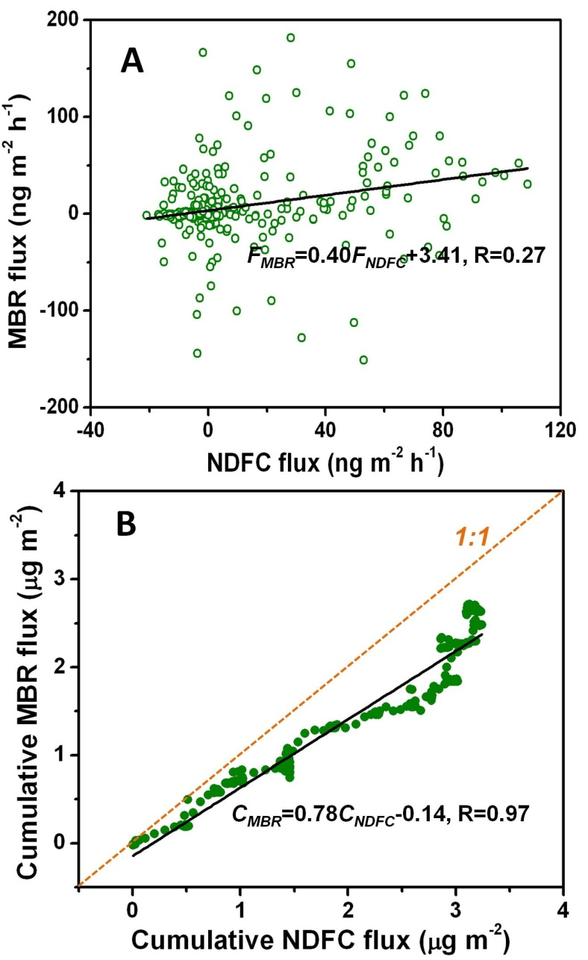
Close Enough, But …
MBR vs. NDFC

Slide 26
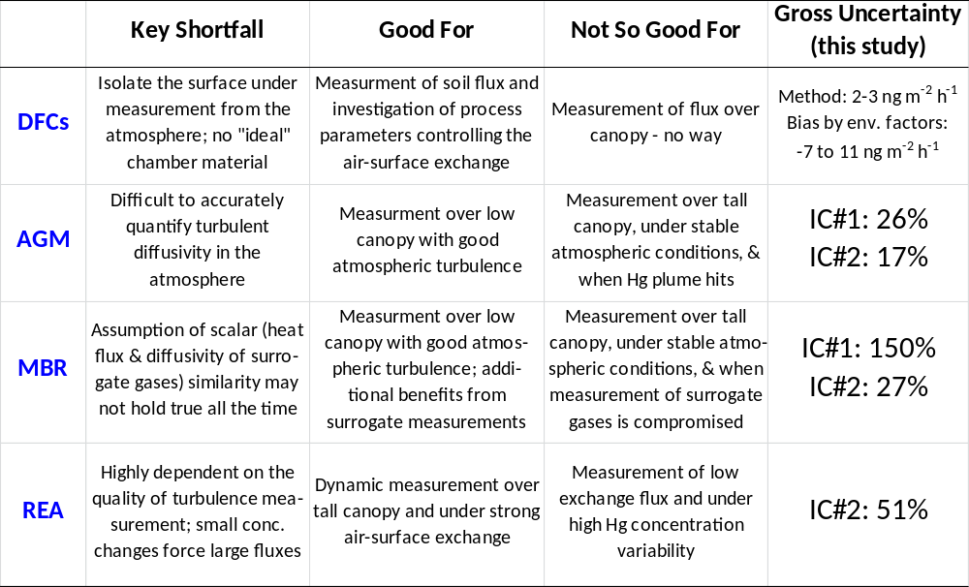
Conclusions

