Slide 1
Big data - diabetes
Jenny Lundberg
4rth International Conference on Big Data Analysis and Data Mining, Paris, France

Slide 2
Content
Background
Data sources
Social media
Predictions
Innovation areas

Slide 3
Big data applied to diabetes
Why?
How?
Sources?

Slide 4
Background
There are in principle three types of diabetes, type 1, type 2 and gestational (pregnancy). More specifically:
• Diabetes is a heterogeneous group of conditions that all result in, and defined by, plasma glucose rises above normal levels chronic, if not well treated. If untreated, death is sooner or later, if later with a lot of unpleasant complications over time.
• The two main types of diabetes, type 1 (10% of all); and type 2 (85-90% of all).

Slide 5
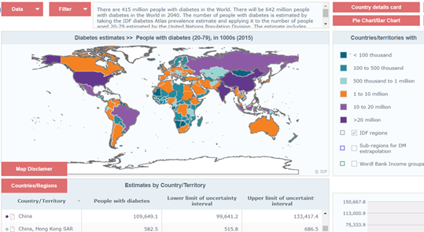
The incidence of the chronic disease diabetes are of epidemic character. 2015, 415 million in the world have diabetes and it is estimated that in 2040, 642 million in the world will have diabetes.
Dark green = “good”
Dark purple = bad
http://www.idf.org/about-diabetes/facts-figures
Notes:
The IDF Diabetes Atlas is updated every two years, and provides diabetes data such as prevalence, mortality, and health expenditure for 220 countries and territories around the world. These data are used widely by news media, governments and other international organisations. It is also used by health professionals, scientists, economists, policy-makers, and national and international agencies.
http://www.diabetesatlas.org/across-the-globe.html
Dear Jenny,
Your copyright request is approved.
Conditions of use can be found: http://www.idf.org/sites/default/files/Copyright conditions_0-1.pdf
In order to correctly cite the IDF Diabetes Atlas, please use following rules: http://www.idf.org/diabetesatlas-new/how-to-cite
If you would like to receive support from our worldwide community, register to D-NET! This new online platform is developed by IDF to connect diabetes professionals worldwide and to make them able to share and learn from each other. (http://d-net.idf.org)
Kind Regards,
Yadi.
YadiHuang
PhD Data Analyst & Coordinator
tel | mailto:Yadi.Huang@idf.org
International Diabetes Federation
Chaussée de La Hulpe,166
B-1170 Brussels, Belgium
tel +32-2-5385511 | fax +32-2-5385114
info@idf.org | www.idf.org | VAT BE 0433.674.528
IDF | Promoting diabetes care, prevention and a cure worldwide

Slide 6
Data Sources
Individual person´s data
Socially shared data
National open data
National data
Hospital, care units data
Companies´data
Other data

