Slide 1

Cardiovascular and Respiratory Effects of RME Biodiesel Exhaust Exposure
Dr. Jenny Bosson
Umeå University, Umeå, Sweden

Slide 2
The Beginnings
Meuse Valley, Belgium 1930
Donora, Pennsylvania, 1948
London, England, 1952

Slide 3
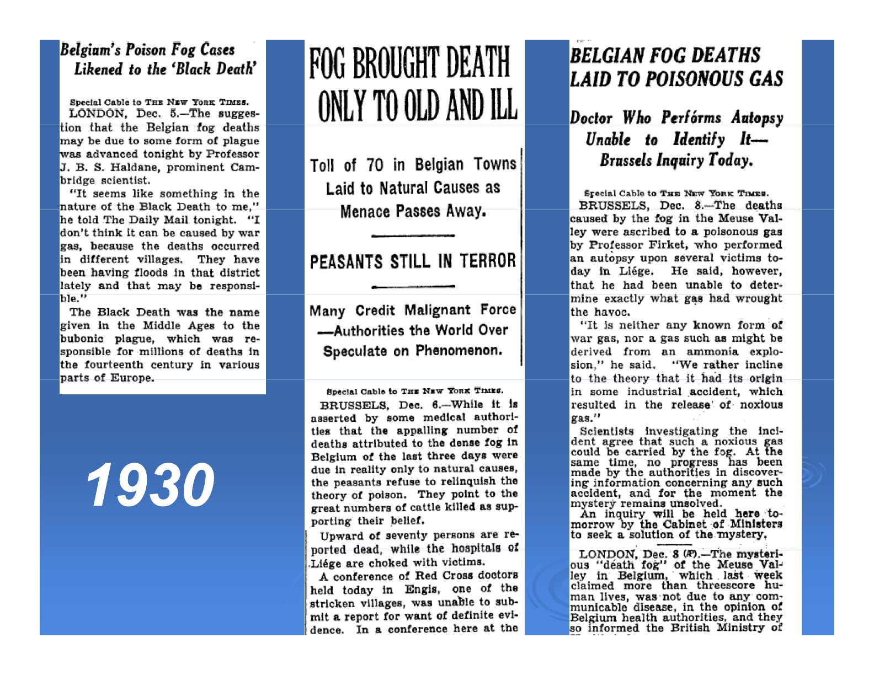
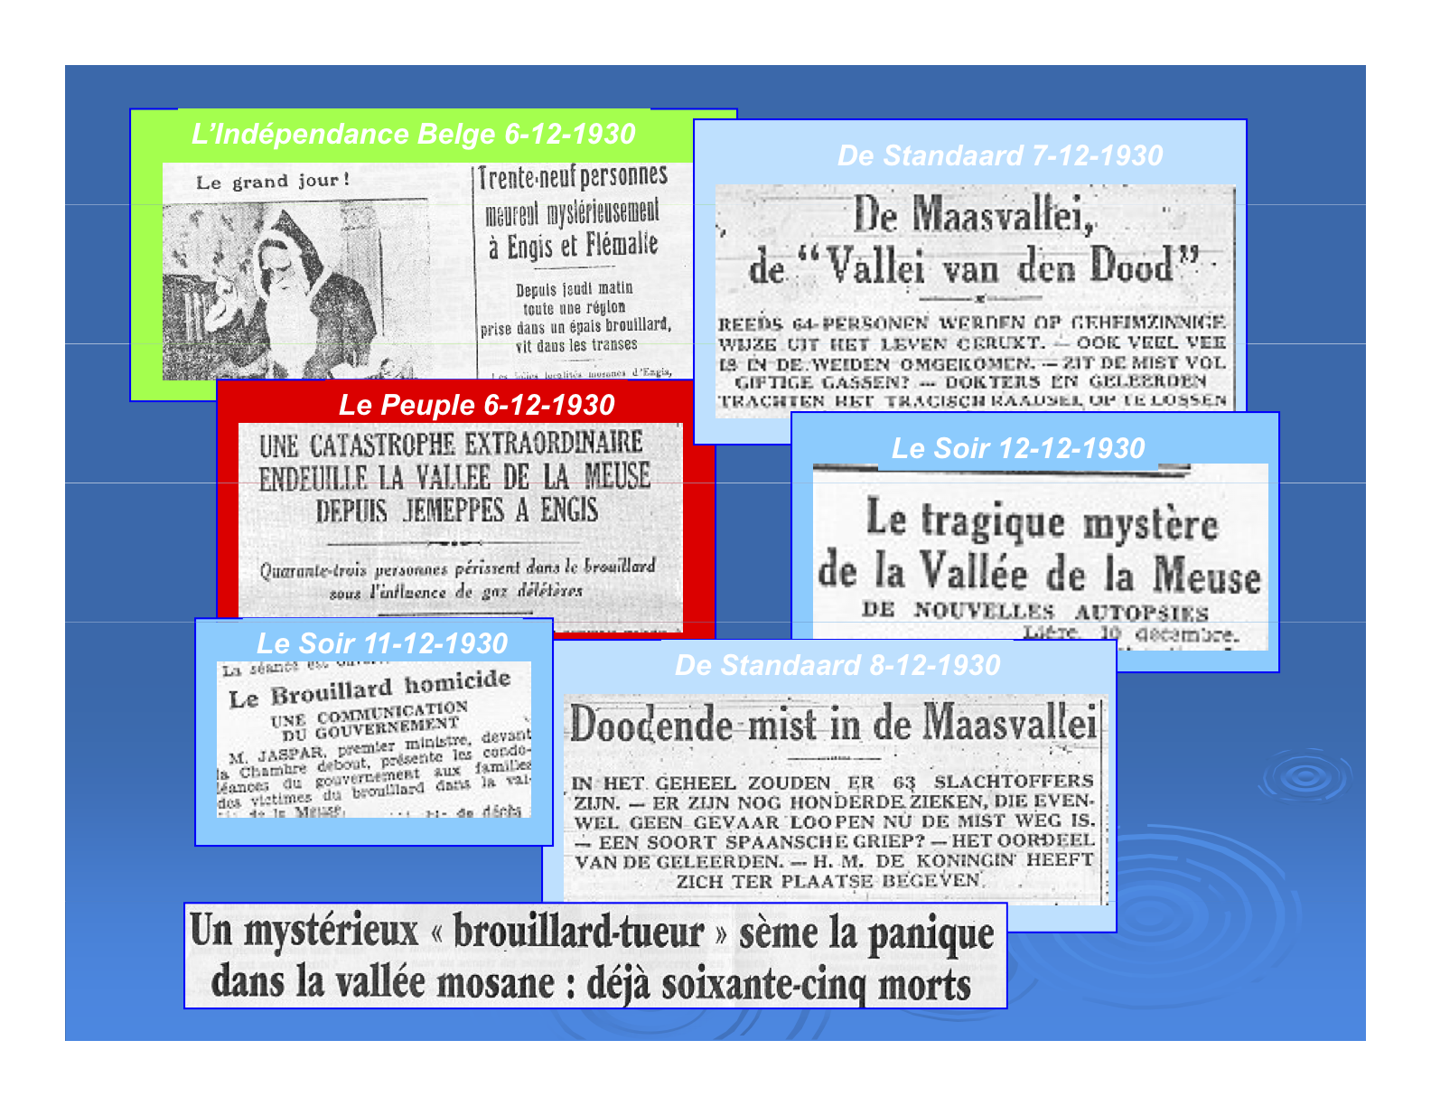
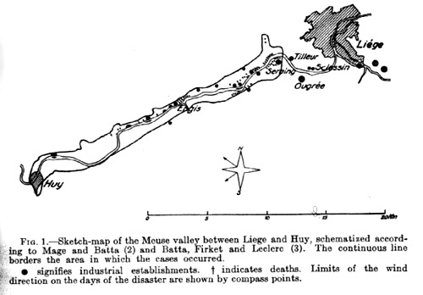
Meuse Valley, Belgium 1930
60 dead

Slide 4
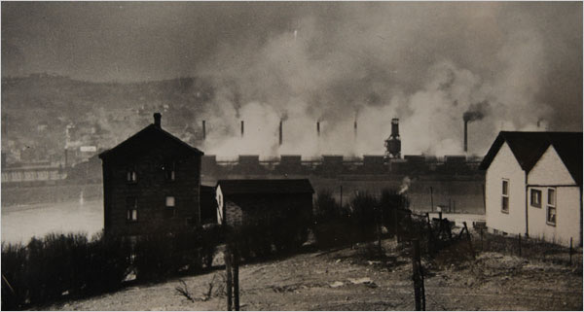
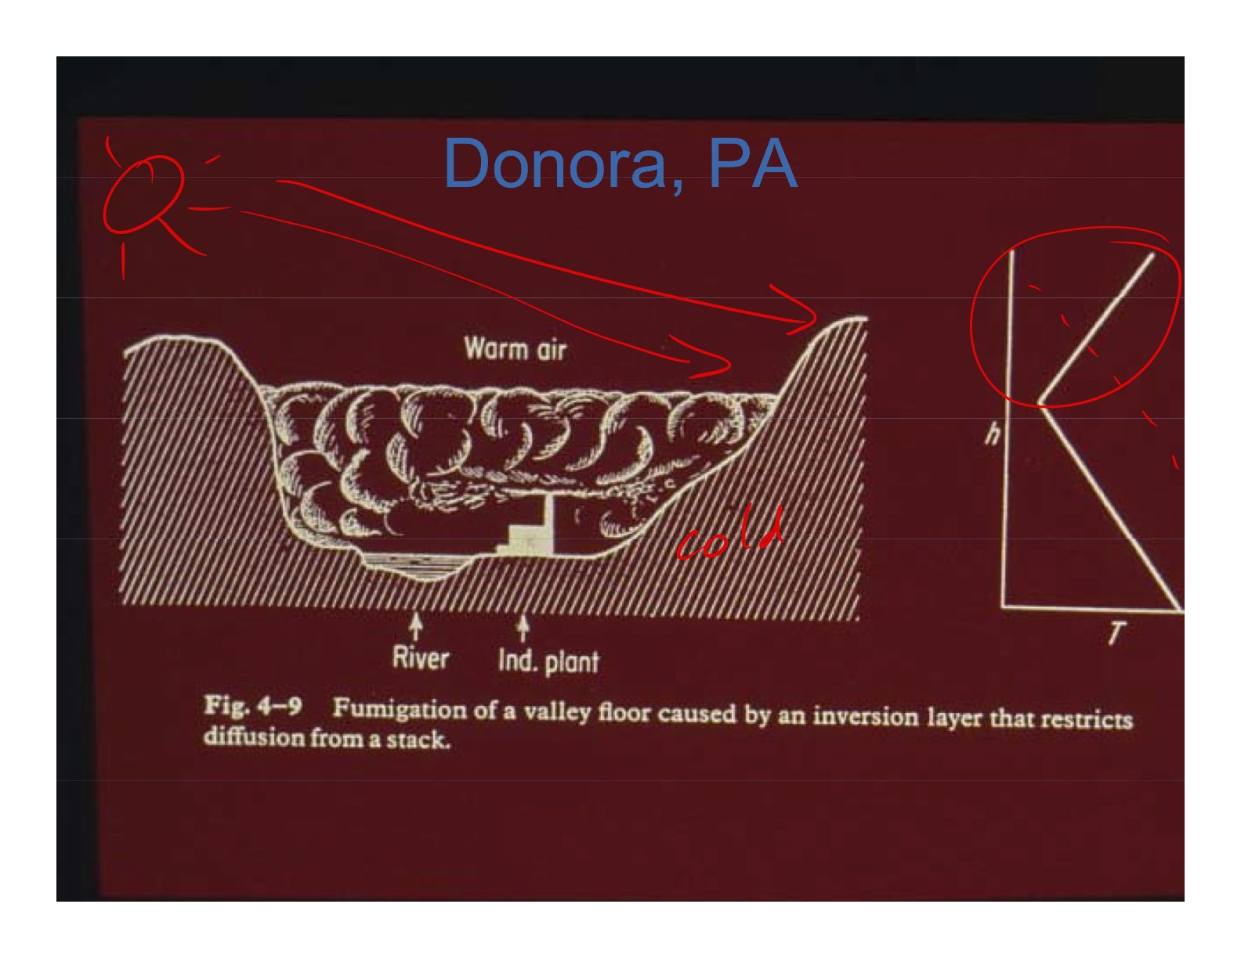
Donora, Pennsylvania 1948
23 dead

Slide 5
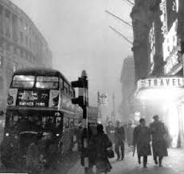
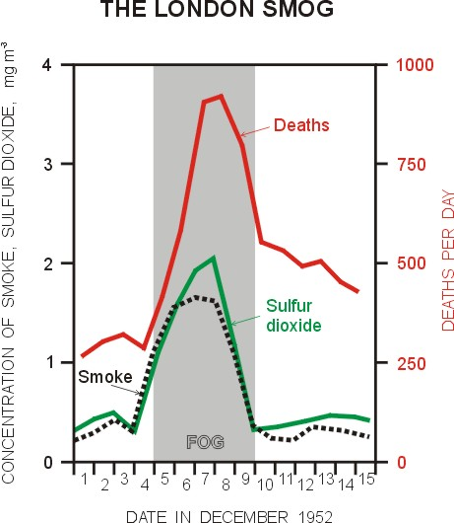
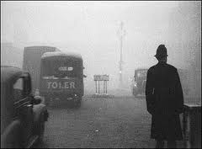
London, England 1952
4000 dead

Slide 6
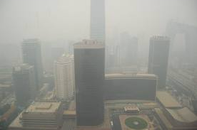
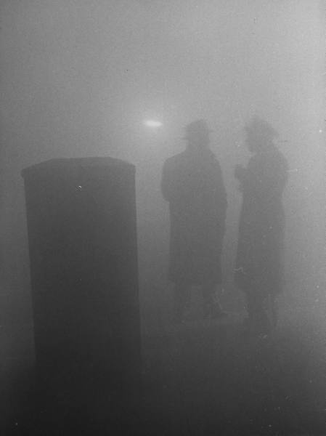
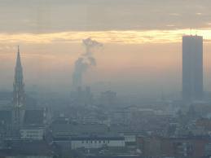
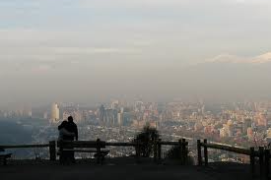
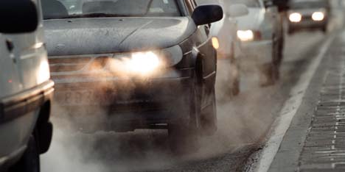
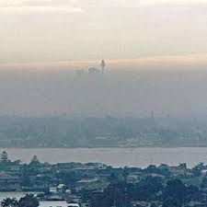
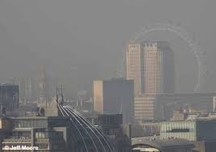
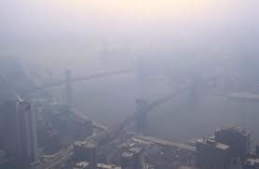
Beijing
London Dec. 1952
Brussels
Santiago de Chile
Umeå 2010
Sydney
London
New York

Slide 7
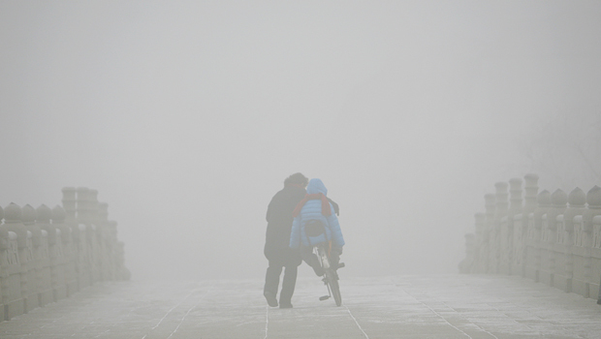
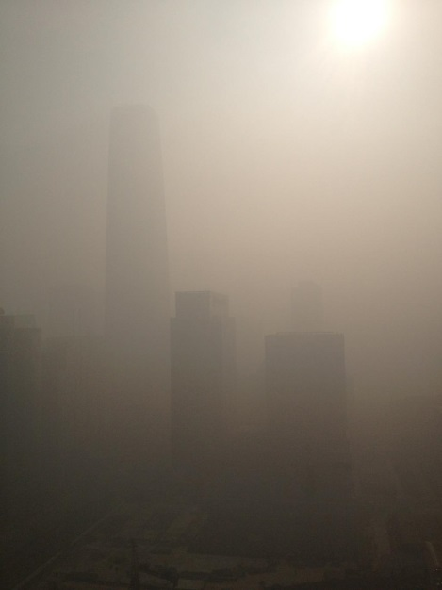
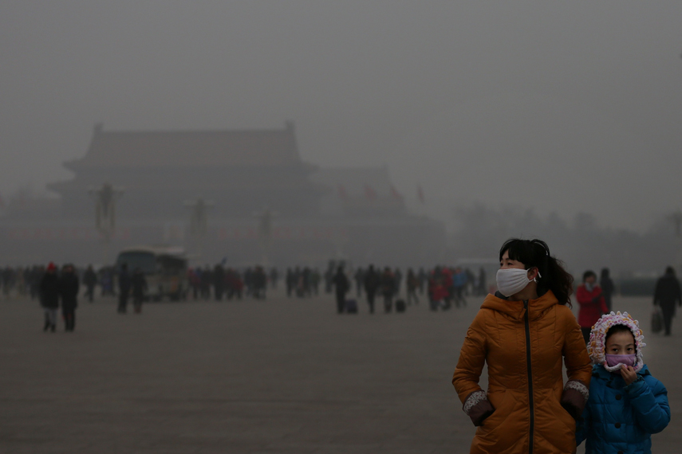

Slide 8
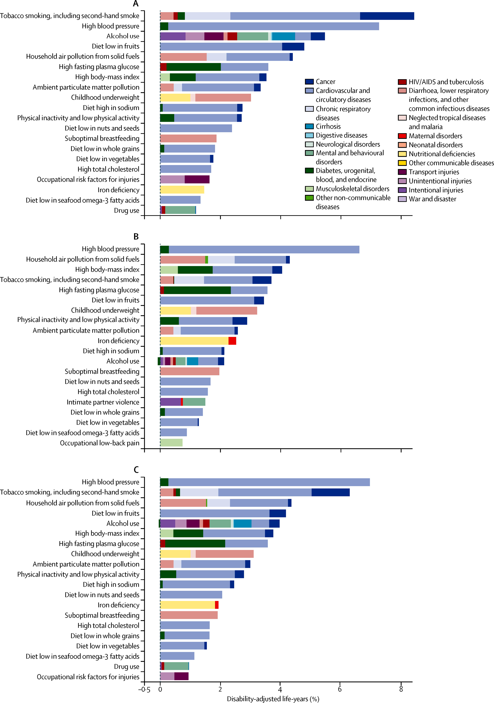
Burden of disease attributable to 20 leading risk factors in 2010
Burden of disease expressed as a percentage disability-adjusted life-years

Slide 9
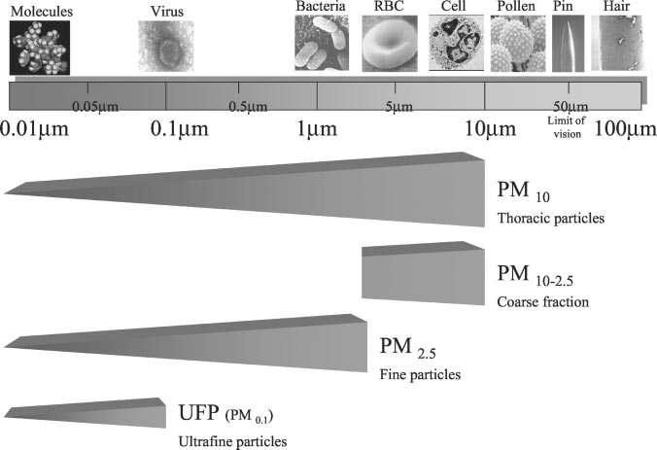
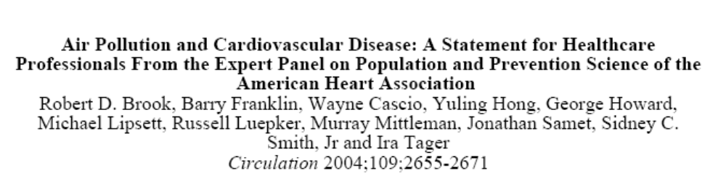

Slide 10
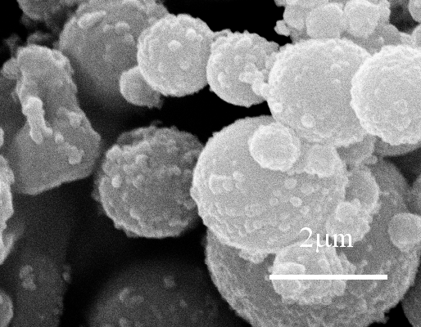
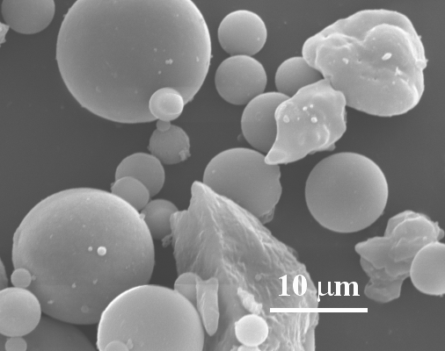
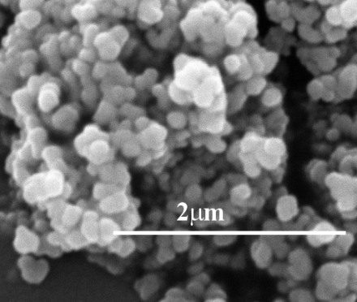
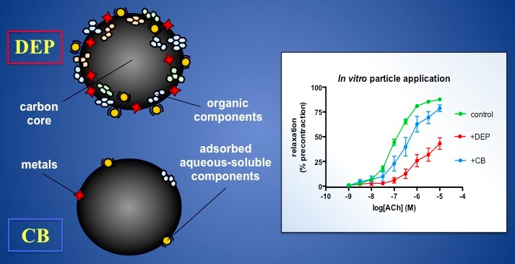
Particulate matter
Course
<10µm
Fine
<2,5µm
Ultrafine
<0,1µm

Slide 11
The smallest particulates are suggested to be the most harmful in ambient air pollution and diesel exhaust emissions are a significant source of small particles in air pollution, 2.5 μm or less, in urban environments (WHO, UN 2001).

Slide 12
Health Effects of Air Pollution
Infant mortality
Lung growth in children
Asthma
COPD
Airway infections
Development of CVD
Myocardial infarctions
Stroke
Arrythmias

Slide 13
Demands for Renewable Energy are Driving an Increase in the Use of Biofuels
Bioalcohols
Biogas
Biodiesel
  First generation (starch, sugar, animal fats and vegetable oil)
  Second generation (non food crop feedstock- grasses, seeds, waste)
  Third generation (microalgae)

Slide 14


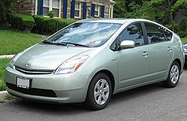

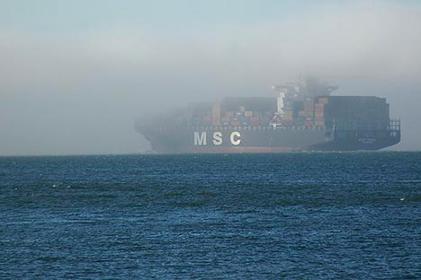
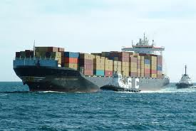

Slide 15
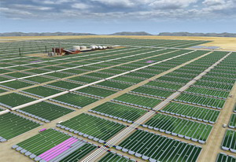
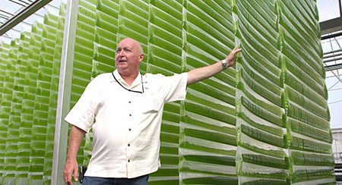
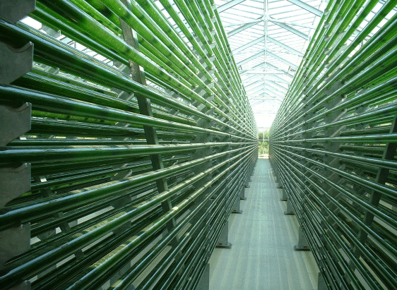
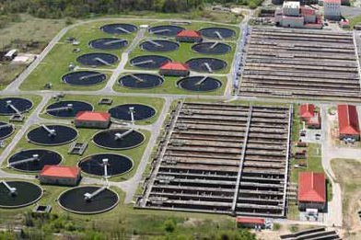
New Developments

Slide 16
Regulations & Goals
EU: by 2020 aims to have 10% of the transport fuel of every EU country come from renewable sources
Sweden: 5-30% blend in all petrodiesel sold
US: Renewable Fuel target of 136 billion liters by 2022
IPCC: 80% renewables target by 2050

Slide 17
Common basic study design
  Double blind
  RCT
  Crossover
Inclusion
Health exam
No informed consent
Do not meet inclusion criteria
Excluded
Randomization
Baseline measurements
Baseline measurements
Exposure A
Exposure B
Measurement of vascular parameters
Measurement of vascular parameters
Data analysis
Exposure code broken

Slide 18
Health Effect Models
Epidemiological studies
In-vitro cell based and cell free models
Animal models
Human experimental models
  Diesel exhaust
  Ozone
  Diesel – ozone interaction
  Wood smoke/Biomass
  Road tunnel exposure
  Biofuels

Slide 19
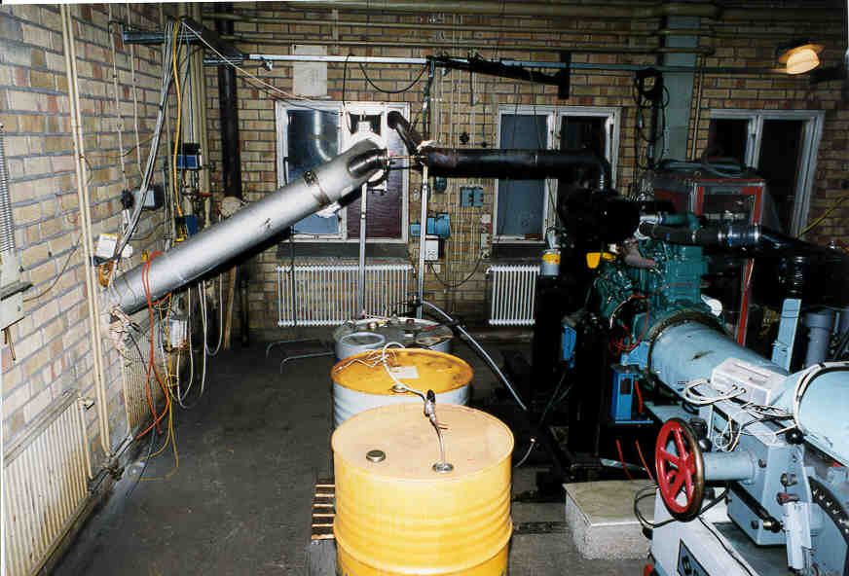
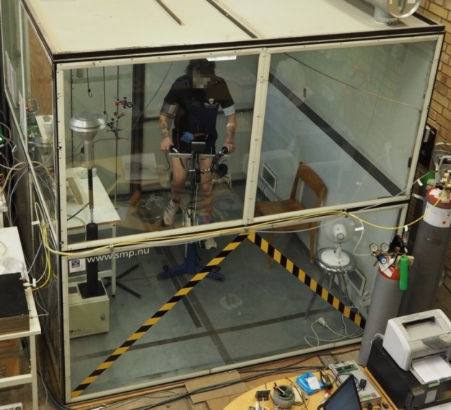
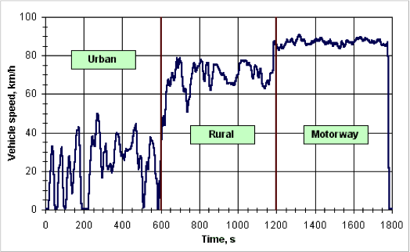
Exposures
One hour exposures, with 15 minute intervals of exercise
European Urban Transient Cycle

Slide 20
Chamber Concentrations Idling vs ETC
 | Idling | ETC, Urban
NO (ppm) | 2.2±<0.1 | 6.6±0.3
NO₂ (ppm) | 0.6±<0.1 | 0.9±0.2
No_{x} (ppm) | 2.8±0.1 | 7.5±0.3
Total HC (ppm) | 1.6±0.2 | 1.2±0.2
Mass (µg/m³) | 330±12 | 254±38
Organic carbon fraction (OC/TC), % | 94.5 | 12
Elemental carbon fraction (EC/TC), % | 5.5 | 88
Total PAH concentration (μg/m³) | 3.5 | 0.96
Particle number concentration, #/cm³ | 9.5×10⁵ | 1.2×10⁵
Notes:
Exposure to DE generated under transient running conditions as well as idling impairs vasomotor function and endogenous fibrinolysis
Exposure to diesel exhaust under ETC conditions was also associated with a novel finding of impaired of calcium channel-dependent vasomotor function

Slide 21
Common basic study design
  Double blind
  RCT
  Crossover
Inclusion
Health exam
No informed consent
Do not meet inclusion criteria
Excluded
Randomization
Baseline measurements
Baseline measurements
Exposure A
Exposure B
Measurement of vascular parameters
Measurement of vascular parameters
Data analysis
Exposure code broken

Slide 22

Cardiovascular effects of RME30/RME100
RME30 vs Petrodiesel
  16 healthy non-smoking subjects, 14 males
  PM 300 µg/m³ for 1 hour
RME100 vs Petrodiesel
  19 healthy non-smoking males
  Similar running conditions, 1 hour exposure

Slide 23
Tools for investigating vascular events of air pollution in humans in-vivo
Arterial stiffness (PWV, PWA)
Forearm plethysmography
Coagulation markers
Heart rate variability and rhythm
Badimon chamber
Blood pressure

Slide 24
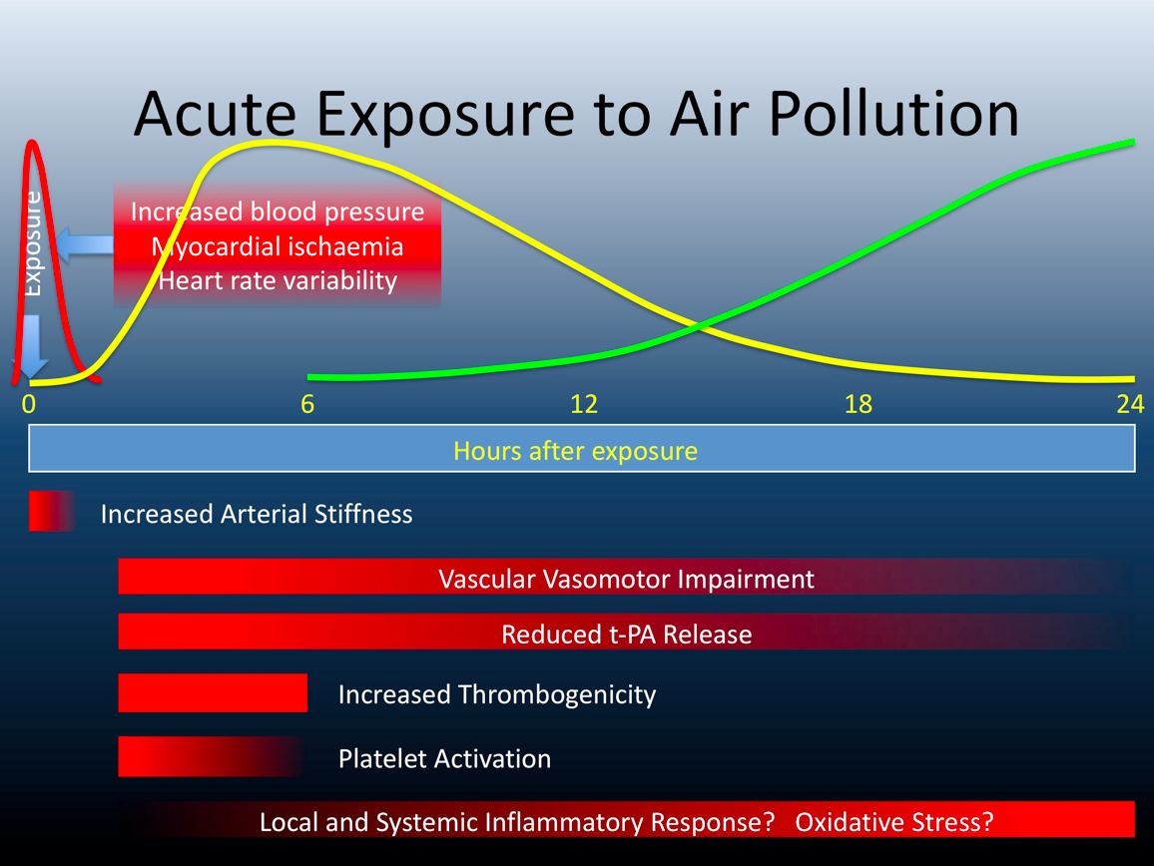

Slide 25
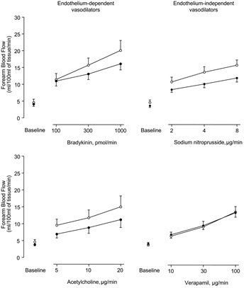
Biodiesel CV studies
Does replacing petrodiesel with RME30 or RME100 mitigate the acute adverse effects following exposure?
Previous studies of diesel exhaust in healthy volunteers show
  5 studies (n=15-30, 98 in total) decreased vasomotor function 2-24 hours post exposure
  2 studies (n= 18 and 20) show increased thrombus formation 2-6 hors post exposure
Forearm blood flow 2 to 4 hours after diesel exposure (•) and air (○) Mills N L et al. Circulation. 2005

Slide 26
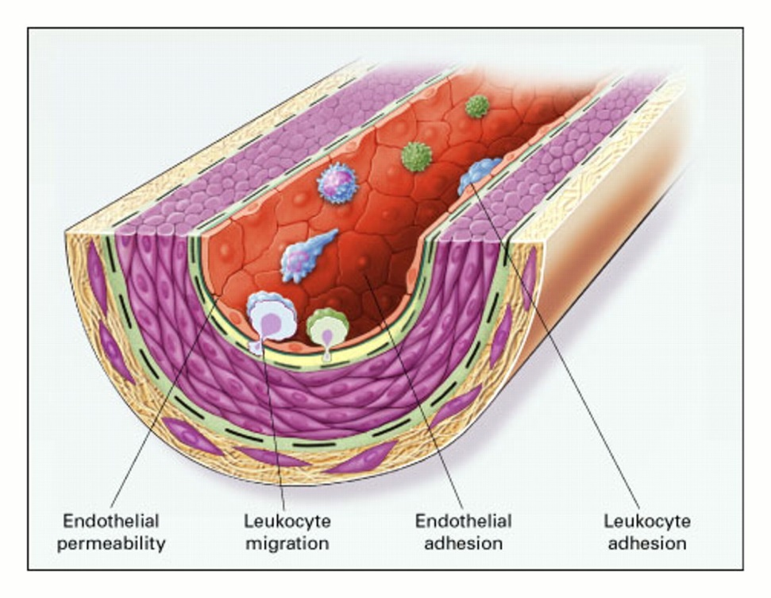
Endothelial Activation is a Key Event in the Initiation and Promotion of Vascular Disease
Injury
Lesion Growth, Destabilization
Vessel Occlusion
  Aggregation
  Plaque Rupture
EC Activation
- ↑ permeability
- ↑adhesion of monocytes
- Relocalization and uncoupling of eNOS
Vessel Wall Accumulates:
- LDL Cholesterol
- Macrophages
Pro-Inflammatory Transformation:
- Oxidized LDL, lipids
Foam Cells
SMC Differentiation

Slide 27
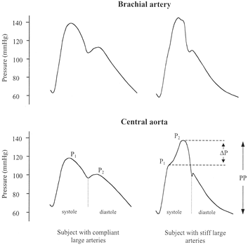
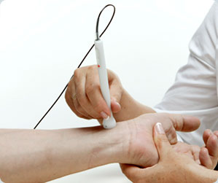
Arterial Stiffness
Oliver and Webb
Noninvasive Assessment of Arterial Stiffness and Risk of Atherosclerotic Events, Arterioscl Throm Vasc Biol, 2003

Slide 28
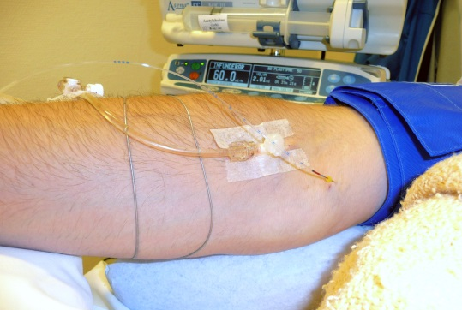
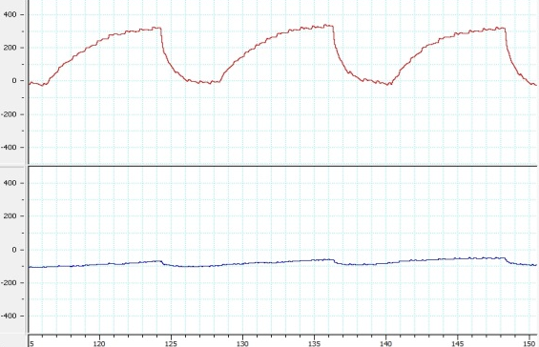
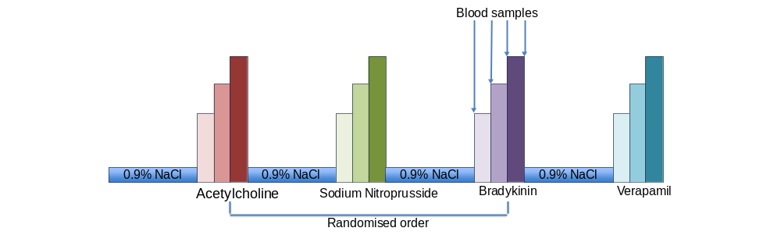
Forearm venous occlusion plethysmography

Slide 29
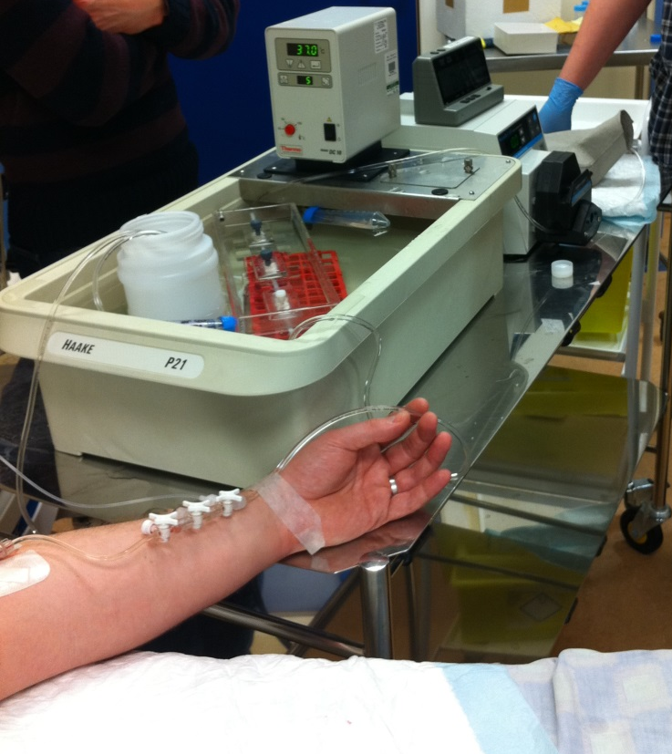
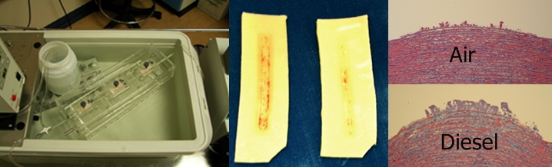
Badimon chamber

Slide 30
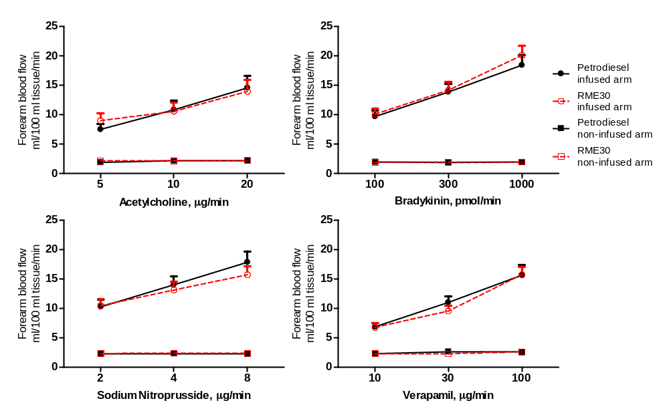
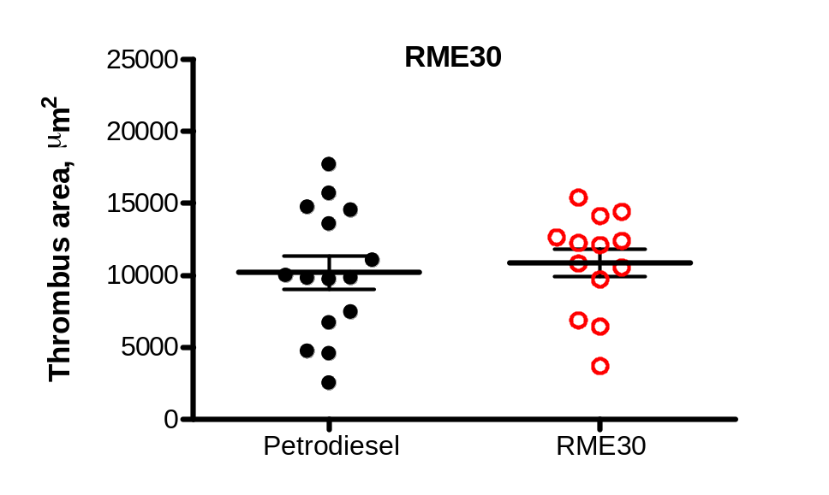
RME30 vs DE- Results

Slide 31
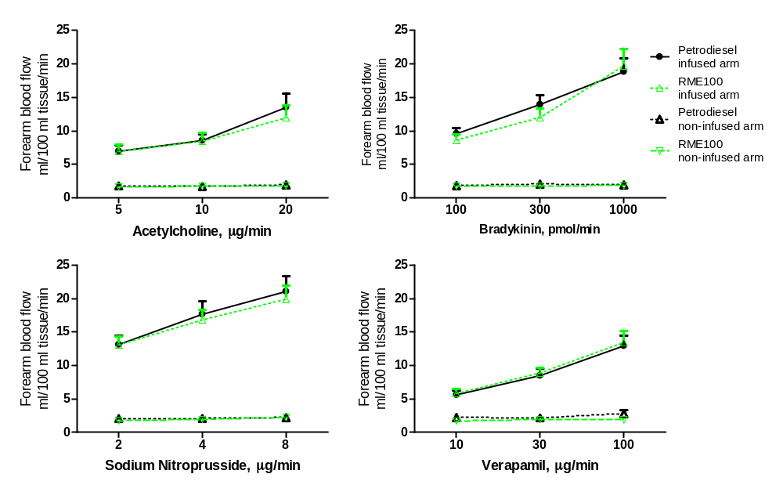
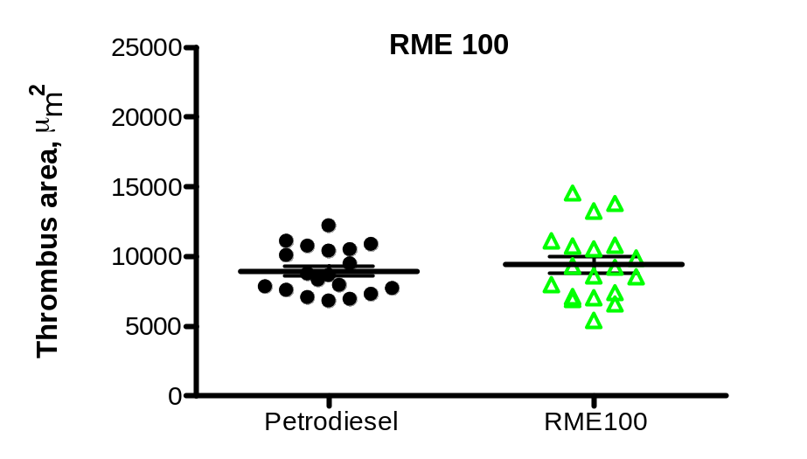
RME100 vs DE - Results

Slide 32
Chamber Characteristics RME30
 | Petrodiesel | RME30
PM₁₀, µg/m³ | 314±27 | 309±30
HC, ppm | 1.0±0.1 | 0.9±0.1
NO_{x}, ppm | 3.9±1.0 | 4.6±1.0
EC/TC, ratio | 0.66±0.01 | 0.64±0.02
Particle bound PAHs, ng/m³ | 156±16 | 127±15
Semi volatile PAHs, ng/m³ | 244±81 | 158±37

Slide 33
Chamber characteristics RME100
 | Petrodiesel | RME100
PM₁₀ , µg/m³ | 310±34 | 165±16
Particle number concentration, x10⁵/cm³ | 1.7±0.3 | 2.2±0.1
Total gaseous HC, ppm | 0.93±19 | 0.87±0.15
NO_{x}, ppm | 6.1±0.4 | 7.3±0.5
EC/TC, ratio | 0.66±0.01 | 0.43±0.03
Particle-bound PAHs, ng/m³ | 156±16 | 76±24
Semivolatile PAHs, ng/m³ | 244±81 | 225±167

Slide 34


Slide 35


Biodiesel Exposures
RME 30 PM10 309.1 mg/m³
Petrodiesel PM10 313.7 mg/m³
RME100 165.0 mg/m³
Petrodiesel 309.8 mg/m³
Particle conc: 211 000 ± 16 000
Particle conc: 170 000 ± 7 000
Folkhälsa och klinisk medicin

Slide 36

Metals

Slide 37


Pulmonary effects of diesel exposure
Epithelium
- IL-8, IL-10, IL-13, GRO-α
Neutrophils
- Infiltration, MPO secretion
Mast cells
- Infiltration, histamine secretion
T-cells
- Infiltration, activation
Antioxidants / free radicals
- Ascorbic acid, GSH

Slide 38
Pulmonary effects of RME100
15 healthy, non-smoking subjects
Filtered air vs RME100 at previous running condition
      160ug/m³
Bronchoscopy at 6h post exposure
      BW (2x20mL)
      BAL (3x60mL)
      Bronchial Biopsies

Slide 39





Bronchoscopy

Slide 40

Results – Submucosal cell counts
Values expressed as median (IQR). *Wilcoxon signed ranks test, p-value <0.05 is considered as significant.

Slide 41

Results – BW cell counts
Cell counts in BW 1&2 as cells/ml. Values expressed as median (IQR).
*Wilcoxon signed ranks test, p-value <0.05 is considered as significant.

Slide 42
Results summary – pulmonary effects
The recruitment of bronchial mucosal and BW neutrophils coincides with previous petrodiesel exposure studies
BW macrophage response is novel for biodiesel
Increase in submucosal eosinophils

Slide 43
Conclusions
Exposure to RME biodiesel exhaust results in comparable adverse respiratory and cardiovascular effects to petrodiesel exhaust despite varying composition and particle reactivity
Should be addressed alongside environmental concerns when new fuel policies are considered due to the potential major public health impacts

Slide 44
Acknowledgements
Umeå, Sweden
  Anders Blomberg Jon Unosson Thomas Sandström
  Hans Arvidsson Frida Holmström Annika Johansson
  Annelie Behndig Christoffer Boman Robin Nyström
  Greg Rankin Jamshid Pourazar Maria Sehlstedt
  Ann-Britt Lundström Micke Kabéle
Edinburgh, Scotland
  Jeremy Langrish David Newby Nick Mills
  Jennifer Raftis Mark Miller Amanda Hunter
London, UK
  Frank J Kelly Ian Mudway
RIVM , Netherlands
Flemming Cassee Miriam Gerlofs
Stockholm, Sweden
Roger Westerholm Ioannis Sadiktsis

