Slide 1

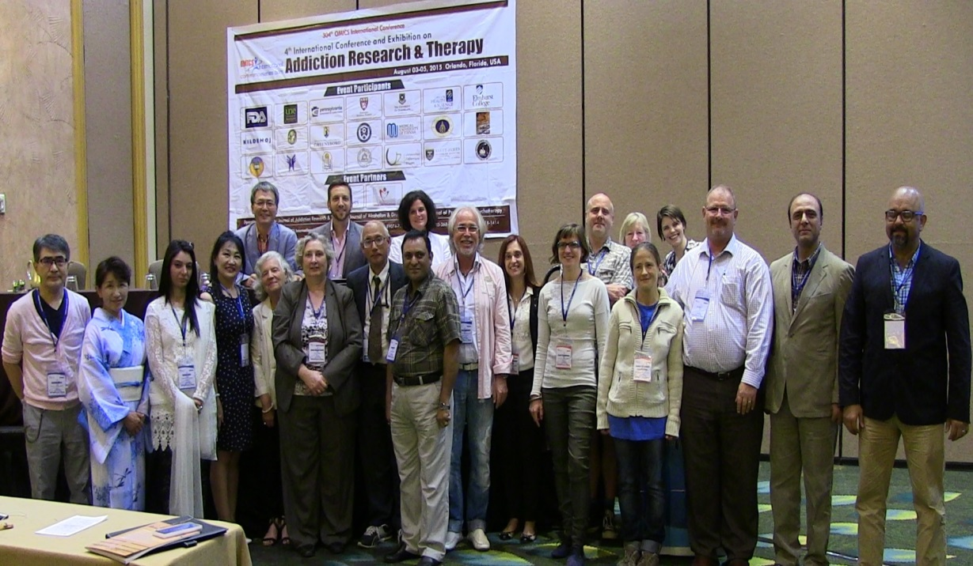
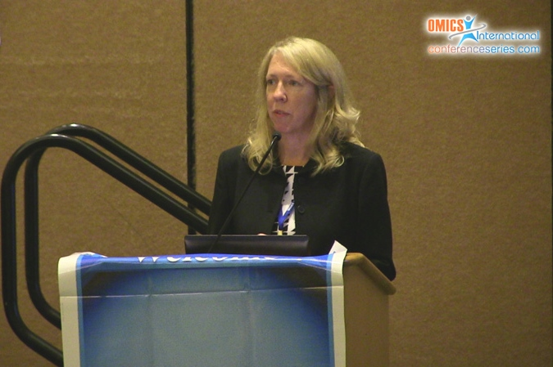
Addiction Therapy 2015
Florida, USA
August 03-08, 2015
Jennifer Loftis

Slide 2



An “immunomodulatory” approach for the treatment of methamphetamine addiction
Jennifer Loftis, Ph.D.
VA Portland Health Care System
Oregon Health & Science University, Portland, Oregon, USA
4th International Conference and Exhibition on Addiction Research & Therapy
Orlando, Florida, USA August 3-5, 2015

Slide 3
Presenter Disclosure Information
Oregon Health & Science University, Dr. Loftis, and other investigators have a significant financial interest in Artielle Immunotherapeutics, Inc., a company that may have a commercial interest in the results of this research and technology.
These potential individual and institutional conflicts of interest have been reviewed and managed by Oregon Health & Science University.

Slide 4

Caveats: Research limitations
Studies vary in terms of:
Quality
Sampling method
Inclusion and exclusion criteria
(e.g., length of abstinence, severity of
dependence, presence of co-morbidities)
Choice of outcome measures
How polysubstance use is addressed

Slide 5
Presentation Overview
I. Background
II. Immune system targets for therapeutic development/intervention
III. “Immunomodulatory” treatment strategies
IV. Future directions

Slide 6
I. Background

Slide 7

"Melancholy" by Constance Marie Charpentier, 1801
Musée de Picardie, Amiens, France

Slide 8
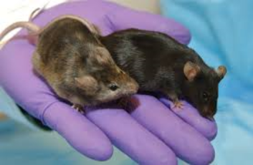
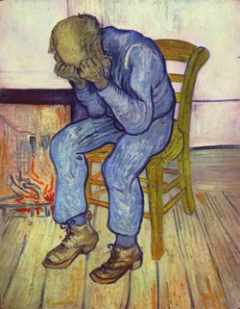
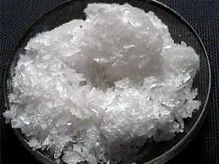

Research focus: Translational psychoneuroimmunology
In humans and across species, our goal is to identify specific mechanisms by which substance use disorders (e.g. methamphetamine) induce abnormalities in immune cell function and contribute to neuropsychiatric impairments.

Slide 9
Why target the immune system for substance use disorders?
Preclinical and clinical studies show that substances of abuse can have significant and long-lasting effects on immune function → behavior
NIDA’s Top 10 List
Nicotine
Alcohol
Opioids (e.g., heroin)
Cannabinoids (e.g., marijuana)
Stimulants (e.g., cocaine, amphetamine, methamphetamine)
Club drugs (e.g., MDMA, GBH)
Dissociative drugs (e.g., ketamine, PCP and analogs)
Hallucinogens (e.g., LSD, mescaline, psilocybin)
Other compounds (e.g., anabolic steroids, inhalants, bath salts)
Prescription medications (e.g., opioid pain relievers, stimulants)
Immune Response
Source: NIDA at http://drugabuse.gov/DrugPages/DrugsofAbuse.html

Slide 10
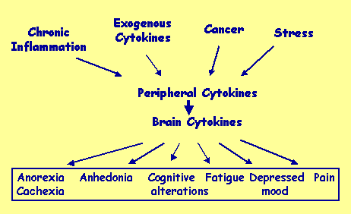
Investigating the relationships among brain, behavior, and immunity in the context of substance use disorders
Substance use disorders
Examples: interferons: IFN-(α, β, γ); tumor necrosis factor: TNF-(α, β); interleukins: IL-1 (α, β), IL-2, IL-6, IL-10; macrophage migration inhibitory factor (MIF); monocyte chemoattractant protein-1 (MCP-1; CCL2)
Adapted from http://cancercontrol.cancer.gov/bimped/Dantzer/sld001.htm

Slide 11
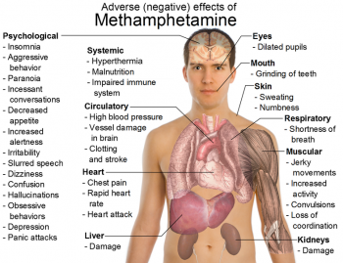


Methamphetamine use is associated with serious physical and mental health disorders
Impaired immune system
Confusion
Depression

Slide 12
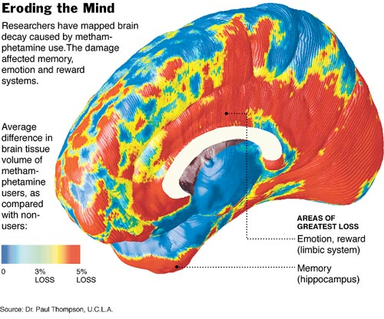
Brains of adults who use methamphetamine show structural abnormalities
Brains from methamphetamine users were 10% larger than “normal”
The limbic region, involved in drug craving, reward, mood and emotion, lost 11% of its tissue.
The hippocampus, lost 8% of its tissue, comparable to the brain deficits in early Alzheimer's Disease.
Red areas show the greatest tissue loss.
(Thompson et al., J Neuroscience, 2004; New York Times; Date: 20 July 2004 )

Slide 13
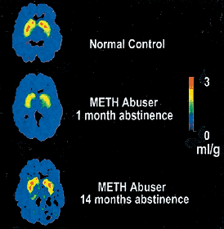
Methamphetamine: Consequences of use
Depleted dopamine transporter levels in methamphetamine users show recovery after prolonged abstinence.
Neuropsychological tests do not improve to the same extent, suggesting that the increase of the dopamine transporters is not sufficient for complete function recovery.
In these brain scans, high dopamine transporter levels appear as red, while low levels appear as yellow/green.
(Volkow ND, et al. Loss of dopamine transporters in methamphetamine abusers recovers with protracted abstinence. J Neurosci. 2001)

Slide 14

II. Immune system targets for therapeutic development/intervention

Slide 15
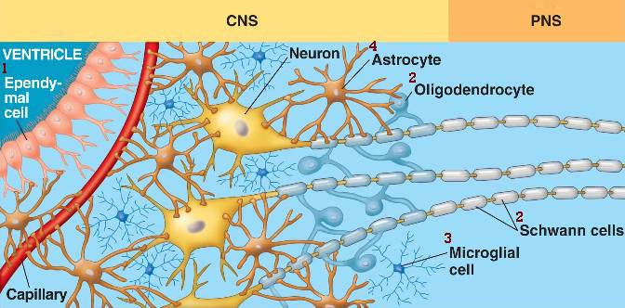

Glia as targets for pharmacotherapeutic interventions
Glia, which constitute the majority of cells in the brain, have many of the same receptors as neurons, secrete neurotransmitters and neurotrophic and inflammatory factors, control clearance of neurotransmitters, and play a key role in synaptic plasticity.
http://bio1152.nicerweb.com/Locked/media/ch49/glia.html

Slide 16
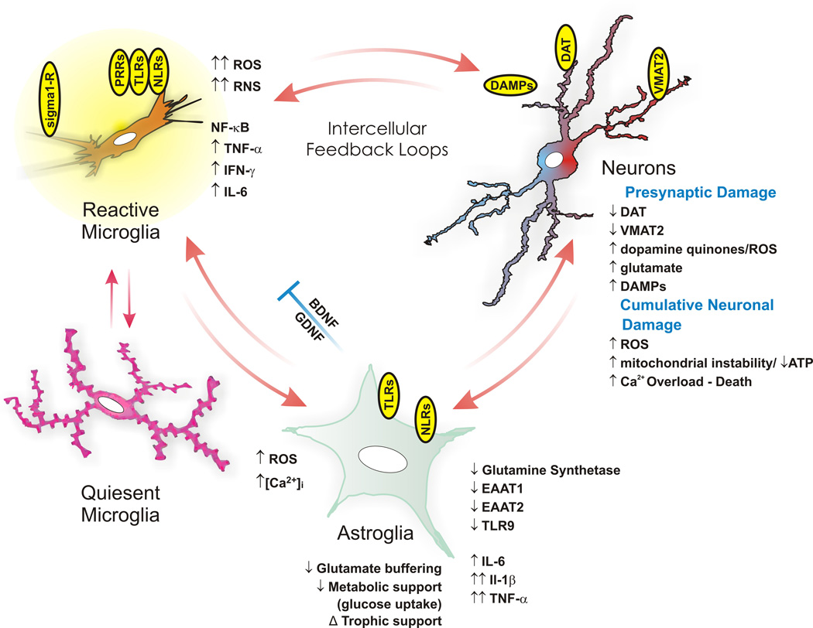
Neuronal damage + a heightened state of glial activation = > positive microglial-astroglial, and neuronal-glial feedback = > increases in neuroinflammation and injury
(Beardsley PM, Hauser KF. Glial modulators as potential treatments of psychostimulant abuse. Adv Pharmacol. 2014)

Slide 17
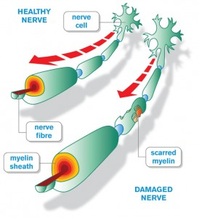
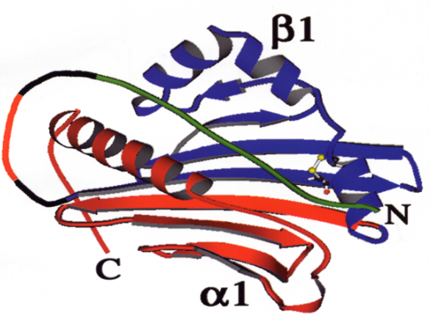
Myelin peptides and T cells
Pre-clinically, recombinant T-cell receptor
ligands (RTL) linked to antigenic peptides:
inhibit recruitment of inflammatory cells to brain,
repair myelin and axonal damage, and
restore impaired motor function.
The RTL is a single exon comprised of the β1 (blue) and α1 (red) domains of a major histocompatibility complex (MHC) class II molecule with a tethered target peptide (green).
RTL target peptide: myelin oligodendrocyte glycoprotein (MOG) peptide
Image courtesy of the Vandenbark laboratory, VA Portland Health Care System

Slide 18
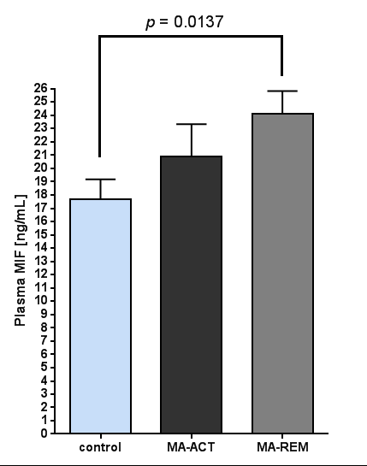
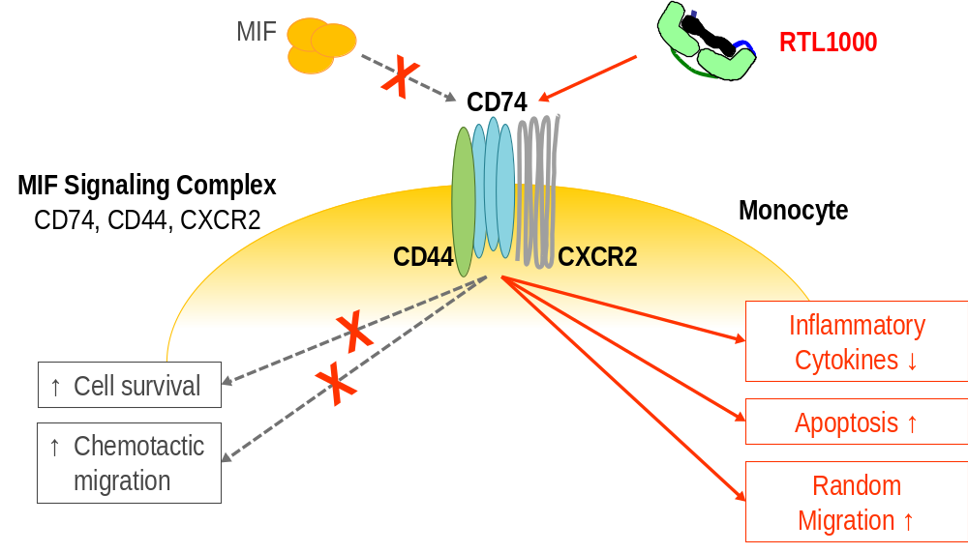
RTL mechanisms of action
(human analog of RTL551)
Binding of RTL constructs with CD74 involves MHC class II-α1/CD74 interactions that inhibit CD74 expression, block activity of its ligand, MIF, inhibit recruitment of inflammatory cells to brain, and reduce inflammation.
These mechanisms are thought to contribute to RTL’s therapeutic effects.
(Image courtesy of the Vandenbark laboratory, VA Portland Health Care System; Huckans and Loftis, unpublished data)

Slide 19
III. “Immunomodulatory” treatment strategies

Slide 20

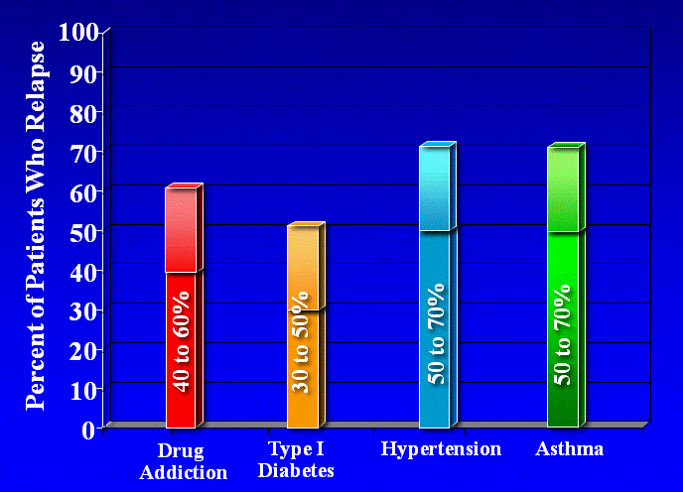
Comparison of relapse rates between drug addiction and other chronic illnesses
Relapse rates following substance abuse treatments are high (~40-60%) but similar to other chronic illnesses.
McLellan et al., JAMA, 2000; http://www.drugabuse.gov/publications/addiction-science/relapse/relapse-rates-drug-addiction-are-similar-to-those-other-well-characterized-chronic-ill

Slide 21
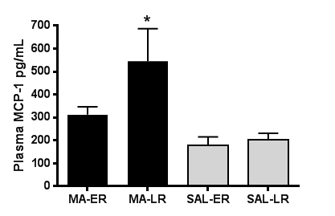
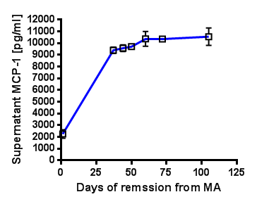
Increased expression of pro-inflammatory immune factors during remission may hinder recovery efforts
Relative to control participants, adults in the MA remission group, but not the MA active group, reported more memory problems and performed worse on tests of attention and executive function.
(Loftis et al., 2011; Huckans and Loftis, unpublished data)

Slide 22
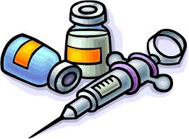
Immunotherapies for methamphetamine and other substance use disorders are under investigation…
To attract antibodies to a substance so that it is too large to pass through the blood brain barrier (i.e., vaccines)
To suppress glial cells by using 3-isobutyryl-2-isopropylpyrazolo-[1,5-a]pyridine (AV411, ibudilast), a phosphodiesterase inhibitor (Snider et al., Eur J Pharmacol, 2013; Beardsley et al., Eur J Pharmacol, 2010)
To heal substance induced neuronal damage and neuropsychiatric impairments through regulation of inflammatory responses within the central nervous system (Loftis et al., PLoS One, 2013; Loftis & Huckans, Addiction, 2011)
To regulate and reduce systemic inflammation and oxidative stress (Wadley et al., Sports Sci., 2015; Korhonen et al., J Womens Health, 2011)

Slide 23
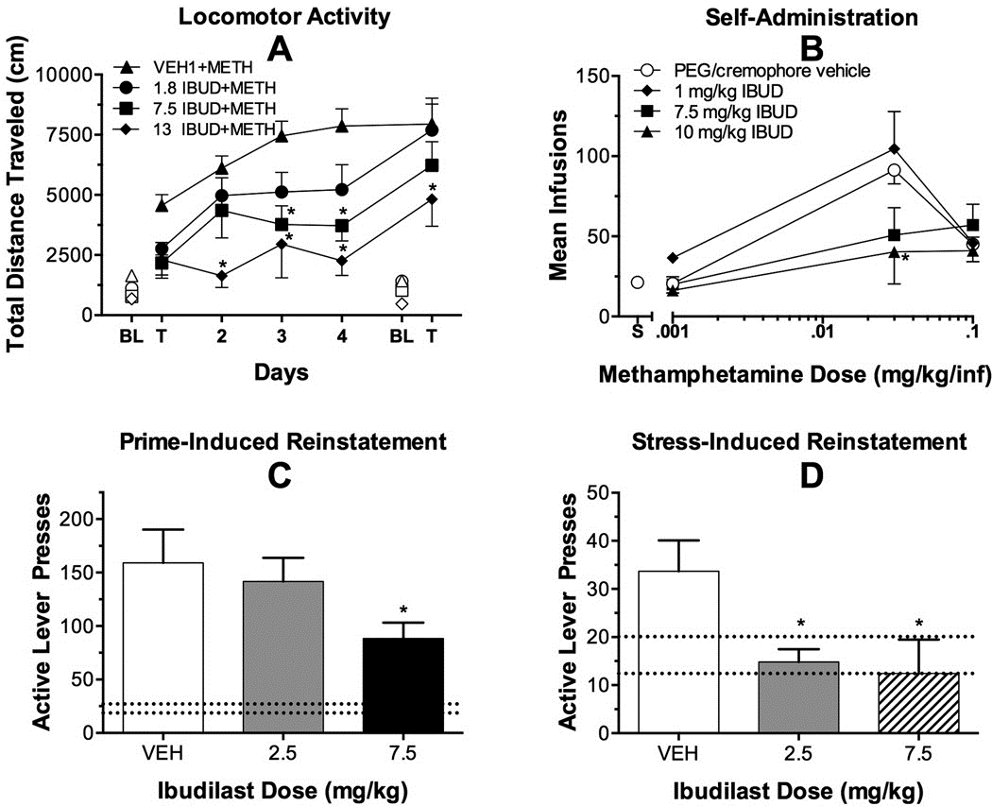
Effects of glial cell inhibition on methamphetamine use
Self-administration
Stress-induced reinstatement
Preclinical data indicate that ibudilast crosses the blood-brain barrier, is well tolerated, is active on oral administration, and reduces glial activation.
Phosphodiesterase (PDE) inhibitors can suppress tumor necrosis factor-α (TNF-α) production by peripheral blood mononuclear cells.
(Snider et al., Eur J Pharmacol, 2012; Beardsley et al., Eur J Pharmacol, 2010; Draheim et al., J Pharmaol Exp Ther, 2004)

Slide 24

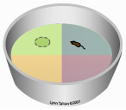
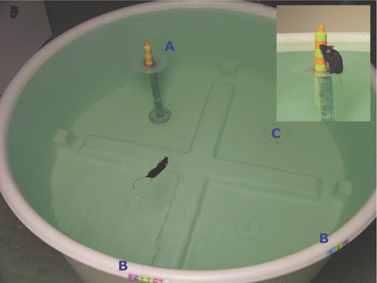
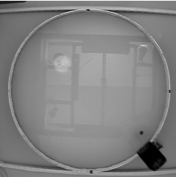
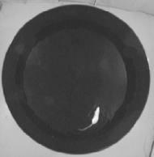
Behavioral measure to assess cognitive functioning: Morris water maze
Tank is divided into 4 quadrants
Visible platform training
Hidden platform training
Probe trial:
No platform

Slide 25
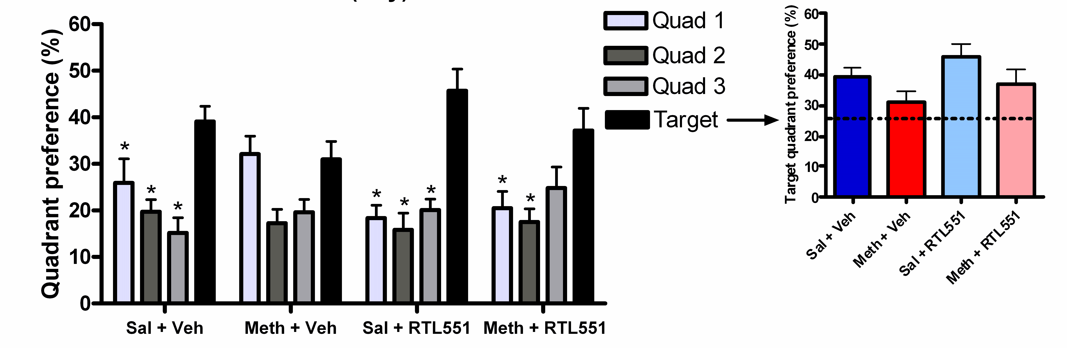
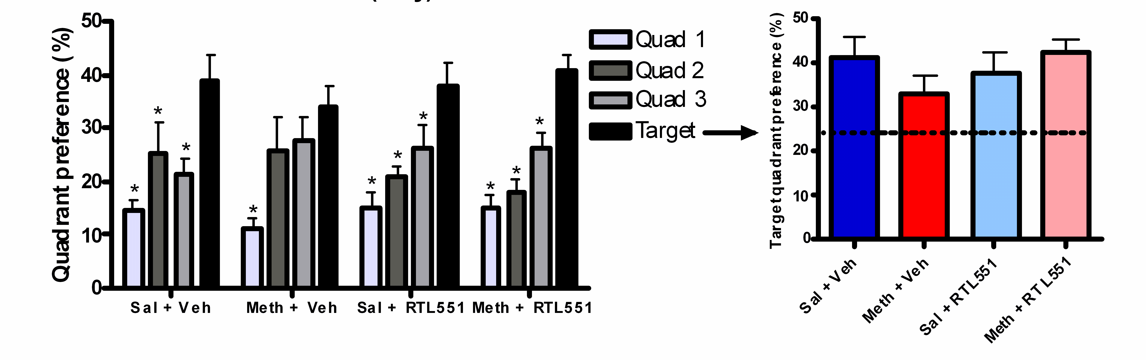
Morris water maze memory test: quadrant preference during the final probe trials show efficacy of RTL551 over vehicle in the treatment of methamphetamine-induced memory impairments
(Loftis, J.M., Wilhelm, C.J., Vandenbark, A.A., Huckans, M. PLoS ONE, 2013)

Slide 26
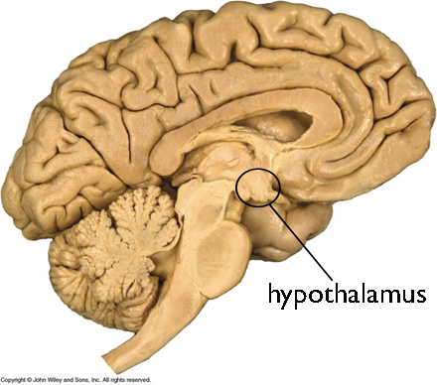
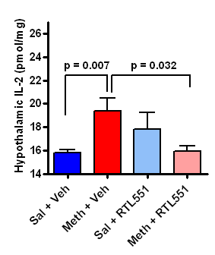
Cytokine expression in the hypothalamus following methamphetamine exposure and RTL treatment
Hypothalamic samples were analyzed by multiplex methods for the detection of IFN-γ, IL-10, IL-1β, IL-2, IL-6, MCP-1, and TNF-α.
The hypothalamus, in particular, is a key brain region for CNS-to-periphery interactions and one that shows damage and altered functioning following methamphetamine exposure.
Loftis, J.M., Wilhelm, C.J., Vandenbark, A.A., Huckans, M. PLoS ONE, 2013

Slide 27
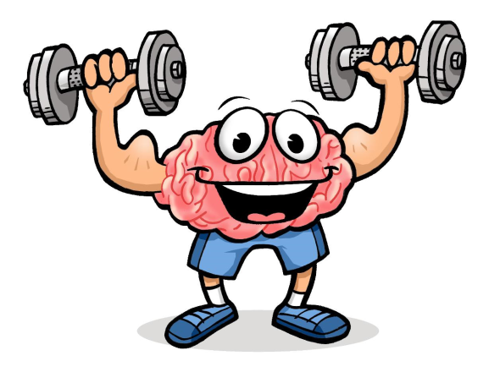
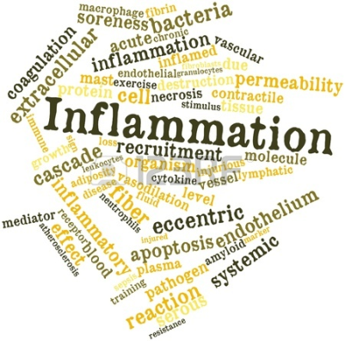
The impact of exercise on depression and anxiety symptoms among abstinent methamphetamine-dependent individuals in a residential treatment setting
OBJECTIVE: To determine the effects of an 8-week exercise program on depression and anxiety symptoms among newly abstinent MA-dependent individuals in residential treatment.
METHODS: N = 135 MA-dependent individuals, newly enrolled in residential treatment, were randomly assigned to receive either a 3-times-per-week, 60-minute structured exercise program for 8 weeks or an equivalent number of health education sessions.
RESULTS: Exercise had a significant effect on reducing depression (P=0.001) and anxiety (P=0.001) symptoms compared to a health education control group.
Results from this study and others suggest that exercise may be an effective intervention for improving symptoms of depression and anxiety (and reducing inflammation) during recovery from methamphetamine dependence.
(Rawson et al., J Subst Abuse Treat, 2015; Haglund et al., Am J Addict, 2015; Petersen and Pedersen, J Appl Physiol, 2005)

Slide 28
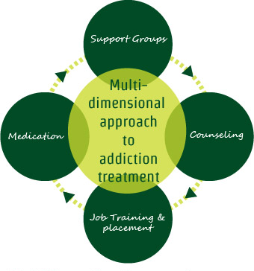


Summary
Taken together, these pre-clinical and initial clinical findings indicate that immunotherapeutic strategies which target specific inflammatory pathways, reduce neurotoxicity, promote neuronal repair, and improve neuropsychiatric function may have potential as treatments for methamphetamine and other substance use disorders.
From brain repair to recovery…

Slide 29
IV. Future directions

Slide 30
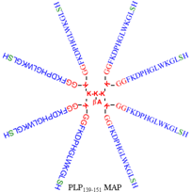
Future directions
Researchers are establishing the safety of an anti-methamphetamine antibody known as mAb7F9 in humans (Stevens et al., Mabs, 2014).
Ibudilast - Phase I safety interaction trial of ibudilast with methamphetamine (n = 11) completed in 2013; phase II randomized trial of ibudilast for methamphetamine dependence is currently recruiting participants (estimated enrollment of140 and completion June 2017).
https://clinicaltrials.gov/
Testing the safety and efficacy of another immunotherapy [multiple antigenic (Ag) peptides (MAP) composed of myelin peptides (e.g., PLP₁₃₉₋₁₅₁, MOG₃₅₋₅₅)] for the treatment of methamphetamine-induced neuropsychiatric impairments and addictive behaviors.
Plans for a Phase I clinical trial of RTL1000 in adults with methamphetamine use disorder are in development.

Slide 31

Collaborators and Acknowledgements
Collaborators:
Marilyn Huckans
Aaron Janowsky
Tamara Phillips
Arthur Vandenbark
David Hinrichs
Clare Wilhelm
Bret Fuller
Elaine Huang
Rebekah Hudson
Jonathan Taylor
Psychoneuroimmunology Research Team (http://www.ohsu.edu/pniresearch)
Financial & Institutional Support
Veteran’s Health Administration
VA Portland Health Care System
Department of Psychiatry, OHSU
National Institutes of Health (NIH)
MARC (NIDA) http://www.ohsu.edu/marc/

Slide 32

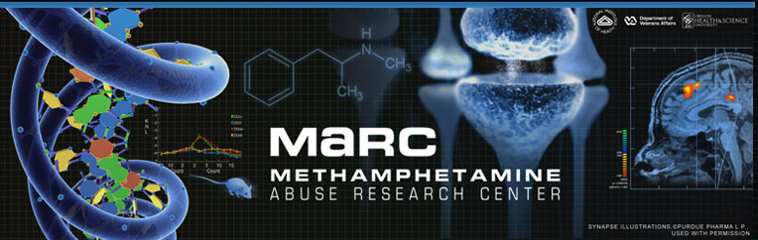
Contact Information
Jennifer Loftis, Ph.D.
Email: loftisj@ohsu.edu
Psychoneuroimmunology Research Team http://www.ohsu.edu/pniresearch
Methamphetamine Abuse Research Center (MARC)
http://www.ohsu.edu/marc/

Slide 33

Meet the eminent gathering once again at
Addiction Therapy 2016
Miami, USA
October 06-08, 2016
Addiction Therapy 2016
Website: addictiontherapy.conferenceseries.com

