Slide 1
Improved Functioning in a Patient with Chronic Dementia Following a Program of Non-Pharmacological Interventions:
Preliminary Support for the Cognitive Therapeutics Method™
Samuel T. Gontkovsky, Jenn Couch, and Naoko Shirota

Slide 2
Existing Approaches to Treat Dementia

Slide 3
What is Dementia?
Referred to as Major Neurocognitive Disorder in the new diagnostic classification system (DSM-V)
Cluster of cognitive symptoms that interfere with activities of daily living and represent a decline from previous levels of functioning
Specific type of dementia determined by underlying etiology, with manifestation of distinct symptoms during the early stages of the disease course

Slide 4

Pharmacological Approaches
Do not prevent, halt, or reverse the progressive mental deterioration associated with neurodegenerative dementia
May function to slow cognitive decline for a period of time (for some people)
Generally targeted at preventing nerve cell destruction

Slide 5
Neuroplasticity
Neuroplasticity refers to the fact that experience and environmental influences often produce changes in the central nervous system, both structurally and functionally
The term describes the nervous system’s potential for alterations through reorganization that enhance not only its adaptability to environmental change but also its capability to compensate for injury or disease

Slide 6
Cognitive Therapeutics Method™ as a Non-Pharmacological Approach

Slide 7

What is the Cognitive Therapeutics Method™ (CTM)?
CTM is a non-pharmacological intervention program created based on the concept of neuroplasticity
Designed to slow progression of cognitive and functional decline and delay onset of new symptoms in areas of the brain that have not yet been affected by the disease process

Slide 8
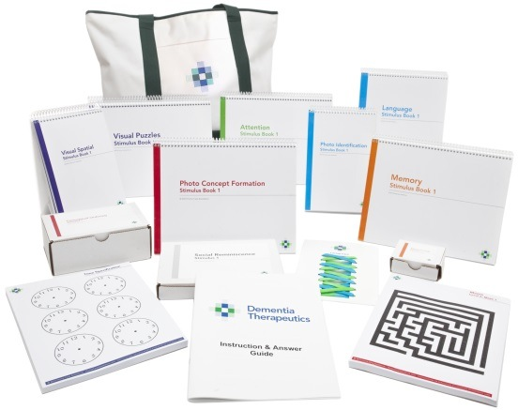
CTM is Unique in Several Ways
Scientific research-based program developed by experts
One-on-one in the home
Personalized according to client abilities and needs
Introduces a comprehensive group of novel activities

Slide 9
Seven Primary Domains of Intervention
Cognitive Stimulation/Training
Social Stimulation
Sensory Stimulation
Dietary Changes
Physical Activity and Exercise
Recreation
Stress Management/Coping

Slide 10
Five Cognitive Sub-Domains
Executive Functioning includes cognitive abilities such as reasoning, problem solving, judgment, and thought flexibility
Attention refers to the ability to focus on a specific piece of information for a long period of time while ignoring distractions
Language refers to the ability to execute verbal functions including spontaneous speech, naming, speech repetition, speech comprehension, reading, and writing
Visual-Spatial Perception involves the ability to accurately perceive an object’s physical location and understand the relationships between objects
Memory refers to the ability to retain information and utilize it later
Executive Functioning
Memory
Visual-Spatial Perception
Attention
Language

Slide 11

Example: Picture Details (Memory)
Observe the picture carefully…

Slide 12
Example: Picture Details (Memory)
Now can you answer these questions?
What were the objects resting on?
How many red apples were there?
Was there a baseball in the picture?

Slide 13

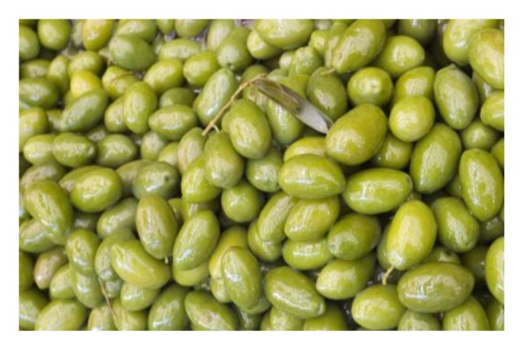


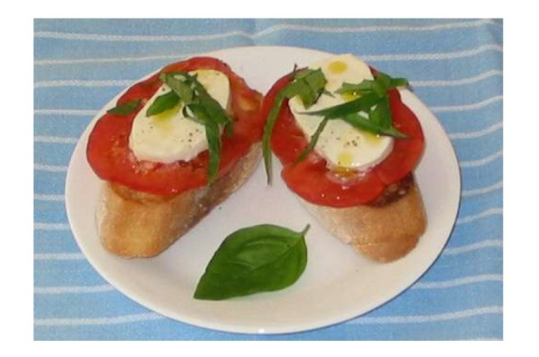
Example: Conceptual Ordering
(Executive Functioning)
Rearrange the cards in order, from start to finish

Slide 14
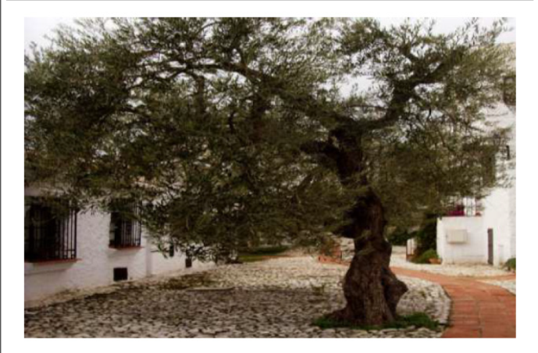

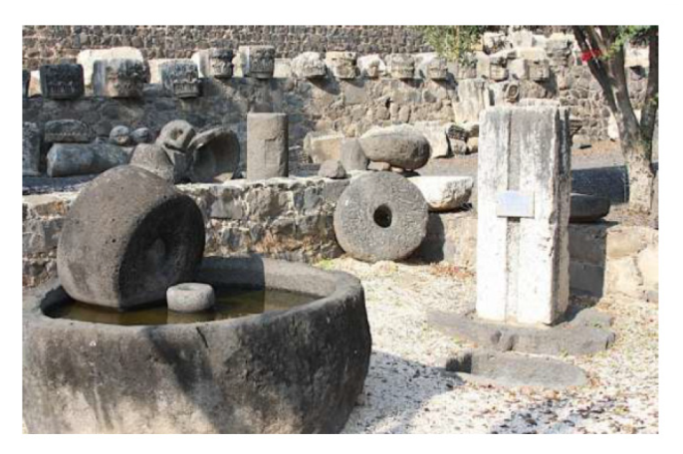


Example: Conceptual Ordering
(Executive Functioning)
Rearrange the cards in order, from start to finish

Slide 15

Example: Object Counting (Attention)
How many stars are there?

Slide 16
Example: Homonyms (Language)
What two words that sound the same but have different meanings would make sense in the following sentences?
Only ______ of the classmates understood how to find the ______ of the two numbers.
______ Mary found an ______ in her picnic basket!

Slide 17
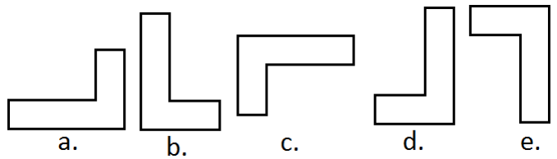
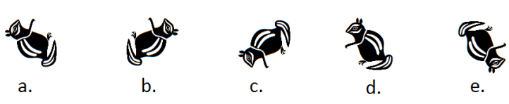
Example: Shape Rotations
(Visual-Spatial Perception)
Four of the five images is a rotation of the same image. Which one of the images is not a rotation but a reverse image?

Slide 18
Case Study

Slide 19
Client Profile
89-year-old, White female
Diagnosis of dementia due to neurodegenerative disease and vascular complications
Aphasic: both receptive and expressive
Stroke several years prior
Wheelchair bound for over 60 years due to spinal cord injury (paraplegia)
Too impaired to complete the standard CTM neuropsychological screening

Slide 20
Interventions Administered with Client
CTM participant for 40 weeks
80% intervention time spent on cognitive interventions

Slide 21
Qualitative Outcomes

Slide 22
Observed Changes: Attention
At the start of the intervention period, the client was cooperative but distracted; after 4 weeks, she began to demonstrate decreased distractibility to irrelevant stimuli
By the end of the intervention period, she could remain focused on tasks for as long as 45 minutes
The client became more attentive to others’ needs

Slide 23
Observed Changes: Language
Client became more willing to speak during the course of participation in the program
She gradually was able to read tongue twisters activity out loud with correct number of syllables
Client also was eventually able to identify more items by name
Expressive language improved

Slide 24
Observed Changes: Visual-Spatial
Marked improvement in visual-spatial tasks
Client was able to complete the Pattern Blocks intervention more quickly and accurately
She also became more attentive to visual-spatial/perceptual detail

Slide 25
Observed Changes: Memory
Observational improvements were noted in short-term memory
Client was able to recall for several days certain images she saw from the Photo Identification intervention
She initially struggled with the Memory Cards intervention but could eventually could find matches in 8 cards
Eventually came recognize the fact that she had grandchildren

Slide 26
Observed Changes: Executive Functioning
Client’s willingness to solve problems increased gradually during the intervention period
Lacing activity was one of the client’s favorite, and she eventually was able to follow the instruction guide carefully and with precision

Slide 27
Observed Changes: Quality of Life
Client became more alert and proactive in voicing thoughts and needs
Caregiver observed that client began to show increased spontaneous speech
Visiting nurse pointed out that client actively identifies issues rather than waiting for nurse to discover them
Enthusiasm towards interventions seemed to induce sense of purpose

Slide 28
Quantitative Outcomes

Slide 29
Frontal Systems Behavior Scale (FrSBe; Grace & Malloy, 2001)
Formal rating scale designed to measure behaviors associated with damage to the frontal lobes and frontal systems of the brain
Developed to provide an evaluation of behaviors prior to and following brain damage; in this case, used to assess behaviors pre-intervention and post-intervention
Consists of 46 items that provide an overall scores as well as scores across the subscales of Apathy, Disinhibition, and Executive Dysfunction
Sound psychometric properties

Slide 30
Frontal Systems Behavior Scale (FrSBe)
FrsBe ratings indicated a 1.3 standard deviation improvement in overall functioning
Subscale analysis revealed a 2.0 standard deviation decrease in Apathy and a 0.7 standard deviation decrease in Executive Dysfunction
No change noted in Disinhibition, but her score on this subscale was not within the clinically significant range prior to initiating intervention
These findings provide preliminary evidence to support CTM as a valid non-pharmacological approach to chronic dementia

Slide 31


The Home Care Assistance Team is Excited to Work with You
Samuel T. Gontkovsky, PsyD
Executive Director of
Research and Development
Jennifer Couch
Neuropsychology Assistant
Home Care Assistance
148 Hawthorne Avenue, Palo Alto, CA 94301 | Tel. (650) 213-8585

