Slide 1

The Nurses Role in the Use of
Medical Aesthetics to
Enhance Patient Satisfaction with Post Treatment Oncology Survivorship
Jennifer Cash, ARNP, MS
Skin Savvy, Rx
Tampa, Florida USA

Slide 2
Learning Objectives
1. Discuss patient survivor aesthetic concerns in the post oncology treatment setting.
2. Introduce the general nursing population to the use of neurotoxins (Botulinumtoxin A injections), dermal fillers and lasers in the care of post treatment survivors.
3. Dispel myths and misconceptions of neurotoxins, dermal fillers and lasers.
4. Reinforce the benefits of using neurotoxins, dermal fillers and lasers for treatment of disease and treatment related side effects from cancer.
5. Discuss incorporating skin care education with focus on self esteem, body image into the medical aesthetics consult/treatment session.

Slide 3
Aesthetic Concerns of Patients
DISEASE AND TREATMENT RELATED SIDE EFFECTS FROM SURGERY, CHEMOTHERAPY AND RADIATION THERAPY
  Physical changes that include scars, surgical deficits, weight loss/gain, telangectasias, hyperpigmentation, skin changes and hair loss
  Emotional changes of decreased coping ability, anxiety, increased stress and chronic fatigue demonstrated on the face and body
  Psychological effects of body image changes and low self esteem that impact relationships

Slide 4
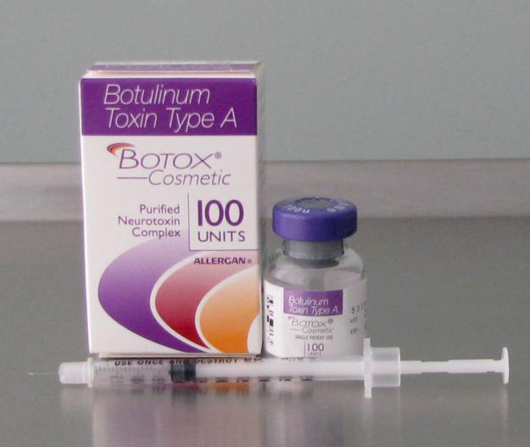
BOTULINUMTOXIN A
Botox®, Dysport®, Xeomin®
    Original brand of Botox®(onabotulinumtoxin A) by Allergan, approved in 1989 for blepharospasm and strabismus. Approved for medical aesthetic use in 2002. Currently, Botox® has 25 different indications in approximately 85 countries, including, but not limited to, chronic migraines, detrusor overactivity, cervical dystonia and upper limb spasticity
    Dysport® (abobutulinumtoxin A) by Galderma, approved in 2009, and Xeomin® (incobotulinumtoxin A) by Merz, approved in 2010

Slide 5
BOTULINUMTOXIN A Con’t
Botulinumtoxin A is a neurotoxin protein derived from the Clostridium botulinum bacterium.
It blocks the release of acetylcholine at the neuromuscular junction reducing muscle contractions smoothing wrinkles
It is a natural purified protein and has controlled action on muscles when administered properly
Safe and effective. Short duration of action
Neuromuscular conditions, sensitivities to human albumin and/or lactose (milk allergy) is possible contraindication

Slide 6
COMMON USES IN POST TREATMENT PATIENTS
    Medical aesthetic uses include
    treatment of facial asymmetry secondary to surgical defects
    headaches/migraines related to nerve dysfunction and/or medication use
    enhanced expression lines in face related to chronic pain and/or stress and anxiety
    Botox® referred to as “the penicillin for self-esteem”

Slide 7
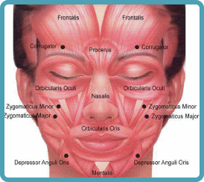

Slide 8
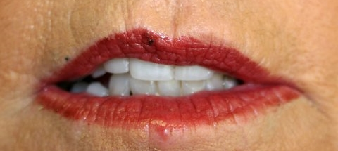
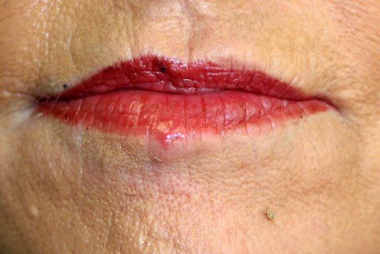
Asymmetric lips at rest
Courtesy of Skin Savvy, Rx Tampa, Florida

Slide 9
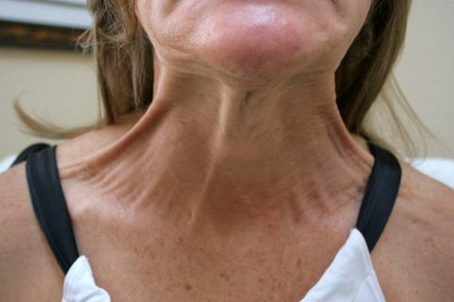
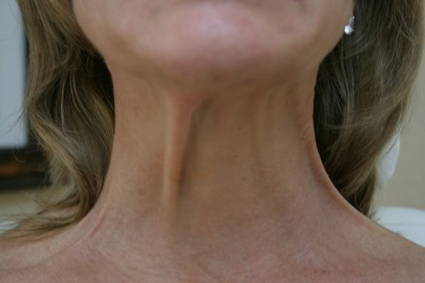
C
Platysmal Bands
Courtesy of Skin Savvy, Rx Tampa, Florida

Slide 10
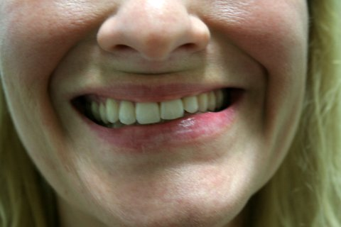
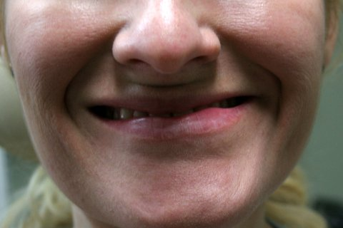
Asymmetric smile
Courtesy of Skin Savvy, Rx Tampa, Florida

Slide 11

HEADACHES/MIGRAINES

Slide 12
DERMAL FILLERS
Intrinsic aging process of thinning of skin, loss of elasticity and diminished dermal collagen, accelerated and compounded by effects of cancer and its treatment.
Dermal fillers address
loss of volume and fat in face secondary to weight loss from disease/treatment (face, hands)
physical manifestations of chronic fatigue/pain (deep folds)
development of scar tissue and residual surgical defects
replacement of hydration and fullness in skin
increasing structural support and volume

Slide 13
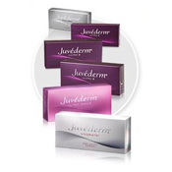


DERMAL FILLERS CON’T

Slide 14
DERMAL FILLERS CON’T
Hyaluronic Acid (HA’s)- Approved 2004, a natural occurring substance in human and animal tissue, lasts 6-12+ months, hydrophilic. Produced from avian staphylococcus equine bacterium, possible allergy testing indicated
Juvederm®, Restylane®, Perlane®, Belotero®, Voluma®
Calcium Hydroxylapatite (CaHA)- Approved 2007, found naturally in human bones and is a mineral-like compound, long lasting (1+ years), no allergy testing
Radiesse®
*Most combined with Lidocaine
** HA’s may be dissolved with the enzyme Hyaluronidase

Slide 15
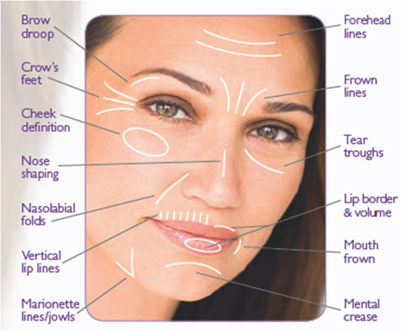
DERMAL FILLER INDICATIONS

Slide 16
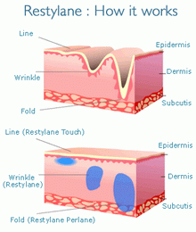
DERMAL FILLERS CON’T
Placement in mid-to-deep dermis, subcutaneous and periosteum

Slide 17
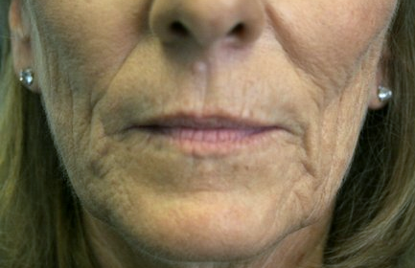
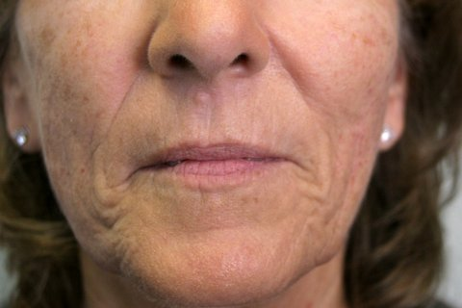
Hollowed Cheeks
Courtesy of Skin Savvy, Rx Tampa, Florida

Slide 18
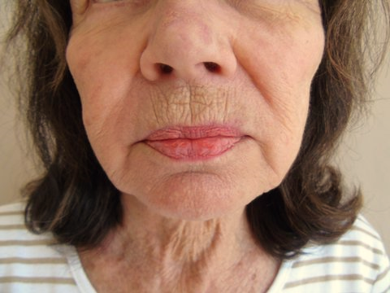
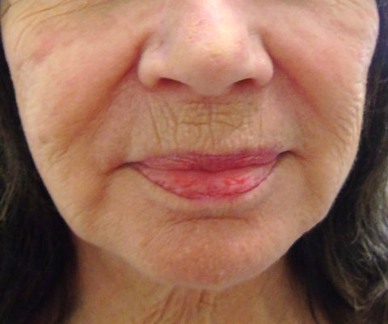
Volume Loss Cheeks
Courtesy of Skin Savvy, Rx Tampa, Florida

Slide 19
LASERS
Variety of types:
Light based (IPL/BBL) for brown/red pigment
Tightening/Lift (Skin Tyte, Ultherapy) for loss of volume/elasticity
Resurfacing (Microlaserpeel) for scarring, thickened, damaged areas
Ablative (Erbium Profractional) for loss of collagen/elasticity
Varilite® for telangectasias
**Typically used in combination for multifactorial skin issues such as scars after surgery requiring Kenalog™ to reduce raised incision sites, Varilite and/or BBL for telangectasias/pigment and Profractional for recruitment of collagen

Slide 20
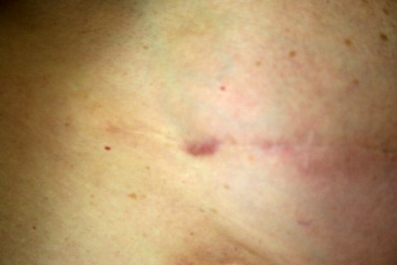
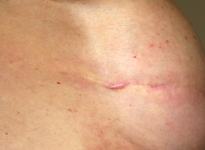
Raised surgical scar with pigment on breast
Courtesy of Skin Savvy, Rx Tampa, Florida

Slide 21
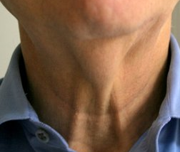
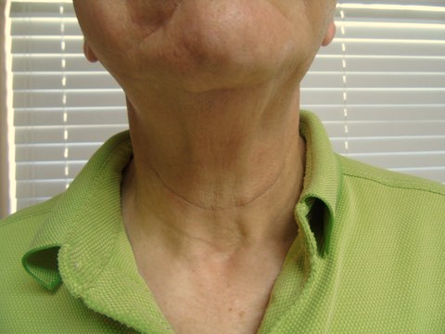
Laxity in Neck
Courtesy of Skin Savvy, Rx Tampa, Florida

Slide 22
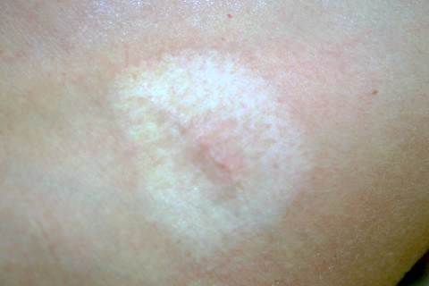
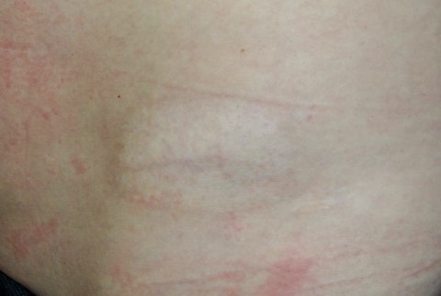
Pigmented Scar
Courtesy of Skin Savvy, Rx Tampa, Florida

Slide 23
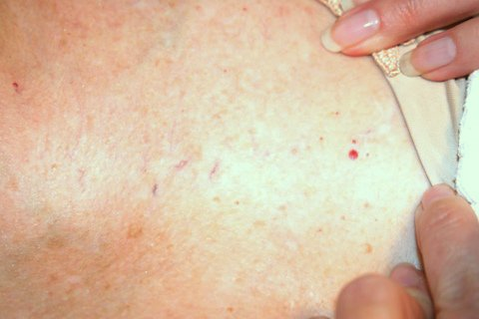
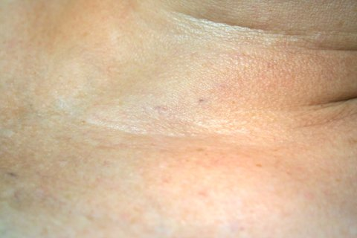
Telangectasias
Courtesy of Skin Savvy, Rx Tampa, Florida

Slide 24
Aesthetics
Most basic need and safest, easiest to accomplish: proper skin care!
Chemotherapy affects fastest growing cells including hair, skin, nails; Radiation therapy causes thinning, desquamation, fibrosis.
Never underestimate the power of a pharmacy grade facial and the socialization during the process. Focus on the patient, not the disease.
Incorporate adjunct services such as lymphatic drainage for facial edema.
Loss of lashes and brows: prescriptive products such as Latisse®
Progressive education with a certification in Oncology Aesthetics (oti-oncologytraining.com) to become a patient advocate for ingredient safety.
THE TAKEAWAY MESSAGE IS FOCUS ON THE LITTLE THINGS! SOMETIMES THAT IS THE ONLY THING A PATIENT HAS ANY CONTROL OVER!

Slide 25
BODY IMAGE AND SELF ESTEEM
Acknowledge the psychological and emotional impact. Nurses are on the forefront of support during active treatment. Post treatment, these patients need support with every day life and relationships. Pallor, dehydration, physical manifestations of treatment remain on the face no matter where the cancer and treatment targeted. It is a constant reminder of what they have been through and what may be in their future.
Never pass on an opportunity to listen. Common to have feelings of vanity or not grateful for surviving cancer, but wanting to be able to look into a mirror again. Preserve self esteem.
Medical aesthetic care and treatment can be empowering in that it is something voluntary and desired by the patient, not mandated by anyone!

Slide 26
REFERENCES
BOTOX® Prescribing Information, 2015 Allergan.
DYSPORT® Prescribing Information, 2015 Galderma Laboratories.
Gold, Michael H. Use of hyaluronic acid fillers for the treatment of the aging face. Clin Interv Aging. 2007 Sept 2(3), 369-376.
Iridex Varilite Laser System Operator Manual. Mountainview, California 2009
Osmosis Skincare. Safe Ingredients in Oncology Aesthetics. August 6, 2015, Skin Inc
Sciton joule Operator Manual. Palo Alto, California 2013.
Small, R. & Hoang, D. A Practical Guide to Botulinum Toxin Procedures. Lippincott, Williams & Wilkins, Philadelphia 2012.
Small, R. & Hoang, D. A Practical Guide to Dermal Filler Procedures. Lippincott, Williams & Wilkins, Philadelphia 2012.
XEOMIN® Prescribing Information, 2015 Merz Pharmaceuticals.

