Slide 1

Detection and Molecular Characterisation of Hepatitis E Virus in Humans, Swine and Wild Boars in Croatia
Jelena Prpić, B.Sc., PhD
Croatian Veterinary Institute

Slide 2
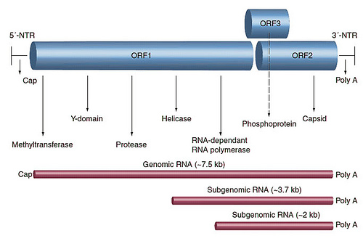
Introduction
• causative agent - RNA virus
• genome- positive sense, ss RNA ~ 7.2kb
https://www.google.hr/search?q=hepatitis+e+virus&biw=1280&bih=891&source=lnms&tbm=isch&sa=X&ved=0ahUKEwiarJHG5I3LAhXFiCwKHXJlDAIQ_AUIBigB#tbm=isch&q=hepatitis+e+virus+genome&imgrc=g2kWwbG7M9MWwM%3A
http://virology-online.com/viruses/HepatitisE.htm

Slide 3
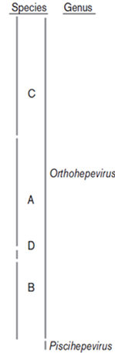
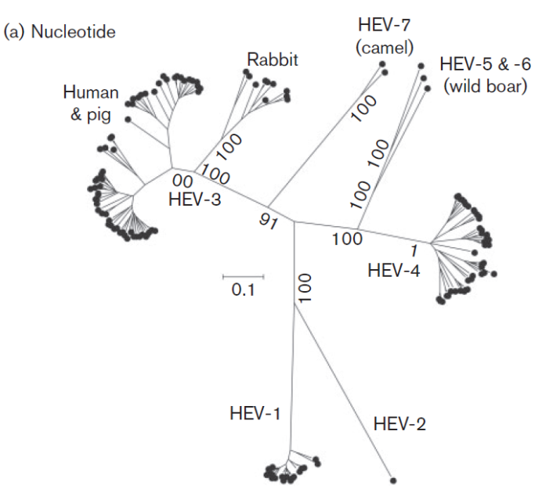
• family Hepeviridae, genera: Orthohepevirus (A, B, C, D) and Piscihepevirus (Smith et al., 2014)

Slide 4
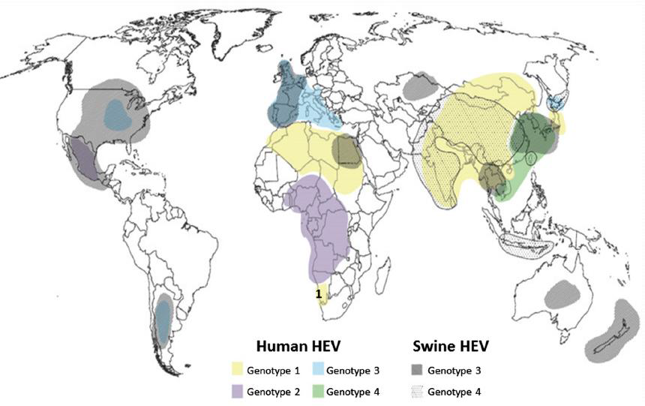
• Hepatitis E virus (HEV) – one of the most common causes of acute hepatitis in many developing countries
• Mortality after infection 1-4%, significantly higher in pregnant women and immunocompromised patients (Kamar et al., 2011; Navaneethan et al., 2008)
Geographic distribution of HEV genotypes
Pérez-Gracia et al., 2014

Slide 5
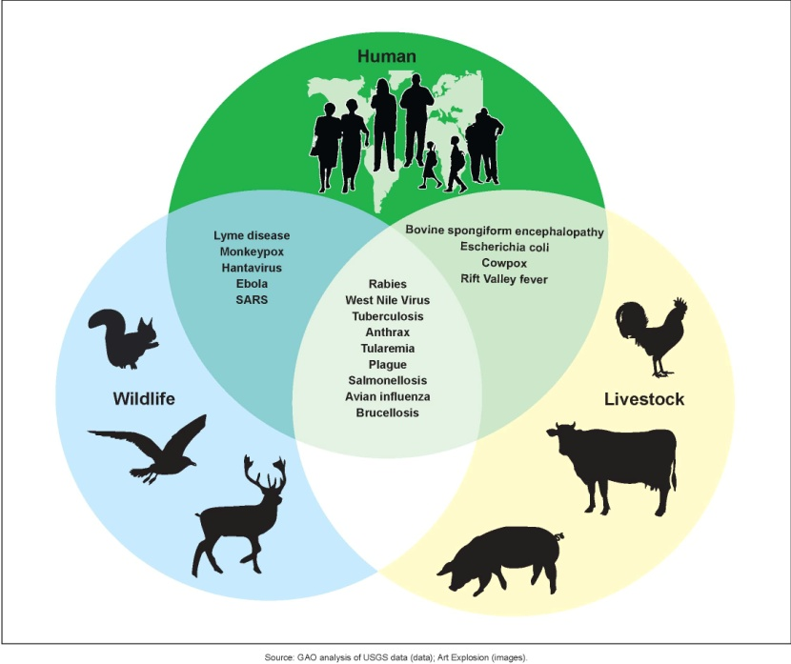
• HEV infection spreads by the fecal-oral route (Li et al., 2005; Yugo and Meng, 2013)
    - Contaminated drinking water
    - Contaminated food of animal origin
• Ability of cross-species infection by some animal strains raises public health concern about potential zoonotic transmission (Clayson et al. , 1995; Meng et al., 1997., Tei et al., 2003.).
• Statistically higher seroprevalence found in pig farmers and veterinarians (Drobeniuc et al., 2001; Meng et al., 2002; Krumbholz et al. 2012)

Slide 6
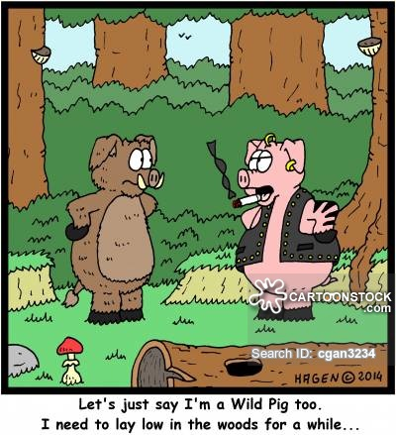
•Potential HEV reservoirs
- Genotypes HEV-3 and HEV-4 have been isolated from a broad range of animals (Meng, 2010; Yugo and Meng, 2013), only domestic pigs, wild boars and deer should be regarded as true reservoirs of the disease (van der Poel, 2014)
- Persistent circulation of the virus within a closed animal population has experimentally been confirmed only for domestic pigs (Andraud et al., 2013)¸in which not only fecal-oral route, but also direct contact transmission has been demonstrated.
- Possibly aerosol transmission has been suggested recently (Bouwknegt et al., 2009)
- HEV shedding pattern, high prevalence, not developing clinical symptoms → domestic pigs are the main HEV reservoir?
- Direct, indirect transmission, organ transplantation (xenotransplantation) →
important public health problem?

Slide 7
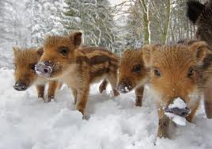
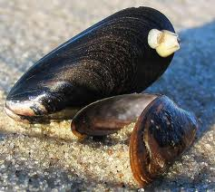
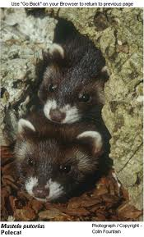
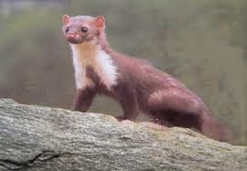
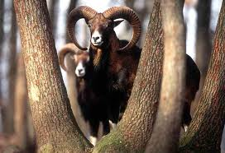
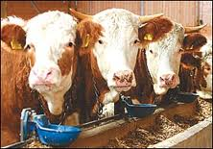
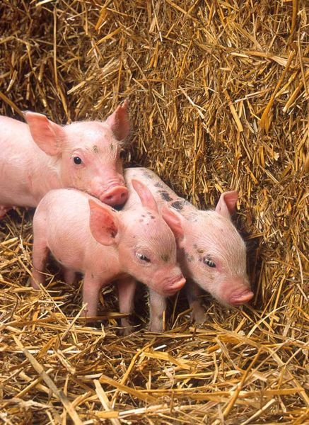
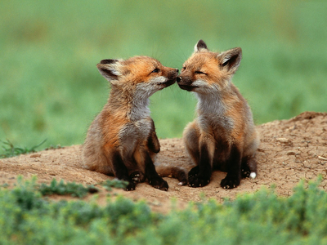
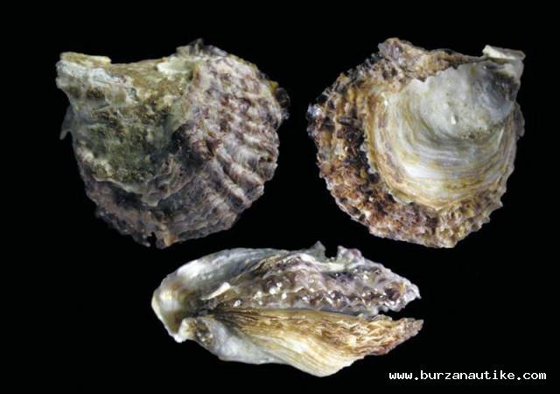
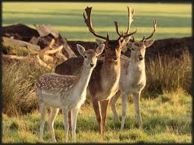
HEV in Croatia since 2009
• domestic pig → farms – 659 samples
→ backyards – 292 samples
• wild boar → 536 samples
• cattle → 32 samples
•roe deer → 40 samples
• red deer → 280 samples
•mufflon → 12 samples
• red fox → 50 samples
• marten → 10 samples
• ferret → 8 samples
• shell → mussel – 252 samples
→ oyster – 286 samples
• human → 57 samples

Slide 8
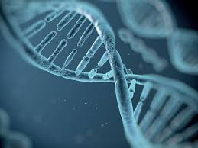
Matherials & Methods
Blood, spleen samples domestic pigs (backyards, farms), wild boars
Human sera samples
Feces domestic farm pigs
Viral RNA extraction
One-step RT-PCR
(van der Poel et al., 2001)
One-step real-time RT-PCR
(Jothikumar et al., 2006)
Nested-PCR with MeT specific primers
(van der Poel et al., 2001)

Slide 9
Sequencing
(Macrogen Inc., Amsterdam, the Netherlands)
Multiple sequence alignement
(ClustalX, Thompson et al., 1997)
Sequence alignement editor
(BioEdit, Hall, 1999)
DNA sequence assembly
(Sequencher 4.8.
www.genecodes.com)
Phylogenetic analysis
(MEGA 5, Tamura et al., 2005)

Slide 10

Results
C4
C2
Genotype 3
C3
C1
Neighbor-joining phylogenetic tree obtained by the analysis of the partial ORF1 region (242 nt) of HEV strains derived from human samples.

Slide 11

C2
Genotype 3
C3
C1
Neighbor-joining phylogenetic tree obtained by the analysis of the partial ORF1 region (242 nt) of HEV strains derived from domestic pig and wild boar samples.

Slide 12
C2
C4
C1
C3
Neighbor-joining phylogenetic tree obtained by the analysis of the partial ORF1 region (242 nt) of HEV strains derived from human, domestic pig and wild boar samples.

Slide 13
Conclusions
Humans:
Human HEV strains clustered into 4 subgenotypes
Human HEV strains showed the highest genetic similarity with Hungarian, Serbian and Dutch strains
Pigs:
Domestic pig strains clustered into 3, wild boar strains into 2 genotypes
The most likely scenario → the virus was transmitted from a farm to backyard pigs and further on to wild boars due to strict bio-security measures implemented on farms that would prevent a vice versa course of infection
The accurate source of infection is difficult to define due to the intensive import from different EU countries in the past decades
Domestic pig and wild boar HEV strains showed the highest genetic similarity with Hungarian and Serbian strains (bordering countries)
To understand this complex epidemiological scenario, more detailed molecular epidemiology studies encompassing a higher number of samples would be necessary

Slide 14
General:
1.
HEV has been detected indomestic pigs and wild boars since 2009 in Croatia
2.
HEV strains are genetically closely related among each other regardless of origin
3.
All analyzed HEV strains were genetically highly identical regardless of origin, indicating mutual source of infection or interspecies transmission
HEV is recognized in humans in 2012 in Croatia
Strains identified as members of subgenotypes C1 and C3 are predominant in Croatia and were derived from all species
Domestic pigs and wild boars may be important reservoirs of HEV in the country presenting a significant risk for HEV infection in humans

Slide 15
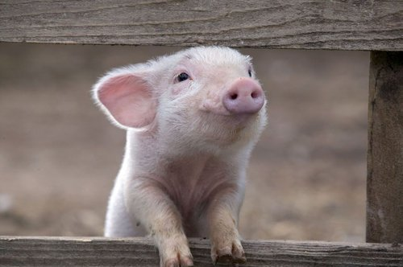
THANK YOU FOR YOUR ATTENTION

