Slide 1


Personalized Healthcare:
From Research to Practice
International Conference on Hospice and Palliative Care
Orlando, Florida
August 31, 2015
Jeff Harrison, PhD, MBA, MHA, FACHE
Professor and Chair Department of Public Health, University of North Florida
Debra Harrison, DNP, RN, NEA-BC
Assistant Professor in Nursing, college of Medicine, Chief Nursing Officer, Mayo Clinic Florida

Slide 2
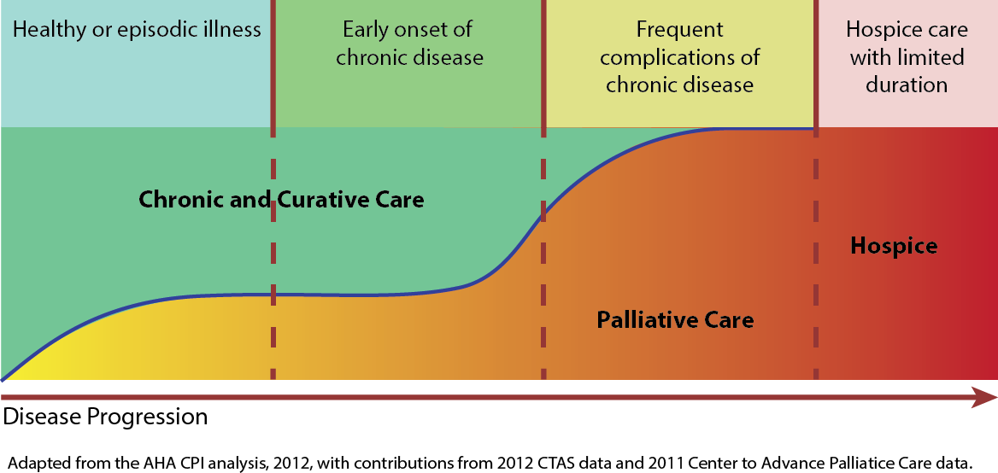

Slide 3
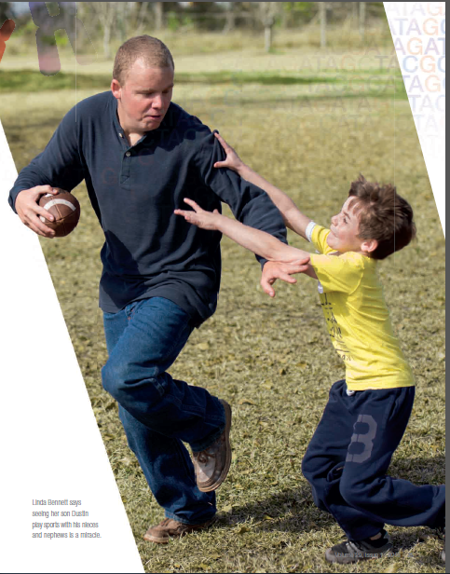

Slide 4

THE FUTURE OF HEALTHCARE
“I look through a half-opened door into the future, full of interest, intriguing beyond my power to describe…”
- Dr. William Mayo (1910)
“Human Genomics represents the new healthcare value paradigm. Individualized Medicine will fundamentally change the structure of the healthcare industry by focusing on preventive medicine, effective treatment modalities, and medical interventions across the life span.”
- Dr. Jeff Harrison (2015)

Slide 5
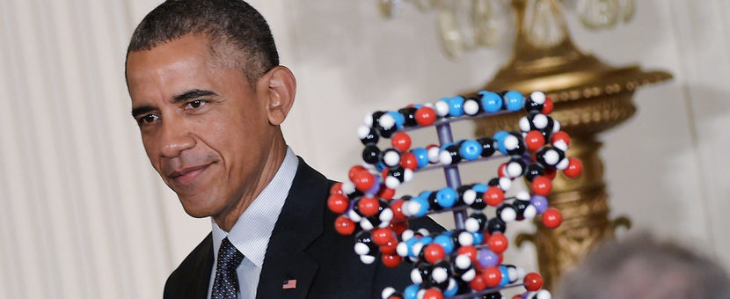

Obama seeks $215 million for personalized medicine
State of the Union Address, 2015
$130 million to NIH for development of a voluntary national research cohort
$70 million to the National Cancer Institute (NCI), part of NIH, to scale up efforts to identify genomic drivers in cancer
$10 million to FDA to support the regulatory structure needed
$5 million to ONC to address privacy and enable secure exchange of data across systems
Notes:
President Obama’s 2016 budget includes a $215 million investment in research on personalized medicine to provide clinicians with new tools, knowledge, and therapies to select which treatments will work best for which patients. That figure includes $5 million for the Office of the National Coordinator to support the development of interoperability standards and requirements that address privacy and enable secure exchange of data across systems.
National Institutes of Health (NIH), together with the Food and Drug Administration (FDA), and the Office of the National Coordinator for Health Information Technology (ONC)
$130 million to NIH for development of a voluntary national research cohort of a million or more volunteers to propel our understanding of health and disease and set the foundation for a new way of doing research through engaged participants and open, responsible data sharing.
$70 million to the National Cancer Institute (NCI), part of NIH, to scale up efforts to identify genomic drivers in cancer and apply that knowledge in the development of more effective approaches to cancer treatment.
•$10 million to FDA to acquire additional expertise and advance the development of high quality, curated databases to support the regulatory structure needed to advance innovation in precision medicine and protect public health.
•$5 million to ONC to support the development of interoperability standards and requirements that address privacy and enable secure exchange of data across systems.

Slide 6
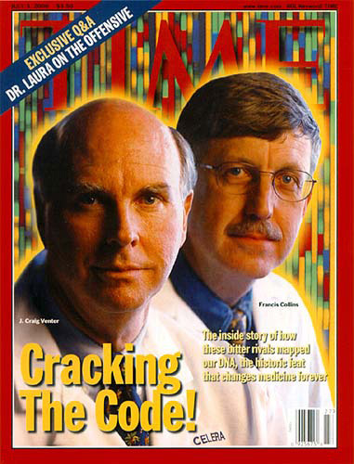
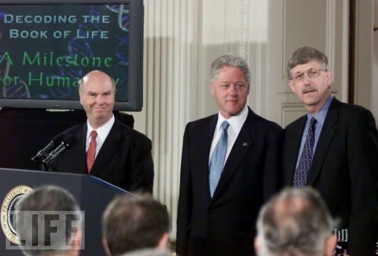
“This will revolutionize the diagnosis, prevention and treatment of most ,
if not all, human diseases.”
-Bill Clinton, June 2000
Slide provided by Alex Parker, Ph.D. Center for Individualized Medicine, Mayo Clinic, FL

Slide 7
15 Years
$3 Billion
Slide provided by Alex Parker, Ph.D. Center for Individualized Medicine, Mayo Clinic, FL

Slide 8
Cost of Whole Genome Sequencing
$1,000 to sequence one human genome
?
Slide provided by Alex Parker, Ph.D. Center for Individualized Medicine, Mayo Clinic, FL

Slide 9

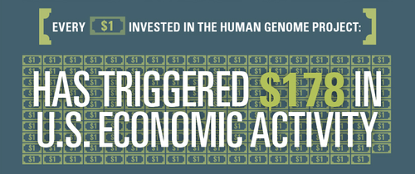
Slide provided by Alex Parker, Ph.D. Center for Individualized Medicine, Mayo Clinic, FL

Slide 10
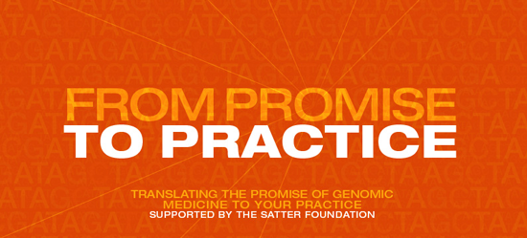
Slide provided by Alex Parker, Ph.D. Center for Individualized Medicine, Mayo Clinic, FL

Slide 11
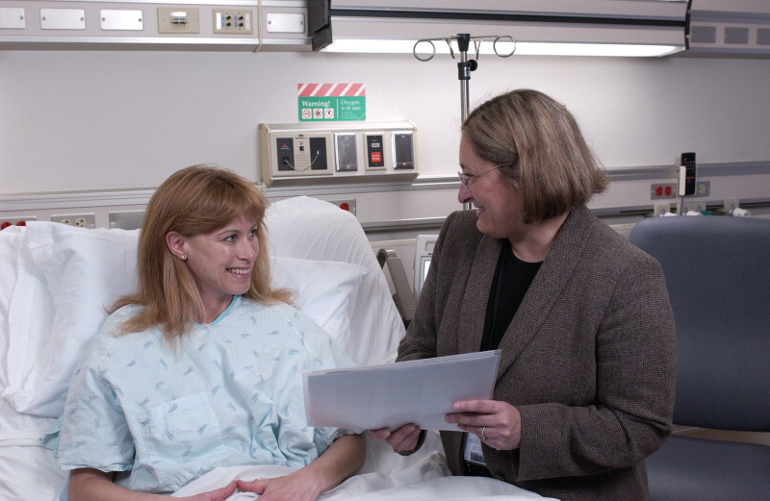
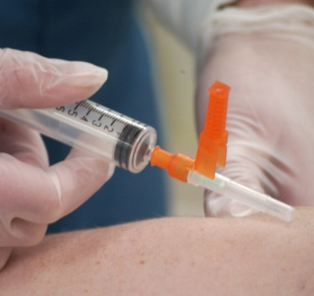
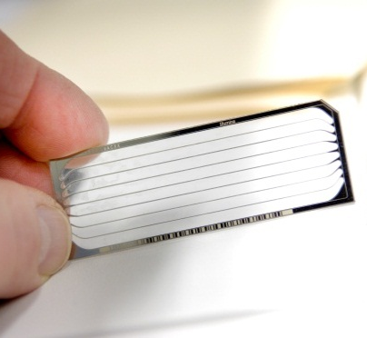
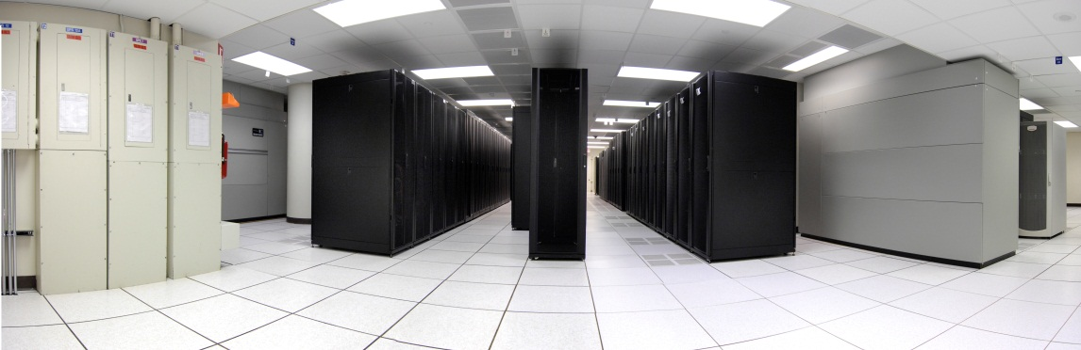
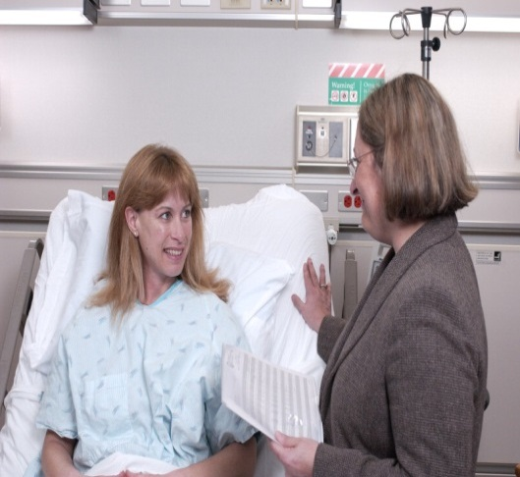
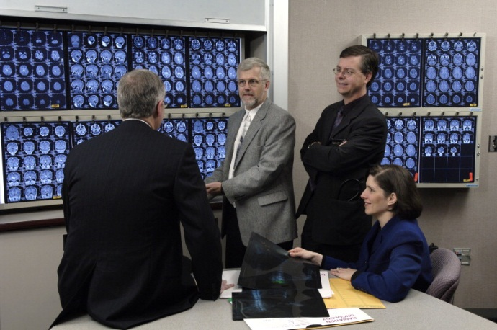
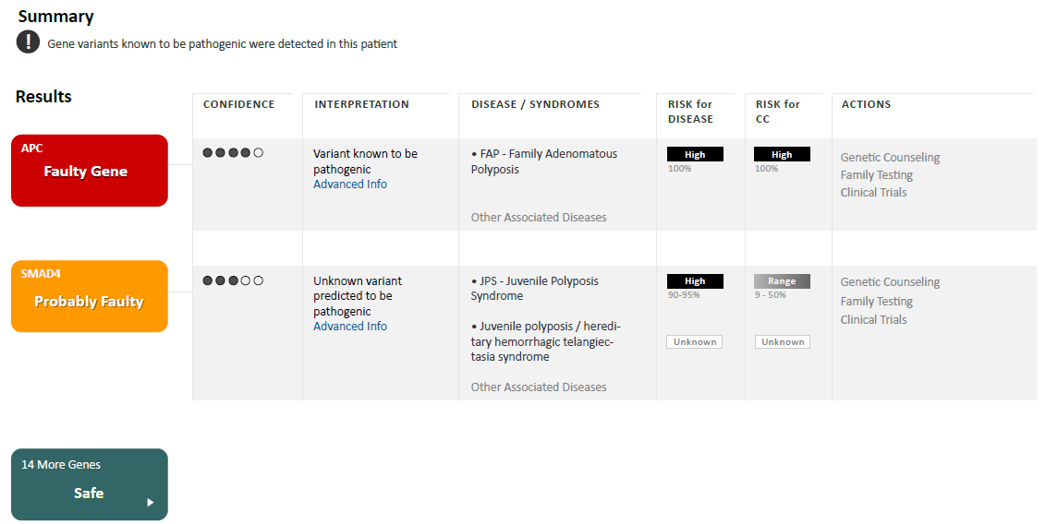
Individualized Medicine Mayo Clinic
Sample Collection
(Blood and/or Tissue)
Next Generation
Sequencing
Data Storage/Analysis
Referral to IM Clinic and Consultation
i
Individualized
Medicine Consult
Expert Review and Consultation
Interpretive Report
Generated
Slide provided by Alex Parker, Ph.D. Center for Individualized Medicine, Mayo Clinic, FL
Notes:
Offering Whole Exome and Whole Genome Sequencing to individual patients
Cancer patients
Diagnostic Odyssey
Patient 1
Proving the potential
Rare variant, potentially treatable
11

Slide 12
Center for Individualized Medicine Team
Primary physician
Individualized Medicine consultants and physician specialists
Palliative Care Specialist
Genetic counselors
Laboratory professionals
Bio-informaticians
Bioethicists
Notes:
The primary care physician, initially a Mayo Clinic physician, will have the advantage of working with a team of specialists to provide care informed by genomics
Primary physician. To ensure you receive the best possible care, we invite and encourage your primary care provider to participate in all discussions about your case. This can be done by teleconference or video conference when appropriate.
IM Clinic consultants and physician specialists. These doctors include specialists in medical genetics, general internal medicine, pediatrics, gastroenterology, cardiovascular diseases, pathology, hematology, oncology and other areas.
Genetic counselors. These health professionals work with doctors and families to help patients understand the process and implications of genome sequencing. They also provide education and support for patients and assist with genome analysis.
Laboratory professionals. These doctorate-level scientists include molecular pathologists and biologists, geneticists, biochemists, and others. They help the team understand how individual changes at the submicroscopic level affect a patient's condition.
Bioinformaticians. This specialized team combines computer science with biology and genetics to filter and distill the trillions of pieces of information from your genome into a brief report that you and your provider can use.
Bioethicist. A representative from bioethics works with the group from start to finish, helping to ensure that all ethical, legal and social implications are considered.
http://mayoresearch.mayo.edu/center-for-individualized-medicine/individualized-medicine-clinic.asp

Slide 13
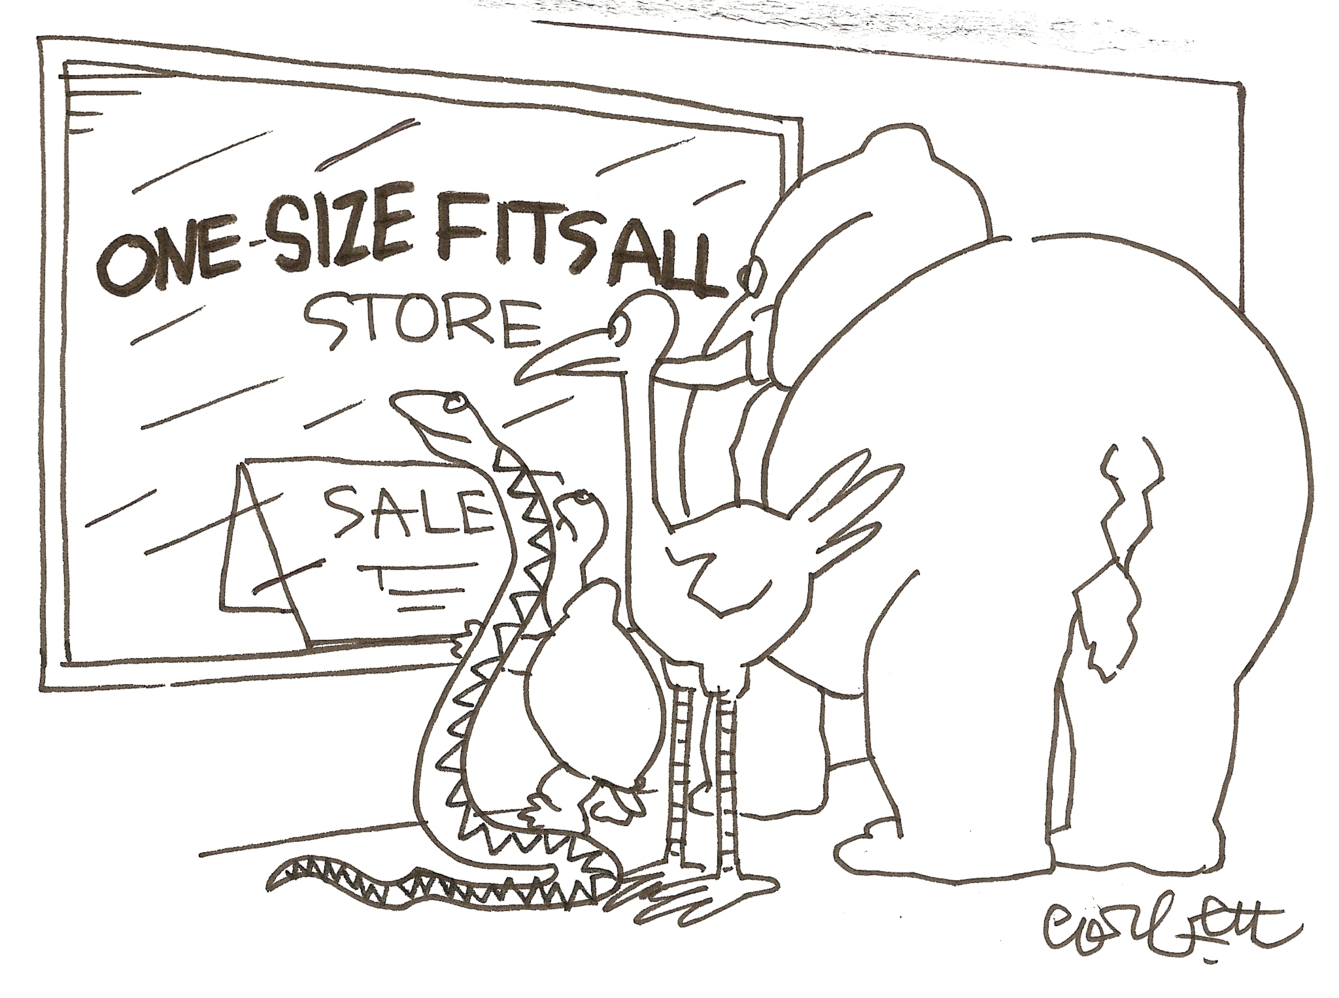

Slide 14
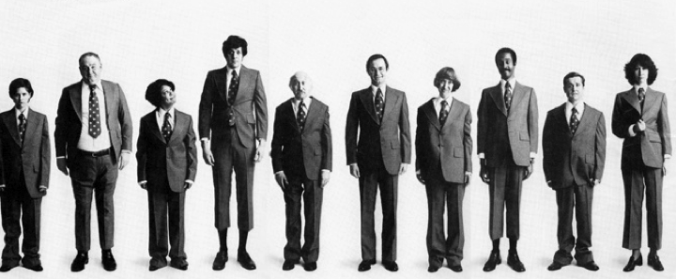
Advanced Cancers
They are using the latest genetic sequencing technologies to move away from a “one size fits all” approach to cancer treatment
Slide provided by Alex Parker, Ph.D. Center for Individualized Medicine, Mayo Clinic, FL

Slide 15
One Size Does Not Fit All…
44-year-old female with cancer in her gall bladder
Cancer has spread to her lungs
Her cancer did not respond to the
“standard therapy”
She enrolled in a clinical trial of a possible new drug for cancers of the gall bladder
No response…
Out of options

Slide 16
Personalized Healthcare
Provides New Hope
Her oncologist consulted with Individualized Medicine Clinic
Team discussed her case and determined she is good candidate for genomic sequencing
Genetic Counselor met with patient and her oncologist to explain pros and cons
Resected the cancer and isolated DNA
Sequenced the DNA from the tumor and our team analyzed it for “clues”
Identified a mutation in a gene called FGFR2
Started targeted therapy against FGFR2

Slide 17
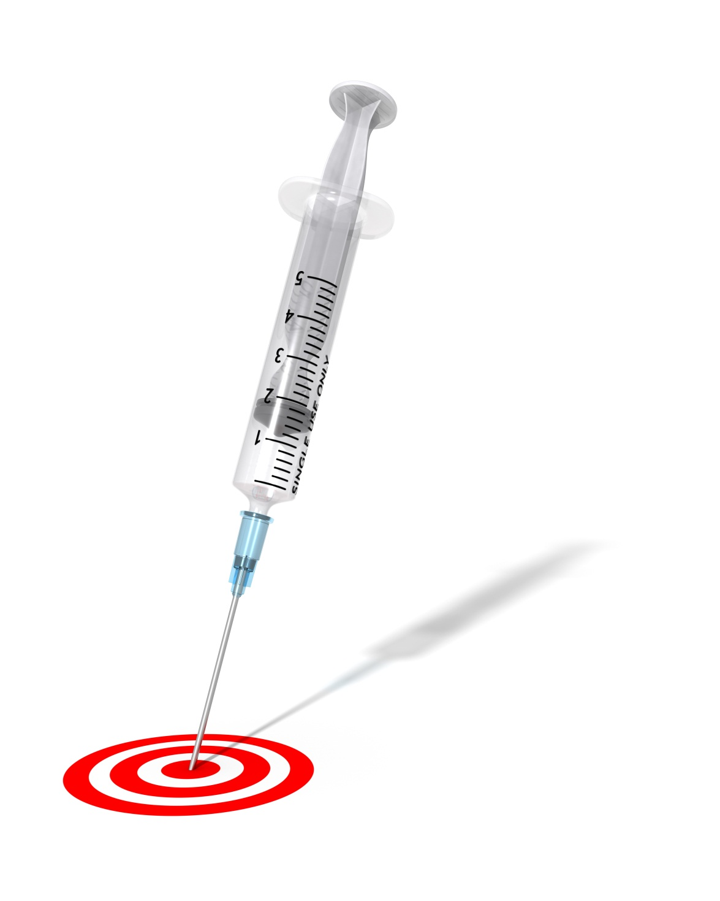
Responded to a drug we would have NEVER thought of using for this patient.
Slide provided by Alex Parker, Ph.D. Center for Individualized Medicine, Mayo Clinic, FL

Slide 18
Competitive Analysis
Direct-to-Consumer genetic testing
  Used for ancestry, paternity, ethnicity and specific disease risks
  Misleading and irrelevant info due to lack of specificity when interpreting test results
  No laws exist that dictate what happens to genetic info when companies go out of business
  Price ranges from under $100 - $1,000
$230 million industry by 2018

Slide 19
“The power in tailored therapeutics is for us to say more clearly to payers, providers and patients… ‘this treatment is not for everyone, but it is for you’.”
John C. Lechleiter
President and CEO, Eli Lilly and Company
Slide provided by Alex Parker, Ph.D. Center for Individualized Medicine, Mayo Clinic, FL

Slide 20
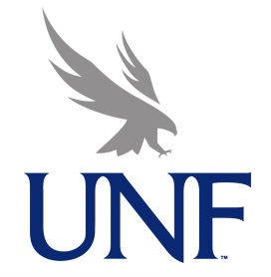
Predictive Genomics Service Line Business Plan
University of North Florida
Matt DeMarino, Luanne Lentz, Pomy Singh, Kate Tison

Slide 21
Disease Raises Many Questions…
What is my risk of developing Disease X?
If I have Disease X, what is the risk I will die from it?
If I chose a treatment for Disease X, what is the risk it won’t work for me?
If I undergo treatment, what is my risk of side effects?
Now more than ever, the answers to these questions can be individualized

Slide 22

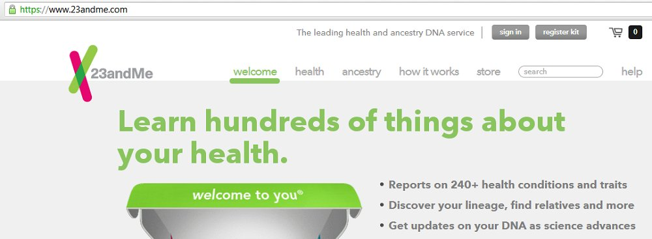
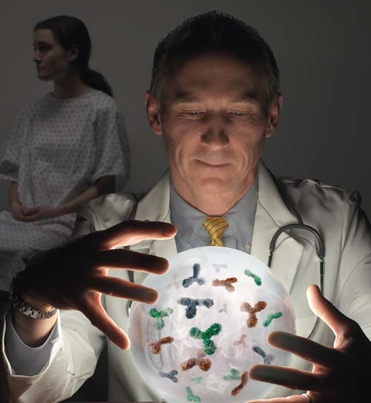
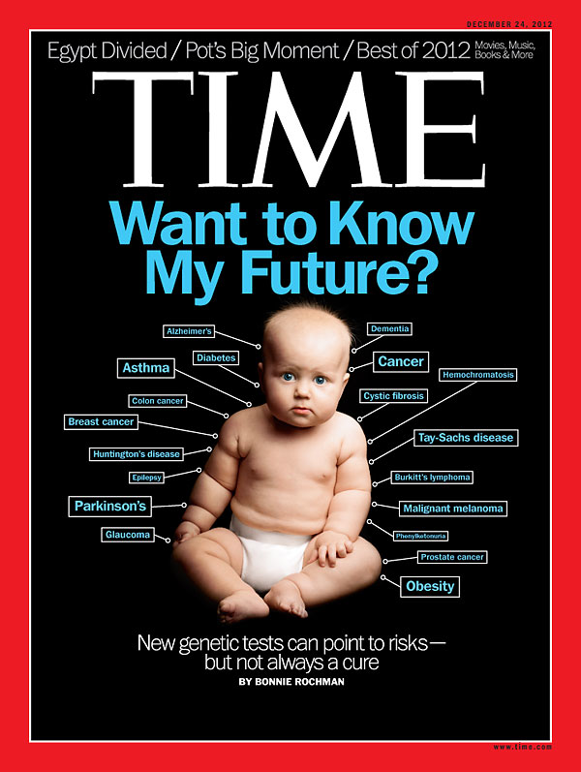
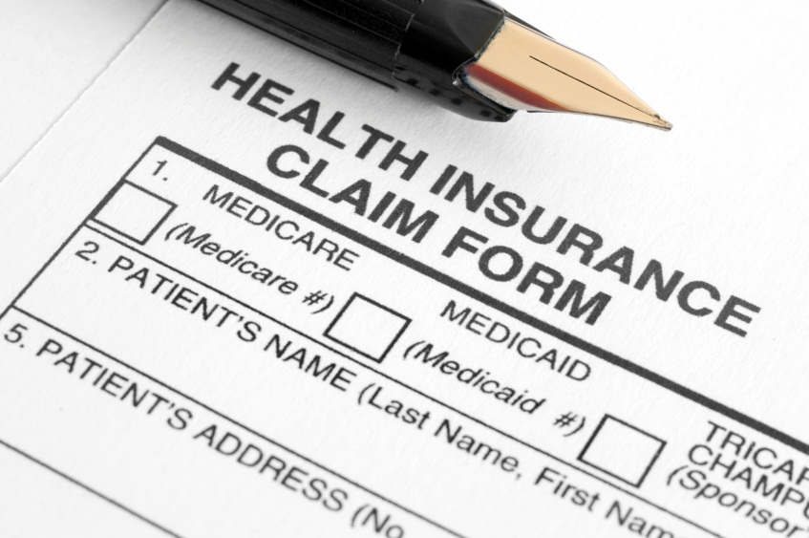


Slide provided by Alex Parker, Ph.D. Center for Individualized Medicine, Mayo Clinic, FL

Slide 23

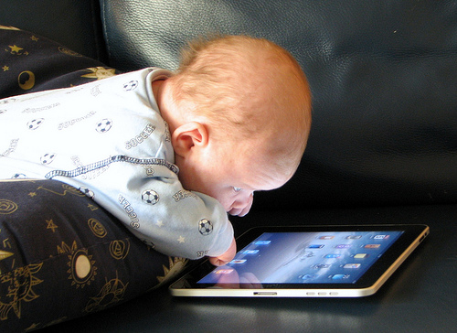
Integration of technology takes time…
…but technology waits for no one.
Slide provided by Alex Parker, Ph.D. Center for Individualized Medicine, Mayo Clinic, FL

Slide 24
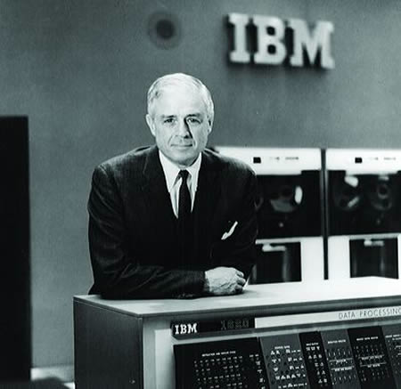
“I think there is a world market for maybe five computers.”
Thomas Watson, Chairman of IBM, 1943
Slide provided by Alex Parker, Ph.D. Center for Individualized Medicine, Mayo Clinic, FL

Slide 25
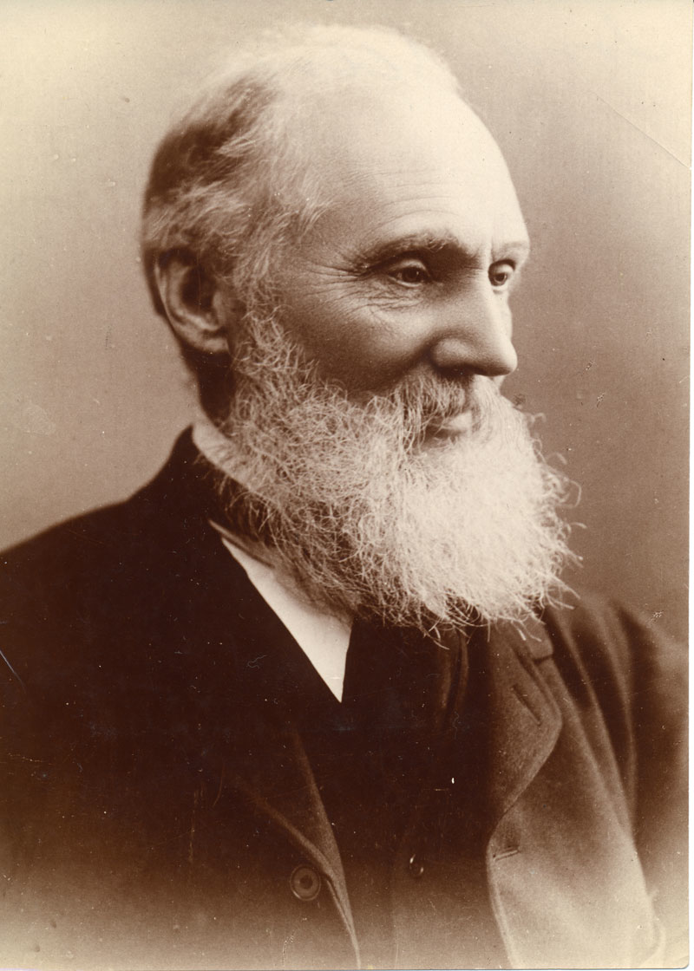
“X-rays will prove to be a hoax.”
Lord Kelvin
President of the Royal Society, 1883.
Slide provided by Alex Parker, Ph.D. Center for Individualized Medicine, Mayo Clinic, FL

Slide 26

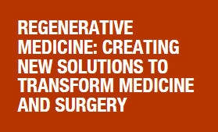
Regenerative Medicine
Another strategy to add to precision medicine and personalized care.

Slide 27

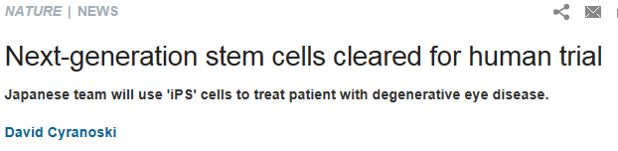
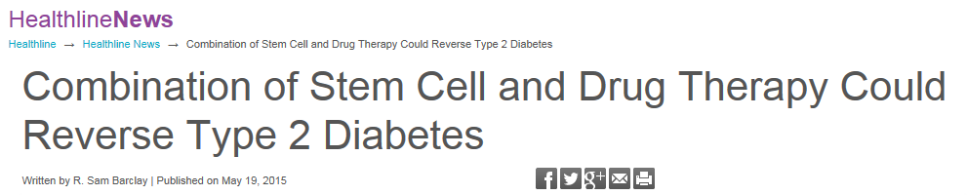
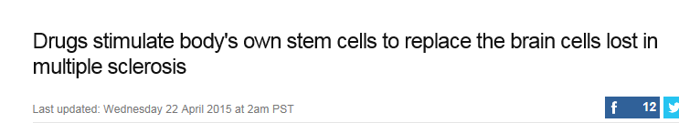
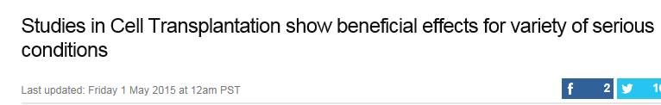
Headlines
Notes:
Stem cell transplantation was pioneered using bone-marrow-derived stem cells by a team at the Fred Hutchinson Cancer Research Center from the 1950s through the 1970s led by E. Donnall Thomas, whose work was later recognized with a Nobel Prize in Physiology or Medicine. Thomas' work showed that bone marrow cells infused intravenously could repopulate the bone marrow and produce new blood cells. His work also reduced the likelihood of developing a life-threatening complication called graft-versus-host disease.^{[41]}
The first physician to perform a successful human bone marrow transplant on a disease other than cancer was Robert A. Good at the University of Minnesota in 1968.^{[42]} In 1975, John Kersey, M.D., also of the University of Minnesota, performed the first successful bone marrow transplant to cure lymphoma. His patient, a 16-year-old-boy, is today the longest-living lymphoma transplant survivor.^{[43]}
At the end of 2012, 20.2 million people had registered their willingness to be a bone marrow donor with one of the 67 registries from 49 countries participating in Bone Marrow Donors Worldwide. 17.9 million of these registered donors had been ABDR typed, allowing easy matching. A further 561,000 cord blood units had been received by one of 46 cord blood banks from 30 countries participating. The highest total number of bone marrow donors registered were those from the USA (8.0 million), and the highest number per capita were those from Cyprus (15.4% of the population).[
Macular degeneration of the retina is one of the conditions researchers hope can be treated with induced pluripotent stem cells.

Slide 28
A Pilot Study: Evaluating the Safety and Feasibility of Using Autologous Adipose-derived stromal cells (ASCS)on Adults with Stage III or IV Pressure Ulcers
Formulating the Question

Slide 29
A National HEALTHCARE Concern…
Each year, more than 1- 2.5 million U.S. patients develop pressure ulcers (Young, 2012)
Pressure ulcers cost $9.1 billion to $11.6 billion per year in the United States. (Berlowitz, 2011)
Directly associated with diminished quality of life, extended length of stay, sepsis, and increased mortality (Stafford, 2012)
Average charge per stay for a patient with a stage III or stage IV pressure ulcer: $43,180 (Jackson, 2011)
Result in more than 17,000 lawsuits and are the second most common claim for wrongful death (Lyder, 2008)
Notes:
An analysis by CMS found that the average charge per stay for a patient with a stage III or stage IV pressure ulcer was $43,180 (Jackson, 2011).

Slide 30

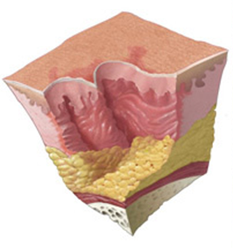

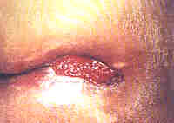
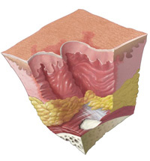
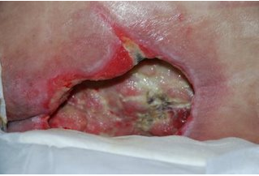
Pressure ulcer staging
Pressure Ulcer Staging
Stage IV
Stage III

Slide 31
The process of clinical research
Pre-clinical testing ($75,000 grant)
Investigational New Drug Application (IND) with FDA approval (2014)
Phase I (assess safety) ($86,000 grant)
Phase II (test for effectiveness)
Phase III (large-scale testing) (RO1 grant)
Licensing (approval to use)
Approval (available for prescription)
Post-marketing studies (special studies and long-term effectiveness/use)

Slide 32
Pre-clinical testing
Adipose-derived Stromal Cells (ASCs)
  Stromal cells can differentiate into a variety of cell types
  Determined ASC count per mL of adipose tissue
  About 1 to 5 percent of the stromal cells are stem cells
Medium to apply to Wound
  How can we sustain the life of the MSCs?
  What is already FDA approved?
  Would it be considered standard treatment?
Notes:
Mesenchymal stem cells, or MSCs, are multipotent stromal cells that can differentiate into a variety of cell types,[1] including: osteoblasts (bone cells),[2] chondrocytes (cartilage cells),[3] and adipocytes (fat cells). This phenomenon has been documented in specific cells and tissues in living animals and their counterparts growing in tissue culture.

Slide 33
Challenges with Conventional Dressings
Dressing | Challenges
Aquacel | Dressing turns into gel when in contact with liquid, making recovery of cells and testing unreliable and difficult.
Covidien | Cell lysed when cultured on dressing.
Fibracol | Acidity of dressing decreased viability of cells
Kaltostat | Acidity of dressing decreased viability of cells
Honey-colloid | Acidity of dressing decreased viability of cells

Slide 34
Current: Phase I - Pilot
The goals of phase I clinical trials are:
  Assess safety for humans
  Select the dose to be used in future studies
During phase I, the study is designed to determine:
  How the human body reacts
  What side effects occur

Slide 35
Outcomes Desired
Ultimately, a less costly, more effective treatment for pressure ulcers.
Recruitment of 12 patients for the randomized clinical pilot study.
Phase II will be a randomized, controlled trial, most likely involving several institutions across wide geographic area.

Slide 36
Future Potential
Treatment for various wounds – diabetic, vascular, burns, etc.
Move to allogeneic, cultured ASCs/stem cells
Need to consider availability to centers without the means to produce the product
Use of the biobank to “save cells” for future regenerative use
Notes:
The Regenerative Medicine Biotrust enables the Center for Regenerative Medicine to collect, process and store cells and other biospecimens from individual patients. As a patient's own cells are often used as a starting point for regenerative therapies, having them readily available in the biotrust is critical.
Any human cells or tissues with application to regenerative medicine and surgery are within the scope of the Biotrust. Examples include cells from umbilical cord blood, ­ fibroblasts or other somatic cells for induced pluripotent stem (iPS) cell reprogramming, iPS cell lines, or partially differentiated cell lineages derived from various stem cell types.
Regenerative medicine applications
Examples of services within the Regenerative Medicine Biotrust include:
IRB and scienti­fic protocol development
Biospecimen collection and primary cell isolation
iPS cell generation
Training in iPS cell culturing techniques
Directed differentiation of various cell types
Protocol development
Cryopreservation, banking and redundant storage of regenerative medicine-related biomaterials

Slide 37
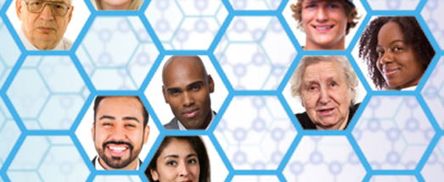
Biobank Potential
http://www.mayo.edu/research/centers-programs/mayo-clinic-biobank/overview
Mayo to study 10,000 patients for drug-gene safety
Notes:
Researchers will be sequencing the DNA of the biobank members for 69 genes that can influence how patients’ metabolize or react to different drugs. The goal is to determine which pharmacogenomic findings are relevant to that individual patient and to insert that information into their medical records — providing an early warning system to prevent adverse drug reactions or ineffective treatments.

Slide 38
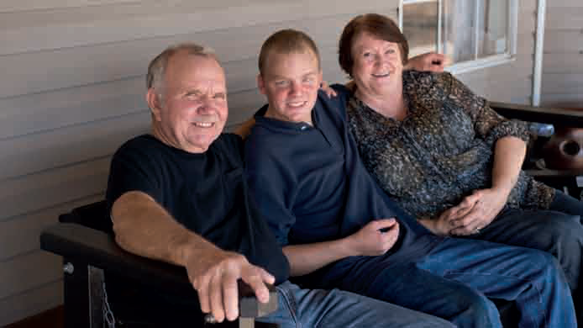


Slide 39
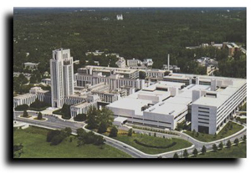
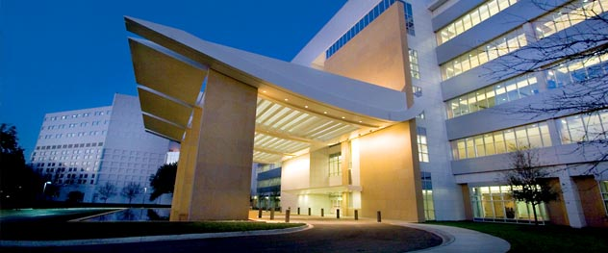
Questions?
Jeff Harrison, PhD, FACHE
Professor and Chair Department of Public Health
University of North Florida
O (904) 620-1440
F (904) 620-1035
Jeffrey.Harrison@unf.edu
Deb Harrison, DNP, RN, NEA-BC
Chief Nursing Officer
Mayo Clinic
Harrison.debra@mayo.edu

