Slide 1
MARINE BASED INGREDIENTS international conference and exhibition on marine drugs and natural products melbourne, australia
July 2016
Jeanine B. Downie, M.D., FAAD
Director, image Dermatology® P.C.
Assistant Attending Mountainside
and Overlook Hospitals
Montclair, New Jersey
Copyright © 2016 image Dermatology® P.C. and Jeanine B. Downie, M.D. All rights reserved.

Slide 2
DISCLOSURES
Johnson & Johnson Allergan
Valeant Pfizer
Galderma Intendis
BTL Exeltis
Revance Restorsea
Theraplex LLC Evidera
Cutera Lifes 2 Good
Medmetriks Bio Pharma X
Nutrafol Neothetics
Ranbaxy Futura Pro
Alphaeon Laviv
Merz Regimen MD
Skin Medica Proctor & Gamble
Thermi RF

Slide 3
Background
marine compounds are currently used in antibiotics derived from fungi
compounds from a sponge have been founds to be useful in treating cancer
neurotoxin from a sea snail has been determined to be as strong and effective as morphine
unicellular organisms make up more than 95% of the living organisms in the ocean
these microorganisms grow where no other life forms can, very deep in the ocean. If they can survive in the ocean depths, they may be helpful in protecting our skin from environmental stressors
ocean organisms can be sunburned and the question is whether they have developed compounds/mechanisms that help repair damage from the environment
perfectly preserved algae – either freezing-drying and/or cold extraction are the best way to preserve seaweed’s potency

Slide 4
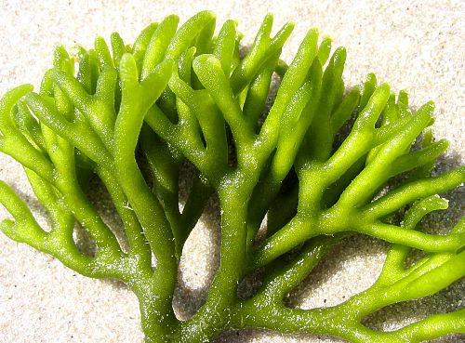
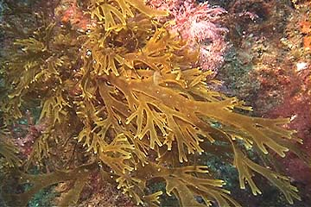
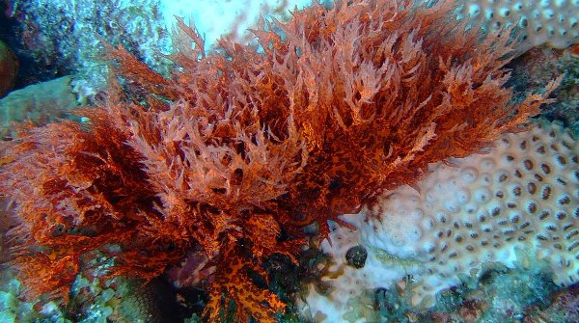
promising marinE compounds I
Chlorella vulgaris – single-cell green algae (below left) with antioxidant properties
Padina pavonica – brown algae (below center)
Porphyridium creuntum – red microalgae (below right)
Chrondus crispus – brown algae extracts that have been shown to affect skin function and structure and offer water binding properties

Slide 5
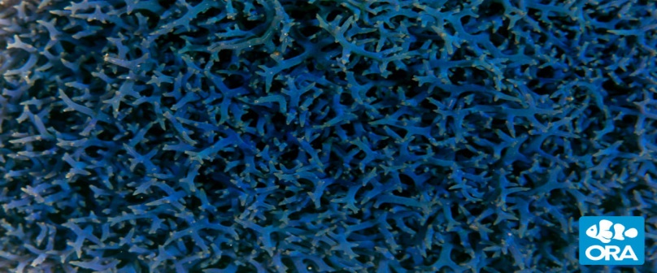
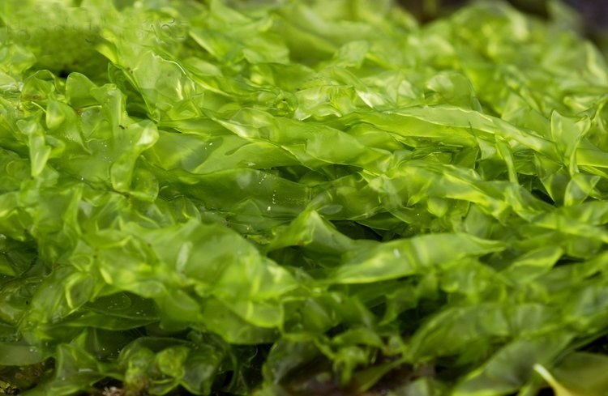
promising marinE compounds II
Fucus vesiculosus – blue algae extract
Spirulina – a type of blue green algae (below left)
Ulva sea lettuce – an edible green algae (below right)
Algae – product different polysacchardes including alginates, laminarans and fucoidans
Alginates – used mostly in foods as thickeners and emulsifiers
Fucoidans – being studied extensively for their potential antitumor, antiviral, anticomplement and anti-inflammatory properties
(Thomas and Kim, Marine Drugs, Jan. 2013)

Slide 6
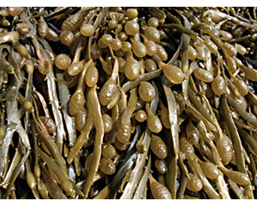
promising marinE compounds III
Exopolysaccharide (EPS) Seafill – a sugar produced outside the cells of brown seaweed (below). This is similar to a biofilm, produced by microorganisms as protection in response to environmental stress. An internal study indicated that EPS Seafill increases collagen and elastin synthesis in human fibroblasts, generating a significant tightening effect on the collagen network

Slide 7
promising marinE compounds IV
Seaweed Oligosaccharide and Zinc Complex (SOZC) – ameliorates symptoms of acne vulgaris, particularly in terms of reducing sebum production and populations of propionibacterium acnes.
(Journal of Cosmetic Science, May/June 2013).
Fucus vesiculosis – catabolites derived from this brown seaweed grown in marine areas subject to extreme environmental changes. Anti-aging properties may include skin tightening, dark circle and wrinkle reduction.
Fucoxanthin – extracted from Laminaria japonica has shown the ability to suppress tyrosinase activity and melanogenesis. This may even out skin tone.
(Thomas and Kim, Marine Drugs, Jan. 2013).
Mycosporine – like amino acids (MAAs) – are ultraviolet light screening compounds that exist in a wide range of organisms. This ingredient could be used for broad spectrum sunscreens.
(Llewellyn and Airs, Marine Drugs, 2010).

Slide 8
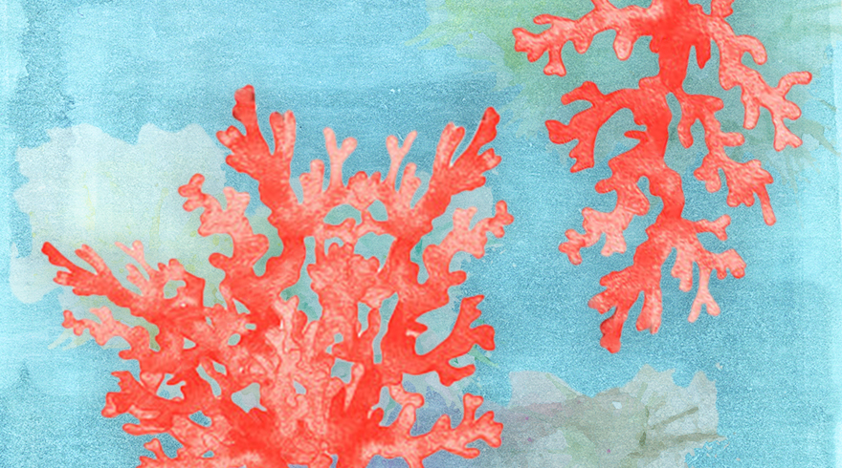
promising marinE compounds V
Chlorella vulgaris – a peptide extracted from this single cell green algae stimulates the production of four types of dermal collagen and elastin. Apparently, it also decreases the breakdown of collagen and elastin. It also stimulates natural cell defenses by increasing the expression of endogenous thioredoxins and protecting against free radicals.
Corallina pilulifera – has phlorotannins and sulfated polysaccharides. These have been shown to prevent oxidative stress from UV light, which is known to lead to photoaging.
(Thomas and Kim, Marine Drugs, Jan. 2013)
Pseudopterogorgia elisabethae – a Caribbean Sea Whip (below) has pseudopterosins which have been studied for their anti-inflammatory properties.
(Dayan, N. Journal of Cosmetic Science, Dec. 2009).

Slide 9
Conclusion
The global cosmeceutical market is expected to grow at a compounded annual rate of 8.62% from 2014 to 2019 (Steamfeed.com, 2015).
The U.S. cosmeceutical industry is currently estimated at 6.5 billion dollars (ASDS, 2015).
The global cosmeceutical industry is currently estimated at 21 billion dollars (AAD, 2016, ASPS, 2015).
Cosmeceuticals are expected to grow another 30% by 2020 (Maheshwari, 2015).
Age-defying products and sunscreens are a key part of cosmeceutical growth (Freedonia, 2015).
By harnessing the potential of bioactive marine compounds and natural products, we can open up new possibilities for cutting age skin care technology.

Slide 10
References
Lewis, Linda W. Med Esthetics. March 2014, Volume 10, Number 2, pp46-52 & 66
Pierre-Yves Morvan, Director of R and D for Phytomer (phytomer.com)
Elemis.com
Gogi Sangha (Chief Scientific Officer) GS Cosmeceutical (gscos.com)
ASDS, 2015
ASPS statistics, 2015

