Slide 1
Financial Forensics - the value of integrated forensic psychology support
ACFEI Forensic Conference , Atlanta, Sept 2015
Jean-Marie van der Elst
CEO, TAS Forensics LLC
www..tasforensics.com

Slide 2
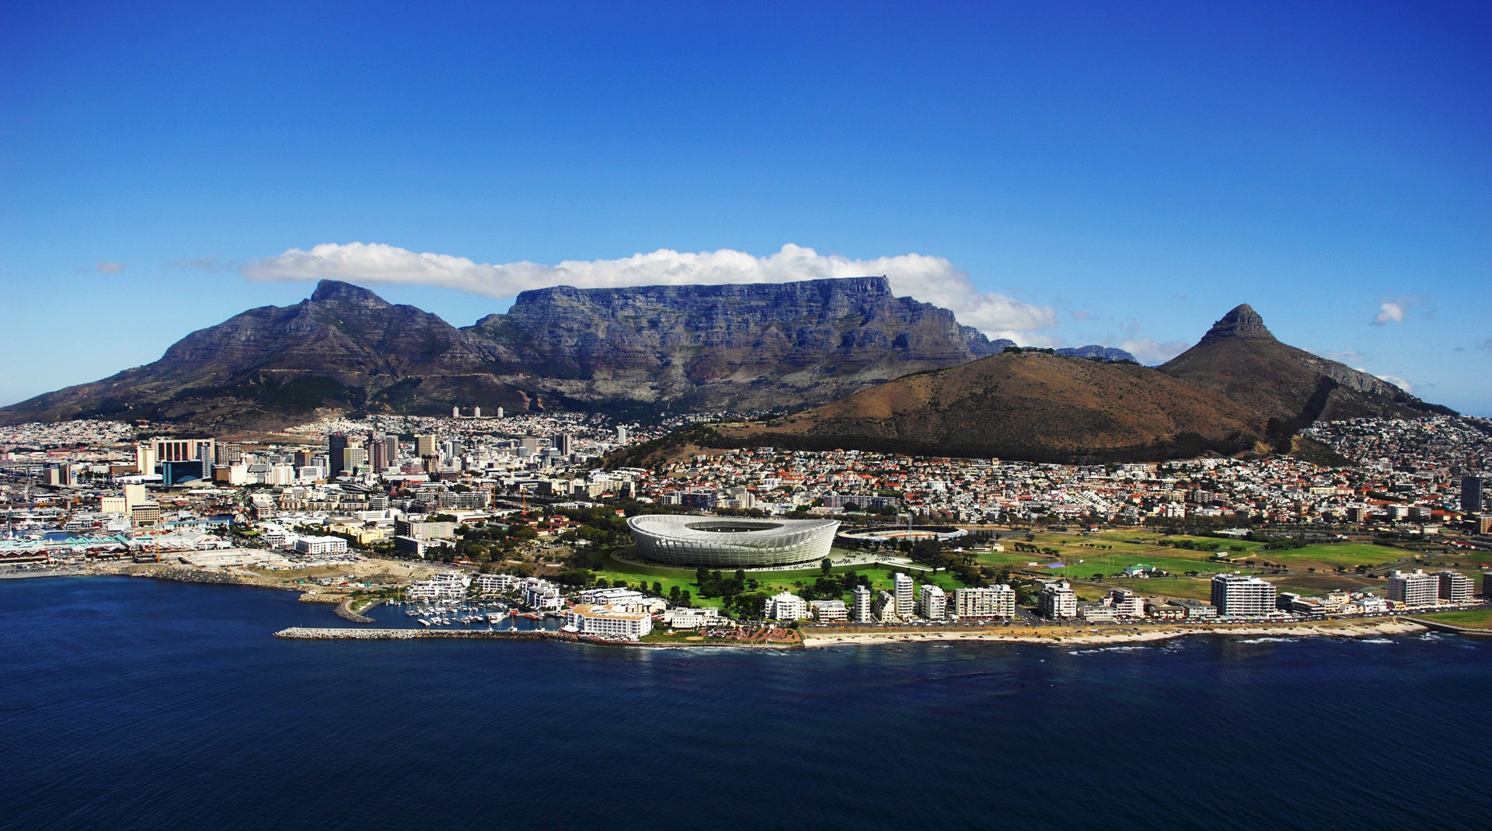
From Cape Town to …

Slide 3
Forensic Finance Services
In financial conflict or anticipated litigation.
- Accounting
- Auditing
- Discovery
- Reporting
- Strategy & Settlement options
- Mediation
- Testimony
- Building knowledge base & learnings

Slide 4
Forensic Industrial Psychology (IP) services
- ‘Emergent’ stage of development in SA
- Assessments & Testing
  * Intelligence tests SSAIS-R
* Neuropsychological tests
* Intellectual assessment, scholastic evaluation, & emotional assessment
* Objective & projective personality tests
* Aptitude and achievement tests
- Mediation
- Testimony
- Building knowledge base

Slide 5
Cases requiring Financial Forensic Services …
- Personal Injury Claims
  * Motor Vehicle Accidents
  * Medical Negligence
  * Work incidents & accidents
  * Other 3rd party claims
- Divorce & Family disputes
- Workplace disputes
- 3rd party claims

Slide 6
Forensic Finance & Accounting
Traditional (White Hat)
- Investigate financial records
- Provide expert reports & testimony
Now (Green Hat)
- Demand for specialized ancillary & integrated services
- Explore & deliver solutions & settlements
- Lateral approach
- Integrated qualitative & quantitative solutions

Slide 7
Integrated Forensic Finance & Ind. Psychology (IP) services
- Quantitative research & analysis coordinated with & supported by IP qualitative psychological rigour.
Early coordination allows
- Broad insight between related experts
- Pointers for discovery
- Context for quantitative discovery
- Focused financial analysis & conclusions
- Formulation of joint strategy
- Platform for mediation options and settlements
- Avoid lengthy, costly disputes & litigation

Slide 8
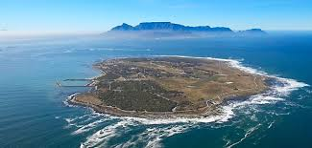
A vision to the future…

