Slide 1



About OMICS Group
OMICS Group International is an amalgamation of Open Access publications and worldwide international science conferences and events. Established in the year 2007 with the sole aim of making the information on Sciences and technology ‘Open Access’, OMICS Group publishes 500 online open access scholarly journals in all aspects of Science, Engineering, Management and Technology journals. OMICS Group has been instrumental in taking the knowledge on Science & technology to the doorsteps of ordinary men and women. Research Scholars, Students, Libraries, Educational Institutions, Research centers and the industry are main stakeholders that benefitted greatly from this knowledge dissemination. OMICS International also organizes 500 International conferences annually across the globe, where knowledge transfer takes place through debates, round table discussions, poster presentations, workshops, symposia and exhibitions.

Slide 2
About OMICS International Conferences
About OMICS Group
OMICS International is a pioneer and leading science event organizer, which publishes around 500 open access journals and conducts over 400 Medical, Clinical, Engineering, Life Sciences, Pharma scientific conferences all over the globe annually with the support of more than 1000 scientific associations and 30,000 editorial board members and 3.5 million followers to its credit.
OMICS International has organized 500 conferences, workshops and national symposiums across the major cities including San Francisco, Las Vegas, San Antonio, Omaha, Orlando, Raleigh, Santa Clara, Chicago, Philadelphia, Baltimore, United Kingdom, Valencia, Dubai, Beijing, Hyderabad, Bengaluru and Mumbai.

Slide 3

Comparative Metabolic Profiling of Halotolerant Bacterial Strains and Identification of Novel-Species Specific Metabolites
G. Jayaraman
VIT University, Tamil Nadu, India
4th International Conference and Exhibition on
Metabolomics & Systems Biology
Philadelphia, USA

Slide 4
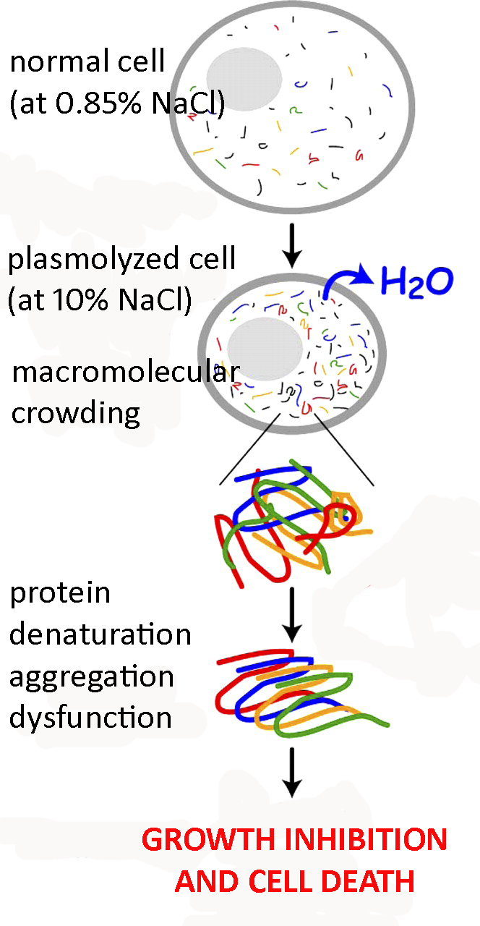
The Research Focus
Saline environments - marine water, salt lakes, brines, salterns, saline soils, salted foods, etc.
Halophilic and halotolerant bacteria have developed two types of strategies (Galinski and Truper, 1994)
Salt-in strategy – K⁺, Cl⁻
Organic solute-in strategy – polar neutral/zwitterionic organic compounds

Slide 5
The ‘Bacterial’ Challenge
Protein stability – one of the most challenging problems in halotolerant bacteria during osmotic stress due to
- reduced water activity
- macromolecular crowding
Compatible solutes help in protecting the protein stability and function under such stress conditions – survival of these organisms
Maintaining protein stability during various biotechnological processes – protein expression, purification, formulations, storage, harsh conditions employed in various processes – food and chemical processing, detergents - a challenging and daunting task

Slide 6
The Starting Point

Slide 7
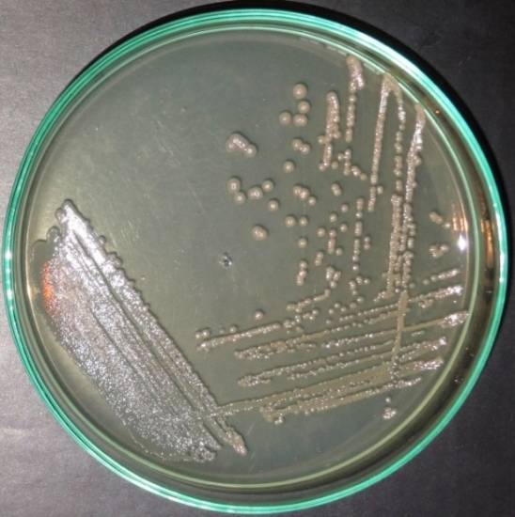
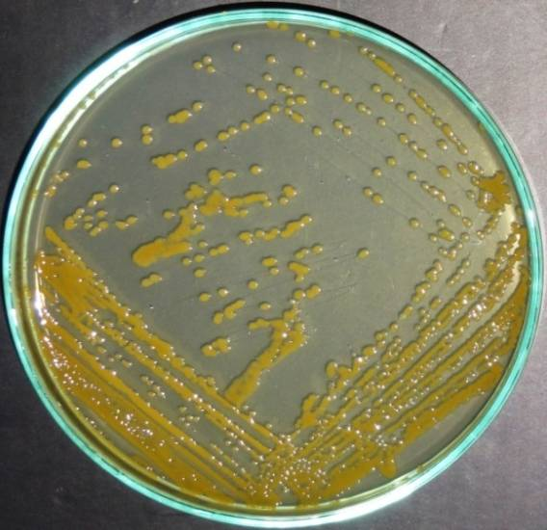
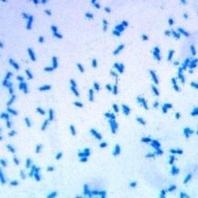
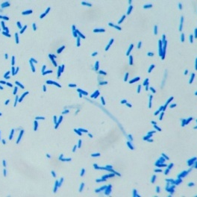
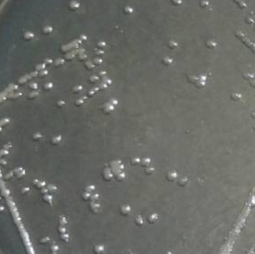
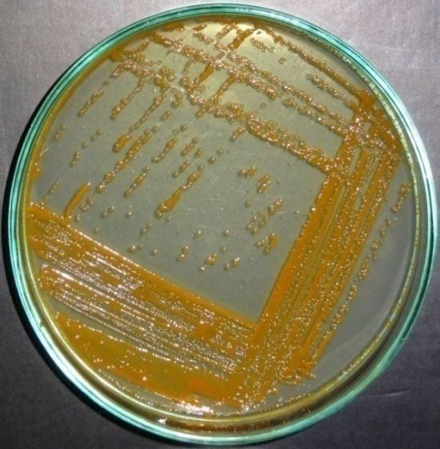
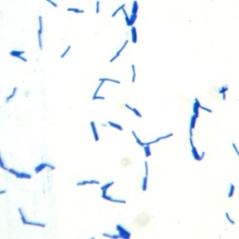
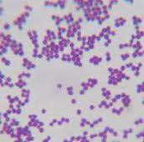
The Isolates
Halomonas hydrothermalis
VITP09 (FJ743438)
Bacillus aquimaris
VITP04 (FJ687490)
Virgibacillus dokdonensis
VITP14 (HQ929427)
Planococcus maritimus
VITP21 (HQ829429)

Slide 8
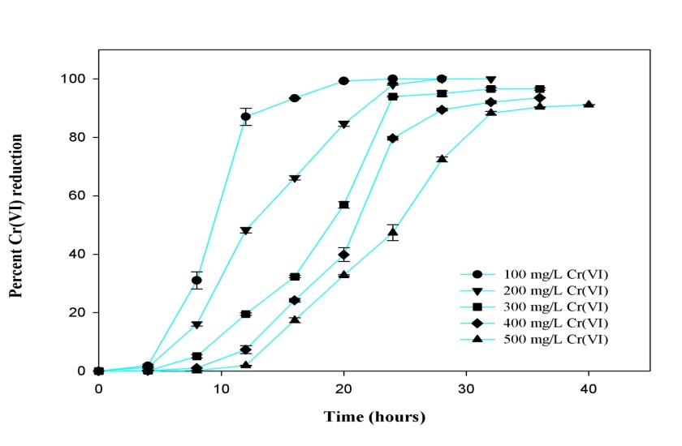
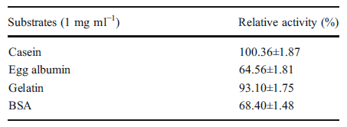
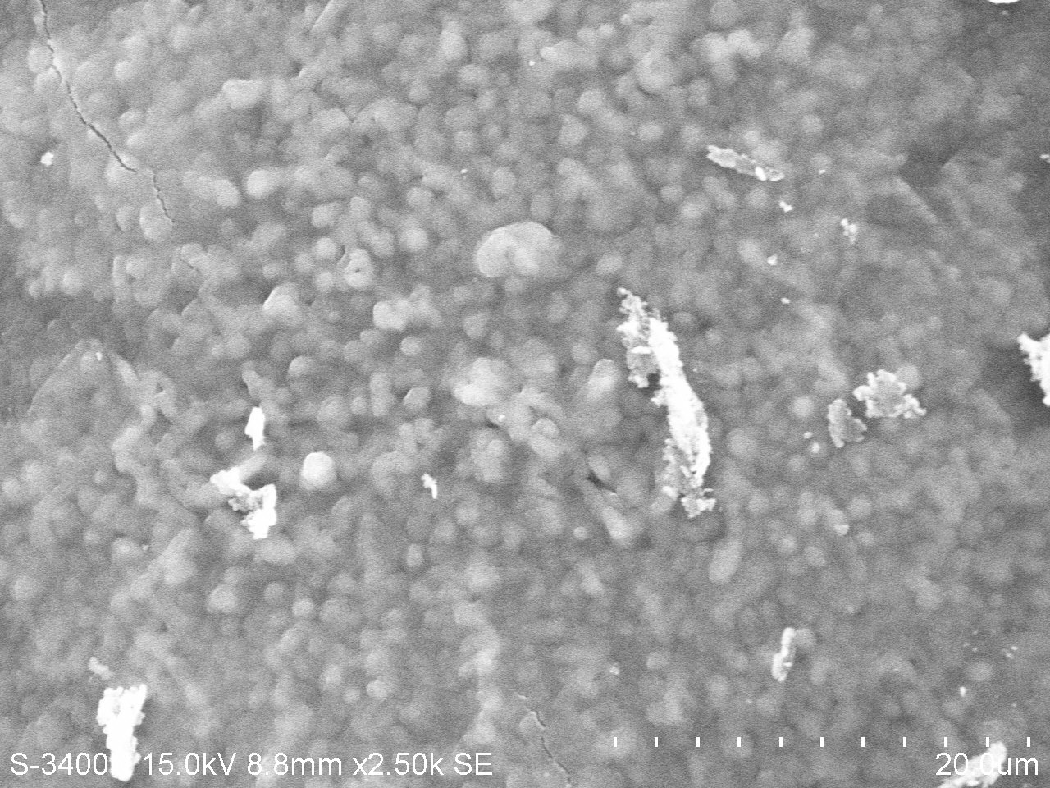
Products & Adaptability
Protease
Amylase
Keratinase
Cellulase
Xylanase
Reduction of heavy metal ions

Slide 9
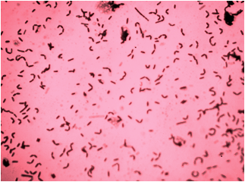
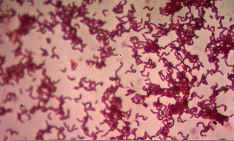
Natural & Induced Adaptability
Amount of NaCl (%) | Amount of NaCl (M) | Number of passages required to reach 1 OD
1 | 0.25 | 4
10 | 2.5 | 8
12 | 3 | 15
With shift in temperature and pH optimum and also increased stability under saline conditions

Slide 10
M9
LB
SALT STRESS INDUCED
BIOCHEMICAL CHANGES
Changes in the intracellular organic solute pools analyzed – UV spectra of the extracts (200 – 400 nm) - varied with respect to the salt concentration, growth media and the type of species.
Could be assumed that the composition of the intracellular organic solutes changes with increasing salt concentrations, type of growth media and bacterial species.

Slide 11
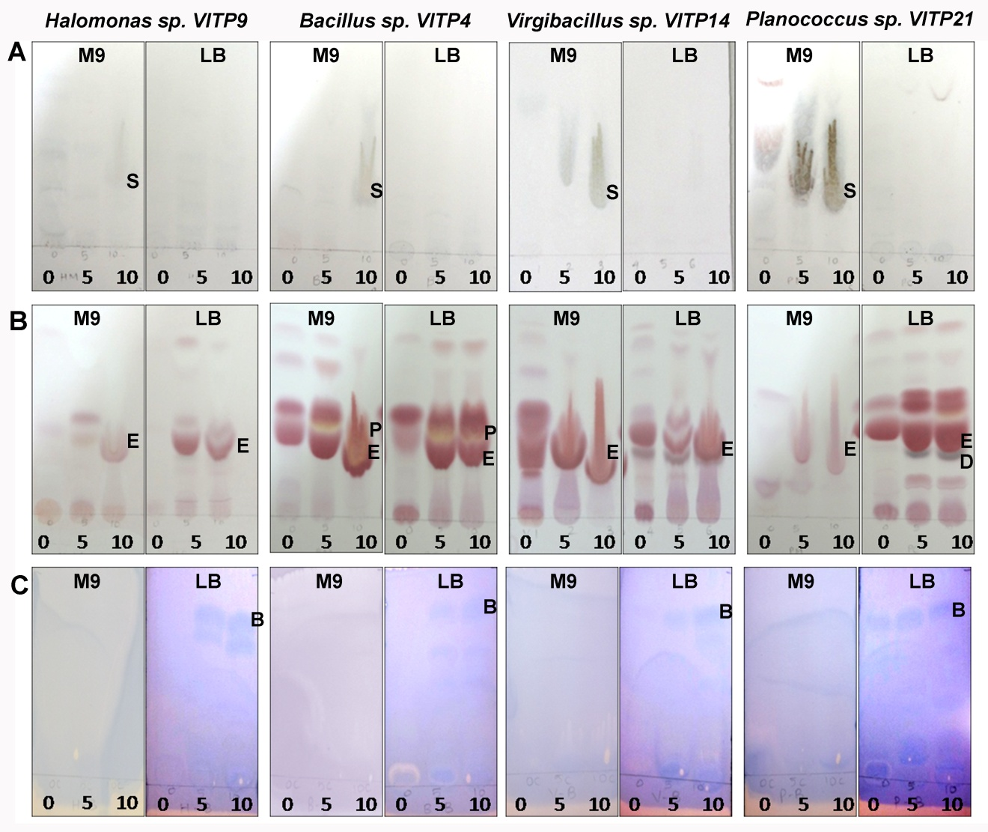
SALT STRESS INDUCED BIOCHEMICAL CHANGES
M9
LB
Sugars
Aminoacids
Methylamines
Significant increase in intracellular levels of sugars and amino acids with increasing NaCl concentration in the growth medium
Intracellular solute profile depended on the growth medium and species
glutamic acid (E), proline (P), aspartic acid (D), betaine (B) identified to increase with increasing salt concentration
Unidentified sugars and amino acids were also detected

Slide 12
SPECTRAL COMPLEXITY
 | 0% NaCl |  | 5% NaCl |  | 10% NaCl |  | Total
Growth Medium | M9 | LB | M9 | LB | M9 | LB
No of cultures (4 bacterial species) | 4 | 4 | 4 | 4 | 4 | 4 | 24
No of NMR samples (Biological replicates) | 8 | 8 | 8 | 8 | 8 | 8 | 48
METABOANALYST 2.0 was used to analyse the data

Slide 13
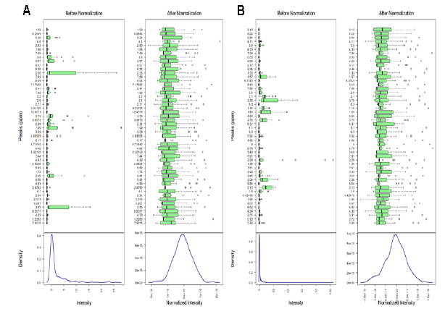
The Data Normalisation

Slide 14
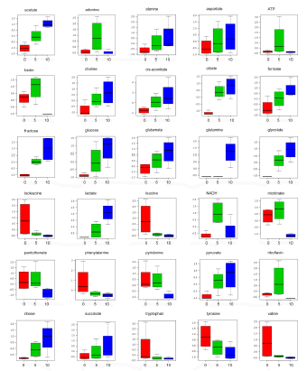
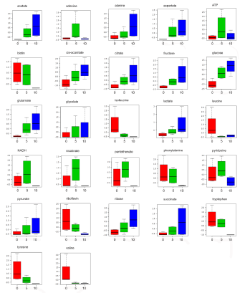
Concentration of Selected Metabolites

Slide 15
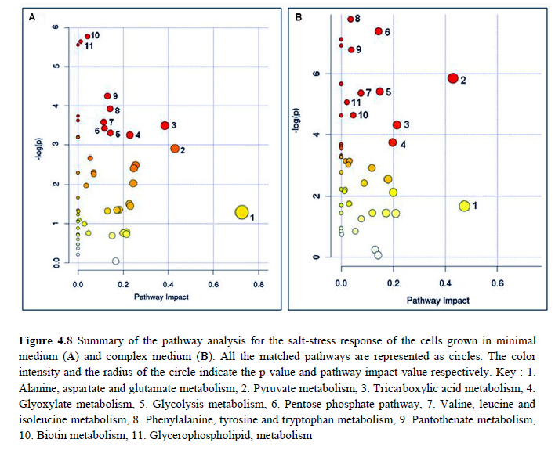
Pathway Analysis

Slide 16
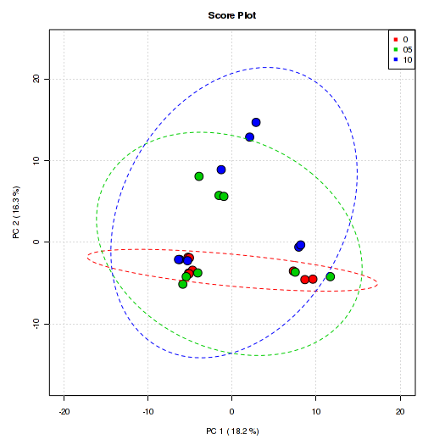
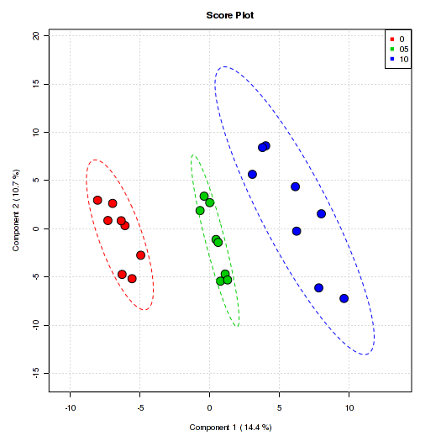
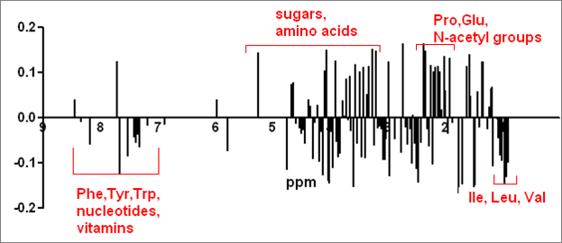
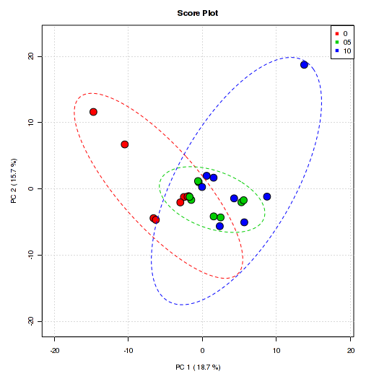
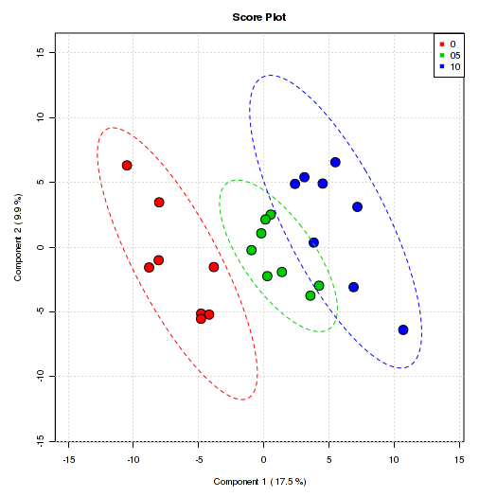
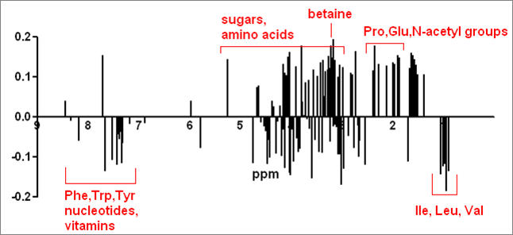
CHEMOMETRIC ANALYSIS
Cells grown in M9 medium supplemented with 0% (red), 5% (green) and 10% (blue) NaCl
PCA score plot
PLS-DA score plot
PLS-DA loadings
p<0.05, R² = 0.93 and Q² = 0.79
Cells grown in LB medium supplemented with 0% (red), 5% (green) and 10% (blue) NaCl
PCA score plot
PLS-DA score plot
PLS-DA loadings
p<0.05, R² = 0.82 and Q² = 0.65

Slide 17
STRESS RESPONSIVE METABOLITES
Putative metabolites |  | Related pathway
Up-regulated
Amino acids | Aspartate | Alanine, aspartate and glutamate metabolism
 | Alanine | Alanine, aspartate and glutamate metabolism
 | Glutamine | Alanine, aspartate and glutamate metabolism
Sugars | Glucose | Glycolysis metabolism, Pentose phosphate pathway
 | Fructose | Glycolysis metabolism
 | Ribose | Pentose phosphate pathway
Organic acids | Pyruvate | Pyruvate metabolism, Tricarboxylic acid metabolism, Glycolysis metabolism, Glyoxylate metabolism
 | Citrate | Tricarboxylic acid metabolism, Glyoxylate metabolism
 | Succinate | Tricarboxylic acid metabolism, Glyoxylate metabolism
 | Cis-aconitate | Tricarboxylic acid metabolism, Glyoxylate metabolism
 | Formate | Pyruvate metabolism, Glyoxylate metabolism
 | Acetate | Pyruvate metabolism, Glycolysis metabolism
 | Lactate | Pyruvate metabolism
 | Glycolate | Glyoxylate metabolism
Down-regulated
Amino acids | Phenyl alanine | Phenylalanine, tyrosine and tryptophan metabolism
 | Tyrosine | Phenylalanine, tyrosine and tryptophan metabolism
 | Tryptophan | Phenylalanine, tyrosine and tryptophan metabolism
 | Valine | Valine, leucine and isoleucine metabolism
 | Isoleucine | Valine, leucine and isoleucine metabolism
 | Leucine | Valine, leucine and isoleucine metabolism
Vitamins | Pantothenate | Pantothenate metabolism
 | Biotin | Biotin metabolism

Slide 18
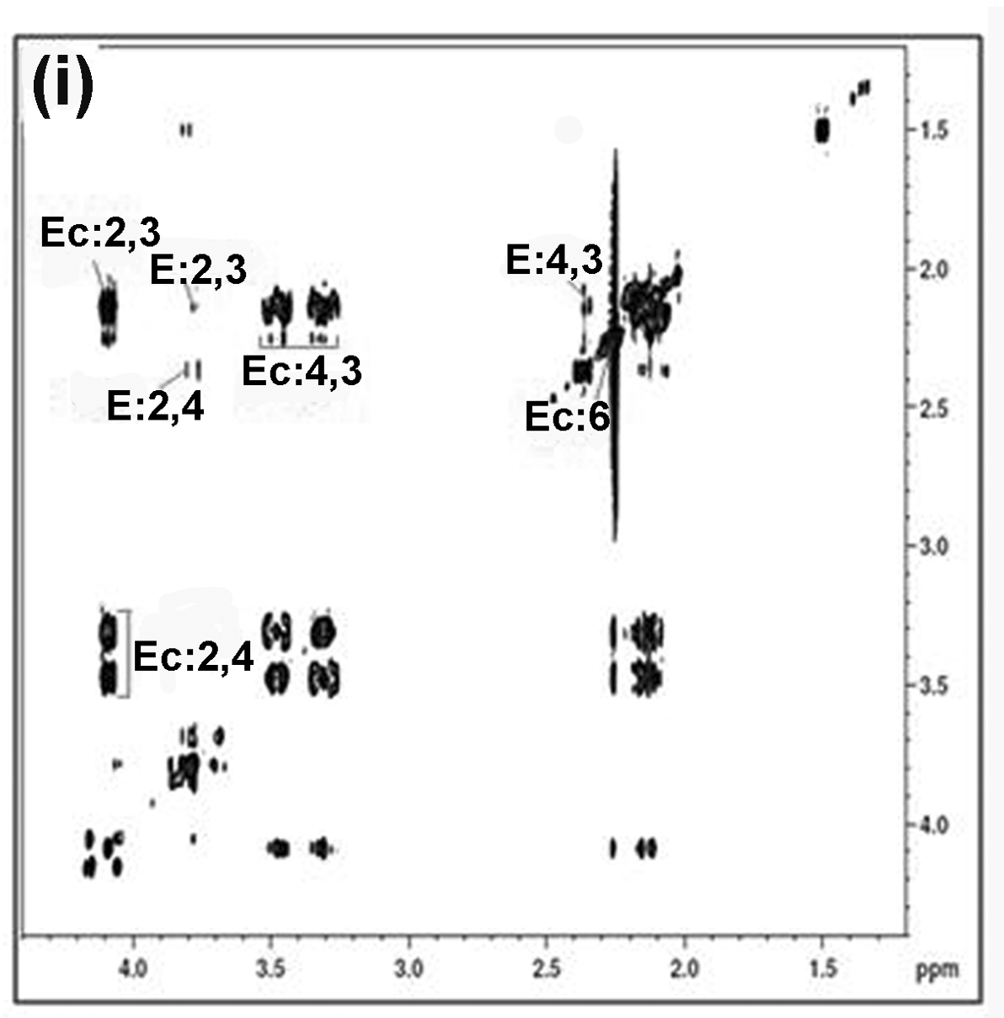
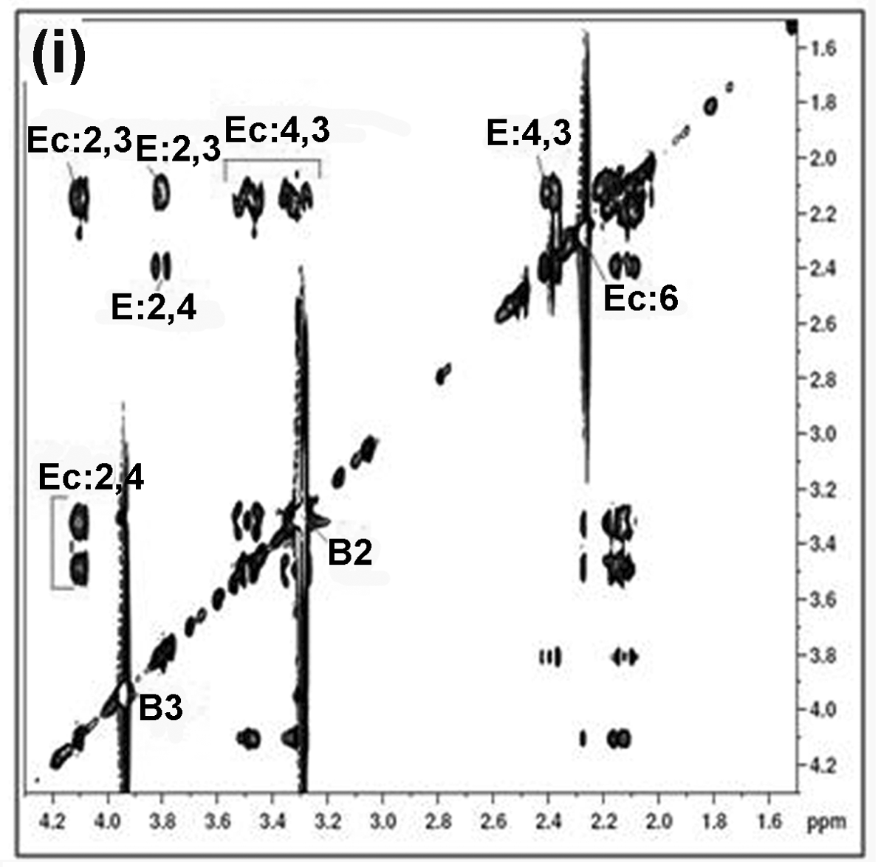
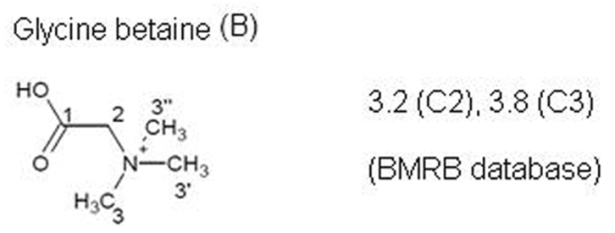
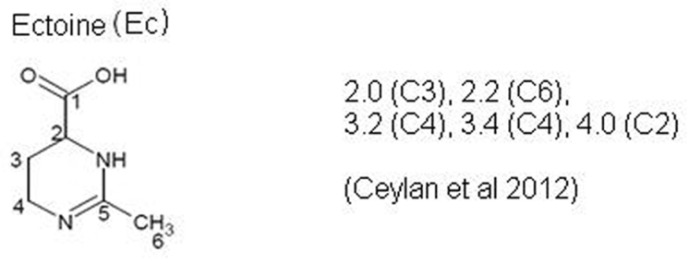
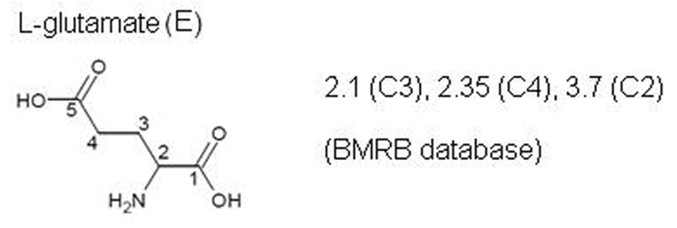
TOCSY SPECTRUM OF Halomonas sp. VITP9
M9
LB
18

Slide 19
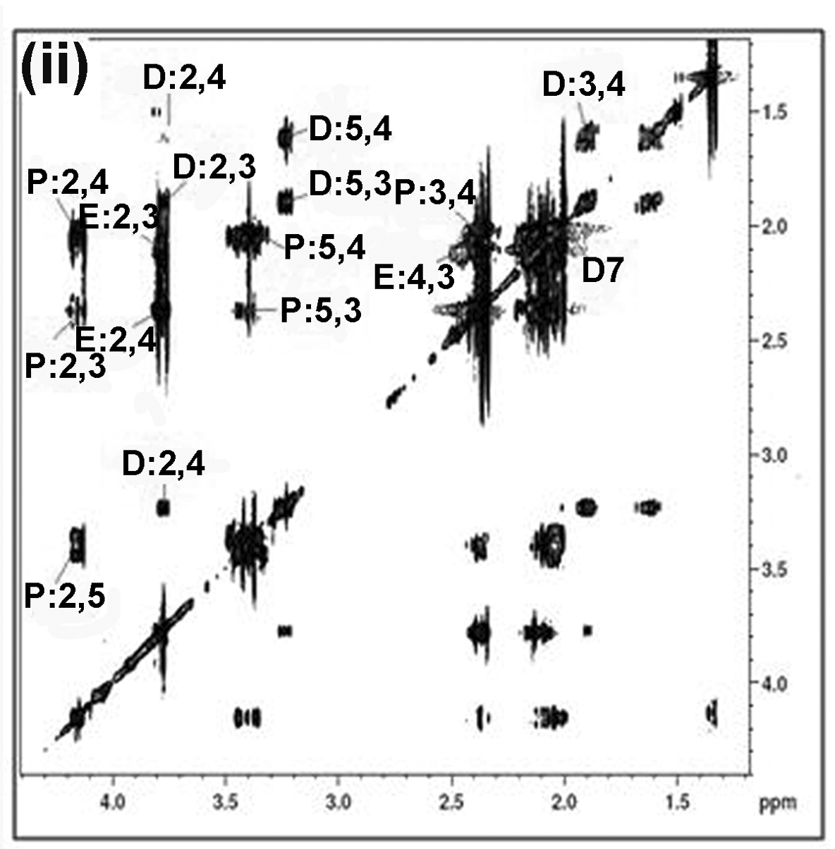
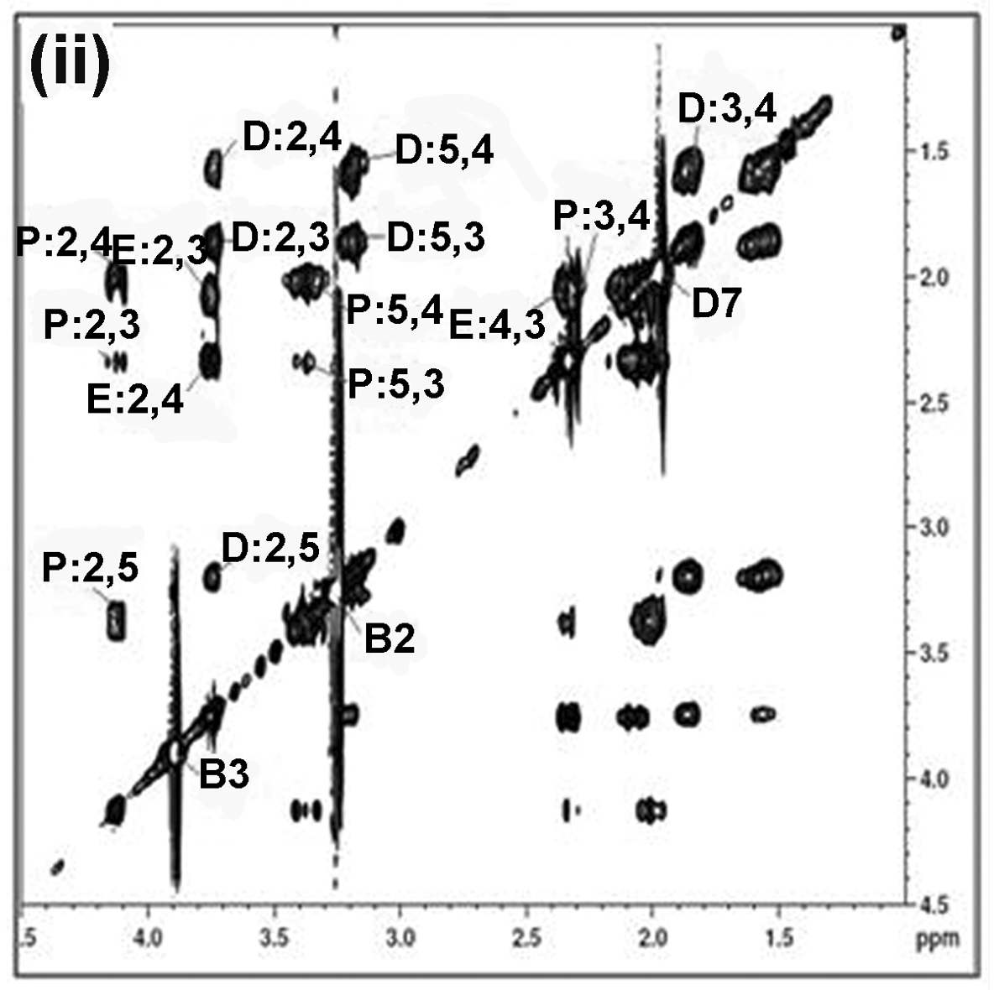
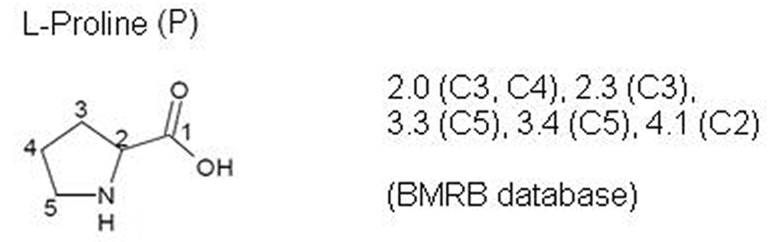
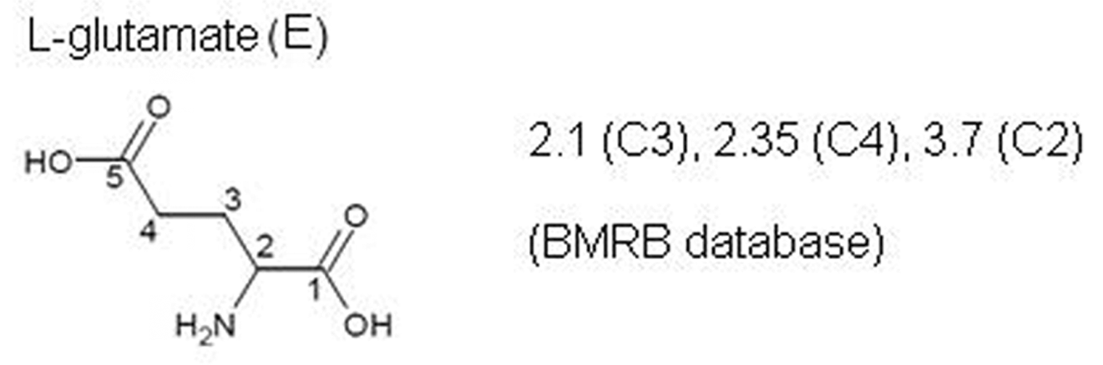
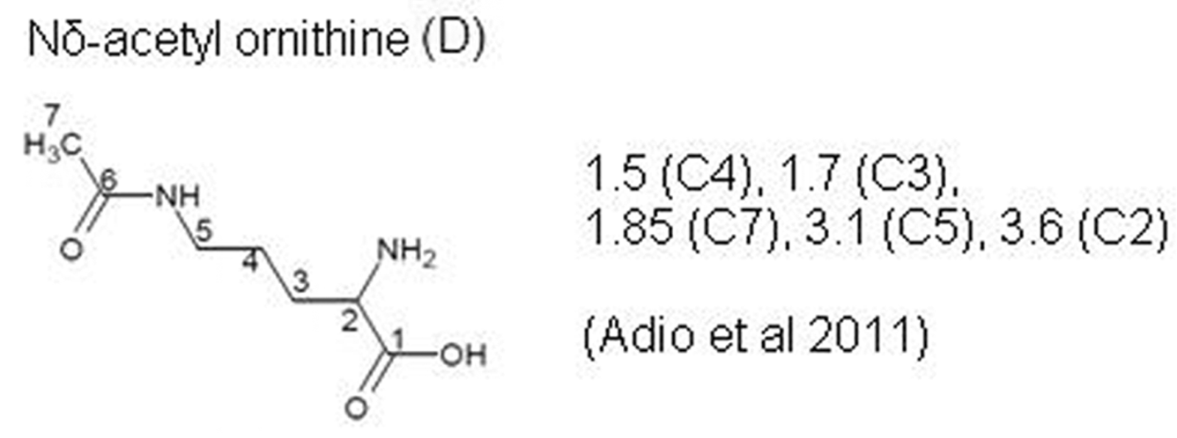
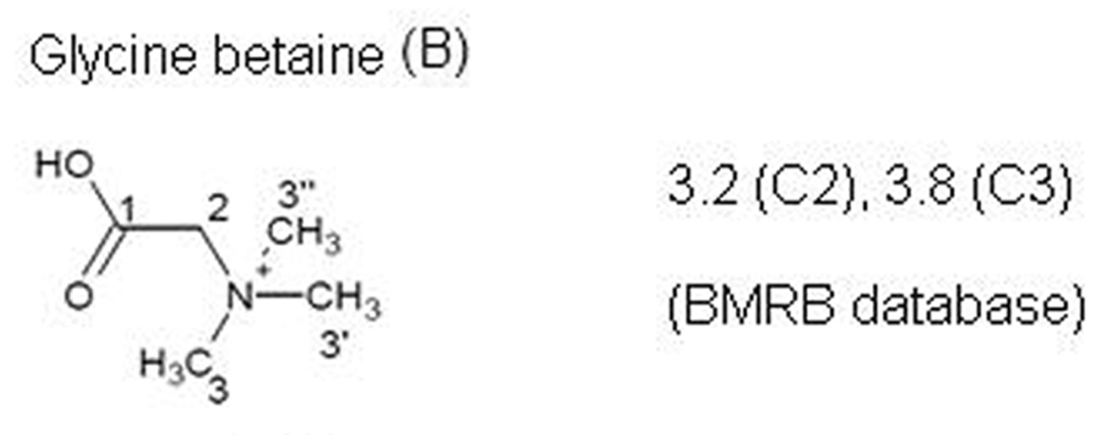
TOCSY SPECTRUM OF Bacillus sp. VITP4
M9
LB
19

Slide 20
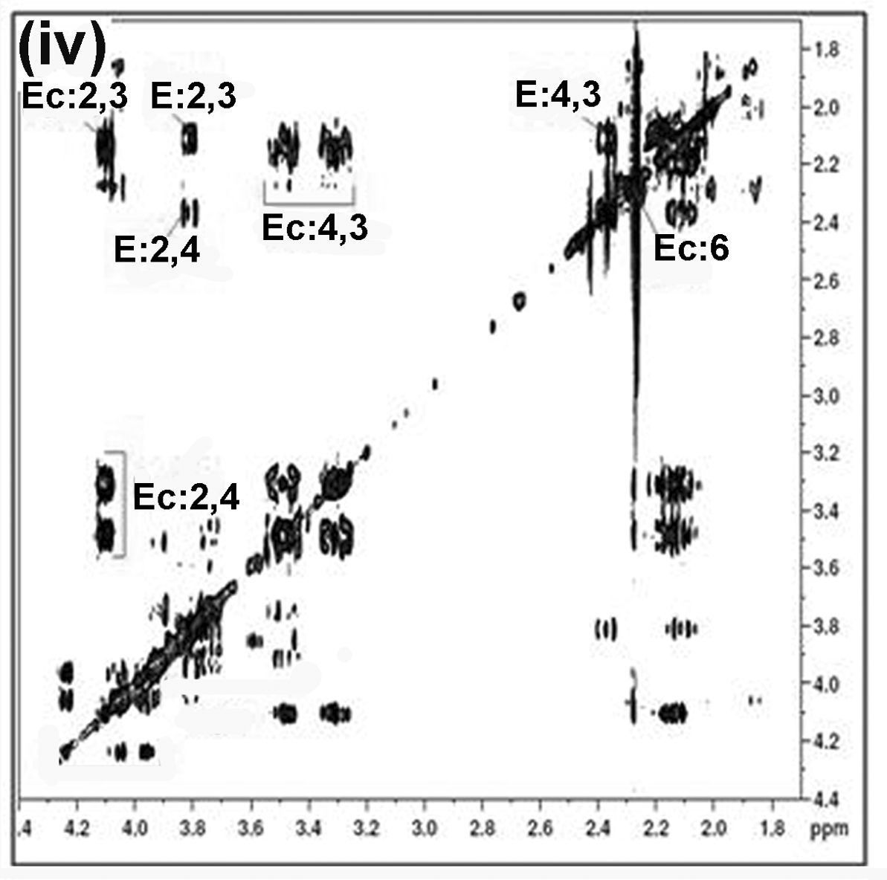
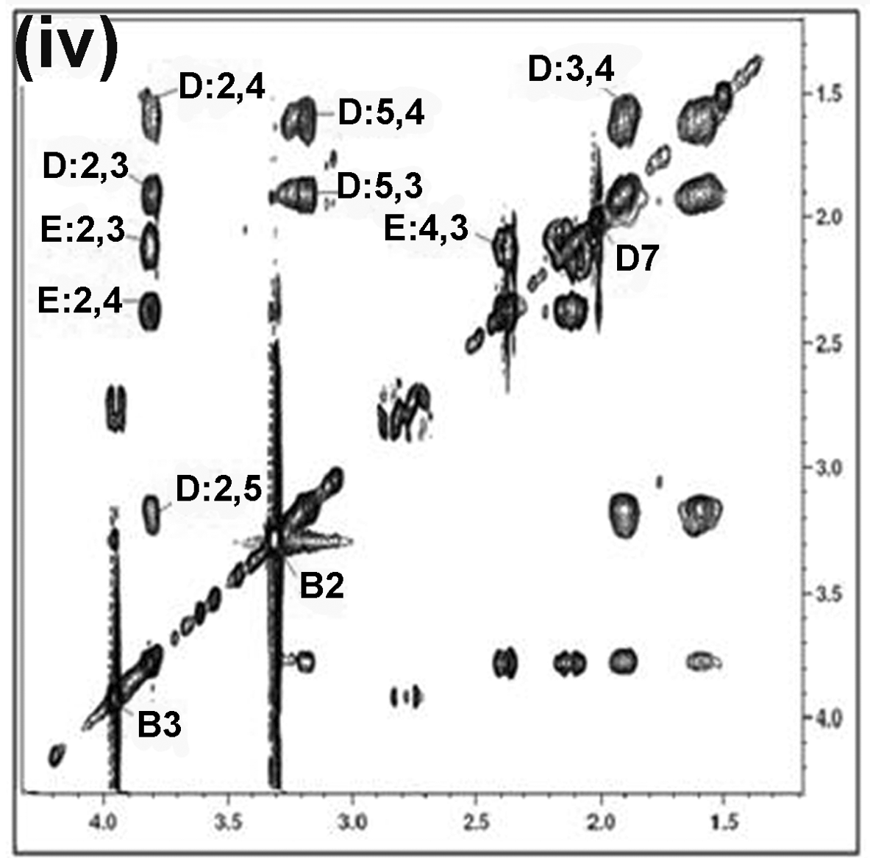
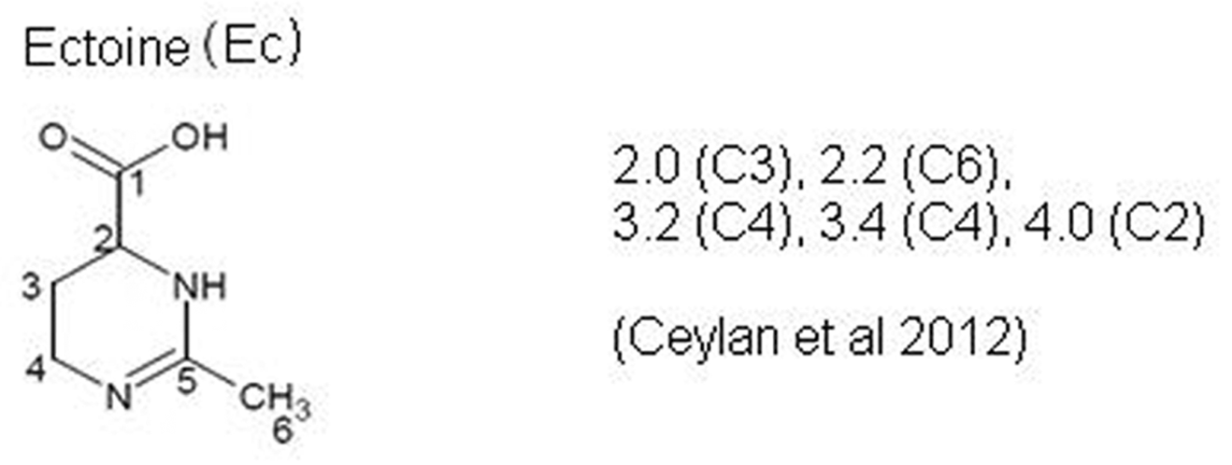
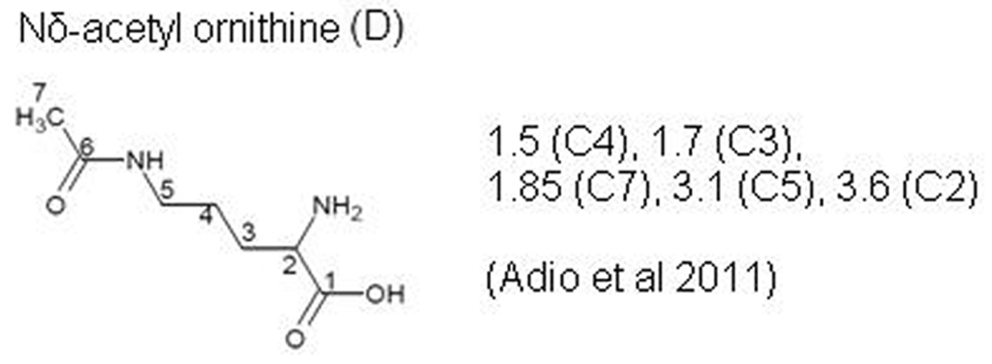
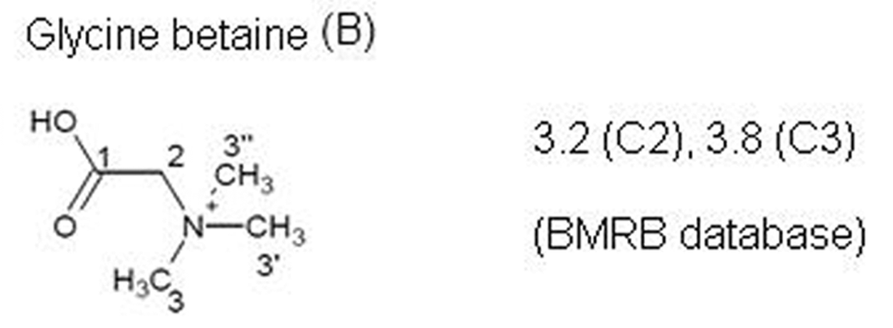
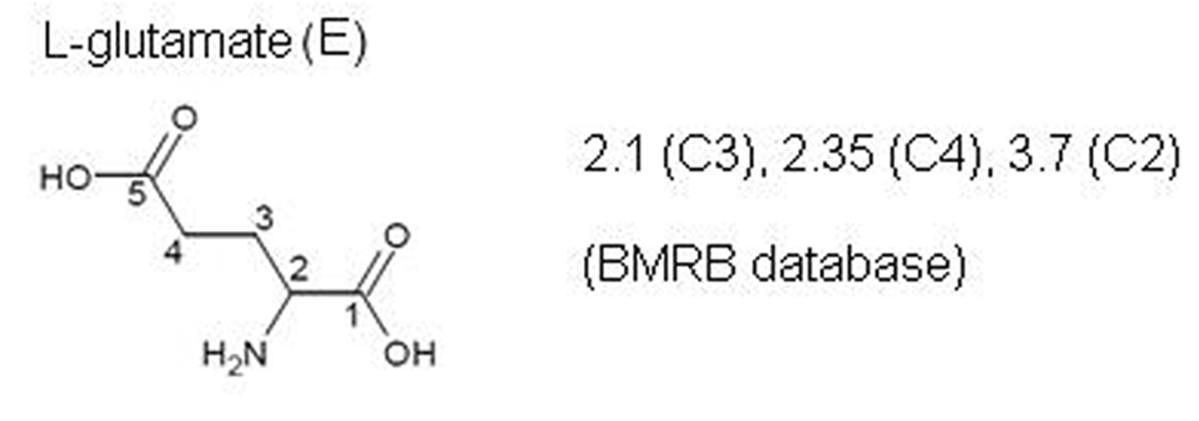
TOCSY SPECTRUM OF Virgibacillus sp. VITP14
M9
LB
20

Slide 21
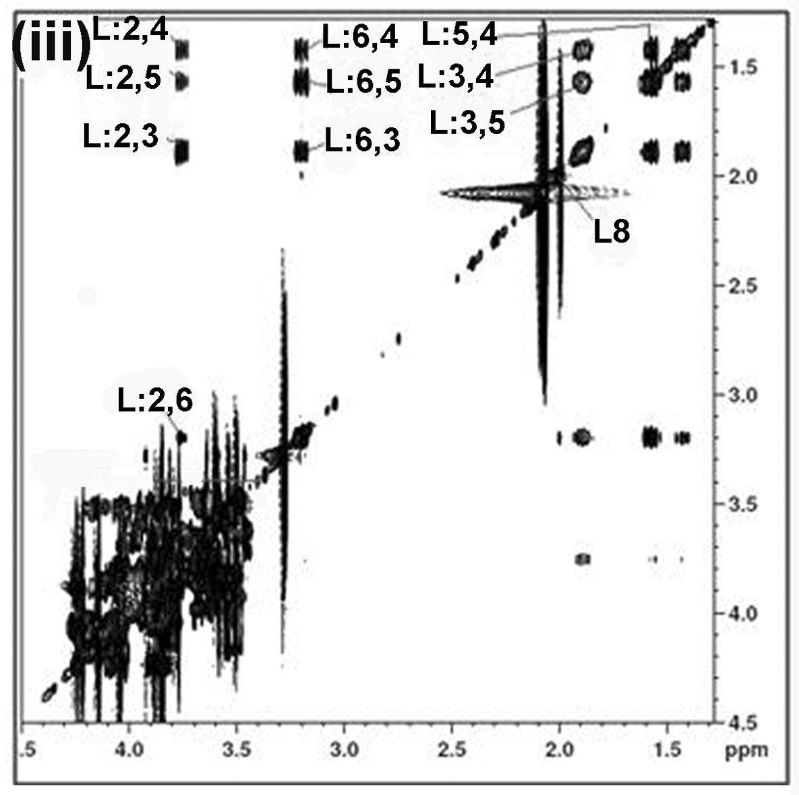
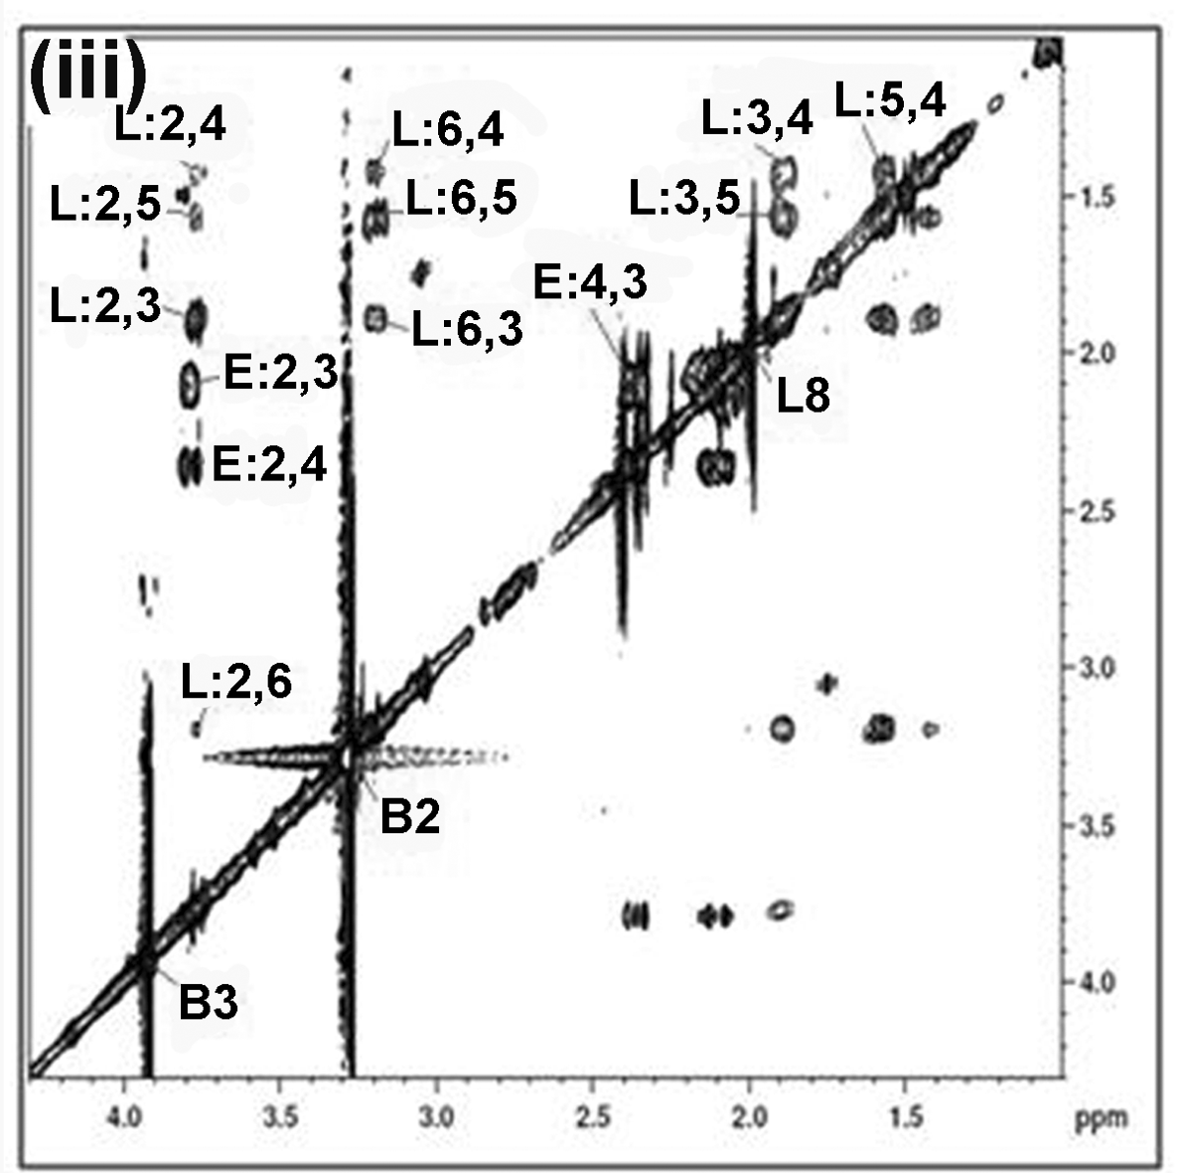
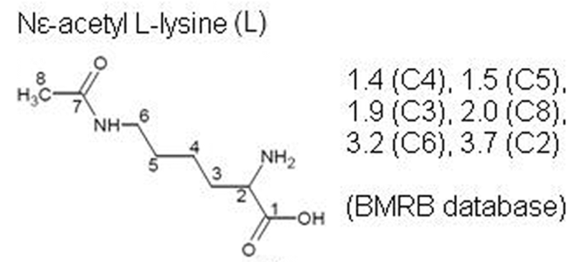
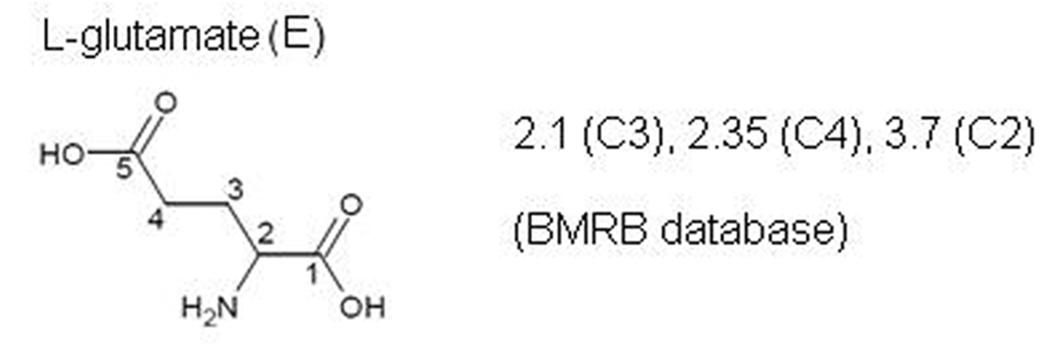
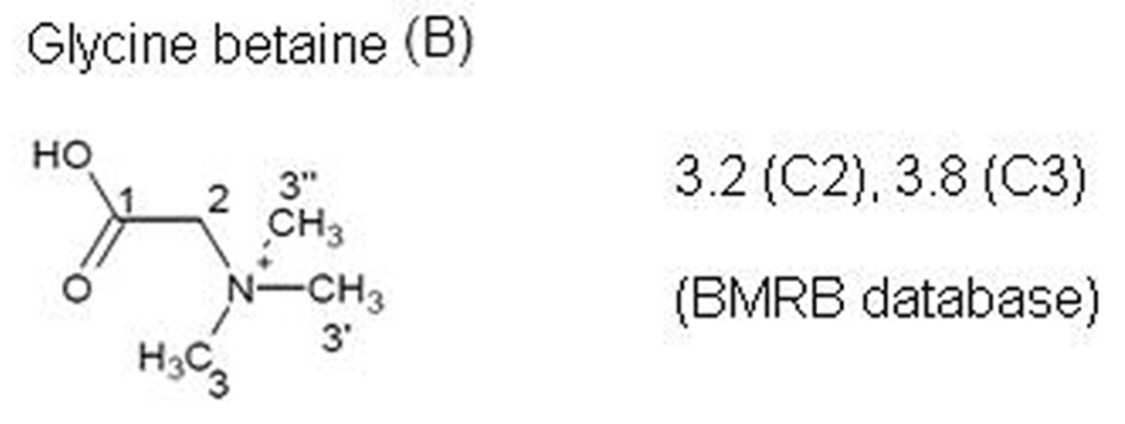
TOCSY SPECTRUM OF Planococcus sp. VITP21
M9
LB
21

Slide 22
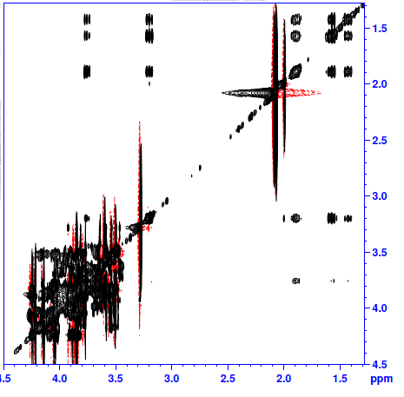
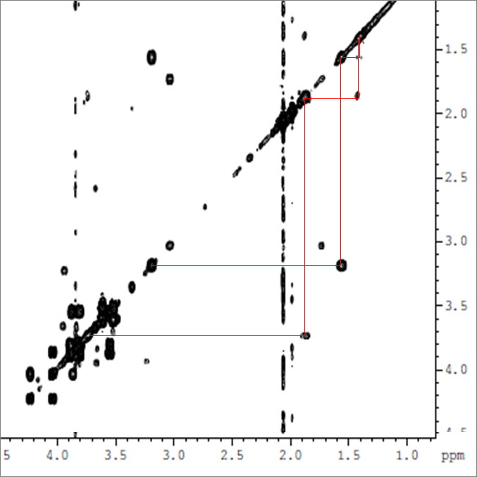
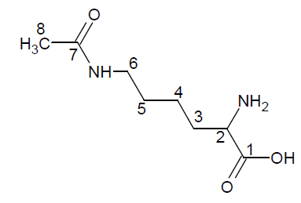
Nε-acetyl lysine
TOCSY
4
COSY
4
5
5
3
3
6
6
2
2
Nε-acetyl lysine

Slide 23



Nδ-acetyl ornithine
TOCSY
COSY
4
4
3
3
5
5
2
2
Nδ-acetyl ornithine

Slide 24
DISTRIBUTION OF OSMOLYTES IDENTIFIED WITHIN THE STRAINS
Bacterial strain | Minimal medium | At 0% w/v NaCl (mM) | At 5% w/v NaCl (mM) | At 10% w/v NaCl (mM) | Complex medium | At 0% w/v NaCl (mM) | At 5% w/v NaCl (mM) | At 10% w/v NaCl (mM)
Halomonas sp. VITP9 |  |  |  |  | Glycine betaine | 0 | 100.36±1. | 137.52±3.
 | Ectoine | 0 | 41.56±2.1 | 96.95±2.7 | Ectoine | 0 | 31.56±1.5 | 83.50±2.8
 | Glutamate | 0.88±0.2 | 26.51±2.1 | 54.62±6.2 | Glutamate | 1.95±0.1 | 8.60±0.9 | 14.90±0.5
 | Aspartate | 0 | 0.13±0.0 | 0.21±0.0 | Aspartate | 0.24±0.0 | 0.39±0.0 | 0.48±0.1
Bacillus sp. VITP4 |  |  |  |  | Glycine betaine | 0.33±0.3 | 65.57±2.2 | 83.75±1.7
 | Proline | 1.34±0.4 | 45.61±6.6 | 112.07±4.1 | Proline | 0 | 36.18±2.5 | 60.80±1.
 | Nδ-acetyl ornithine | 0.40±0.0 | 4.16±1.1 | 24.70±4.6 | Nδ-acetyl ornithine | 0.62±0.1 | 28.20±1.7 | 36.45±0.7
 | Ornithine | 0.13±0.0 | 0.23±0.0 | 0.31±0.0 | Ornithine | 0 | 3.23±0.0 | 5.32±0.0
 | Glutamate | 1.34±0.0 | 66.01±1.4 | 98.59±1.9 | Glutamate | 18.64±2.3 | 36.62±2.3 | 44.71±0.4
 | Aspartate | 0 | 0.19±0.0 | 0.42±0.1 | Aspartate | 0 | 0.89±0.1 | 3.65±0.1
Virgibacillus sp. VITP14 | Ectoine | 0 | 32.95±7.1 | 69.44±7.8 | Glycine betaine | 2.32±0.5 | 62.91±4.3 | 112.44±0.
 |  |  |  |  | Nδ-acetyl ornithine | 2.25±0.3 | 6.25±1.5 | 12.79±2.5
 |  |  |  |  | Ornithine | 0.02±0.0 | 3.45±0.0 | 7.18±0.2
 | Glutamate | 7.35±2.0 | 26.85±1.3 | 64.65±4.7 | Glutamate | 11.62±0.5 | 21.37±1.9 | 37.42±2.2
 | Aspartate | 0.04±0.0 | 0.10±0.0 | 0.145±0.0 | Aspartate | 4.11±0.6 | 8.38±0.8 | 10.89±1.0
Planococcus sp . VITP21 |  |  |  |  | Glycine betaine | 2.07±0.8 | 78.80±2.5 | 113.32±0.
 |  |  |  |  | Proline | 0 | 4.36±0.9 | 36.05±1.4
 | Nε-acetyl lysine | 3.45±0.1 | 45.12±1.5 | 107.49±2.1 | Nε-acetyl lysine | 3.05±0.2 | 11.60±1.9 | 31.29±1.0
 | Lysine | 0.53±0.0 | 4.46±0.1 | 8.53±1.0 | Lysine | 3.04±0.1 | 5.34±0.5 | 10.32±0.5
 | Glutamate | 1.30±0.1 | 13.40±0.5 | 27.10±2.5 | Glutamate | 9.62±2.2 | 21.37±1.9 | 36.92±1.5
 | Aspartate | 0.76±0.5 | 1.38±0.4 | 2.86±0.2 | Aspartate | 5.91±0.0 | 12.81±0.0 | 15.94±0.1

Slide 25
METABOLIC PATHWAY ANALYSIS – SYNTHESIS OF NITROGENOUS OSMOLYTES
glucose
Compatible solutes synthesized from aspartate and glutamate family (energetically economical), directed from the glycolytic pathway and citric acid cycle – as depicted by the metabolomic analysis
(MetaboAnalyst 2.0 – pathway analysis)
pyruvate
acetyl-CoA
citrate
oxaloacetate
α-ketoglutarate
aspartate
glutamate
ectoine
lysine
proline
ornithine
Nε-acetyl lysine
Nδ-acetyl ornithine

Slide 26

UNKNOWN SUGAR-OSMOLYTE FROM Planococcus sp. VITP21
Anomeric signal ≈ 5.3 ppm
Glucose and Fructose moieties
Similarity with sucrose

Slide 27
HOMONUCLEAR 2D NMR
TOCSY (TOtal Correlated SpectroscopY)
COSY (COrrelated SpectroscopY)

Slide 28
HETERONUCLEAR 2D NMR
HMBC (Heteronuclear Multiple Bond Correlation)
HSQC (Heteronuclear Single Quantum Correlation)
(G1, F2)

Slide 29

STRUCTURE ELUCIDATION OF THE UNKNOWN SUGAR-OSMOLYTE
Differences in ppm values between sucrose and unknown sugar-osmolyte
1H NMR
13C NMR
(2-acetamido-2-deoxy-α-D-glucopyranosyl)-(1->2)-β-D-fructofuranose
DEPT-13C NMR
>CH-NH-

Slide 30

SUPPORTING INFORMATION – ESI-MS
Molecular formula : C₁₄H₂₅O₁₁N₁
Molecular weight : 383.35
Molecular ion [M-H] ⁻ : 382.34 (theoretical)
: 382.33 (experimental)
(2-acetamido-2-deoxy-α-D-glucopyranosyl)-(1->2)-β-D-fructofuranose
This sugar-osmolyte has not been previously reported for its natural synthesis.
Notes:
Protein stabilizing property

Slide 31

EFFECT OF THE SOLUTES ON PROTEIN STRUCTURAL STABILITY – FLUORESCENCE
At pH 7
 | T_{m} ˚C
Control | 58.6
Ectoine | 59.6 (1)
Betaine | 59.6 (1)
N-acetyl lysine | 58.6 (0)
Proline | 59.6 (1)
Sucrose | 62.6 (4)
Trehalose | 60.6 (2)
Sugar-osmolyte | ?

Slide 32

EFFECT OF THE SUGAR-OSMOLYTE ON PROTEIN STRUCTURAL STABILITY – CIRCULAR DICHROISM
At pH 7
 | T_{m} ˚C
Control | 57.8
Sucrose | 61.4 (3.6)
Sugar-osmolyte | 62.5 (4.7)

Slide 33


EFFECT OF THE SOLUTES ON GIBBS FREE ENERGY OF UNFOLDING
At pH 7
Osmolytes modulated protein function by manipulating their stability – increased the T_{m} and ∆G_{U}

Slide 34
EFFECT OF SOLUTES ON pH PROFILE
At 40 ˚C
Optimum activity at pH 5

Slide 35
EFFECT OF SOLUTES ON pH STABILITY
At 40 ˚C
Solutes increased stability at all pH ranges

Slide 36
STRUCTURAL STABILITY AT pH 5
 | T_{m} ˚C | T_{agg} ˚C
Control | 50.5 | 42.1
Ectoine | 52.5 (2) | 49.7 (7.6)
Betaine | 52.5 (2) | 45.4 (3.3)
N-acetyl lysine | 51.5 (1) | 44.9 (2.8)
Proline | 51.5 (1) | 44.1 (2)
Sucrose | 59.6 (9) | 50.8 (8.7)
Trehalose | 53.5 (2.9) | 45.7 (3.6)
Sugar-osmolyte | 60.9 (10.4) | 46.2 (4.1)
Improved the structural stability - shifting the N↔D equilibrium towards left
by delaying unfolding - increase in T_{m}
by inhibiting aggregation – increase in T_{agg}
Notes:
Protein hydrophobicity increases with decreasing pH due to protonation of COO- groups. Tends to aggregate. Inhibition of aggregation stabilizes the structure

Slide 37


IMPROVED ACTIVITY AND STABILITY AT ACIDIC pH 3
***
***
***
***
***
***
Structural stability at pH 3
 | Tm ˚C
Control | 30.5
Ectoine | 40.5 (10)
N-acetyl lysine | 41.5 (11)
Proline | 34.5 (4)
Catalytic activity, catalytic stability and structural stability are improved by solutes –N-acetyl lysine
Notes:
Activity, stability and Tm, Tonset and Tagg of ectoine, acetyllysine and proline compared to control at pH 3 p value

Slide 38
OPERATIONAL STABILITY –
INACTIVATION KINETICS AT 50˚C AND pH 5
 | t1/2 (min)
Control | 6.67
Ectoine | 13.11
Betaine | 12.10
N-acetyl lysine | 9.47
Proline | 9.25
Sucrose | 14.37
Trehalose | 13.41
Sugar-osmolyte | 17.22
Proof-of-concept for osmolyte induced protein stability under denaturing stress conditions
Such comparative studies result in the identification of suitable solutes for improving the activity and stability of the protein of interest
Notes:
More adequate measure of stability is obtained by investigating the effect on the operational stability

Slide 39
SALIENT FEATURES OF THE STUDY
  Synthesis / accumulation of species specific and growth media dependent compatible solutes to achieve halotolerance
  Changes in the levels of metabolites of the aspartate and glutamate metabolic pathway to restore homeostasis
  Two strains (Planococcus maritimus VITP21 and Bacillus aquimaris VITP4) capable of synthesizing rarely occurring N-acetylated diamino acids, Nε-acetyl lysine and Nδ-acetyl ornithine were reported.
  A novel sugar osmolyte, (2-acetamido-2-deoxy-α-D-glucopyranosyl)-(1→2)-β-D-fructofuranose, synthesized de-novo by Planococcus maritimus VITP21 was discovered.
  These compatible solutes could enhance the stability of proteins

Slide 40
Acknowledgement
Scholars
Pooja
Nidhya
Jabeen Thaz
Lavanya
Facilities
TIFR, Mumbai
IISc, Bangalore
SIF, VIT
VIT University
OMICS International

Slide 41
Let Us Meet Again
We welcome you all to our future conferences of
OMICS International
Please Visit:
www.metabolomicsconference.com
www.conferenceseries.com
http://www.conferenceseries.com/clinical-research-conferences.php

