Slide 1
About Omics Group
OMICS Group International through its Open Access Initiative is committed to make genuine and reliable contributions to the scientific community. OMICS Group hosts over 400 leading-edge peer reviewed Open Access Journals and organize over 300 International Conferences annually all over the world. OMICS Publishing Group journals have over 3 million readers and the fame and success of the same can be attributed to the strong editorial board which contains over 30000 eminent personalities that ensure a rapid, quality and quick review process.

Slide 2
About Omics Group conferences
OMICS Group signed an agreement with more than 1000 International Societies to make healthcare information Open Access. OMICS Group Conferences make the perfect platform for global networking as it brings together renowned speakers and scientists across the globe to a most exciting and memorable scientific event filled with much enlightening interactive sessions, world class exhibitions and poster presentations
Omics group has organised 500 conferences, workshops and national symposium across the major cities including SanFrancisco,Omaha,Orlado,Rayleigh,SantaClara,Chicago,Philadelphia,Unitedkingdom,Baltimore,SanAntanio,Dubai,Hyderabad,Bangaluru and Mumbai.

Slide 3
Overview of Optical Fiber and Fiber Laser R&D at Lawrence Livermore Laboratory
September 9, 2014
Jay W. Dawson, Mike Messerly, Matt Prantil, Reggie Drachenberg, Graham Allen, Paul Pax, John Heebner
OFFICIAL USE ONLY

Slide 4
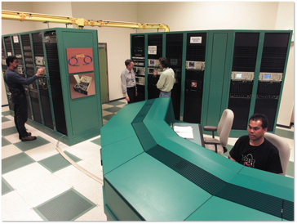
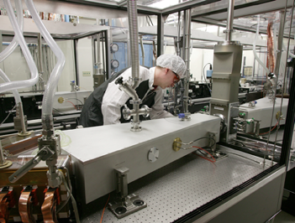
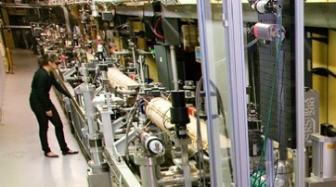
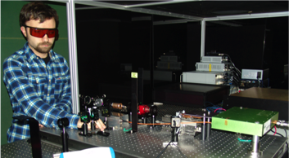
Fiber-based injection seed lasers are an ongoing LLNL need
NIF & ARC MOR
Mercury Injection Seed Laser
T-REX PDL and Interaction Seed
LBNL Photo-Cathode Drive

Slide 5
A future interest is laser technology for accelerator applications
International Coherent Amplifier Network (ICAN)
G. Mourou, B. Brocklesby, T. Tajima, J. Limpert, Nature Photonics vol. 7, pp. 258 (2013)
http://science.energy.gov/%7E/media/hep/pdf/accelerator-rd-stewardship/Lasers_for_Accelerators_Report_Final.pdf

Slide 6
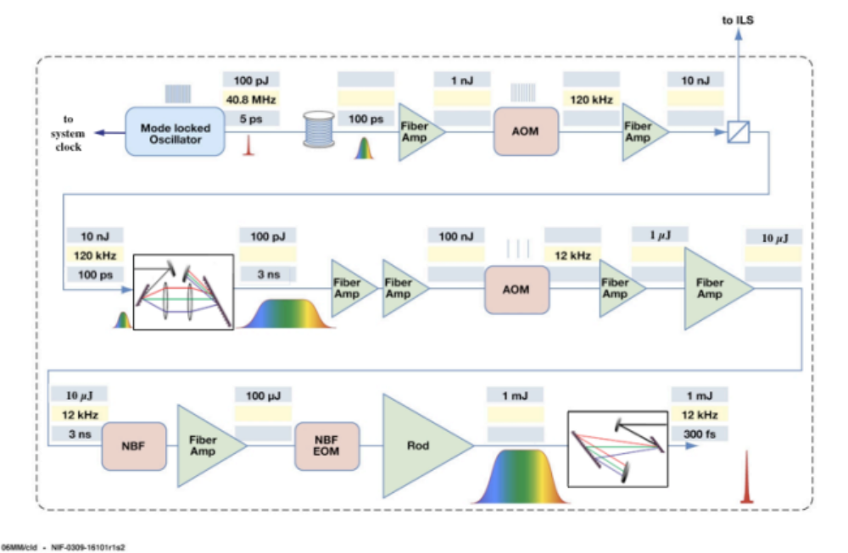
Block diagram of a single arm short pulse fiber laser system

Slide 7
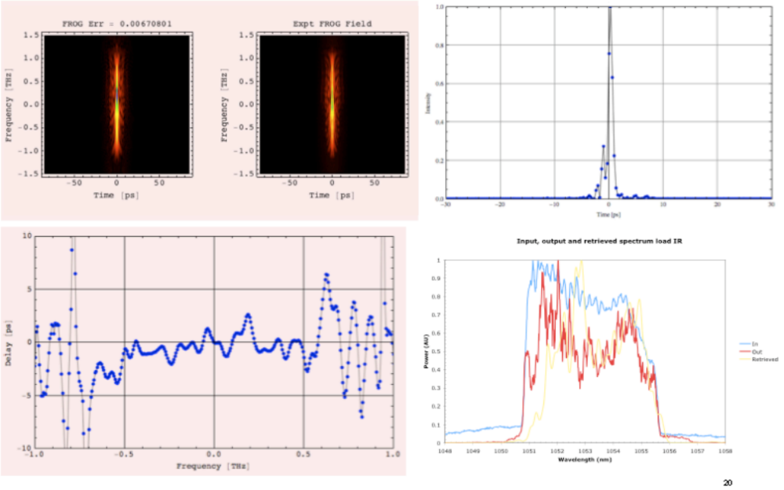
Pulse quality in short pulse fiber laser is a significant challenge
FROG data from a system producing 1µJ pulses

Slide 8
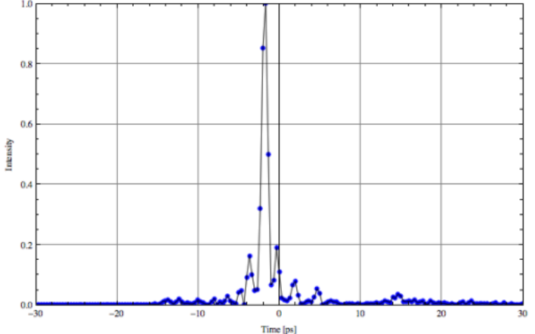
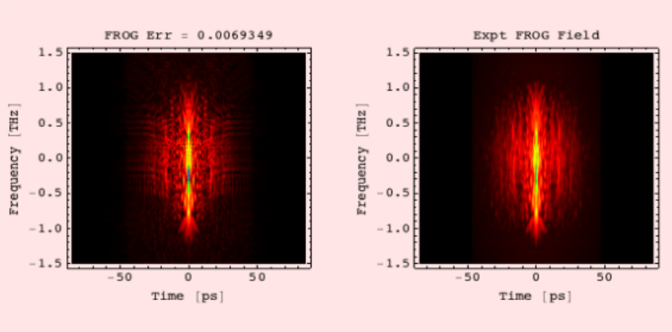
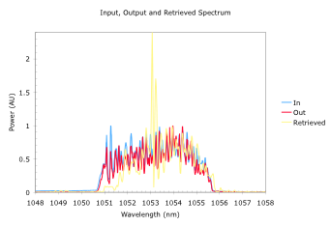
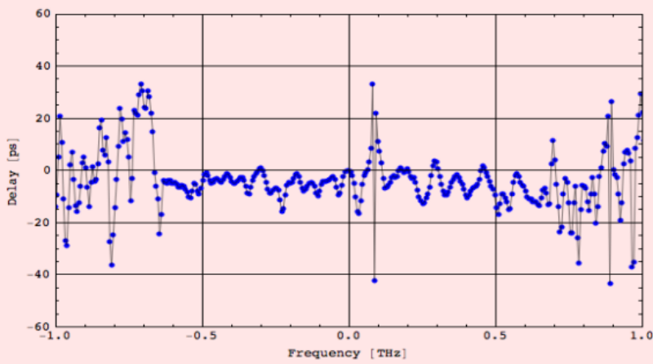
The challenge increases with higher pulse energy
FROG data from a system producing 100 µJ pulses B = 6, Chirped Fiber Bragg Grating Stretcher

Slide 9
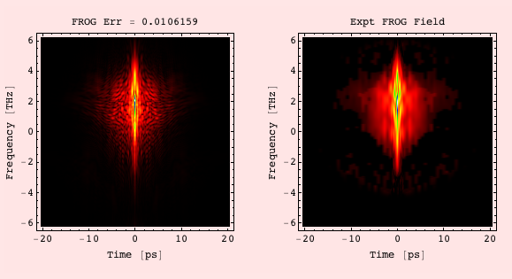
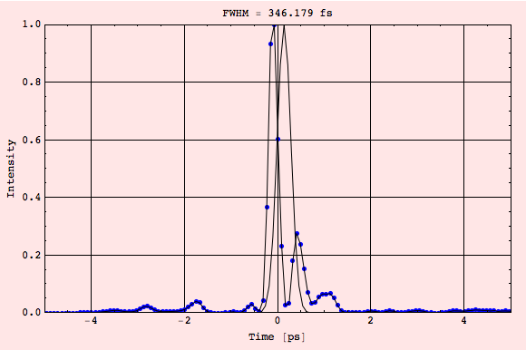
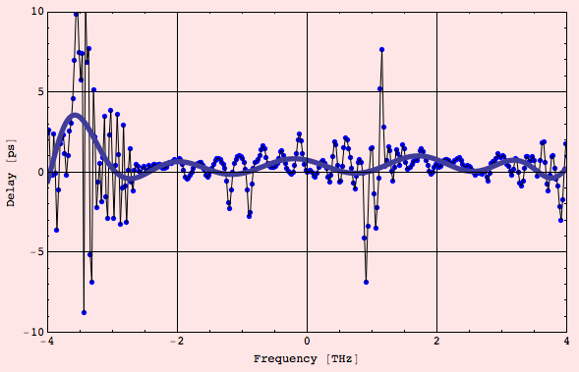
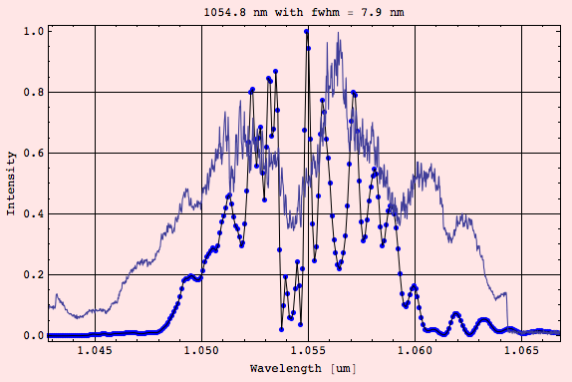
Lowering B and using a bulk stretcher improves the pulse
FROG data from a system producing 500µJ pulses

Slide 10
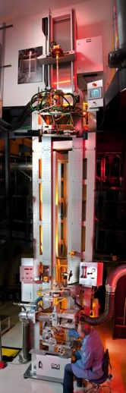
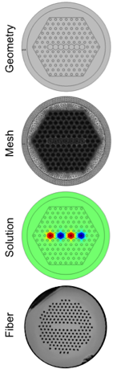
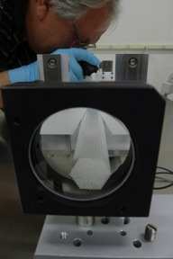
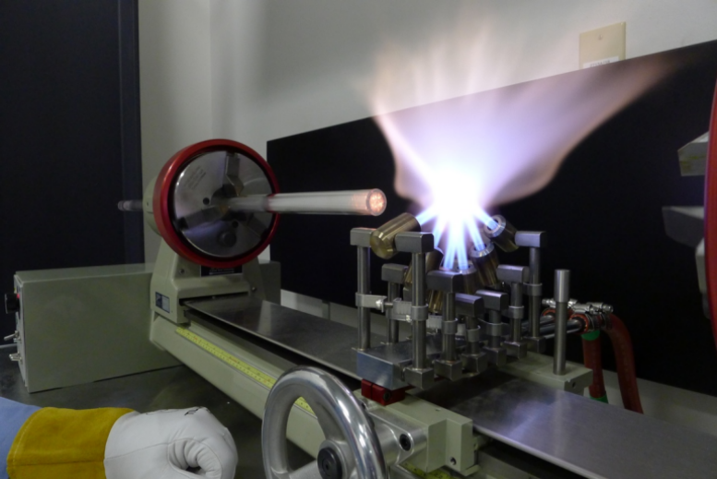
In FY12, we commissioned optical fiber fabrication at LLNL
Computational design expertise
“Stack and draw” photonic crystal fiber preforms
8.2 m optical fiber draw tower
Only facility in the DOE complex and unique for co-location of process development and advanced computing power.

Slide 11
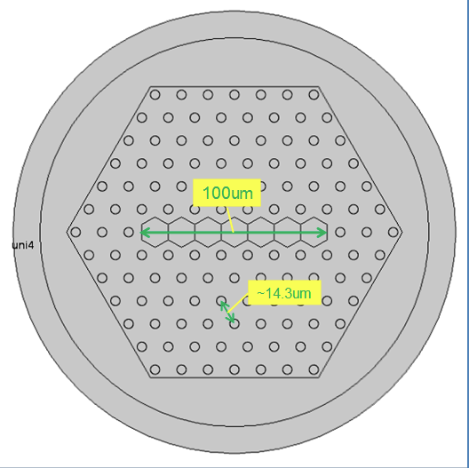
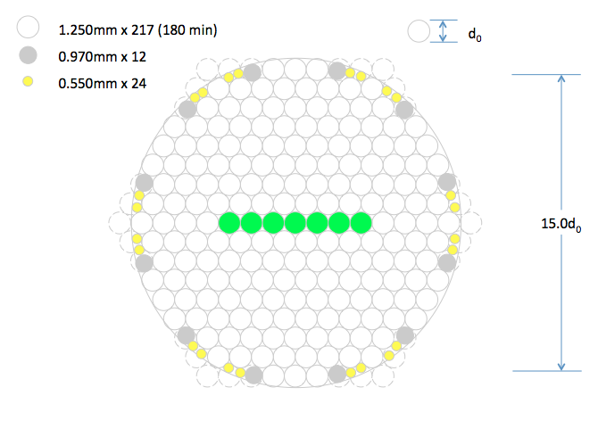
Fibers are designed and then a manufacturing plan is created

Slide 12
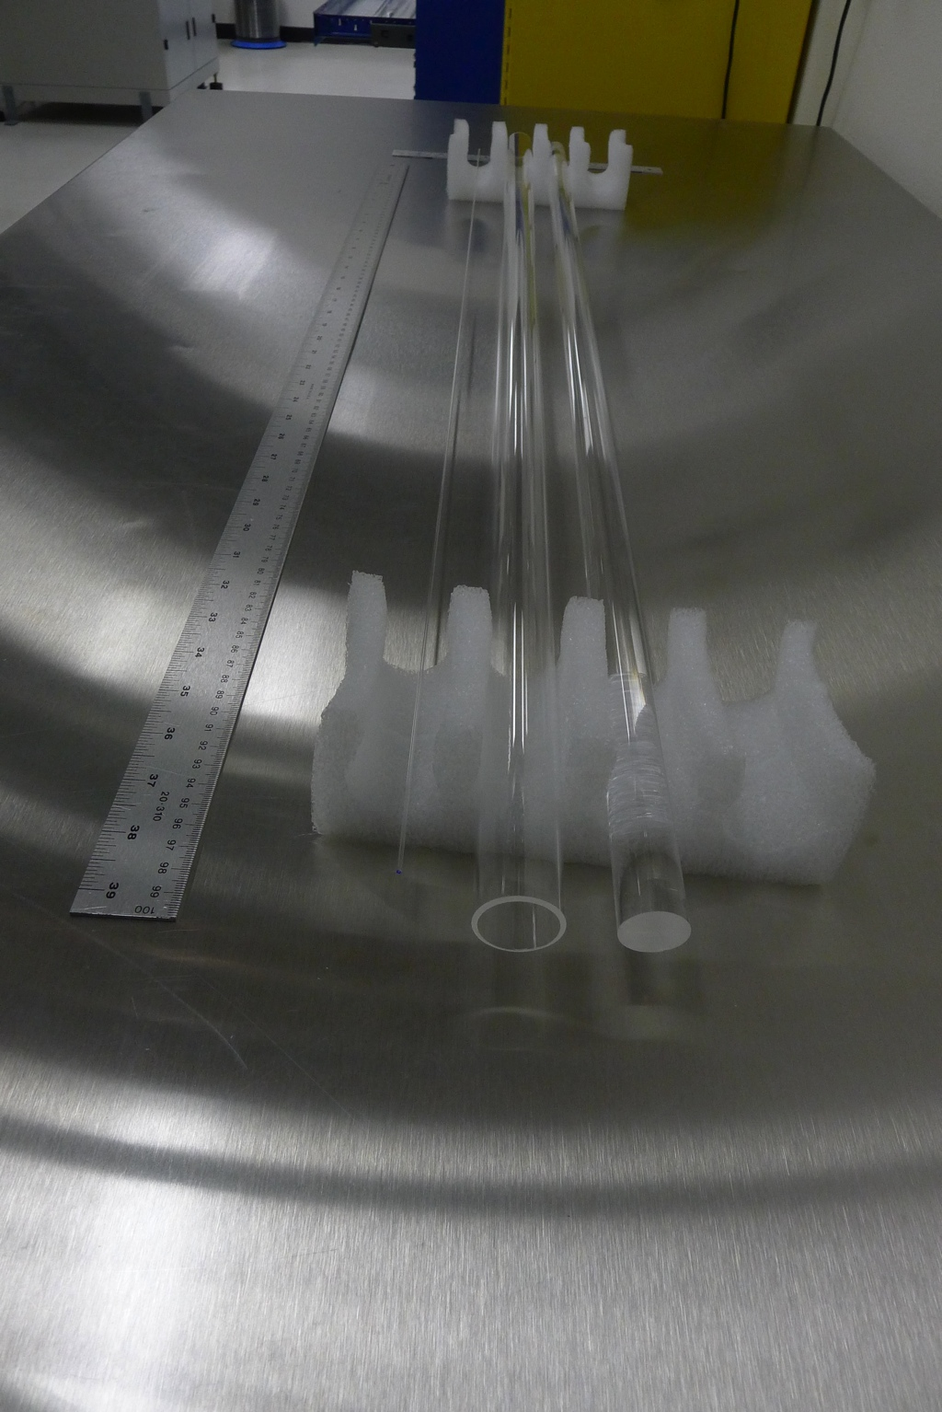
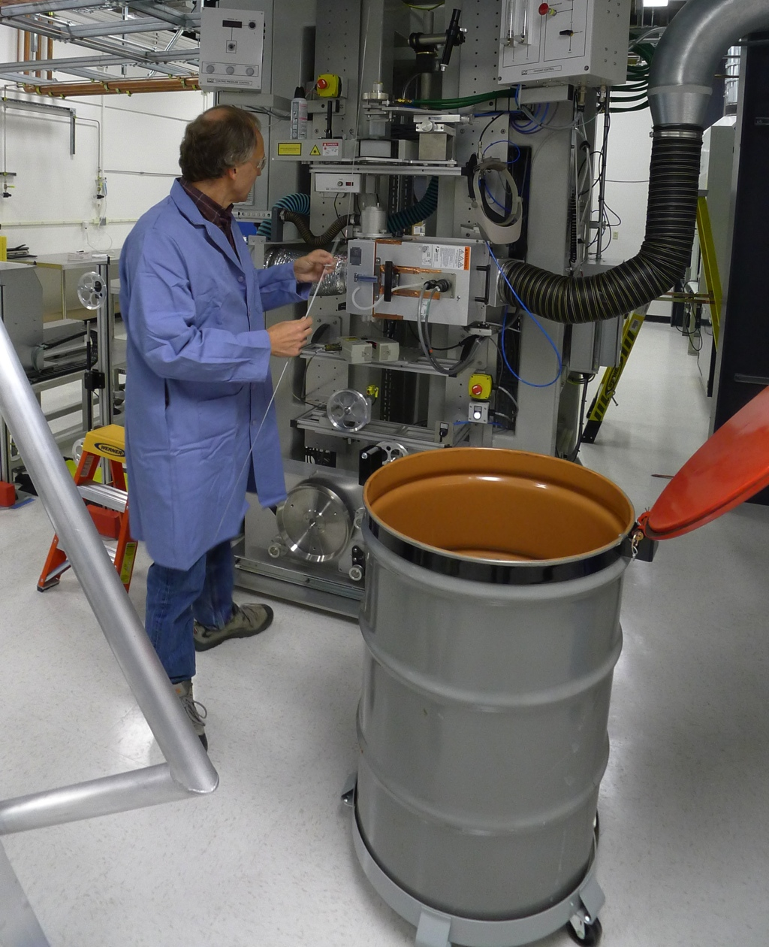
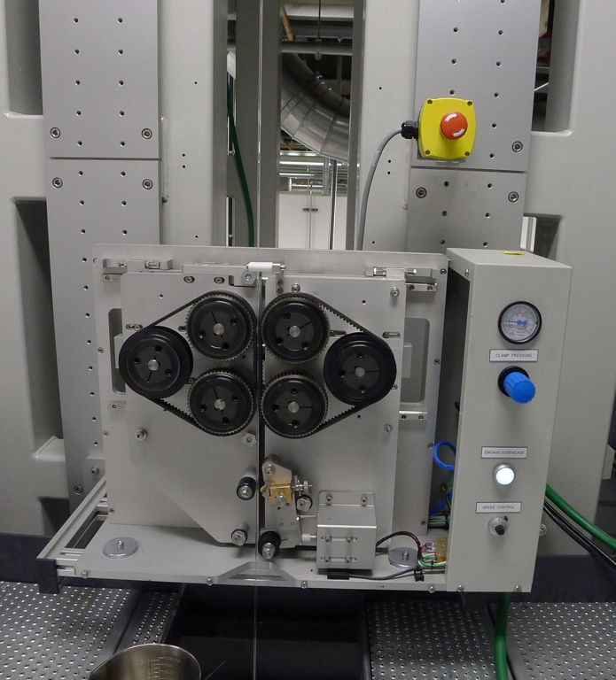
Stock silica is drawn to the dimensions for manufacture

Slide 13
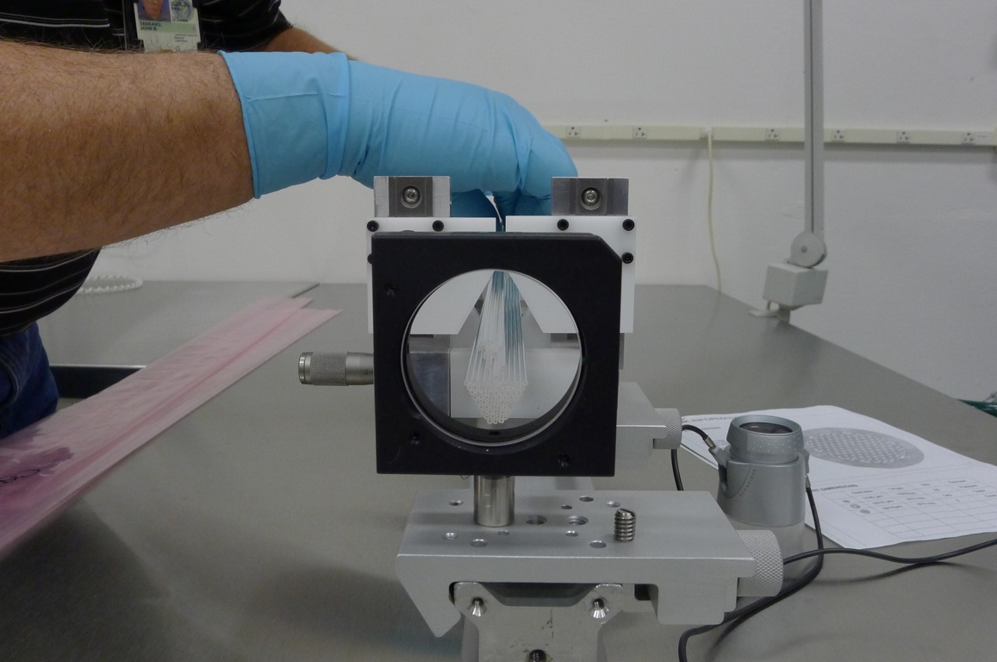
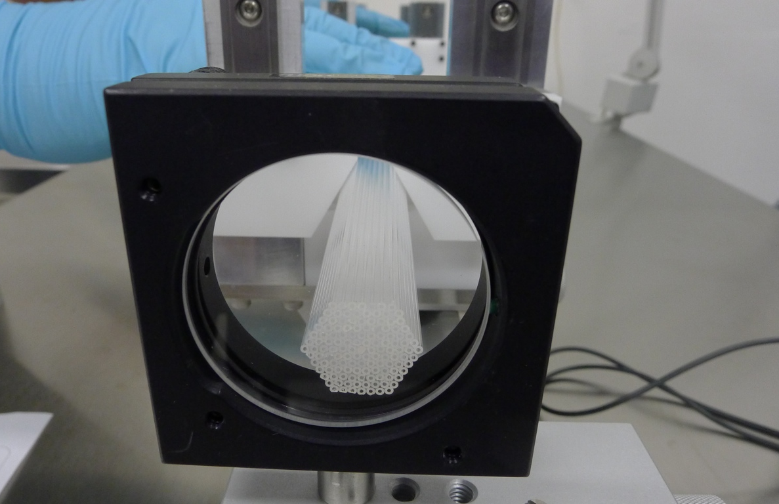
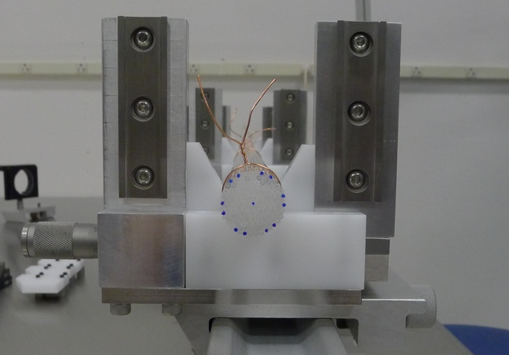
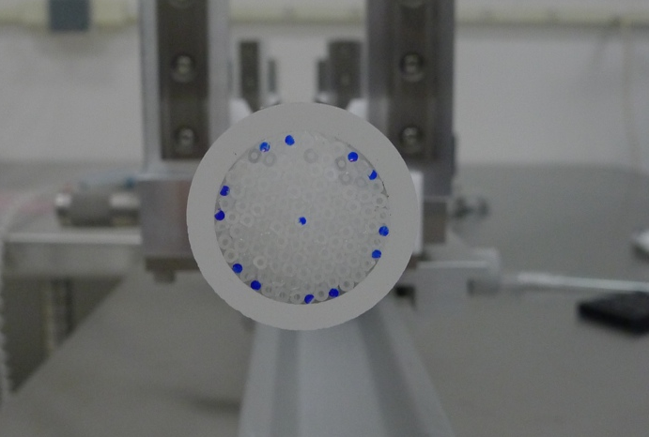
1 to 3 mm canes are stacked and sleeved into a preform

Slide 14
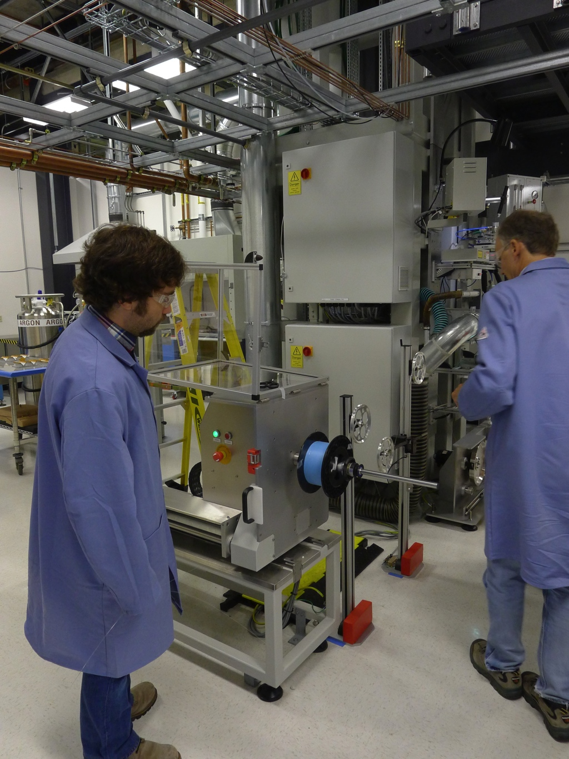
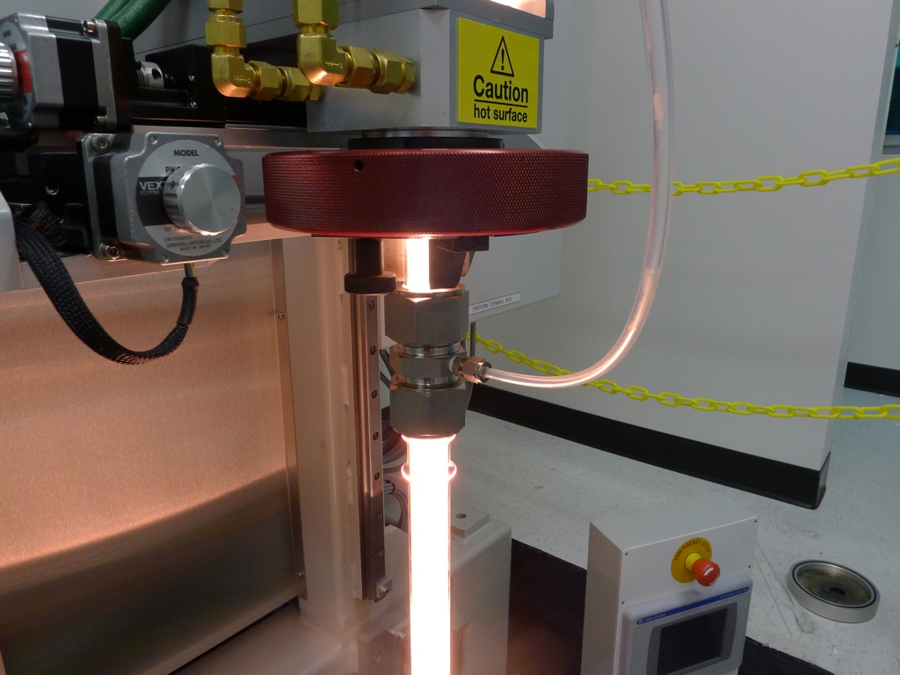
Pressure, vacuum and heat convert the preform into an optical fiber

Slide 15
Standard fiber lasers are limited in average power and pulse energy, but we are exploring ideas for improvement
Average Power vs. Year
Pulse Energy vs. Year
Little to no progress in diffraction limited single aperture power or energy scaling has been reported in 4-5 years!
R&D focus has shifted to beam combination as limits of conventional fibers have effectively been attained
Novel waveguides offer the potential for improvements
Notes:
Useful Data for Vision.xls

Slide 16
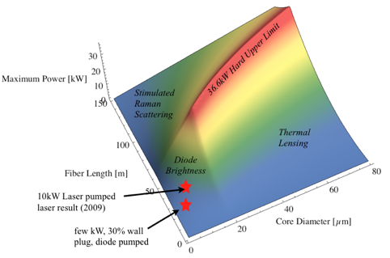
We authored a key study on fiber laser power scalability
>160 citations to date with high impact in the directed energy weapons community
J.W. Dawson et al., “Analysis of the scalability of diffraction-limited fiber lasers and amplifiers to high average power,” Optics Express vol. 16, pp. 13240-13266 (2008)

Slide 17
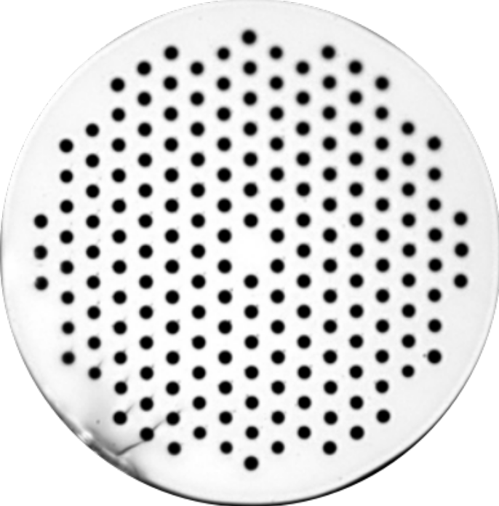
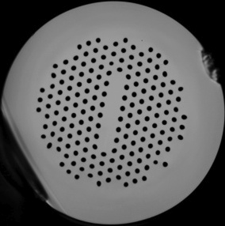
The power scaling limits may be overcome with a slab waveguide
Typical Circular Waveguide
LLNL Slab Waveguide
Slab waveguides permit 1-D heat flow, preferential bending perpendicular to the short axis and aperture scaling parallel to the long axis

Slide 18
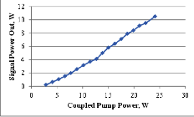
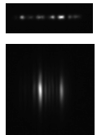
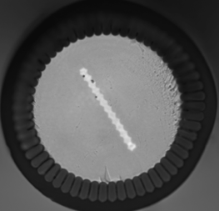
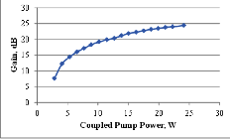
A Yb³⁺ doped slab waveguide shows stable laser amplification
10 W at 50% optical efficiency
Optical Near Field
250 µm
200 µm
10 µm X 120 µm
Optical Far Field
25 dB Gain (>300X)
Yb³⁺ Slab Waveguide
Secondary Waveguide for Diode Pump Light

Slide 19
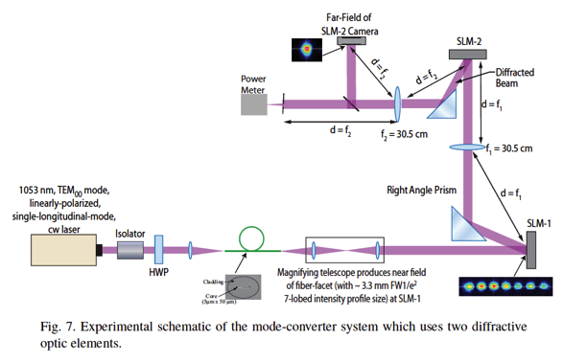

Modes are transformed to diffraction limited beams via diffractive optics
Winner 2013 R&D 100 Award!
Outside interest has already been expressed in this technique via forthcoming blurb in Laser Focus World and interest in collaborations
A.K. Sridharan, et al., “Mode-converters for rectangular-core fiber amplifiers to achieve diffraction-limited power scaling,” Optics Express, vol. 20, pp. 28792-28800 (Dec 2012)

Slide 20
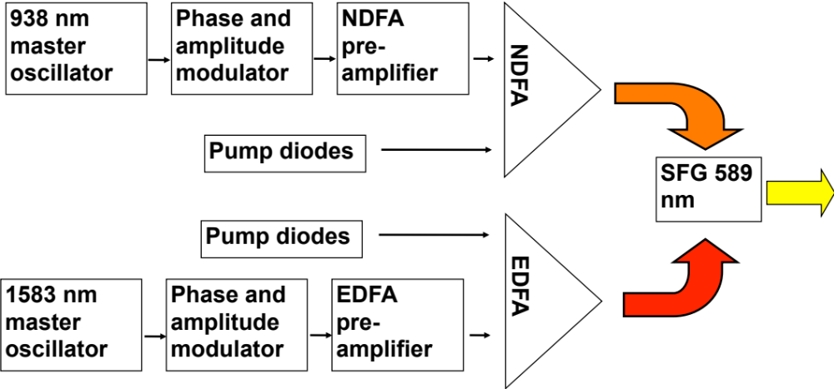
We have developed fiber lasers for 589 nm guide star laser systems

Slide 21
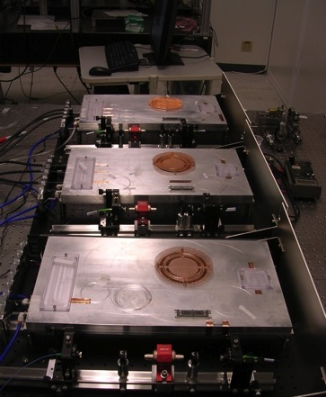
A key challenge was development of 900 nm fiber lasers
Nd³⁺ PM fiber amplifier chain
Host quality yields low efficiency at 938nm, but other glass compositions can attain 50%
The challenges were suppression of lasing at 1µm, lack of an industrial base at the 900nm wavelength and a difficult to fabricate glass composition.

Slide 22
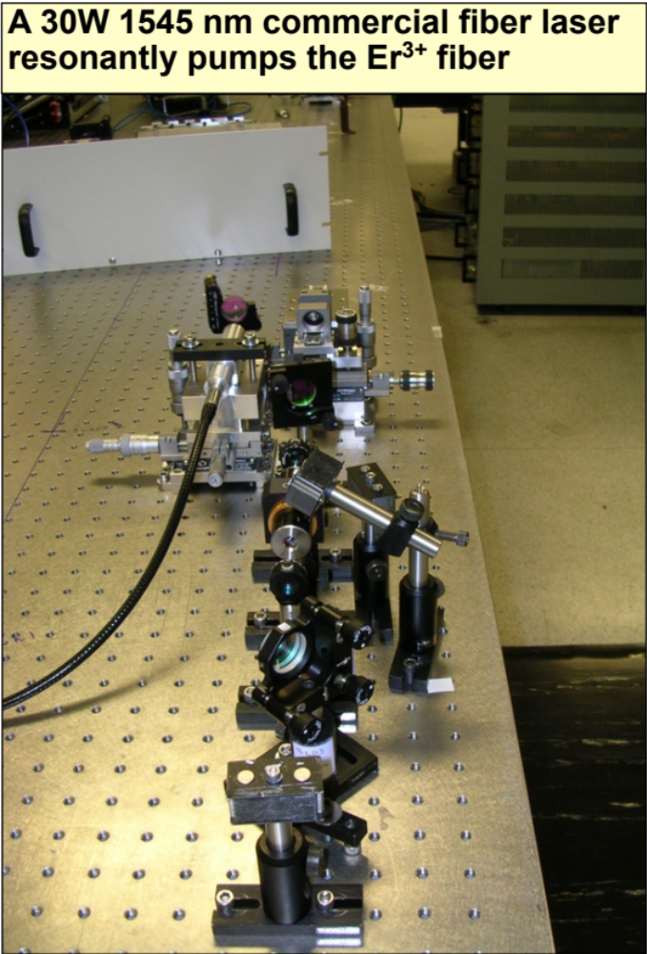
The project also required 17 W of pulsed power at 1583nm

Slide 23
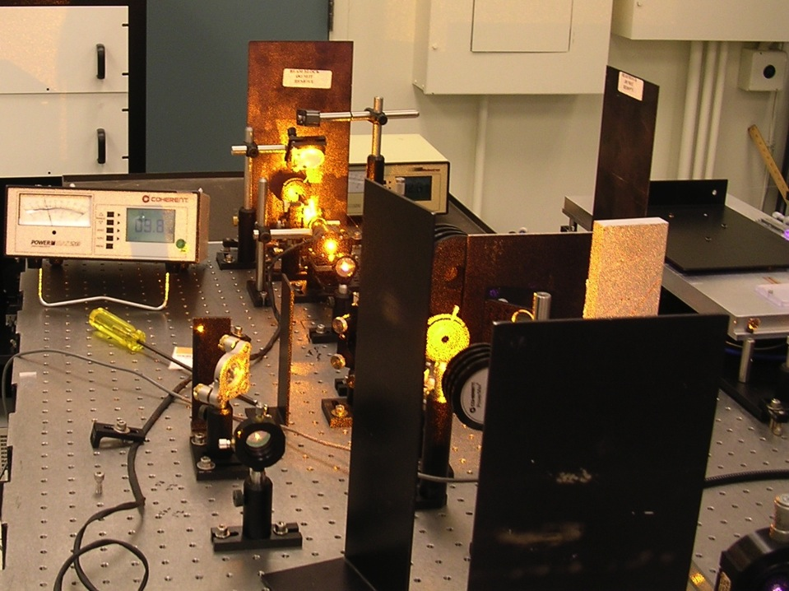
10W 589nm Fiber Laser
Feasibility of 900 nm fiber lasers to 15W
Pulsed 1583nm lasers to 15W
Frequency conversion of fiber lasers at high power
Laser in process of transfer to UC Santa Cruz

Slide 24
Summary
LLNL has a wide range of capabilities in optical fibers and lasers
We are focused primarily on pulsed fiber laser systems for a variety of applications; injection seed lasers, lasers for accelerators, other scientific applications
We have established the capability to make micro-structured optical fibers and foresee many interesting new possibilities in this area

Slide 26
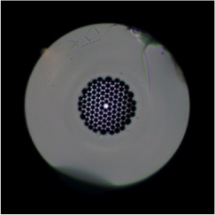
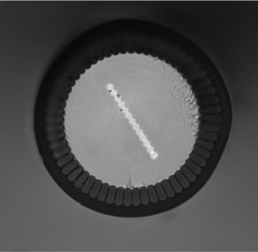
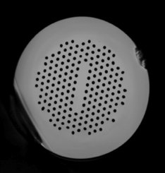
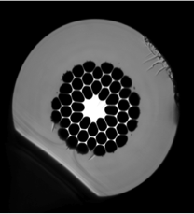
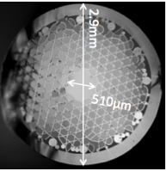
We have demonstrated the capability to make a wide variety of fibers
First fiber small core
1st Passive
Ribbon Fiber
1st Yb³⁺ Doped Ribbon Fiber
125 µm
215 µm
200 µm
100 µm
10 µm X 120 µm
Hollow Core Cane (preform)
UV Rad Hard
Qualification Fiber
250 µm
250 µm

Slide 27
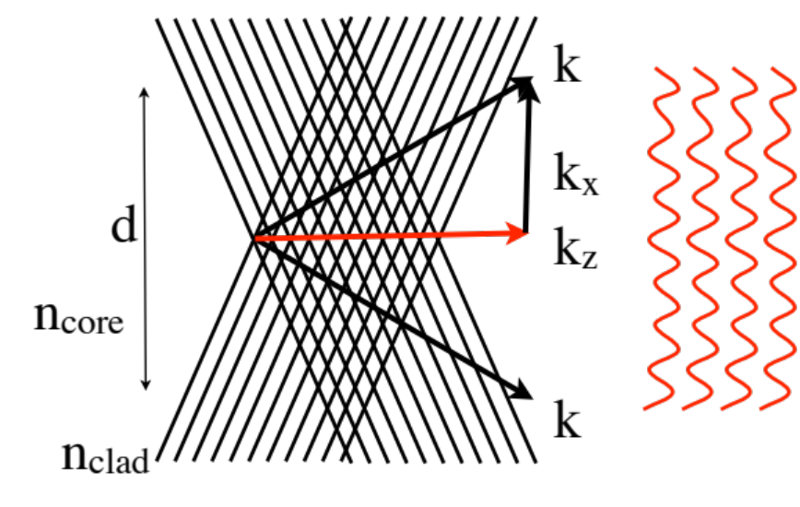
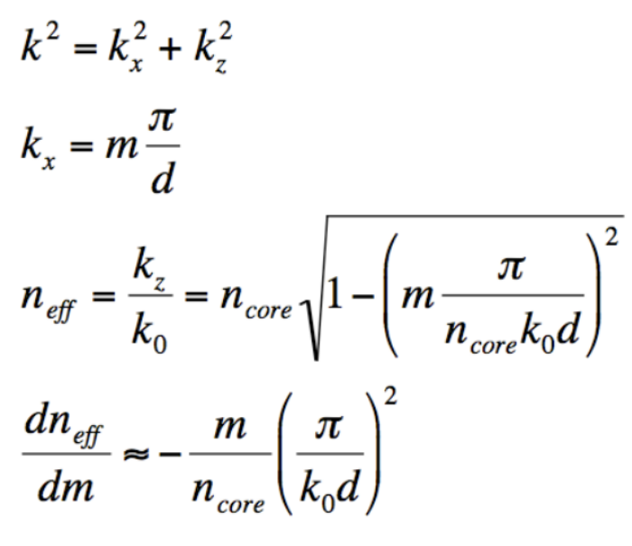
Beam quality on the long axis is stabilized via a higher order mode
Higher order modes can be thought of as the interference of 2 plane waves
Higher modes have different phase speeds and thus do not exchange power efficiently
A key challenge has been efficient transformation between these higher order modes and diffraction limited beams

Slide 28
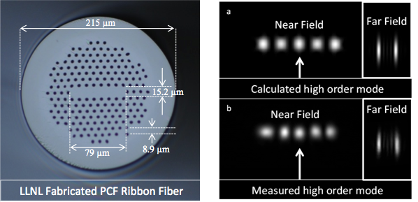
Our optical fiber facility enabled us to fabricate slab waveguides

Slide 29
Let Us Meet Again
We welcome all to our future group conferences of Omics group international
Please visit:
www.omicsgroup.com
www.Conferenceseries.com
http://optics.conferenceseries.com/

